Slide 1
High Field Vertical Magnet Test Facility for the US Magnet Development Program
G. Velev
Information provided by: C. Sylvester, G. Chlachidze

Slide 2
Outline
  Why a new Vertical Magnet Test Facility in the context for high field accelerator magnet R&D and MDP
Conceptual design; reuse any infrastructure and test devices for cost savings, e.g.
  Power supplies dump resistor bank
  Power leads
  Quench protection and monitoring system
  Magnetic measurement systems
Preliminary cost estimations
Summary

Slide 3
Why new Vertical Magnet Test Facility?
One of the primary goals of the US Magnet Development Program is to pave the way for future high field accelerator magnets, e.g. 16-20 T dipoles with aperture of ~50-70mm.
The x-section of magnet is increasing with the field - need a test facility with larger cryostat diameter, e.g. CERN proposal
Goal: to construct a vertical test facility (pit) for 1-meter diameter magnets operating at 1.8-1.9K and max current ≥20kA, for testing Nb₃Sn, hybrid magnets (Nb₃Sn+HTS), utility structure to test magnet components in HF
Fermilab has unique capability to build such facility for MDP
  1.8K testing capabilities
  30 kA power supply system
  25-ton lifting capability for a single object in vertical direction
Need initial investment to construct the pit and cryostat

Slide 4
New CERN High field test facility
Slide from V. Benda et al. talk: ICEC25-ICMC2014 2014, The Netherlands
✓
✓
✓
✓
✓
✓
✓
✓
✓
✓

Slide 5
FCC Magnet parameters – example
MDP doesn’t have a facility to test such magnets
Baseline parameters of the 16 T dipoles for the FCC, Berlin, 2017

Slide 6
Current R&D test facilities
Inst. | V/H | T_{min} | L_{max} | ID _{max} | I_{max} | User | Availab.
BNL | V | 1.9 K | 5.2 m | 0.67 m | 22 kA | HL-LHC | <2025
FNAL | V | 1.8 K | 3.7 m | 0.63 m | 30 kA | Open/MDP | now
LBNL | V | 4.5 K | 2.2 m | 0.8 m | 25 kA | Open/MDP | now
Some info from P. Wanderer, presentation

Slide 7
Fermilab VTF Summary
Parameter | Existing VMTF | Proposed HFVMTF
Operating Temperature | 1.8K | 1.8-1.9K
Maximum Current (1st PS) | 30 kA | 30 kA (re-use existing)
Maximum Current (2nd PS) | Not available | Incl. 10 to 15 kA ( to test hybrid magnets )
Helium Vessel Diameter | 25.8 inches (655 mm) | 42 inches (1066 mm)
Maximum Length of Test Object | 3750 mm | >2000 mm (funds limited)
Maximum Diameter of Test Object | 630 mm (MQXFS1 with skin) | 1000 mm
Crane Capacity | 10 tons | 25 tons (existing)
Location | IB-1 VMTF Bay | IB-1 (IB1 High Bay)

Slide 8
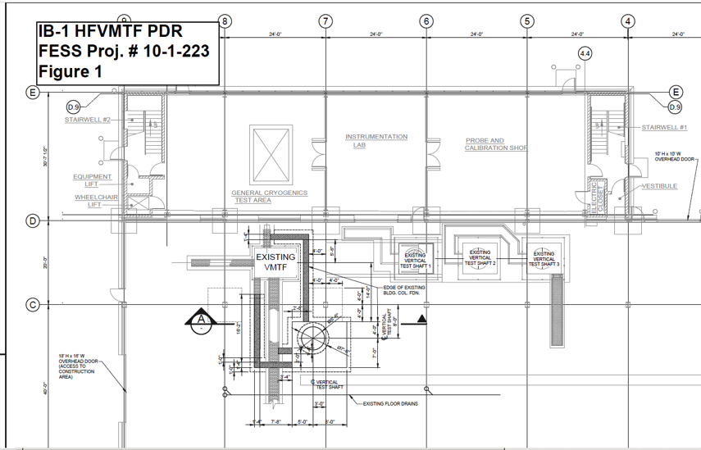
Preliminary Civil Construction Drawing (10-1-223)

Slide 9
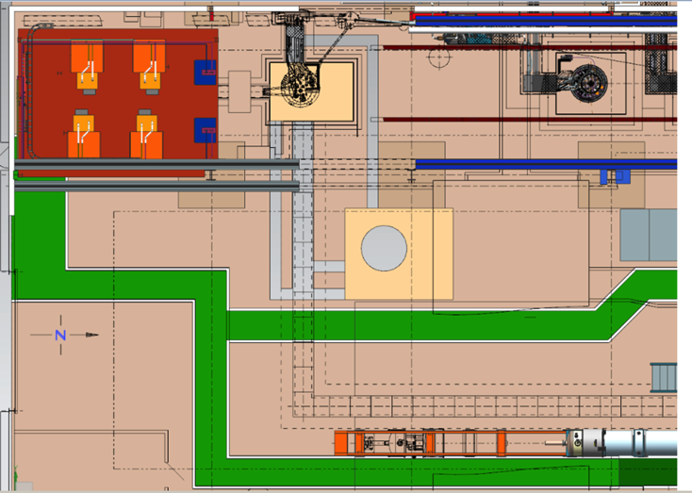
Proposed location of HFVMTF in IB-1 High Bay area
30 kA PS
VMTF
HFVMTF
High Bay Garage Door
High Bay 25-ton
Crane Area
Stand 4
Control room

Slide 10
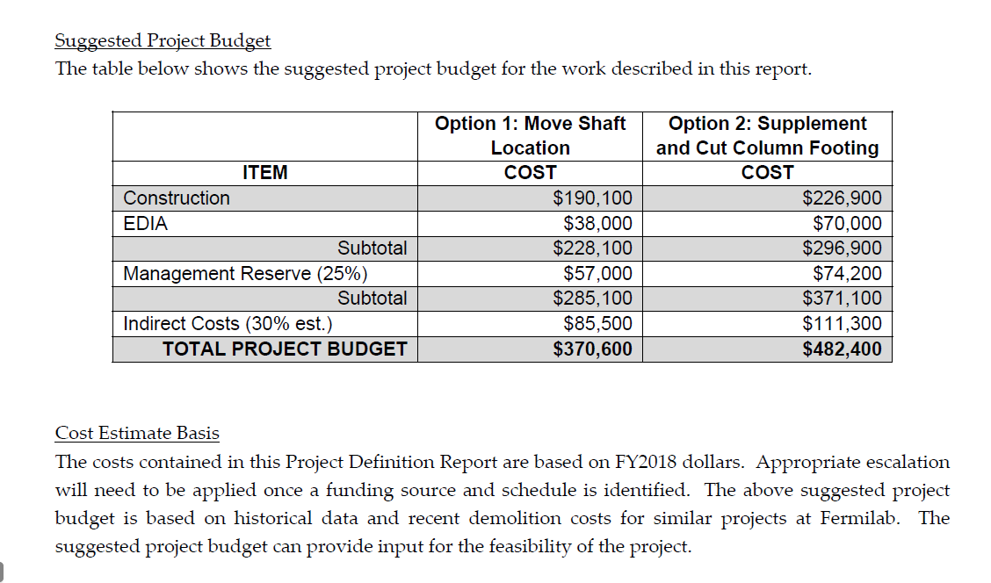
Civil Construction Estimate (FY18 $)
From Project (10-1-223) Definition Report Developed by FESS

Slide 11
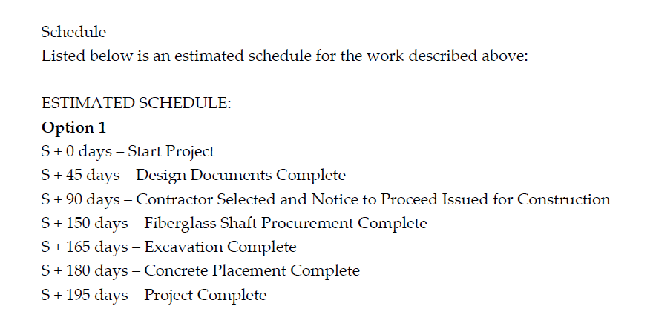
Civil Construction Schedule –Step I
30 days construction period
* From Project (10-1-223) Definition Report Developed by FESS

Slide 12
Effort Estimate for Cryostat, Lambda Plate, and Civil Construction oversight
(for TD Employees)
Task | Des. | Engr. | Tech.
Cryostat Design and Engineering | 240 | 400
Fabricate Cryostat |  | 80
Cryostat Installation | 40 | 240 | 480
Design and Fab. Lambda Plate, SS ring and Plugs | 120 | 40 | 480
Design, Fab., and assemble Baffles | 40 | 20 | 40
Design ASME BPV Code Stamped Top Plate | 120 | 120
Generate Safety Documentation and perform Load test |  | 360 | 32
Construction Oversight (Task Manager and Tech.) |  | 280 | 20
Total Hours by Job Title | 560 | 1540 | 1052
FTE | 0.27 | 0.74 | 0.50

Slide 13
M&S - Cryostat and Lambda Plate Assembly
Item | $k
Cryostat (by ASME Code Shop) | 225.7
Cryostat Installation | 26.6
Lambda Plate plugs (incl. CLIQ Lead feedthroughs) | 11.7
G-10 Lambda Plate and the Stainless Steel outer ring | 25.0
ASME BPV Coded Top Plate | 45.0
Baffles (incl. LN2 baffle) | 28.3
Total - Cryostat and Top Plate Assembly | 362.3

Slide 14
Conclusion
We propose to build a new vertical test facility at Fermilab to support future MDP high field magnets
To minimize the cost to the MDP we will reuse any possible device and infrastructure from the current test facility (VMTF)
Schedule:
  Spring of FY19: start the design of the Cryostat and Lambda Plate
  Summer of FY19: perform civil construction of the pit, before HL-LHC prototype test
  FY20 : order the Cryostat and Lambda Plate
  Late Spring of FY20: installation of the Cryostat and Lambda Plate
  FY20 cryoplant shutdown: installation of the He/N supply pipes and PS leads
  End of FY20/Beg of FY21 – commissioning and engineering run of the HFVMTF
No conflict with the current FNAL projects (HL-LHC, Mu2e, LCLS II and LBNF is expected)

Slide 15
FY19-FY20 funds
To start the HFVMTF project we need:
  FY19 M&S: $310-$370k for the civil construction – should be external funds
  Design of the Cryostat and Lambda Plate - it will be covered internally
  Fy20 M&S: ~$363.2k for Cryostat and Lambda Plate Assembly, Should be mix between external and internal funds
  Installation and commissioning - should be internal labor.

Slide 16
Back up Slides

Slide 17
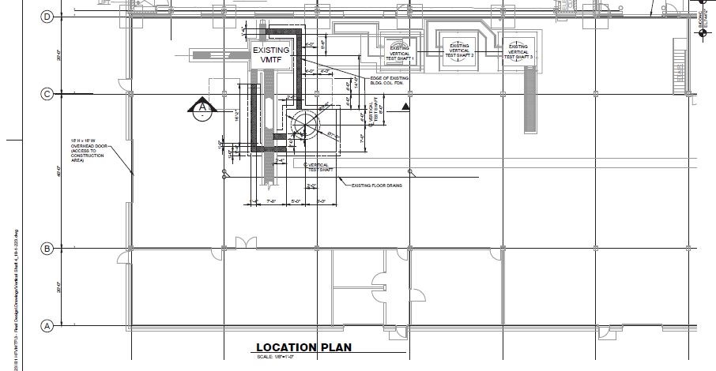


Proposed location of HFVMTF in IB-1 High Bay area
Shaft ID | 50.00
Shaft Depth | 240.00
Pit Width | 84.00
Pit Length | 120.00
Cryostat OD | 42.00
Upper LHe section Dia. | 27.81
Lower LHe section Dia. | 25.81
Shaft ID | 66.00
Shaft Depth | 240.00
Pit Width | 120.00
Pit Length | 156.00
Cryostat OD | 58.00
Upper LHe section Dia. | 44.00
Lower LHe section Dia. | 42.00
Max Magnet Dia. | 40.00

Slide 18
3912 mm (154 in)
655 mm (25.8 in)
706 mm (27.8 in)
http://citeseerx.ist.psu.edu/viewdoc/download?doi=10.1.1.583.3707&rep=rep1&type=pdf

