Slide 1
Hybrid magnet design
Shlomo Caspi
US Magnet Development Program
Lawrence Berkeley National Laboratory

Slide 2
CCT conceptual dipole design
Magnetics
19 T – Lorentz forces
6 layers
Any conductor – Nb3Sn, HTS (carrying the same current)
Internal Structure
CCT spars
Assembly/Disassembly
External structure
Yoke and Shell

Slide 3
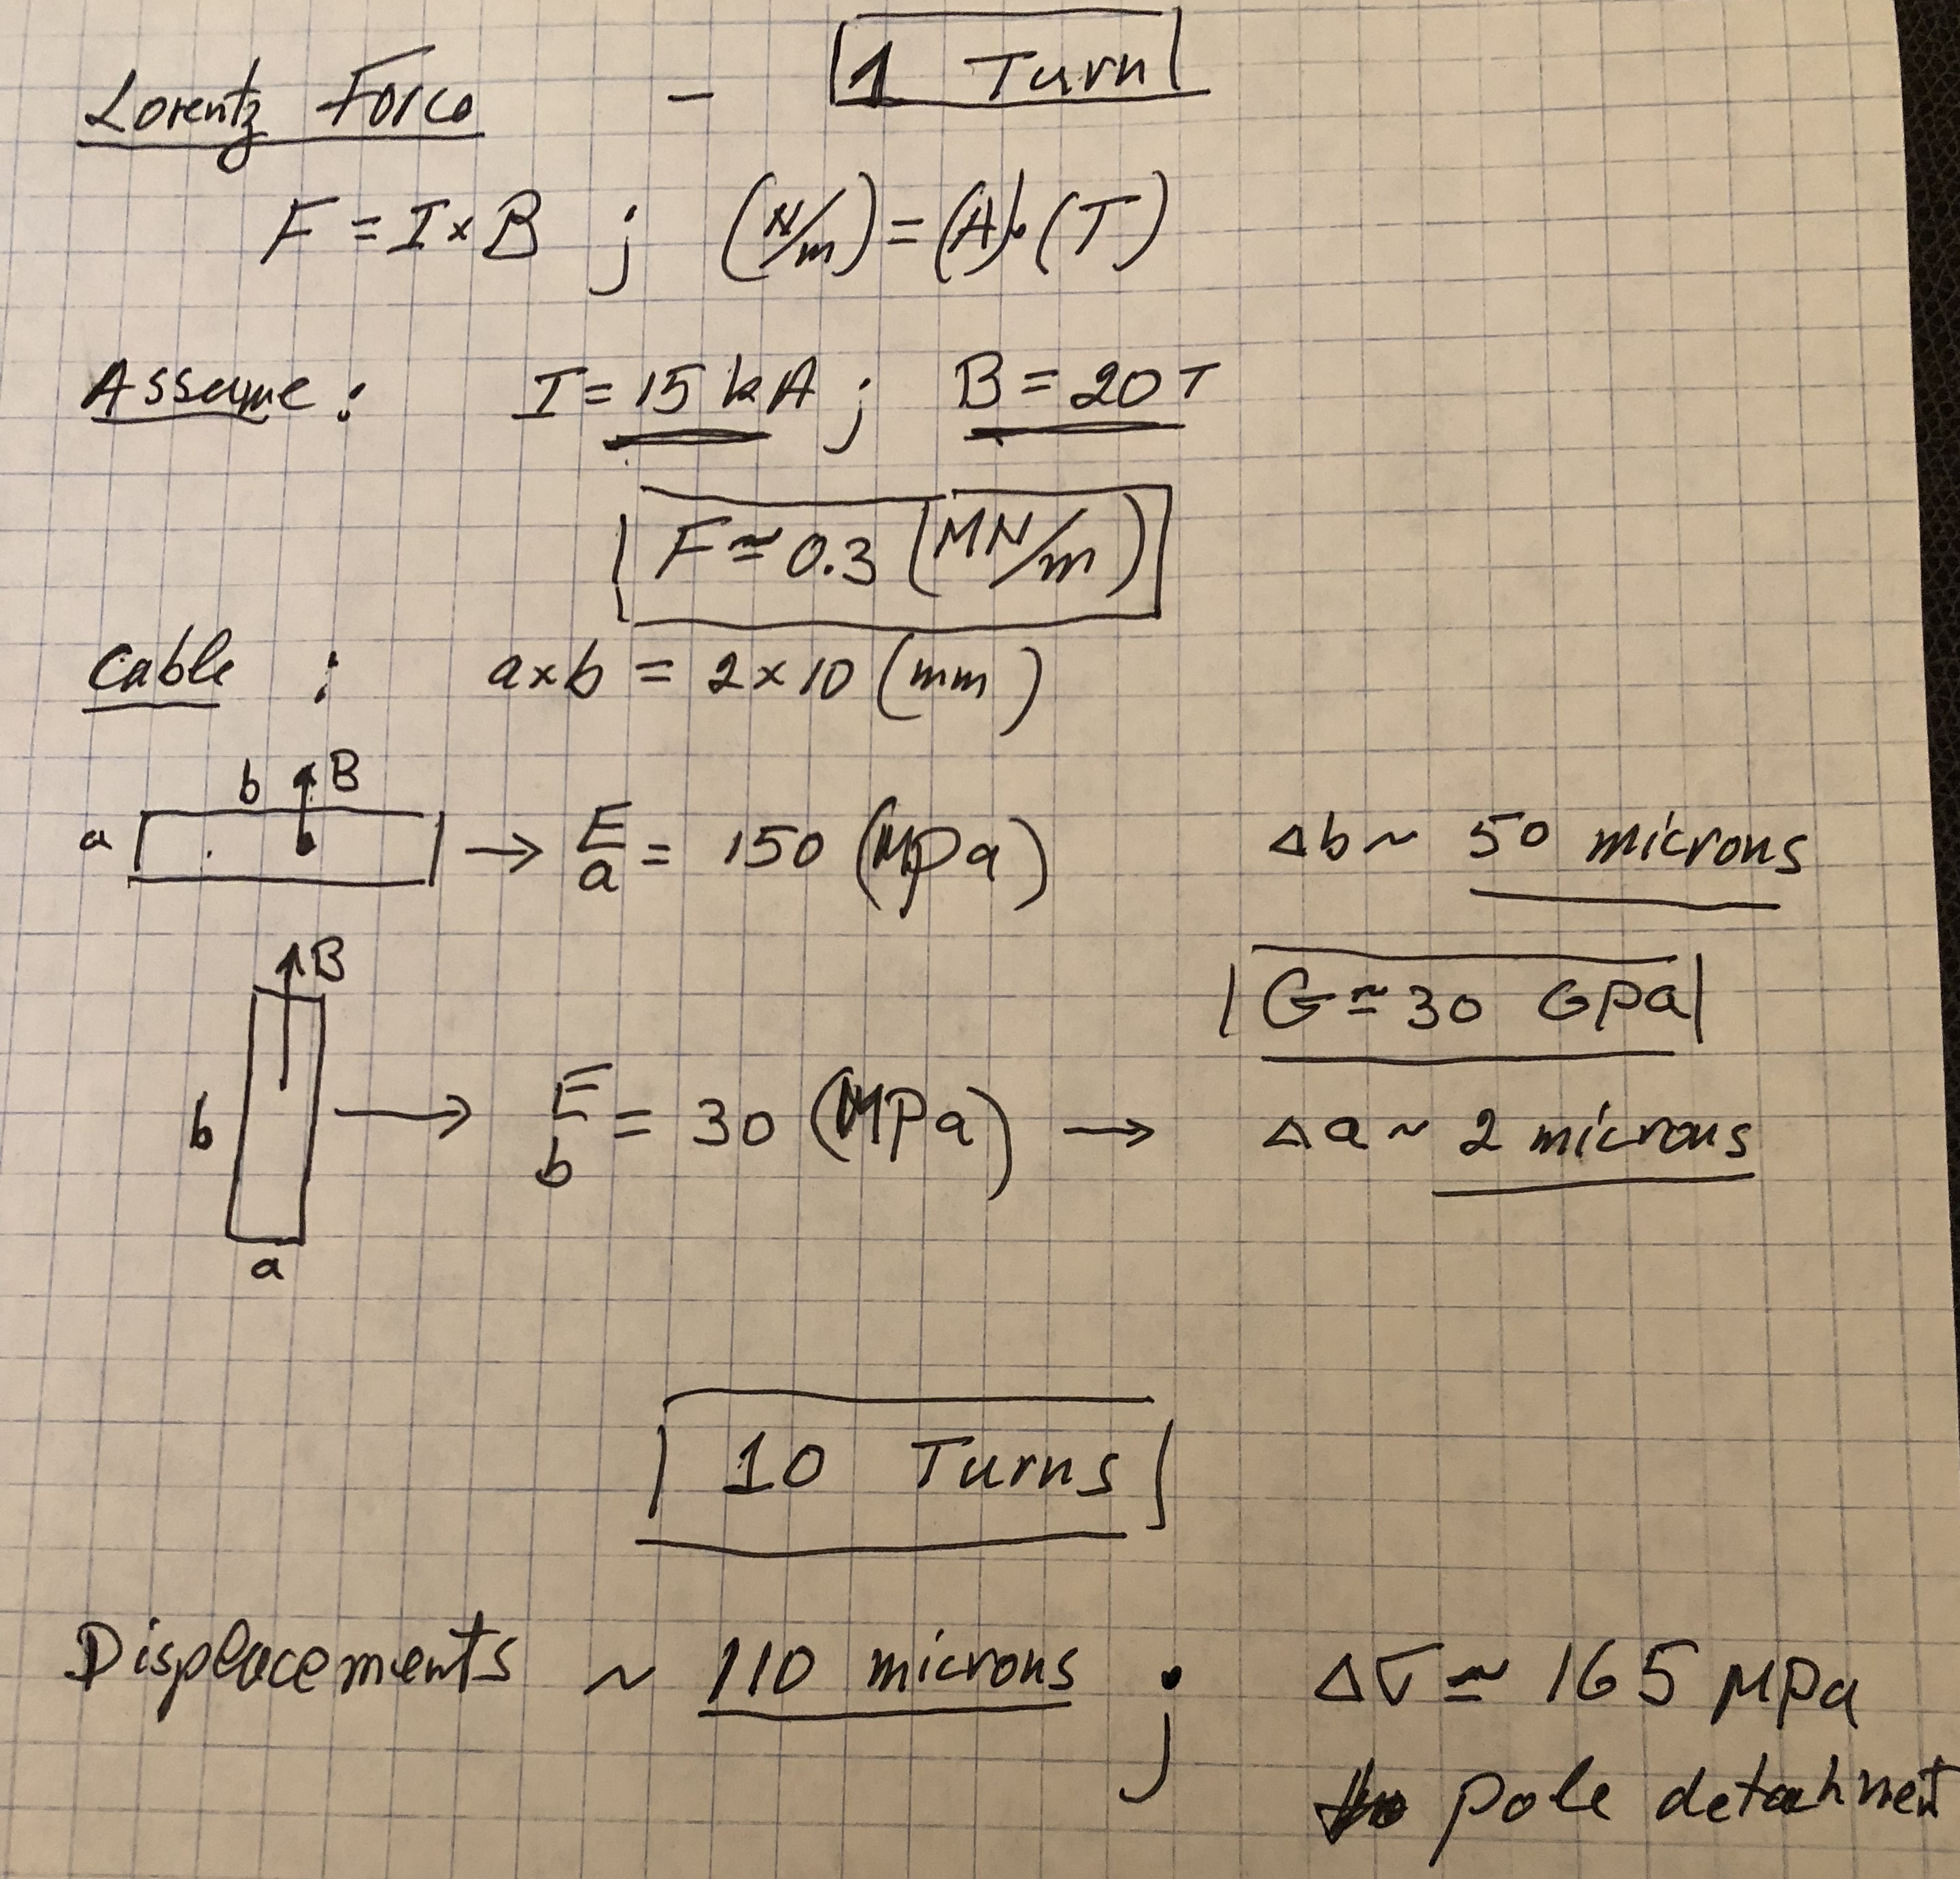
Lorentz Force – Back to basics
An isolated turn at 20T
pre-stress
coil bending
We want a turn in a box

Slide 4
19 T CCT dipole
More than 60 mm of wide conductors needed for 6 layers
Layers snuggly fit
“Smart-shims” are used for assembly and disassembly
Internal Structure - Lorentz forces are transferred to spars.
External Structure – prevent layers bending by an iron yoke

Slide 5
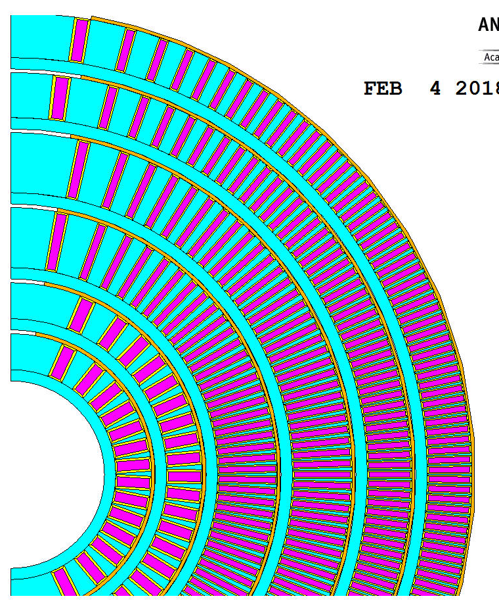
Internal structure
Layer (mm)
1 Ri = 25
Ro= 37.6
2 Ri = 38.6
Ro= 51.2
3 Ri = 52.2
Ro= 71.2
4 Ri = 72.2
Ro= 91.2
5 Ri = 92.2
Ro= 107.2
6 Ri = 108.2
Ro= 123.2
shell -1 Ri = 124.2
Ro= 134.2
Shell-2 Ri = 260
Ro= 325
All spars are 3 mm
Layer to layer gaps 1mm
All smart-shims 80 deg.
“smart-shim”
spar

Slide 6
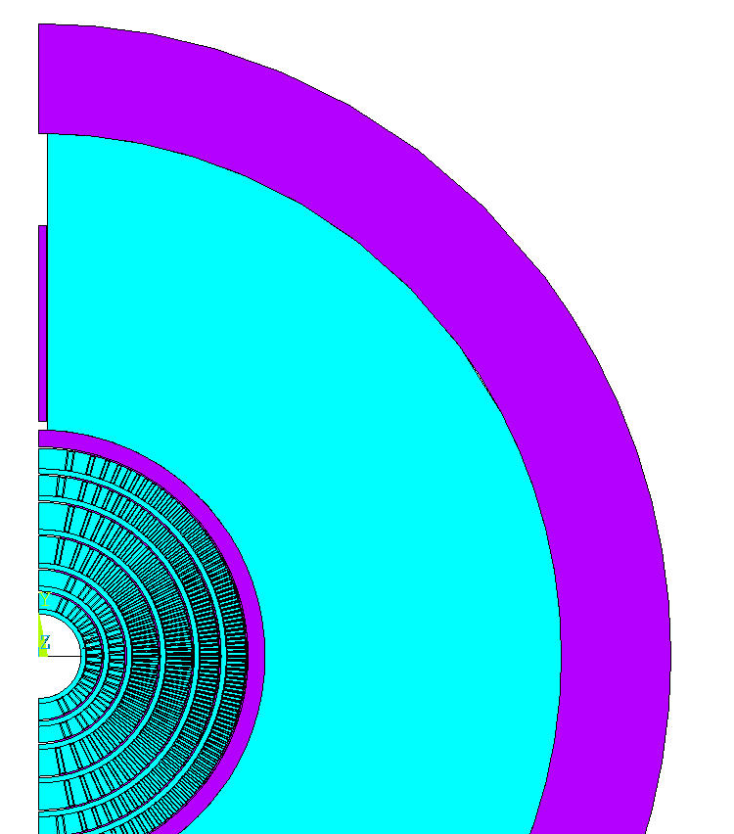
19 T, 14 kA/turn

Slide 7
Magnet Assembly

Slide 8
The CCT magnet
Each layer is machined, wound, reacted and impregnated separately
6 layers are assembled using “smart-Shims”
A thin Aluminum shell is placed over layer 6
An iron yoke is placed over the coils and held by an Aluminum shell
“smart-shims” take care of any geometry irregularity between layers and function similarly to “keys and bladders”

Slide 9
Assembly using “Smart-Shims”
Insert layer 1 into layer2 (~1mm radial gap)
Layer 2 is bent, a “smart-shim” inserted, epoxy injected, curing, layer 2 springs back
The two layers are fitted snugly (not bonded)
Process continuous for all layers
By reversing the process the layers could be disassembled
5 KN/m ~ 5 microns
GAP

Slide 10
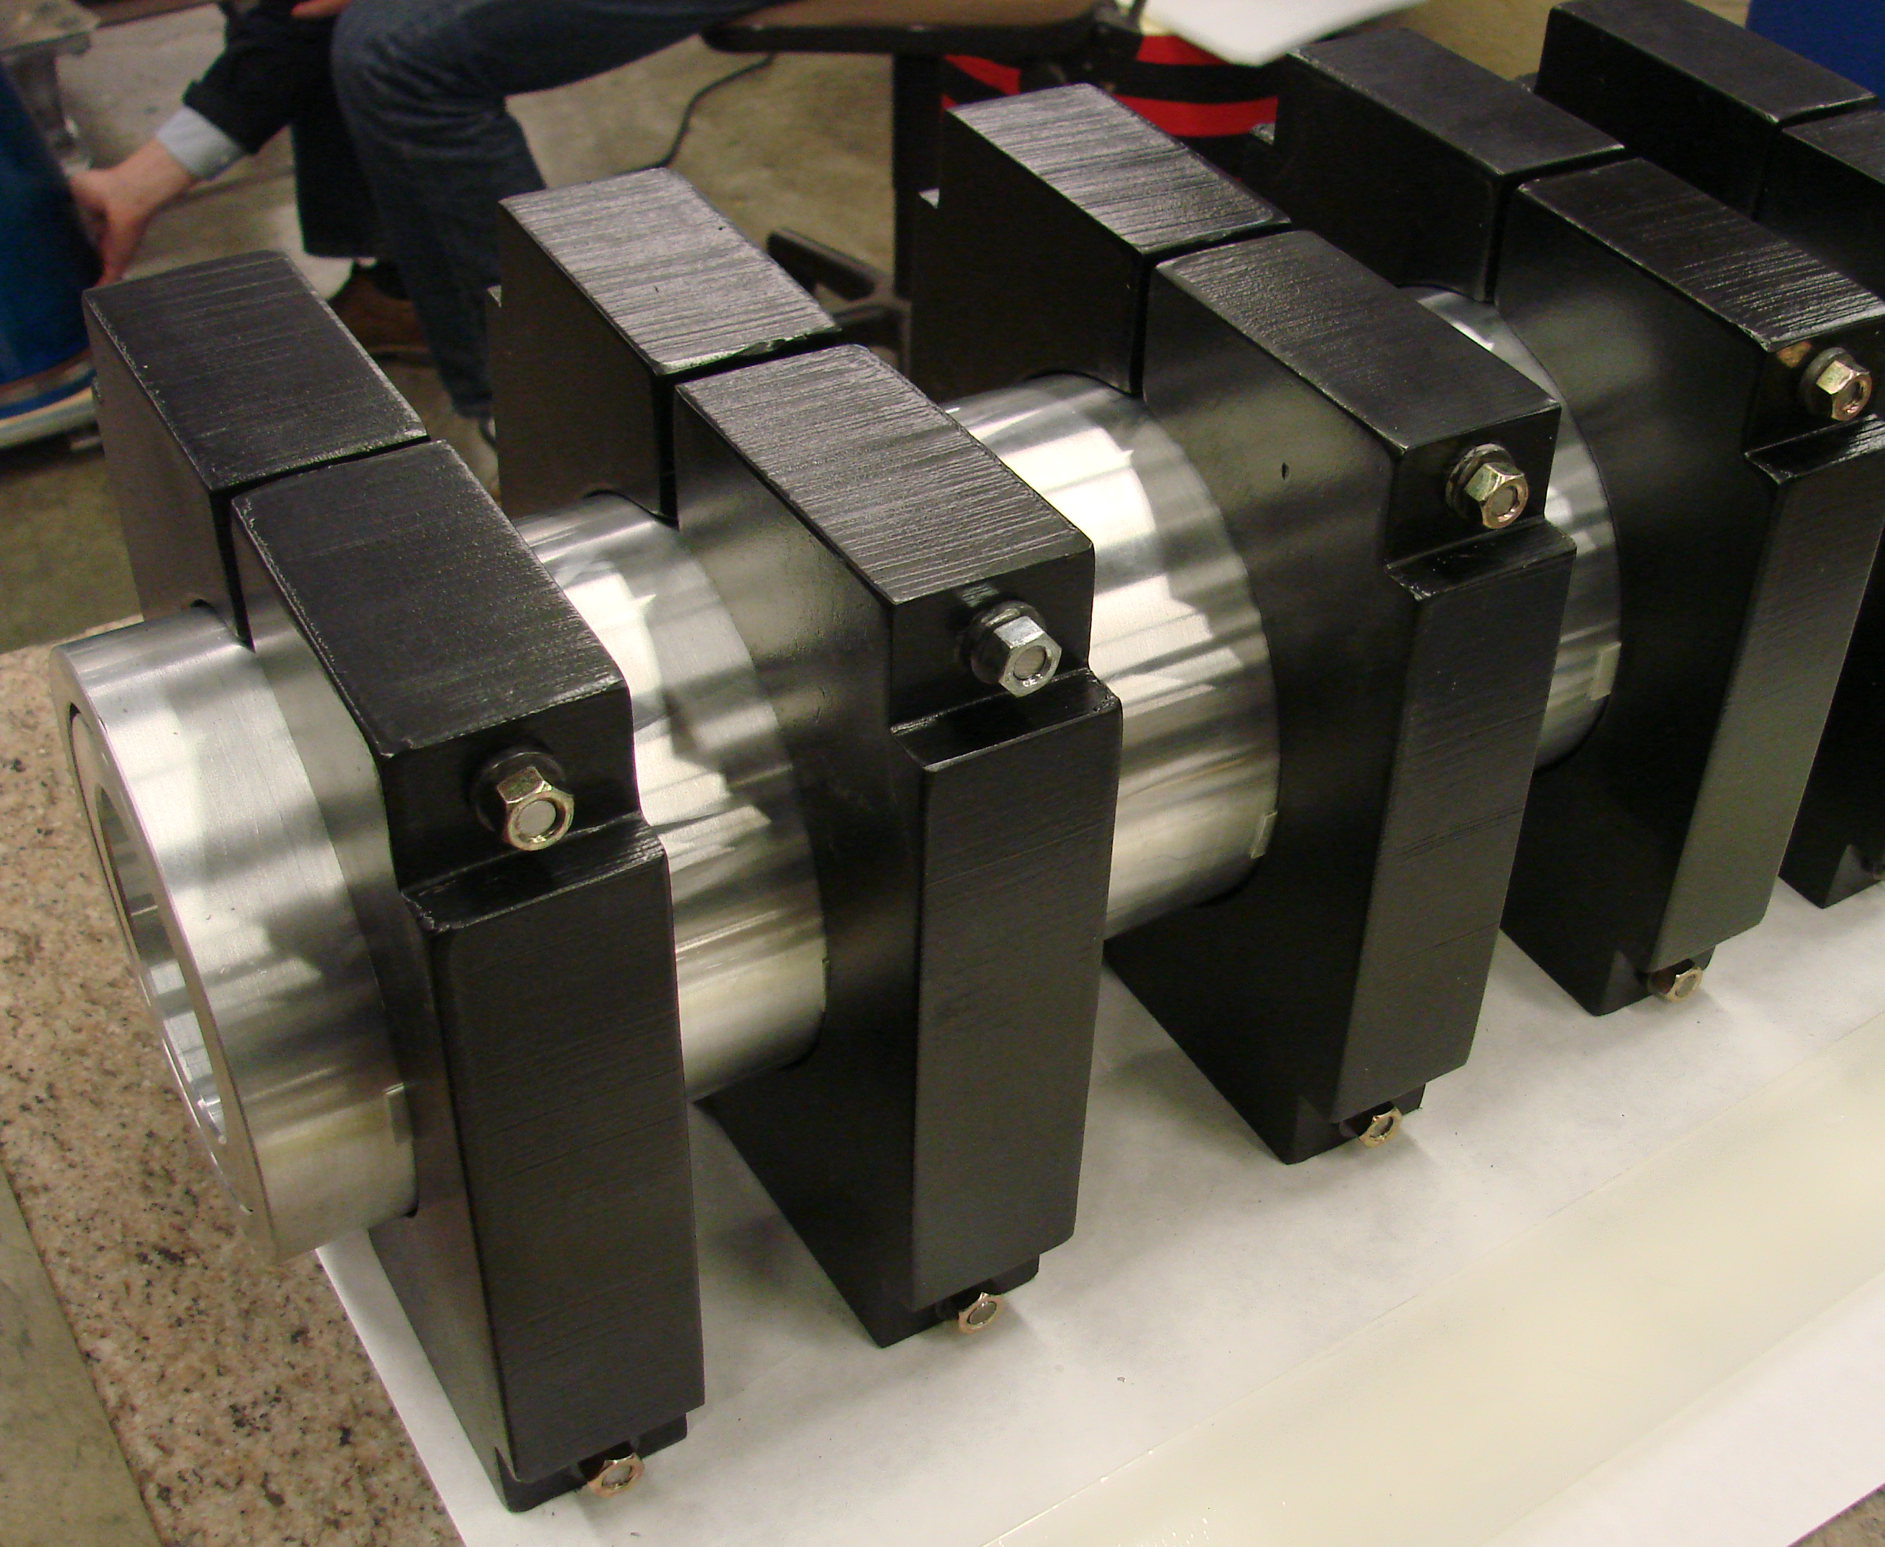
Placing CCT layer 1 into 2
~1 mm gap
Clamps used to deform layer 2

Slide 11
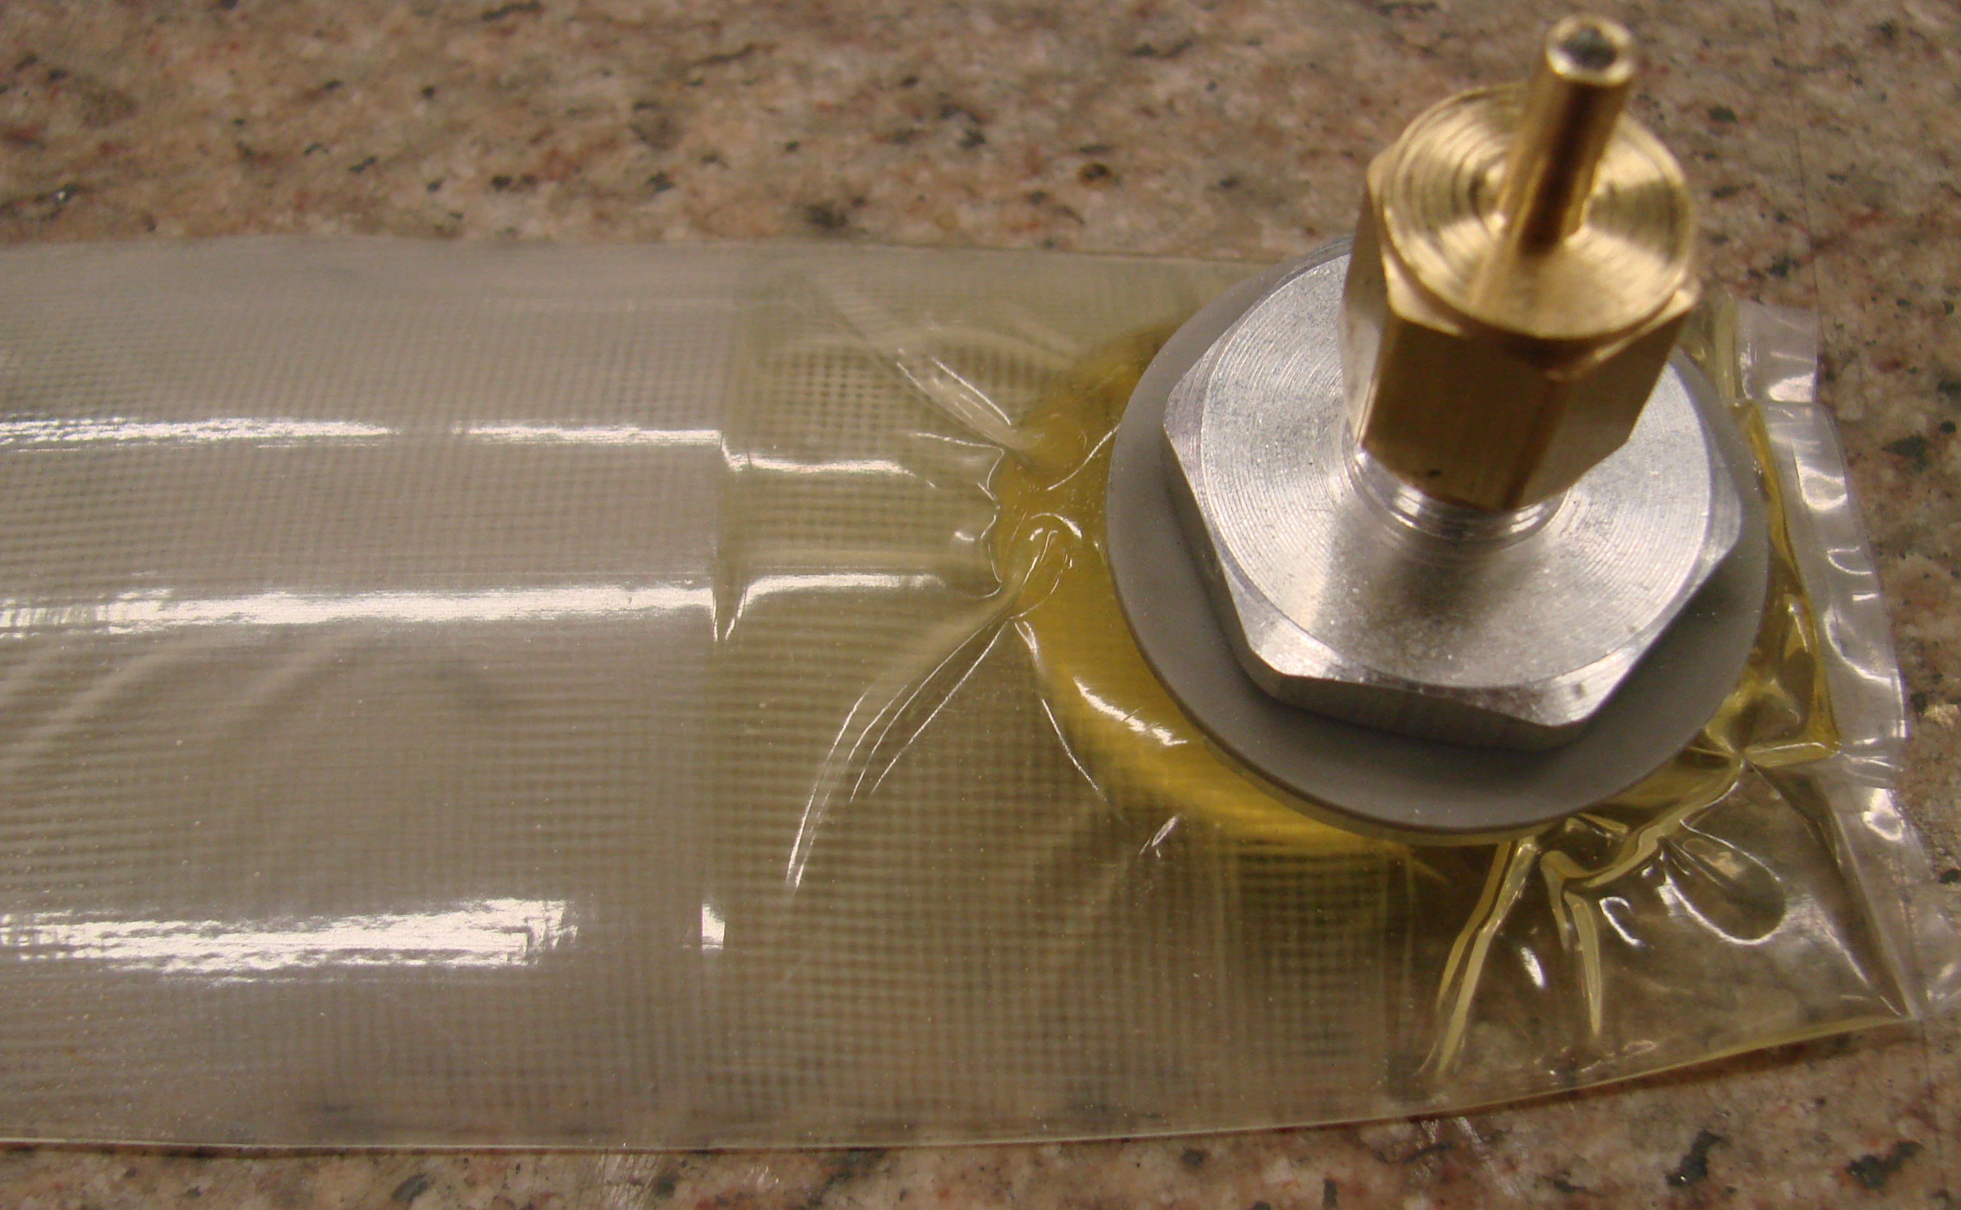
“smart-shim” removed

Slide 12
Bend layer 2
Radial Displacement (m)
Layer 2, 3.1 microns
Scale factor 1000

Slide 13
Inflate shim between layers 1-2
Radial Displacement (m)
Scale factor 1000

Slide 14
Release Layer 2
Layer 2, 2.9 microns
Scale factor 1000

Slide 15
Release shell-1
Shell-1, 5.4 microns
Scale factor 1000

Slide 16
Displacements -- Shims + conductor
Scale factor 1

Slide 17
Azimuthally stressed conductor - RT
Less than 2 MPa
Scale factor 1

Slide 18
Azimuthally stressed conductor - Cold
All under compression
-17 to -141 MPa
Scale factor 1

Slide 19
Azimuthally stressed conductor – 19T
+65 to -167 MPa
Scale factor 1

Slide 20
Radial stressed conductor – 19T
+17 to -145 MPa
Scale factor 1

Slide 21
Azimuthally stressed inner structure – RT
6 to -4 MPa
Scale factor 1

Slide 22
Azimuthally stressed inner structure – cold
+146 to -516 MPa
Scale factor 1

Slide 23
Azimuthally stressed inner structure – 19T
All under compression
+328 to -668 MPa
Scale factor 1

Slide 24
Structural shells - RT
Low ~ 1 MPa
Scale factor 1

Slide 25
Structural shells - cold
+396 to -145 MPa
Scale factor 1

Slide 26
Structural shells – 19T
+430 to -26 MPa
Scale factor 1

Slide 27
Structural Yoke – cold
+28 to -350 MPa
Scale factor 1

Slide 28
Structural Yoke – 19T
+74 to -531 MPa
Scale factor 1

Slide 29
Conclusions
Magnet assembly using “smart-shims”.
Internal structure to integrate Lorentz forces in spars.
External structure to prevent internal bending

Slide 31
Layer 1- coil Azimuthal Stress (MPa)
Assembled cold 19T
Sy (MPa) = +60, -100 cold = +30, -30 19T =+80, -40

