Slide 1
US Magnet Development Program
Design of a shell-based
Utility Structure
Mariusz Juchno
US Magnet Development Program
Lawrence Berkeley National Laboratory

Slide 2
Outline
Goals of the utility structure design effort
Shell based structure concept
Present and future coil parameters
Utility structure cross-section details
2D and 3D model results for 15T coil pre-load
Towards 16 T coil
Conclusions

Slide 3
Goals
Developing a shell-based magnet structure to be used for testing MDP coils
Provide adequate pre-stress for 17T operation
  200MPa peak compressive stress
  Prevent tensile stress in the pole area (pole-turn separation)
  Rapid and reproducible magnet assembly/disassembly
  Compatible with the existing 15 T 4-layer Cos-theta magnet design (FNAL)
Investigation of design limits and sensitivities
  Close coil-structure design effort
  Impact of structure dimensions and features on pre-load capability
  Coil features and fabrication technology impact on the ability to provide pre-load
  Effect of fabrication tolerances on mechanical performance

Slide 4
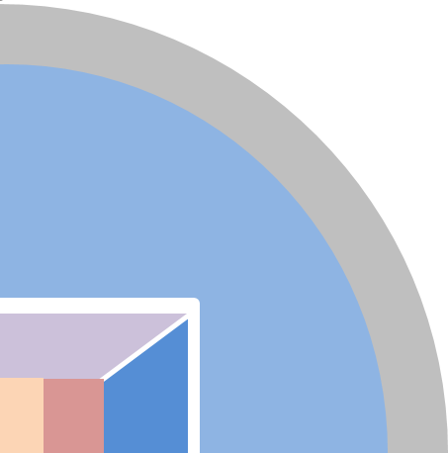
Bladder and Key pre-load concept in a Shell-based structure
Bladder operation
  Pressure acting on the yoke side compensated by reaction force in the shell (tension)
  Pressure acting on the pad side compensated by the reaction force in the pole (compression)
Room temperature pre-load
  Keys replace bladders
  Reaction forces drop slightly (~10-20%)
Cool-down
  Reaction forces increase due to aluminum shell shrinkage
Magnetic forces (coil pre-loaded)
  Reaction force in the shell remains almost the same as after cool-down
  Reaction force in the pole decreases due to magnetic force
Magnetic forces (coil un-loaded)
  Magnetic forces higher than pre-load
  Coil can separate from the pole
  Reaction force in the pole drops to zero
  Reaction force in the shell increases due to magnetic forces

Slide 5
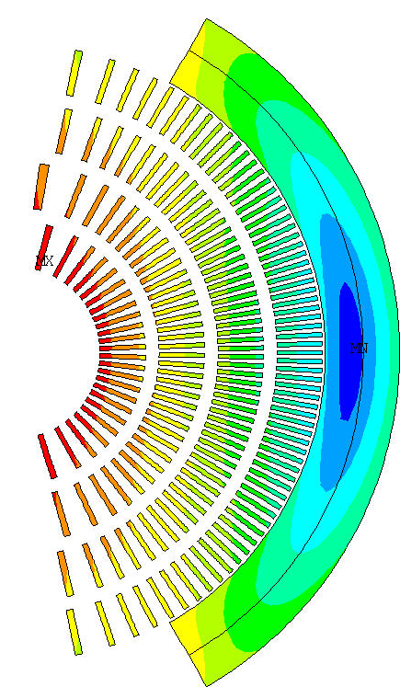
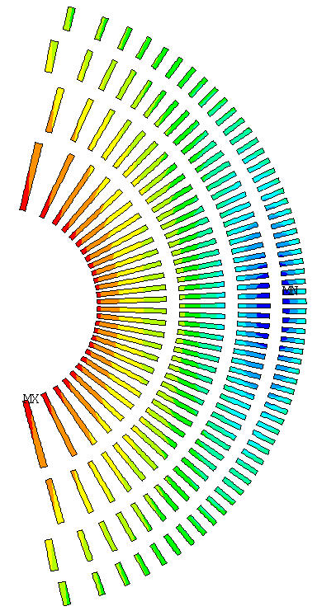
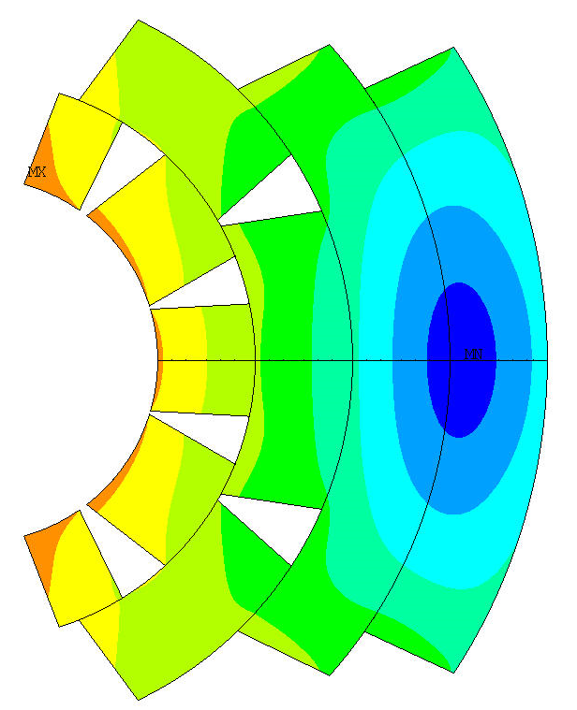
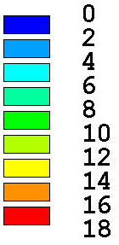
Coil parameters
[preliminary/conceptual/approximate]
 | B [T] | Fx_{quad} [MN/m] | Fy_{quad} [MN/m] | OD [mm]
CT | 15 15.6 | 6.8 7.4 | -3.9 -4.5 | 188
CT-SM | 16 | 9.5 | 4.1 | 208
CCT | 17 | 11 |  | 194
CCT-CT | 18 | 14 |  | 256
HTS/LTS | >16 | ? | ? | < 280 ?
Cos-Theta
(15T)
CCT
(17T)
CCT-CT
(18T)
B [T]
No internal
support structure
Internal support structure
(stress management)
Magnetic field in conductor

Slide 6
Structure with octagonal coil-pack
Aluminum cylinder
Iron yoke
Iron pads
Load-keys
Axial rod holes
Structure with octagonal coil-pack
  Improves yoke stress distribution and rigidity
  Coil-pack horizontal and vertical size = 320 mm
    Smaller coil – axial rods in the coil-pack
    Bigger coils – axial rods in the yoke
Three load-keys
  Horizontal
    Pre-load function
  Diagonal
    Stress distribution and rigidity
  Vertical
    Alignment
  Possibility of closing yoke gap
Bladders
  Mid-plane (2)
  Diagonal (8)
  Yoke (4 or 6)
  Vertical (2)

Slide 7
Structure and coil-pack dimensions
Currently considered for calculation
  Coil pack width 320 mm
  Shell OD 750 mm
  Shell TH 75 mm
Current configuration allows pre-tensioning the shell to ~12 MN/m force per magnet quadrant
  Assuming that yoke remains open
  Assuming max. 45 MPa bladder pressure
  Maximum forces defined but the shell OD
Factors needed to be consider
  Hybrid HTS/LTS coils (coil pack size)
  Cryostat (Shell OD)
  Closed yoke gap (structure rigidity)

Slide 8
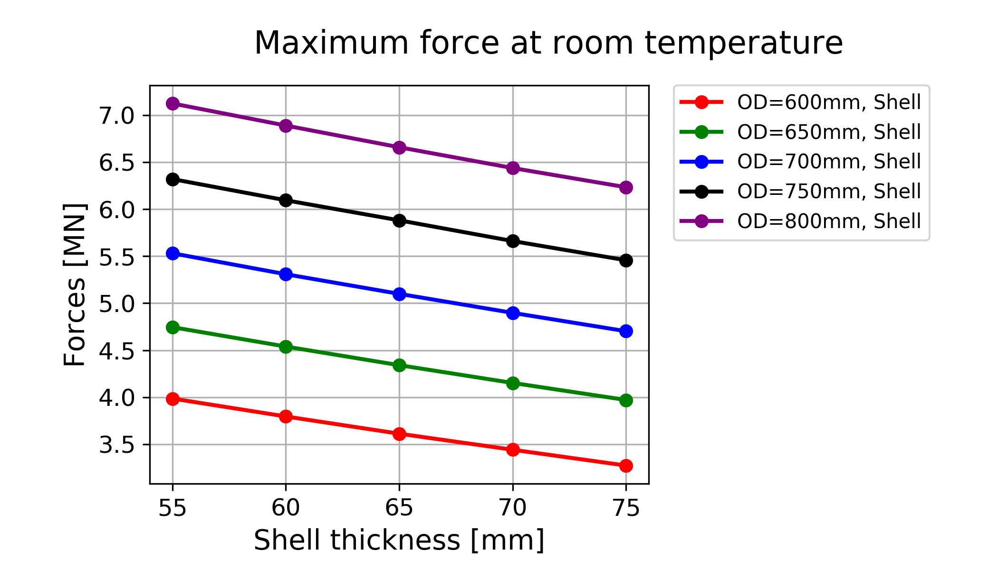
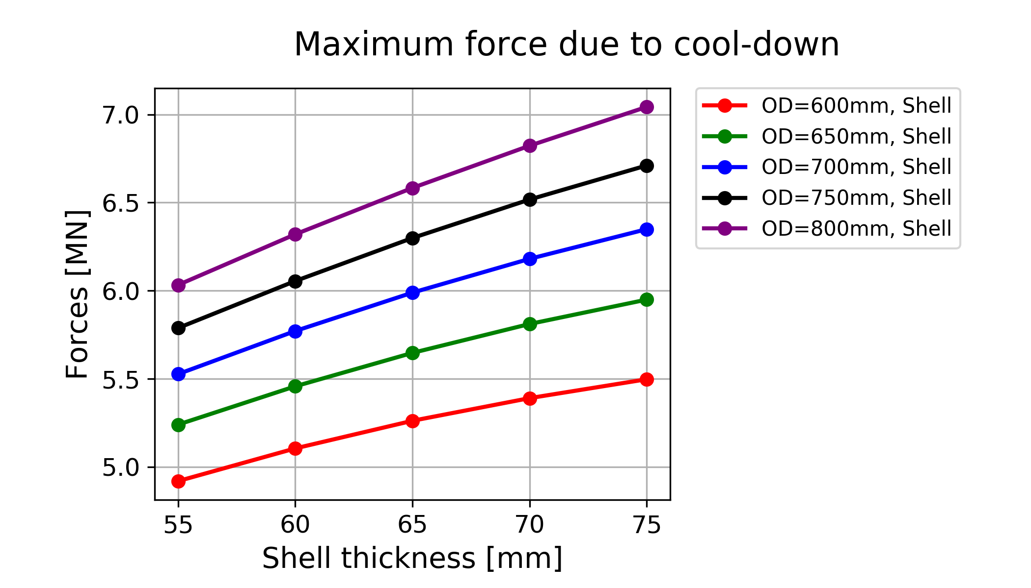
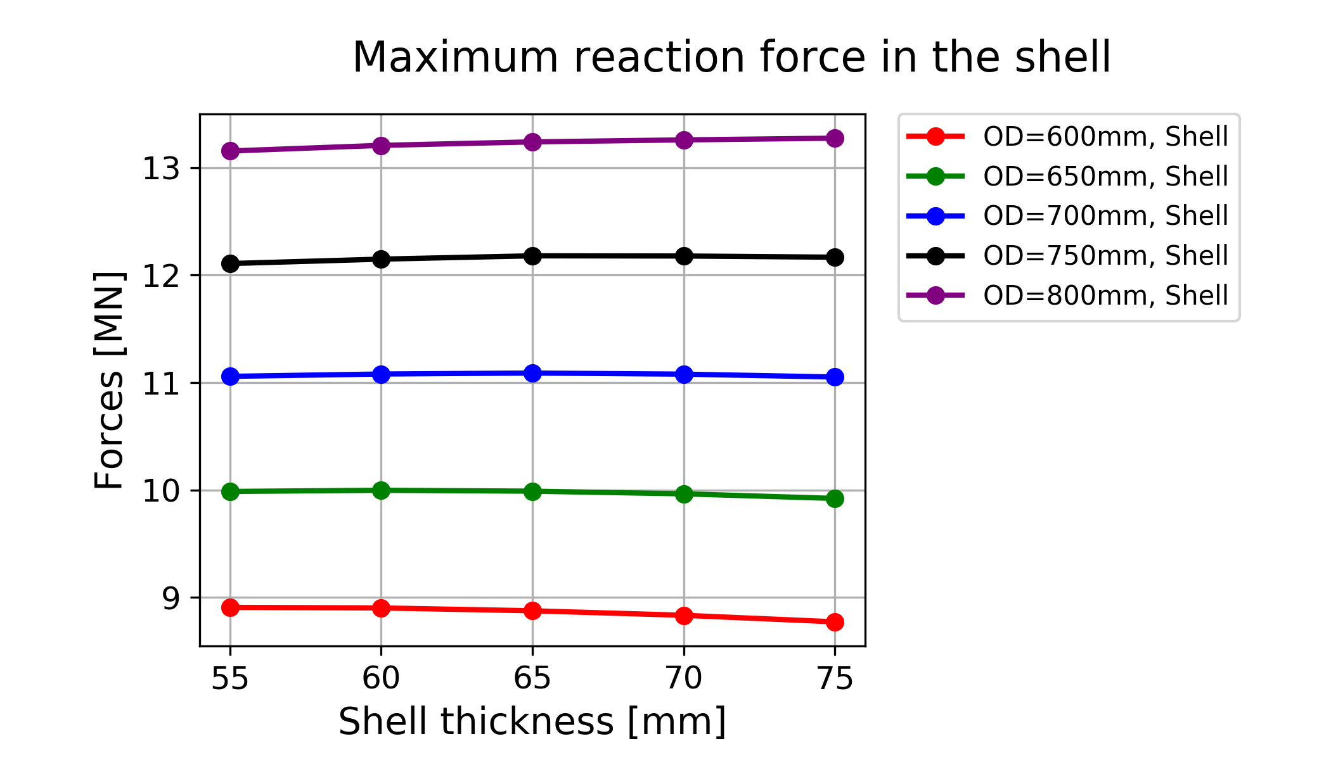
Maximum reaction forces in the shell
Maximum force defined by OD
Thicker shell
  Less space for bladder
  Thinner shell can be inserted with fixed bladder pressure
  Higher force gained during cool-down

Slide 9
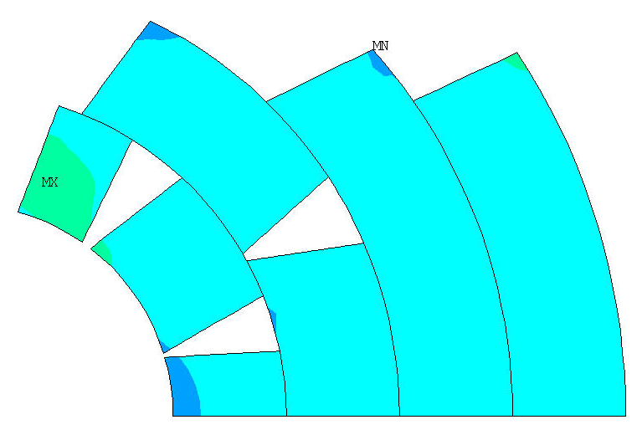
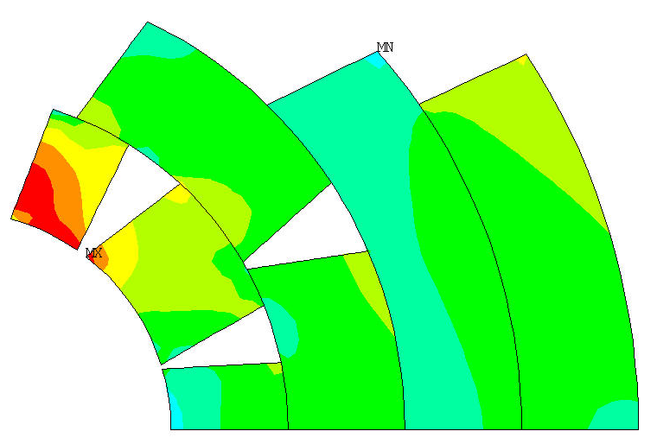
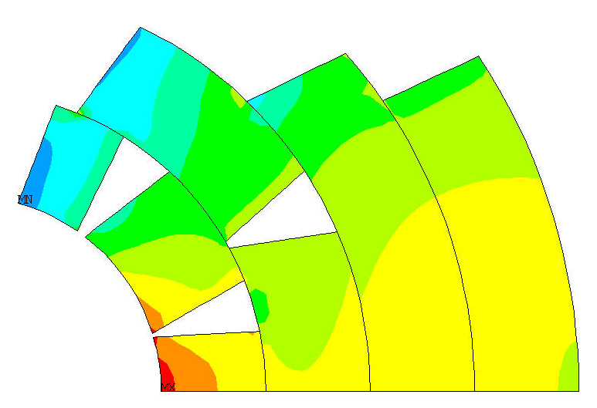
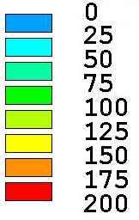
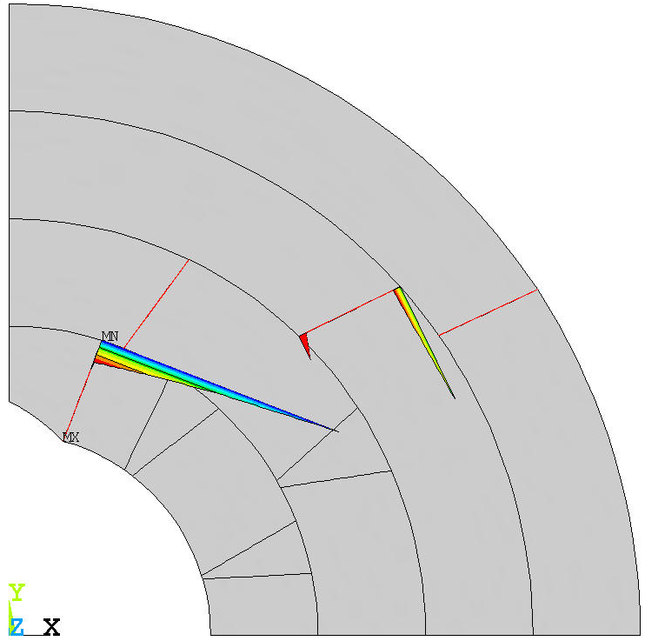
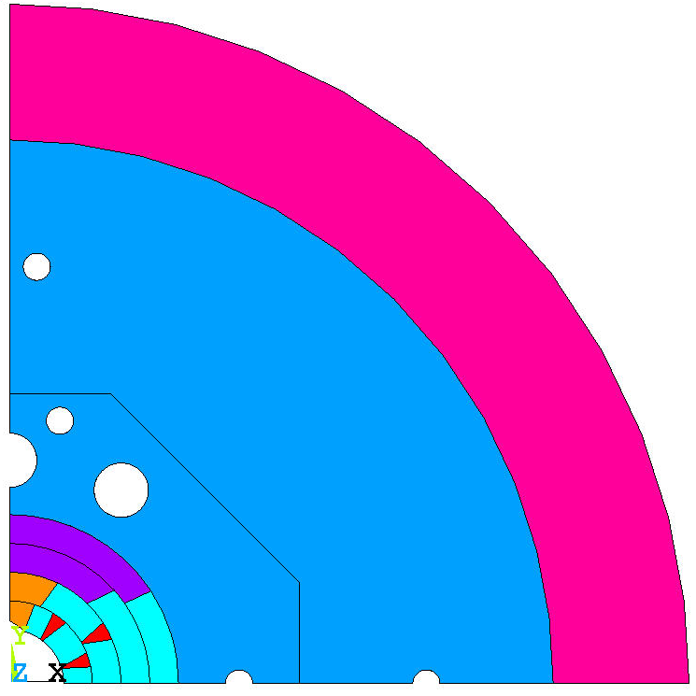
Utility Structure
2D analysis
300K
4K
4K+15T
MPa
Pole-turn separation
15 T Pre-load
  Bladder operation < 80 MPa
  Room temperature < 60 MPa
  Cool-down < 200 MPa
  Magnetic forces < 200 MPa
16 T Pre-load
  Bladder operation ~ 100 MPa
  Room temperature ~ 80 MPa
  Cool-down ~ 220 MPa
  Magnetic forces ~ 220 MPa
Updated cross-section
Poles
~1um
Conductor
 | 4 K | 300 K
E_{r} | 55 GPa | 44 GPa
E_{Θ} | 44 GPa | 44 GPa
α_{r} | 2.6 x10³ 1/K
αΘ | 3.3 x10³ 1/K

Slide 10
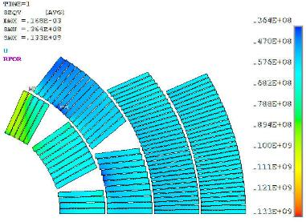
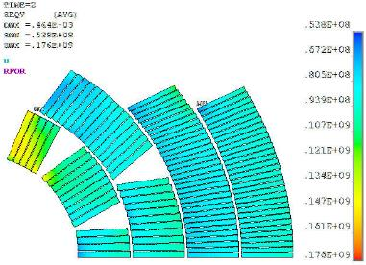
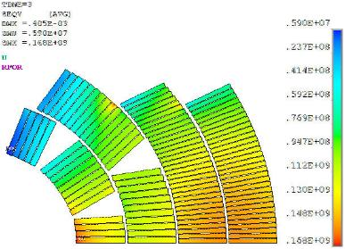
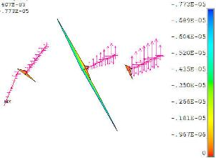

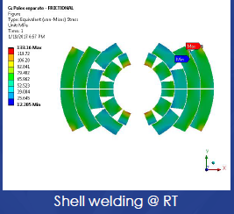
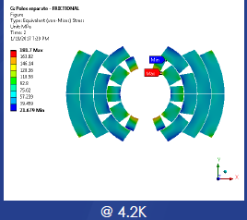
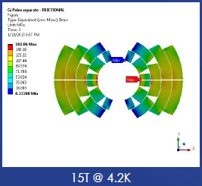
15 T dipole demonstrator – 2D FEA
FNAL analysis
300K
4K
4K+15T
L3
L4
L2
L1
S_{eqv}=133 MPa
S_{eqv}=176 MPa
S_{eqv}=168 MPa
FEAC/U. Patras 2D analysis
S_{eqv}=133MPa
S_{eqv}=182MPa
S_{eqv}=161MPa

Slide 11
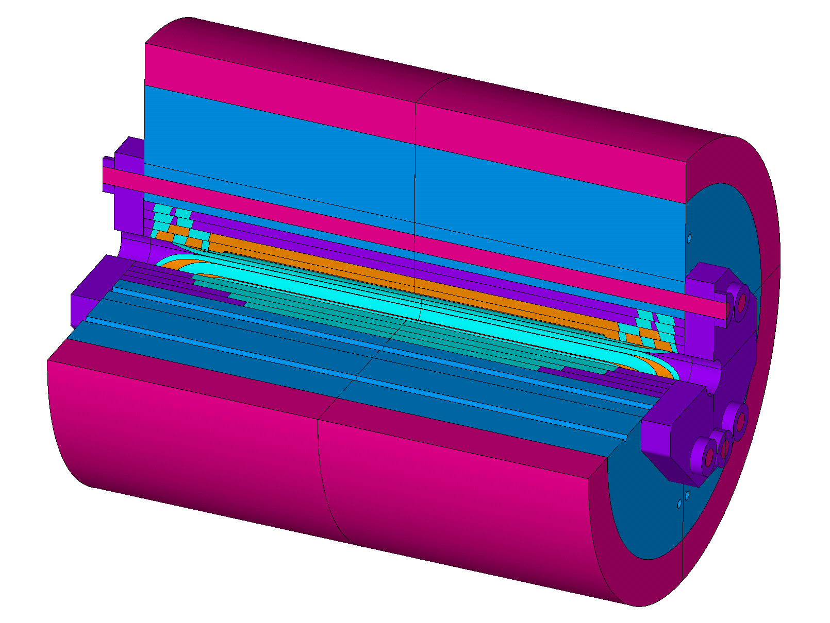
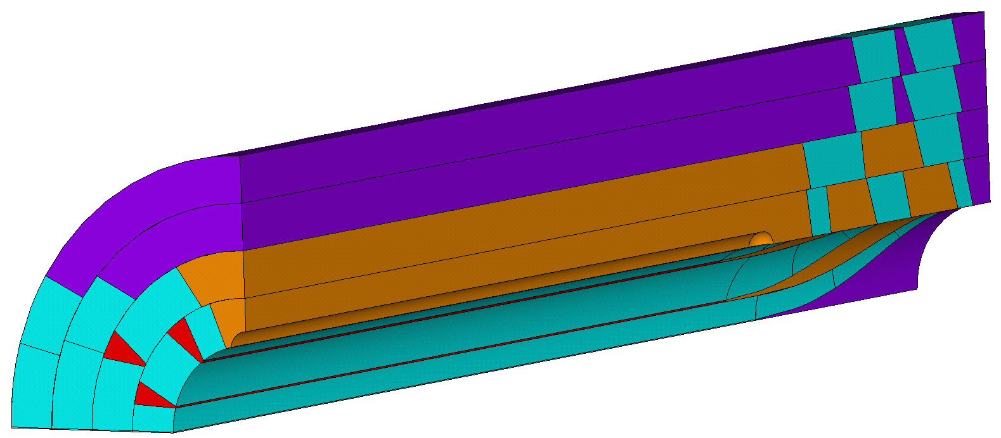
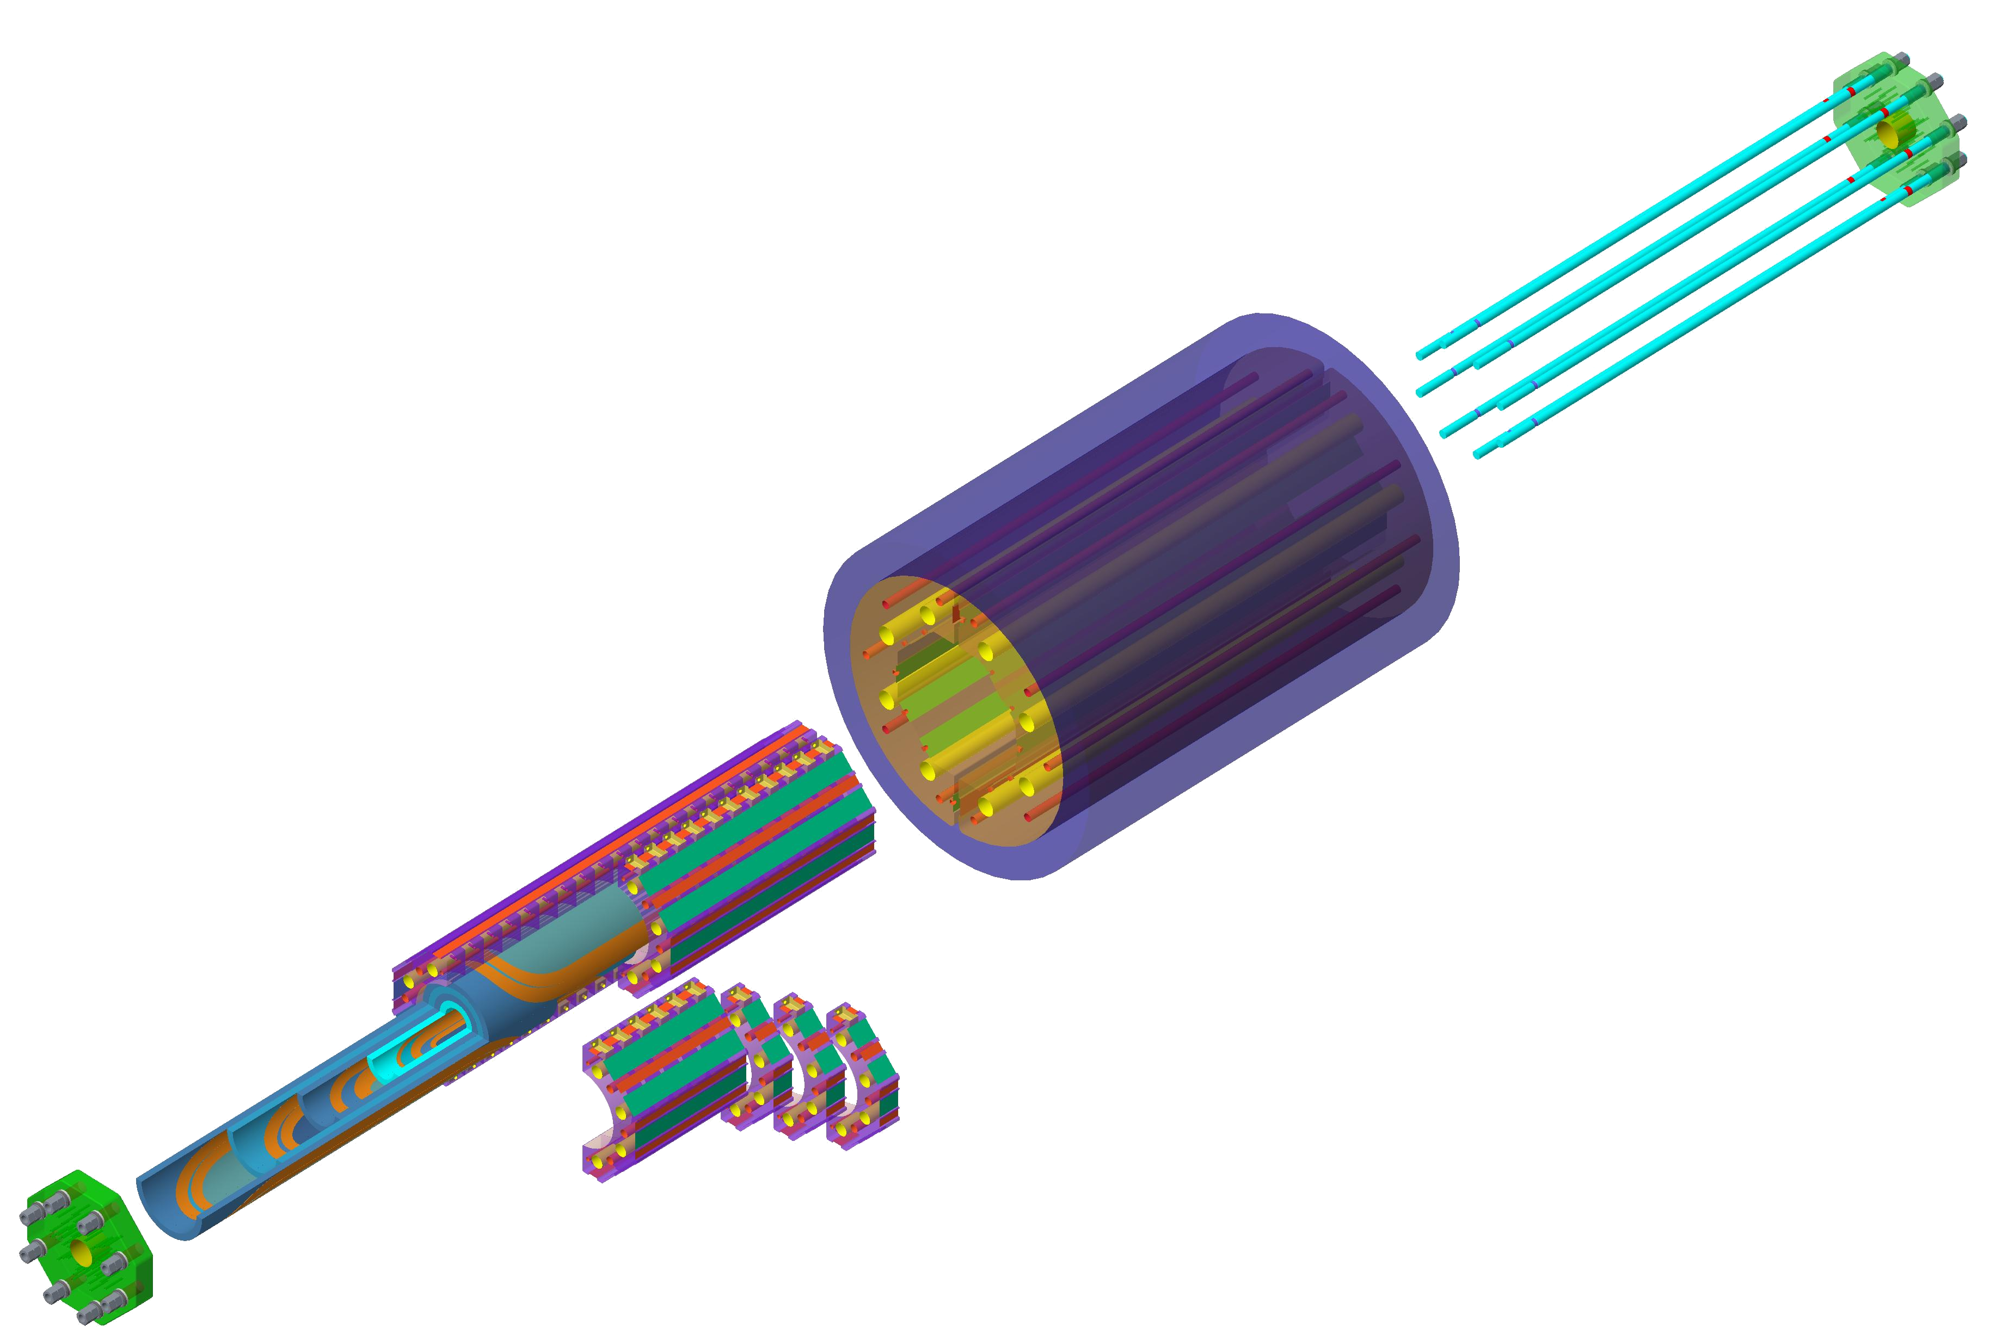
Development of the 3D model
3D ANSYS model developed
  Initial simulations using 15 T Cos-Theta coils
  Validation and optimization is ongoing
Work on engineering design was initiated

Slide 12
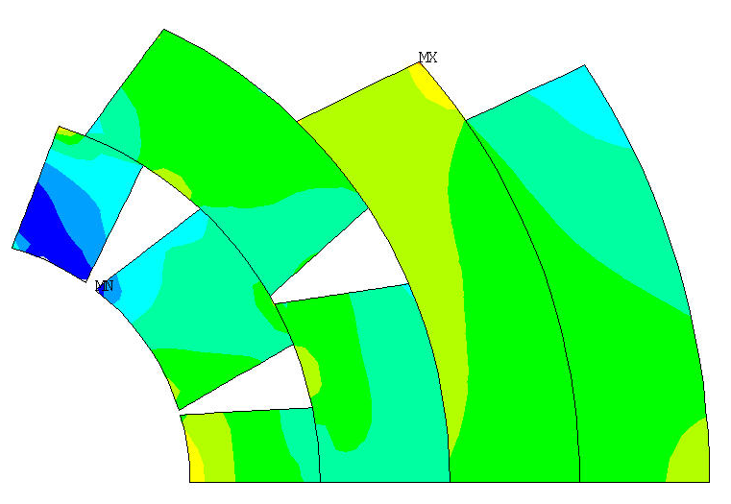
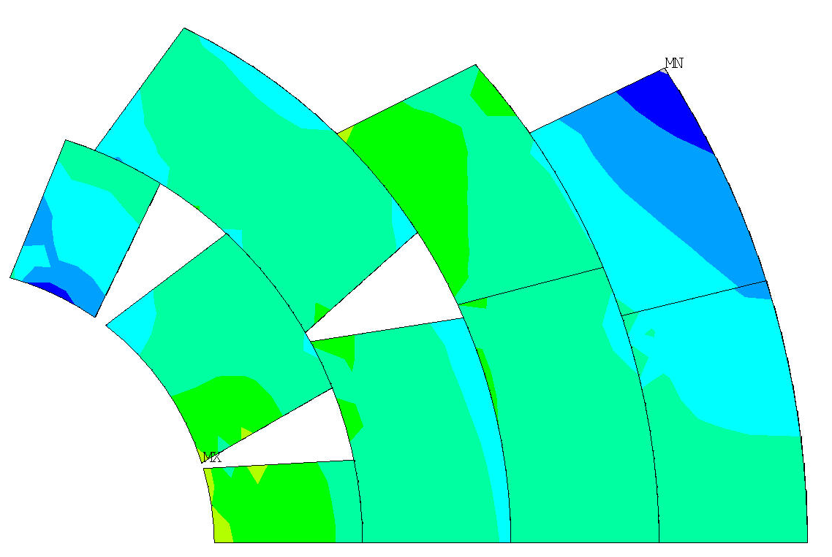
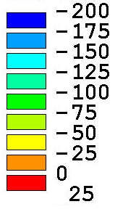
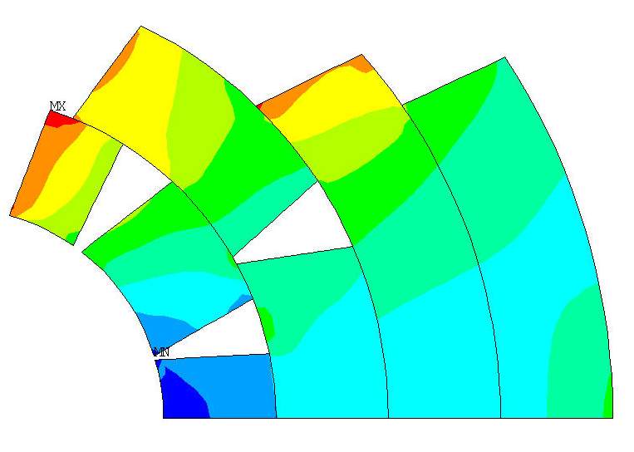
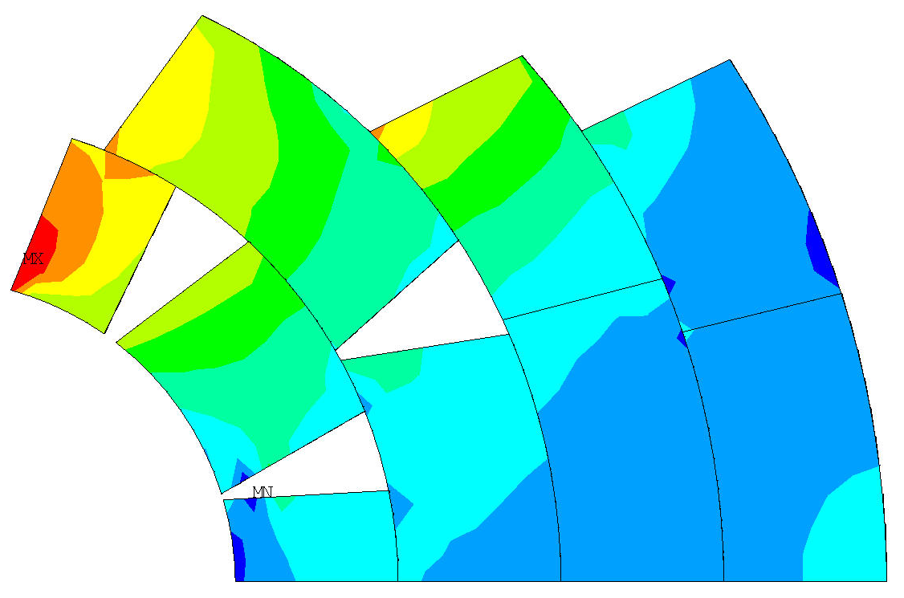
Utility Structure
Azimuthal coil stress (2D vs 3D)
2D
3D
MPa
Compression
4K
4K+15T

Slide 13
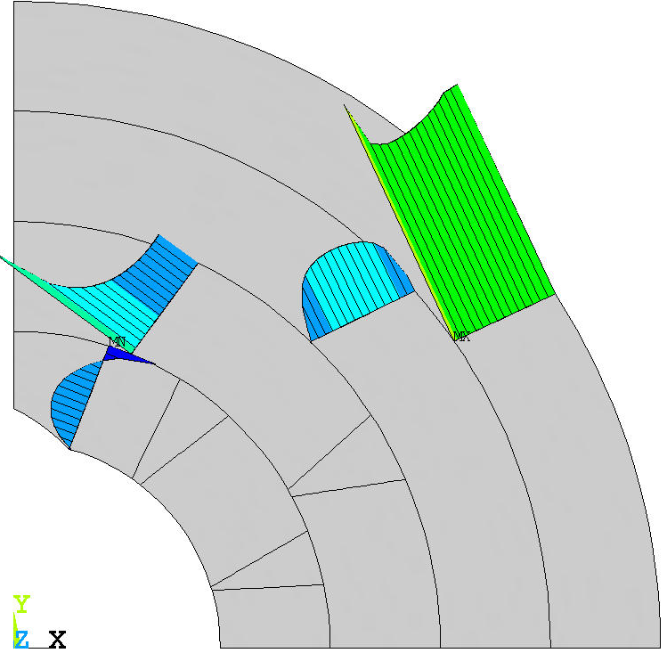
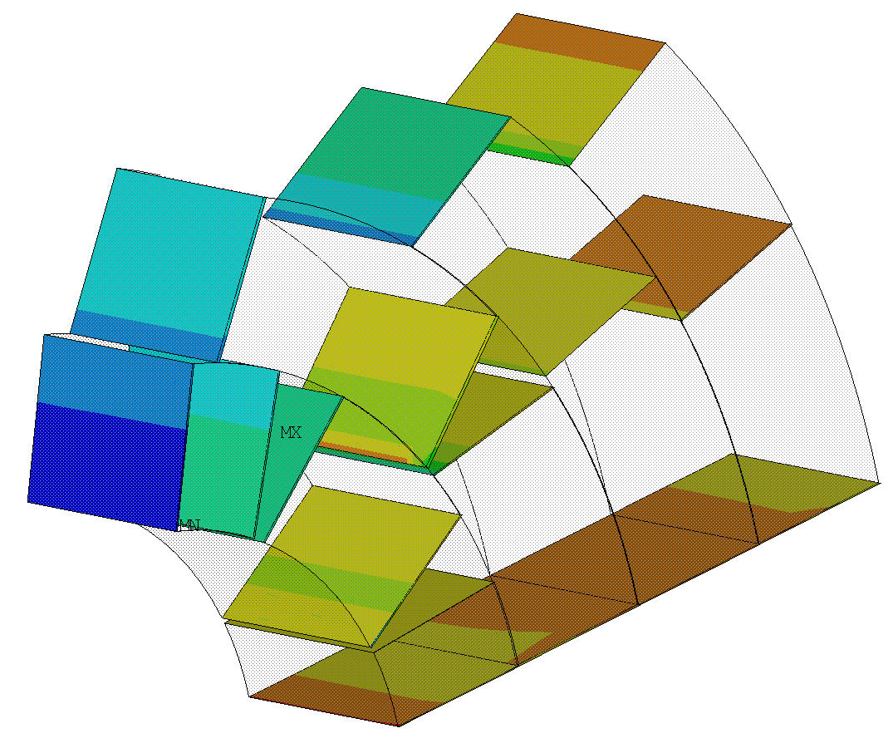
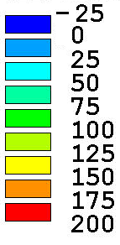
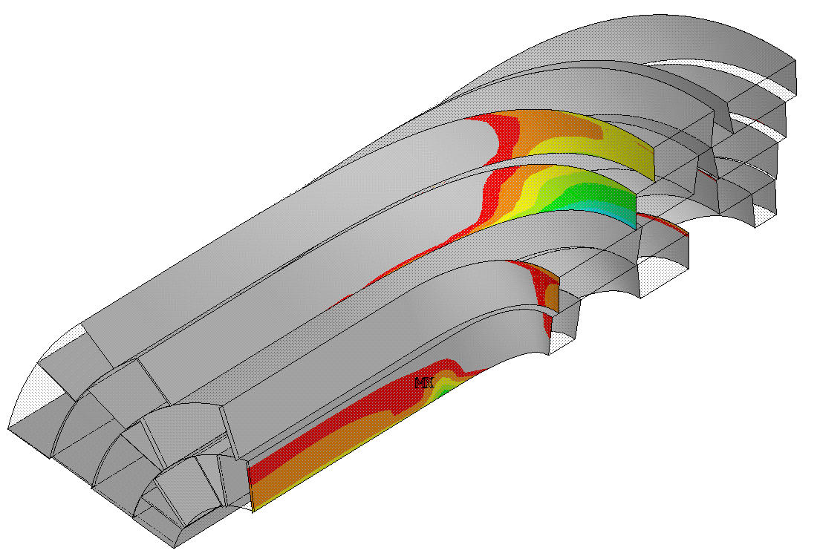
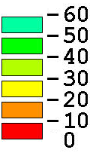
Coil to pole/spacer contact
2D
MPa
3D
Compression
Optimization of the pre-load level
  Orthotropic coil properties
Axial pre-load and tension in the coil-ends under investigation
  Copper wedge to spacer interface
  Layer 3-4 to pole contact
MPa
Tension

Slide 14
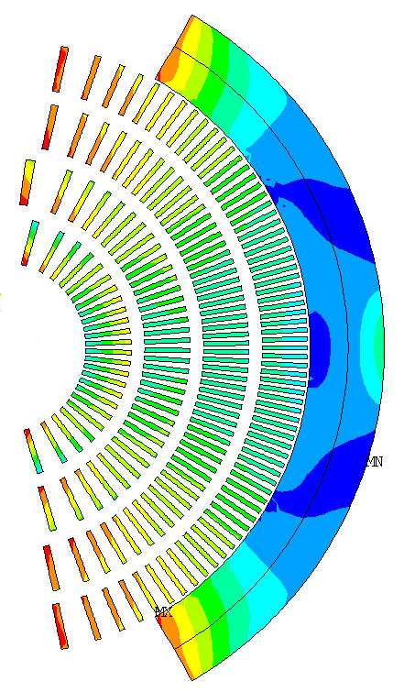
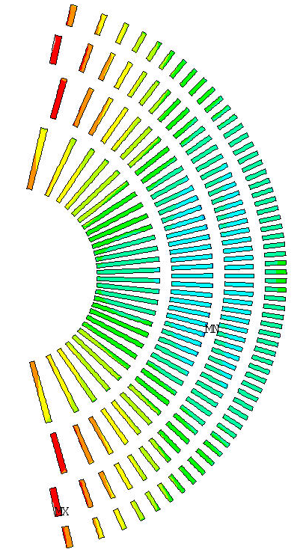
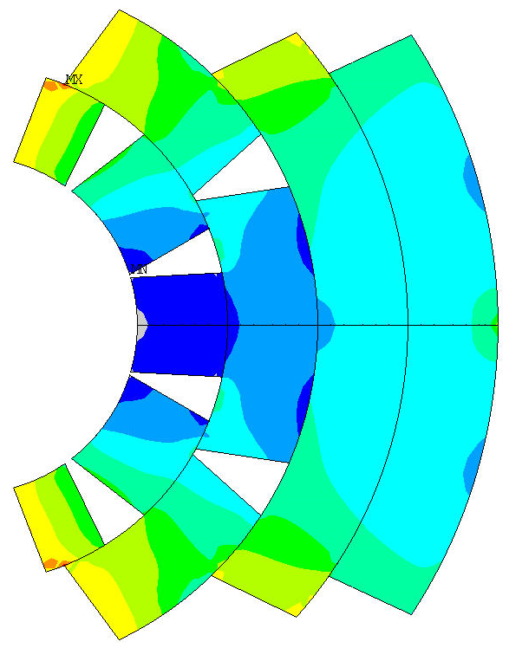
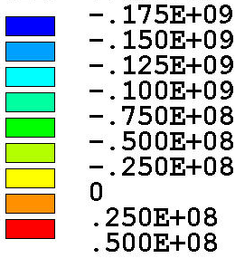
Utility Structure
With different coil types
Same structure was applied
Shell OD 750mm
Shell TH 75mm
Same iron yoke
Only pads were changed
Pre-load adjusted only by load-key shims
Possibility to close the yoke gap at cold (rigidity)
  Closed collars ?
Cos-Theta
(15T)
CCT
(17T)
CCT-CT
(18T)
B [T]
No internal
support structure
Internal support structure
(stress management)
Magnetic field in conductor
Cos-Theta
<50 MPa at RT
<200 MPa at 4K
<190 MPa at 15T
CCT
<60 MPa at RT
<200 MPa at 4K
<160 MPa at 17T
CCT-CT
<100 MPa at RT
<200 MPa at 4K
<170 MPa at 18T
σ_{Θ} [Pa]
No internal
support structure
Internal support structure
(stress management)
Azimuthal stress in conductor

Slide 15
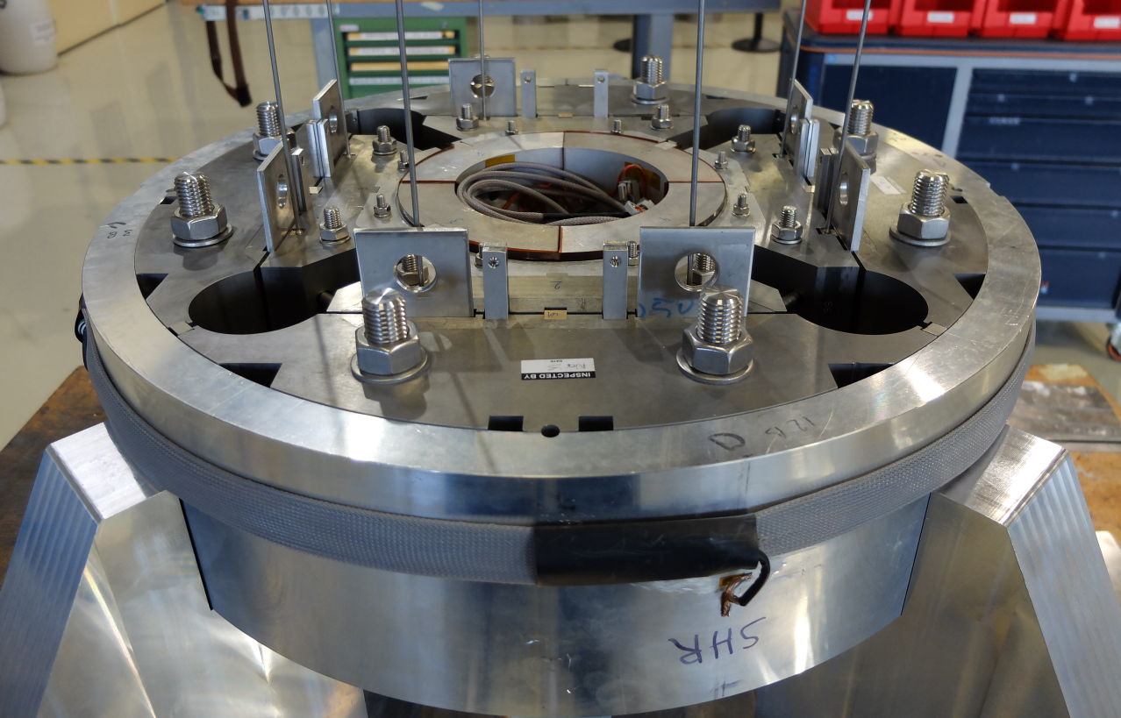
Conclusions and Future Work
Concept of the utility structure has been developed and analyzed
  Reusable yoke-shell assembly with a coil-dedicated pads
  Tentative dimensions established but further optimization is needed
  15 T Cos-theta coil and CCT coil analyzed with utility structure pre-load
  Work on 16T coil pre-load analysis initiated (CT/SM, CCT/CT, LTS/HTS hybrids)
  Structure rigidity with closed yokes needs further investigation (closed collars)
3D model of the utility structure developed
  15 T Cos-theta coil model implemented
  Validation and optimization is ongoing
  Axial pre-load system implemented
Engineering design work initiated
  CAD model of the full structure
  Assembly procedure
  Short mechanical mock-up

Slide 16
Thank You!

