Slide 1
US Magnet Development Program
Nb₃Sn Magnets:
CCT Dipole Program
Diego Arbelaez
US Magnet Development Program
Lawrence Berkeley National Laboratory

Slide 2
CCT Dipole Session
CCT program overview
Current status for CCT high field dipole magnet development
Challenges and issues being addressed
Future plans
CCT4 Test
CCT4 modeling and analysis (Lucas Brouwer)
CCT4 diagnostics and quench behavior (Maxim Martchevskii)
6-Layer CCT Hybrid concept (S. Caspi)

Slide 3
CCT Motivation
“A critical aspect of the program is to aggressively investigate innovative new design concepts that may prove to have better performance at a lower cost per T-m”
“The main motivation is in the area of mechanical stresses: preliminary calculations show dramatic reduction in azimuthal stresses, effectively eliminating these stresses as limitations in the magnet design”
“the concept will allow for conductor grading and for the implementation of HTS materials for very high-feld CCT magnet designs”

Slide 4
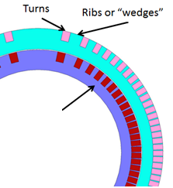
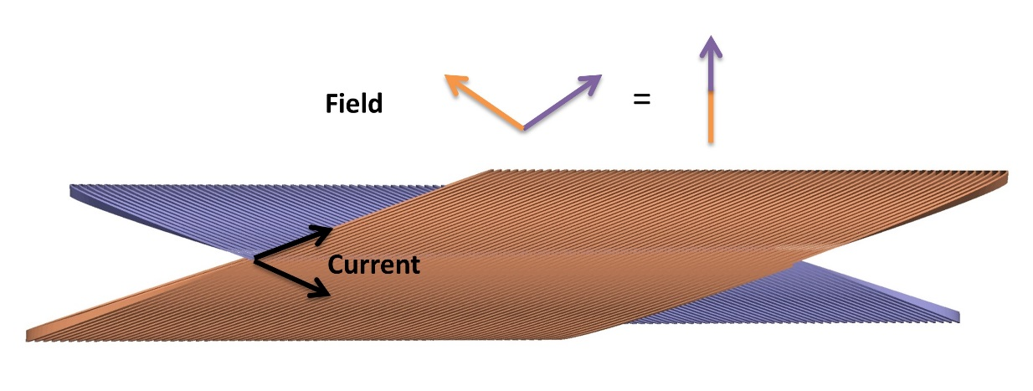
Concept – CCT Dipole Magnet
Canted windings in opposing directions produce dipole field (cancel solenoidal field)
Transverse current density has natural cos-theta distribution
Windings are placed in a mandrel with grooves - Ribs in mandrel intercept Lorentz force leading to substantially reduced azimuthal stress
Ribs Intercept Lorentz Force
Winding Geometry
Transverse current density with cos-theta distribution approaches a perfect dipole current density distribution

Slide 5
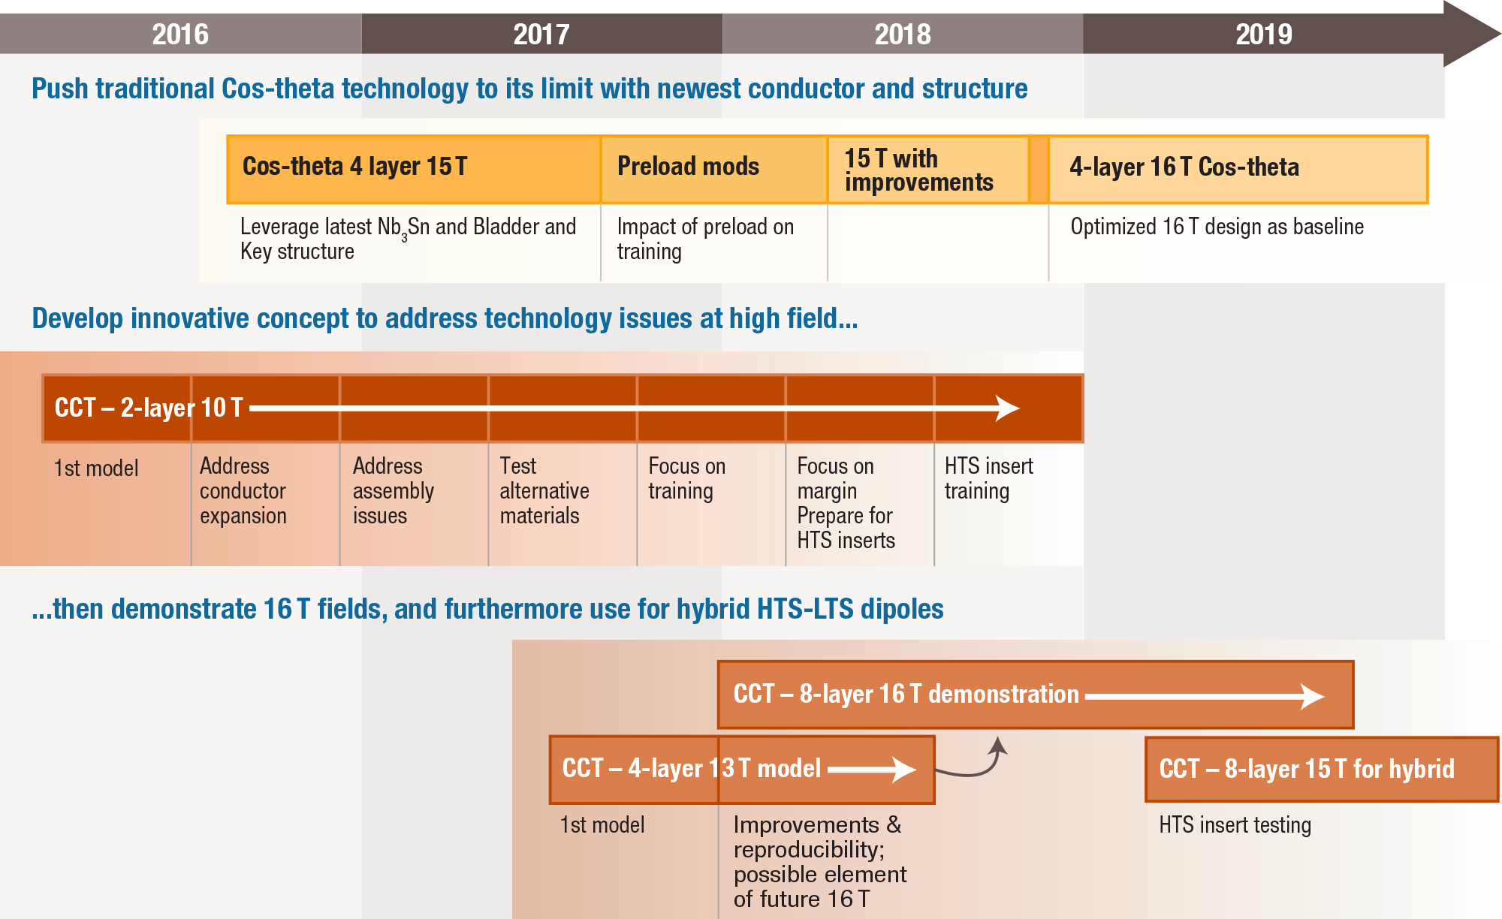
CCT Program Plan

Slide 6
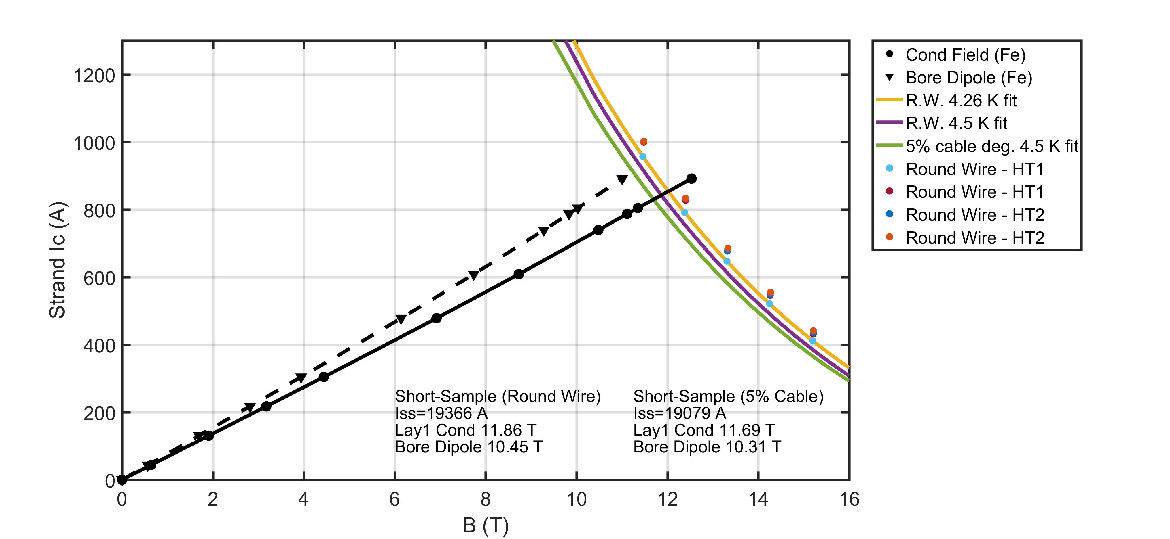
2-Layer Nb₃Sn CCT Dipole Magnet Series
Tested CCT 2-layer series has nearly identical geometry
90 mm diameter inner bore
1 m physical length
Mandrel grooves for 10 mm wide and 1.4 mm thick cable
Magnet Parameters
 | CCT3/4
Conductor | Nb₃Sn RRP 54/61
Cu:SC ratio | 0.85
Inner Bore Diameter [mm] | 90
Cable Width [mm] | 10.1
Cable Thickness [mm] | 1.4
Number of Strands | 23
Cable Insulation | S-glass Braid 0.2 mm thick
Iron Yoke | Yes
Impregnation Material | CTD-101K
Short Sample Current [kA] | 19.3
Short Sample Bore Field [T] | 10.4
Magnet Load Line for CCT4

Slide 7
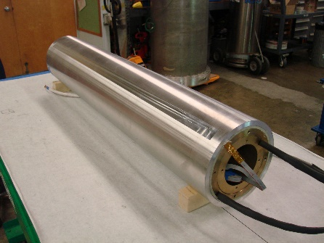
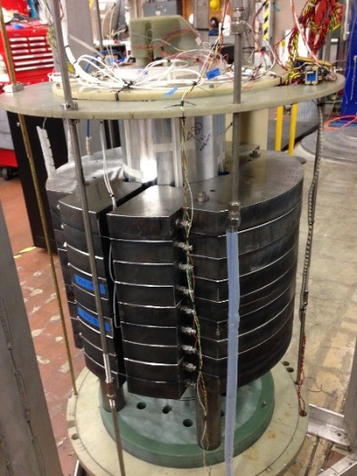
Progress on 2-Layer CCT Development
CCT2
5.3 T short-sample dipole
90 mm clear bore
23 strd. NbTi cable (0.8 mm SSC Inner)
5/2015: tested up to 4.7 T
CCT3
10.4 T short-sample dipole
90 mm clear bore
23 strd. Nb₃Sn cable (0.8 mm OST 54/61)
3/2016: tested up to 7.4 T (69% of SS limit)
Conductor damage is the likely limiting factor
CCT4
10.4 T short-sample dipole
90 mm clear bore
23 strd. Nb₃Sn cable (0.8 mm OST 54/61)
8/2017: tested up to 9.1 T (86% of SS limit)
Long initial training but good memory

Slide 8
2-Layer CCT Nb₃Sn Plan (CCT Technology Development)
 | CCT3 | CCT4 | CCT5
Bore size [mm] | 90 | 90 | 90
Groove design | constant width | 1.25 mm gap at pole | 1.65 mm gap at pole
Conductor | RRP 54/61 Ta doped | RRP 54/61 Ta doped | RRP 108/127 Ti doped
HT Temp [C] | 650 | 660 | 665
Potting configuration | full magnet | full magnet | individual layers
Epoxy | CTD-101K | CTD-101K | FSU Mix 61
Layer-to-layer interface | bonded | mold released | mold released bend & shim
Conductor damage
Field quality
Cost and scalability
Training
* Only change last year’s plan is new bend & shim approach for layer-to-layer interface

Slide 9
CCT Technology Development: Complementary Programs
Modeling
Mechanical modeling
Large scale models
Periodic models
Homogenization
Quench modeling
Cable behavior/Heat treatment experiments
Cryogenic materials testing
Material properties
Strength and fracture toughness
Interface strength
Training Experiments
Subscale CCT

Slide 10
Towards High Field CCT Demonstrator
Started work on 6-Layer CCT Design (See talk by S. Caspi)
4 outer layers using Nb₃Sn
Inner 2 layers can use Nb₃Sn or HTS conductor and be powered independently
Layer 3 inner radius should will be large enough to accommodate HTS inserts (~120 mm?)
Bend and shim method is used to couple layers

Slide 11
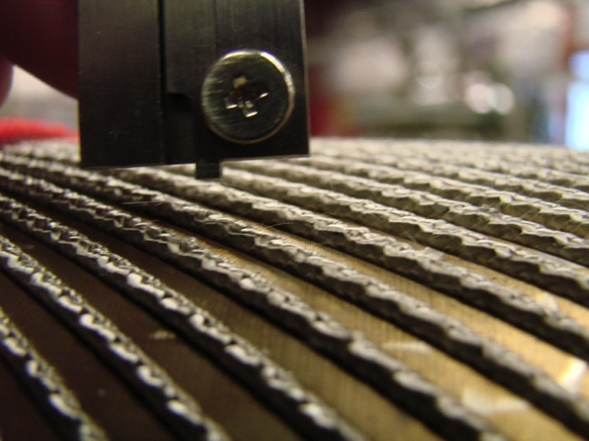
CCT3 Test Results
CCT3 reached 69% of short sample current after 28 quenches
Higher current can be achieved at higher ramp rates
Most quenches in the same region (within 5 turns from end IL)
Observed instability suspected to be due to conductor damage from lack of gaps
CCT3 Quench Current
Cable Protrudes after Heat Treatment

Slide 12
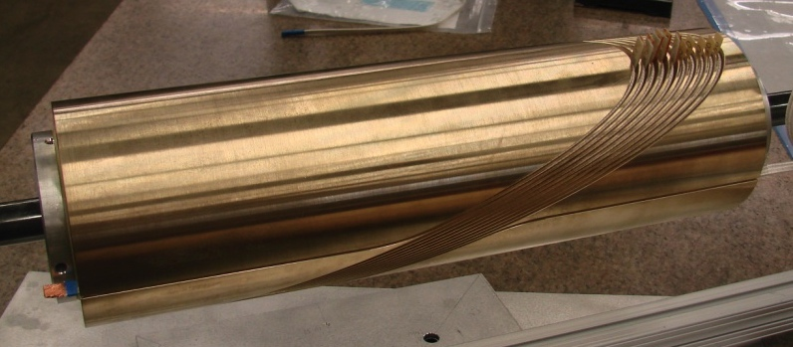
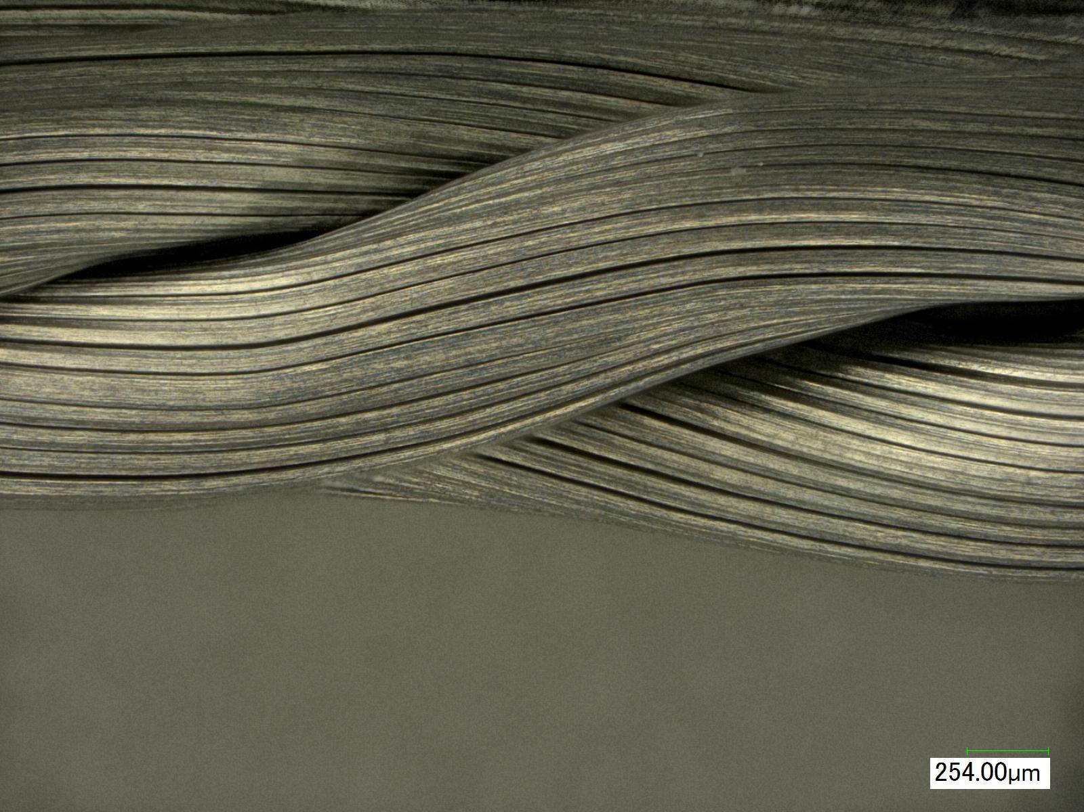
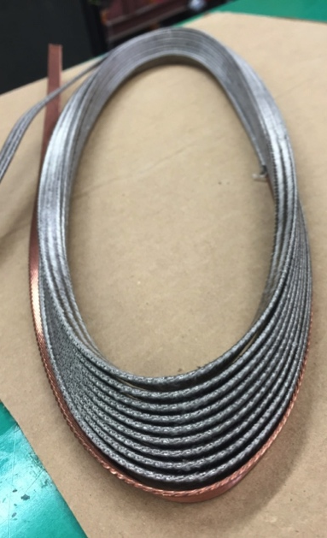
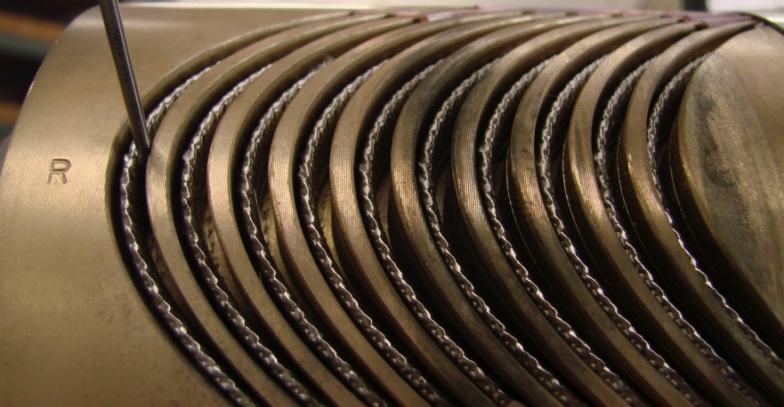
Heat Treatment Experiments
Need to avoid conductor damage during heat treatment and assembly
Test mandrel with large gaps at the pole was machined to further understanding
Cable is removed and etched down to the sub-elements to inspect for damage
No apparent damage was seen after initial test with added pole expansion space
CCT Heat Treatment Test Mandrel
Extracted Cable
Etched Cable Sample
Measured Gaps After Heat Treatment

Slide 13
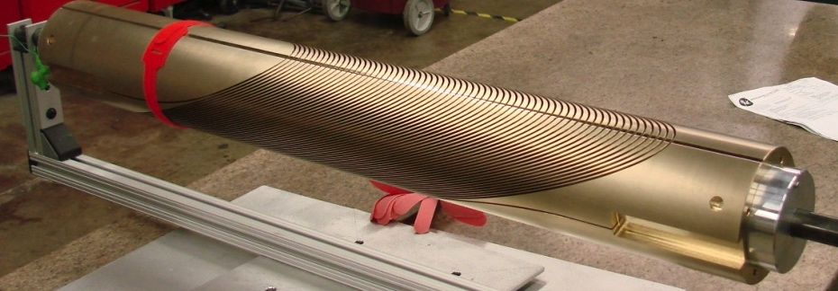
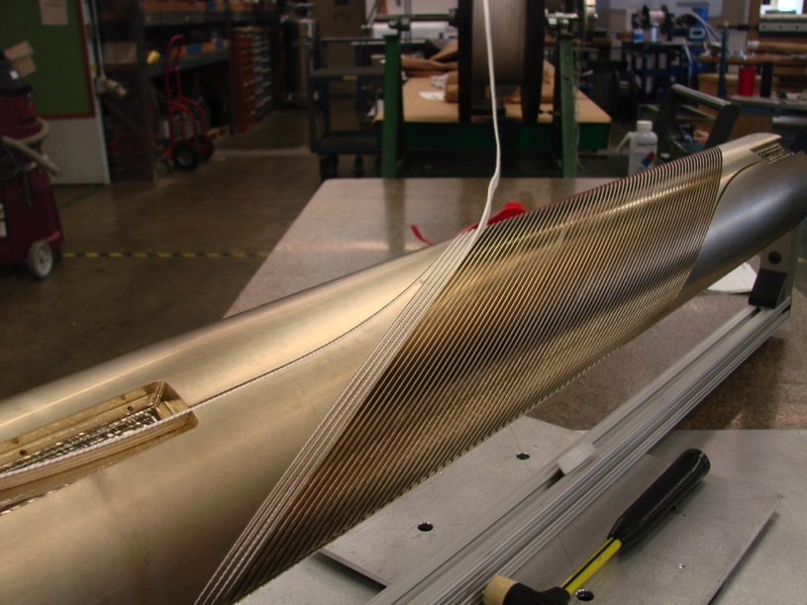
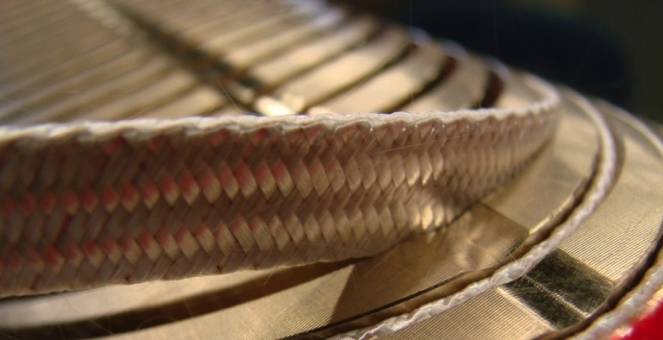
CCT Mandrels and Winding
Aluminum Bronze mandrels are machined on 4-Axis CNC milling machine
Conductor is placed into the groove without tension
Pockets are machined into the mandrels for lead splices
Machined Mandrel
Coil Winding
* Tooling Required is Minimal

Slide 14
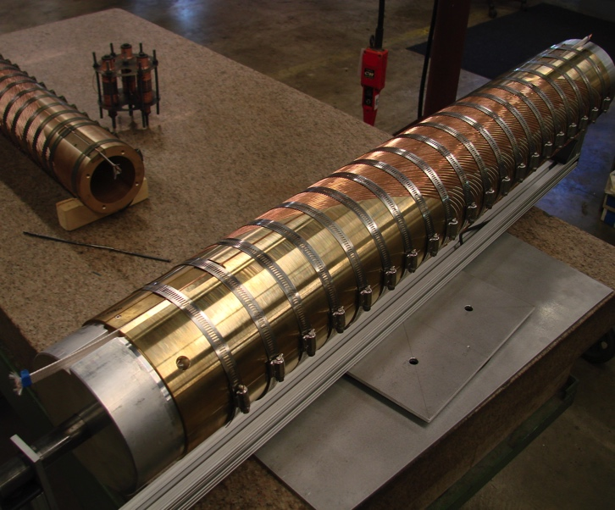
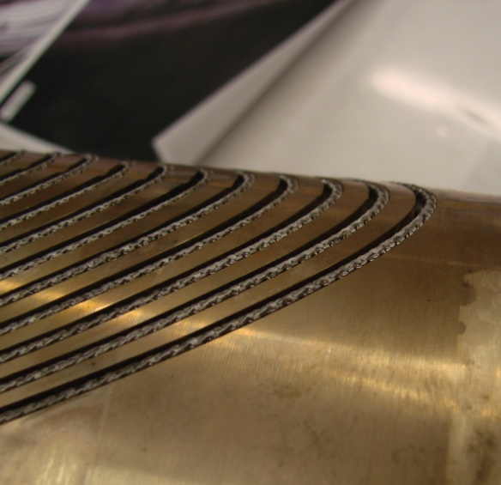
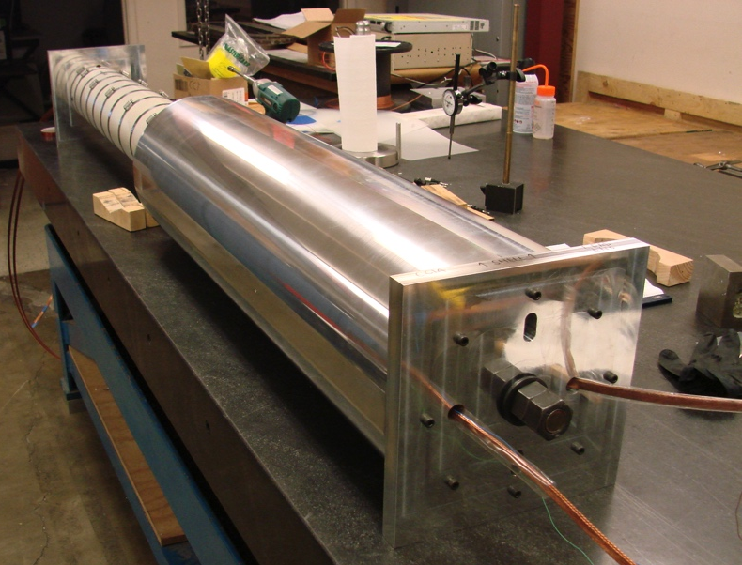
CCT4 – Heat Treatment and Assembly
Copper wire is used to force the cable to the bottom of the channel
Mandrel is secured with hose clamps
Cable is below mandrel surface after heat treatment
Layers are wrapped with G10 sheets and inserted into the outer layer and shell
CCT4 Heat Treatment Configuration
Cable Position After Heat Treatment of CCT4
CCT4 Assembly

Slide 15
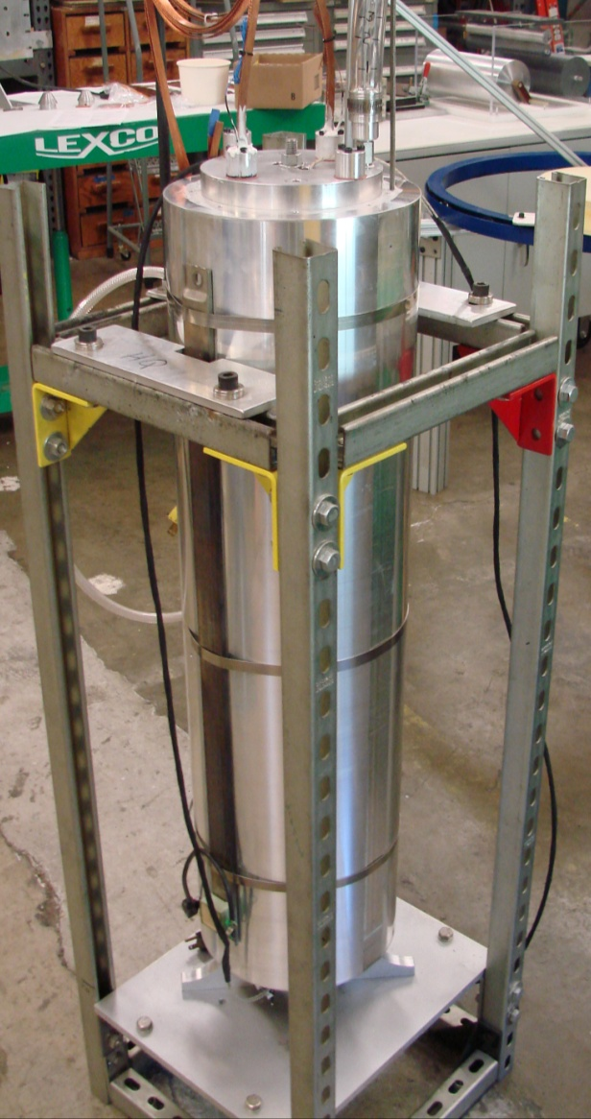
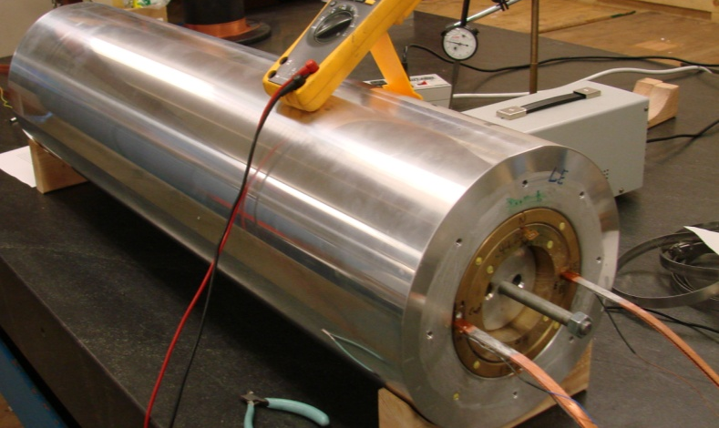
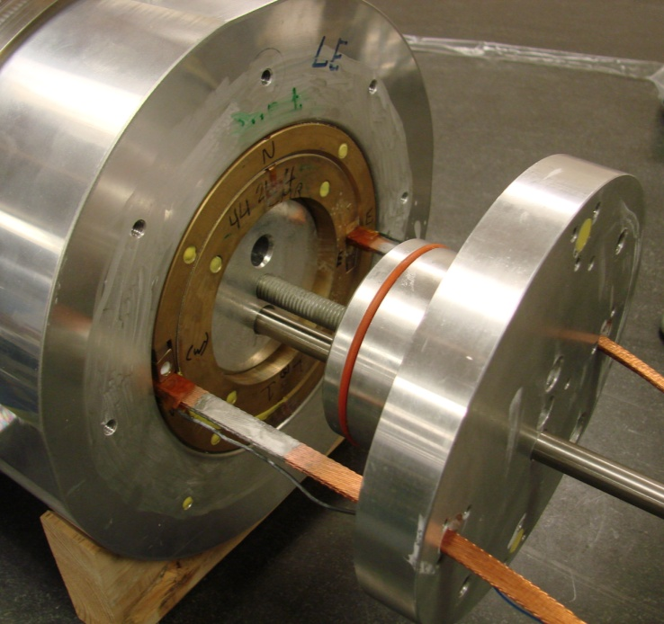
CCT4 Magnet Impregnation
Coils and shell assembly is impregnated with epoxy
Simple tooling is used to create a seal from the bore to the ends of the shell
Inside of outer layer and shell were mold-released to avoid energy release from delamination at the interfaces
Next Step: Development of individual layer potting and assembly is under way
Potting Assembly
CCT4 Coil Assembly
Sealing End Caps

Slide 16
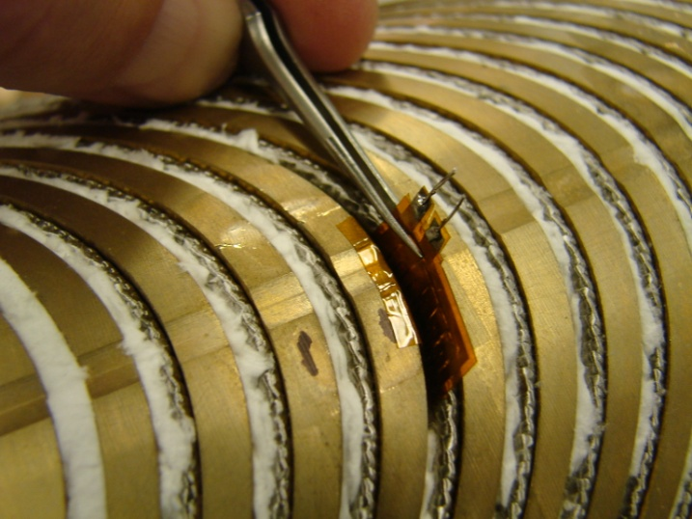
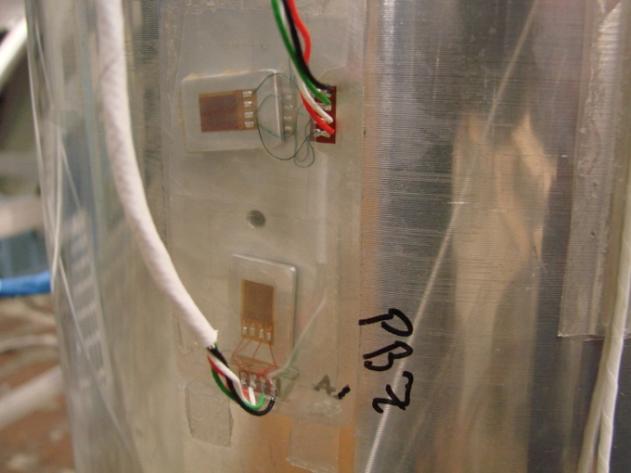
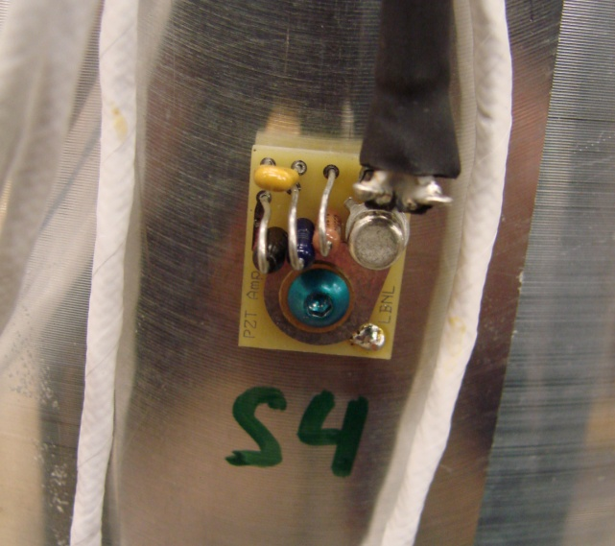
Instrumentation
Voltage taps at various turns in the coil
Acoustic sensors at 10 locations on the shell
Strain gages on shell (pole and midplane)
Spot heater with associated voltage taps and thermometer in groove
Spot Heater
Strain Gages
Acoustic Sensors

Slide 17
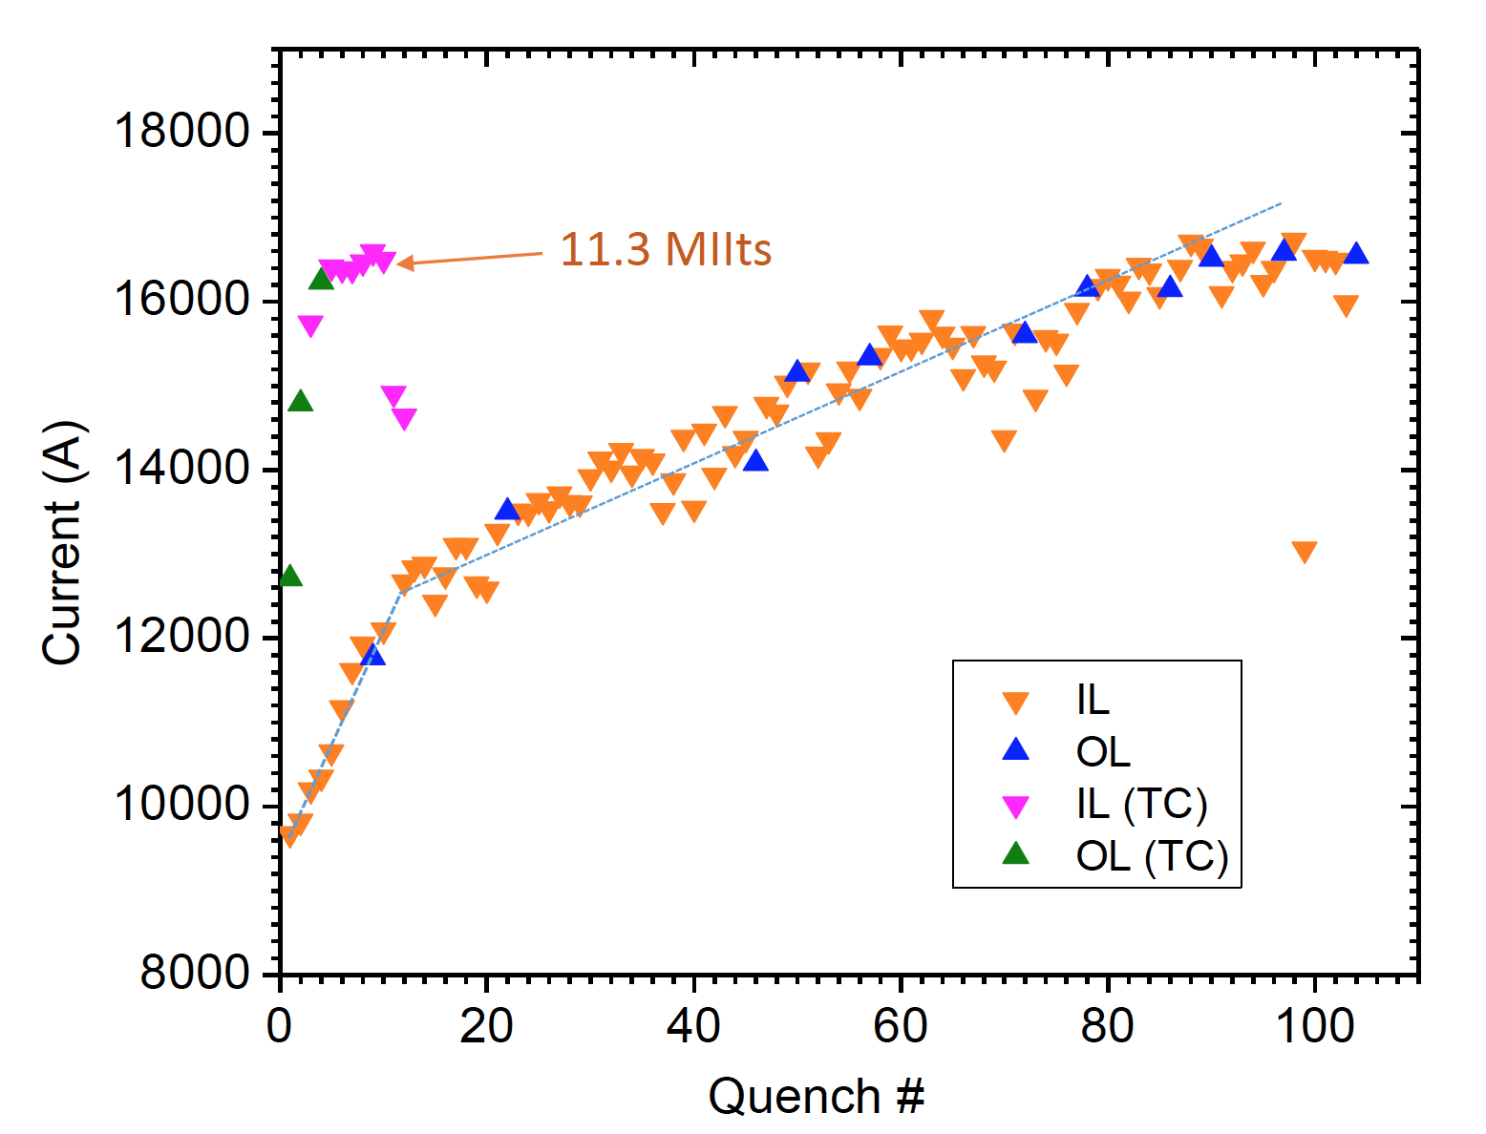
CCT4 Test Results
Reached 86% of round wire short sample after 85 quenches
Maximum current is 17.6 kA
Maximum bore field is 9.14 T (90 mm aperture)
Magnet exhibits long training but good memory after thermal cycle
Reduction in training is the main focus for CCT5
CCT4 Training
* See talk by M. Marchevsky

Slide 18
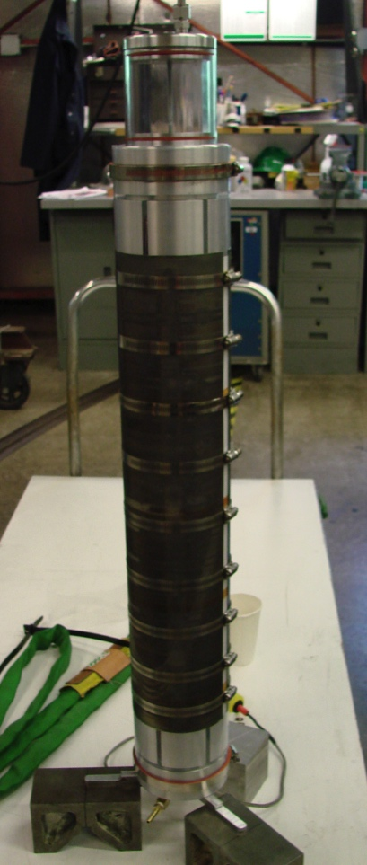
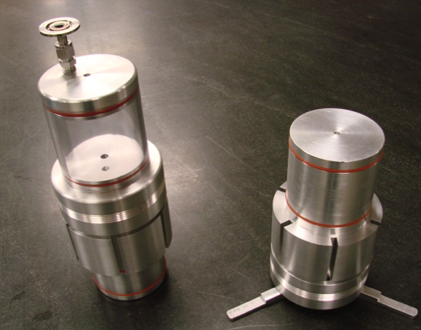
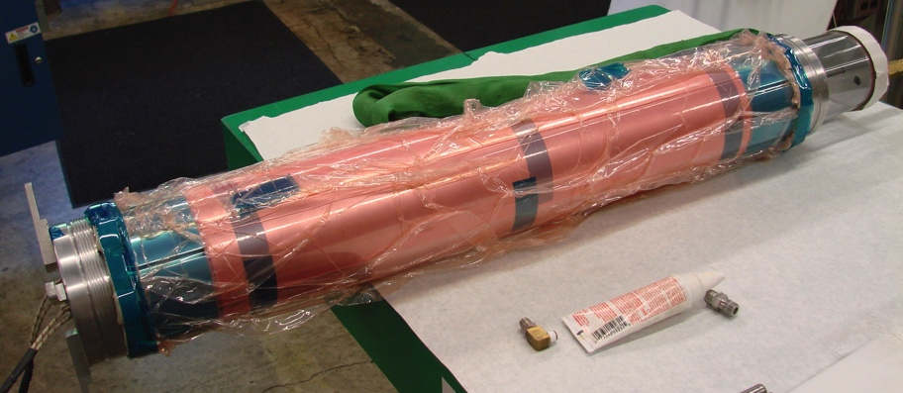
Potting of Individual Layers
Motivation
Individual potting of layers is desirable since magnet can be assembled and disassembled after testing
Faster turnaround for R&D if only one layer needs to be fabricated
Damaged or problematic layer can be replaced
Layers can be reused for a four or more layer magnet
Plan to test sealing methods on 10-turn mandrel before proceeding to CCT5 mandrels (expect to complete test in ~4 weeks)
Shrink Tube Method
Potting Tooling
Vacuum Bag Method

Slide 19
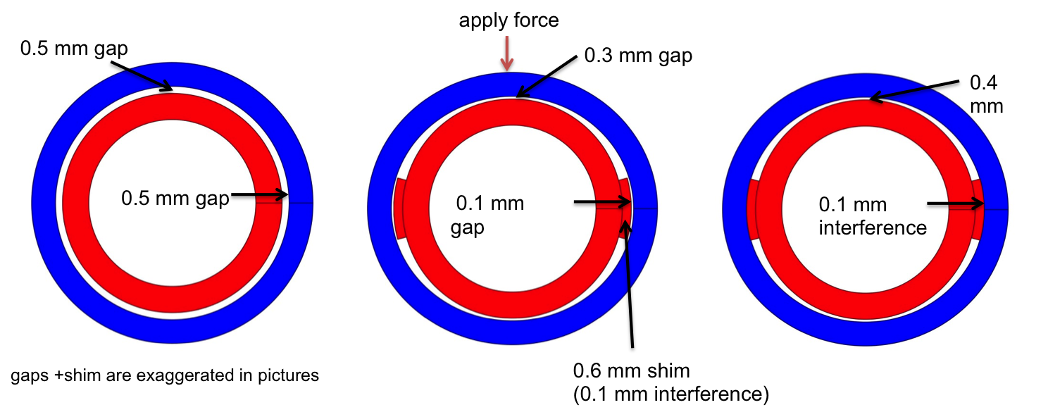
Bend and Shim Method for Coupling Layers
Assembly method with strong mechanical coupling between layers is necessary if layers are potted individually
Allows for optimization of bending stress by using the shim width and amount of bending as free parameters
Initial test have shown that it is difficult to slide shim with the small clearance that is required to avoid over-bending the mandrels
Distortion of the mandrels during heat treatment would further complicate the process
Currently developing conformable shim method with glass filled bag that is impregnated with epoxy
Apply Force
Gap decreases
Reduced gap
shim
Interference
Gap increases

Slide 20
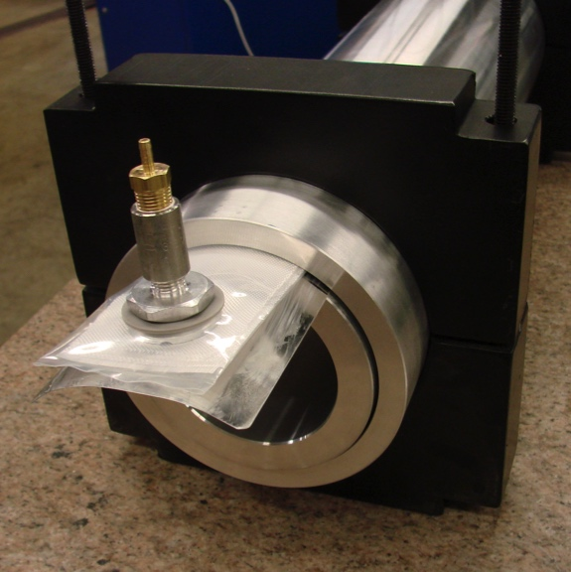
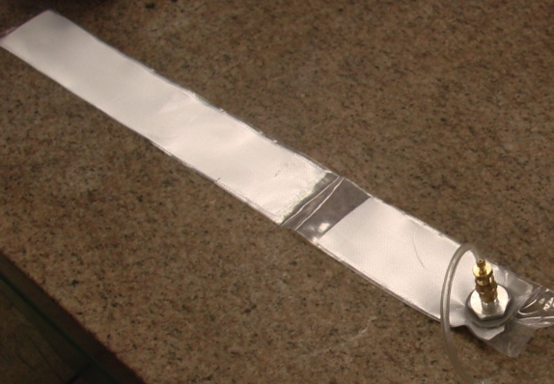
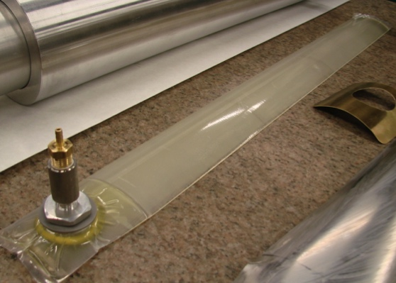
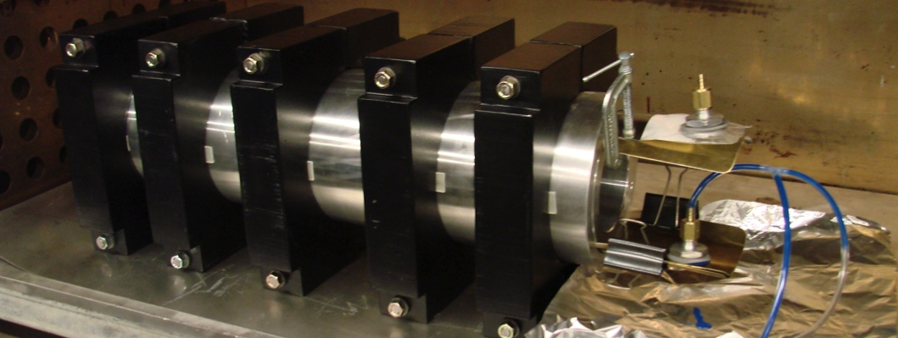
Conformable Shim Testing
Significant progress has been made in developing the conformable shim process
Investigating use of different bag materials and epoxies
Likely will use Kapton bags
Investigating use of low temperature cure epoxies (CTD-528, Stycast 2850)
Will test the strength of the shim by replacing inner layer with an Iron cylinder and performing a Liquid Nitrogen cooldown test
Cured Shim after Extraction
Glass Filled Bag
Bend and Shim Test Setup

Slide 21
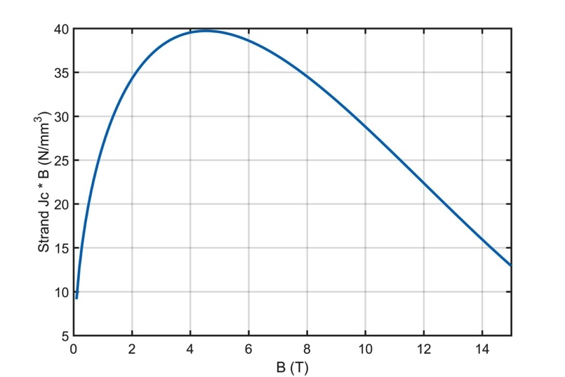
A Subscale Program for CCT Will Increase The Speed of Technology Development
Motivation
Allows for faster turn-around to understand CCT behavior
Can be tested in small cryostat
Design
5.2 T bore field and small mandrels and cables
Operate at higher Lorentz force on the conductor
Normal stress is comparable to that for full size two layer models
Shear Stress is about half of the full size model
Stresses are substantially above level where training starts in full size 2-layer models
Better understanding of CCT magnets
Testing of epoxies and interfaces
Mandrel deformation during heat treatment
Test of assembly methods
Test of new instrumentation methods
Lorentz Force
Lorentz force density peaks at 4.5 T
CCT 2-Layer
CCT Subscale

Slide 22
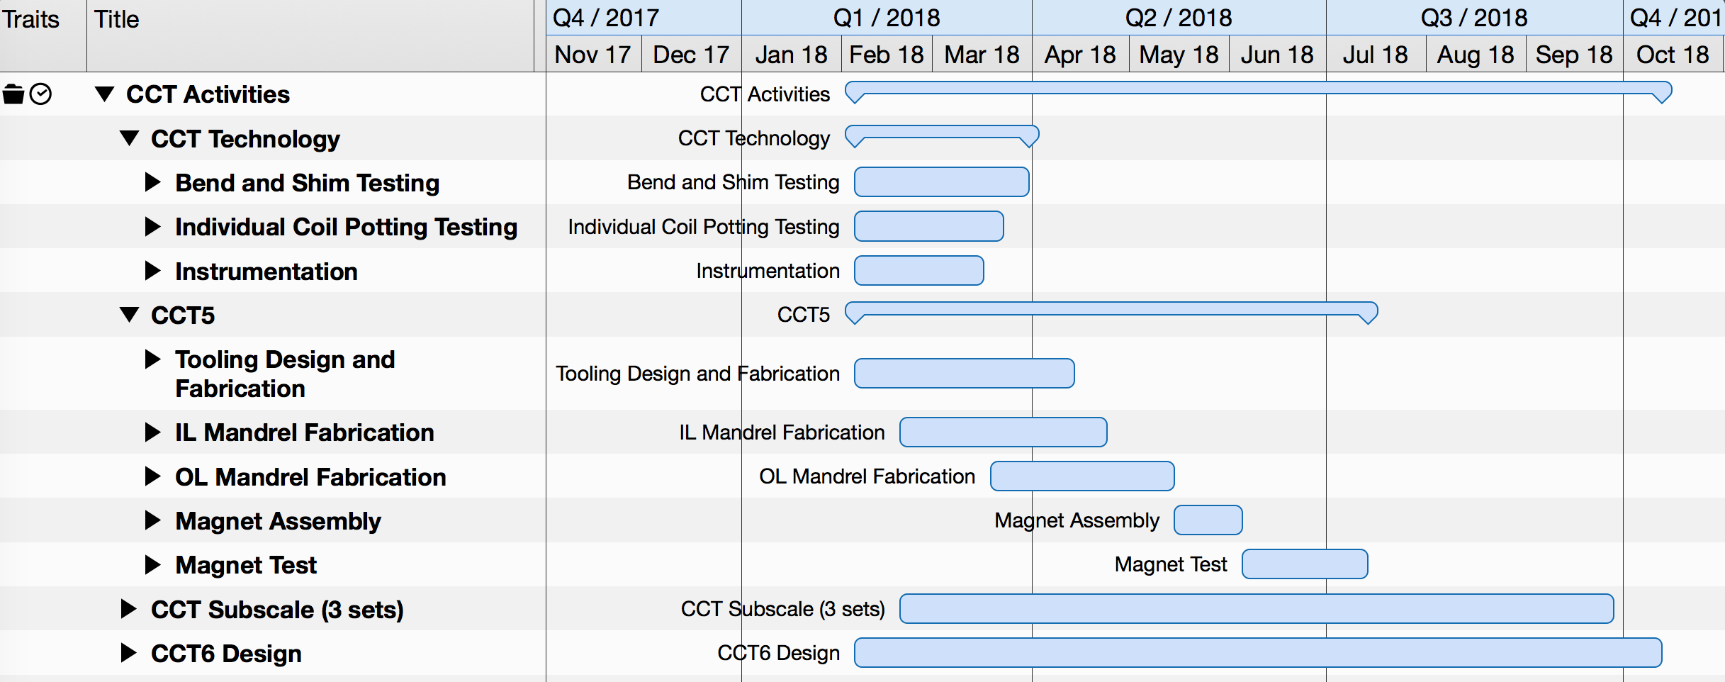
CCT Short-Term Activities
CCT Technology Development
CCT5 Fabrication and Testing
Initial CCT Subscale Fabrication and Testing
CCT6 Design

Slide 23
Summary
CCT program focuses on new and innovative design of dipole magnets
CCT technology and understanding has advanced through the development of two layer models
Issues with conductor damage have been resolved with the modified design of CCT4
Next main focus is on training reduction (CCT5 and subscale)
Layer-to-layer interfaces
Matrix properties
Subscale CCT will allow for more focused experiments on training and mechanical behavior
Work on next steps for CCT development (6-layer magnet) is in the early design stage
Current activity slowed down due to funding limitations

