Slide 1
CCT4 Modeling and Test Results
February 8th 2018
2nd MDP Collaboration Meeting: Jacksonville, Florida
Lucas Brouwer
US Magnet Development Program
Lawrence Berkeley National Laboratory

Slide 2
Introduction
Overview:
mechanical modeling of CCT4 shows potential trouble areas
overlaying acoustic data with modeling results
comparison of strain gauge data between tests and with ANSYS

Slide 3
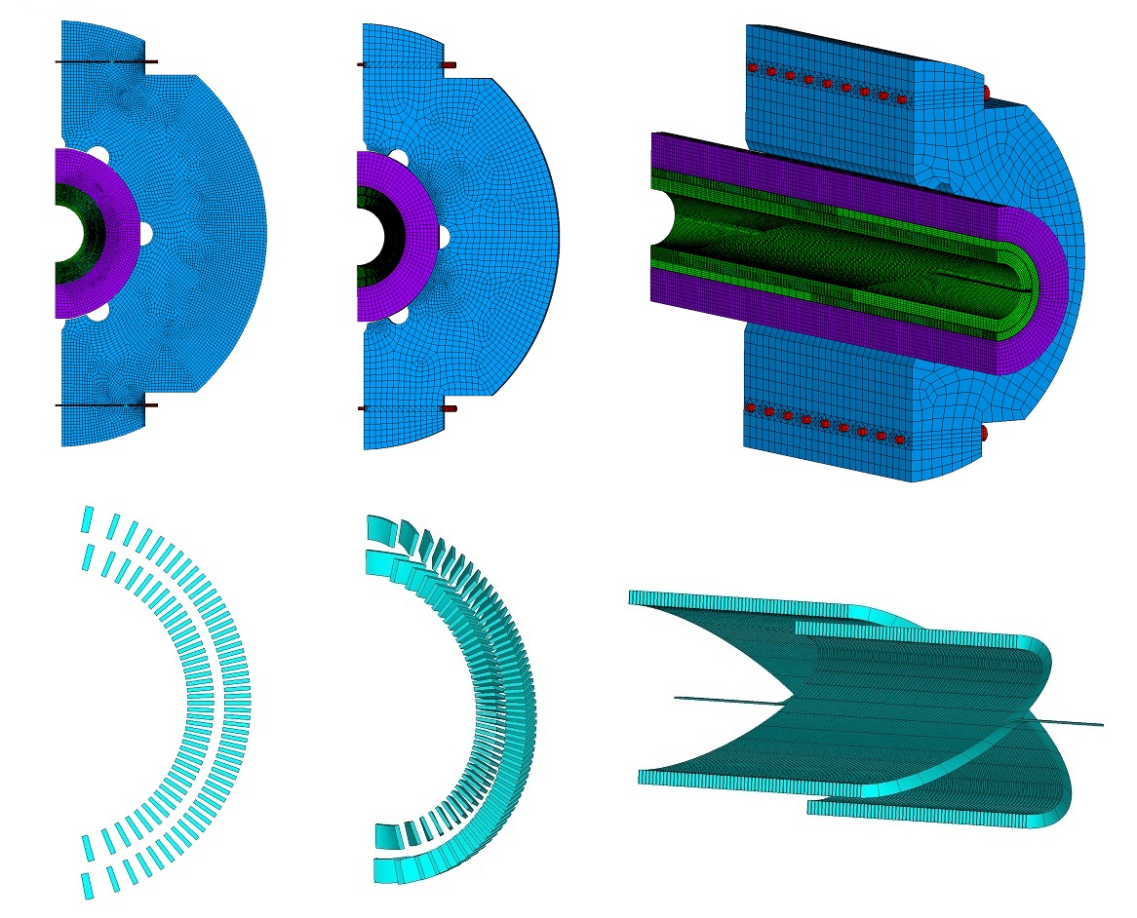
Overview of CCT4 ANSYS Models
2D 3D periodic 3D full
2D
- design of external structure
- limited parametric studies
3D periodic
- 3D conductor stress state
- circuit-coupled protection study
3D full
- choice and validation of 3D periodic boundary conditions
- critical for understanding test results from short magnets (CCT3,4,5)
3D full results will be shown
“Improved Modeling of Canted-Cosine-Theta Magnets”, IEEE Trans. Appl. Supercond., PP 99, Nov. 2017

Slide 4
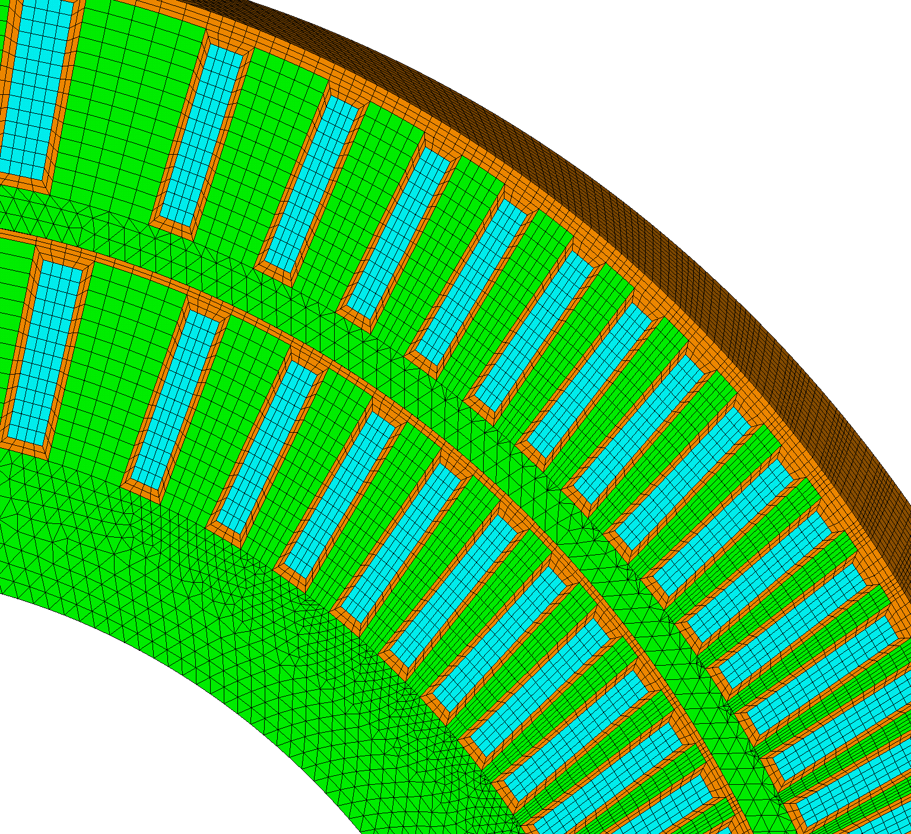
Mechanical Behavior of Interfaces is Important for the CCT
Epoxy interfaces are a possible source of quenches
between cable and channel
between layers
element coordinate system alignment allows for anisotropic conductor and epoxy (warp,fill,normal) properties
layer of epoxy around conductor (brown)
and b/w layers
4

Slide 5
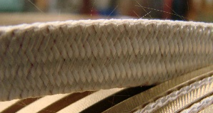
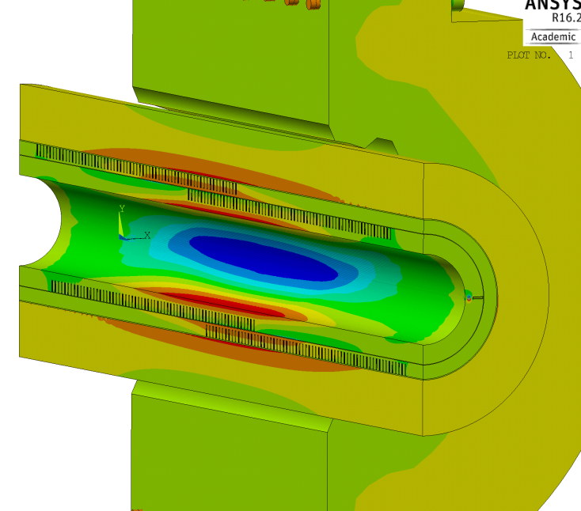
Trouble Spots for Correlation with Acoustic Measurements
Where should we look for trouble? Where is the epoxy likely to fail first?
#1: large conductor-channel shear at +- 45 deg
Syz
Sxz
#2: large shear between layers at pole of bonded model

Slide 6
Overlaying Acoustic Data and Modeling Results – Interlayer Shear
See Diego’s talk for a new assembly method to better define layer interface (Bend+Shim)

Slide 7
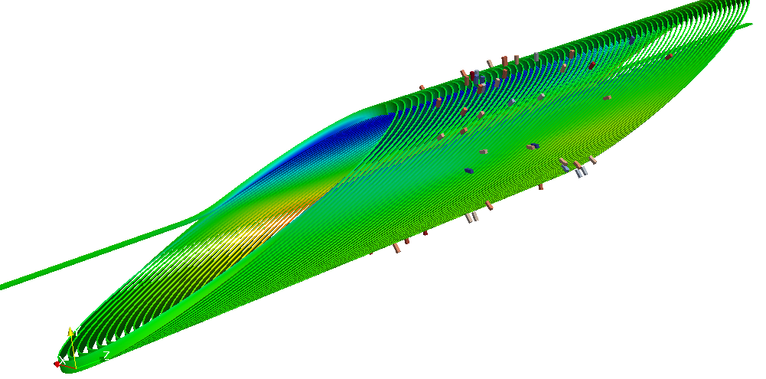
Overlaying Acoustic Data and Modeling Results – Conductor Shear
No strong conclusions yet, but we are using modeling to help guide our search (more in Maxim’s talk)

Slide 8
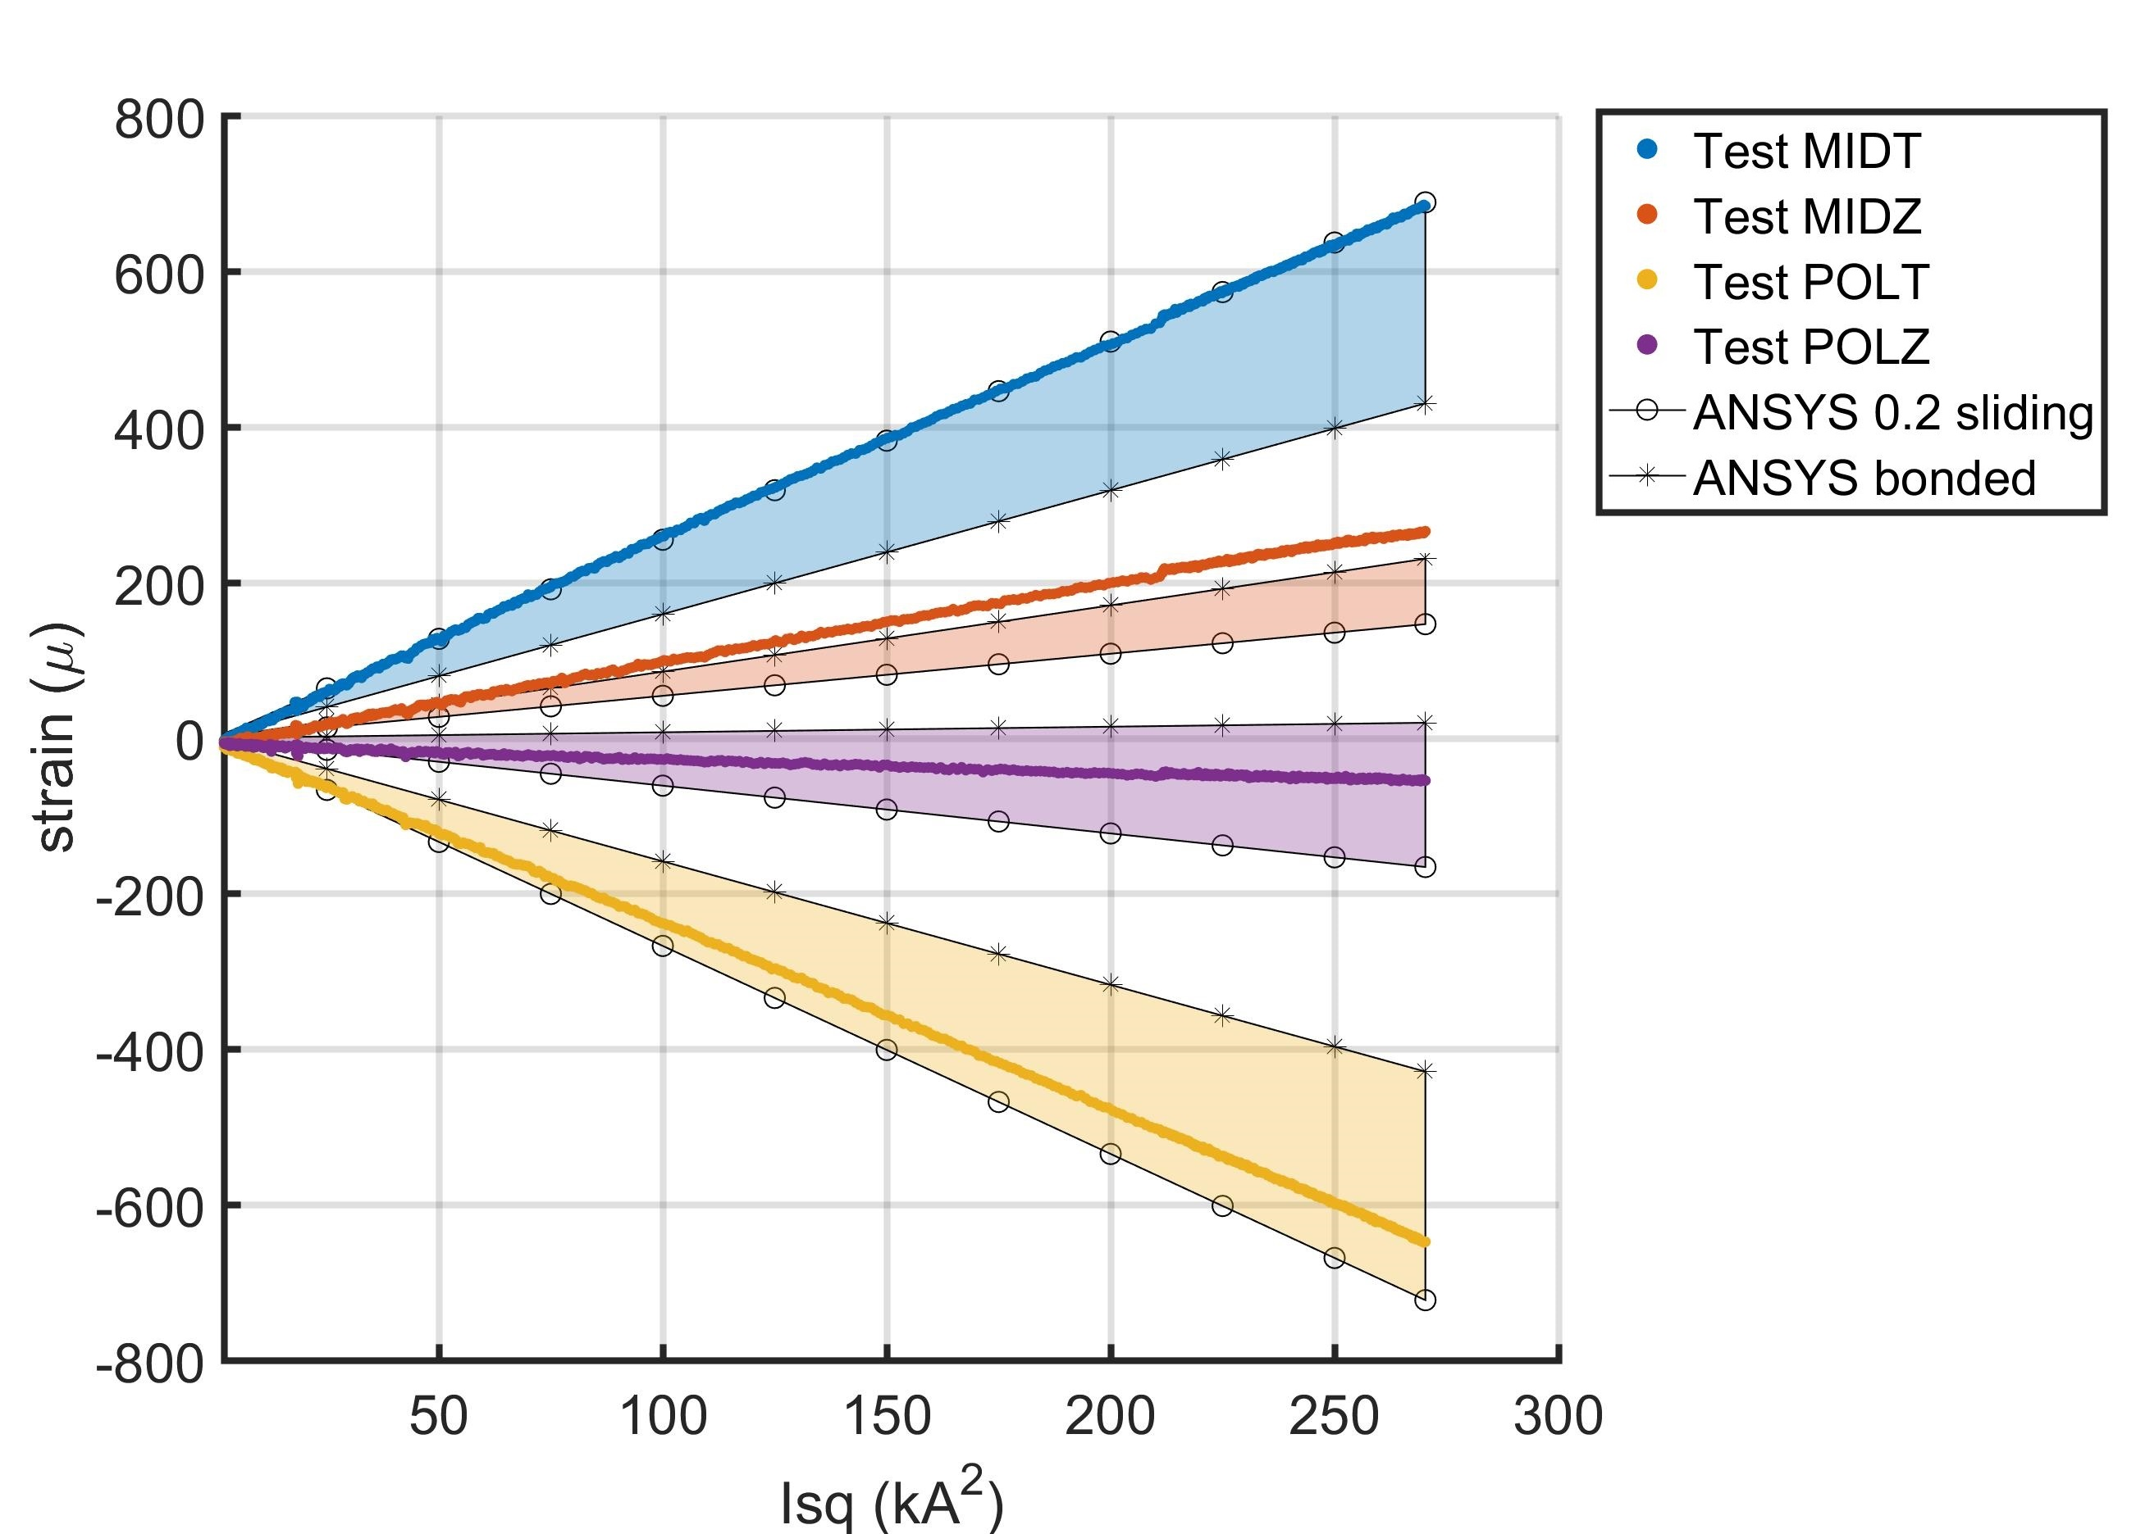
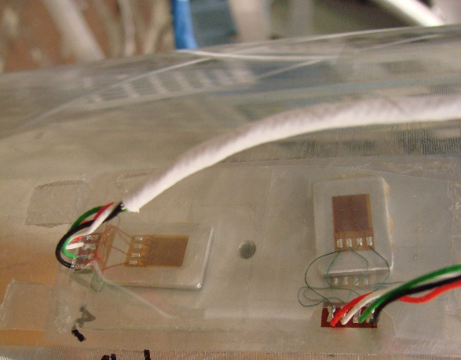
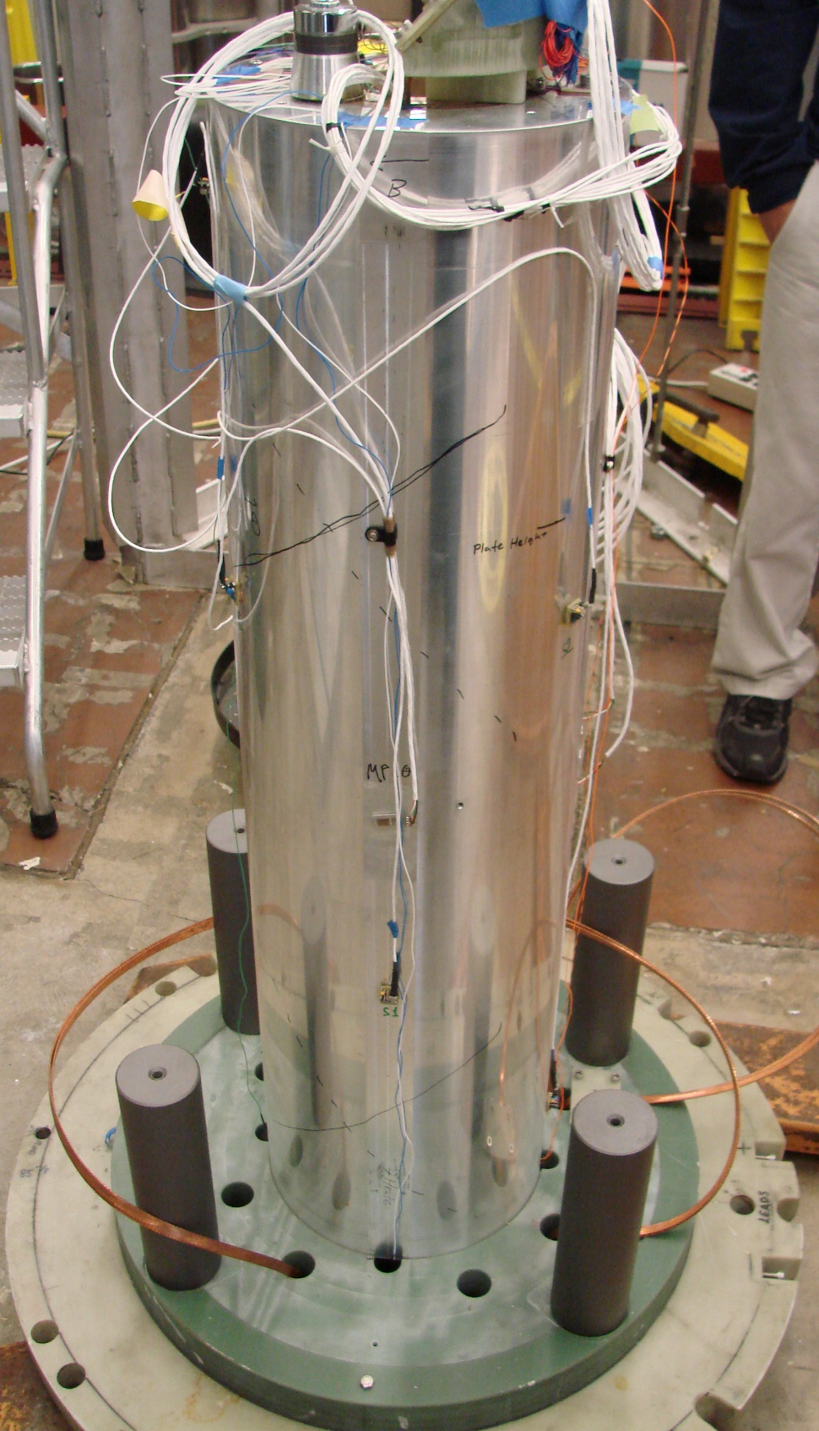
Strain Gauge Data: First Test of CCT4
Compare CCT4 test to full 3D ANSYS model with bonded vs. sliding
Strain gauges are mounted on the aluminum shell at the pole (POL) and midplane (MID) in both azimuthal (T) and axial (Z) directions
Strain gauges during powering are similar to ANSYS prediction

Slide 9
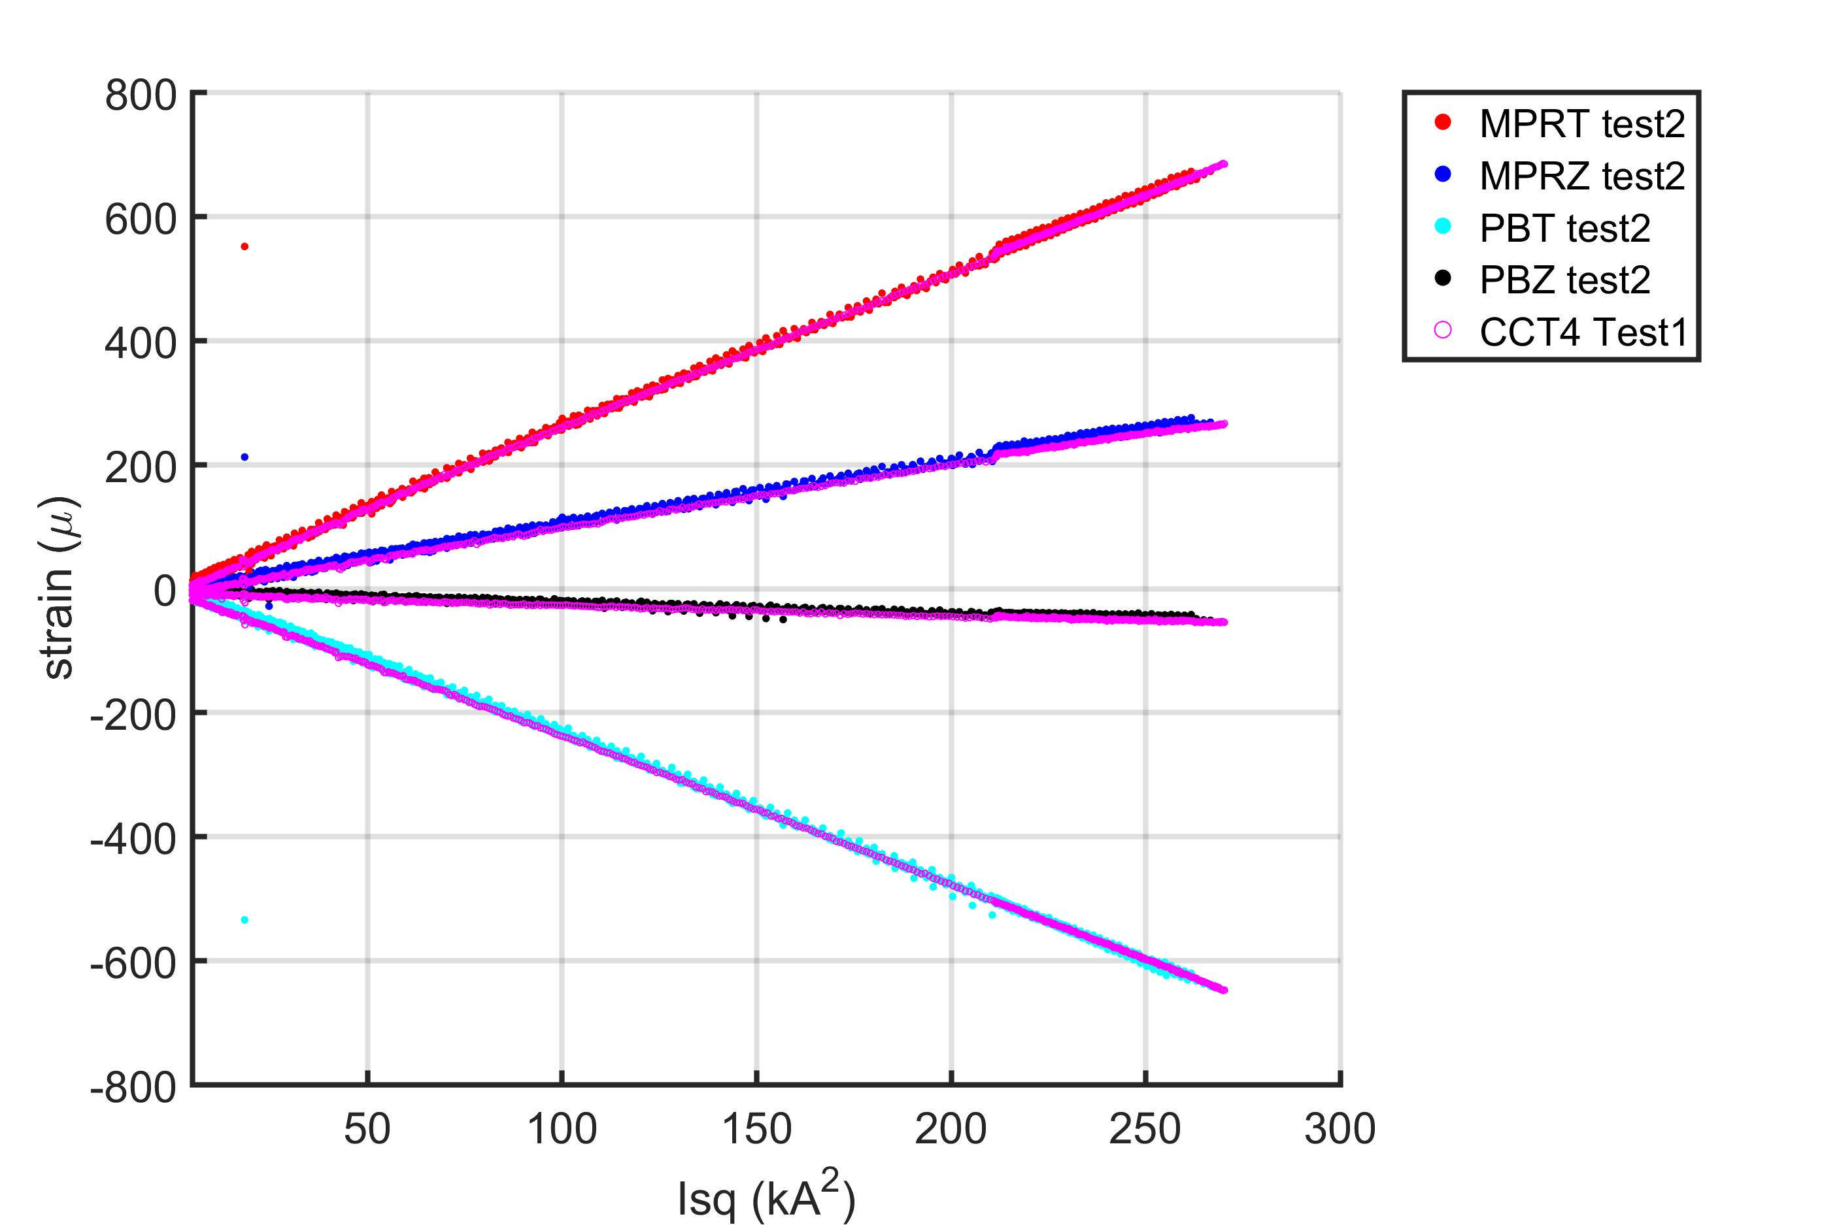
Strain Gauge Data: Thermal Cycle of CCT4
All of thermal cycle ramps vs. the final ramp from the CCT4 initial test
Gauge readings are still linear and the same as before the thermal cycle (no significant change)

Slide 10
Extra Slides

Slide 11
Contact Shear at Layer to Layer Interface
Layer to Layer Bonded
Peak shear location moves from pole to midplane depending on layer interface property (bonded vs. friction)
Layer to Layer Sliding

Slide 12
Overlaying Acoustic Data and Modeling Results – Interlayer Shear (First 20)

Slide 13
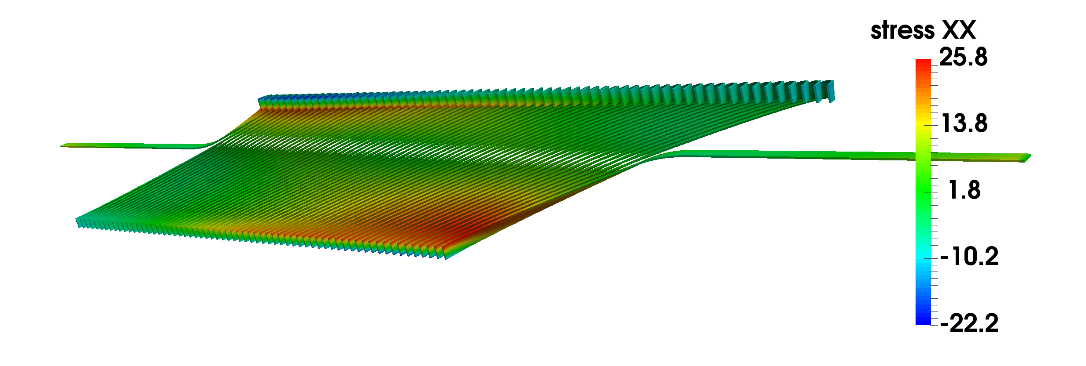
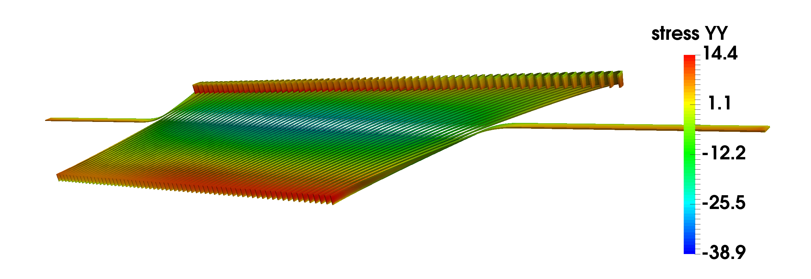
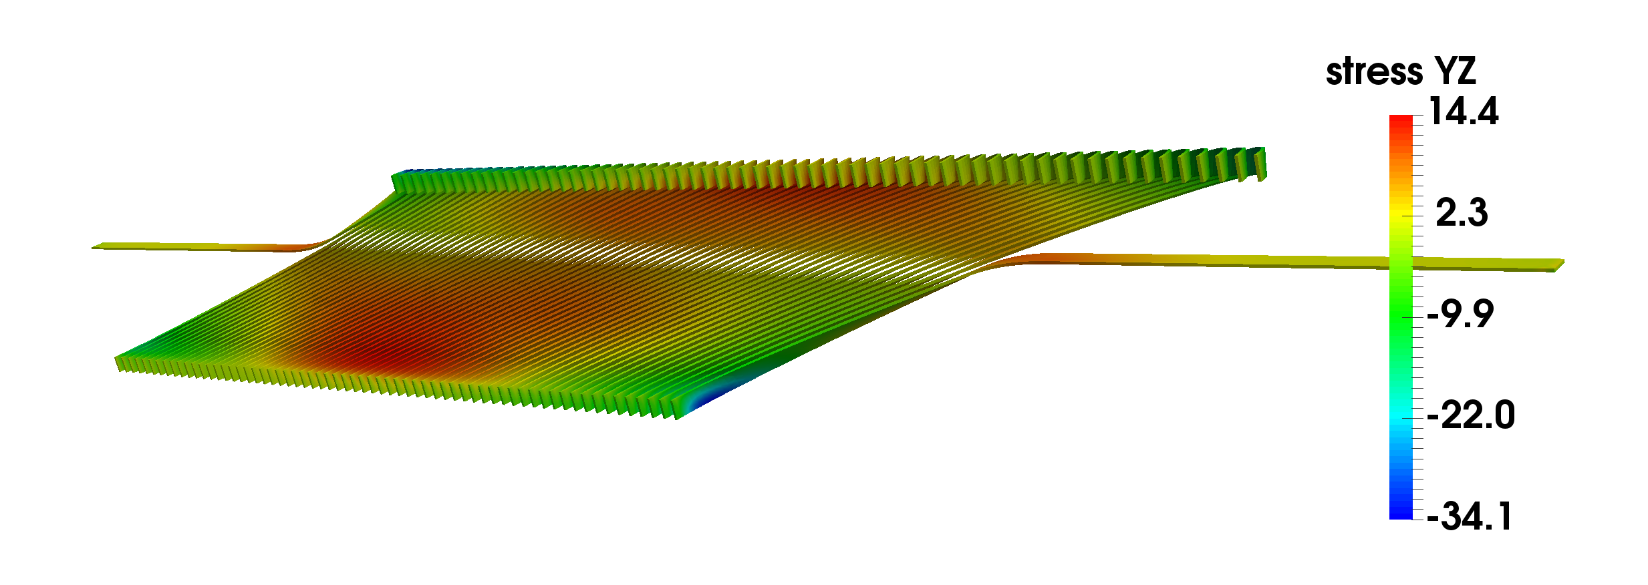
CCT4 Local C.S. Stresses at Short-Sample Current
tangent
tangent-radial
radial
tangent-binormal
binormal
radial-binormal

