Slide 1

User Defined Elements in ANSYS for 2D Multiphysics Modeling
February 9th 2018
2nd MDP Collaboration Meeting: Jacksonville, Florida
Lucas Brouwer
US Magnet Development Program
Lawrence Berkeley National Laboratory

Slide 2
ANSYS with User Elements can Include SC Specific Effects
Want to include in one simulation:
  eddy currents in structure
  external circuit coupling
  yoke saturation
  eddy currents in conductor (IFCC, +)
  current sharing + quench prop
  connection to thermal model with full (T,B) mat. prop.
standard ANSYS
ANSYS with user defined elements

Slide 3
Motivation
Many present and future tests rely on the capability to model these effects for design of protection systems and to understand test results
  IFCC quench back in Nb₃Sn SCU [very high Je]
  Bi2212 racetrack coils with CLIQ [test in 1-2 month w/FSU]
  CCT3-5 eddy current losses in shell [1/2 MITTS, dominates decay]
  CCT5/PSI CCT test with CLIQ [tests in 6-12 months]
  future insert/outsert configurations [strong inductive coupling]

Slide 4
What is a User Element in ANSYS?
Geometry Generation
Meshing
Boundary conditions
Loads
Solution
Post processing
Load transfer between models
Replace code which builds element matrices: uel.f, uec.f -> compile custom ANSYS.exe
Available
- node location
- loads
- node temperature
- material prop.
- ANSYS functions
Element customized by defining
- element shape functions
- material properties: if complex function desired (T,B,Jc,etc.)
- formulation
Element matrix generation is now determined by user program
- stiffness, damping, etc.
Reproduces ANSYS default elements with extra capability of
conductor losses (inter-filament coupling currents)
current sharing / quench propagation
B,T dependent material properties
simulation of quench back, CLIQ, etc.

Slide 5
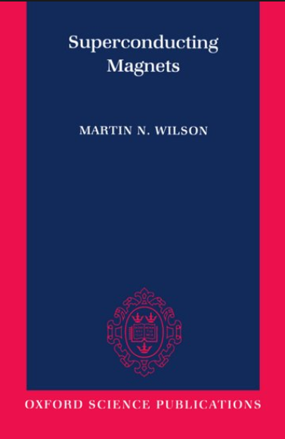
Equiv. Magnetization Term is Included in FEM Formulation for IFCC Losses
Equivalent Magnetization for Inter-filament Coupling Current Losses has already been successfully implemented in many codes (ROXIE, LEDET, COMSOL, etc.)
Tau is dependent on conductor properties: twist pitch, rho_eff(T, B)

Slide 6
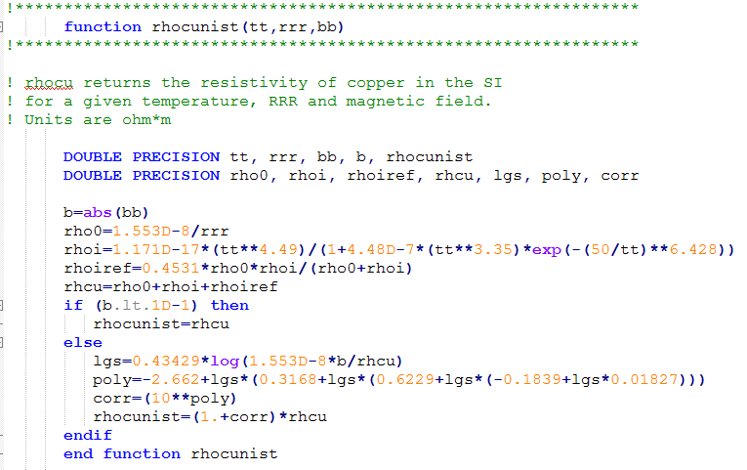
Material Properties are Programmed
Roxie Material Database* has been implemented, large flexibility for future material properties (simple Fortran functions)
User chooses with element keyoptions Example format: NIST rhocu(T, RRR, B)
+ more…
*”Review of ROXIE’s material property database for quench simulation”,
G. Manfreda, CERN EDMS Nr: 1178007, 2011.

Slide 7
Overview of Implementation of UDE’s
Electromagnetic Regions
multi-field solver
Thermal Regions
default (ex. PLANE53)
iron, air, structure areas
eddy currents in structure
mat. prop. (temp)
temp
default (ex. PLANE77)
iron, structure areas
mat. prop. (temp)
joule heating
FEM
FEM
user defined (USER102)
conductor areas
conductor loss (IFCC, etc.)
quench state, current sharing
mat. prop. (B, temp)
temp
user defined (USER101)
conductor areas
quench propagation
mat. prop. (B, temp, quench state)
joule heating
B, quench state
coupled with stranded formulation
Circuit
default (CIRCU124)
QPS: dump resistor, CLIQ, etc.

Slide 8
Verification and Benchmarking is in Progress with a Mix of Codes and Data
STEAM collaboration [ CERN: B. Auchmann, L. Bortot ]
  dipole model comparison with COMSOL
LBNL Nb₃Sn Undulator
  L/R extraction data with clear quench back (from past tests)
LBNL Bi2212 Racetracks [ FSU: Daniel Davis ]
  comparison with LEDET
  CLIQ test at LBNL (in ~1-2 months)
LBNL/PSI Nb3Sn CCT [ PSI: J. Gao, B. Auchmann ]
  CLIQ test at LBNL (in ~6-12 months)

Slide 9
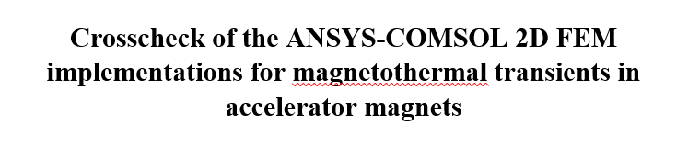

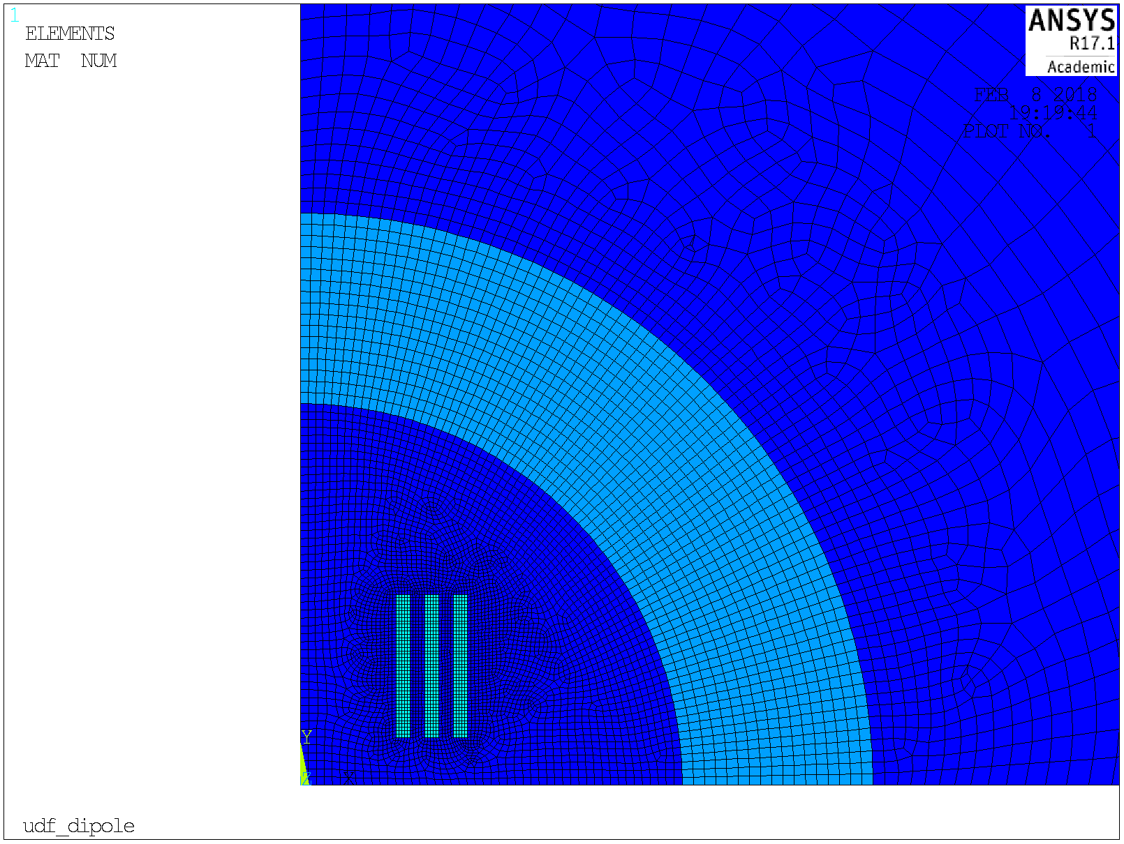
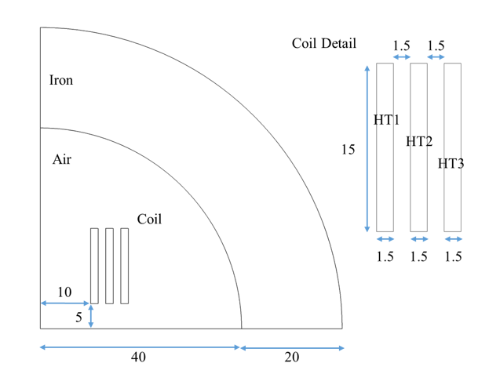
Verification Study (with CERN)
L. Bortot, B. Auchmann

Slide 10
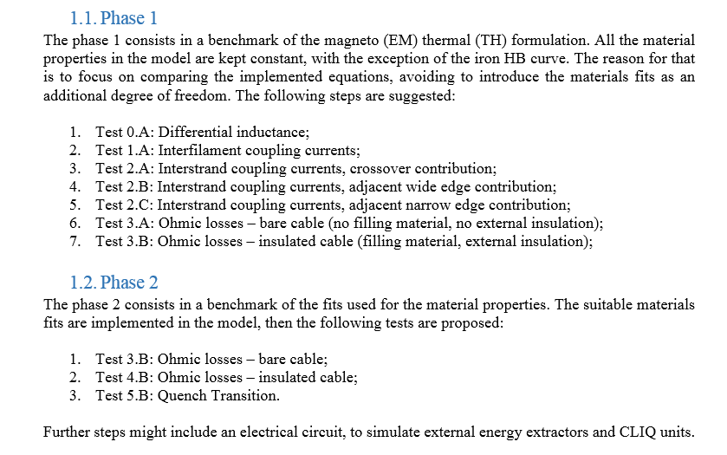
Planned Comparisons
Start Simple -> work up to fully coupled simulations

Slide 11
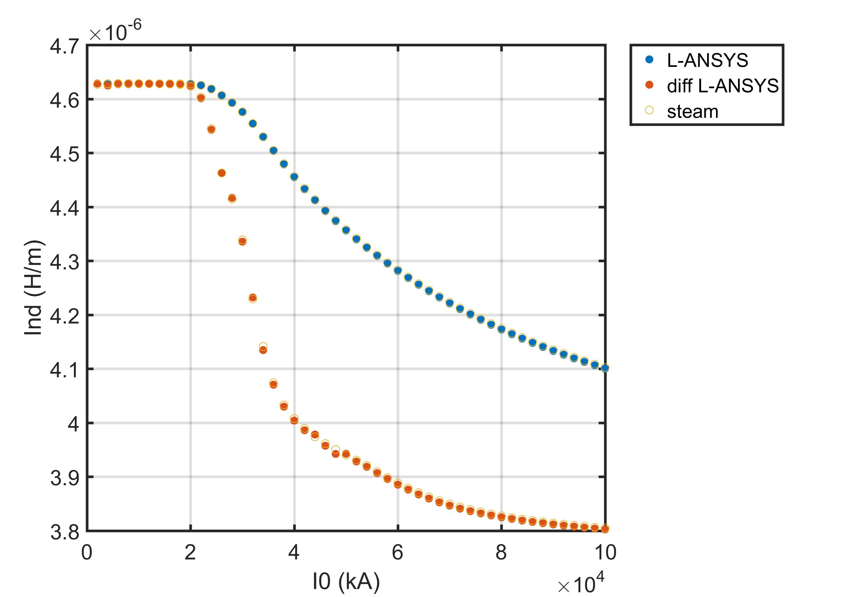
Example: Inductances Agrees with Comsol for a Simple Ramp
Simple ramp, iron saturation changes inductance vs. current
STEAM data is courtesy of L. Bortot

Slide 12
Implementation of Elements for This Case is Straight Forward
These lines are the only deviation from a default ANSYS simulation using plane53
choose USER102 for conductor
set keyopts (IFCC_flag, mat. prop fit. Etc)
set real constants (RRR, Lp, ect.)

Slide 13
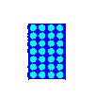
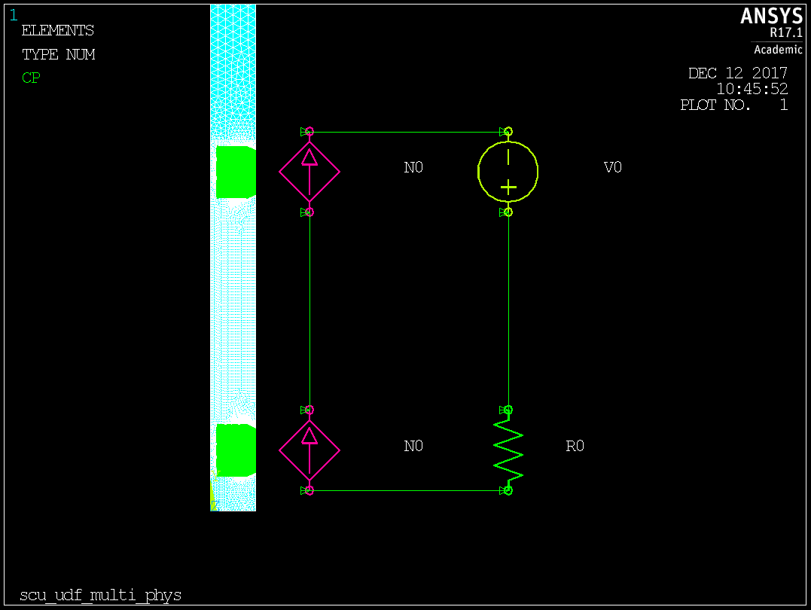
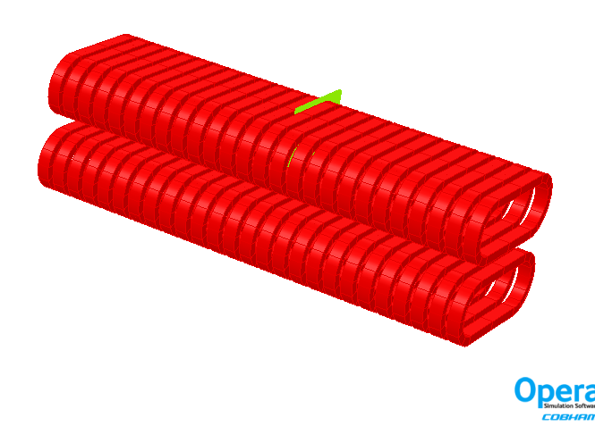
Fully Coupled Example: 2D User Elements Predict Nb₃Sn SCU Quench Back
ANSYS model

Slide 14
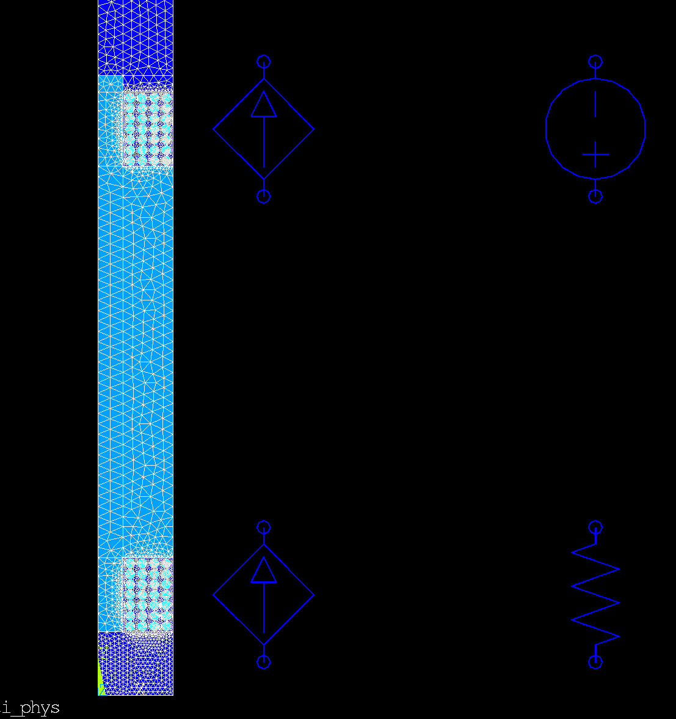
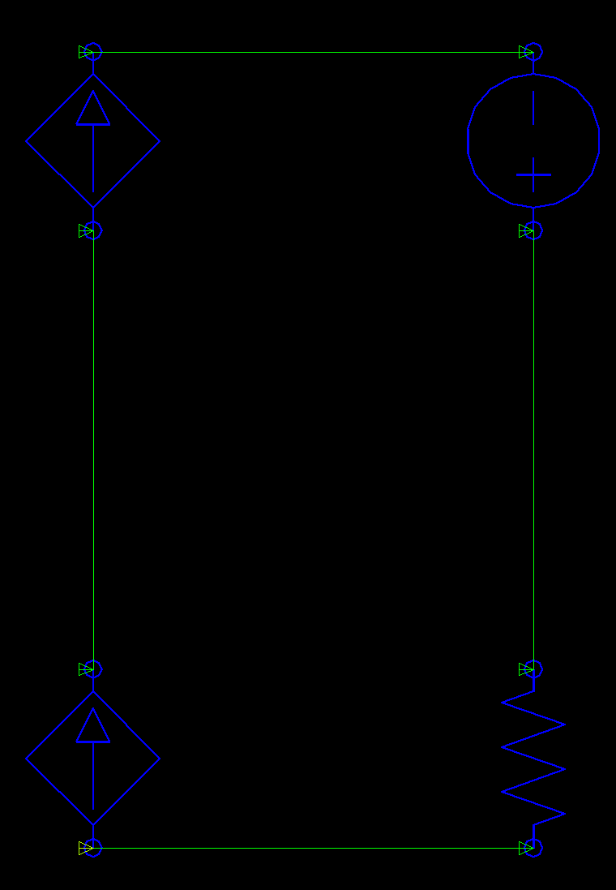
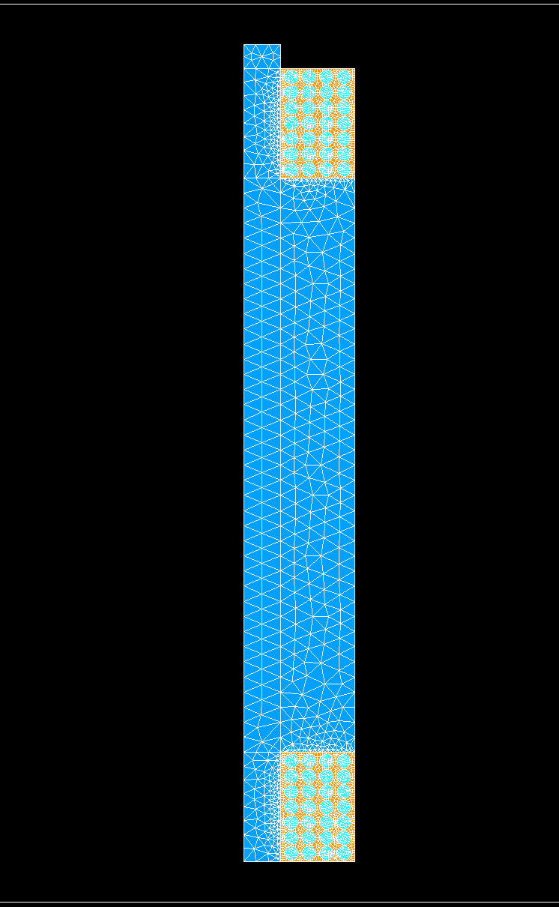
Implementation of UDE’s for SCU
Magnetic Mesh coupled to L/R circuit
Thermal Mesh
MFS couples with unique time stepping for each
mesh in shared regions is the same
conductor region is user102
circuit is default circu124
other regions are default plane53
conductor region is user101
other regions are default plane77

Slide 15
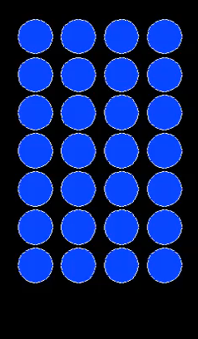
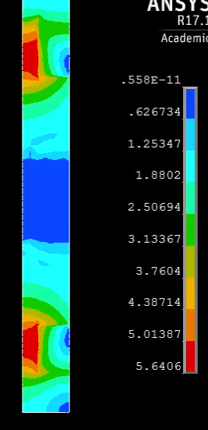
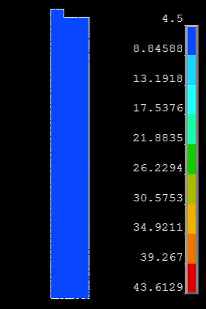
Example: 2D User Elements Show Nb₃Sn SCU Quench Back
magnetic + circuit model
thermal model
B + quench state
IFCC and joule heating
temp

Slide 16
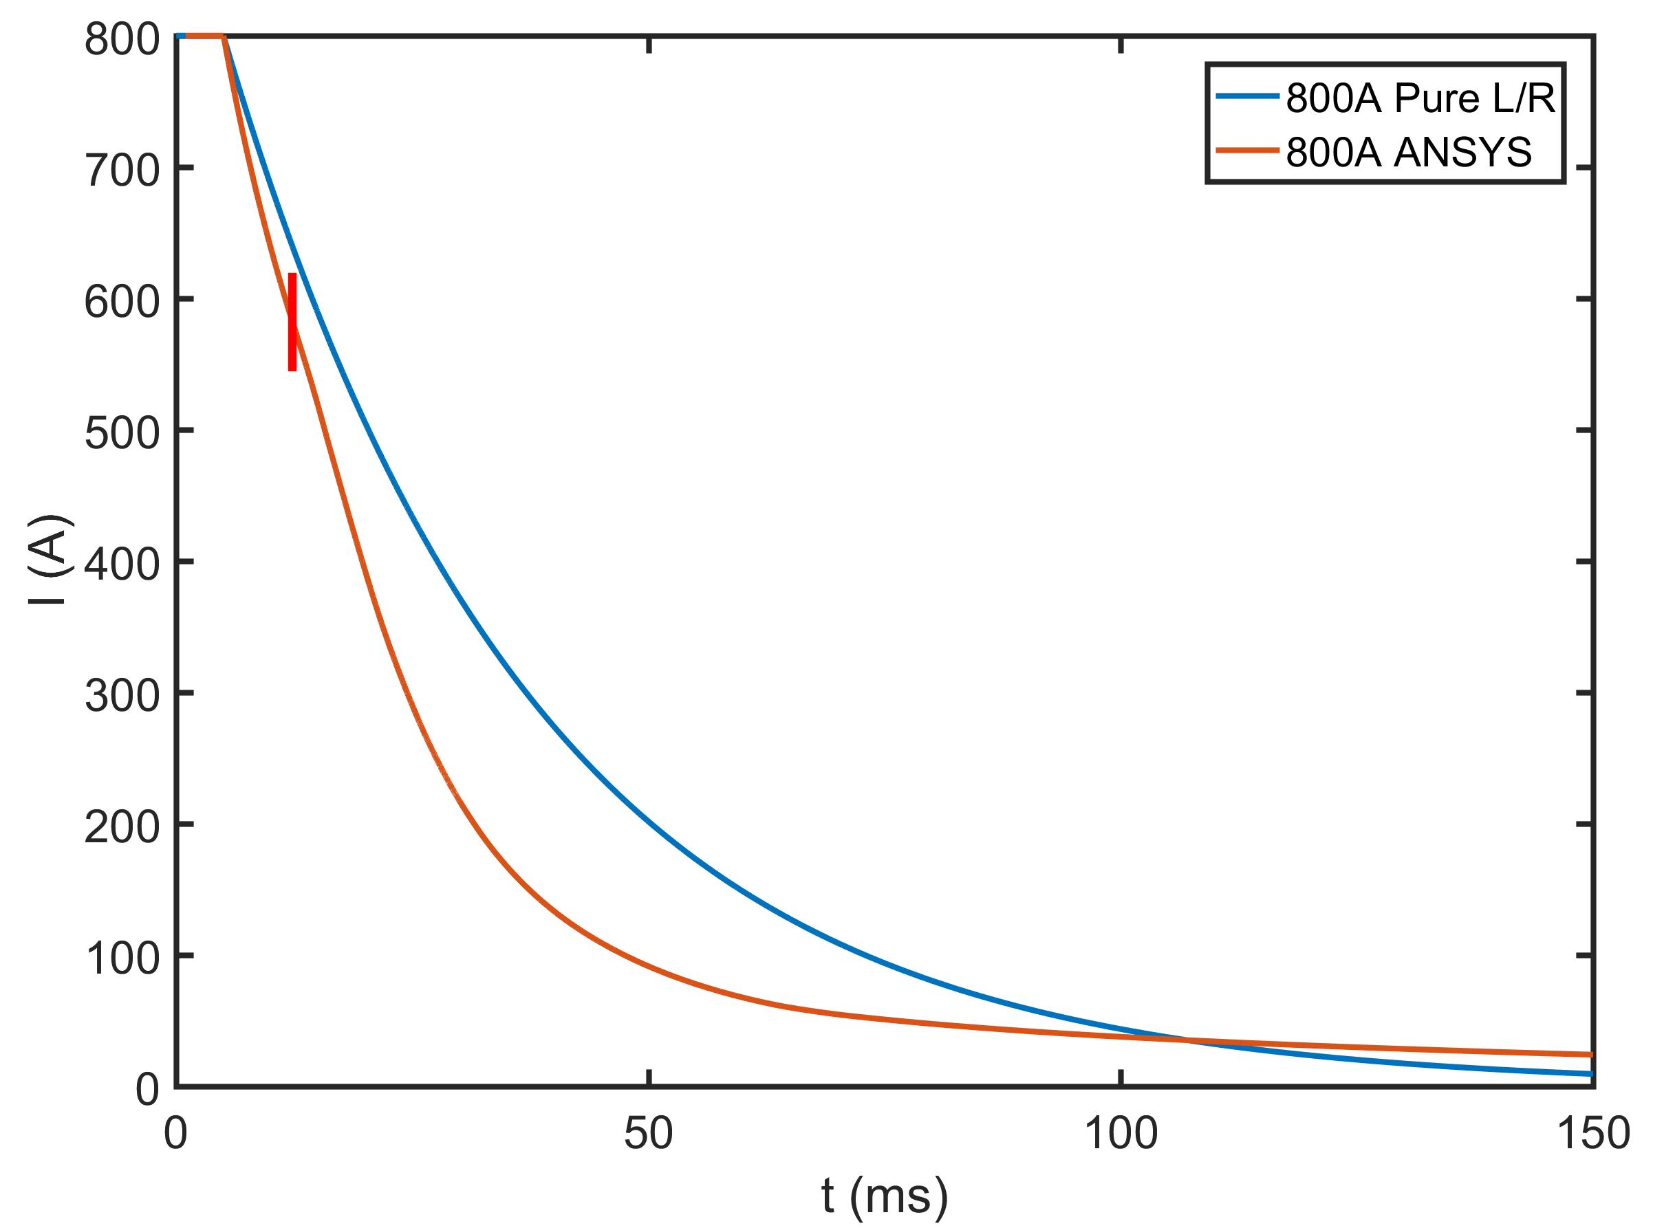
Quench Back at High Current
deviation is IFCC only
first quench
deviation is IFCC + coil resistance growth
also iron yoke saturation

Slide 17
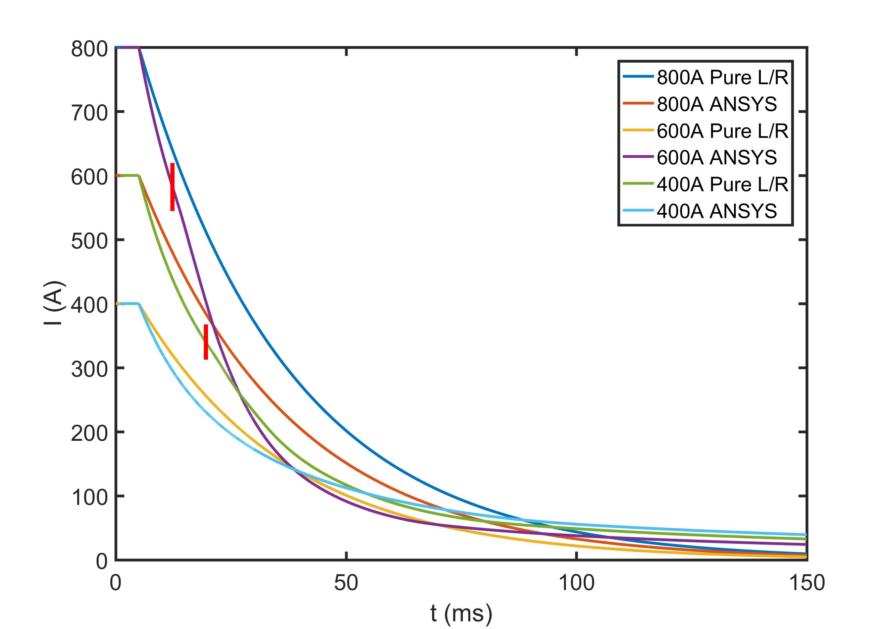
Quench Back at Different Current Levels

Slide 18
Summary and Future Plans
A set of user defined elements in ANSYS has been developed which adds
  IFCC losses
  B,T dependent material properties
  current sharing and quench
User elements are user friendly (same use as normal elements)
Verification and benchmarking is started with a variety of data and codes
Future plans for development
  continue verification of 2D
  integration with STEAM
  add ISCC, strand magnetization (hysteresis)
  extension to 3D and parallel solutions HPC, clusters, etc.

Slide 19
Thanks To
Paul Scherrer Institute
Bernhard Auchmann, Jiani Gao
Cern
Lorenzo Bortot, Bernhard Auchmann
LBNL
Diego Arbelaez, Daniel Davis (also FSU-Maglab), Emmanuele Ravaioli (also CERN), Tengming Shen, + more
End goal is to develop a tool for the broader community. If you are interested in helping or using the elements please let us know. lnbrouwer@lbl.gov

Slide 20
Extra Slides

Slide 21
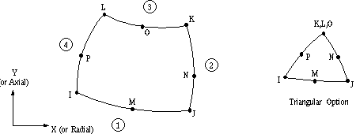
A user defined thermal element: USER101
Based on plane77
  2D (8 node)
  dof: temp
Extra functionality added by UDE
  mat. prop. as function of B, T, quench state (Roxie library)

Slide 22
A user defined magnetic element: USER102
Based on plane53
  2D vector potential (8 node)
  stranded conductor circuit-coupling (using circu124): Az, curr, emf
Extra functionality added by UDE
  IFCC using equivalent magnetization term
  quench state checking (current sharing) and resistance growth
  mat. prop. as function of B, T

Slide 23





STEAM Co-Simulation Architecture
User
Co-simulation
Scenario
Co-simulation
Tool Adapters
Magnet
Circuit
Controller
User
Model
Definitions
Automated Model Generation

Slide 24
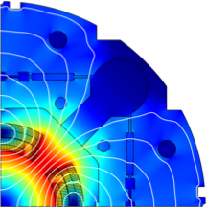
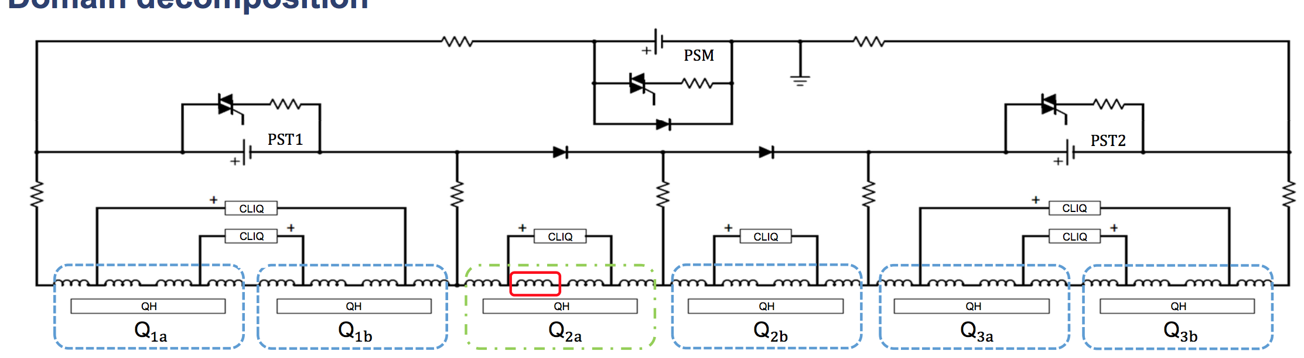
Example: the HL-LHC Triplet
Cosimulation of:
  5x LEDET
  1x COMSOL
  PSpice circuit model
  PSim controller model
Deeper insight in and validation of operational scenarios.
Study of failure scenarios (fewer symmetries)

