Slide 1
Nb₃Sn Training DB and new data
Stoyan Stoynev
US Magnet Development Program
Fermi National Accelerator Laboratory
9 Feb 2018
Jacksonville, Fl

Slide 2
Outline
Introduction and Reminder
“Database”
Current work and goals
Incoming data

Slide 3
Introduction
One of the goals of MDP is
“Explore the performance limits of Nb₃Sn accelerator magnets with a focus on minimizing the required operating margin and significantly reducing or eliminating training”
Training takes time (including recovery) and resources
Slow training ultimately limits the effectiveness and operational levels of magnets
To reduce costs and improve performance we need to understand the causes of slow training (in Nb₃Sn prototypes)

Slide 4
Reminder
At FNAL we were working on creating a database that would contain relevant test data for past and future tests
We are exploring available data to look for correlations
(statistical analysis)
Further analysis on features found is also pursued
Ultimately we want to take advantage of the large statistics for improving magnet fabrication and thus performance
The “database” helps in analyzing large amounts of data

Slide 5
Progress over the last year
We re-centered our “database” analysis on coils
Some “historical” data recovered, summarized
Extended data set now includes TQ and HQ coils
Additional emphasis on performancee outliers
(still to follow up on underlying reasons)
On next slides the “database” and data analysis points
are interleaving emphasizing their natural dependency

Slide 6
“Database”
Ideally we want to have a database that
Contains all relevant test data worldwide – past and present
Is updated on a regular basis
Is easily accessible and readable
Has a pre-defined structure that generally does not change
Practically all sub-points are problematic (currently)
A “working” version of the database is more realistic and the proximity to the ideal is a question of interest and resources

Slide 7
“Working” database(s)
From Trey:
From Arup:
Us (extended versions):
Everyone uses one (or more) but they are not public and not uniform across people’s versions
We will all benefit if we can agree on some minimal (but not small) set
that can be promptly filled for each coil/test and then shared

Slide 8
Findings
It is not straightforward to get proper and prompt data outside US
(even when we are collaborating)
We need to declare what the support for a “common” (and how common) database is
It is unlikely we have the resources for a real database support but we can do well with alternatives
Historical data is hard to retrieve, we need to plan to preserve it including by sharing
Progress also depends on resources and local priorities

Slide 9
Continuing work
We are summarizing the performance of past tests (in terms of coils)
Scrutinizing the behavior of particularly good or bad coils
Establishing and searching for patterns and features/correlations
(also across series, structure or magnet types)
Extending performance to stress/strain (in addition to current)

Slide 10
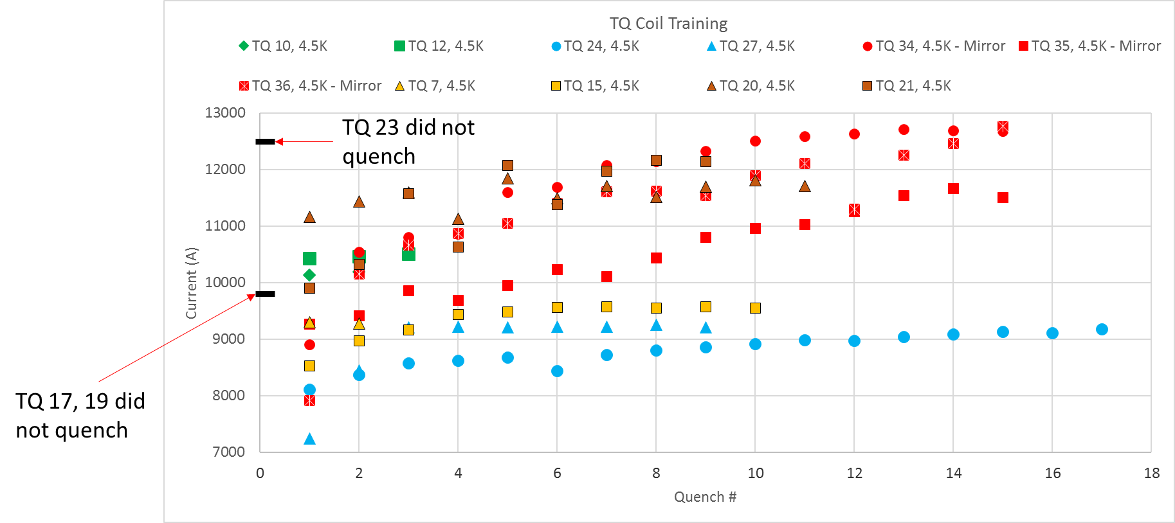
TQ series
We now have SSL
per coil or have
some estimate on
billet-to-billet
variations
(will use for proper
normalization)

Slide 11
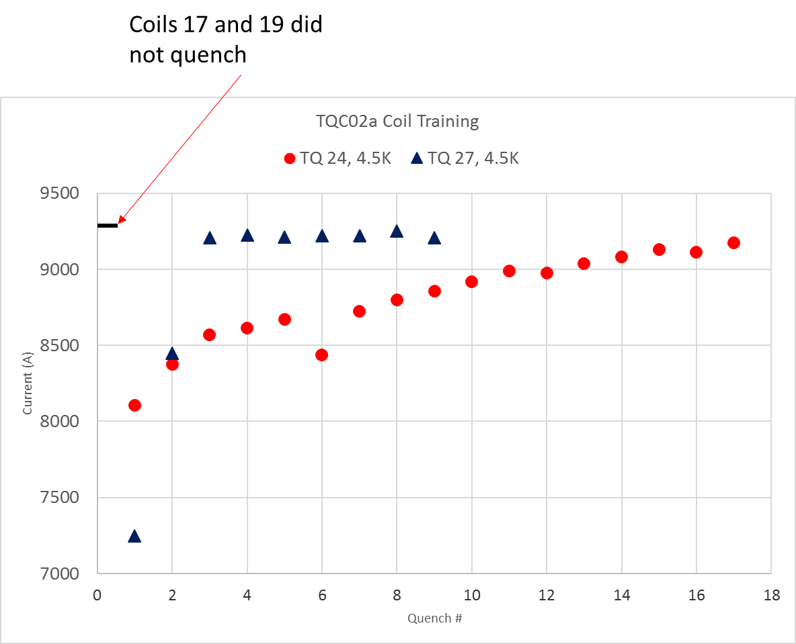
TQ series – closer look example
TQ 17 and 19 did not quench
(in low ramp rate training; quenched later at high ramp rates)
TQ 27 had very fast training
TQ 24 had slow training
TQ 17 and 19 were previously
collared and de-collared

Slide 12
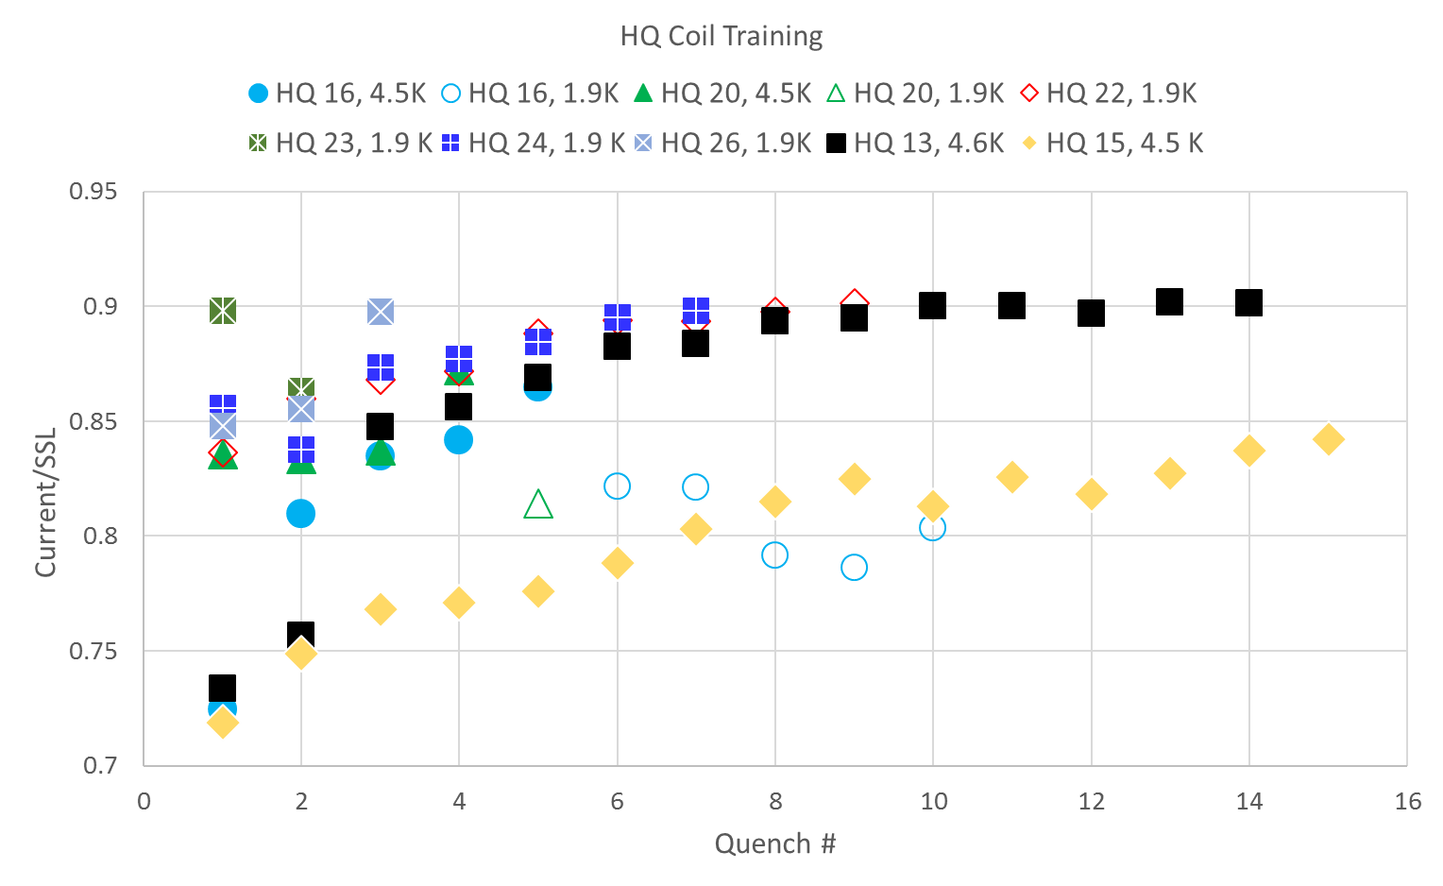
HQ series
We now have SSL per coil
(will use for proper normalization)
Using SSL per magnet
on this plot
We have the set of TQ, HQ, MBH and QXF coils/magnets tested at FNAL

Slide 13
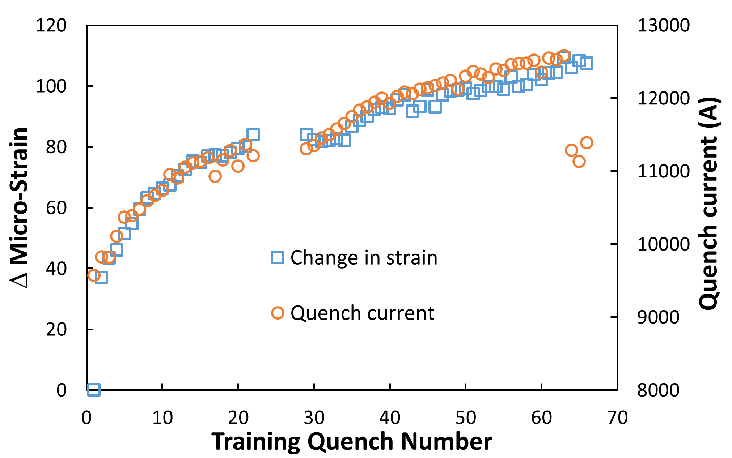
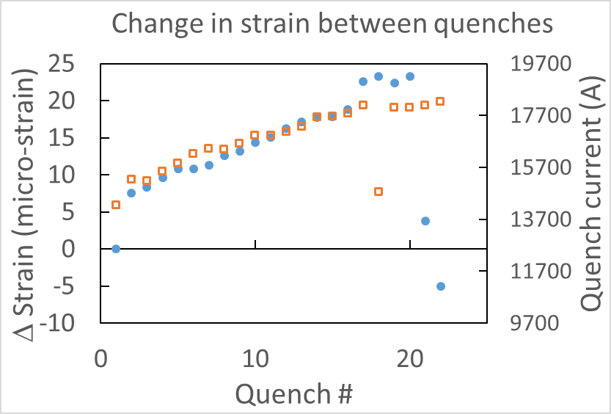
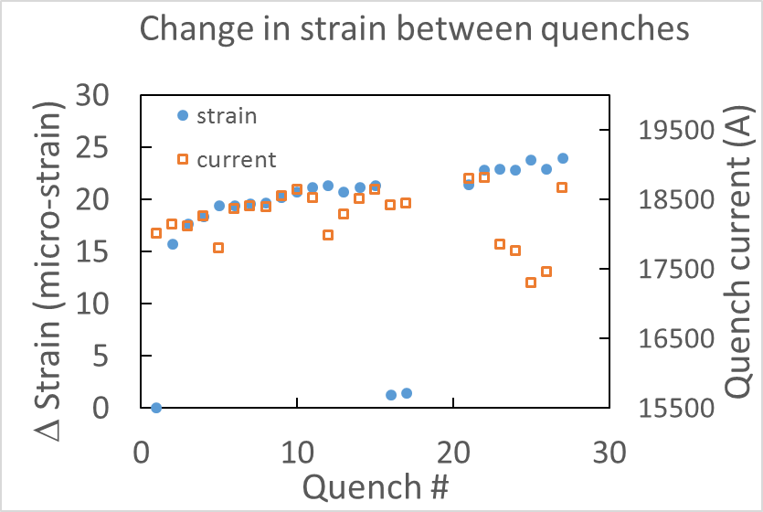
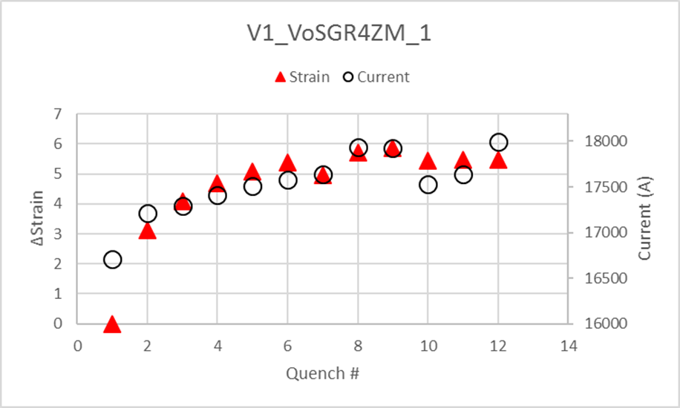
Strain
MBHSP02
(“Typical” MBH)
Similar observation for “bullet” SG (MBH series)
and rod SG (QXF series)
Behavior features with detraining and
pre-stress differences (QXF)
What is the relevance of data…
MQXFS01b
(higher azimuthal pre-stress)
MQXFS01a
MQXFS01c
(higher axial pre-stress)

Slide 14
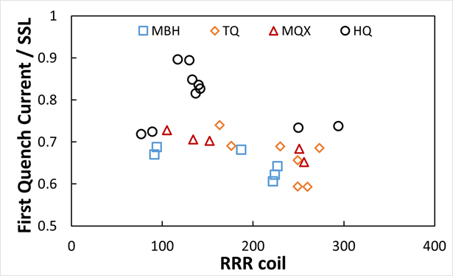
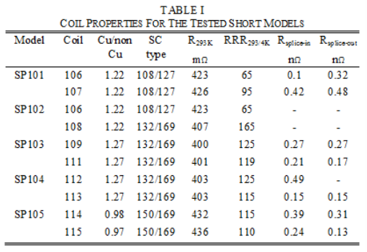
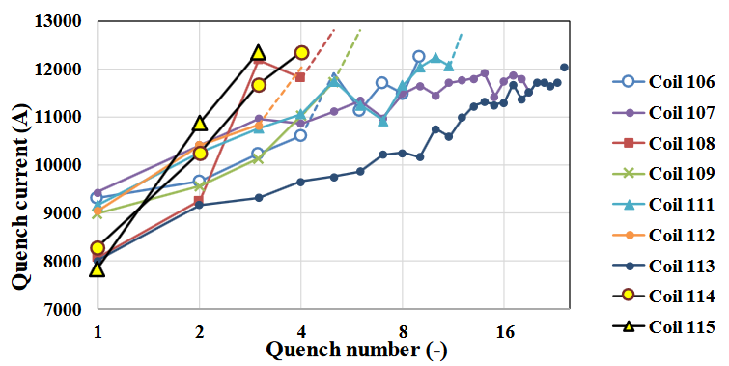
More on RRR
(You saw this before)
CERN 11 T Models
From G. Willering (MT25)
The lowest RRR coil has one of the highest “first” quench currents,
The highest RRR coil has one of the lowest “first” quench currents
I still don’t have the SSL per coil among others
(common database? shared “database” entry?)
I almost had the data for MQXFAP1 from BNL…

Slide 15
Incoming data
There are ongoing tests for the “11 T” and the quads HL-LHC program
It would be great if we had prompt access to all the parameters and test data (both in pre-defined formats, preferably)
In next years we’ll get a lot of LHC “production” magnets/coil data which will be of interest – need to prepare a “database” format for easy analysis and cross correlations (with prototypes too)
We need to work in close collaboration with CERN obviously
We can use the opportunity to address several general points –
data preservation, data sharing, data formatting, data analysis tools
(even if this will be US only)

Slide 16
Milestones
Complete the current work for ASC2018 (publish)
Include (public) data from CERN (11 T) if available by then
Include and summarize available CERN and BNL data
(11T dipoles and HL-LHC quads) – over the next year
Track performance differences for similar coils, in particular fabricated at CERN and in the US – over the next year
Publish findings
Up to here we need the data and a dedicated person to deliver.
In the worst case – limited data analyzed and results delayed.

Slide 17
Milestones (2)
Hypothesis testing (plans for sub-scale tests) – resource dependent
What is a relevant “sub-scale” (a bigger topic we are discussing at FNAL)
How many “samples” are enough
Is there another way (to test)?
Common database (drafting, finalizing choices) – resource dependent
Who is participating, at which level
What is in the database
What is the relevant format
We need to be able to fabricate and test “samples”
(think racetracks as inserts but possibly something else)
We need to have responsible people investing some of their time on this, at least.
If we had all the resources but were limited at the current number of people
(supporting the same other activities), we still couldn’t make fast progress

Slide 18
Summary
Let’s agree to provide a common “database” entry
for each magnet test
We are finalizing a summary paper on magnet performance at FNAL and correlations observed partially based on database input
Extended set of data and observations to come afterwards
We want to plan for hypothesis testing (needs funding)

Slide 19
Back up

Slide 20
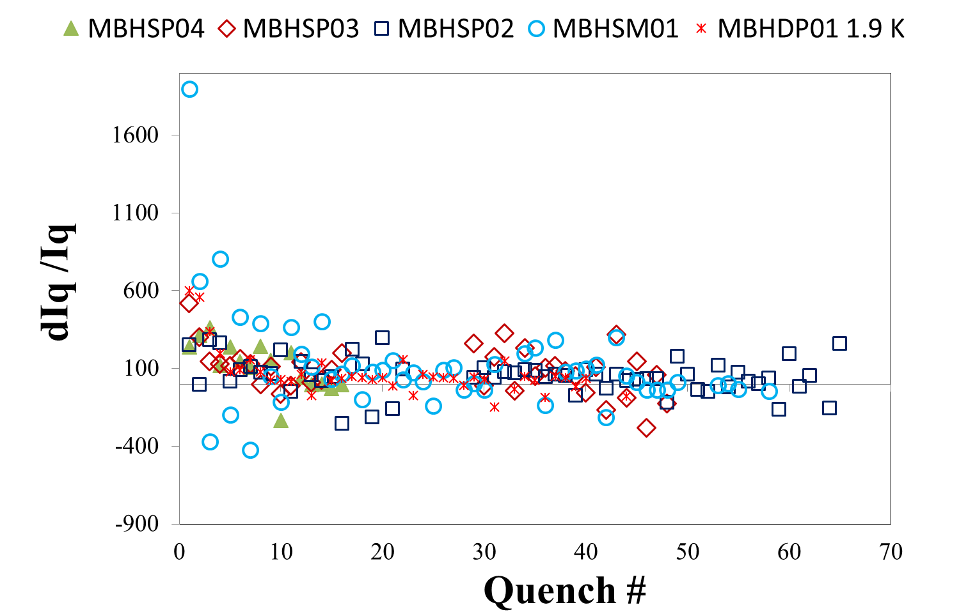
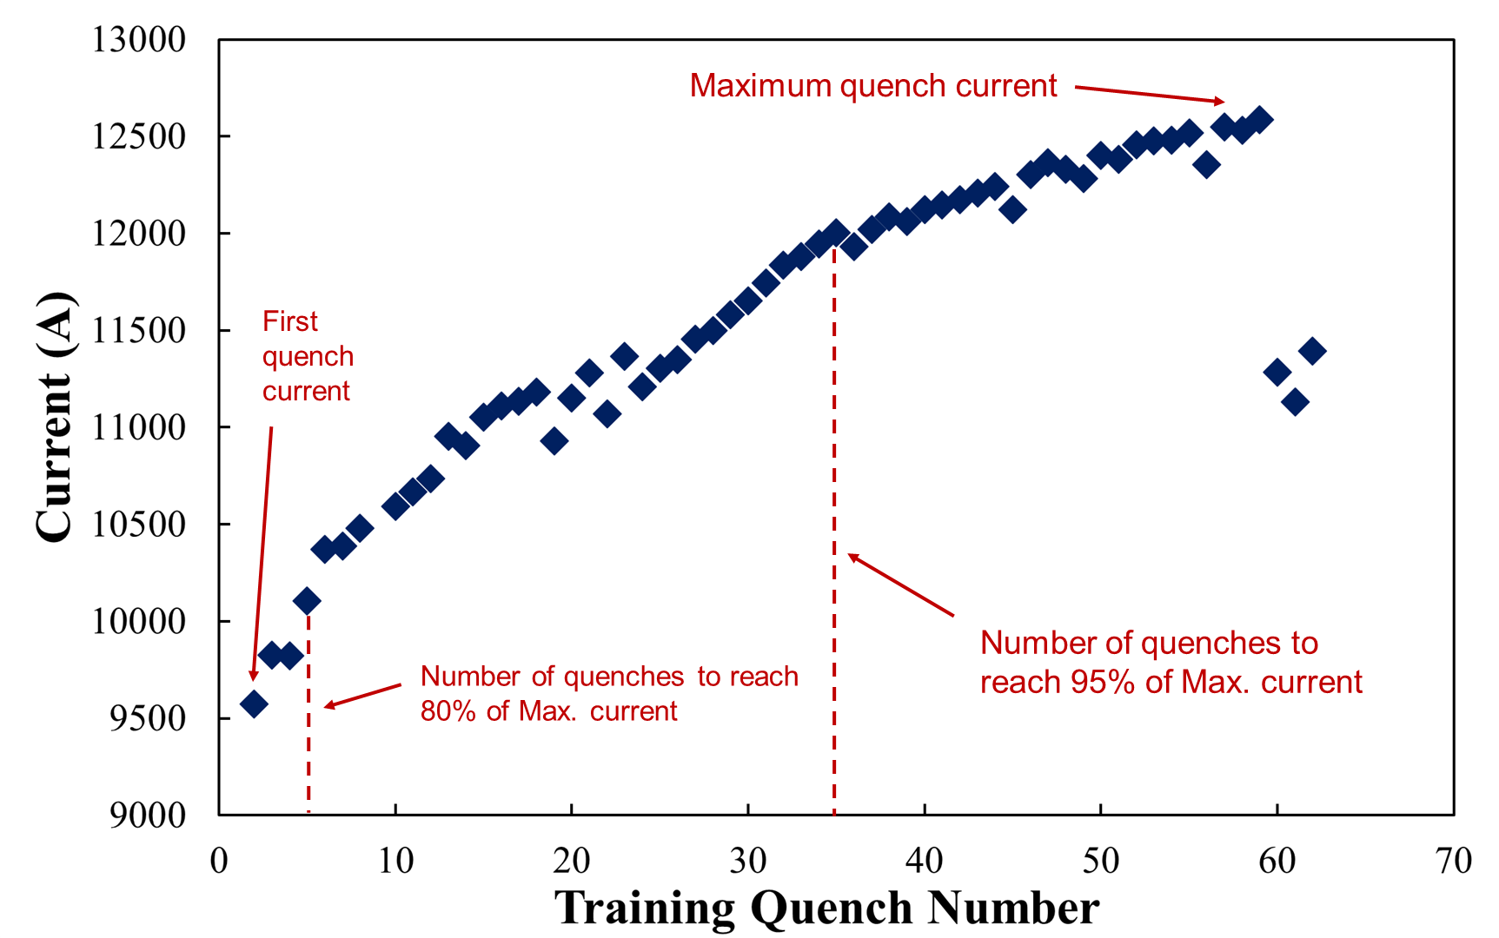
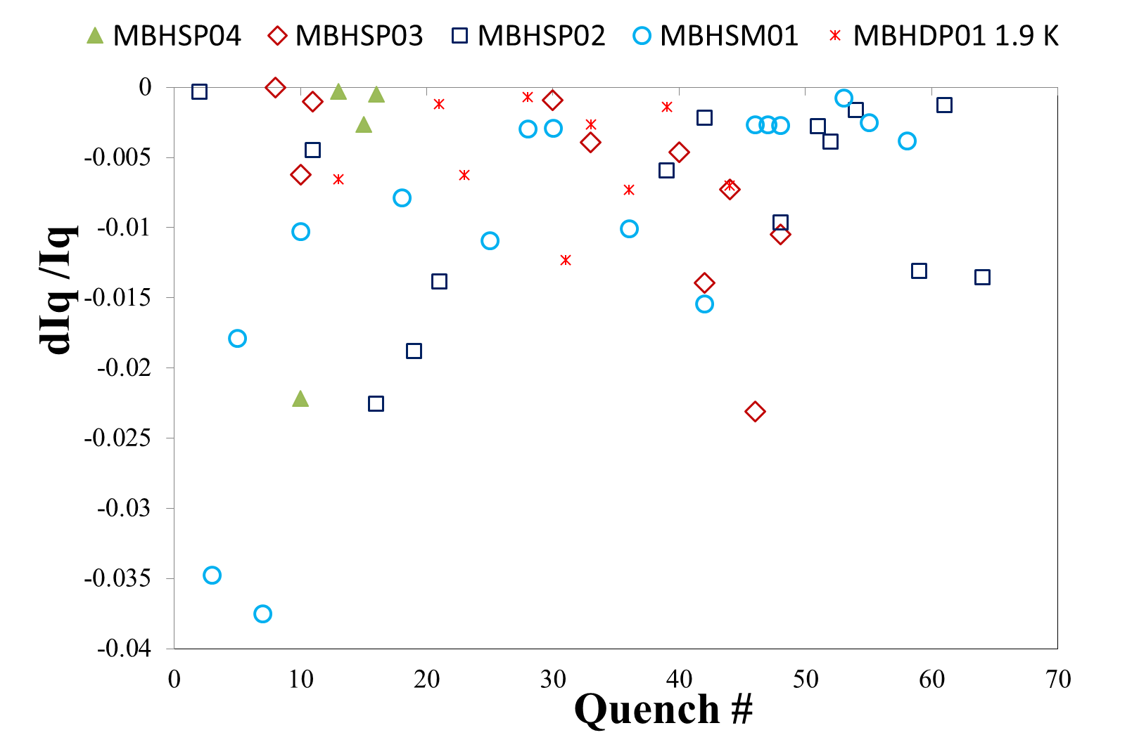
Quench Parametrization
Find a minimal set of parameters describing the main features
Current (could be normalized) training
First quench
Number of quenches of “fast” training
Number of quenches of “slow” training
Current (could be normalized) differentials
Include number of detraining quenches
(at different training regions)
Current differentials
Current
Only negative differentials
detraining
quenches

Slide 21
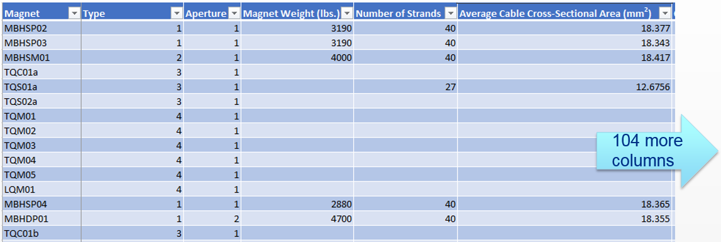
Tabulated View of Data
More magnets
Data would be available in one place and could be
processed partially or fully

Slide 22
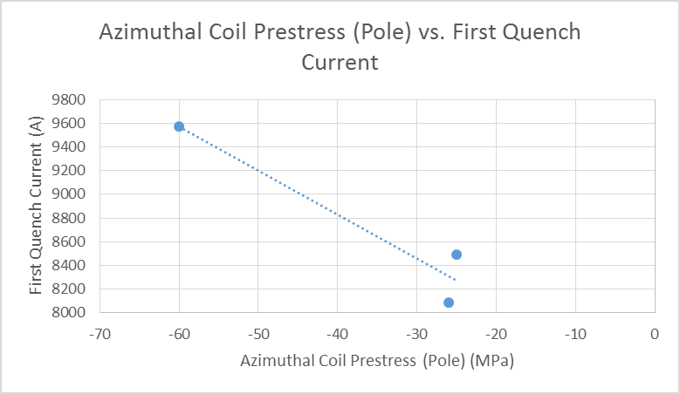
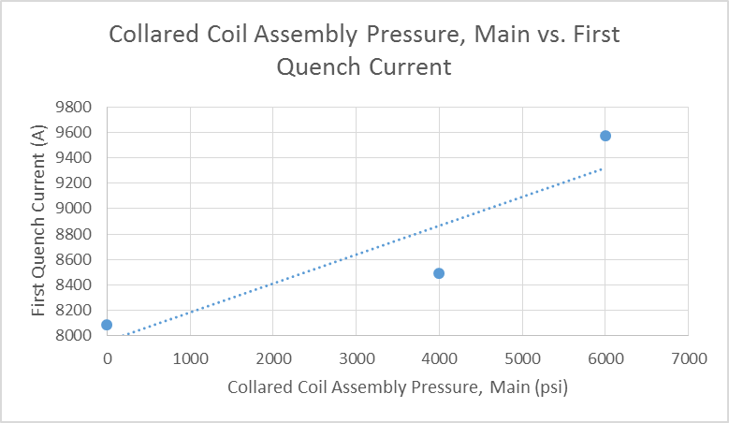
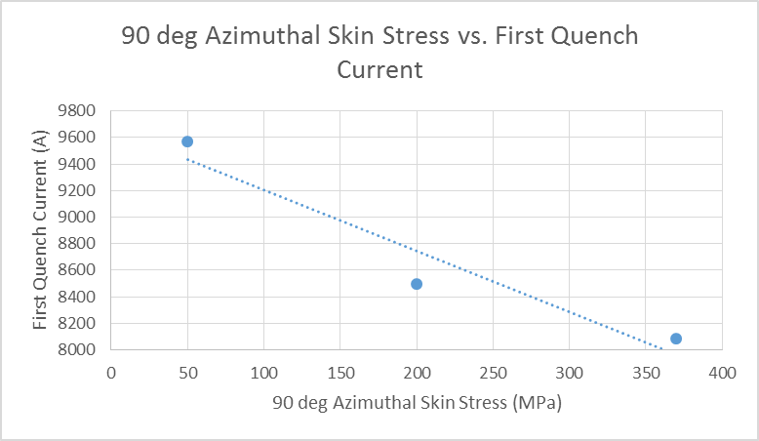
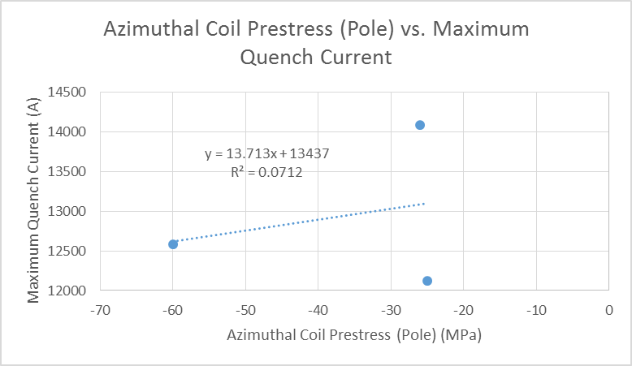
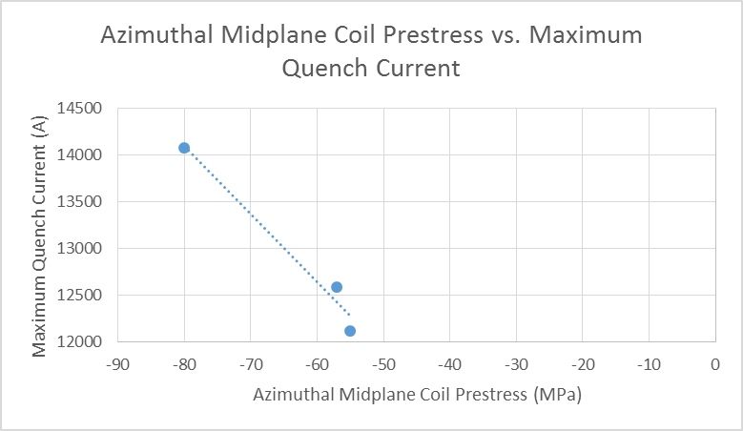
Correlations
Analysis on a limited (for now) data sample
Few tens of different correlation plots were created
Only preliminary findings available
Limited resources (time) spent for now
Prestress/pressure vs first quench current
Prestress vs maximum (“last”) quench current
Examples of pre-stress
correlation plots

Slide 23
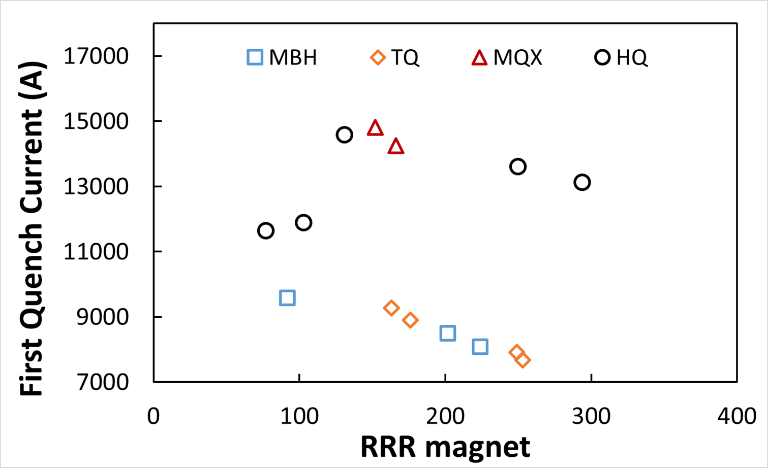
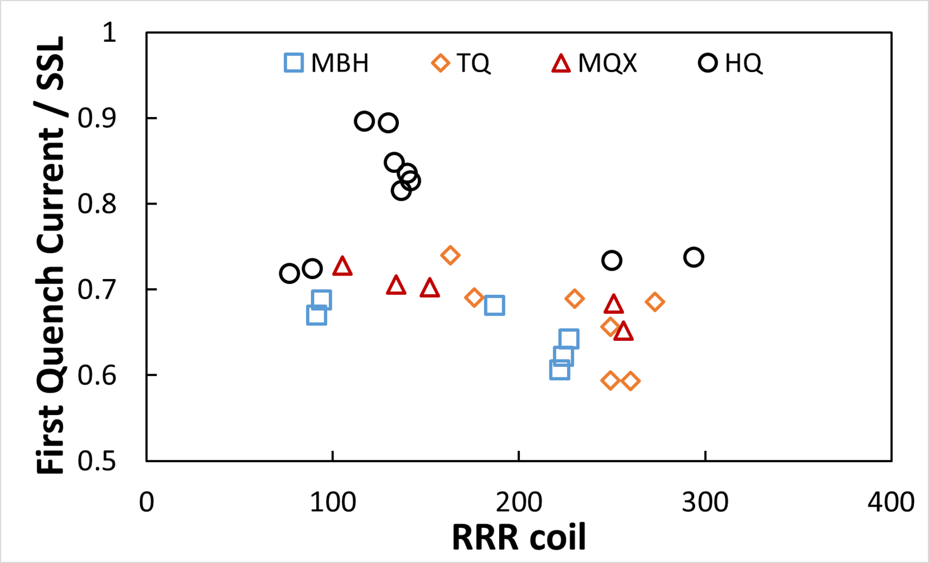
Correlations (2)
For some of the dependencies more complete picture is drawn
Absolute current (series magnets)
Normalized current (coils)
coils 15,16
same cable #
coils 15,16
same cable #
Correlation coefficients for the coil-RRR (HQ coils 15,16 excluded):
c(MBH) = -0.76, c(TQ) = - 0.67, c(MQX) = -0.92, c(HQ) = -0.90
Heat treatment is possible underlying reason for the RRR correlations,
further investigation pending.

Slide 24
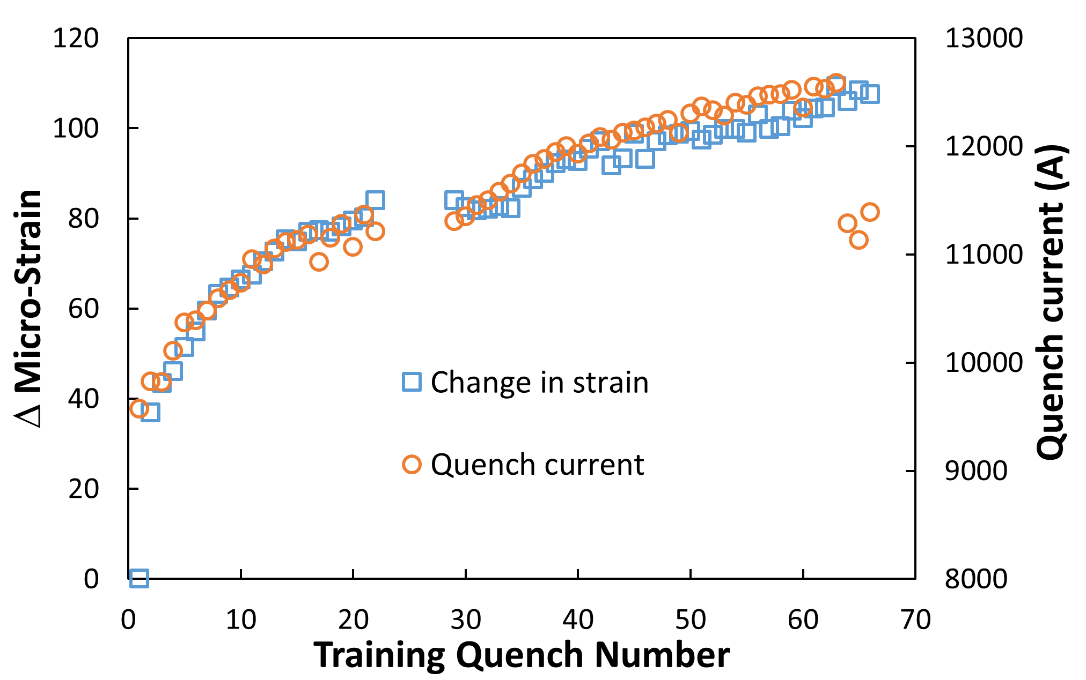
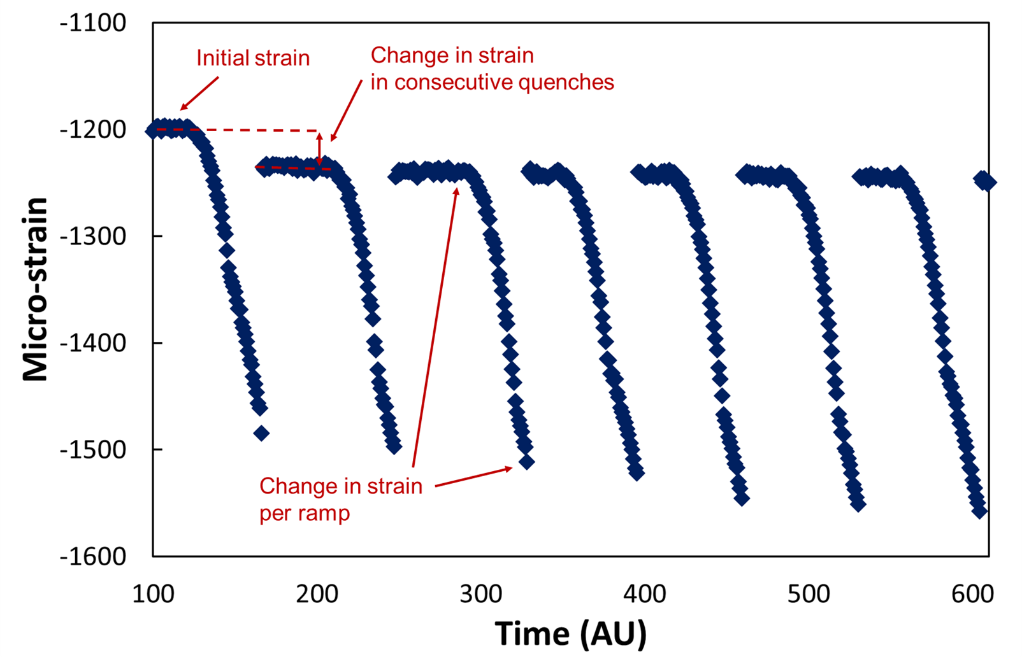
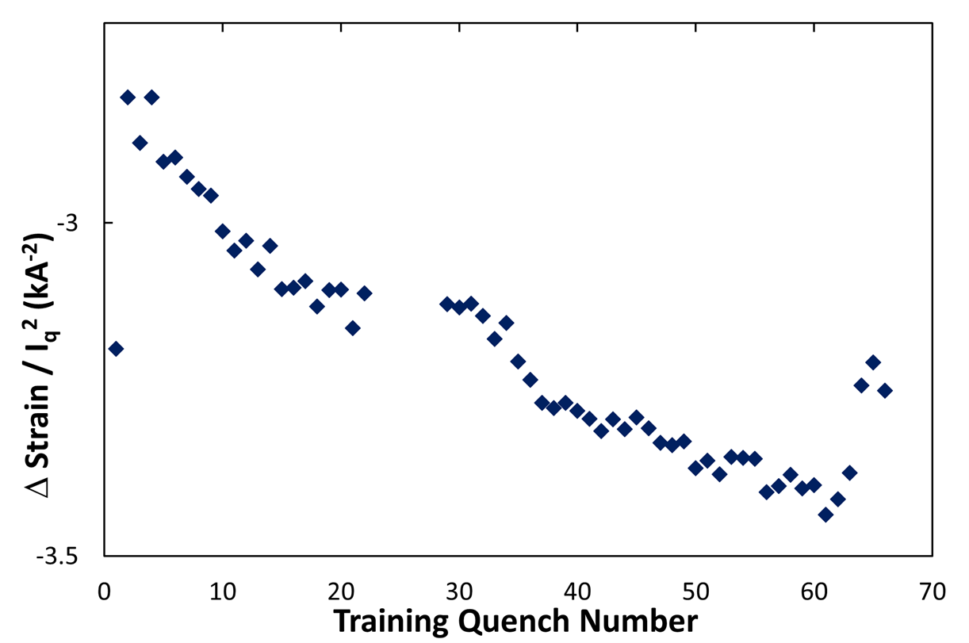
Magnet Training - Current and Stress
One of the first hints from the analysis was to investigate more the performance in terms of stress
Magnet training happens in terms of stress as well
Longitudinal strain gauge /SG/ readings (“bullets”) were found to be most representative of features
Bullet-to-bullet behavior is different
Strain change
between ramps
Training quench ramps
x 10⁻⁶
(not the same shape for all bullets)
Strain change
during ramps
normalized to current square

Slide 25
Hypothesis testing
One of the main problems we have is the
lack of enough reproducible tests
Ideally we’d like to have weekly tests under controlled conditions
However, fabricating even short models is slow and expensive
We are reviewing options for high current tests
Very short race-track magnets
Cable “composite” under external pressure in external magnetic field
“Reusable” models (re-assembly and reconditioning of a model;
a model with epoxy alternatives)

