Slide 1
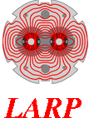
Design of a Compact 16 T Common-Coil Dipole for Future Colliders
E. Ravaioli (LBNL)
M. Juchno, GL. Sabbi (LBNL)
24 January 2018

Slide 2
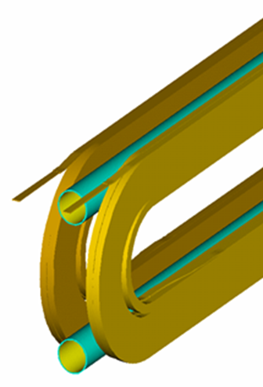
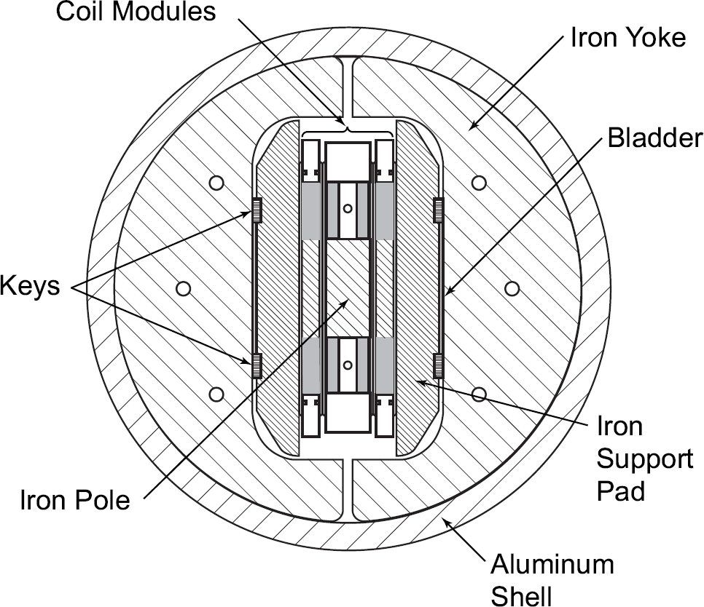
Common-coil layout
Concept: 2-in-1, vertical orientation, coil winding shared between apertures
Initial focus on large bending radius and possible use of pre-reacted cable
For wind and react, potential advantages from modularity, flat cables, grading
Achieved ~15 T in technology tests, and ~10 T with (limited) bore & field quality
R&D issues:
Engineering design for aperture & field quality (auxiliary coils and/or flared ends)
Optimization of bore support structure (similar to block-coil)
Compactness, magnetic length vs. coil length, end field quality
Outer structure challenges and opportunities (compared with horizontal layout)
RD3b model at LBL reached 14.7 T

Slide 3
Main features of the proposed design
Goals of the present design
→ Achieving the FCC target performance (bore field, aperture, margin, field quality, quench protection)
→ Design choices aiming at compactness, lower inductance, easier quench protection, lower powering voltage
Main features
→ Large bending radius for the main coil (allowing use of large cable)
→ Reduced beam separation with top-bottom asymmetric coil design
→ Fabrication time, cost, and risks: Straight coils (no flared ends); Fewer layers and turns; Compact design: 550 mm iron yoke OD, ~630 mm shell OD (targets)
→ Compatible with key & bladder mechanical structure
→ Main and auxiliary coils powered in independent electrical circuits

Slide 4
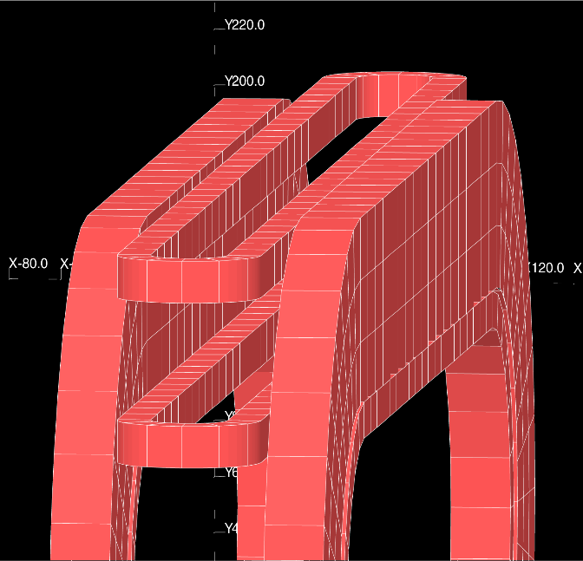
Very simple 3D sketch
[1] R. Gupta, “A Common Coil design for High-Field 2-in-1 Accelerator Magnets,” 1997 Particle Accelerator Conference, 1997.
[3] GL. Sabbi et al., “Design of Racetrack Coils for High-Field Dipole Magnets,” IEEE Transactions on Superconductivity, 2001.
Main coils: Common-coil
Auxiliary coils: Block-coil

Slide 5
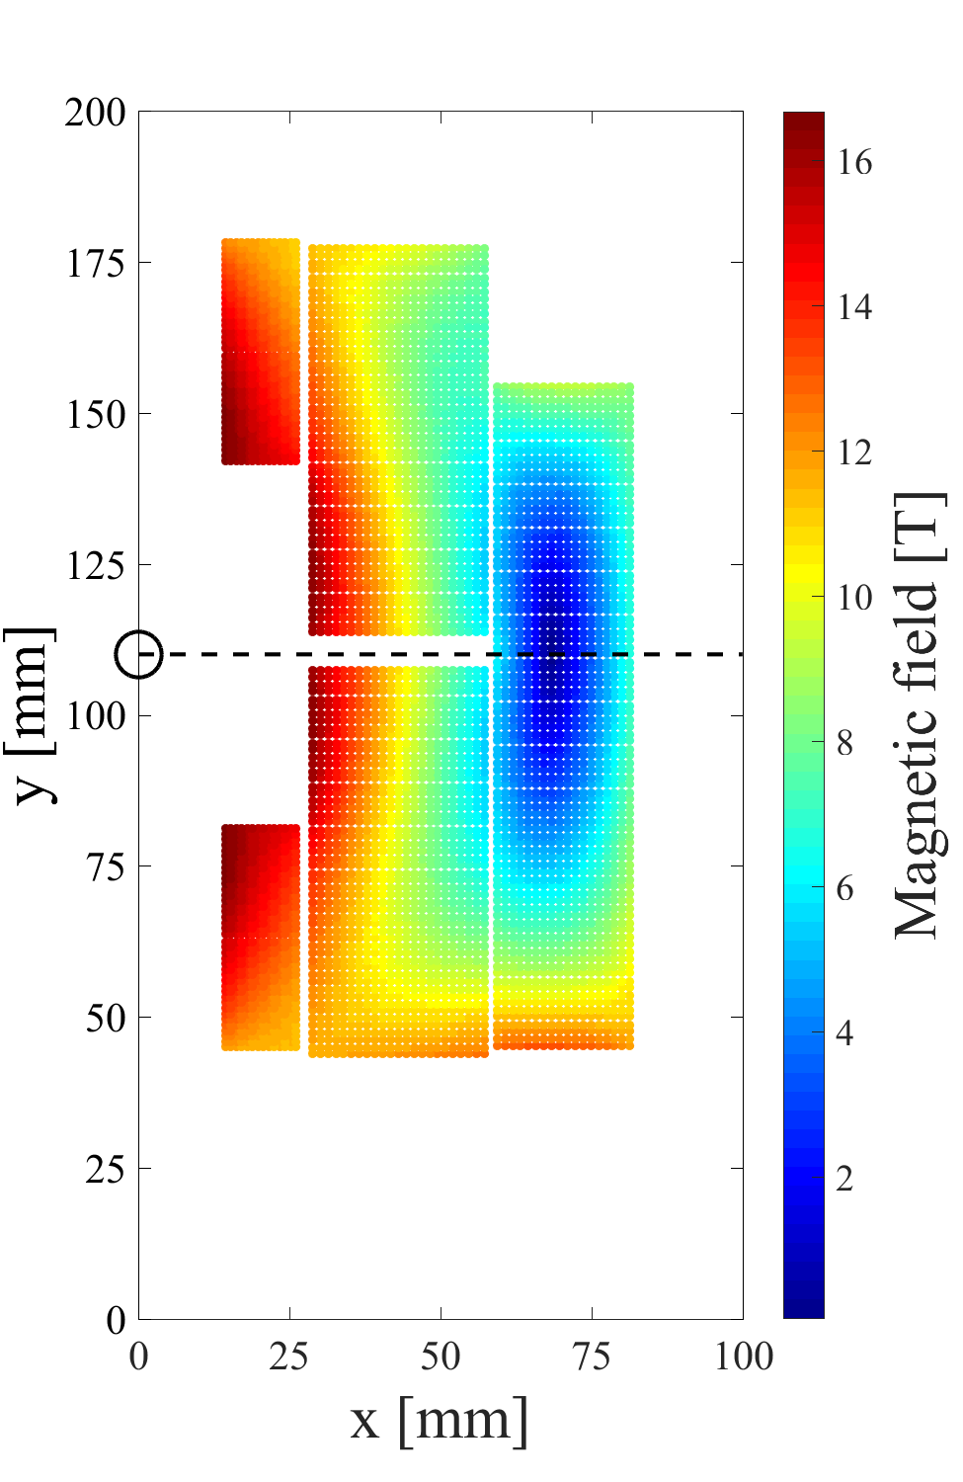
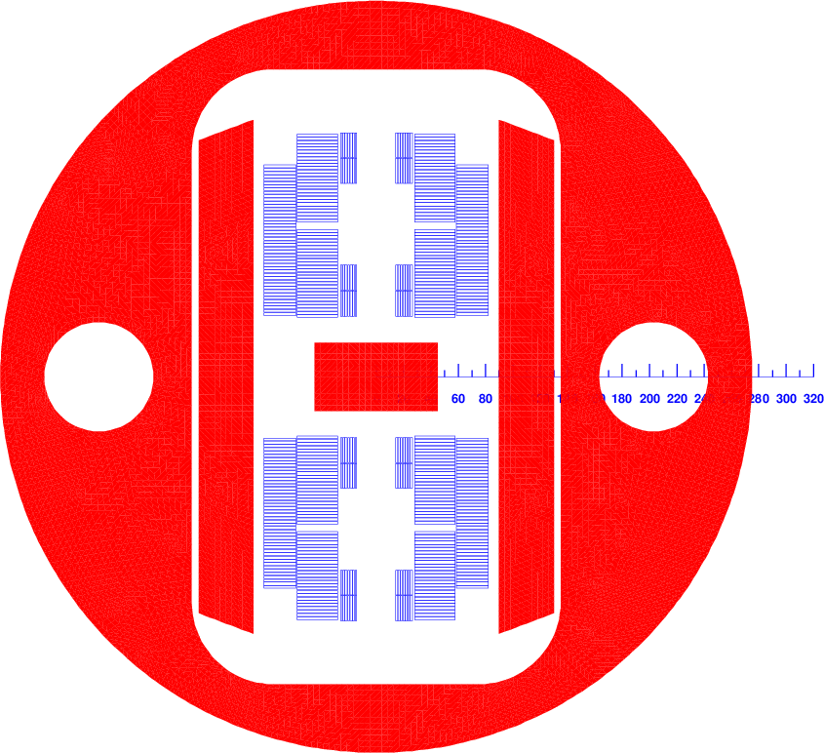
2D magnetic design – 16 T bore field
Simply 8 racetrack coils!
3D end layout
Al shell
Top-bottom coil asymmetry
Iron yoke
Pressured bladders & load keys for preload

Slide 6
Magnet parameters
Nominal performance | Magnet
Bore dipole magnetic field | 16.0 T
Operating temperature | 1.9 K
Coil aperture | 56 (h) x 59.6 (v) mm
Target margin at I_{nominal} | 14%
Clear aperture [6] | 50 mm
Intra-beam separation | 220 mm
Iron yoke external diameter | 550 mm
Self-inductance at 16 T | 9.8 mH/m
Self-inductance at ~1 T | 14.2 mH/m
Magnet length | 14.3 m
Total stored energy | 3.58 MJ/m
Conductor mass needed for FCC | 12.1 kton
FCC target
Used in magnetic analysis. To be confirmed after detailed mechanical analysis.
Compare to 6.9 mH/m of the LHC main dipole that reaches 8.3 T

Slide 7
Coil parameters
Nominal performance | Main coil - Out | Main coil - In | Auxiliary coil
Operating current | 28.6 kA | 28.6 kA | 11.1 kA
Current density in the SC | 2209 A/mm² | 991 A/mm² | 882 A/mm²
Peak field in the conductor | 13.1 T | 16.3 T | 16.7 T
Short sample magnetic field | 15.2 T | 19.0 T | 19.5 T
Margin on the load line | 14.1% | 14.2% | 14.3%
Temperature margin | 5.6 K | 5.5 K | 5.5 K
Turns per “quadrant” | 23 | 27 | 14
Strand area per “quadrant” | 74.9 cm² | 112.4 cm² | 25.4 cm²
Minimum bending radius | 44.6 mm | 43.2 mm | 14.0 mm
Current density in the Cu | 1032 A/mm² | 1239 A/mm² | 1103 A/mm²
Hot-spot temperature at 105% nominal current | 237 K | 223 K | 127 K

Slide 8
Outside FCC study parameter range
Conductor parameters
Conductor | Main coil - Out | Main coil - In | Auxiliary coil
Superconductor | Nb₃Sn | Nb₃Sn | Nb₃Sn
Number of strands | 36 | 46 | 40
Strand diameter | 1.20 mm | 1.20 mm | 0.85 mm
Cu/noCu ratio | 2.14 | 0.8 | 0.8
Cable width | 23.3 mm | 29.8 mm | 18.3 mm
Cable thickness | 2.10 mm | 2.10 mm | 1.49 mm
Insulation thickness | 0.15 mm | 0.15 mm | 0.15 mm
Jc(16 T, 1.9 K) | 2245 A/mm² | 2245 A/mm² | 2245 A/mm²
Common-coil compatible with large cable size due to large bending radius.
A large cable allows achieving the target field with fewer layers and turns, obtaining lower self-inductance and easier protection.

Slide 9
Magnetic field quality – Coil optimization
Harmonics at nominal current [units]
Normal |  | Skew
b3 | -0.1 | a2 | -0.2
b5 | 0.5 | a4 | -0.8
b7 | -2.8 | a6 | 0.0
b9 | -1.6 | a8 | 0.6
Magnetic analysis and optimization performed with ROXIE
Good field quality and compactness achieved with top-bottom coil asymmetry design (aperture center, turn numbers, auxiliary coil position)

Slide 10
Magnetic field quality – Yoke optimization
Several features included in the iron cross-section to improve control the harmonics in the full range 5-100% of nominal current.
Yoke design can definitely be improved to further reduce a2 and b3 harmonics

Slide 11
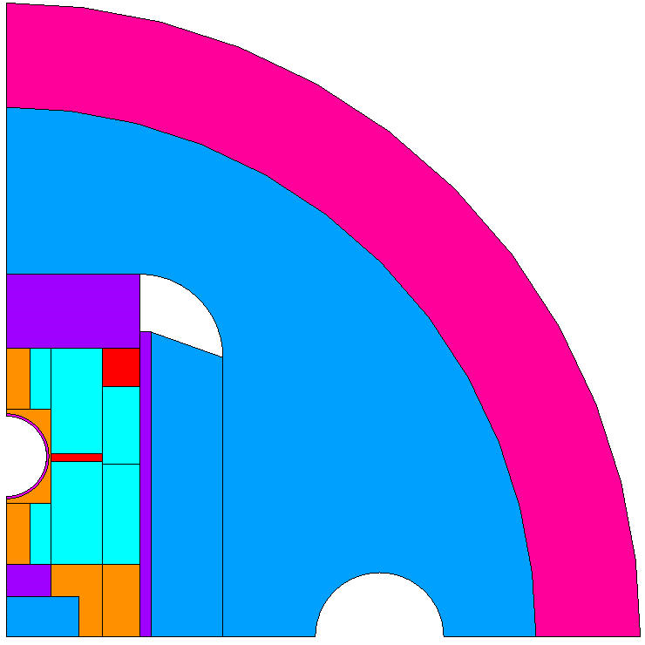
2D mechanical model (in progress)
Aluminum shell
M. Juchno
Iron yoke
Cu/bronze wedges
Stainless-steel
Iron pad
Titanium poles
Coil pack
Ti bore support
Titanium poles
Iron core

Slide 12
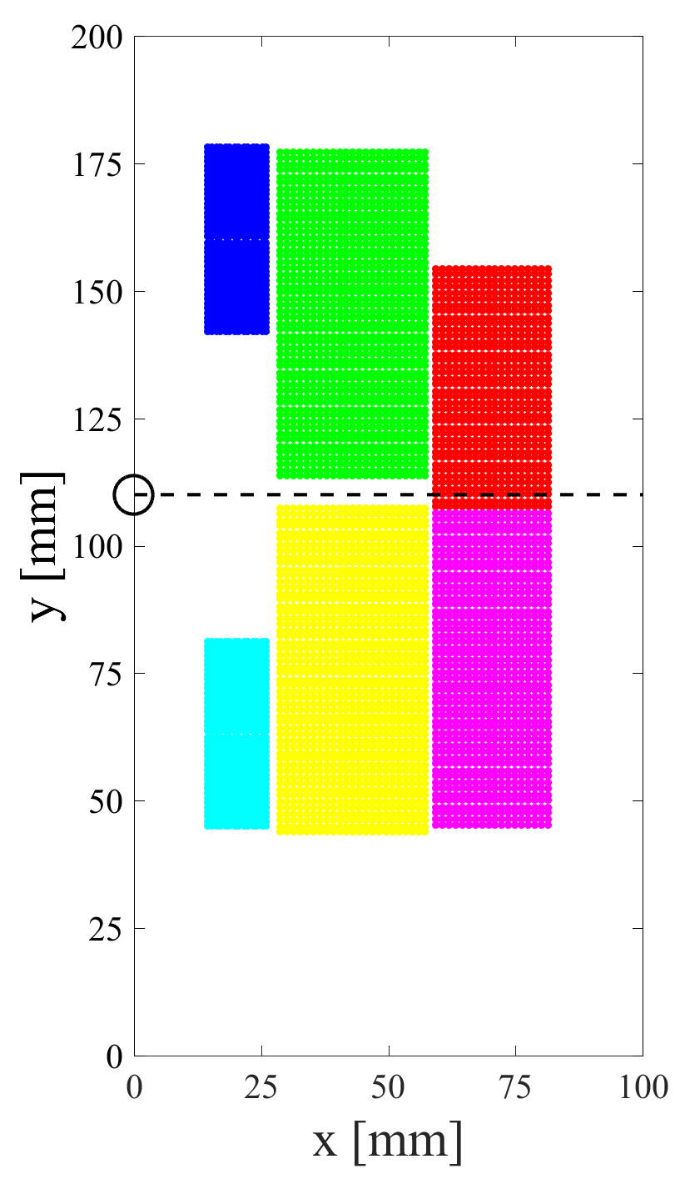
Mechanical forces at I_{nominal}
5
Block # | Force X [MN/m] | Force Y [MN/m]
1 | -0.51 | -1.84
2 | -0.99 | 4.11
3 | 6.50 | -2.69
4 | 6.70 | 3.16
5 | 2.09 | -0.39
6 | 2.08 | 0.44
3
1
4
2
6

Slide 13
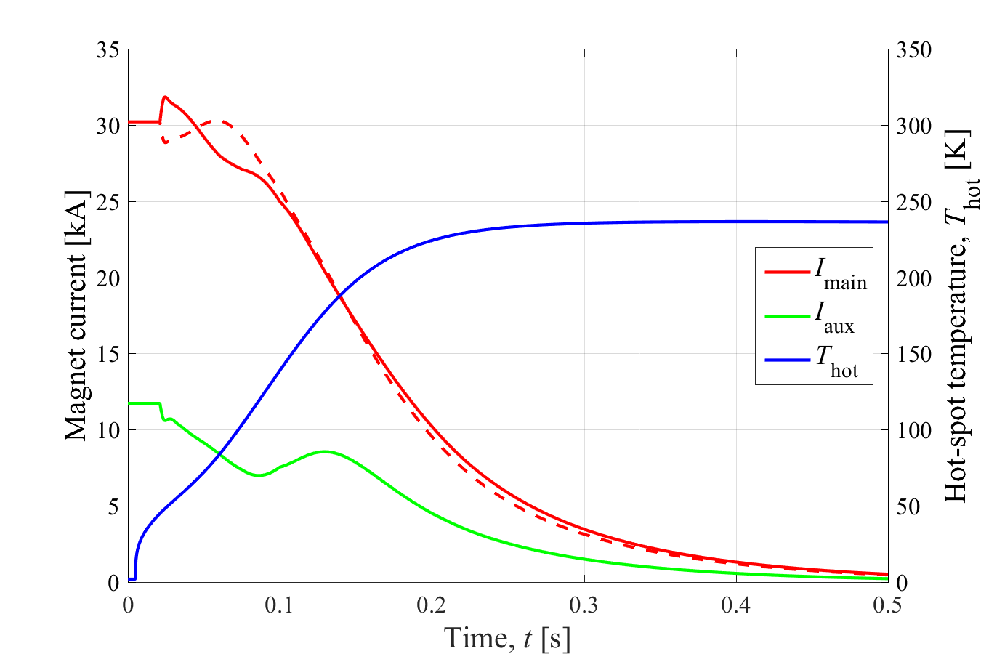
Quench protection at 105% I_{nominal}
Main common-coils and auxiliary block-coils are powered separately
They are magnetically coupled
Quench protection based on one 40 mF, 1 kV CLIQ unit

Slide 14
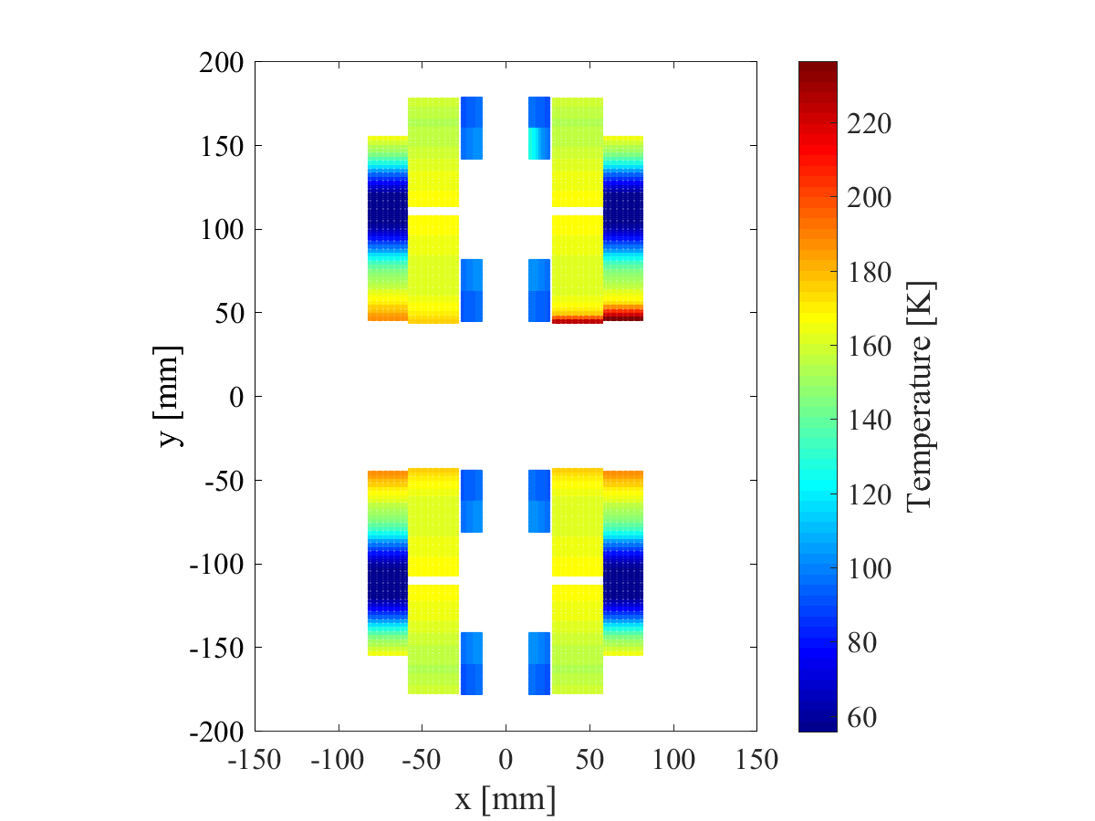
Quench protection at 105% I_{nominal}
Cu/noCu ratios in the three conductors (graded common coil, auxiliary coil) are adjusted so as to reach similar hot-spot temperatures in case of a quench
Hot-spot temperature after a quench at 105% nominal current: <240 K

Slide 15
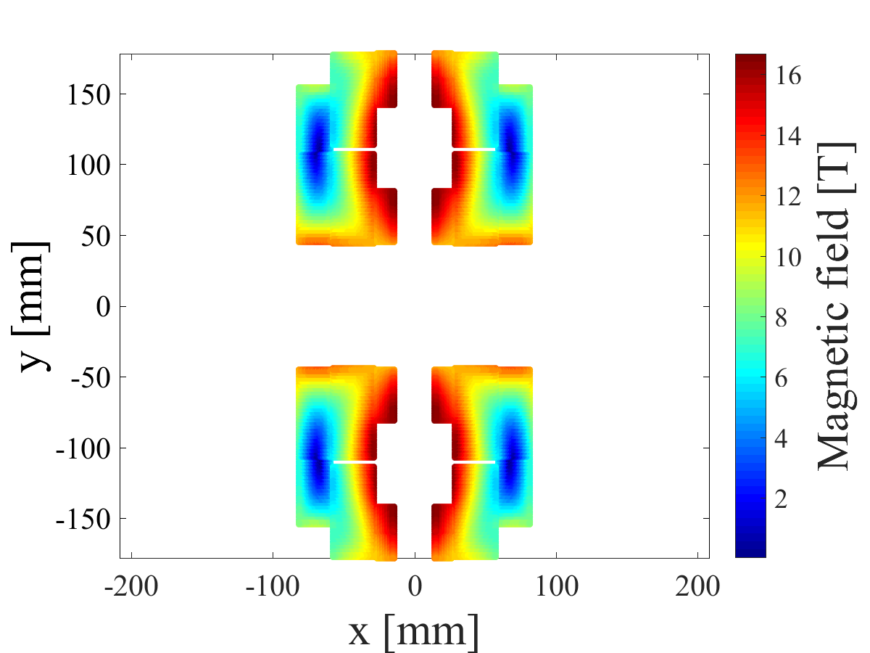
Main results – Recap
16 T bore magnetic field with 14% margin at 1.9 K
43 mm minimum bending radius (for the main coil)
14 mm minimum bending radius (for the auxiliary coil)
213 cm² of strand cross-section in the entire magnet
220 mm beam separation
550 mm outer diameter iron yoke (before detailed mechanical analysis)
141 mH self-inductance for the 14.3 m long magnet
<240 K hot-spot temperature at 105% nominal current

Slide 16
Conclusions
This design meets the FCC magnetic requirements achieving lower number of layers, lower self-inductance, and easier operation/quench protection
The characteristics of common coil layout, such as featuring flat cables and larger bending radius at the coil ends, are well suited for using a large cable
Common-coil design achieves less magnetic efficiency than cos-theta and block-coil designs, which results in higher superconductor cost
Modifications to coil windings and iron cross-section allow efficiently compensating field errors arising due to the small beam separation distance
2D mechanical analysis ongoing

Slide 17
References
[1] R. Gupta, “A Common Coil design for High-Field 2-in-1 Accelerator Magnets,” 1997 Particle Accelerator Conference, 1997.
[2] GL. Sabbi et al., “Conceptual Design of a Common Coil Dipole for VLHC,” IEEE Transactions on Superconductivity, 2000.
[3] GL. Sabbi et al., “Design of Racetrack Coils for High-Field Dipole Magnets,” IEEE Transactions on Superconductivity, 2001.
[4] R. Benjegerdes et al., “Fabrication and test results of a high field, Nb₃Sn superconducting racetrack dipole magnet,” 2001 Particle Accelerator Conference, 2001.
[5] A.F. Lietzke et al., “Test Results of RD3c, a Nb₃Sn Common-Coil Racetrack Dipole Magnet,” IEEE Transactions on Applied Superconductivity, 2013.
[6] GL. Sabbi et al., “Performance characteristics of Nb₃Sn block-coil dipoles for a 100 TeV hadron collider,” IEEE Transactions on Applied Superconductivity, 2015.
[7] L. Bortot et al., “STEAM: A Hierarchical Co-Simulation Framework for Superconducting Accelerator Magnet Circuit”, MT25, submitted, 2017.
[8] E. Ravaioli et al., “Lumped-element dynamic electro-thermal model of a superconducting magnet,” Cryogenics, 2016.
[9] E. Ravaioli et al., “Design of a Compact 16 T Common-Coil Dipole for Future Colliders,” IEEE Transactions on Applied Superconductivity, submitted for publication.

Slide 18
QUESTIONS?
ERavaioli@lbl.gov

Slide 19
Annex

Slide 20
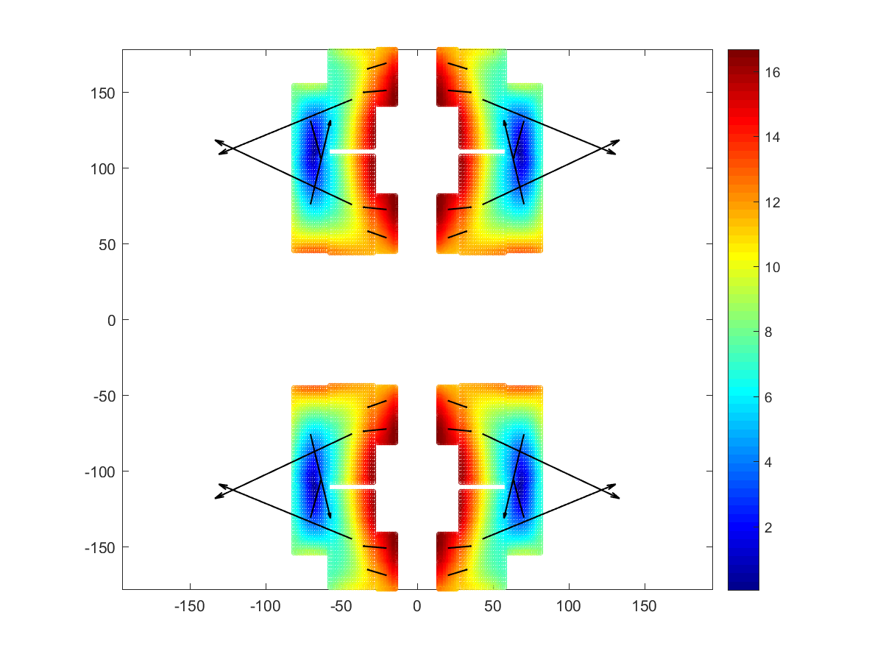
Mechanical forces
5
Block # | Force X [MN/m] | Force Y [MN/m]
1 | -0.51 | -1.84
2 | -0.99 | 4.11
3 | 6.50 | -2.69
4 | 6.70 | 3.16
5 | 2.09 | -0.39
6 | 2.08 | 0.44
3
1
4
2
6

