Slide 1

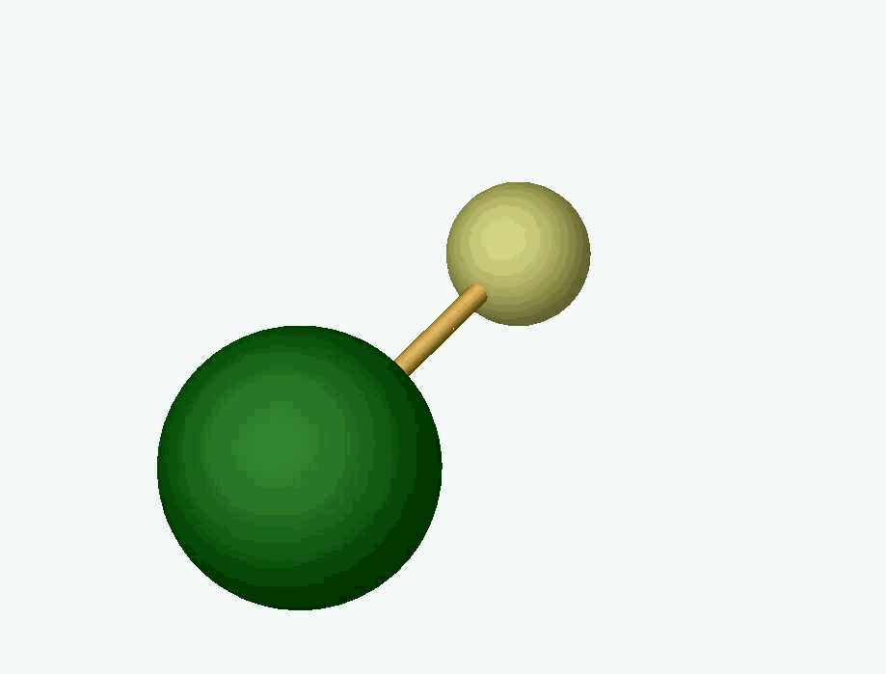
Nuclear Anapole Moments
Proof of principle for the ZOMBIES nuclear anapole moment “factory”
Near-future prospects for anapole measurements
Questions for theorists: what measurements maximize physics impact?
Sidney Cahn
Physics Department
Yale University
DeMille
Group
Past Funding
NSF

Slide 2


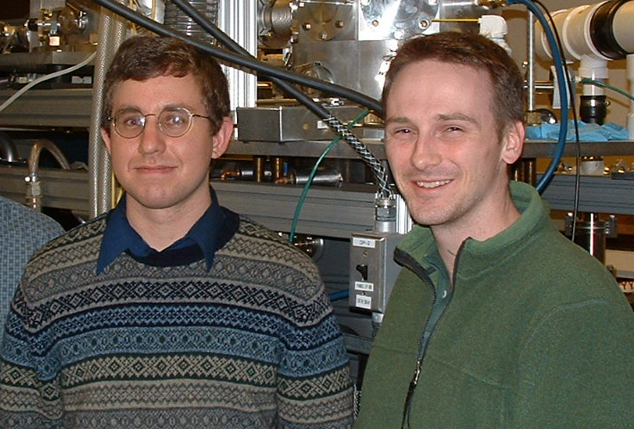
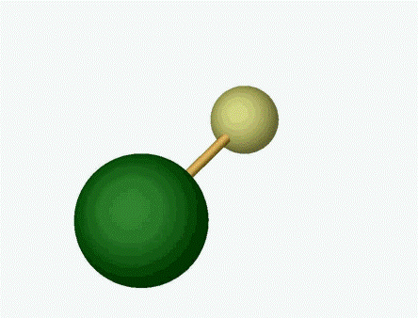

ZOMBIES @ Yale
Emine Altuntas
David DeMille
DeMille
Group
Jeffrey Ammon
David Rahmlow, Dennis Murphree

Slide 3
Tree-level NSD-PV suppressed ⇒ radiative corrections non-negligible
e
e
e
V_{e}+A_{e}
A_{e}
σ_{e}
σ_{e}
γ
Z⁰
Z⁰
γ
I
V_{N}+A_{N}
V_{N}
I
N
N
Z⁰, W±
N
Tree-level
NSD-PV
from suppressed
V_{e}A_{N} term:
[C₂ subject to
QCD renormalization]
HPV interactions
inside nucleus induce
anapole moment
[couples to electron
magnetically ]
Coherent sum:
weak charge & magnetic hyperfine
See G. Gwinner 280for A_{e}V_{N}

Slide 4
3 contributions to NSD-PV: scaling with Z & A
Overall Z²
|κ’₂| ≅ g_{A} (1-4sin²θ_{W})/2 ≅ -.05
κ’ _{Q} ∝ small (<κ’_{a} /4)
& well understood
--ignore
Simple shell model: valence nucleon over closed core
Poorly-known hadronic PV nucleon-nucleus couplings
Anapole term dominates in heavy nuclei:⎟ κ’_{a}⎜ > ⎟κ’₂⎜

Slide 5
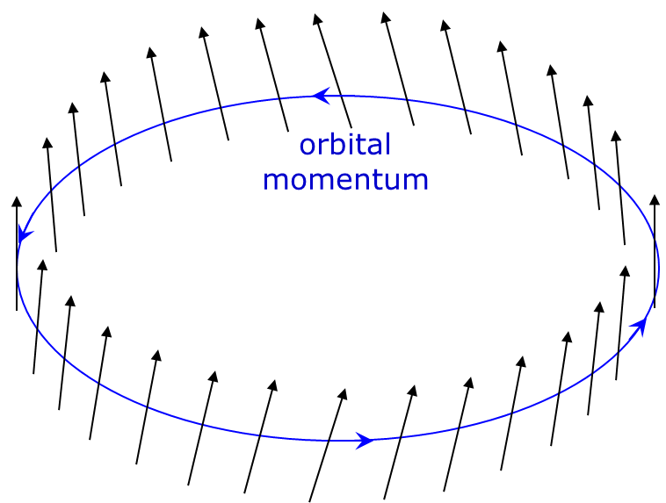
Hadronic PV in nucleus induces nuclear spin helix
= magnetic dipole + anapole
spin tilted
along momentum
Current loop
(dipole)
=
+
Current helix
(anapole)
Simple model for nuclear anapole
(valence nucleon + constant-density core):

Slide 6
Microscopic physics of the nuclear anapole moment
Nucleon-nucleon HPV interactions perturb nuclear structure:
N₁
N₁’
W
S
DDH
description of HPV:
effective meson exchange parameterizes range & isospin structure
π, ρ, ω
S
W
N₂
N₂’
Hamiltonian for unpaired nucleon interacting w/paired core
gives spin-momentum correlation
6 terms in principle;
2 linear combinations estimated important for anapole (DDH)

Slide 7
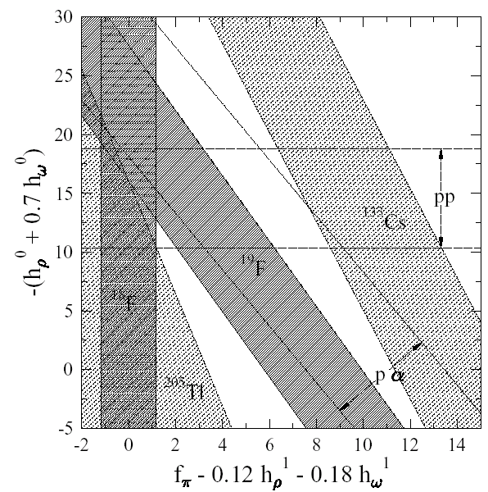
“Old style” DDH plot of HPNC measurements including anapole measurements (past & future)
New odd-p
isotopes
New odd-n
isotopes
Our approach:
general method to enable MANY anapole measurements
Assumes ~30% uncertainty in nuclear structure calculations

Slide 8
Enhanced NSD-PV mixing in simple molecules
J^{P} = 1⁻
J^{P} = 0⁺
Naturally small rotational splitting (~10⁻⁴ eV vs. ~1 eV in atoms)
can be bridged w/Zeeman shift:
10¹¹ enhanced PV mixing vs. classic experiments with atoms
Notes:
.

Slide 9


ZOMBIES experimental schematic
ablation laser pulse
Superconducting Magnet
$$𝓔$$
Electrodes
Laser
Laser
PMT
Solid Ba Target
(6)
(2)
(3)
(4)
(5)
(1)
Molecular
Beam Source
Fluorescence
Collection
z
$$ℰ$$
W
(PMT)
(1)
(2)
(3a)
(3b)
(4)
(5a)
(5b)
(6)

Slide 10
Stark interference method: apply oscillating E-field to mix nearly-degenerate levels
Center of Magnet:
Homogeneity δB/B < 10⁻⁷
E₋
Zeeman-shifted Energy E
E₊
Position z ∝ Time t = z/v

Slide 11
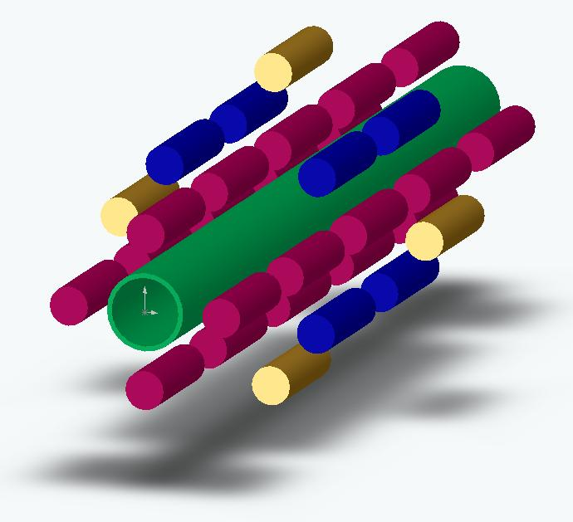
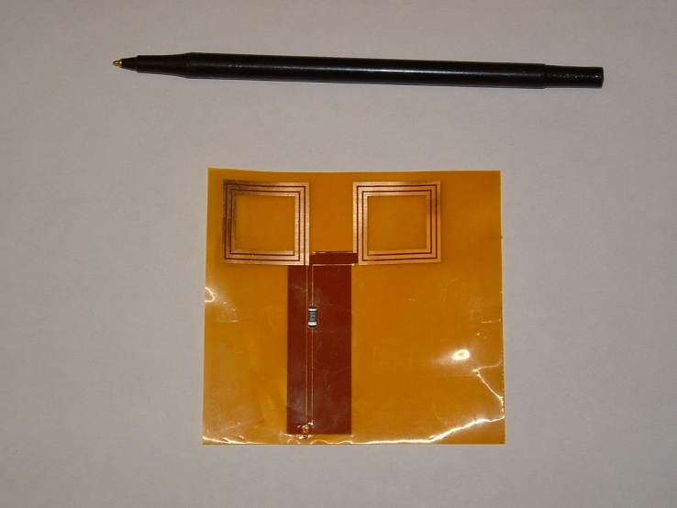
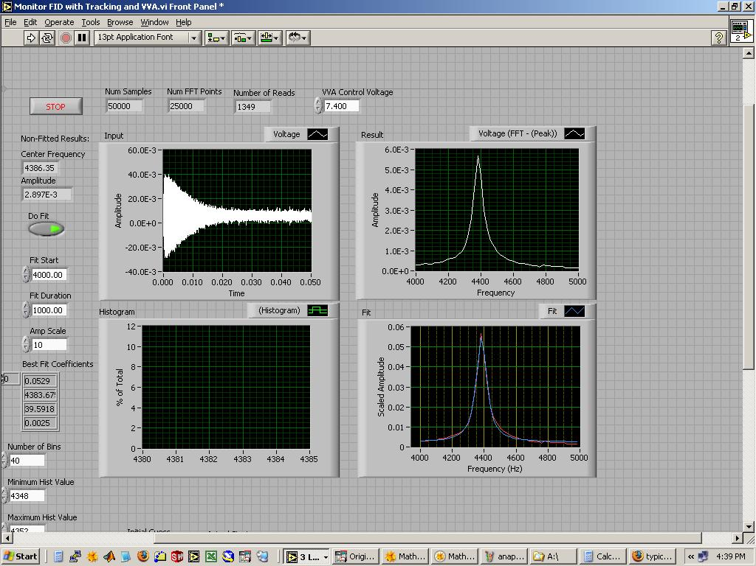
B-field measurement: initial/crude
molecular beam axis
broadband probe on flex circuit
array of 32 NMR B-field probes
FID trace + FFT fit: δB/B = 0.01 ppm in one 60 ms shot

Slide 12
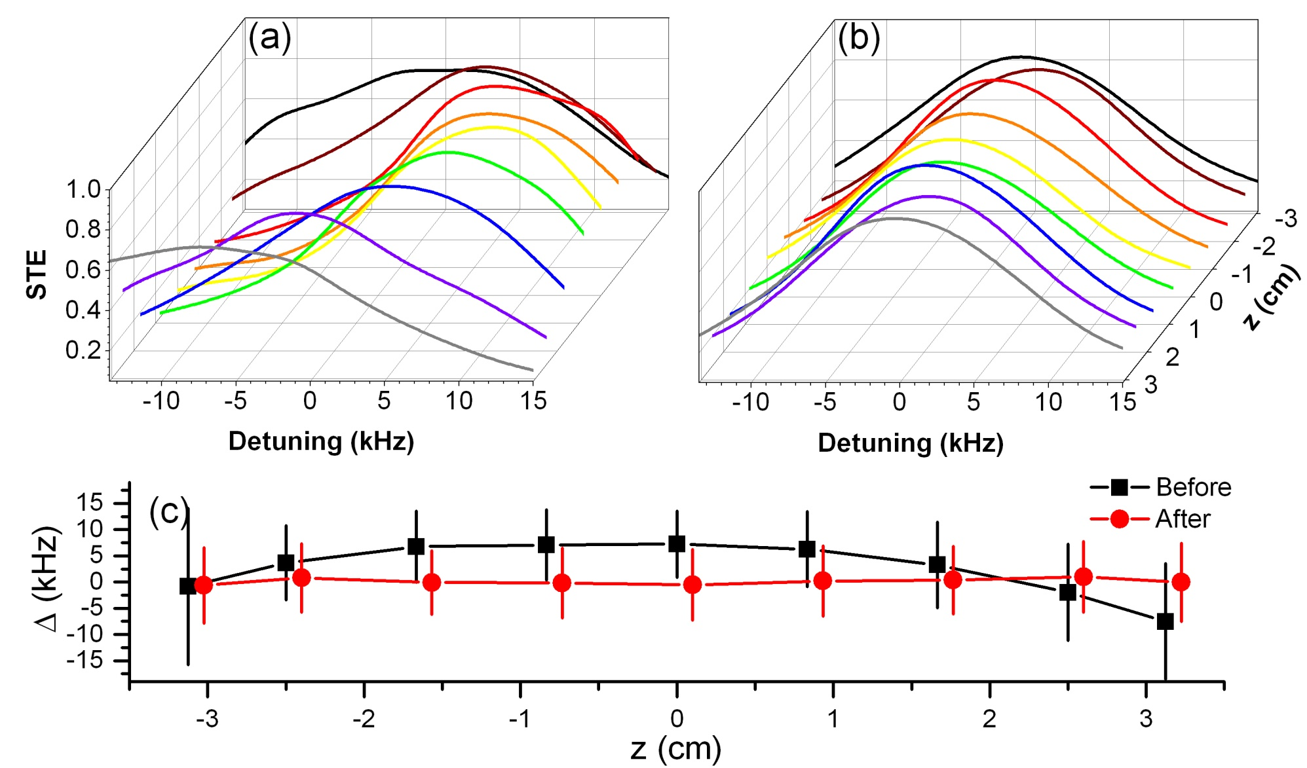
Fine B-field control: results with 52 shim coils
Initial measurement & shimming with 32x NMR probes
Final measurement & shimming using molecule signals
r.m.s. variation δB/B < 20 ppb [6 cm L. x 1 cm D. cylinder]

Slide 13
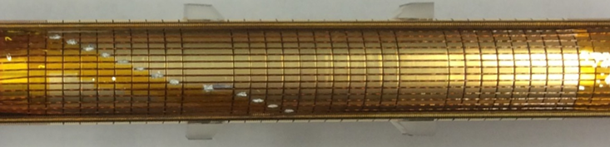
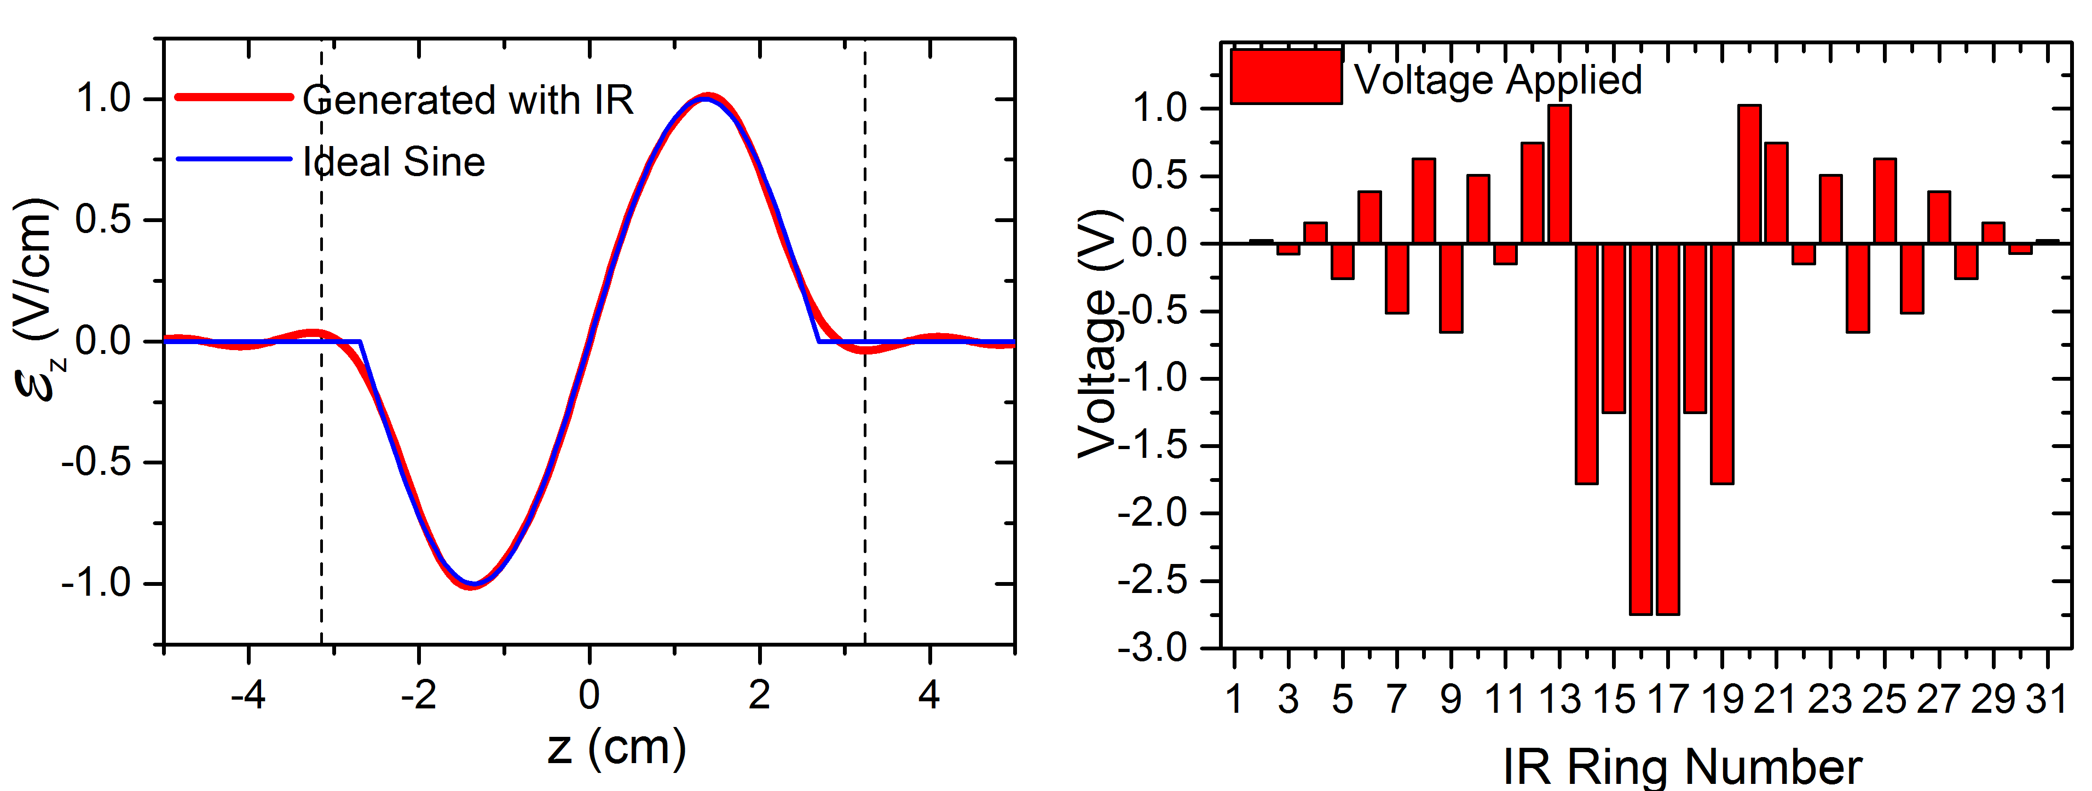
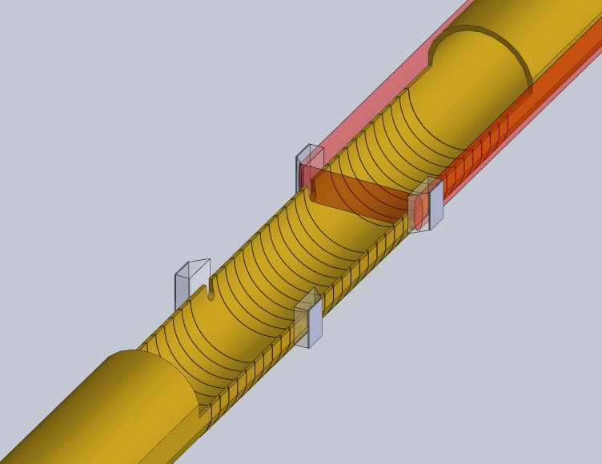
-field control
Ring electrodes create sine wave E-field along z-axis:
Prism
Solder
Wire
in channel
Tube
Rings
Prism
Ring
Rings
Prism
Ring
Rings
Tube
Molecular beam
Laser beam

Slide 14
Detecting PV in near-degenerate levels: Stark interference
PV mixing iW encodes physics of interest
|->
|+>
Apply oscillating E-field, 1 cycle:
“Large”
Stark Term
Even in
Small
PV Term
Odd in
D. DeMille, et al., Phys. Rev. Lett. 100, 023003 (2008)
S. B. Cahn, et al., Phys. Rev. Lett. 112, 163002 (2014)

Slide 15
Signal, Asymmetry, Sensitivity
Dispersion-like
function
of detuning Δ
Best sensitivity from large interaction time T

Slide 16
Properties of NSD-PV asymmetry: example ¹³⁷BaF
Typical numbers for ¹³⁷BaF:
Δ ₀ ~ 1/T ~ 2π × 1 kHz
ω = 2π × 100 kHz
dE₀ /ω = 0.1
W = 2π × 5 Hz
typical
~1-10% asymmetry
expected for ¹³⁷BaF

Slide 17
NSD-PV with BaF
Ba
Initial physics goal: NSD-PV with ¹³⁷BaF
Odd neutron (¹³³Cs had odd proton)
Heavy → large effect, anapole moment dominates
Large enough natural abundance – don’t need enriched source
Required lasers = simple, cheap diodes
F
Proof of principle using ¹³⁸Ba¹⁹F: recently completed
Larger natural abundance (~75% vs ~11% for ¹³⁷Ba)
Uses same beam source, lasers, magnet, etc. as ¹³⁷BaF
W(¹³⁸Ba) = 0 Hz (no unpaired nucleons = no NSD-PV)
W(¹⁹F) ≈ 0.002 Hz ≈ 0 (light, small electron spin density in BaF)
Test for systematics with known answer

Slide 18
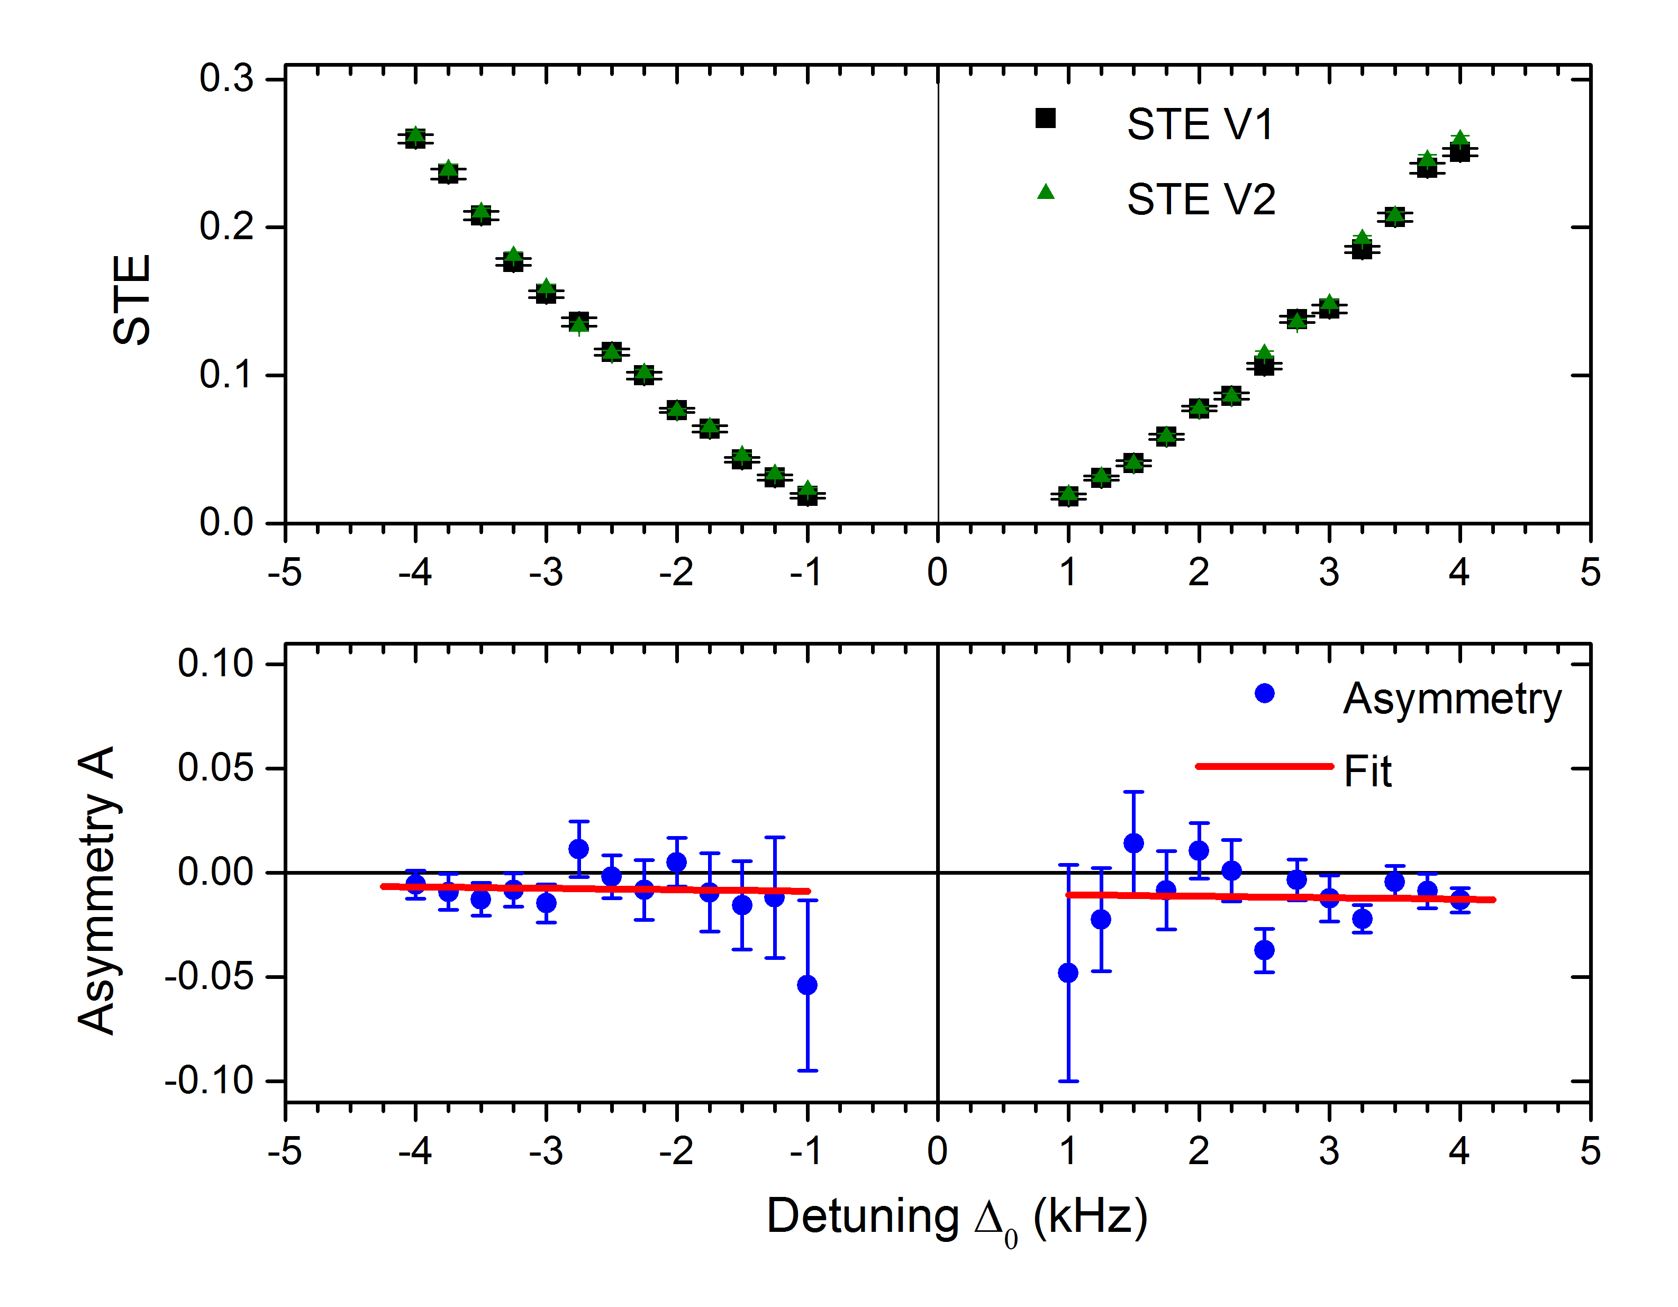
NSD-PV data with ¹³⁸Ba¹⁹F
Measure, cancel, & remeasure B-field gradients and non-reversing E-fields
to suppress possible systematics & quantify residual errors
Measure NSD-PV signal & asymmetry
Fit to function
(PV) + (systematics)

Slide 19
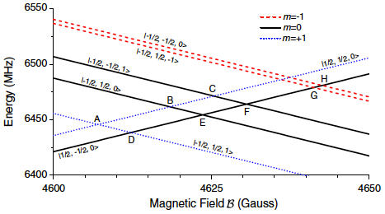
Different level crossings to suppress systematics
|m_{S}, m_{I}, m_{N} >
S: electron spin
I: nuclear spin
N: rotation
n: molecular axis
Measured quantity,
different for
each crossing
NSD-PV parameters:
same at all crossings
Angular factor:
Different for each crossing (sign & magnitude)
Analytically calculable
Molecular wavefunctions:
same at all crossings,
accurately computed

Slide 20
Systematic & total uncertainty evaluation
Strategy
  Deliberately exaggerate imperfection by known, large factor
  Measure effect on the NSD-PV matrix element W
  from coupling to ambient imperfections in the experiment
Final Error Budget with ¹³⁸Ba¹⁹F
  ~170 h data
  ~6x10⁷ molecules total

Slide 21
What does the ¹³⁸Ba¹⁹F result mean?
  ⇒ Limit on ¹⁹F anapole + C_{2P} :
  Proves we have no unknown systematics
  Systematics limited by statistical power (so far)
…but no substantive information about HPV
So What?
See: Nguyen et al., PRA 56: 3453-3463, (1997)

Slide 22
What does the ¹³⁸Ba¹⁹F result mean?
  Same experimental uncertainty in ¹³⁷BaF would mean
~10% of predicted value
Compares favorably to JILA ¹³³Cs result:
C.S. Wood et al., Science 275, 1759 (1997)
Unprecedented sensitivity to NSD-PV
General technique enables measurements in broad range of nuclei
E. Altuntas, J. Ammon, SBC, and D. DeMille, Phys. Rev. Lett. 120, 142501 (2018)
E. Altuntas, J. Ammon, SBC, and D. DeMille, Phys. Rev. A 97, 042101 (2018)
See: Nguyen et al., PRA 56: 3453-3463, (1997)

Slide 23
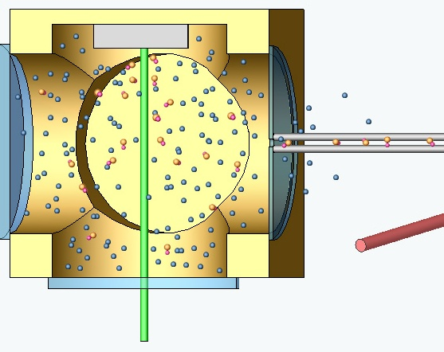
Near Future: cryogenic Buffer Gas-cooled Beam
[Maxwell et al. PRL 2005; Patterson & Doyle J Chem Phys 2007;
Barry et al. PCCP 2011; Hutzler et al. PCCP 2011]
Liquid helium bath
or pulse-tube refrigerator
Inject hot molecules (e.g. via laser ablation)
Cool w/cryogenic buffer gas @ high density
Efficient extraction to beam
via “wind” in cell: 10⁻⁴ → 10%-40%
“Self-collimated” by extraction dynamics
Rotational cooling in expansion: T ~ 4 K
Moderately slow: v ~ 200 m/s
~10³× beam brightness; ~3× larger interaction time;
enables magnetic focusing ⇒ ~20× flux
Gain in NSD-PV statistical sensitivity: ~400×

Slide 24
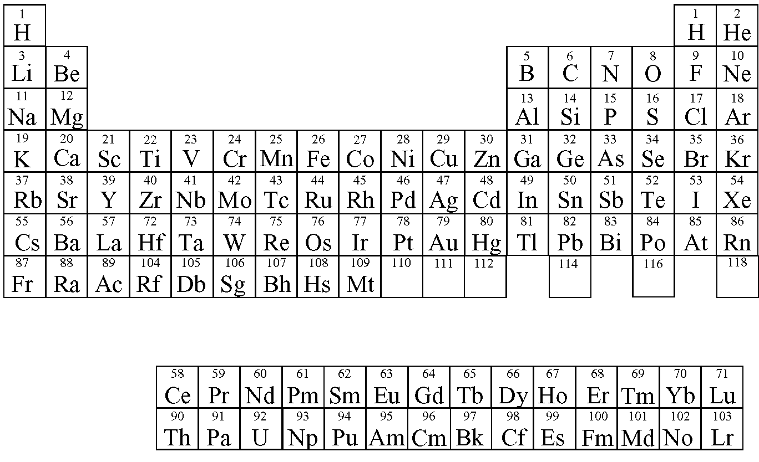
Viable nuclei for anapole/NSD-PV measurement
10% measurement possible with demonstrated sensitivity, 1 h data
Requires systematics ~2-10x better (likely OK)
Statistics likely OK, requires systematics ~100x better

Slide 25
ZOMBIES NSD-PV: Outlook & questions
  New lab under renovation, occupancy this summer
  with cryogenic beam source
  Realistic goal: ~2 years to ¹³⁷Ba measurement
Question for theorists: what to do next with this method?
--lightest nuclei (accurate calculations via no-core shell model)…?
  --could C₂ values be extracted reliably from light nuclei
  with existing HPV data & understanding?
  --quantitative uncertainties on shell model calculations!
¹³⁵BaF,⁸⁹YO ?,⁸⁷SrF ?,⁹BeI ? Xe¹⁹F? ³⁹KSr, ³⁹KCa, ⁶LiSr, ⁷LiSr
Notes:
XeF19 a quarter million for lasers
Ba135F
9BeI lasers straightforward. Spectroscopy work
39KSr, 39KCa some spectroscopy, laser ablation
YO 100K lasers
SrF big nuclear spin, but already used extensively in the lab
Ba135F -> YO (odd proton)

Slide 26
Extra slides

Slide 27
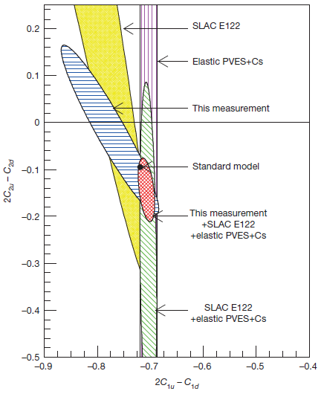
Physics Motivation: neutral weak currents & QCD
Z⁰ Exchange
Vector electron – axial nucleon
weak coupling constants (C_{2N}, C_{2P})
Related to fundamental electron-quark
couplings (C_{2u}, C_{2d}) via QCD
Complementary to PVDIS e-P
measurements at JLAB
(different linear combinations of C₂’s
& nucleons vs. quarks)
Nuclear anapole moments
Nucleon – nucleon PV couplings
(still poorly known…)
“Anapole Moment Table”
-unique signatures for each nuclear species
JLAB PVDIS Collab.
Nature 506, 67 (2014)

Slide 28
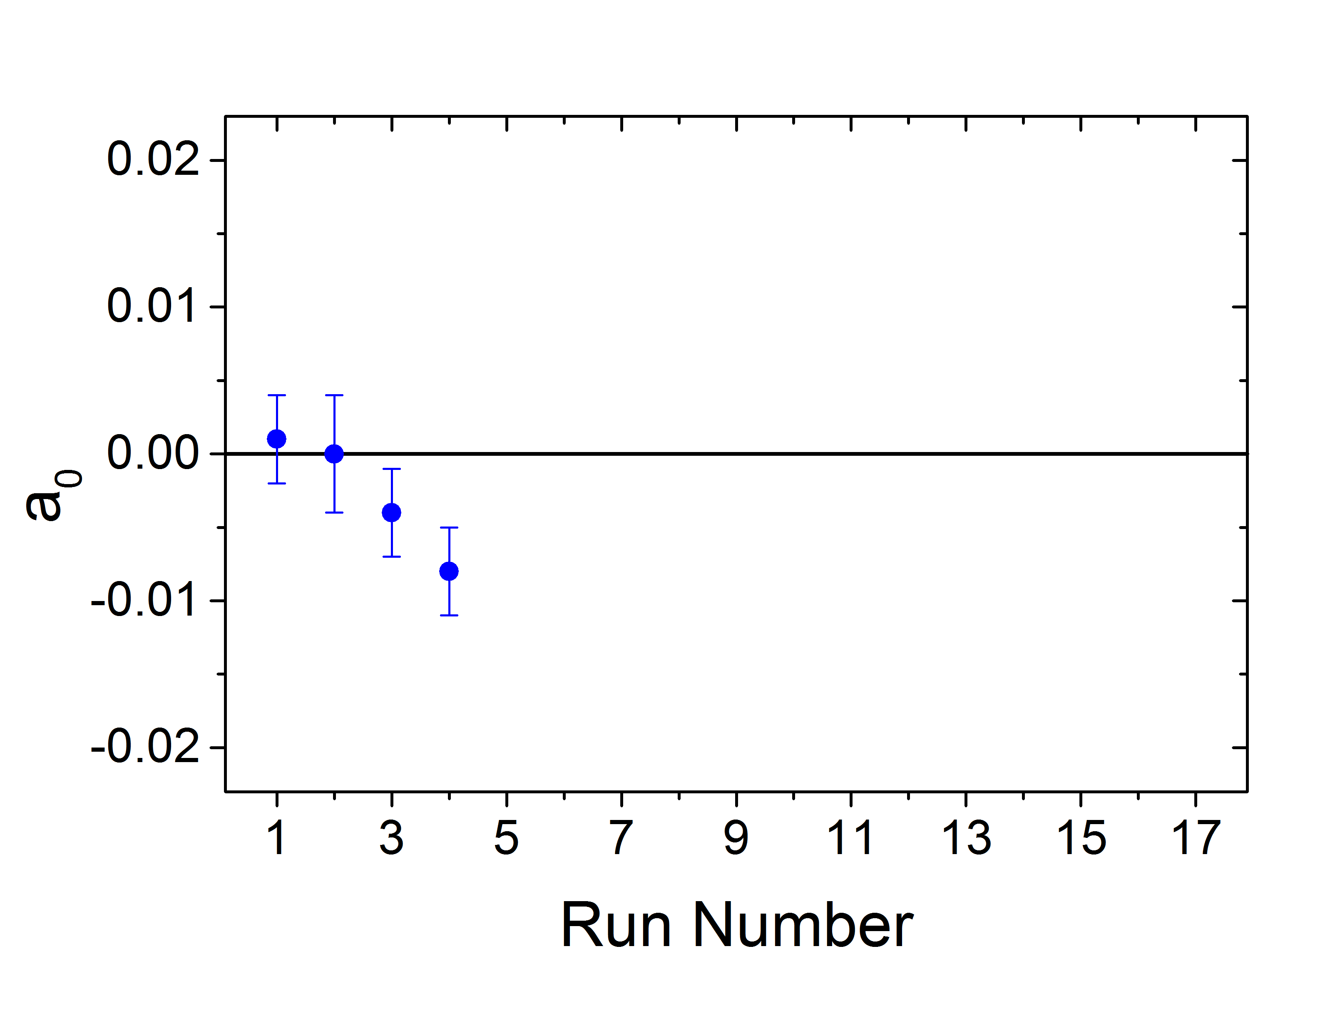
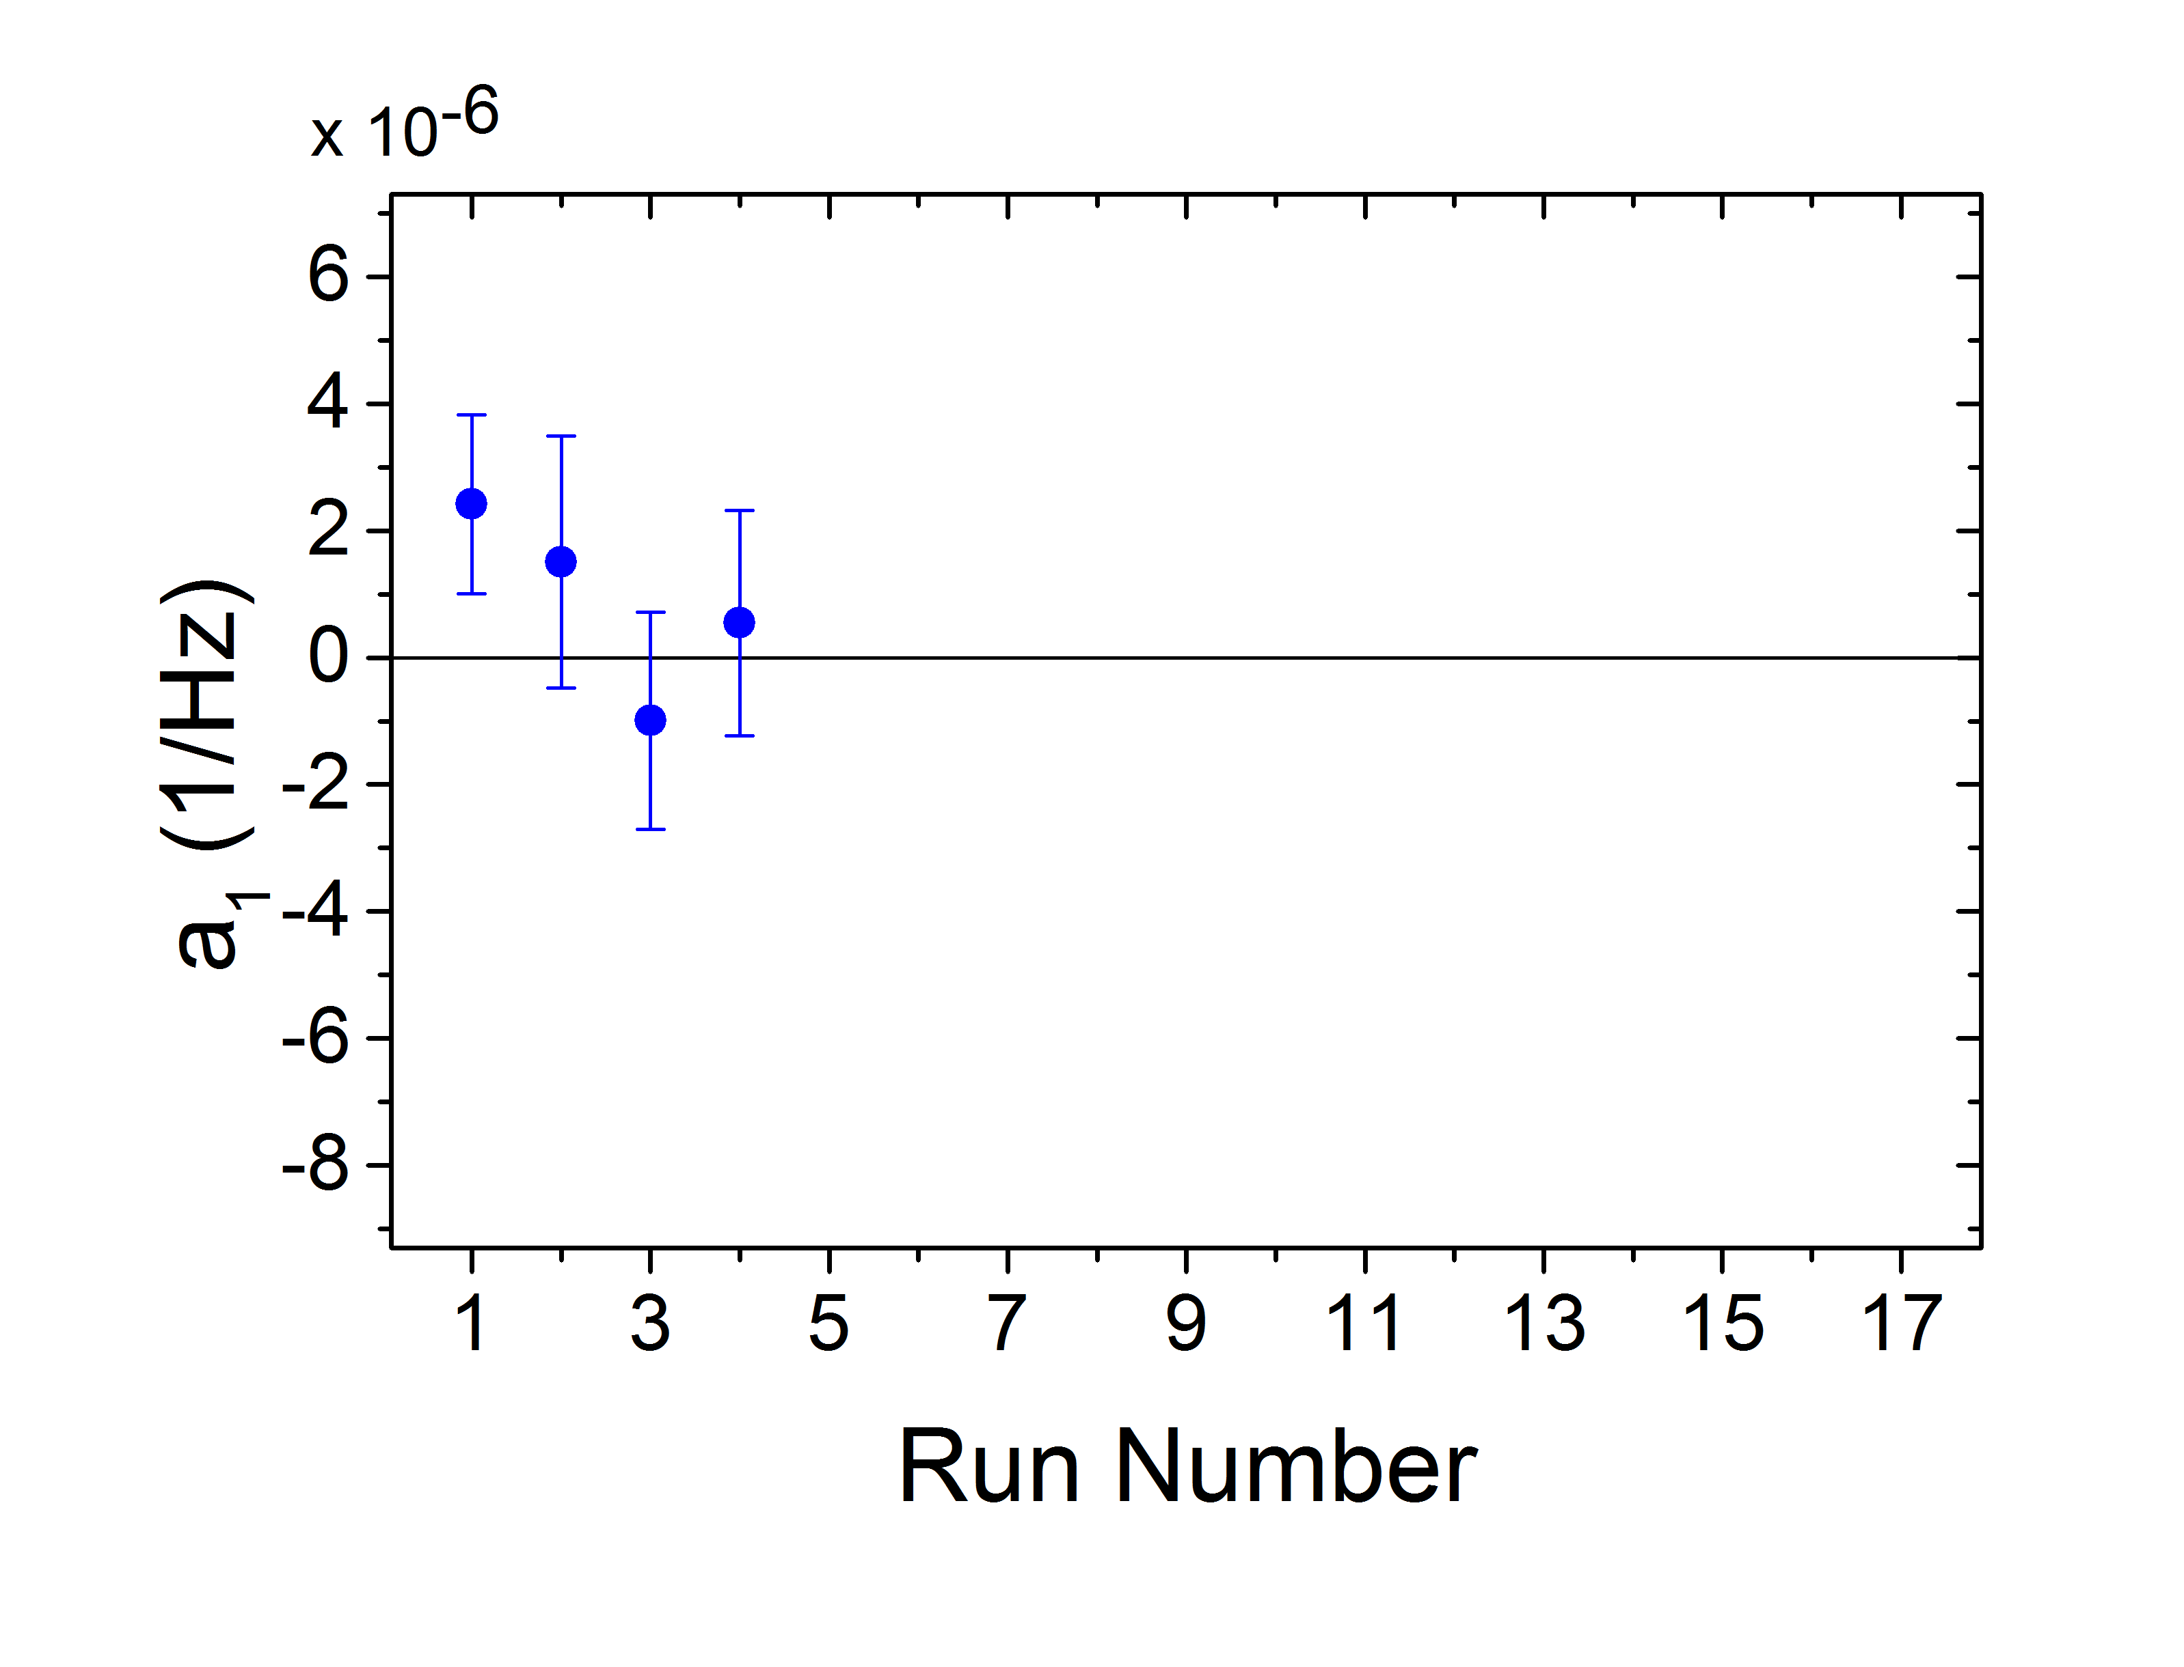
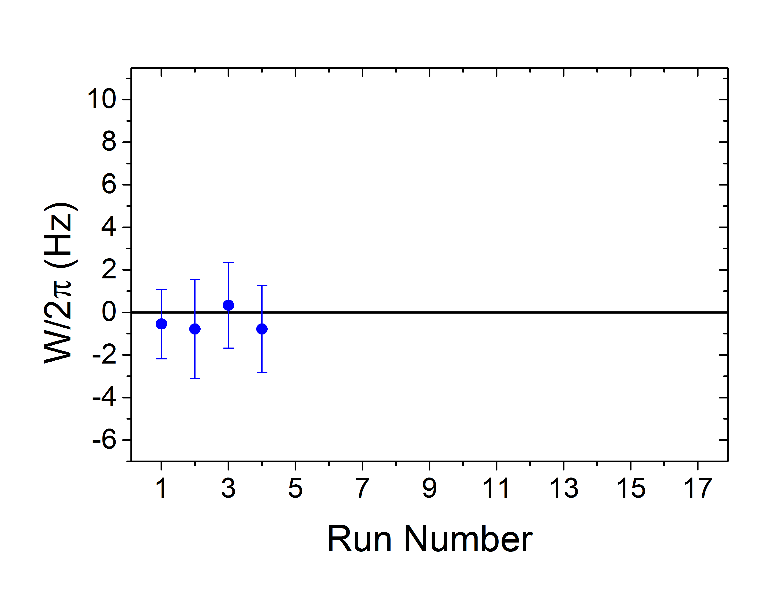
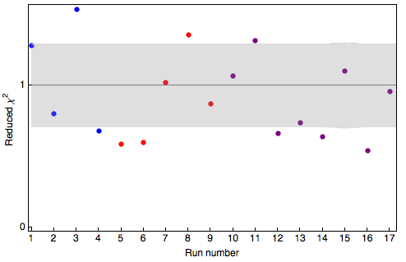
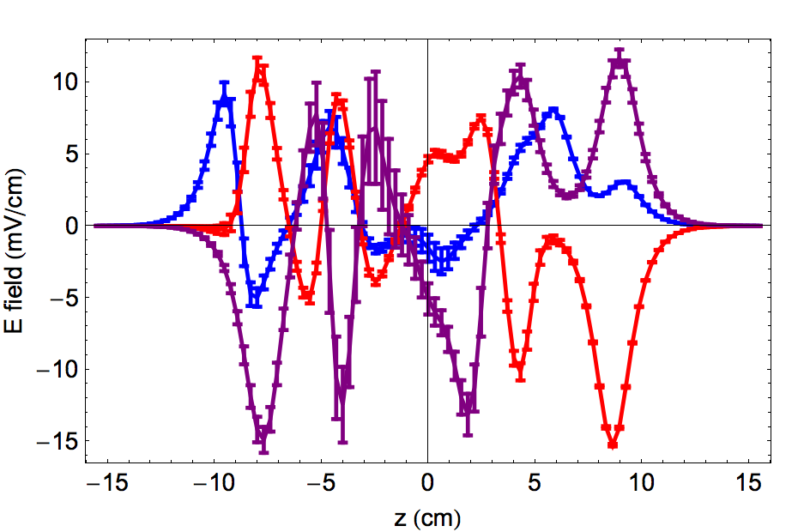
NSD-PV data with ¹³⁸Ba¹⁹F
Fit to
From stray E-fields alone
From stray E-fields + B-gradients
NSD-PV
¹³⁸BaF expected W = 0
Measured with 3 different stray E-fields
(all below 15 mV/cm)
a₁ terms consistent with zero: no systematics

Slide 29
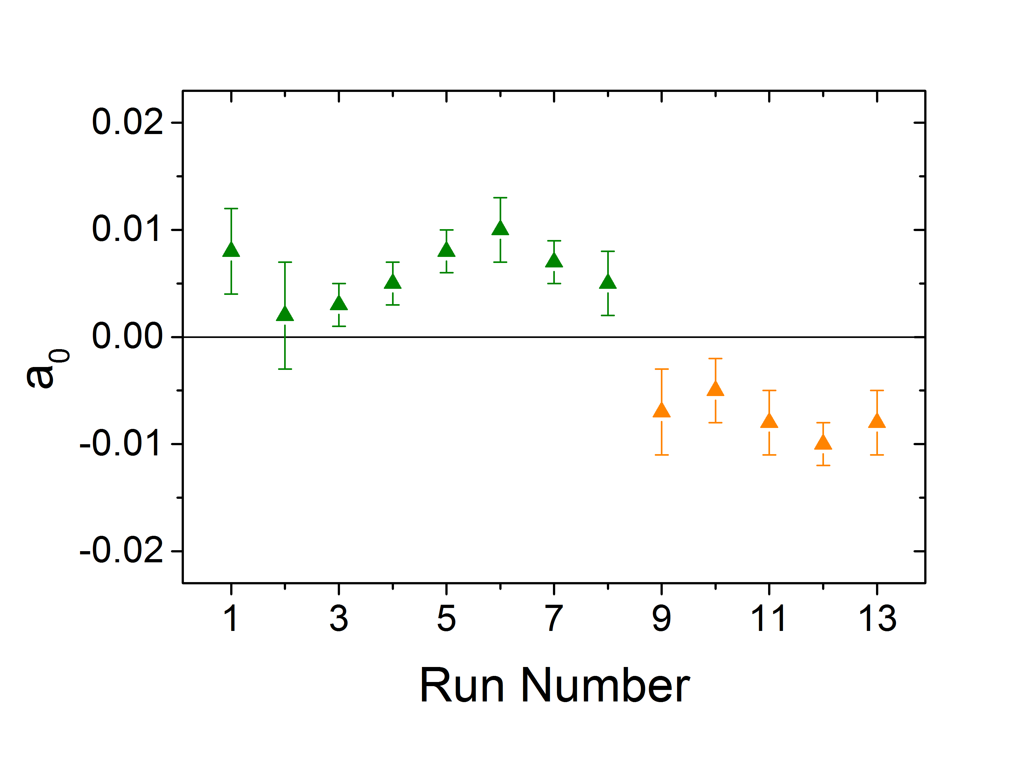
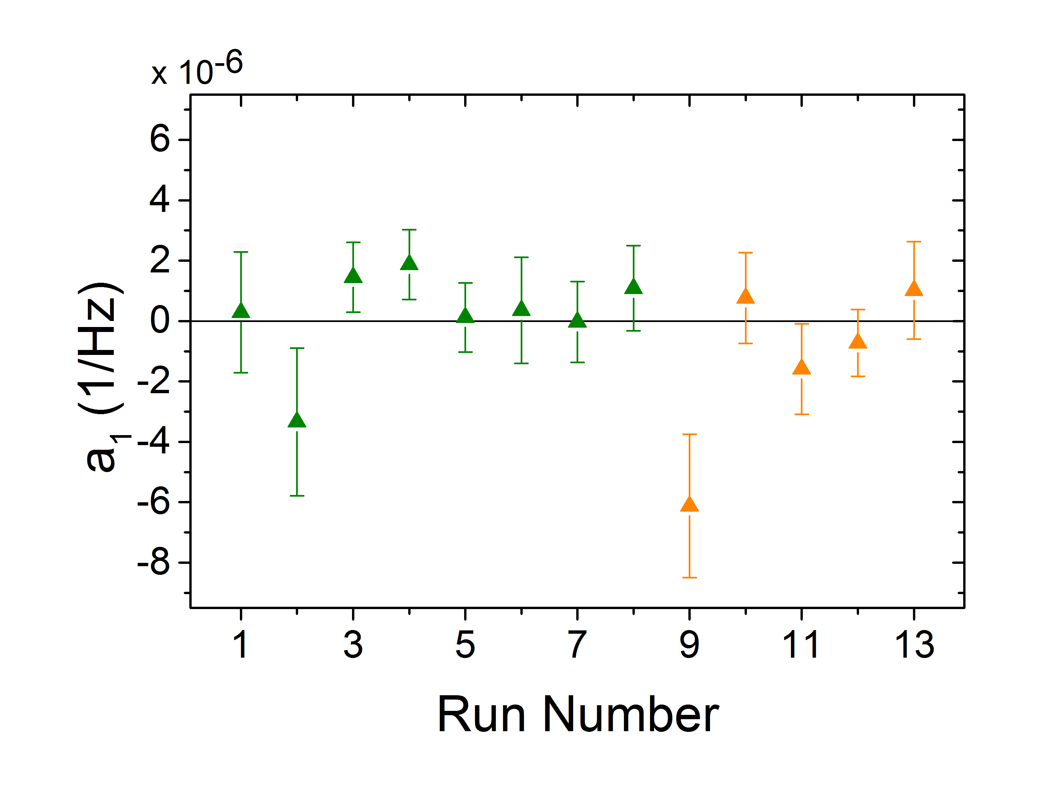
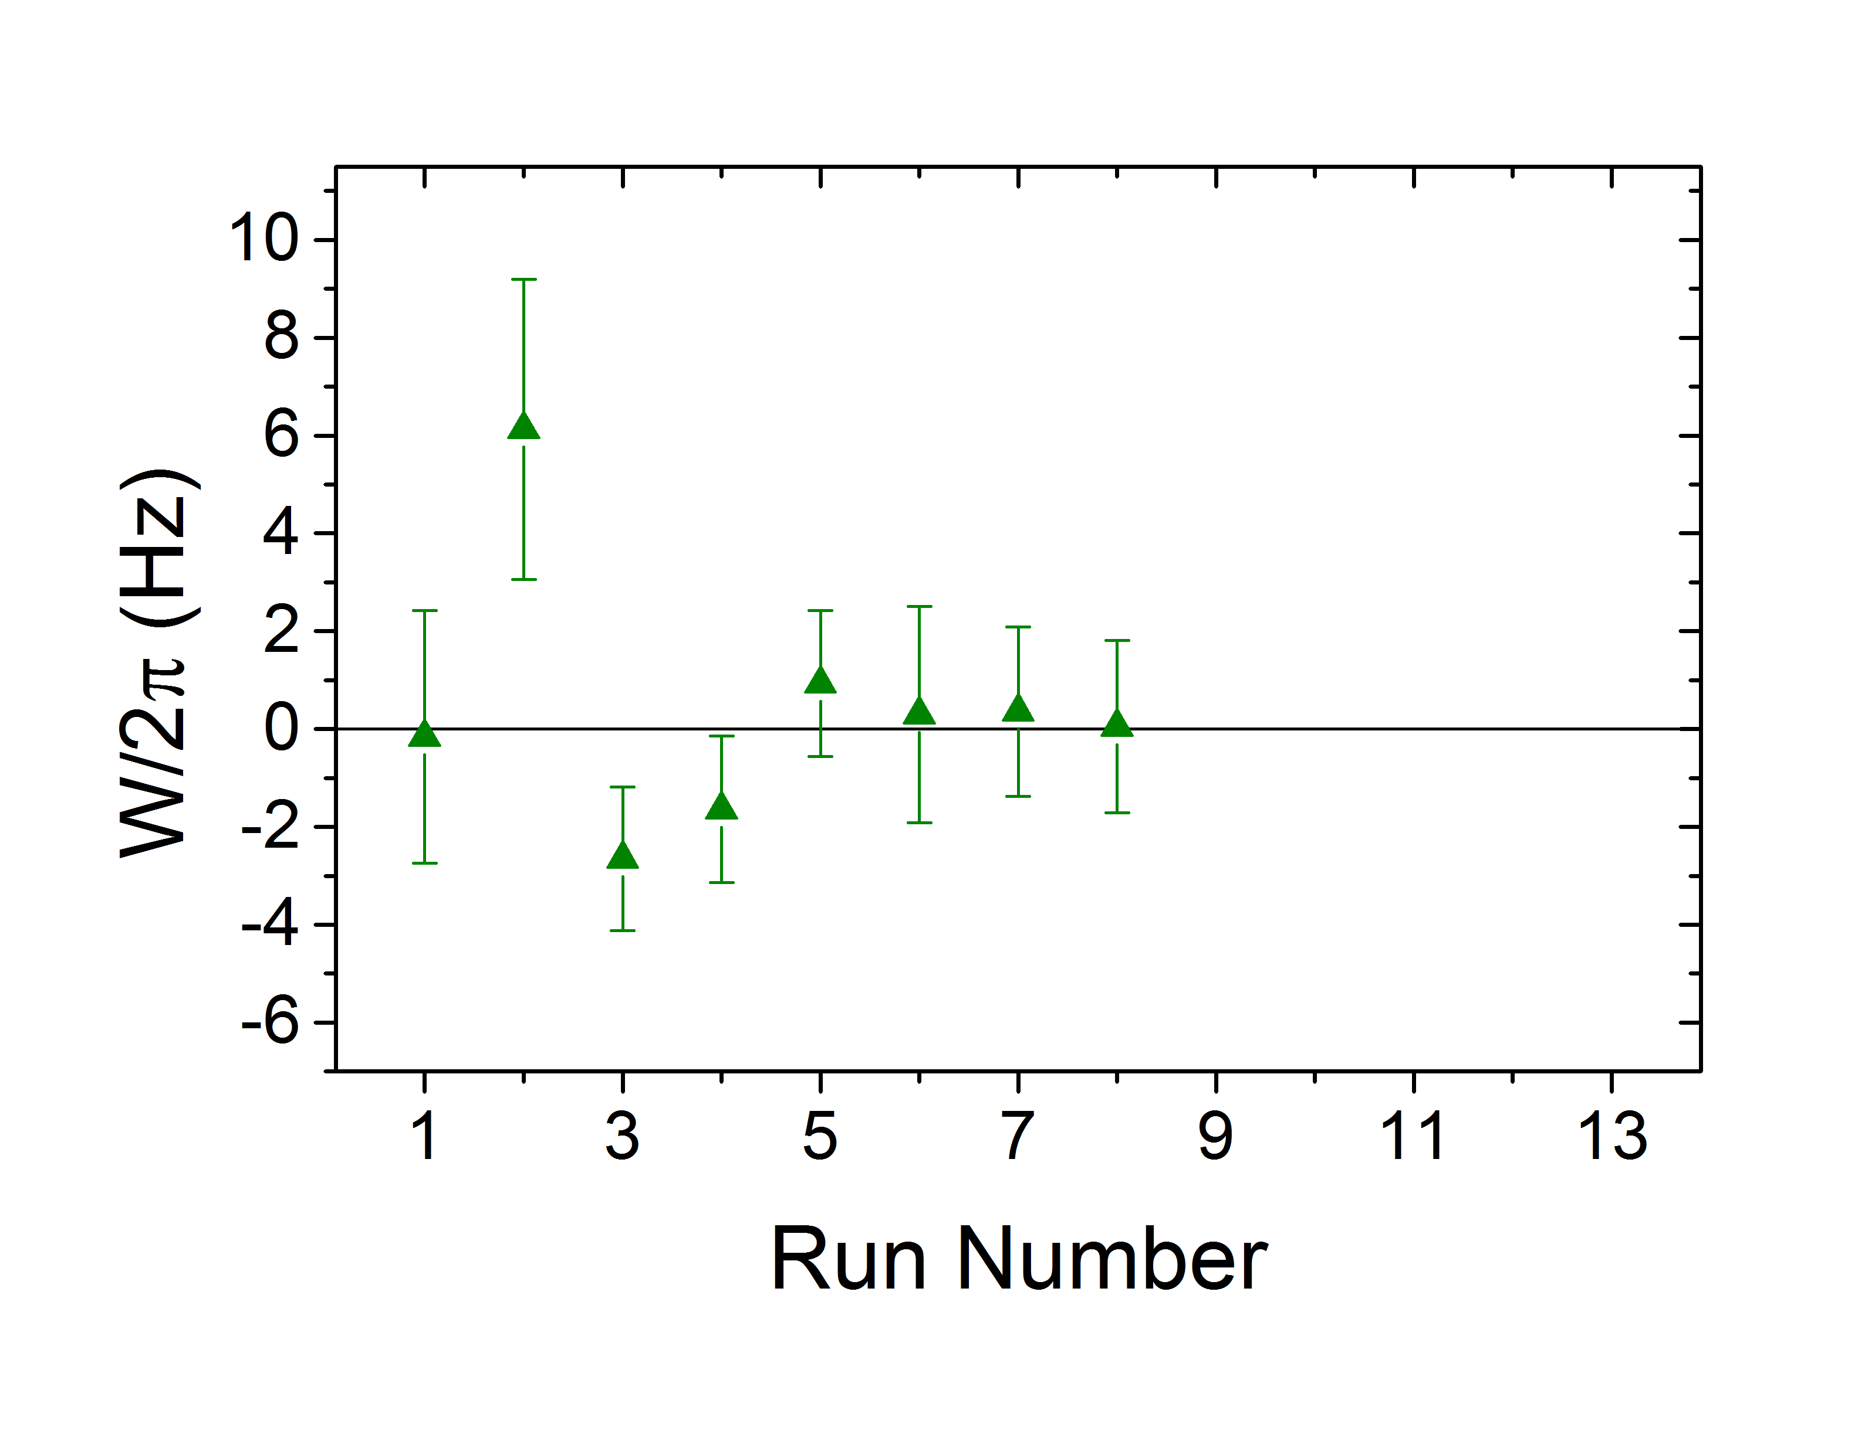
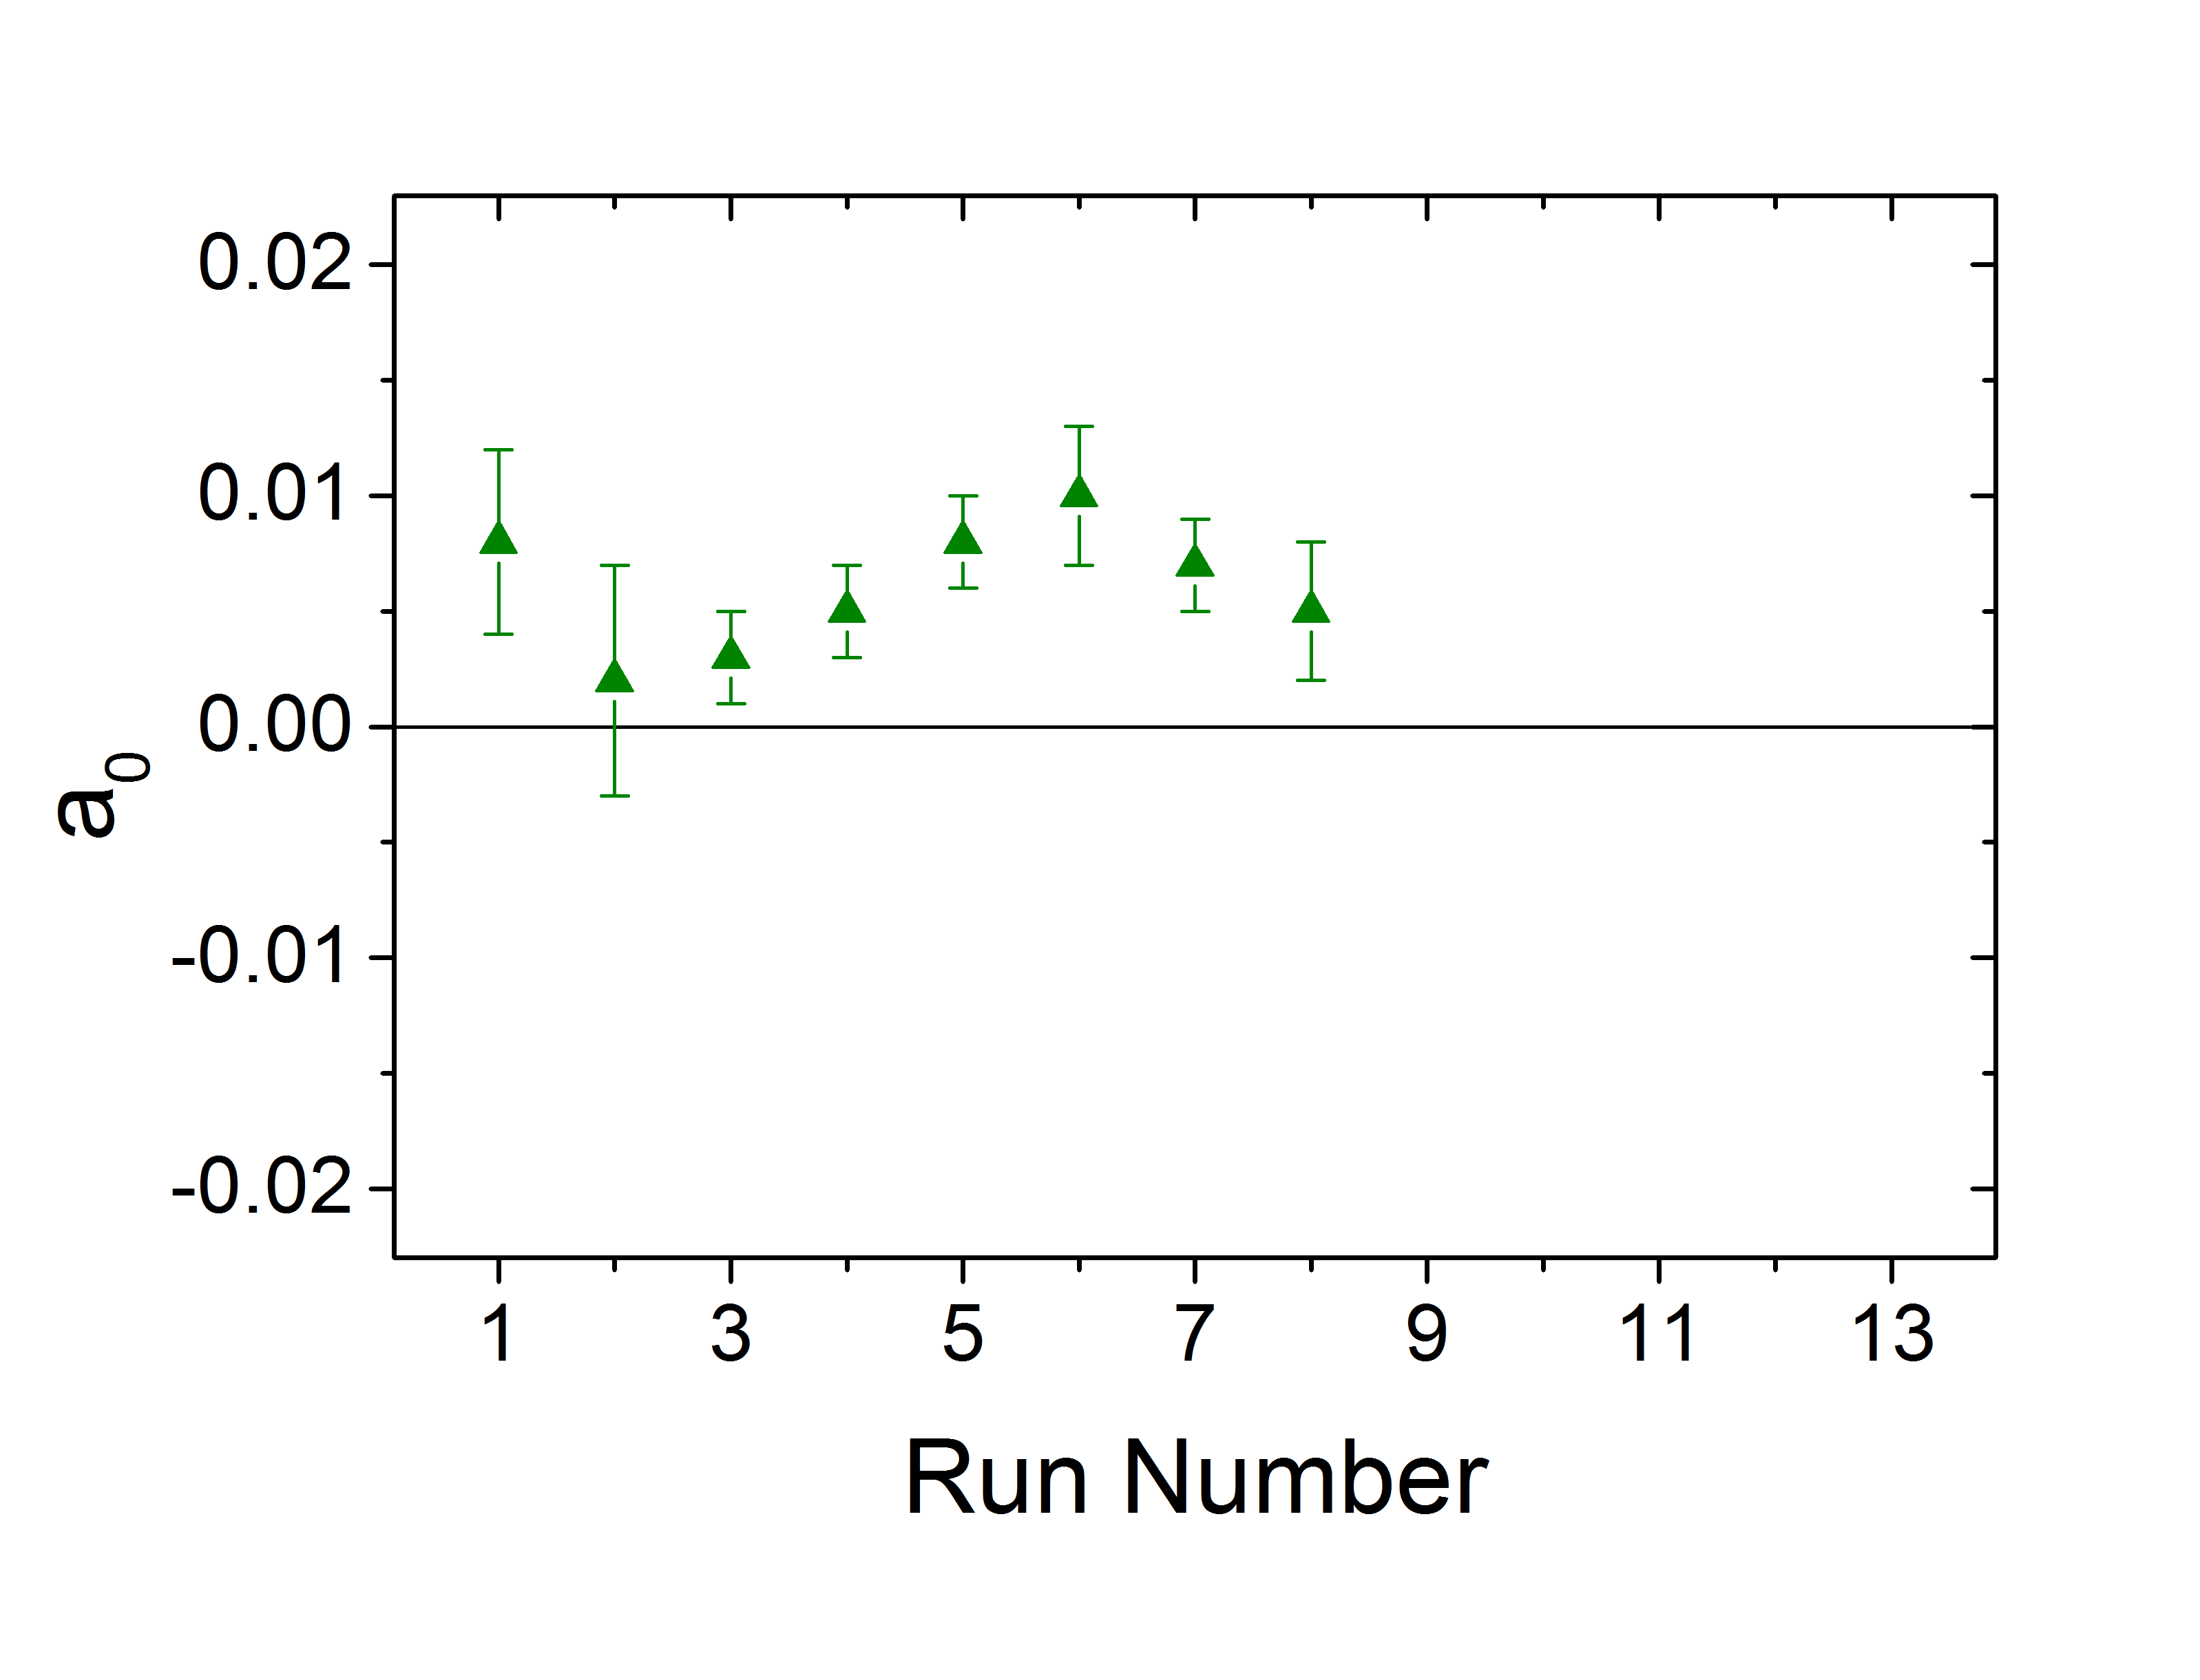
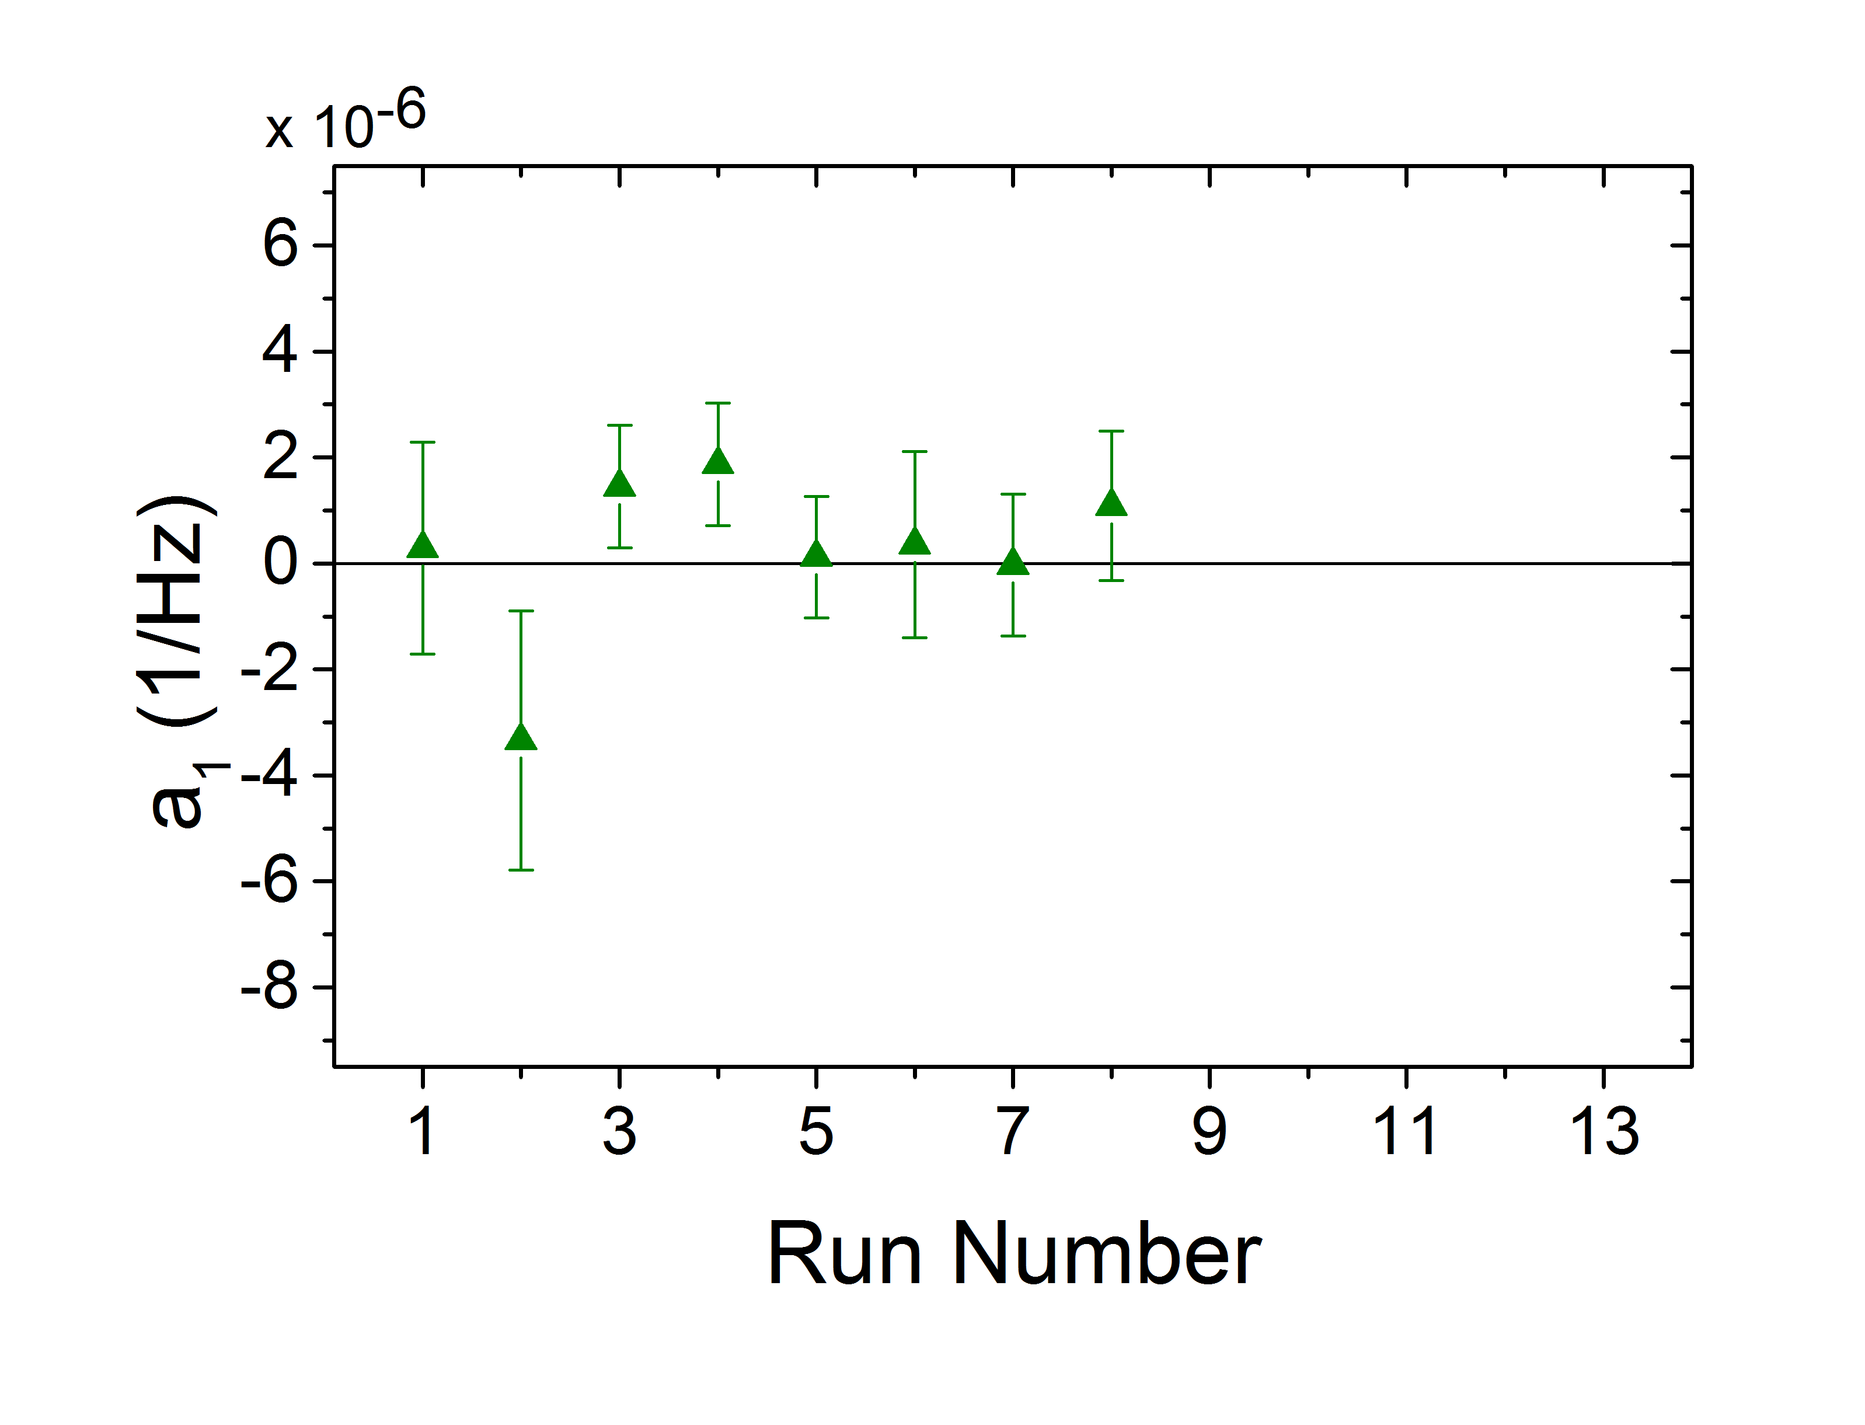
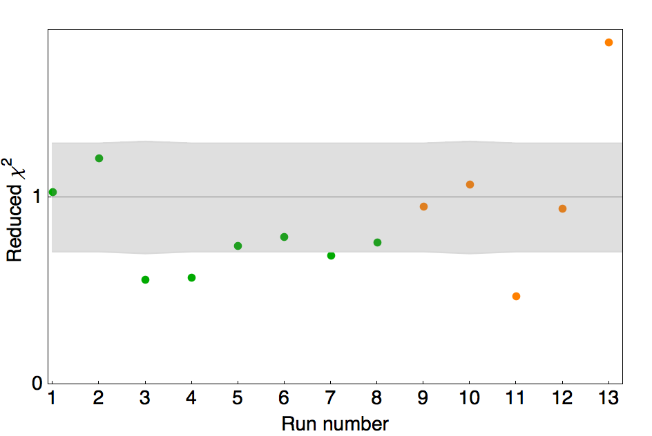
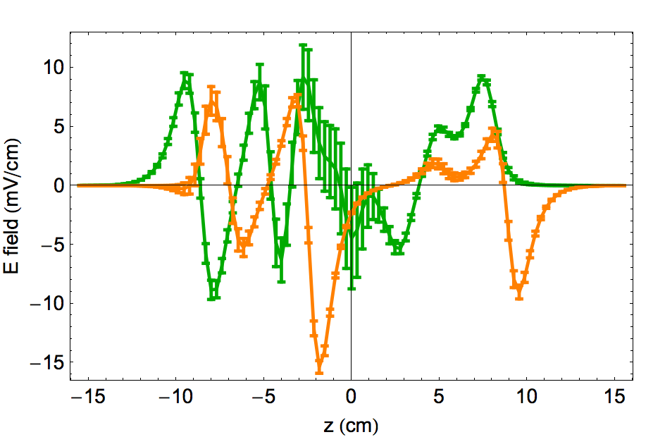
NSD-PV data with ¹³⁸Ba¹⁹F: 2nd crossing W→-W
¹³⁸BaF expected W = 0
Measured with 2 different stray E-fields (all below 15mV/cm)
No systematics → a₁ terms consistent with zero

Slide 30
Determination of k_{Z} a.k.a. V_{e}A_{n} a.k.a. C_{2P,N} (…?)
Measurements with a few heavy nuclei should determine
intranuclear PNC couplings to ~30% (nuclear structure unc.)
Additional measurements could be interpreted as measurements of κ_{Z} with uncertainty
δκ_{Z}/κ_{Z} ~ 0.2 × (κ_{a}/κ_{Z}) ∝ A^{2/3}
Goal: ~20% measurement of NSD-PNC in nuclei with κ_{a}  κ_{Z}
i.e. Sr (Z=38, A=87)
Requires technique with greatly improved sensitivity!

Slide 31
Determination of C₂’s (…?)
PV-DIS (JLAB)
(2014)
Bates
SAMPLE
e-p vs. e-D
elastic
scattering
2000+2003
anticipated
light
odd-n
isotope
(⁸⁷Sr)
(proj.)
Current allowed region
Standard Model prediction
SLAC e-D deep-
inelastic scattering (‘79)

Slide 32
Using molecules to get at NSD-PV
Diatomic molecules systematically have close rotation+hyperfine levels of opposite parity--B-field tuning can give ΔE ~ 10⁻¹¹ eV! [Kozlov, Labzowsky, & Mitruschenkov, JETP 73, 415 (1991)]
Ground state levels have long lifetimes, excellent energy resolution ⇒high sensitivity to PV energy shifts (from AC Stark) [Fortson]
Can use proven technique for nearly-degenerate levels (atomic Dy) [Nguyen, Budker, DeMille, & Zolotorev PRA 56, 3453 (1997)]
Versatile, well-characterized beam source for all desired species [widely used; charaterized by Tarbutt et al., {Hinds}, J. Phys. B 35, 5013 (2002).]
Wide range of molecular species with required spectroscopic data already known [Hertzberg, etc.]
Estimated sensitivity sufficient for desired low-Z nuclei (odd p and odd n), plus wide range of heavier nuclei
Simple molecules (1 valence e⁻, ²Σ_{1/2} state) amenable to interpretation (via calculated valence electron wavefunctions) at ~20% level [Kozlov & Labzowsky, J. Phys B 28, 1933 (1995)]

Slide 33
Z
O
M
B
I
E
S
The ZOMBIES NSD-PV experiment at Yale
eeman-tuned
ptically prepared and detected
olecular
eams for the
nvestigation of
lectroweak effects using
tark interference

