Slide 1
Overview of 1K TEM Project
Lucas Brouwer, Tengming Shen, Ryan Norris, Aurelio Hafalia, Ross Schlueter, Li Wang, Jim Ciston, Peter Ercius, Qing Ji, Marian Mankos, Colin Ophus, Alexander Stibor, Andreas Schmid, Andrew Minor, and Peter Denes
Cross area project: mix of ATAP, Engineering, Molecular Foundry (Energy Sciences and Physical Sciences)
+ Industry (ElectronOptica)

Slide 2
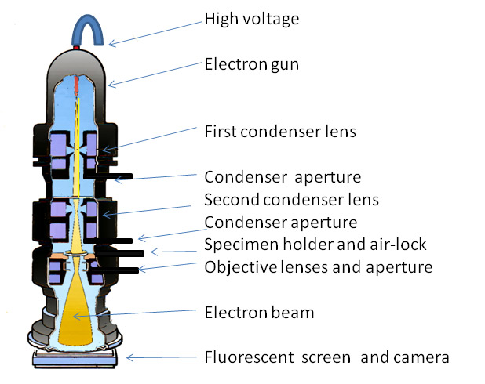
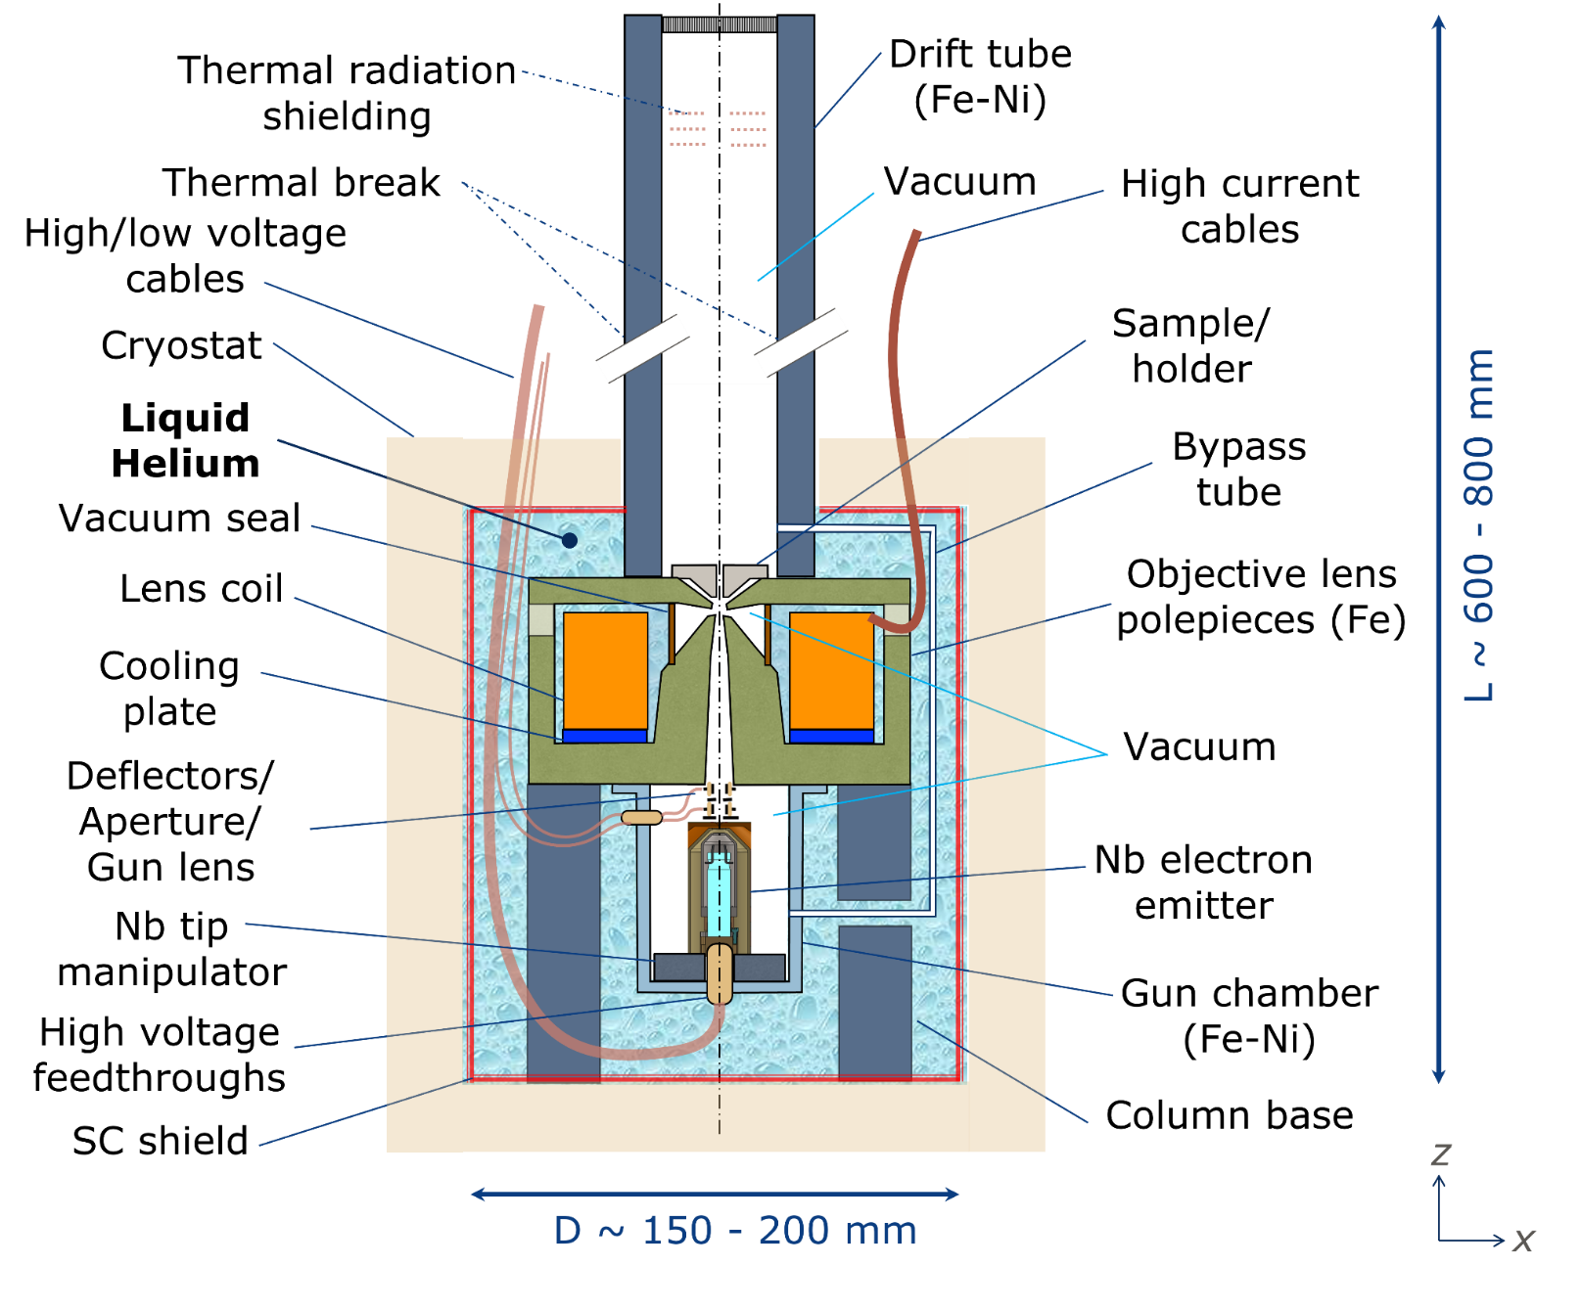
Demonstrator for 1K TEM
https://www.wikipedia.org/

Slide 3
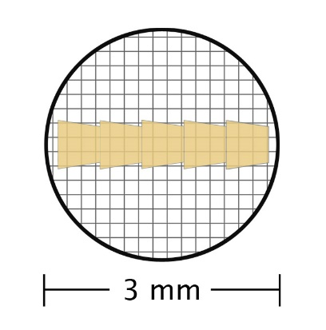
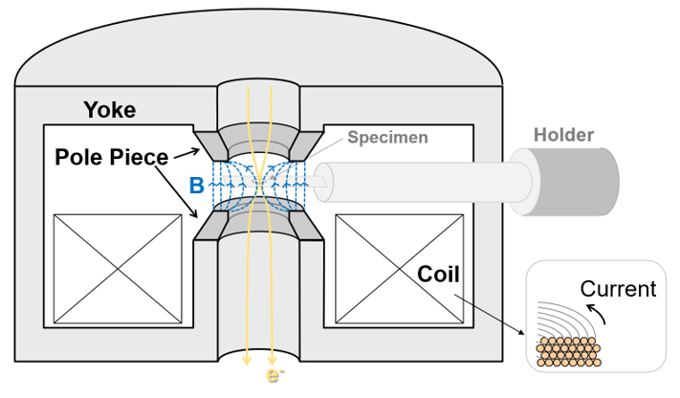
Thin sample disk
Objective Lens
iron dominated (~1.5 T)
precise pole piece shape determines field
https://www.wikipedia.org/
****Pass around example pole pieces

Slide 4
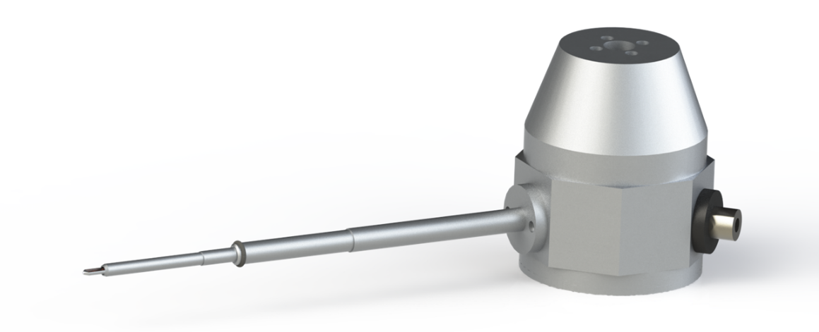
Why do we want to make an all cold microscope?
stability is a key challenge for modern microscopes, amplified by recent advances in aberration correction and the desire for experiments with cryogenically cooled samples
Cryogenic sample holder to place cold sample into a warm microscope
issue | solution explored by 1K-TEM project at LBNL
mechanical drift | cool entire microscope to LHe temp
mag. field drift | ultra-stable, persistent current SC magnets
 | superconducting magnetic shielding
http://www.science.uwaterloo.ca/~gsciaini/research.html

Slide 5
https://link.springer.com/article/10.1557/mrs.2019.288

Slide 6
1K TEM project history
LDRD (1-2 years)
  design study (focused on SC magnet / electron source)
Initial Basic Energy Sciences (BES) funding (~3 years)
  demonstrate SC lens and electron source technology
  build and operate SC lens in persistent current mode and characterize stability
  measuring stability of field with probes
New BES funding (3 years starting now)
  combine electron source, SC lens, and detector into mini-microscope
  measuring stability of beam with detector

Slide 7
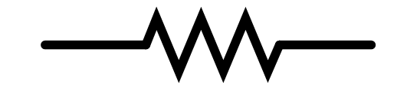
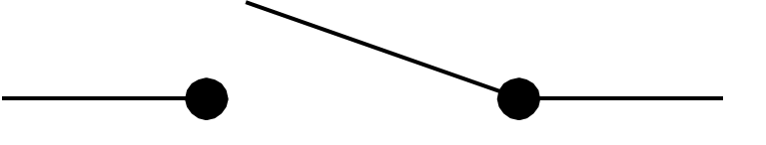
Persistent current mode with a superconducting switch (common for MRI)
Charging Mode
Persistent Mode
-
+
-
+
SC joint
SC joint (~pico-Ohm)
Rpcs ~1-2 Ohm
Rpcs ~0
SC lens
SC lens
Cold
Cold

Slide 8
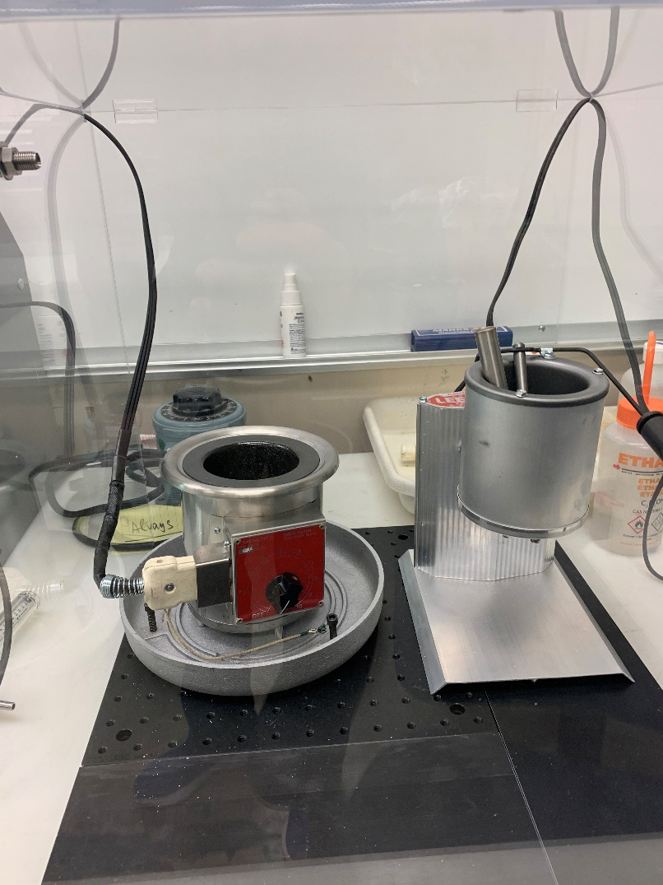
SC joints – typically 10⁻¹² Ohm for Nb-Ti

Slide 9
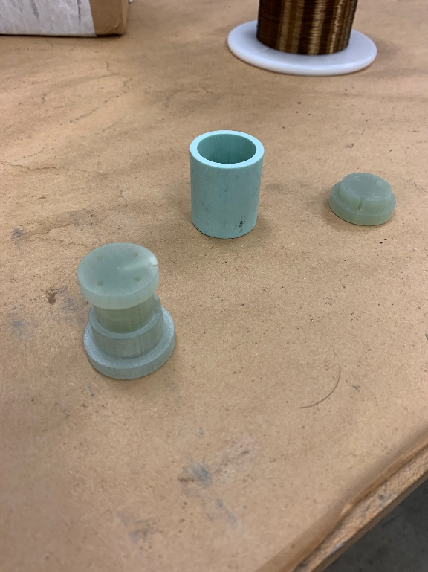
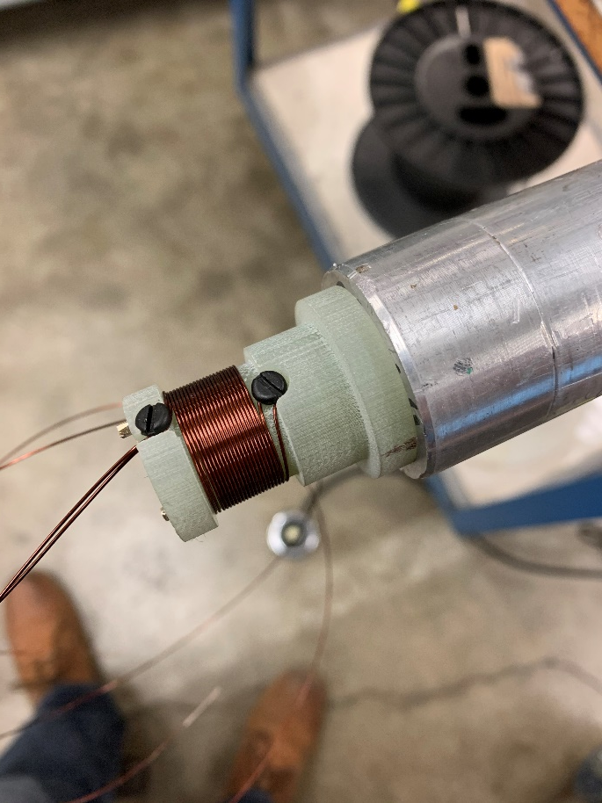
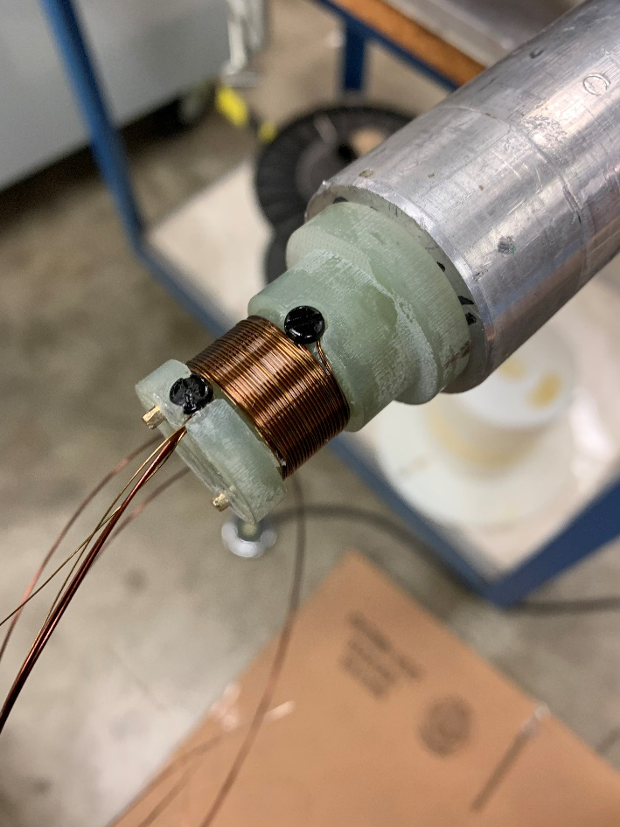
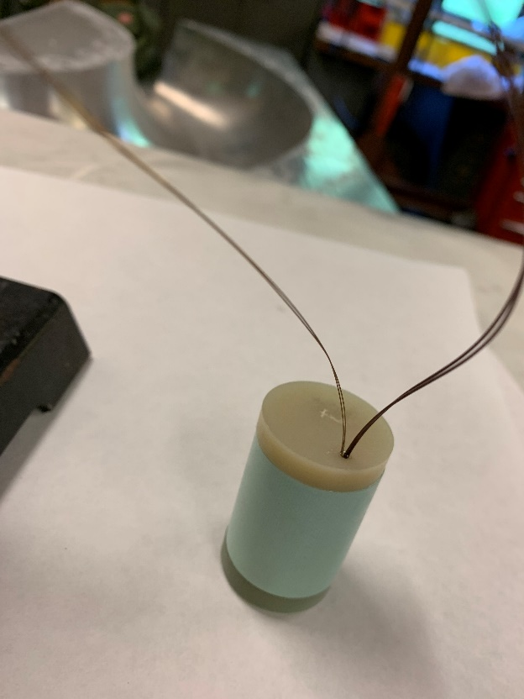
Nb-Ti persistent current switch
Bobbin / caps
Nb-Ti (Ni-Cu matrix)
Cowound heater wire
Final switch

Slide 10
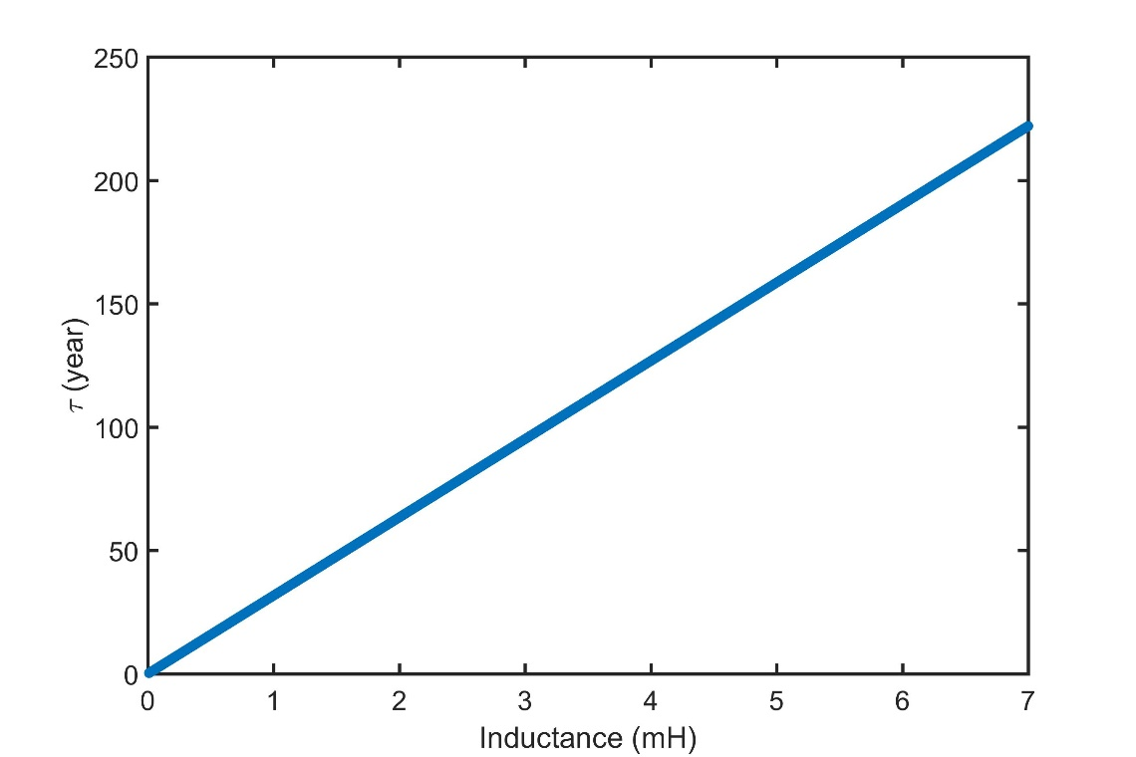
L/R time constant vs. inductance (assume 1 pΩ resistance)
Persistent: PCS heater off
Rpcs ~0
joint resistance (nΩ -pΩ)
SC lens
index loss

Slide 11
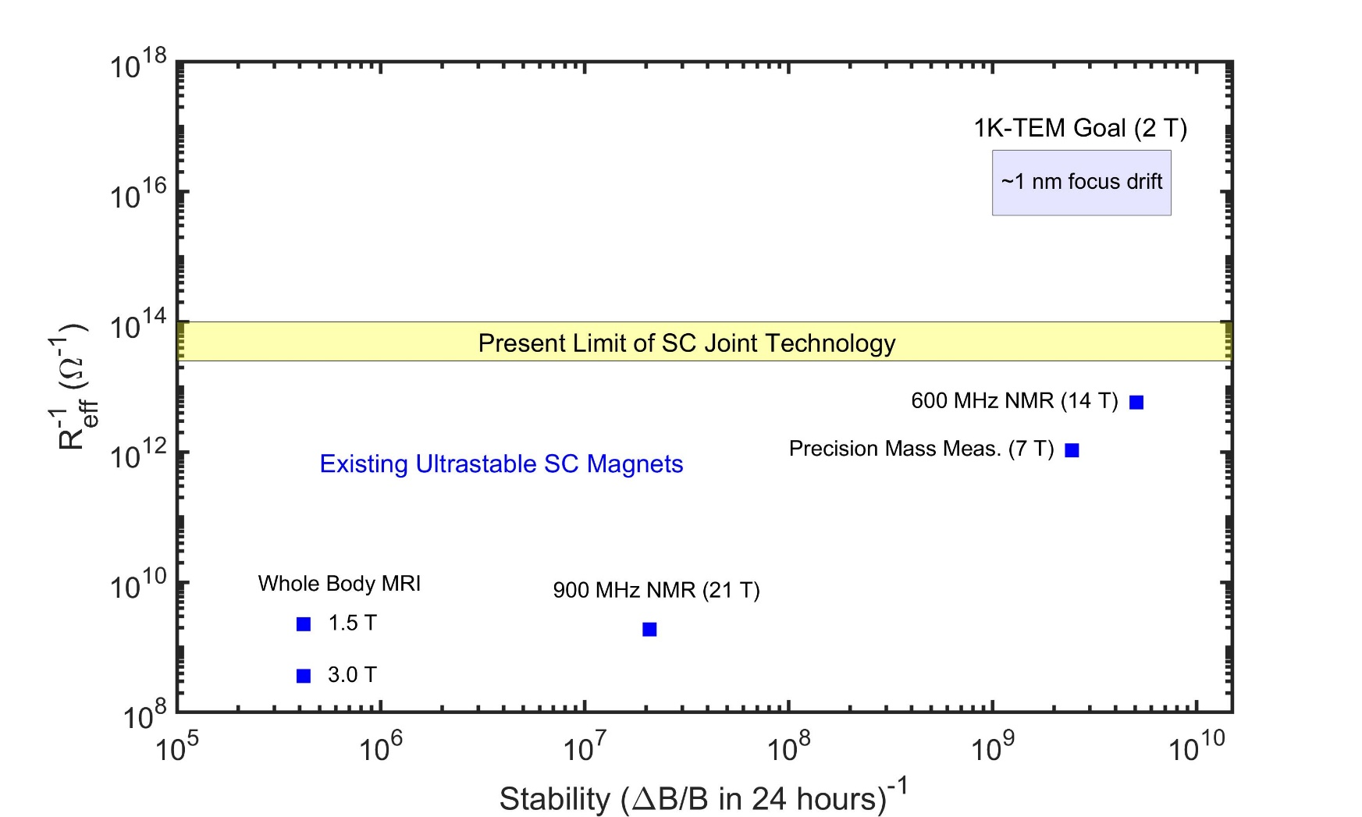
We can’t achieve the stability we want need with only persistent current operation, we need active stabilization too

Slide 12
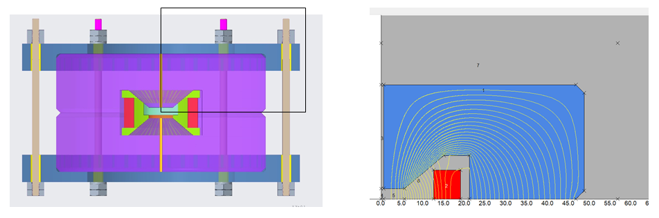
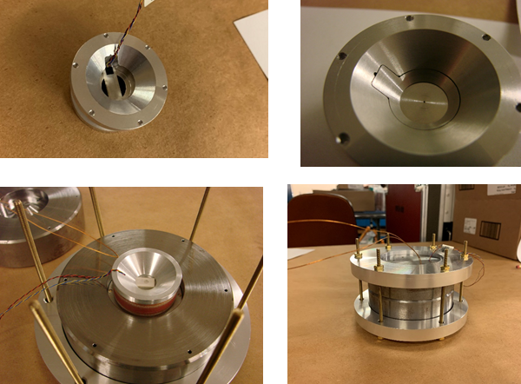
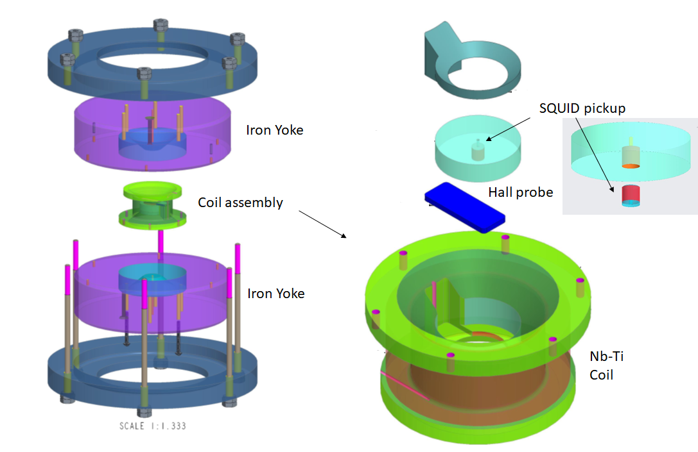
1.95 T, prototype Lens

Slide 13
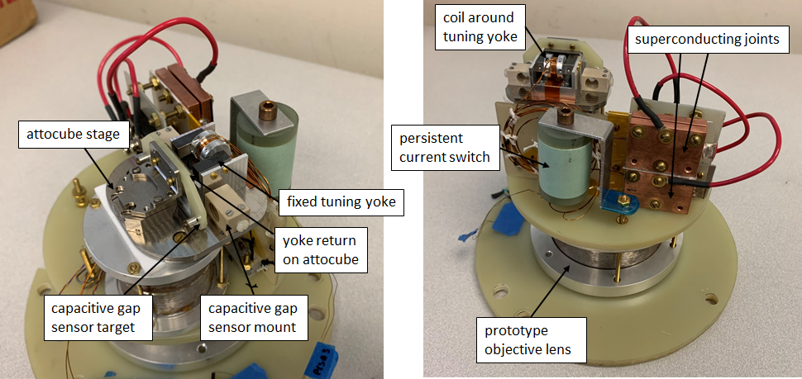
Magnet assembly with PCS, joints and tuner

Slide 14
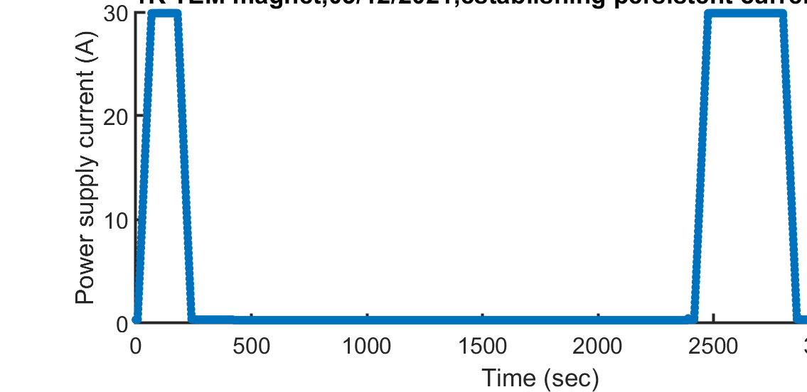
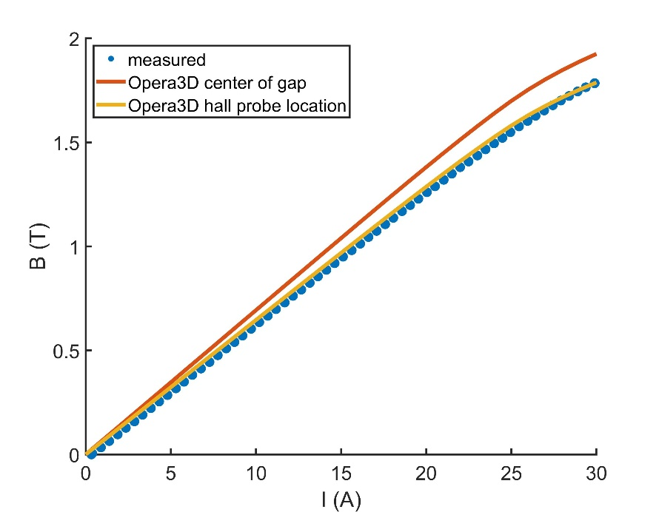
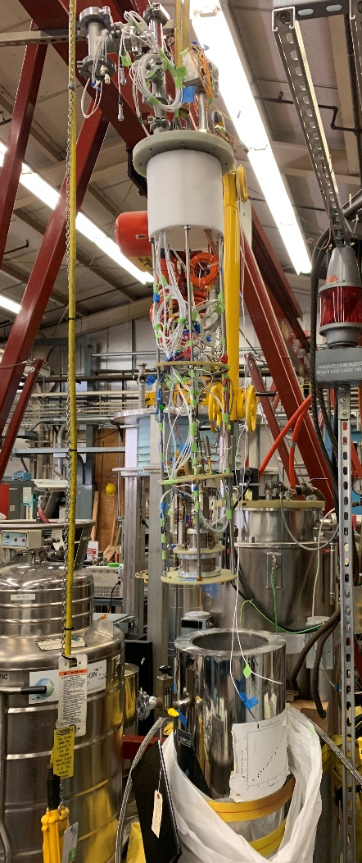
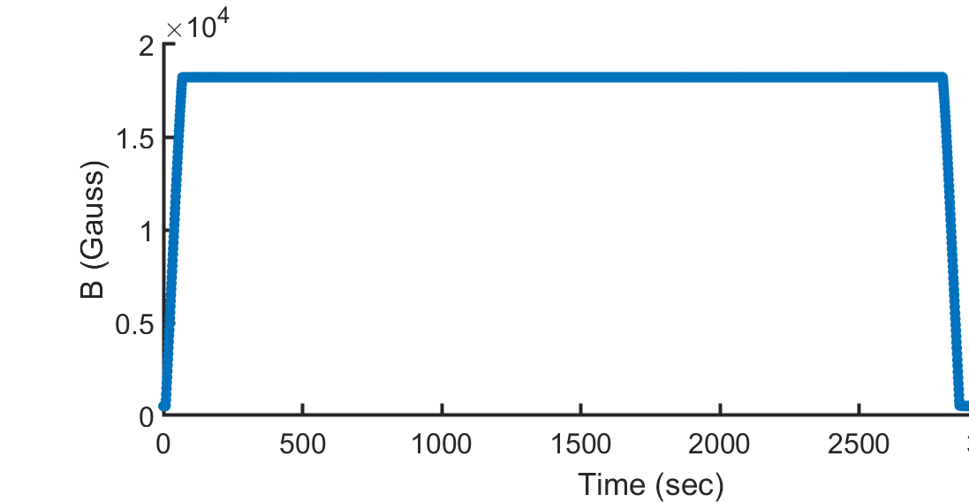
Persistent current operation at 2 T routinely established without quench
Header with magnet assembly
Measured field vs. current is in agreement with Opera3D (shows saturation effects)
LHe bath cryostat
1.82 T at hall probe
Persistent current operation

Slide 15
We can’t achieve the stability we want need with only persistent current operation, we need active stabilization too

Slide 16
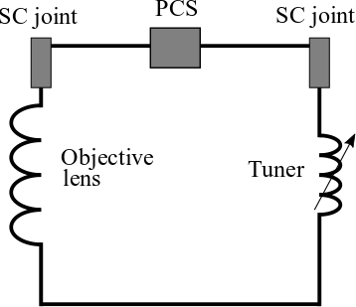
Movement of the cryogenic stage changes the inductance of the “tuner” magnet which shifts flux to or from the main lens (active tuner to stabilize the current)
SC joint
SC joint
iron
series coil
gap change
objective
lens
tuner
gap
attocube

Slide 17
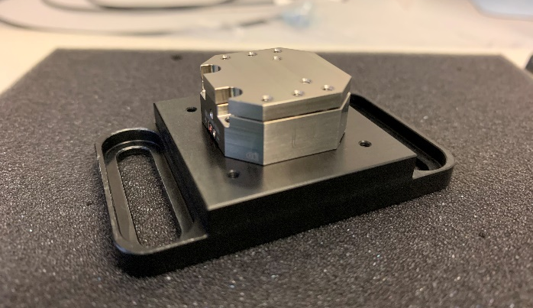
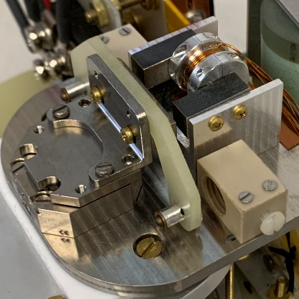
Capacitive gap sensors independently measure stage position in LHe
ANPx101 with 5 mm range
Cap probe mounts
https://www.capacitec.com/
Cap sensor targets
4 K calibration allows for moving to a desired gap change during active stabilization programs

Slide 18
Experimental demonstration: stabilizing to the noise level of the Hall probes (a few ppm at 1.95 T)
Brouwer et al, “Stabilization and control of persistent current magnets using variable inductance”, Supercond. Sci. Technol. 2022, https://doi.org/10.1088/1361-6668/ac549b

Slide 19
Summary of first phase of 1K TEM
demonstrated we can build a Nb-Ti lens and operate in persistent current mode
new technique for stabilization of persistent current magnets, demonstrated it works up to the precision with which we can measure (in theory it can do much better)
not completed
  magnetic shielding / ultimate stability measurements with SQUIDs etc.
  cryostat stabilization

Slide 20
Next Steps (3 years starting now)
add magnetic shielding and cryogenic stabilization to our existing experiment
build and test beam-based demonstrator, combine lens with electron source, high vacuum, detector, shielding etc. (all in liquid helium bath)

