Slide 1
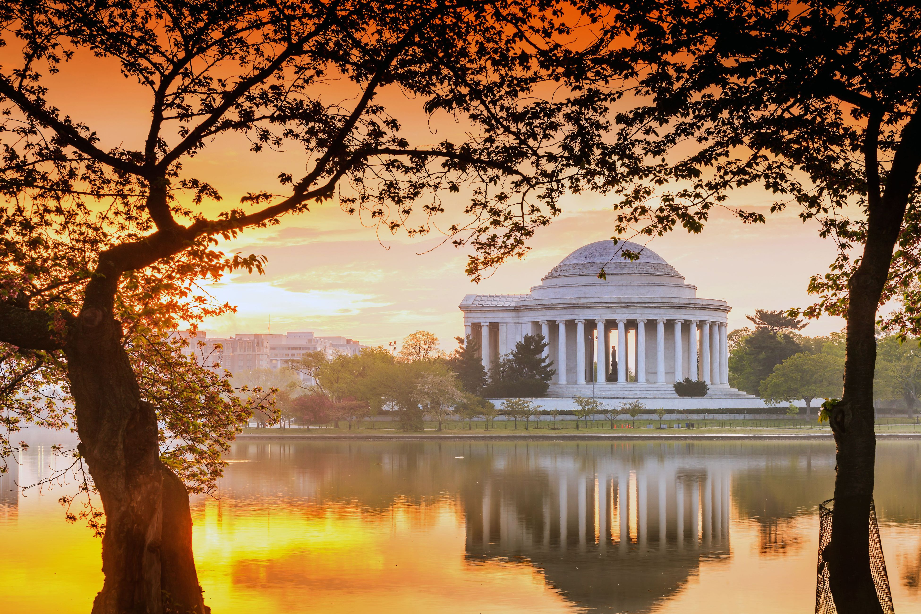
WANDA 2024
February 26th-29th
Welcome!
Workshop for Applied Nuclear Data Activities
Sponsored by the Nuclear Data Interagency Working Group

Slide 2
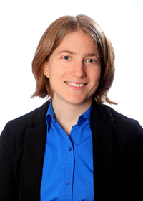
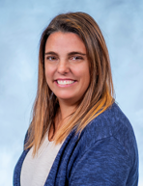
Amy Lovell
Staff Scientist
Nuclear Theory, Los Alamos National Laboratory lovell@lanl.gov
Jesse M. Brown
Staff Scientist
Nuclear Data Group
Oak Ridge National Laboratory
brownjm@ornl.gov
Lisa Felker NPRD Program Administrator
Lawrence Livermore National Laboratory felker7@llnl.gov

Slide 3
WANDA 2023
Workshop for Applied Nuclear Data Activities
We’re delighted to be at the Hilton Arlington National Landing this year
All sessions are in the Adams and Madison Rooms (here)
The Monroe I and II are available for side discussions all week
>170 registrants over the course of the week
Social (for those who registered) Wednesday evening, 6-8pm, at the Hilton in the Crystal Ballroom

Slide 4
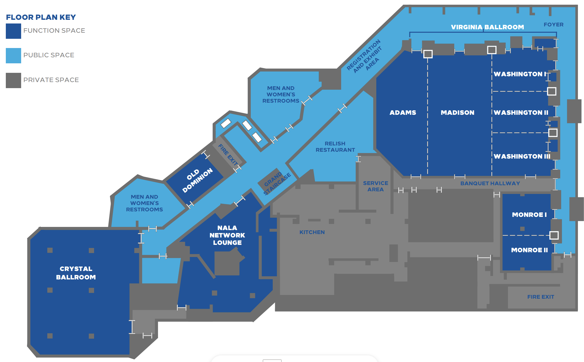
Main Meeting
Posters
Side-Bars
Dinner

Slide 5
WANDA 2024 Goals
The goals of each session are to:
Present and discuss nuclear data needs from all steps along the pipeline
Prioritize these needs
Develop a plan to address the needs
At the end of WANDA, an overview document will be produced from the outcomes of each session
Previous workshop reports and presentations can be found:
https://www.nndc.bnl.gov/ndwg/workshops.html
Data users
Program managers
Discuss and develop cross cutting nuclear data needs
Data producers
Data processors
Data evaluators

Slide 6
WANDA Session Goals
The goal of each session (Monday afternoon – through Wednesday) is to identify actionable nuclear data tasks that will have an impact on the application of interest, i.e. roadmapping
Focus on all stages of the nuclear data pipeline: measurements, theory, evaluation, processing, validation; what is needed to get data to the users, not just now but also in the future?
Where are there overlaps with multiple mission spaces?
Where can opportunities be leveraged within existing and planned work?
Your participation in crucial! The reported outcomes are based on comments and discussions that occur over the course of the week

Slide 7
Agenda for WANDA 2024
Date/time | Topic
Monday, 2/26, 8am – noon | Introduction and program manager review
Monday, 2/26, 1pm – 5pm | FES: Fusion Neutronics Chairs: L. Gustad, K. Kelly, M. Loughlin
Tuesday, 2/27, 8am – noon | FES: Tritium Production Chairs: P. Humrickhouse, S. Lyons, S. Quaglioni
Tuesday, 2/27, 1pm – 5pm | FES: Material Damage Chairs: P. Romano, P. Wilson
Wednesday, 2/28, 8am – noon | Isotopes & Targetry for Nuclear Data Chairs: M. Gott, K. Manukyan, E. O'Brien, E. Vermeulen
Wednesday, 2/28, 1pm – 5pm | Uncertainty Quantification Chairs: R. Casperson, N. Gibson, U. Mertyurek, D. Neudecker
Thursday, 2/29, 8am – noon | Current project reviews
Thursday, 2/29, 1pm – close | Session reviews and closing

Slide 8
Poster session, Wednesday 5pm
Immediately following the Uncertainty Quantification Session, before the no-host dinner
Located in the Washington Rooms (behind this main room)
Posters will be up all week – check them out during breaks, etc.
Handouts (see Lisa and Stacy) have titles, presenters and abstracts

Slide 9
WANDA 2024
February 26th-29th
Thank you in advance!
WANDA is not possible without all of your participation:
Session chairs
Speakers
Rapporteurs
Project PIs and DC program managers
Nuclear Data Working Group
Office of Nuclear Physics and the Nuclear Data Interagency Working Group (NDIAWG)
Lisa Felker
Comments, questions, and suggestions?
Amy Lovell, lovell@lanl.gov
Jesse Brown, brownjm@ornl.gov
Lisa Felker, felker7@llnl.gov
Todd Bredeweg, toddb@lanl.gov
Jo Ressler, ressler2@llnl.gov

