Slide 1
Fusion Neutronics Session
Session Overview
Laura Gustad (MDA)
Keegan Kelly (LANL)
Mike Loughlin (ORNL)
What are the anticipated reactions for energy production, and do specific data needs exist?
What are the products of these reactions, and are there data needs for understanding secondary reactions?
Are there gaps in current neutronics code capabilities to accurately model the interactions?
ND must accurately predict shielding, activation, dose rates, and neutron diagnostics.
What data are necessary to operate neutron sources (IFMIF, FPNS, etc.)?

Slide 2
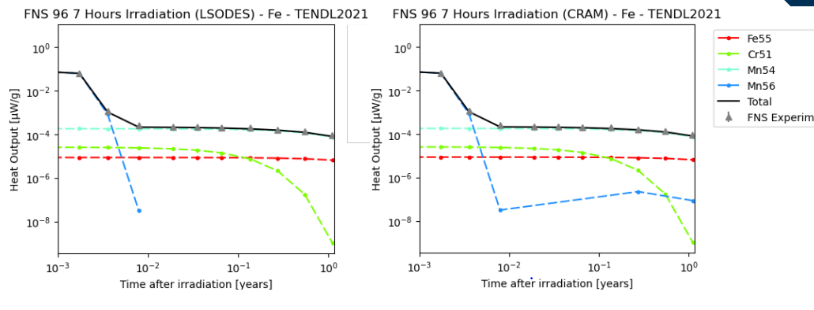
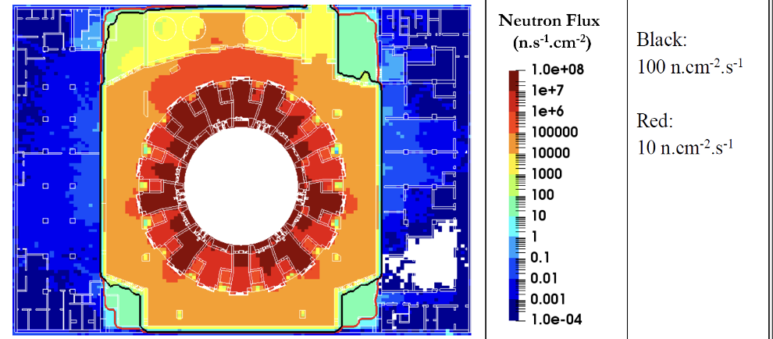
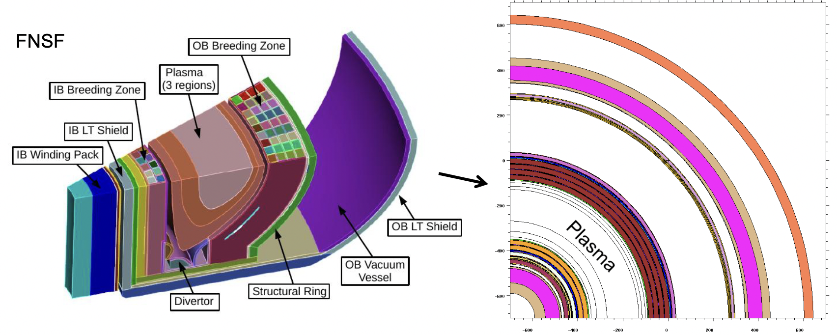
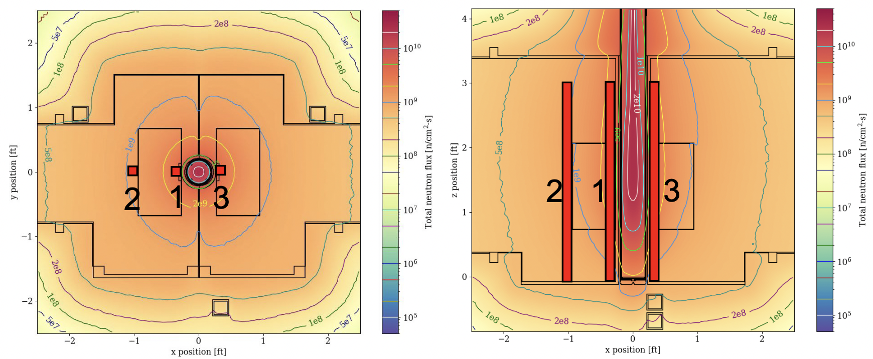
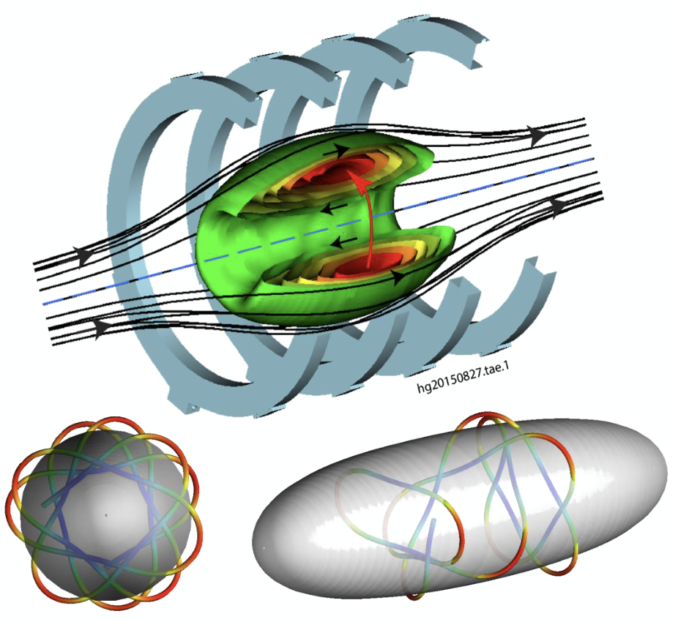
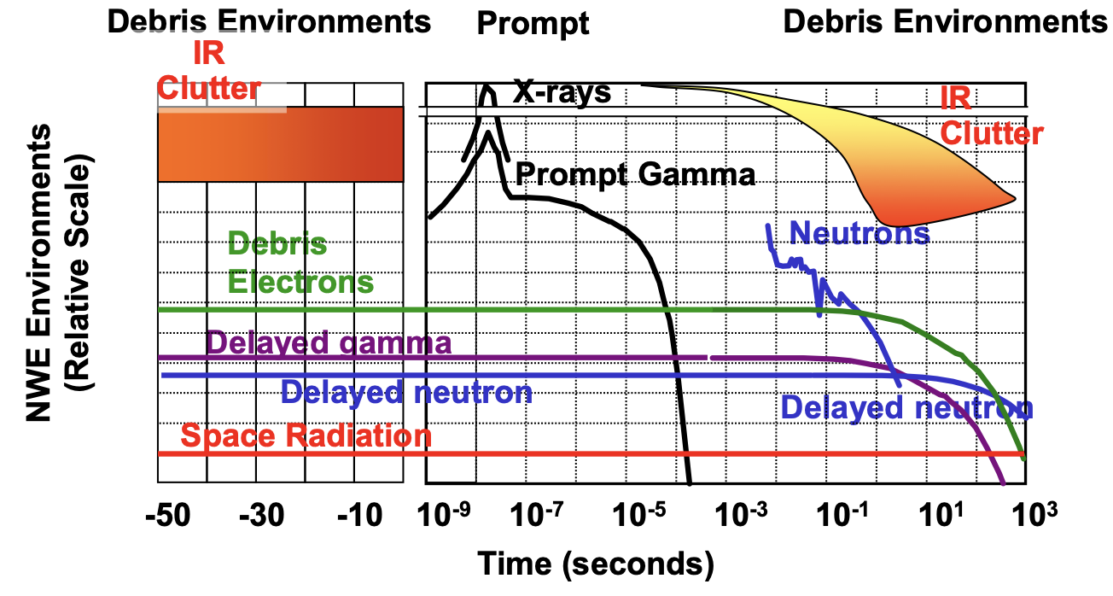
Application/User Perspective
Sources, Diagnostics, Electronics
Mike Loughlin - ORNL
CRAM
David Foster - UKAEA
FENDL Updates
Tim Bohm – U. Wisc.
SHINE
Ross Radel - SHINE
p-¹¹B
Jed Styron - TAE
DoD Needs
Laura Gustad - MDA

Slide 3
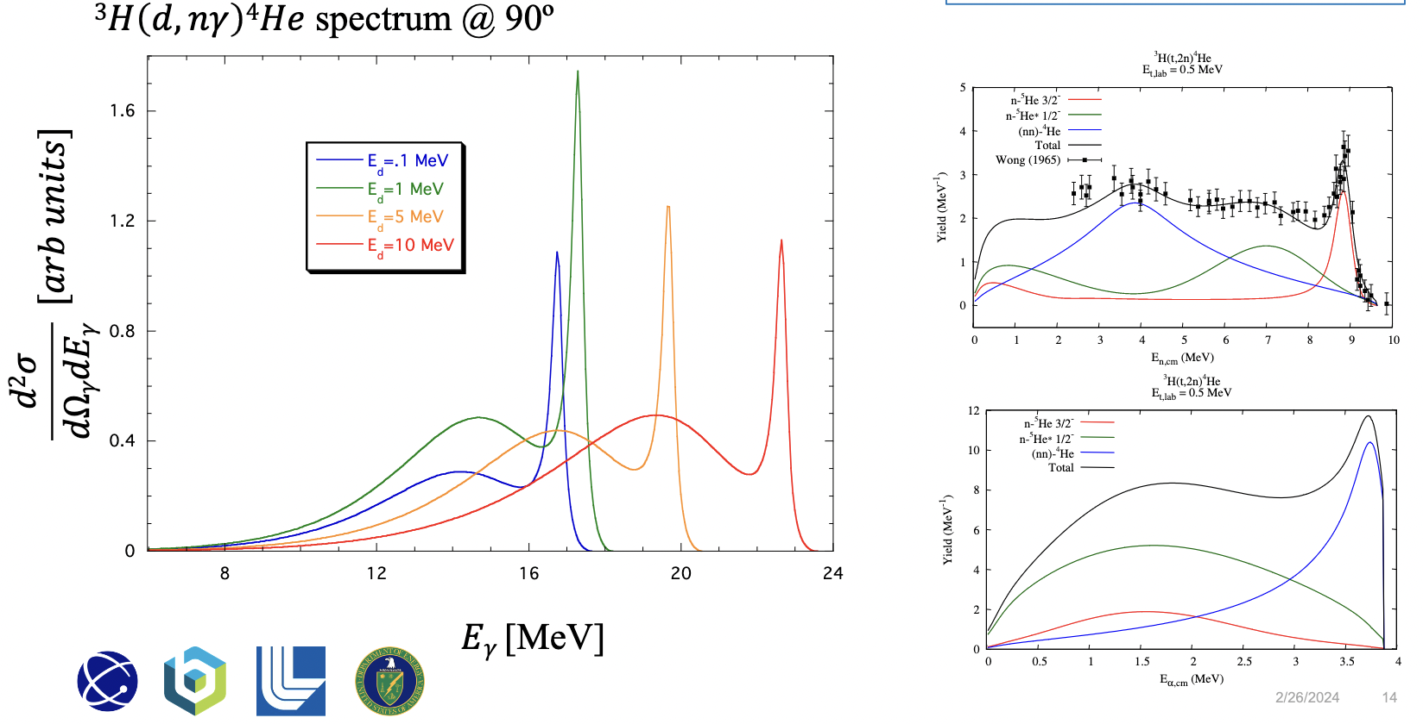
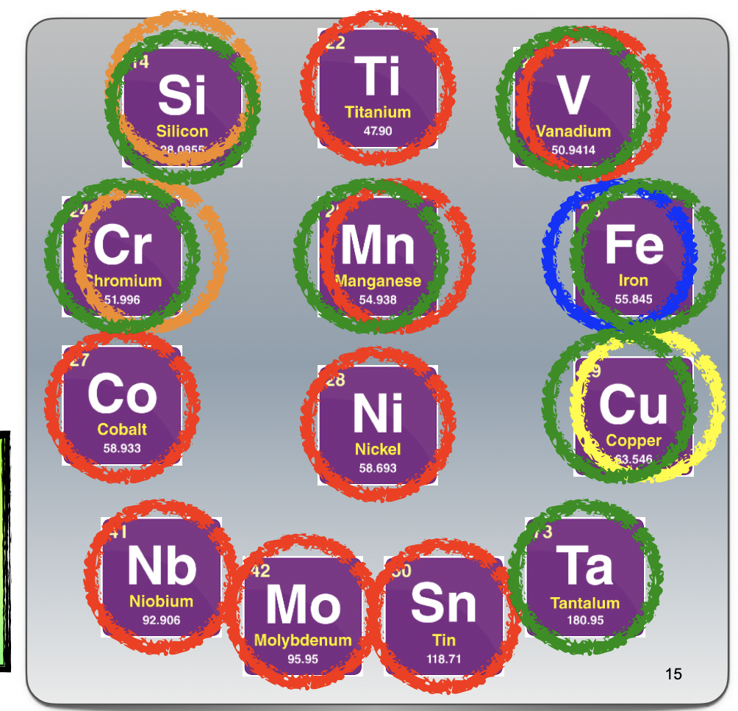
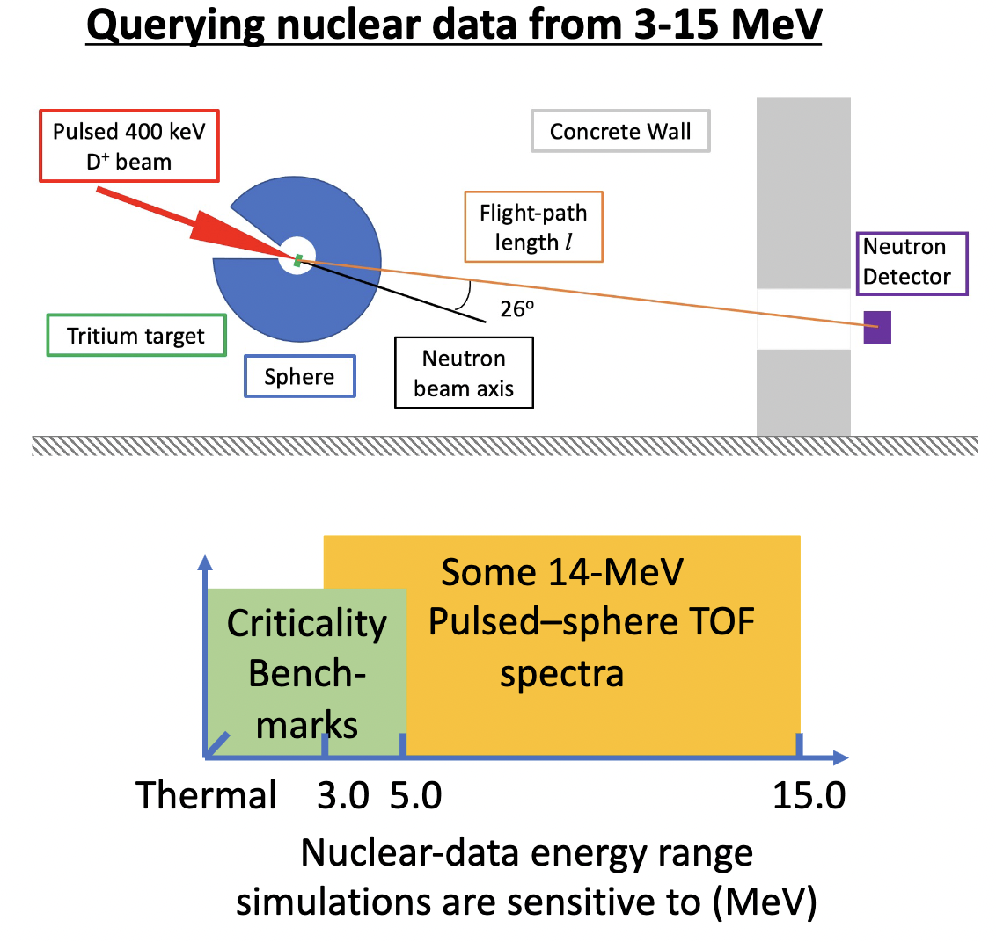
Nuclear Data Evaluations
Light Element Evals
Mark Paris - LANL
Heavy
Evals
Gustavo Nobre
- BNL
Pulsed Sphere
Data Validation
Robert Casperson - LLNL

Slide 4
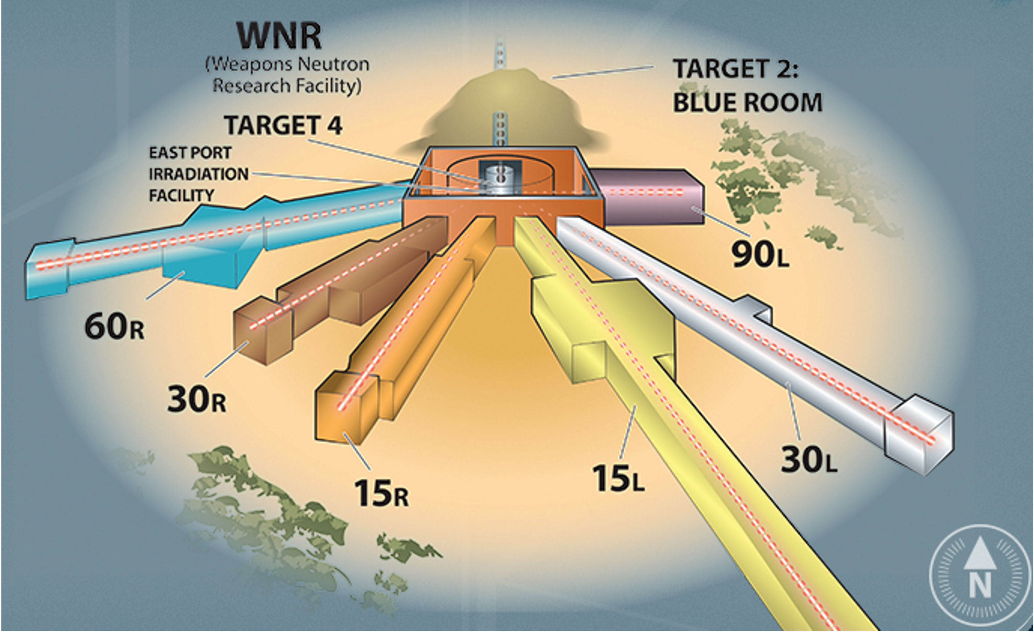
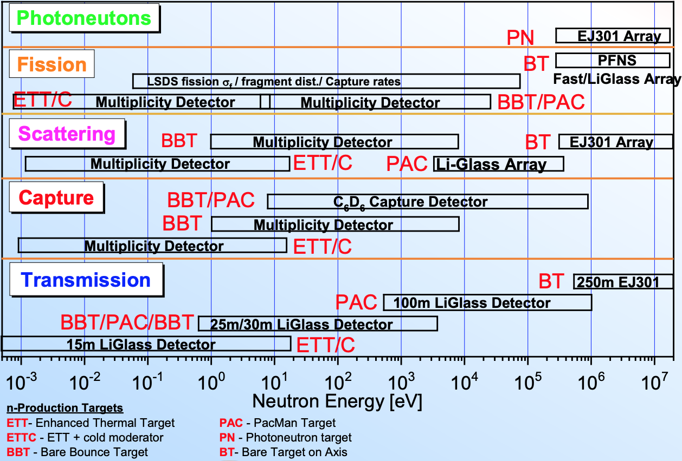
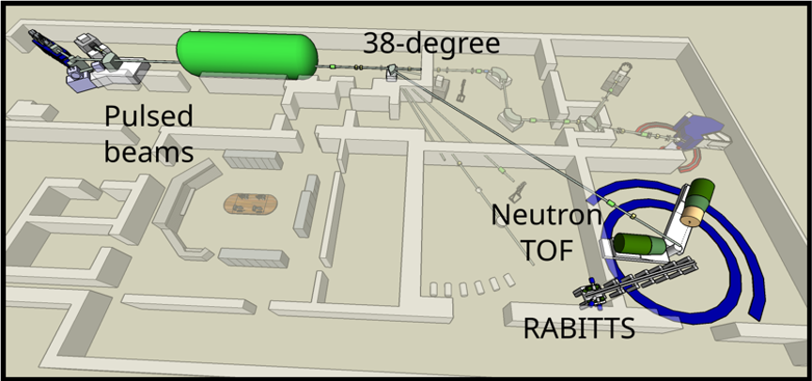
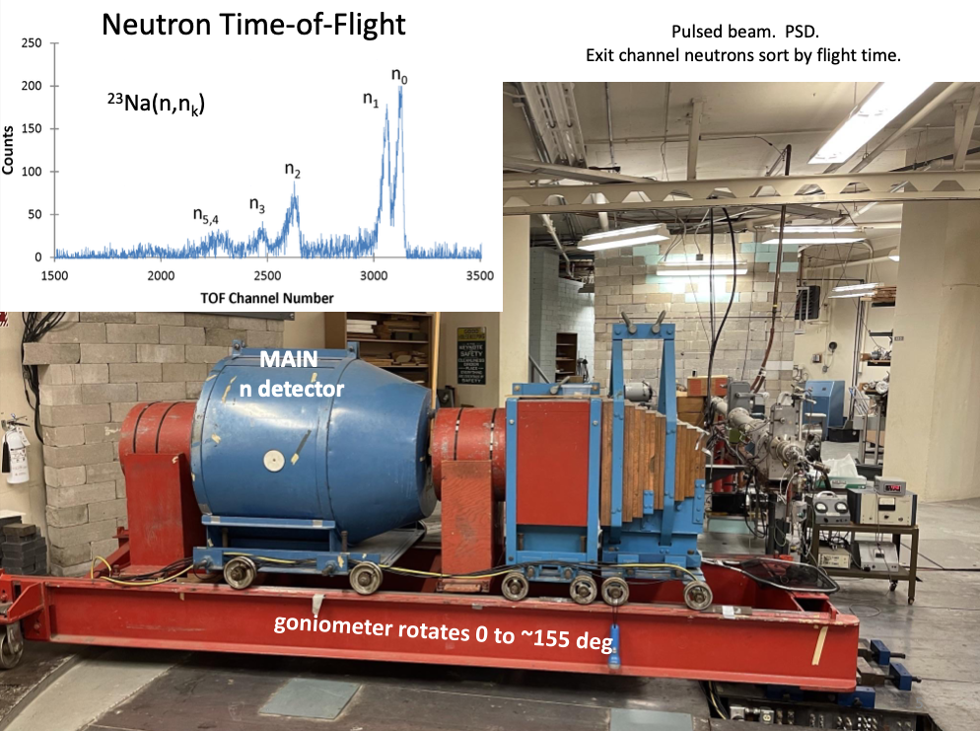
Experimental Capabilities
LANL
LBNL
RPI
TUNL
UML
OU
UKy

Slide 5
Fusion Neutronics Session
Highlights / Take-aways (1)
Laura Gustad (MDA)
Keegan Kelly (LANL)
Mike Loughlin (ORNL)
Path for 14 MeV light ion evaluations has been identified
Reactor nuclear data needs focus on ⁶Li, ⁷Li, Be, structural materials
Activation of several materials for decay heat, diagnostics, and dosimetry; importance of isomer production
Isotopes needing attention:
  ⁹Be(n,2n) – fundamental for neutron breeding
    1.75 MeV (n,2n) threshold accessed by 2.45 MeV D-D and 14 MeV D-T neutrons
  Modern light element evaluations do not currently reach 14 MeV
  From Pulsed Spheres: Li, C, O, Mg, Al, Ti, Fe, Pb
  Med/Heavy Evals: Co, Cu, Mo, Nb, Sn, Ni, Mn, Ti, V
White source, mono-E, and reactor neutron facilities are ready to carry out neutronics measurements of interest.

Slide 6
Fusion Neutronics Session
Highlights / Take-aways (2)
Laura Gustad (MDA)
Keegan Kelly (LANL)
Mike Loughlin (ORNL)
Need additional comprehensive sensitivity studies using reliable covariances
Differential measurements are needed at a distribution of energies, not just at 14 MeV! – Integral and differential measurements complement each other
Need survey of nuclei in need of measurements and evaluation, and those in need of just evaluation
Close communication between evaluators, experiment, and users.
  Accelerating communication will accelerate the process
Prospect of building a small-scale fusion device to understand the issues associated with running a functional reactor for energy production

Slide 7
Recommendations
Program to prioritize nuclear data needs considering the impact (feasibility, economy) on fusion reactor design
  Short list of most promising concepts
Evaluation of the nuclei and nuclear reactions identified in fusion reactor sensitivity studies are (a) in need of new measurements, or (b) in need of a new evaluation
Coordinate exploitation of various neutron sources to cover range of neutron energies, flux, fluence, integral and differential experiments.
  Central repository of information on facility capabilities
Decision on high fluence neutron source
Work force development, evaluations, neutron sources and fission and fusion facilities.
Continued exchange of information between ND and fusion communities.

Slide 8
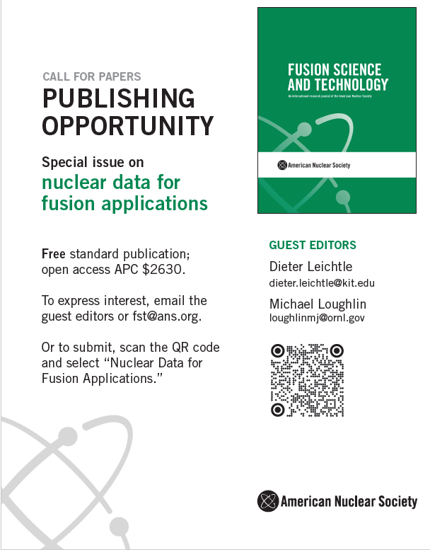
Keegan Kelly
kkelly@lanl.gov

