Slide 1
Isotopes & Targetry for Nuclear Data – Session Summary
WANDA 2024
Thursday February 29th, 2024
NDWG POC: Etienne Vermeulen (LANL)
Chairs: Matt Gott (ORNL), Khachatur Manukyan (Notre Dame), Ellen O’Brien (LANL)
Rapporteur: Jonathan Morrell (LANL)

Slide 2
Target Needs Survey

Slide 3
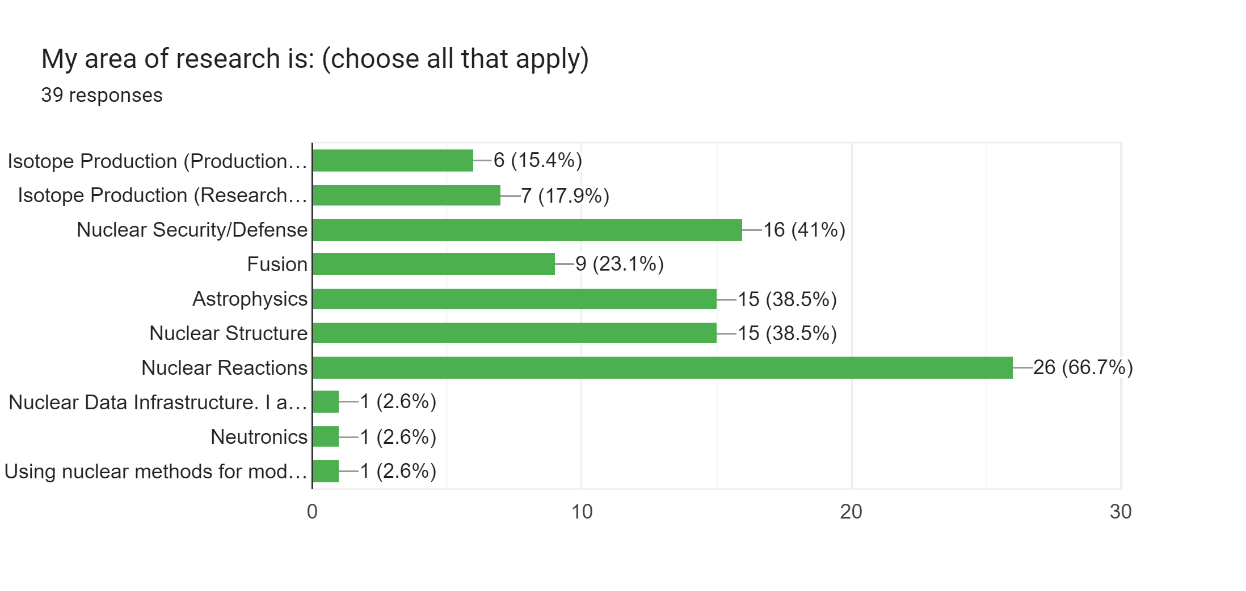
Target Needs Survey

Slide 4
Target Needs Survey
Radioisotopic Purity Requirements

Slide 5
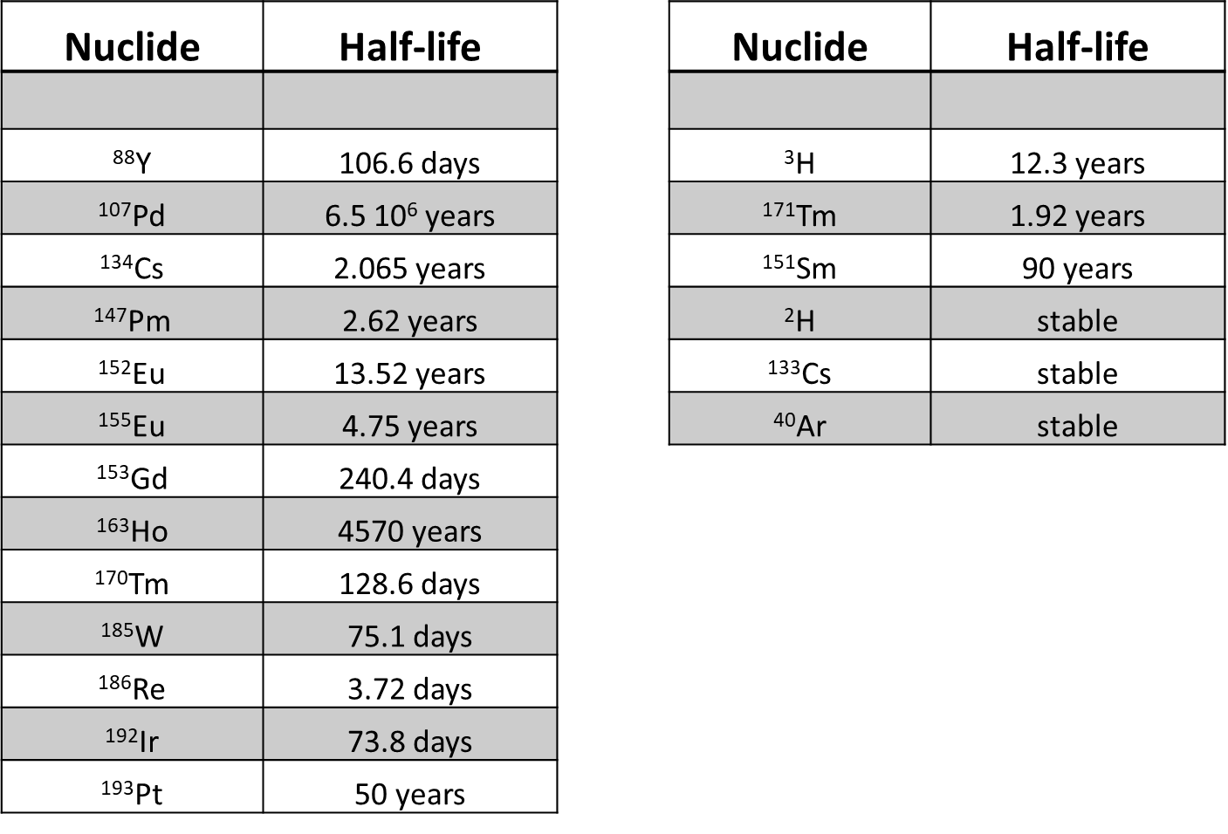
Applications/users of targets for the generation of nuclear data
Radioactive targets for the measurement of neutron-induced reactions
The DICER & LENZ instruments at LANSCE have proven that it is possible to take useful nuclear data on relatively short-lived radioactive targets

Slide 6
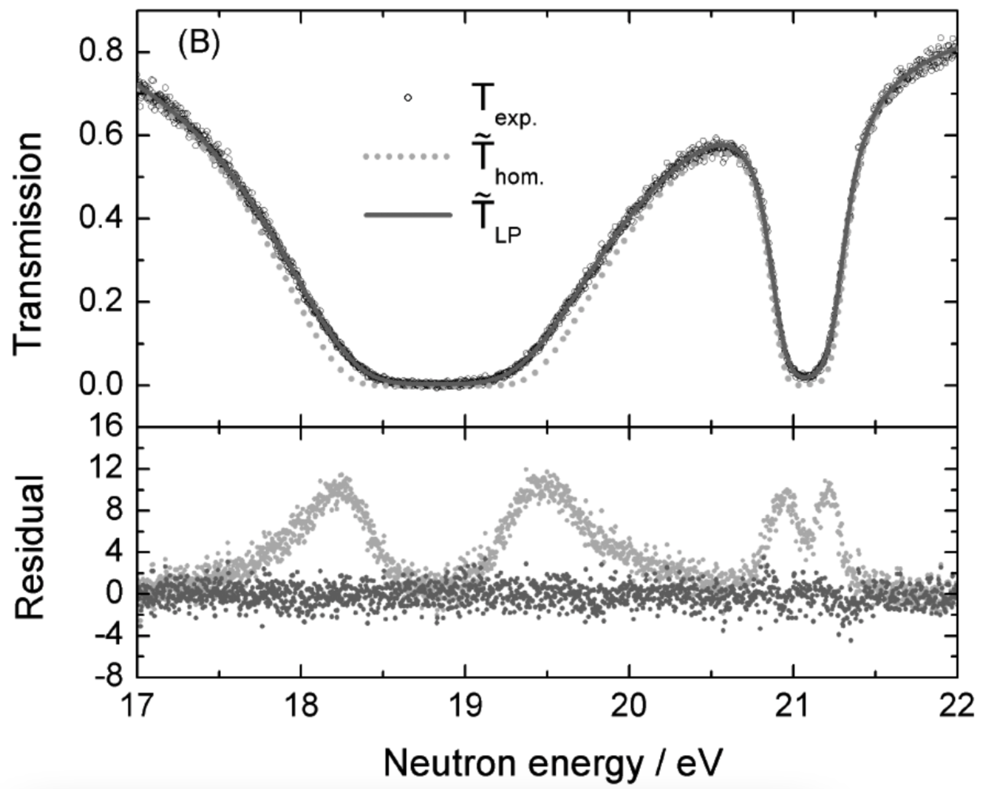
Applications/users of targets for the generation of nuclear data
Isotopic purity and uniformity are important
Target characterization is as important as (if not more than) high purity
When looking at isotopes via NIDC, listing the production route would be invaluable
This needs to be a formal request to DOE IP

Slide 7
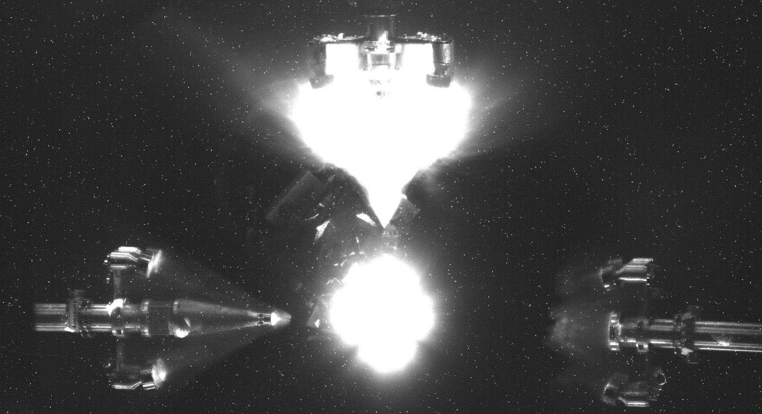
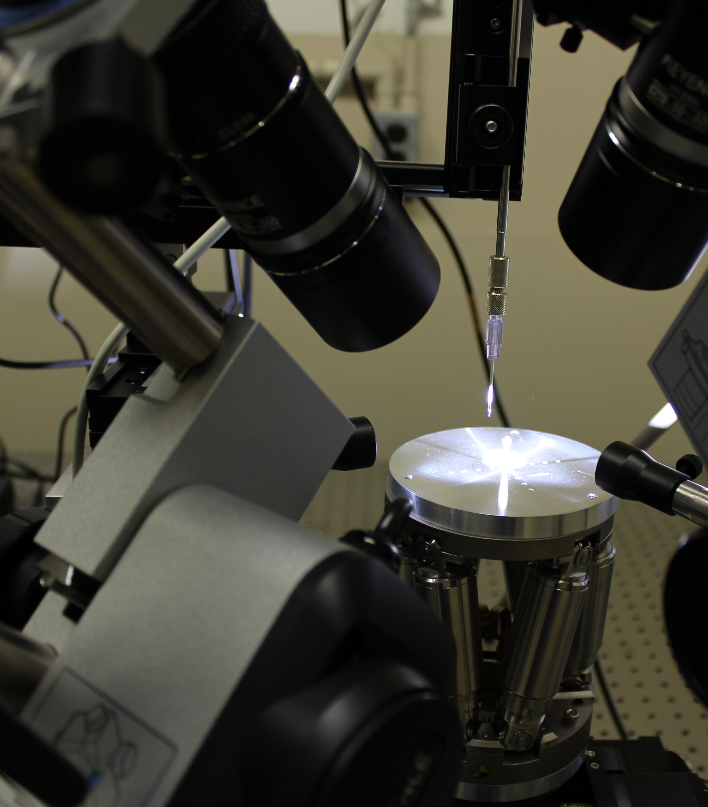
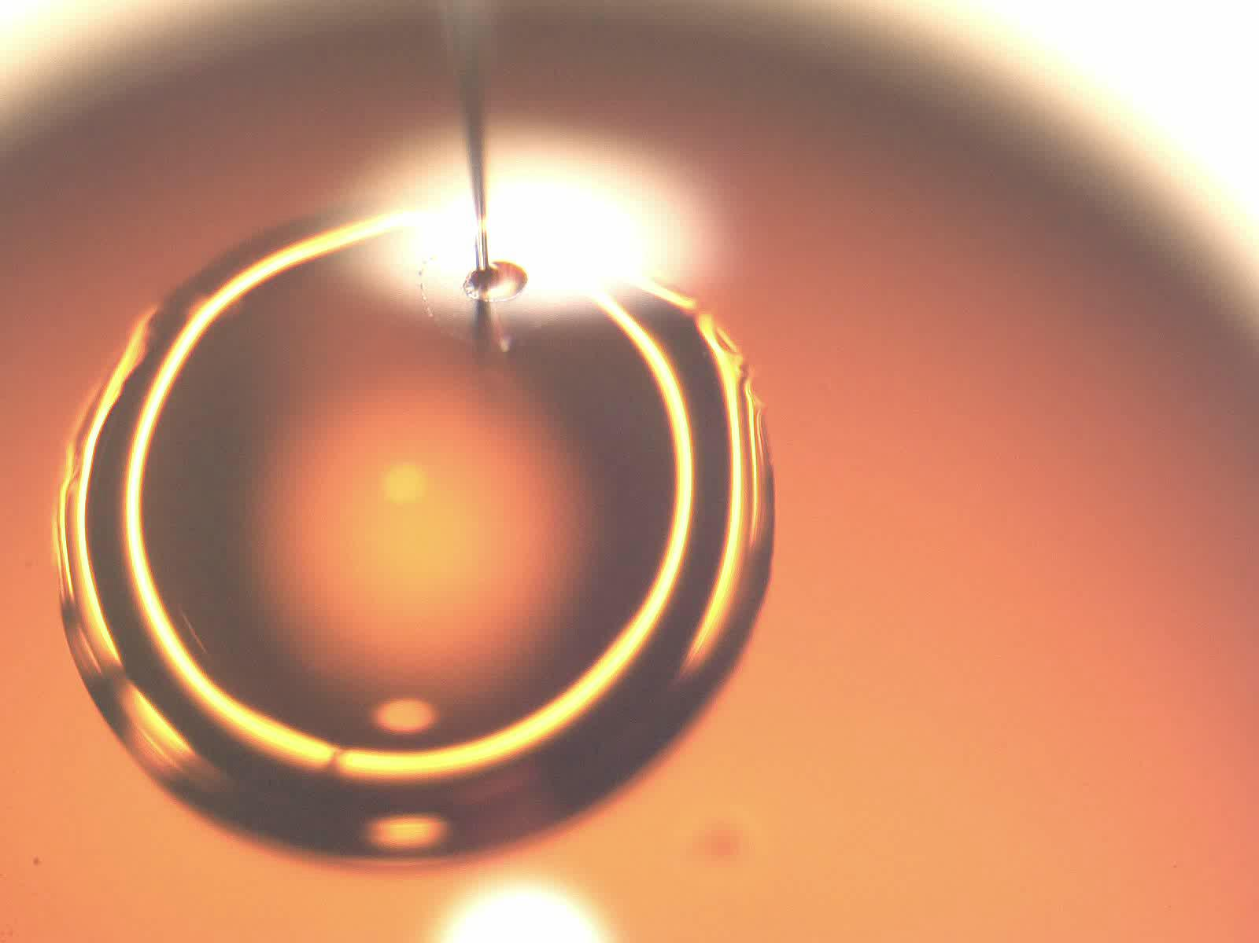
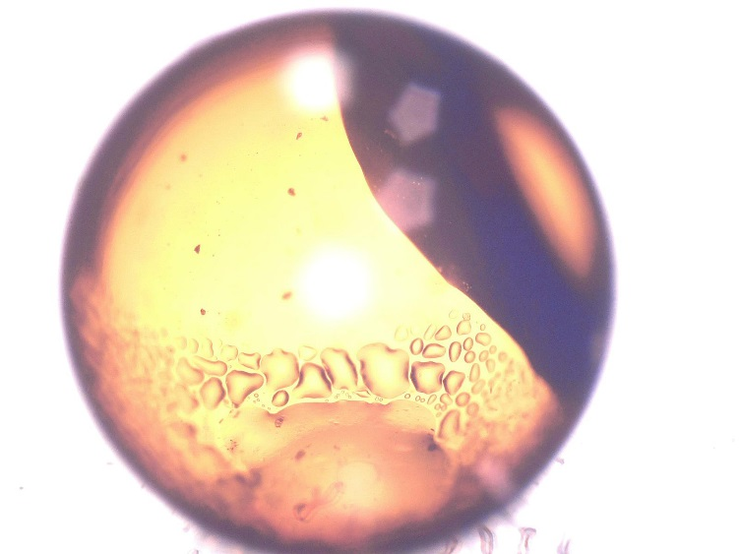
Target fabrication - NIF
Capillary entering fill-tube hole
10 μm
NIF utilizes a new class of targets that are incredibly time consuming/challenging to make but represents an important new frontier in ICF research
Very small quantities of material (limited by maximum activity) present new measurement opportunities.
Preparation time limits half-life of radioactive targets accessible.
100 μm

Slide 8
Target Fabrication
Novel target fabrication techniques are being developed to meet emerging needs
3D printing with spherical powders, combustion synthesis coupled with spin coating & electro spraying, inkjet printing, isotopic doping

Slide 9
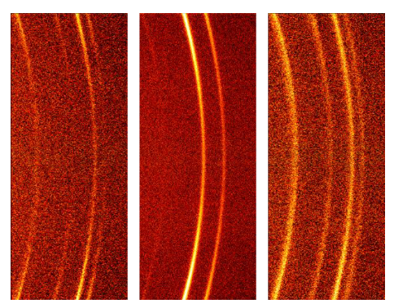
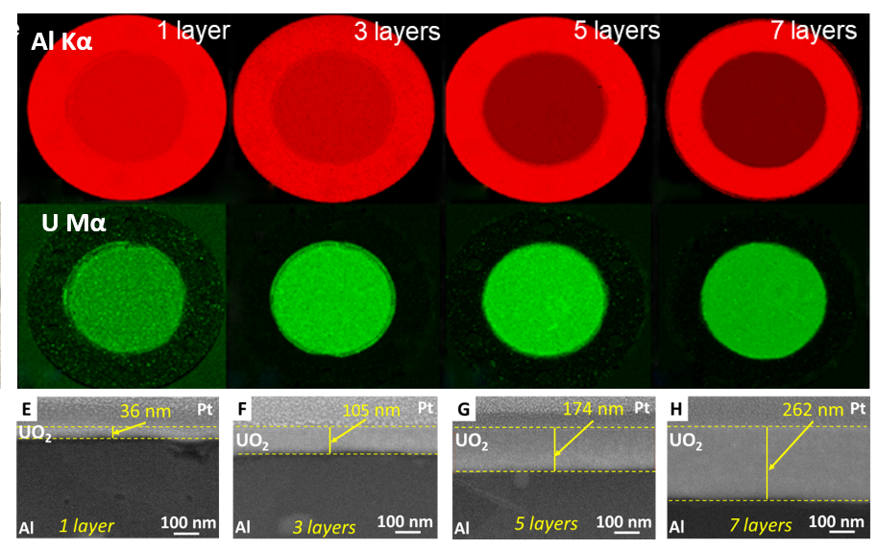
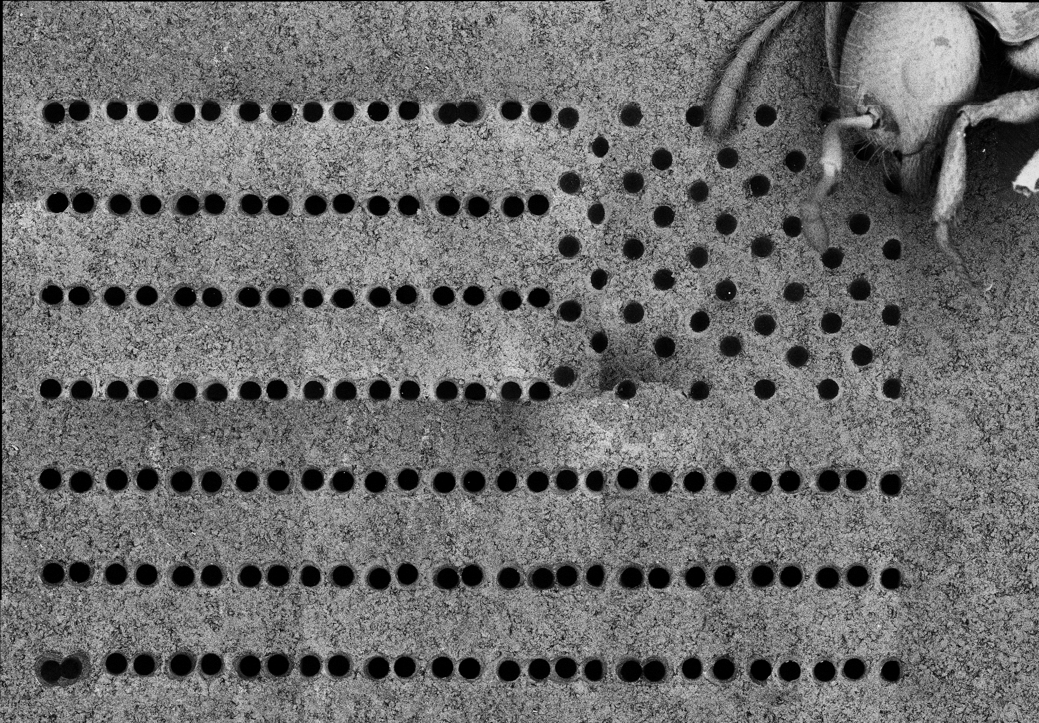
Target Characterization
Methods for characterization of targets are also being considered by target producers
SEM/FIB/EDS, XRD, XRF, TEM, XPS

Slide 10
Discussion
Workforce Development
The next generation is needed to ensure that we have continuity of capability in target fabrication techniques.
Workforce development is a challenge and a need. It is still clear that there are only a few skilled target makers and we need more!
New workforce needs a diverse set of backgrounds and education levels – trades, material science, chemistry, physics, engineering
Investment in workforce pipeline development & target fabrication facilities is needed.
Involvement of academic institutions is critical for this.
Notes:
You have to start at the university level.

Slide 11
Discussion
Target characterization & tracking (history) is key!
Assay, assay, assay! Traceable target assays that are available long after an experiment is complete are critical for uncertainty quantification.
Needs & techniques required for assays are different for stable and radioactive targets.
Hafnium is not Zirconium (we all agree on this one).
Target information should be provided in all publications.
Is there some way to standardize target information provided so that it is easier to import to EXFOR?
Investment to stand up something similar to the Nuclear Science User Facility (NSUF) model for target fabrication & characterization would be invaluable.

Slide 12
We need more statistics, please share!

