Slide 1
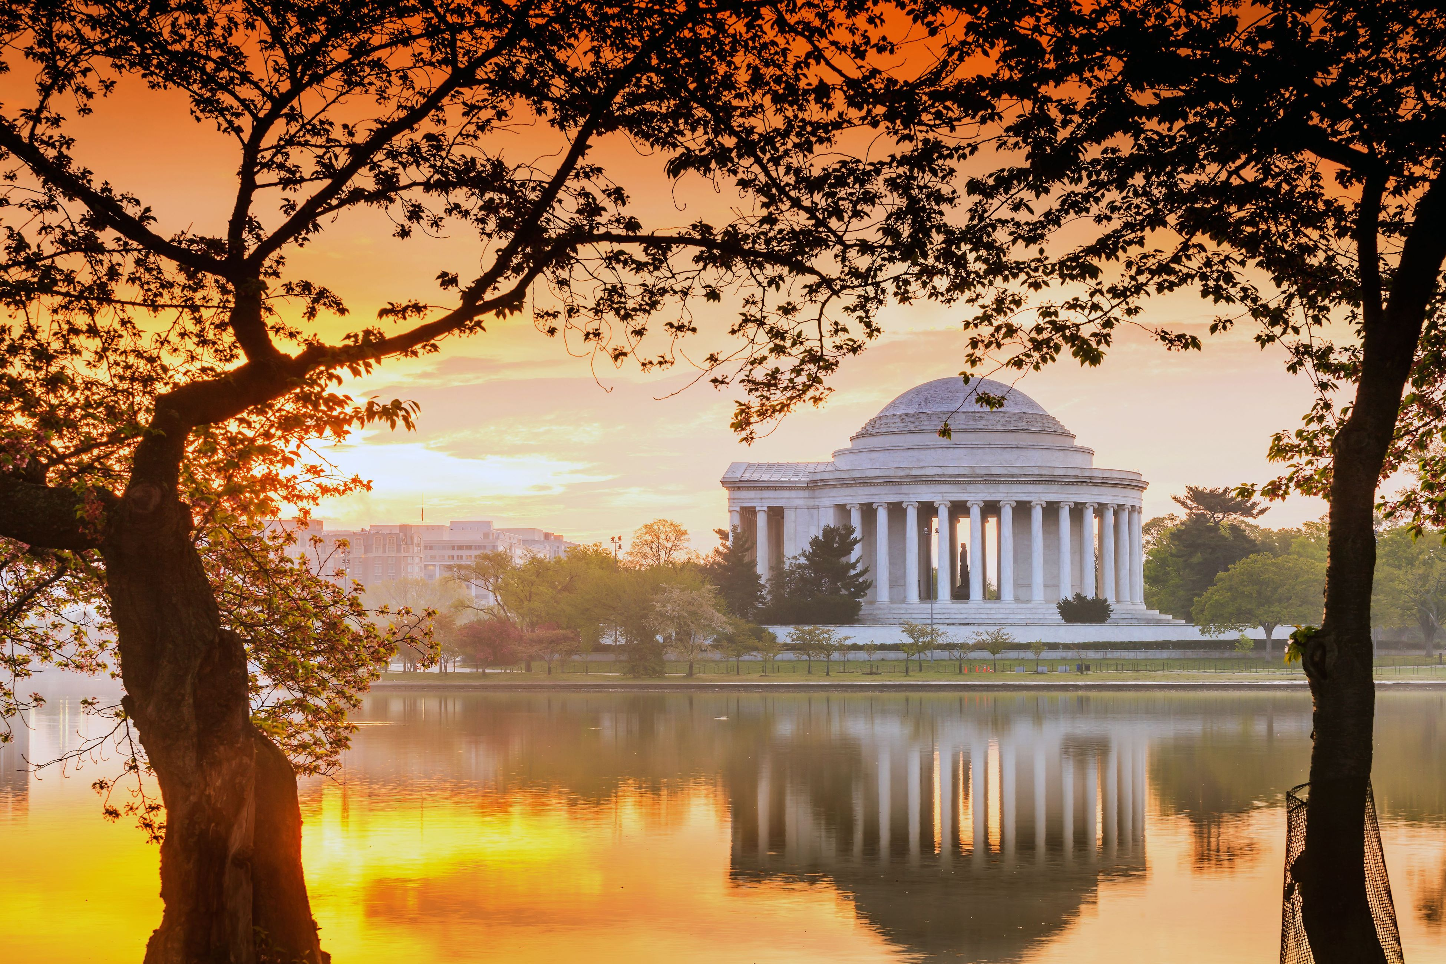
WANDA 2024
February 26th-29th
Closing
Workshop for Applied Nuclear Data Activities
Sponsored by the Nuclear Data Interagency Working Group

Slide 2
WANDA only happens because of all of you
We once again want to thank:
The program managers for their support, discussion, and clear overviews of their nuclear data needs and a special thanks to the members of the NDIAWG for their continued support of these efforts
The NDWG for their planning efforts
The session chairs for their expertise and organization in bringing together experts in our five topic areas and leading discussions on data needs
The speakers who also provided their expertise and knowledge
The FOA PIs and participants for sharing their projects’ progress and showing the successes of WANDA
All of our attendees for their time and contributions to discussions, to provide input for the future of nuclear data
Lisa, Stacy, and Cheryll for all of their hard work organizing, greeting, running presentations, and making the meeting flow smoothly!

Slide 3
[Almost] final feedback and discussion
What did you like and/or dislike with WANDA 2024?
What do you think about the venue?
Format:
Starting on Monday?
No parallel sessions?
Poster session
Session topics:
How engaging were the topics this year?
What should we focus on next year?

Slide 4
Past Session Topic Suggestions
S/U Sessions
Sensitivity studies
“Truth in Covariances” and S/U analysis
Methods for propagating uncertainties
Covariances and errors in benchmark and data tuning
UQ/S capabilities development and methods
Benchmark/validation/propagation of uncertainties
Benchmarks and metadata
Uncertainty Quantification in Nuclear Data
Pipeline Sessions
Methods for cross section data library tuning
Turning ND pipeline into a Bayesian network
Future of nuclear data pipeline
Methods to speed up pipeline using (or not) advanced computing
Best practices/SQA
Ensure Utilization of new data in Application Code
What ND measurements, modelling, evaluation, compilation and other horizontal methods should look like in say 2040
Program Based Sessions
A focused topic for NE
FRIB needs
NRC could use more discussion
Space, medical and fusion applications
Versatile Test Reactor (VTR)
Nuclear data for decommissioning
Medical isotope nuclear data library
Other Sessions
Structural materials
Thermal scattering
Processing codes and formatting
Disentangling Multiphysics models/data
Shielding - Elastic and inelastic scattering as it pertains to shielding - Validation for shielding
Scattering: elastic and inelastic
Theory
Materials and targetry
Follow-up of Atomic Data session
Processing big data sets
Gaps in facilities and infrastructure
Code development: processing, evaluation, transport
The production of a charged-particle reaction library to 200+ MeV/amu and how to validate
Direct measurements of radioisotope targets
Gamma production
The transition from resonant to continuous treatments of nuclear data
Data needs synergies
ENDF 9.0
Catch-all/Miscellaneous/Stand-alone talks

Slide 5
Session Topic Suggestions from WANDA2022
more on space applications
short-lived isotopes
Nuclear data for radiation damage metrics
Importance and treatment of cross-reaction channel correlations
Derivation of uncertainty in experimental data measurements
Determination of uncertainty in calculated cross sections
Nuclear data needs to enable new neutron detection capabilities/systems
New nuclear data opportunities and needs arising from FRIB coming online
Nuclear decay data continues to be a point of concern for Nuclear Forensics
Spontaneous fission yields (SFY), including data for Pu240 and Cm isotopes.
The integration of fission yield inventories calculations for SFY into SCALE/ORIGEN.
Fusion
Walkthrough of past workshop recommendations and assessment of progress (this might require more homework ahead of WANDA - but workshop attendees could discuss what still needs to be done to close or if open recs are still needed)
Maybe something more in depth on medical (how to ""do"" nuclear data with biology - cancer treatments, etc). A lot of good discussions during WANDA22 during stopping power session and presentation from NIH"
neutron capture
Nuclear data for medical applications (production, dosimetry, etc.). Focus on alpha emitters.
FRIB needs,
Uncertainty Quantification
Recent data updates and the downstream effect on applications
Data of importance for safeguards measurements
"The Future of Nuclear Data Processing" would make a great session and is long overdue.

Slide 6
Wrapping up WANDA 2024 and looking ahead to WANDA 2025
WANDA 2024
Session chairs need to send their reports (thanks to the rapporteurs who took detailed notes during the session) March 15, 2024
Amy and Jesse will then write the final report
Survey is coming for your feedback
you will be able to suggest topics and chair-people for that topic
WANDA 2025
We're planning to book this venue for Feb. 10-13, 2025
See you in DC next year!

Slide 7
Thank you for making WANDA a success!
Program Managers:
Tim Hallman (DOE)
Keith Jankowski (DOE)
Rian Bahran (EOP/OSTP)
Michael Halfmoon (DOE)
Ethan Balkin (DOE)
David Matters (DOE)
Joanna Ingraham (DRTA)
David Kulp (DTRA)
Tod Caldwell (DOE)
Jim Peltz (DOE)
Doug Bowen (ORNL)
Session Leads:
Laura Gustad (MDA)
Keegan Kelly (LANL)
Mike Loughlin (ORNL)
Paul Humrickhouse (ORNL)
Stephanie Lyons (PNNL)
Sofia Quaglioni (LLNL)
Paul Romano (ANL)
Paul Wilson (UWM)
Matt Gott (ORNL)
Khachatur Manukyan (ND)
Ellen O'Brien (LANL)
Etienne Vermeulen (LANL)
Robert Casperson (LLNL)
Nathan Gibson (LANL)
Ugur Mertyurek (ORNL)
Denise Neudecker (LANL)
Rapporteurs:
Peter Brain
Jeremias Garcia-Duarte
Erin Good
Joe Henderson
Jonathan Morrell
Aaron Tamashiro
Noah Walton
And all speakers, attendees, and participants!
It is integral to bring together data funders, producers, evaluators, users, preservers, processors, and validators to identify cross-cutting needs.
WANDA would not be possible without you!

Slide 8
Questions, comments, or suggestions?
Contact any of us:
Jesse Brown, brownjm@ornl.gov
Amy Lovell, lovell@lanl.gov
Lisa Felker, felker7@llnl.gov
Todd Bredeweg, toddb@lanl.gov
Jo Ressler, ressler1@llnl.gov

