Slide 1
Isotopes & Targetry for Nuclear Data
Wednesday, Feb. 28th, 2024
NDWG POC: Etienne Vermeulen (LANL)
Chairs: Matt Gott (ORNL), Khachatur Manukyan (Notre Dame), Ellen O’Brien (LANL)

Slide 2
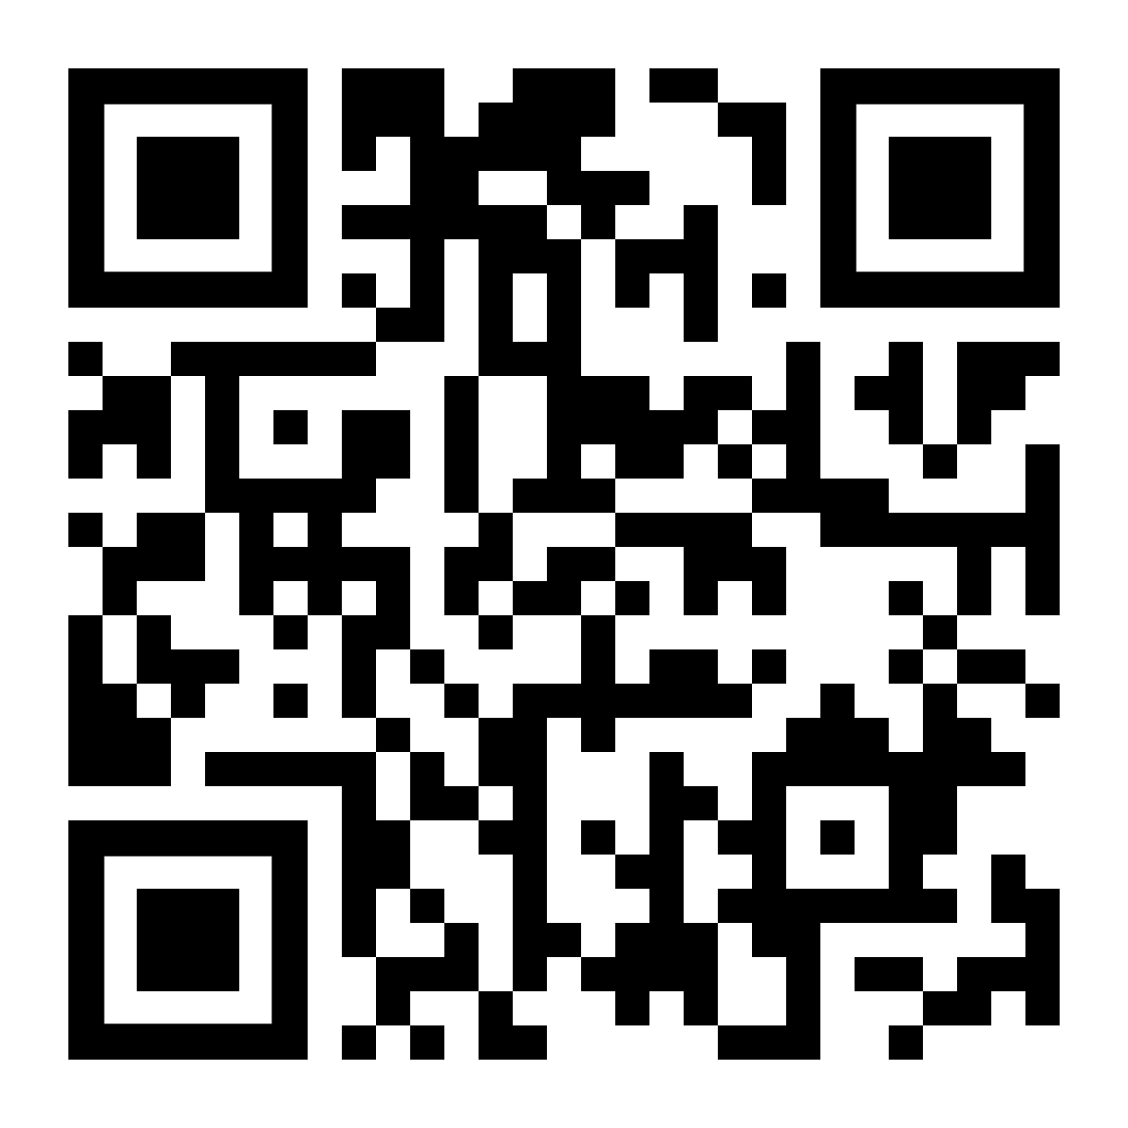
Please take the targetry needs survey!!

Slide 3
Session Summary
This session will be focused on cross-cutting developments, challenges, and needs in the field of targetry for nuclear data applications, including the availability of enriched stable and radioactive isotopes. Invited talks and discussion will be focused on target needs for a variety of nuclear data application spaces, the availability of these targets, and novel targetry fabrication techniques. The intent of this session is to discuss unmet needs and identify areas in which investment would benefit the quality and availability of targets for end users to generate nuclear data.

Slide 4
Goals
What do you need?
Applications side – what unmet target needs do you have
Specific ties to benefiting communities/application areas
Target fabrication side – what capabilities are you missing?
Is there any capability and or technology that would improve/increase your ability to make targets
Emphasis on actionable items –
activities that could be funded
level of effort needed

Slide 5
Discussion
Are there any target forms and/or materials (e.g. enriched stable isotope or radioactive isotopes) that you are unable to obtain?
How can we reduce uncertainties in nuclear data with improved characterizing targets?
What characterization metrics would provide needed information to reduce these uncertainties?
Are there any missing capabilities for successful execution of your mission/R&D?

