Slide 1
Wanted: Tiny radioactive samples for neutron transmission measurements with DICER at LANSCE
Experiendo cognoscitur
Th. Stamatopoulos¹, P. Koehler¹, A. Couture^{1,} G. Rusev²
V. Mocko², E. Vermeulen², E. O’Brien²
B. DiGiovine³
Physics Division, Los Alamos National Laboratory, 87545, NM, USA
Chemistry Division, Los Alamos National Laboratory, 87545, NM, USA
Weapons Stockpile Modernization Division, Los Alamos National Laboratory, 87545, NM, USA
LA-UR-24-21823

Slide 2
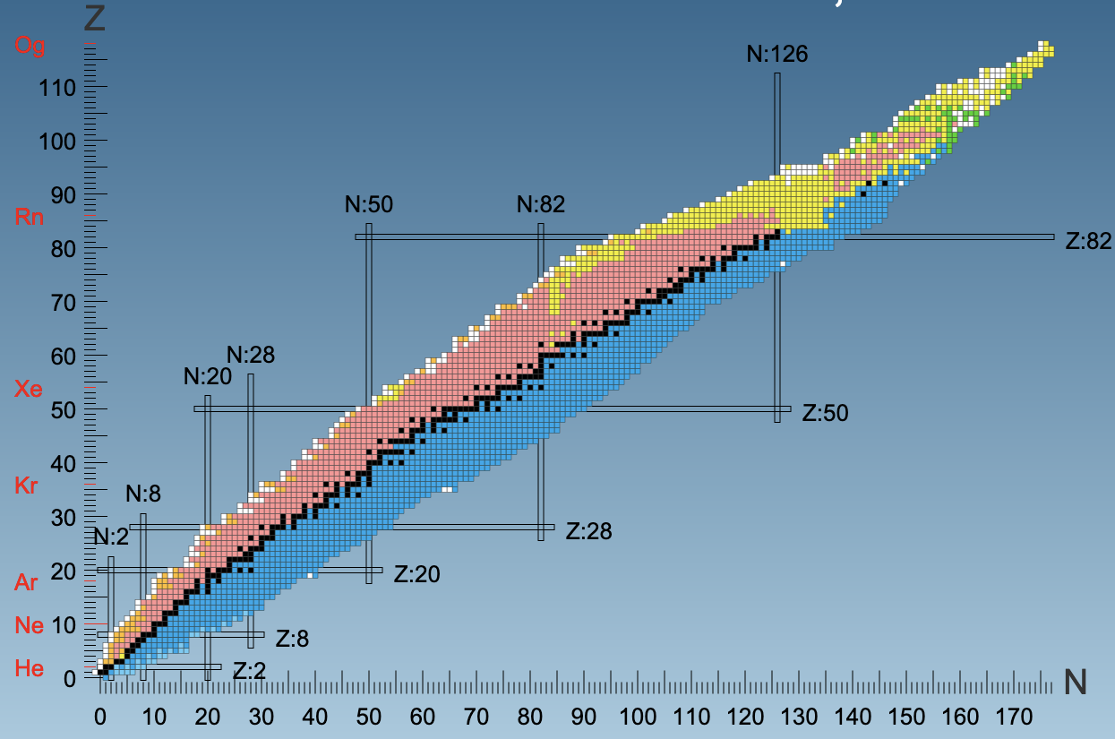
The why
Notes:
This is the chart of nuclides. Each little square represents a nucleus with a given combination of number of neutrons (N, the horizontal axis) and protons (Z, the vertical axis). The black squares represent stable nuclei and it’s what we call the valley of stability. As a general rule of thumb, the further away we move from the valley of stability, the smaller the half like of the nucleus. Now let’s zoom in a random region.

Slide 3
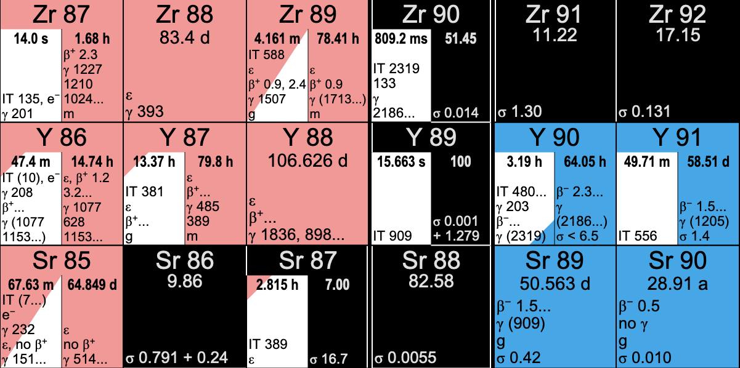
The why
(n,γ)
(n,2n)
Notes:
Again the black nuclei are stable and the rest are radioactive. Their half life is shown under their name. The “pink” nuclei disintegrate by electron capture or b+ and they “transform” themselves in the lower right nucleus or in bottom-right diagonal element indicated with the arrows.
An important element is to know the production and destruction rates of certain nuclei when they happen to be in a neutron field. There are two basic ways to destroy and produce certain nuclei. You can absorb a low energy neutron (i.e. E<1 keV) and then spit out gamma rays and that moves you to the next right nucleus or absorb a high energy neutron (E > 10 MeV) and then spit out 2 or more neutrons (n,2n) which moves you to the nearest left nucleus. The better you know the production/destruction rates known as cross sections, the better you can predict what will happen in a dynamic environment.

Slide 4
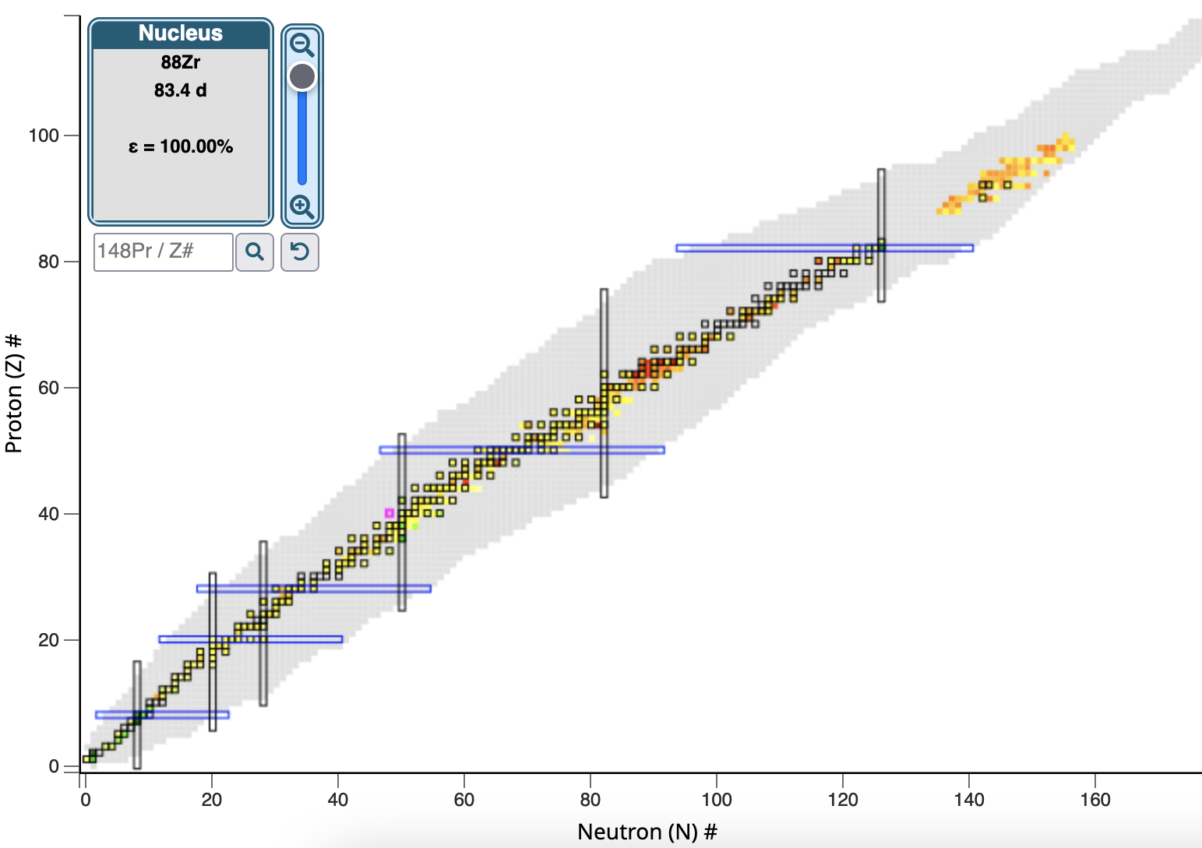
The what-we-know
Notes:
This work is focused on the (n,g) process. Measuring neutron capture rates it not trivial for radioactive nuclei. Just for fun look at the known (n,g) cross section for 25meV neutron energy. All the grey boxes are unknown. The gray squares are typically radionuclides.

Slide 5
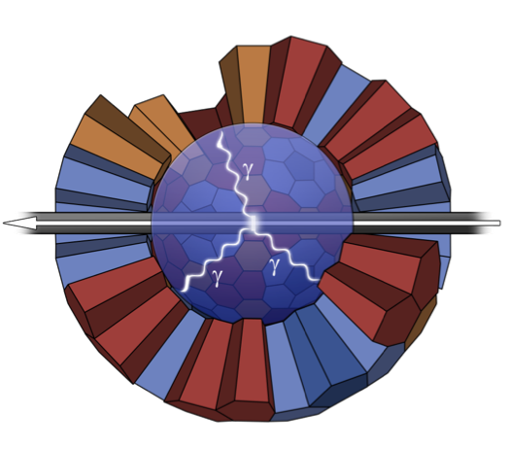
The how-we-wish
Notes:
The reason this is difficult is, in typical (n,g) experiments, the nucleus under study, is placed very close to gamma detecotrs. So the gamma rays from the disintegration can mix up with the gammas from (n,g). We developed an indirect way to measure capture rates when other techniques fail.

Slide 6
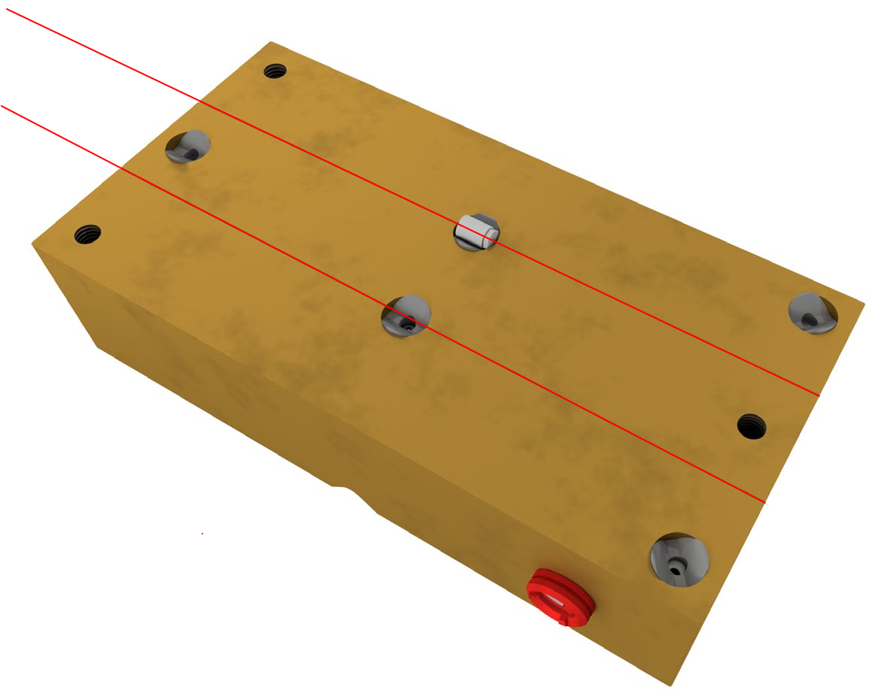
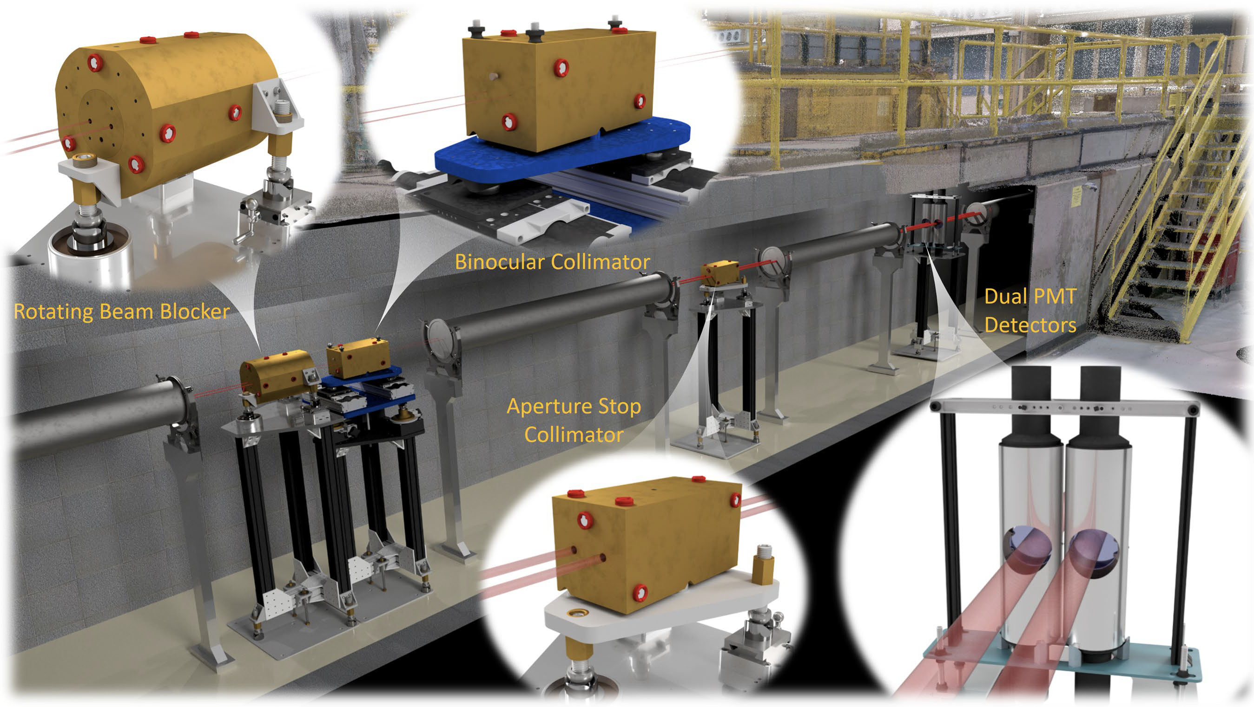
The how-we-can
Notes:
Instead of capture we can study the transmission of neutrons through nuclei and from that we can deduce or extract the neutron capture cross section. This is what the Device for Indirect Capture Experiments on Radionuclides does or DICER.I won’t go into details because this session is focused elsewhere. What I’ll say though is that in these experiments the sample thickness is a very important parameter. You need a certain thickness to acquire good data. Also keep in mind that when you want to study radioactive samples you have to think about the dose rates the personnel will be exposed to and also the difficulty of fabricating large amounts of material. IN other words, there’s a mass limitation. Given the certain length that’s required, you need to make samples with small diameter. What I’m showing here is DICER and long story short is that it’s an instrument with a very precise and sophisticated collimation system that measure the transmission of neutrons through a sample. This instrument is designed to study very tiny amounts of materials that span from ng to a few mg. Currently we can measure samples with 1mm diameter and we are going to switch to 0.1mm. And this where you take it.

Slide 7
The where
LANSCE@LANL
1st takeaway: walking distance from IPF!
2nd takeaway: A few minutes drive to the hot-cells.
Notes:
Instead of capture we can study the transmission of neutrons through nuclei and from that we can deduce or extract the neutron capture cross section. This is what the Device for Indirect Capture Experiments on Radionuclides does or DICER.I won’t go into details because this session is focused elsewhere. What I’ll say though is that in these experiments the sample thickness is a very important parameter. You need a certain thickness to acquire good data. Also keep in mind that when you want to study radioactive samples you have to think about the dose rates the personnel will be exposed to and also the difficulty of fabricating large amounts of material. IN other words, there’s a mass limitation. Given the certain length that’s required, you need to make samples with small diameter. What I’m showing here is DICER and long story short is that it’s an instrument with a very precise and sophisticated collimation system that measure the transmission of neutrons through a sample. This instrument is designed to study very tiny amounts of materials that span from ng to a few mg. Currently we can measure samples with 1mm diameter and we are going to switch to 0.1mm. And this where you take it.

Slide 8
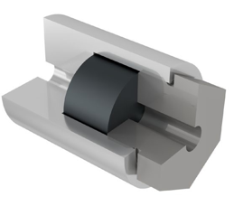
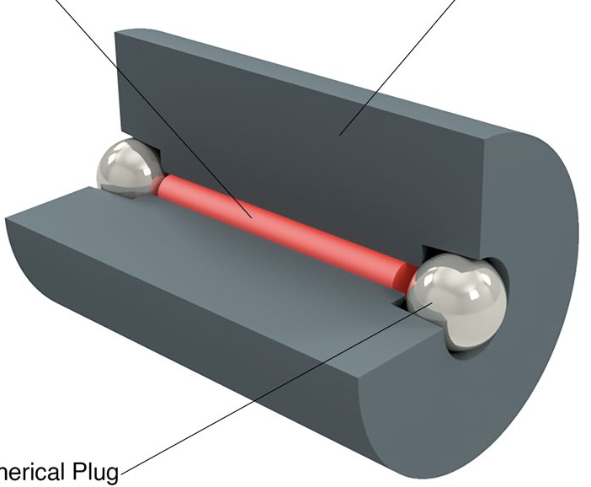
A few specs
Cylinder
1 mm or 0.1 mm diameter
1.5 cm in length
Liquid, powder and metallic samples.
Sample canister: 1.5 cm long, 1 cm diameter
Cryogenic and gaseous targets are on the works
Powder
Al plug
Al canister with a pass-through hole
Capillary tube
Powder sample, stuffed in a capillary tube, plugged with Al wire and placed inside an Al DICER canister
Metallic sample (Mo, Cd, Gd) in an Al screw down canister.
Liquid radioactive ⁸⁸Zr sample, dispensed in a W canister
Notes:
This is a synergy between physics, chemistry, radiochemistry and engineering. We nailed out the physics and the engineering of the instrument so we know how to do experiments and analysis. Each new measurement we want to do is a research project by itself and requires brainstorming between physics, chemistry and engineering. I’ll give you a few examples of some of the specs that go on the table and are actually the starting points of discussions.

Slide 9
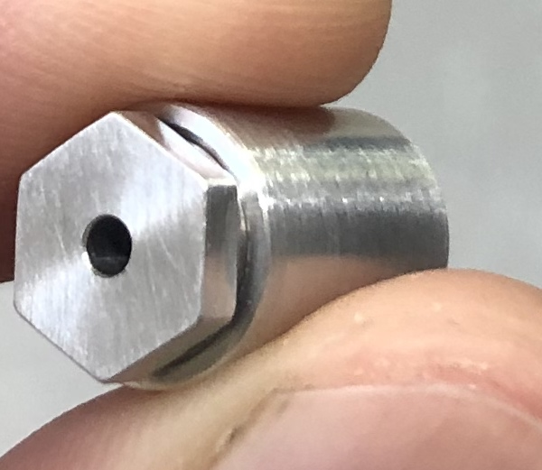
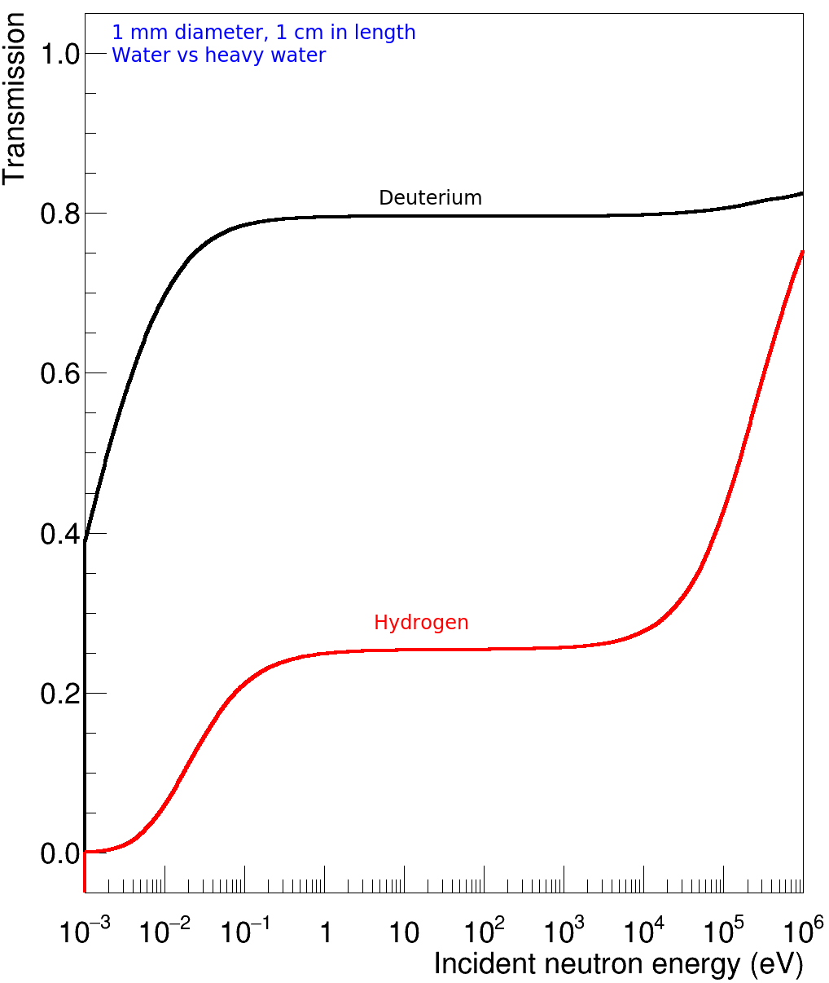
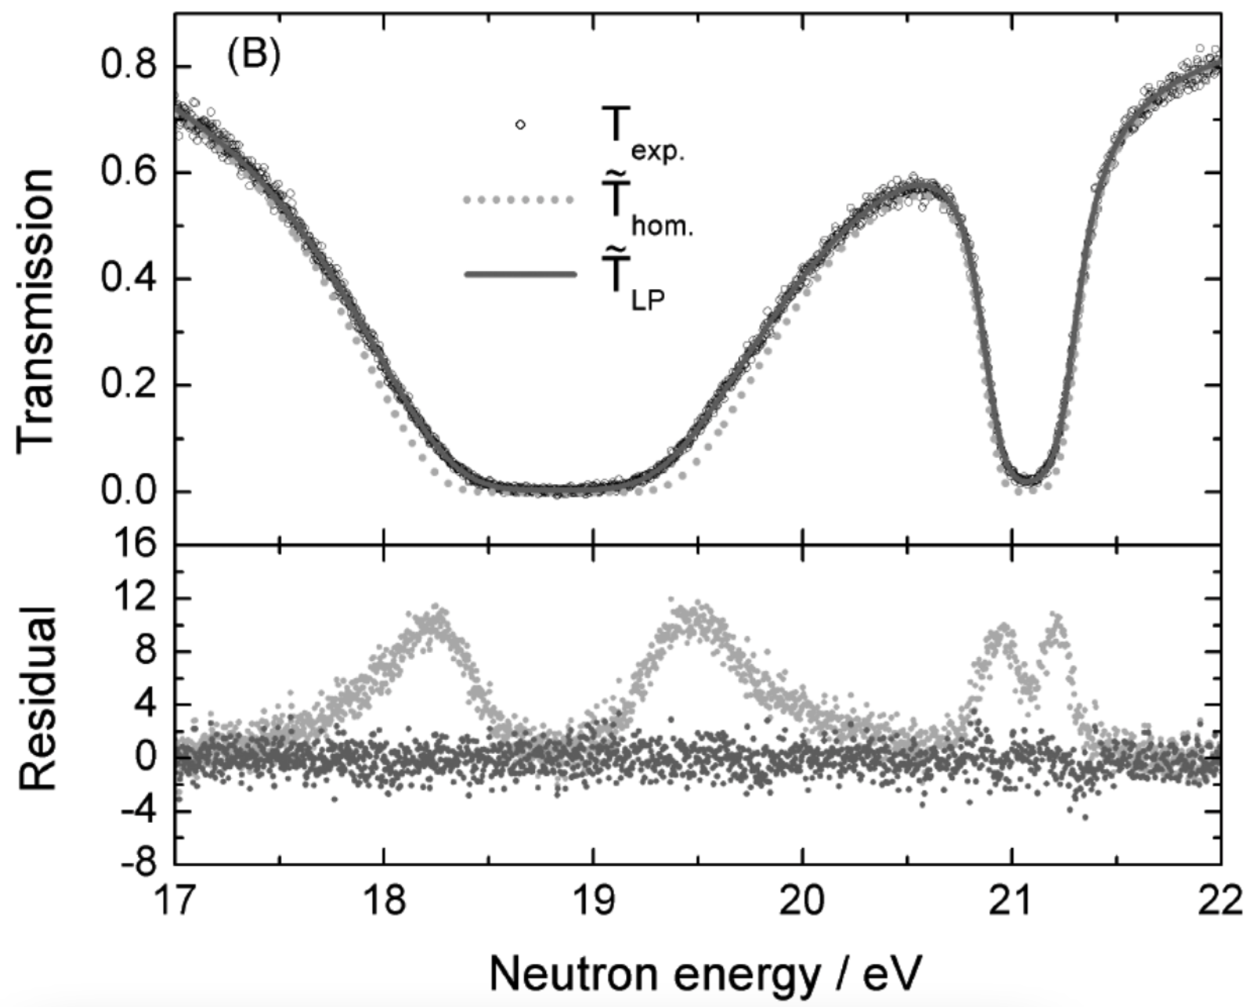
A few more specs
Samples should fit the DICER sample format (1/0.1 mm diameter, 1.5 cm length)
Uniformity and homogeneity
Minimization of hydrogen: replacement with deuterated compounds(?)
Other components in the sample, should be transmission friendly: Avoid nuclei that are neutron absorbers.
1 mm diameter, 1 cm length
Water vs Heavy Water
Deuterium
Hydrogen

Slide 10
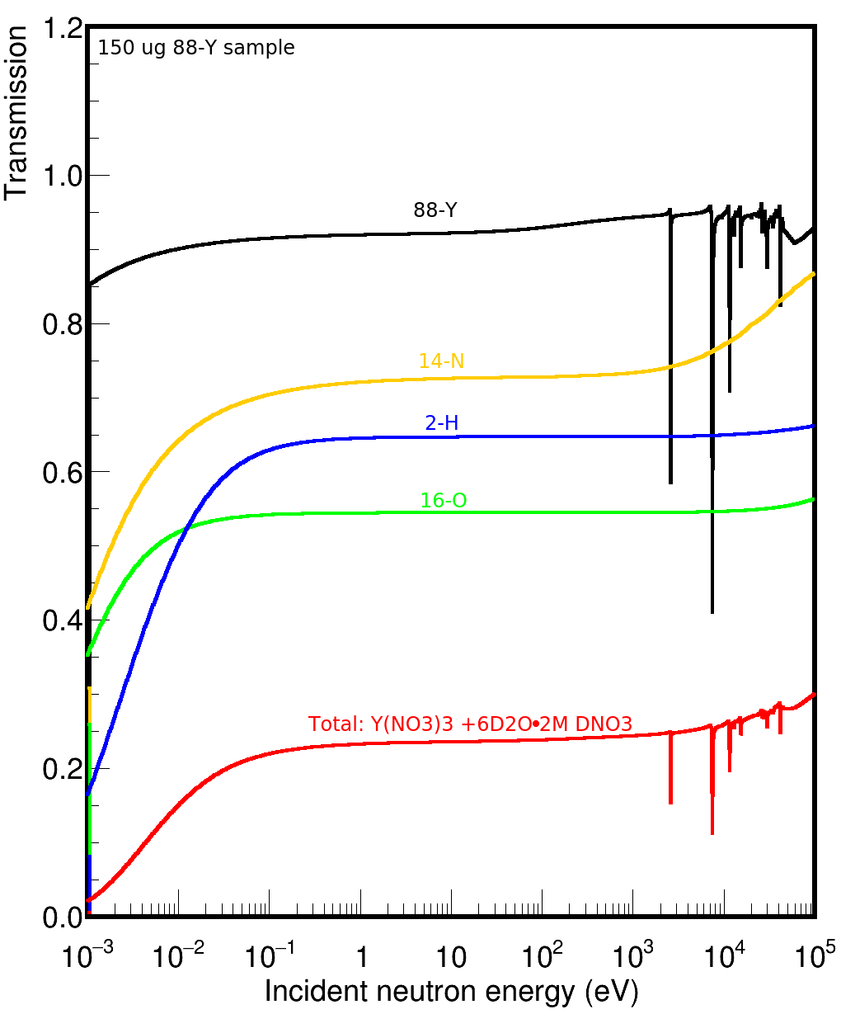
A few more specs
Samples should fit the DICER sample format (1/0.1 mm diameter, 1.5 cm length)
Uniformity and homogeneity
Minimization of hydrogen: replacement with deuterated compounds(?)
Other components in the sample, should be transmission friendly: Avoid nuclei that are neutron absorbers.
1 mm diameter, 1 cm length
Water vs Heavy Water
150 ug 88-Y sample
Deuterium
88-Y
14-N
2-H
16-O
Hydrogen
Total: Y(NO₃)₃ + 6D₂O 2M DNO₃

Slide 11
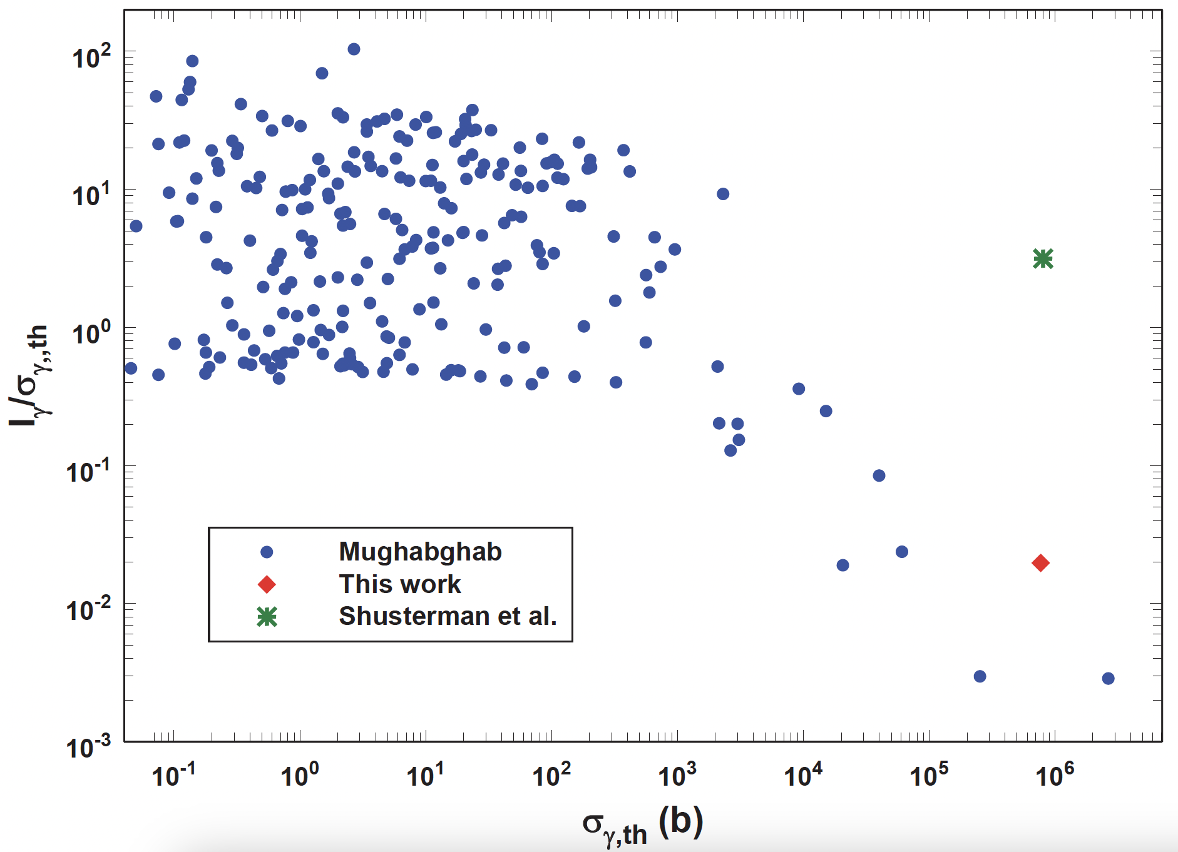
The curious case of ⁸⁸Zr (t_{1/2} = 83.4 days)
LLNL: σ_{γ}^{th} = 0.861(69) Mb Shusterman et al., Nature 565, p 328 (2019)
LLNL: I_{γ} = 2.530(280) Mb Shusterman et al., PRC 103 124614 (2021)

Slide 12
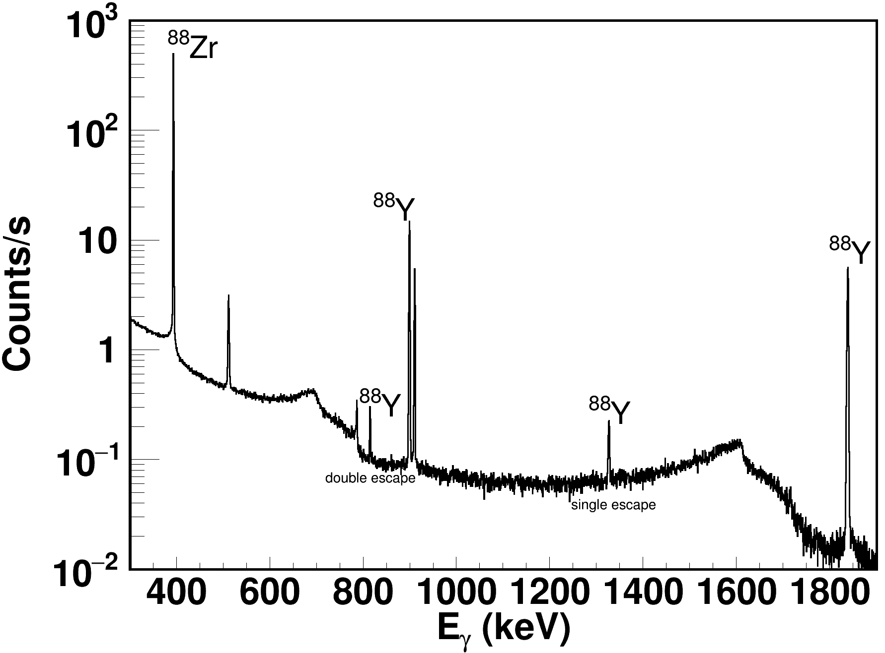
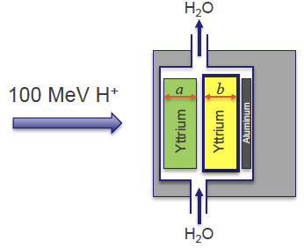
DICER-IPF synergy: The ⁸⁸Zr case aka a success story
The radioactive sample fabrication relies on the synergy between LANSCE and IPF
Proton irradiation of a suitable bulk material (⁸⁹Y)
Chemical separation and purification (600 mCi, 10 mL ⁸⁸Zr + H₂O●6mol/L HCl )
Gamma spectroscopy to extract mass
A. Matyskin et al, Sci. Rep., 2023 13(1), 1736
A. Stamatopoulos et al., J Rad. Chem., 2022, 331(12)
A. Stamatopoulos et al., EPJ., Conf. 260, 03006 (2022)

Slide 13
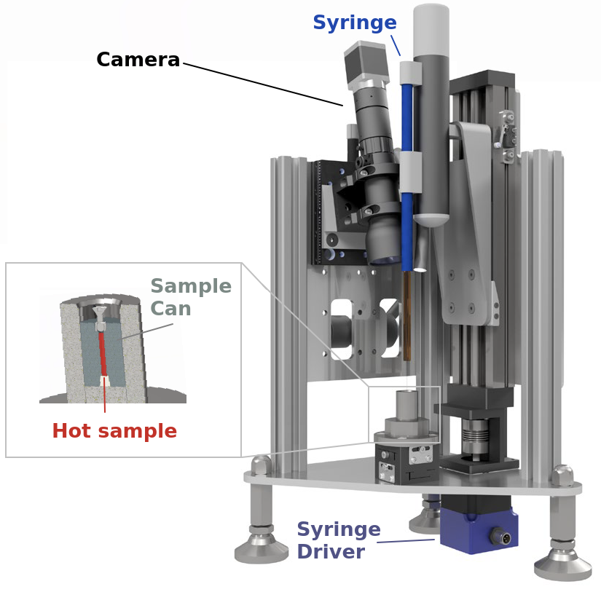
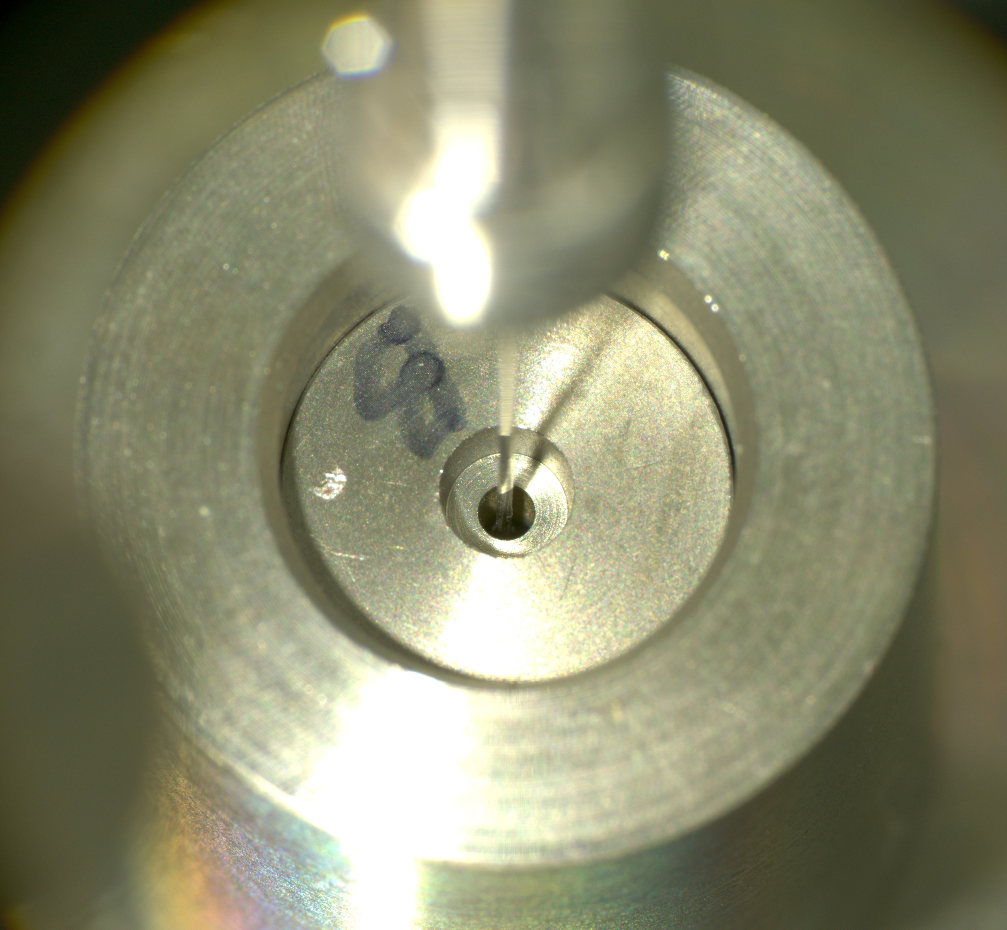
Development of filling station
To enclose our ⁸⁸Zr liquid sample, we developed a filling station that was remotely operated in the hot cells and dispensed the material in W cans.

Slide 14
Development of a 0.1 mm collimator : ⁸⁸Y case
Need for 0.1 mm-diameter samples: Development of a new 0.1 mm collimator

Slide 15
Development of a 0.1 mm collimator
Need for 0.1 mm-diameter samples: Development of a new 0.1 mm collimator

Slide 16
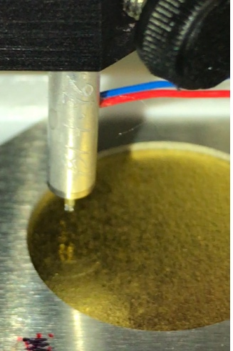
Development of inkjet printing
Inject printing of radioactive samples is a possibility we are currently exploring
This will hopefully allow to print samples with a small diameter (i.e. ⁸⁸Y)

Slide 17
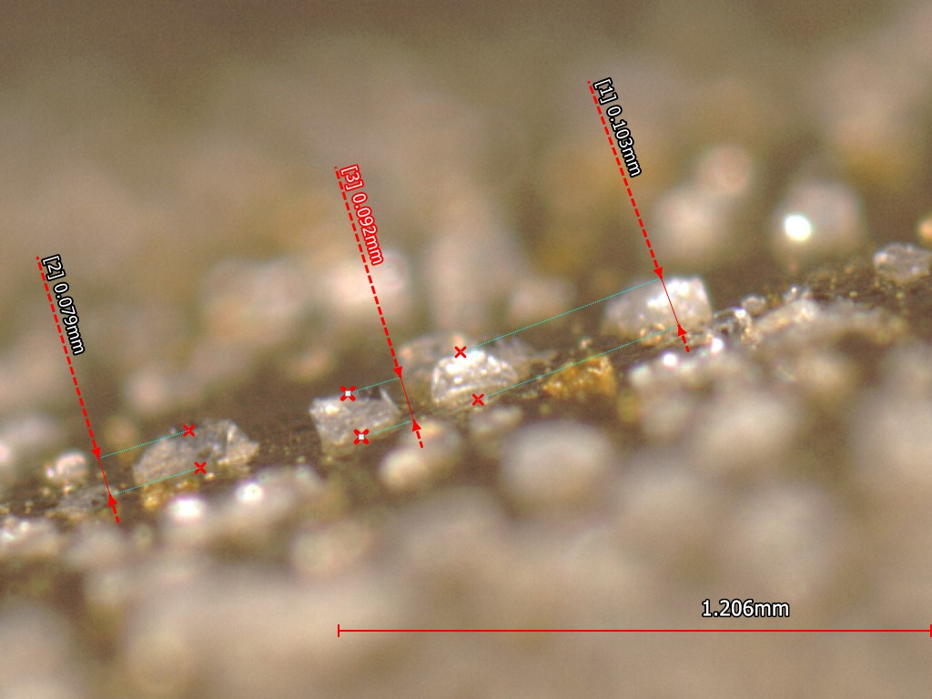
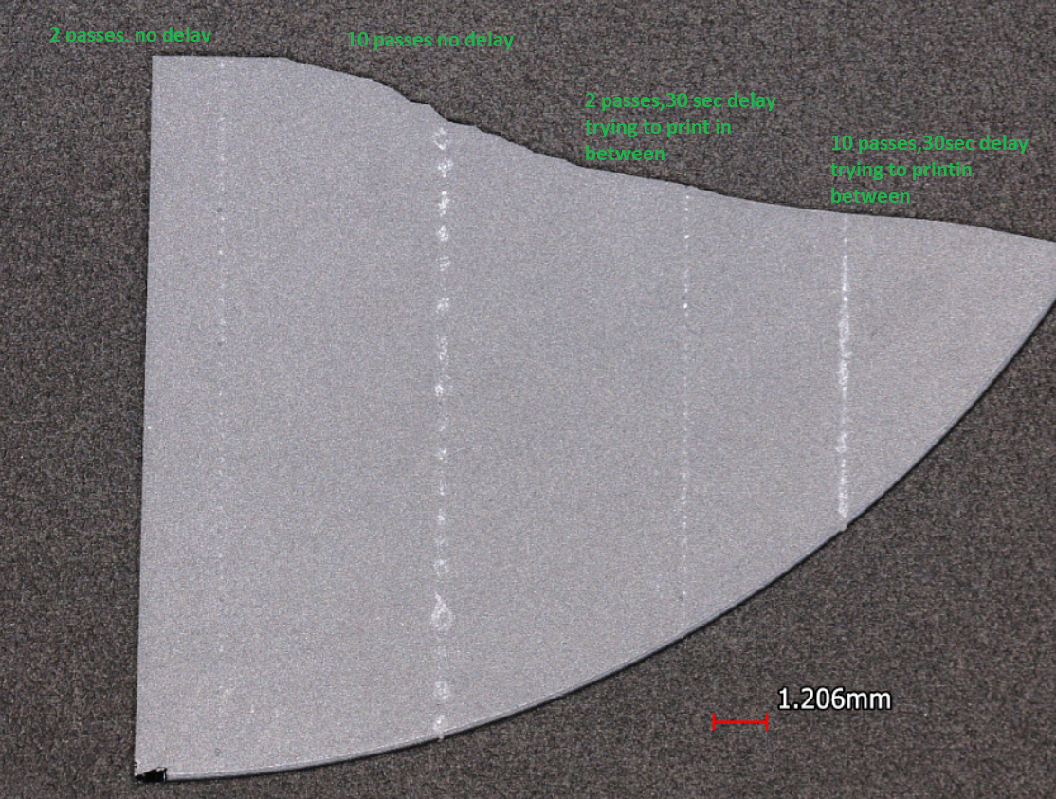
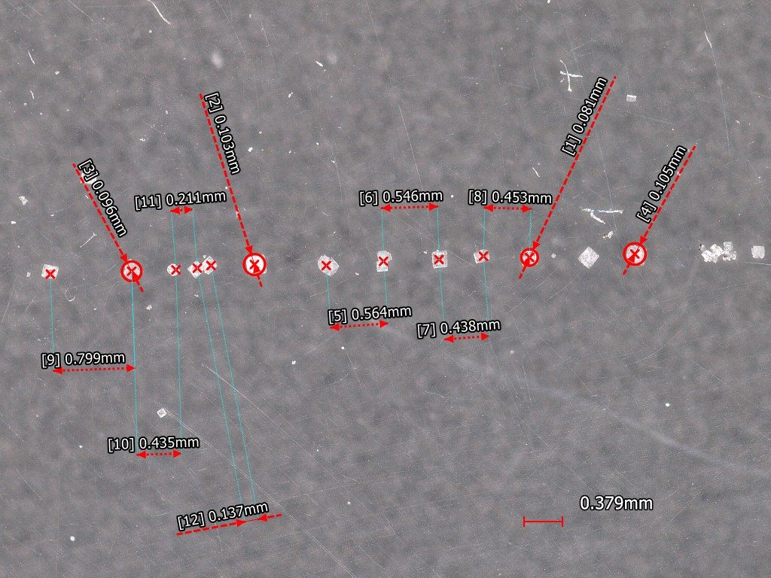
Development of inkjet printing
We managed to print NaCl, some Vanadium salts and YOCl.
NaCl on silicon substrate; different printer settings
NaCl on Au substrate
NaCl on plastic substrate

Slide 18
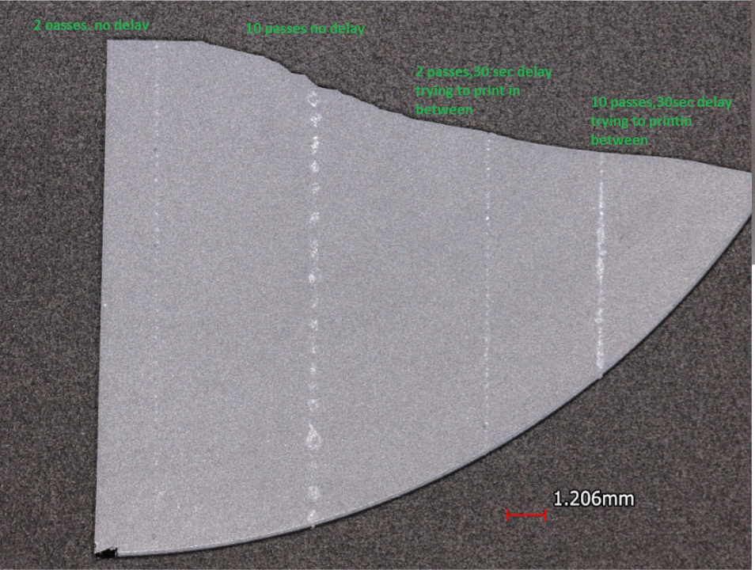
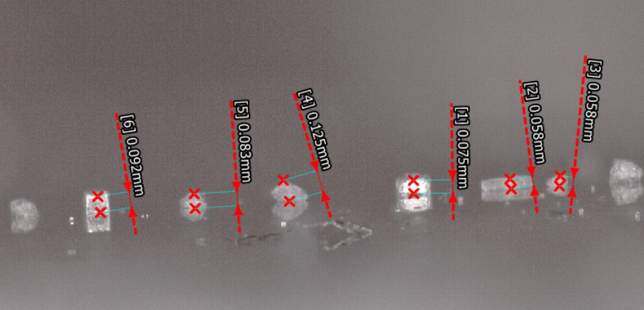
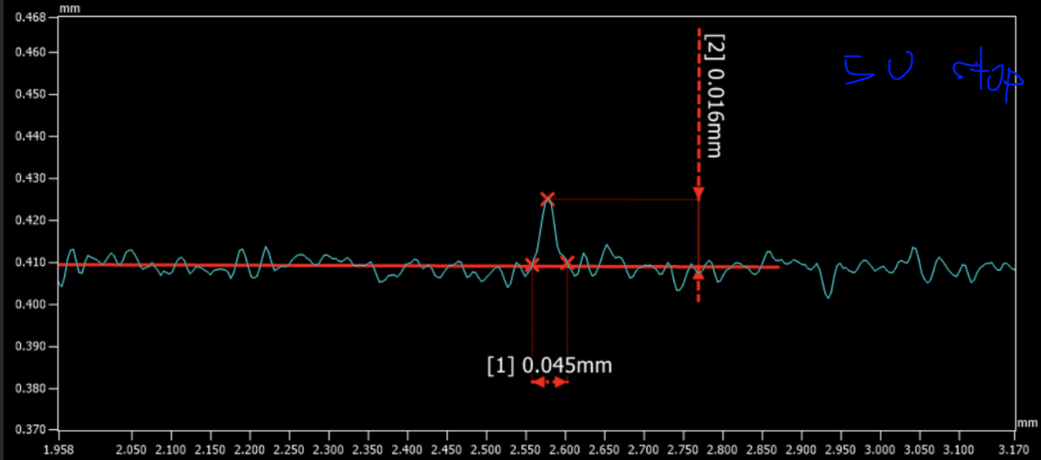
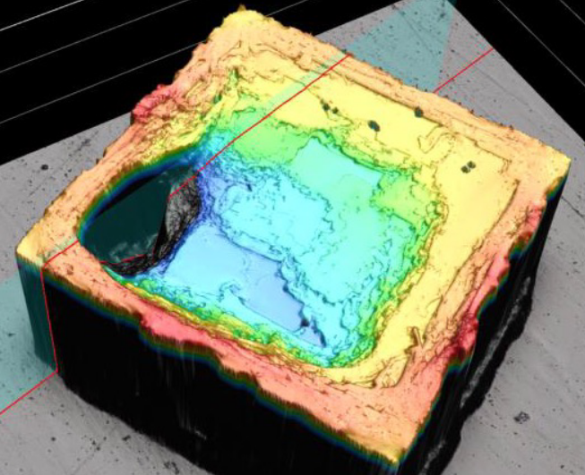
Development of microjet printing
Inkjet printing of radioactive samples is a possibility that LENZ and DICER are currently exploring

Slide 19
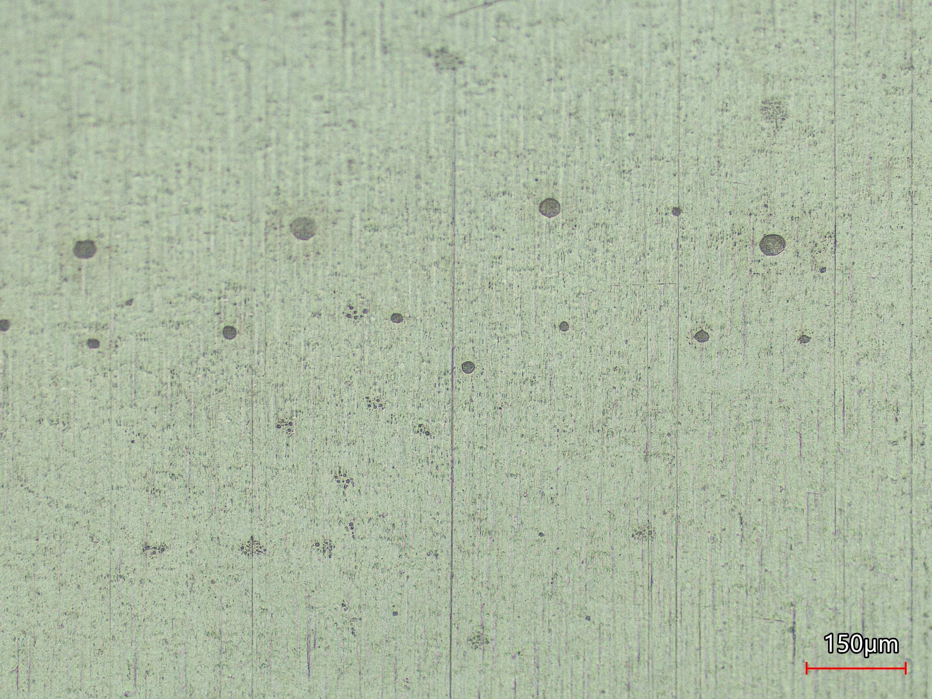
Development of microjet printing
YOCl ink printed on Zr substrate by Scott Essenmacher

Slide 20
A few future nuclides we would like to study
Nuclide | Half-life
⁸⁸Y | 106.6 days
¹⁰⁷Pd | 6.5 10⁶ years
¹³⁴Cs | 2.065 years
¹⁴⁷Pm | 2.62 years
¹⁵²Eu | 13.52 years
¹⁵⁵Eu | 4.75 years
¹⁵³Gd | 240.4 days
¹⁶³Ho | 4570 years
¹⁷⁰Tm | 128.6 days
¹⁸⁵W | 75.1 days
¹⁸⁶Re | 3.72 days
¹⁹²Ir | 73.8 days
¹⁹³Pt | 50 years
Nuclide | Half-life
³H | 12.3 years
¹⁷¹Tm | 1.92 years
¹⁵¹Sm | 90 years
²H | stable
¹³³Cs | stable
⁴⁰Ar | stable

Slide 21
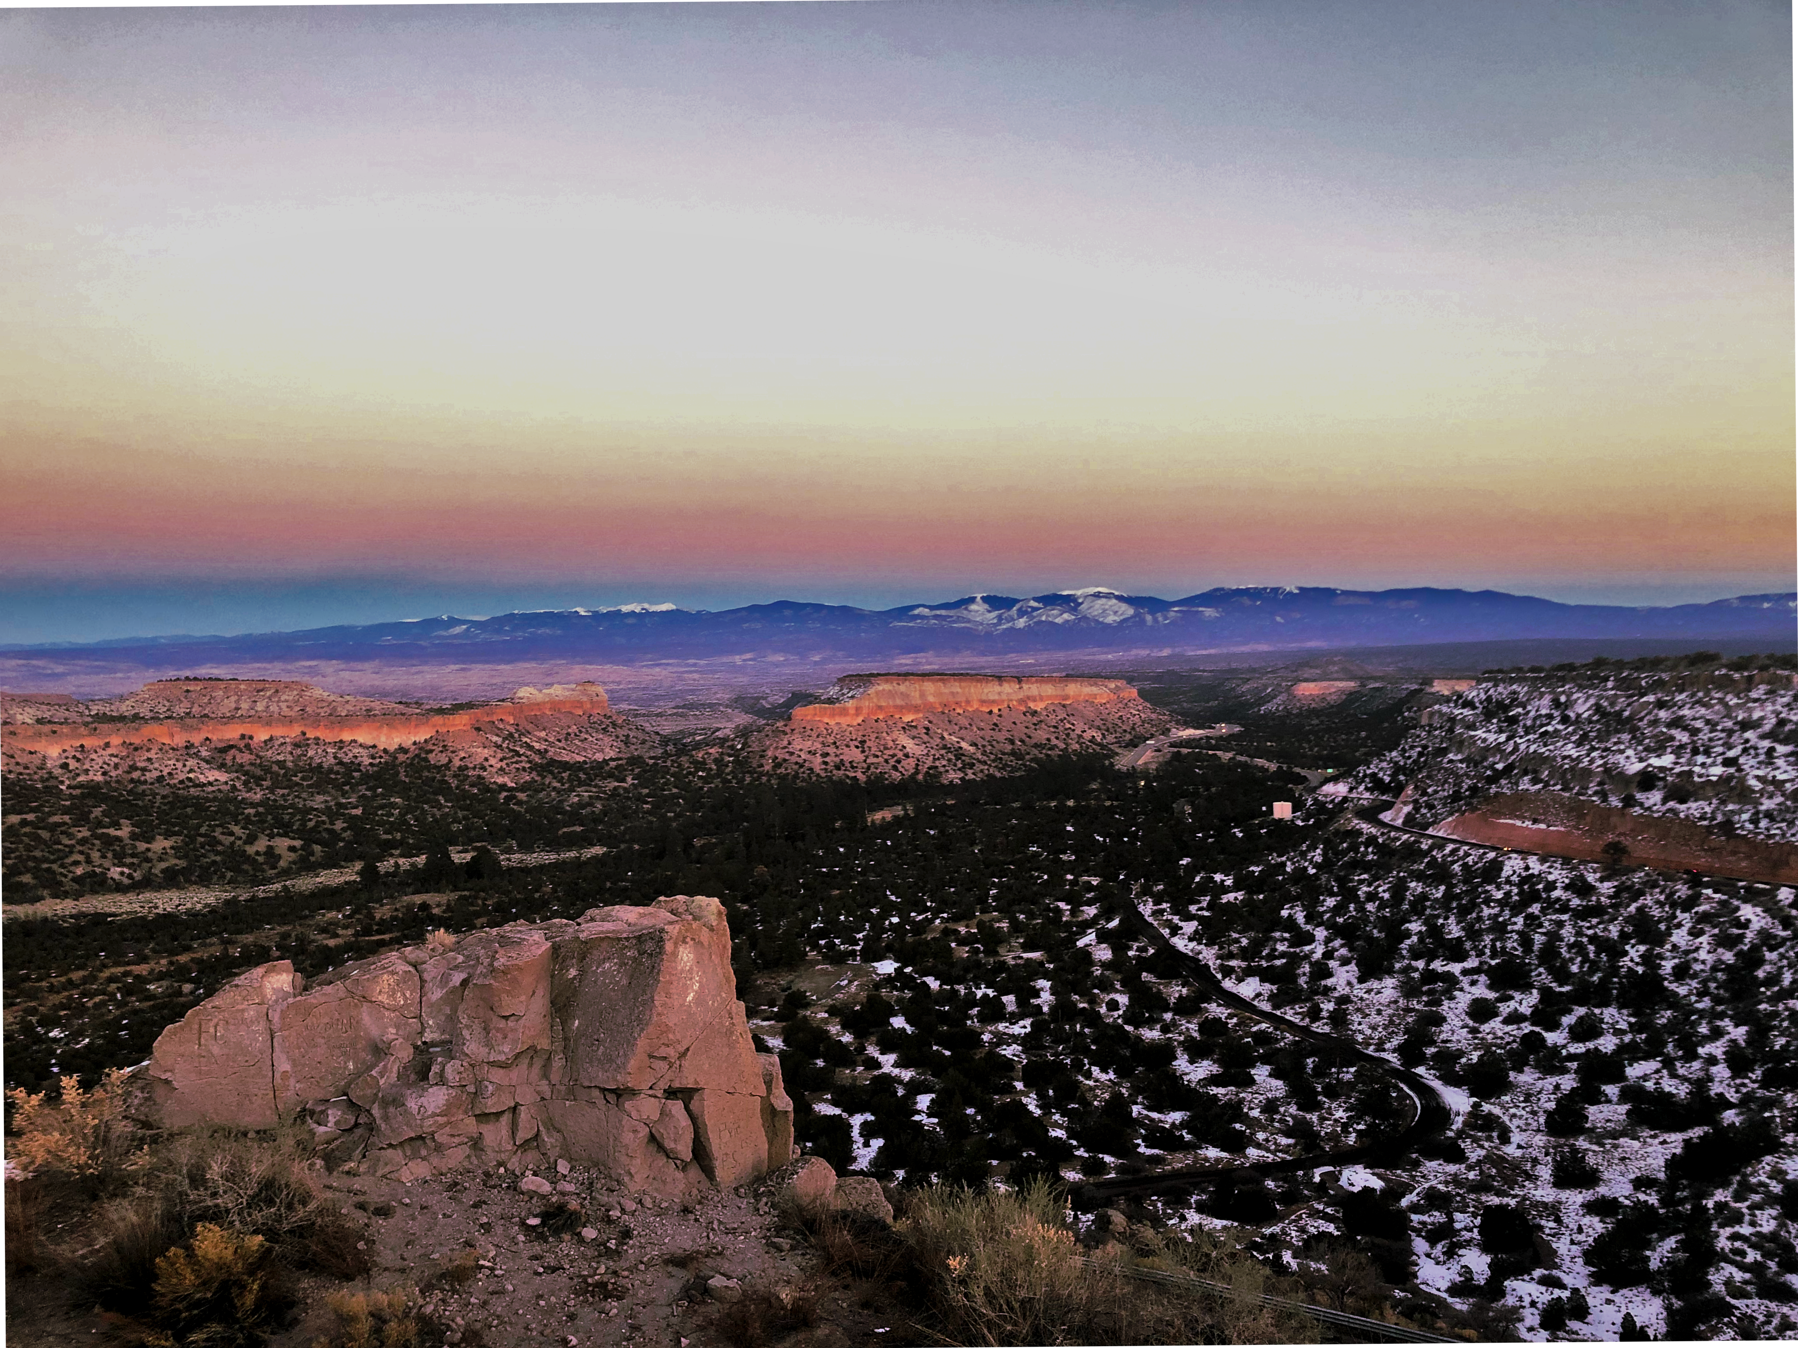
Thank you for
your attention!

Slide 23
⁹Back-up slides

Slide 24
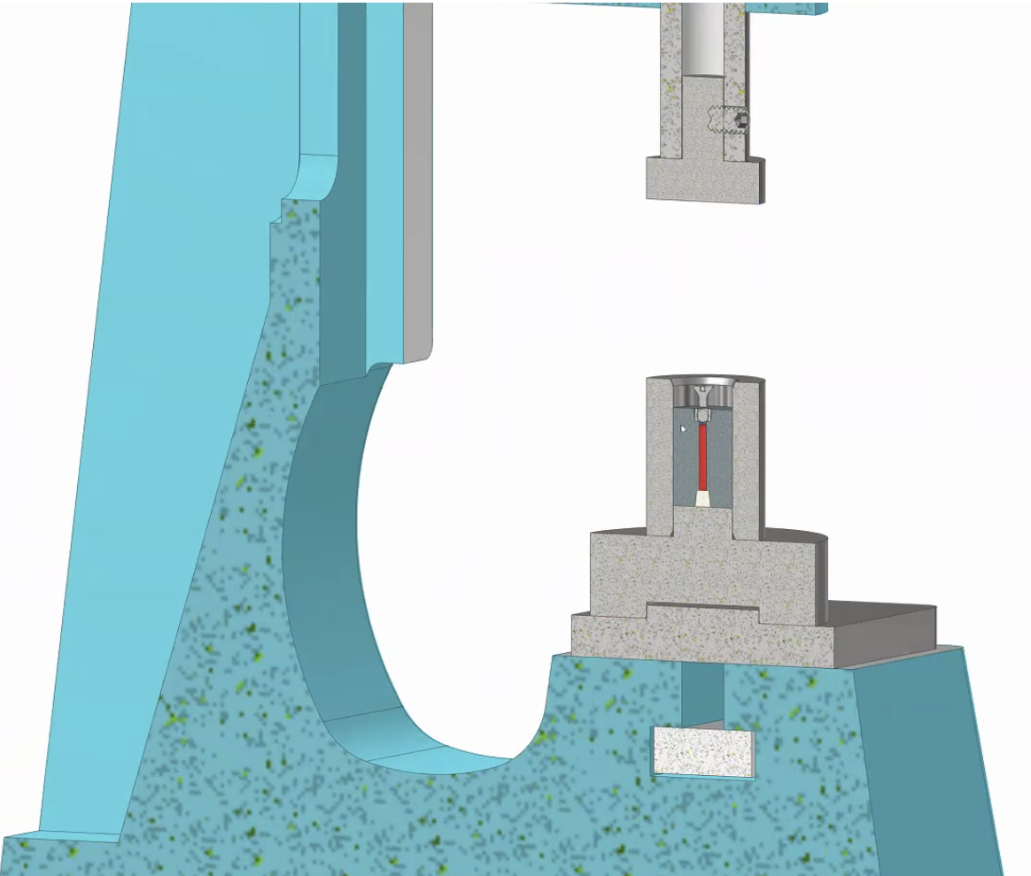
Press that we used to seal the 88Zr sample

Slide 25
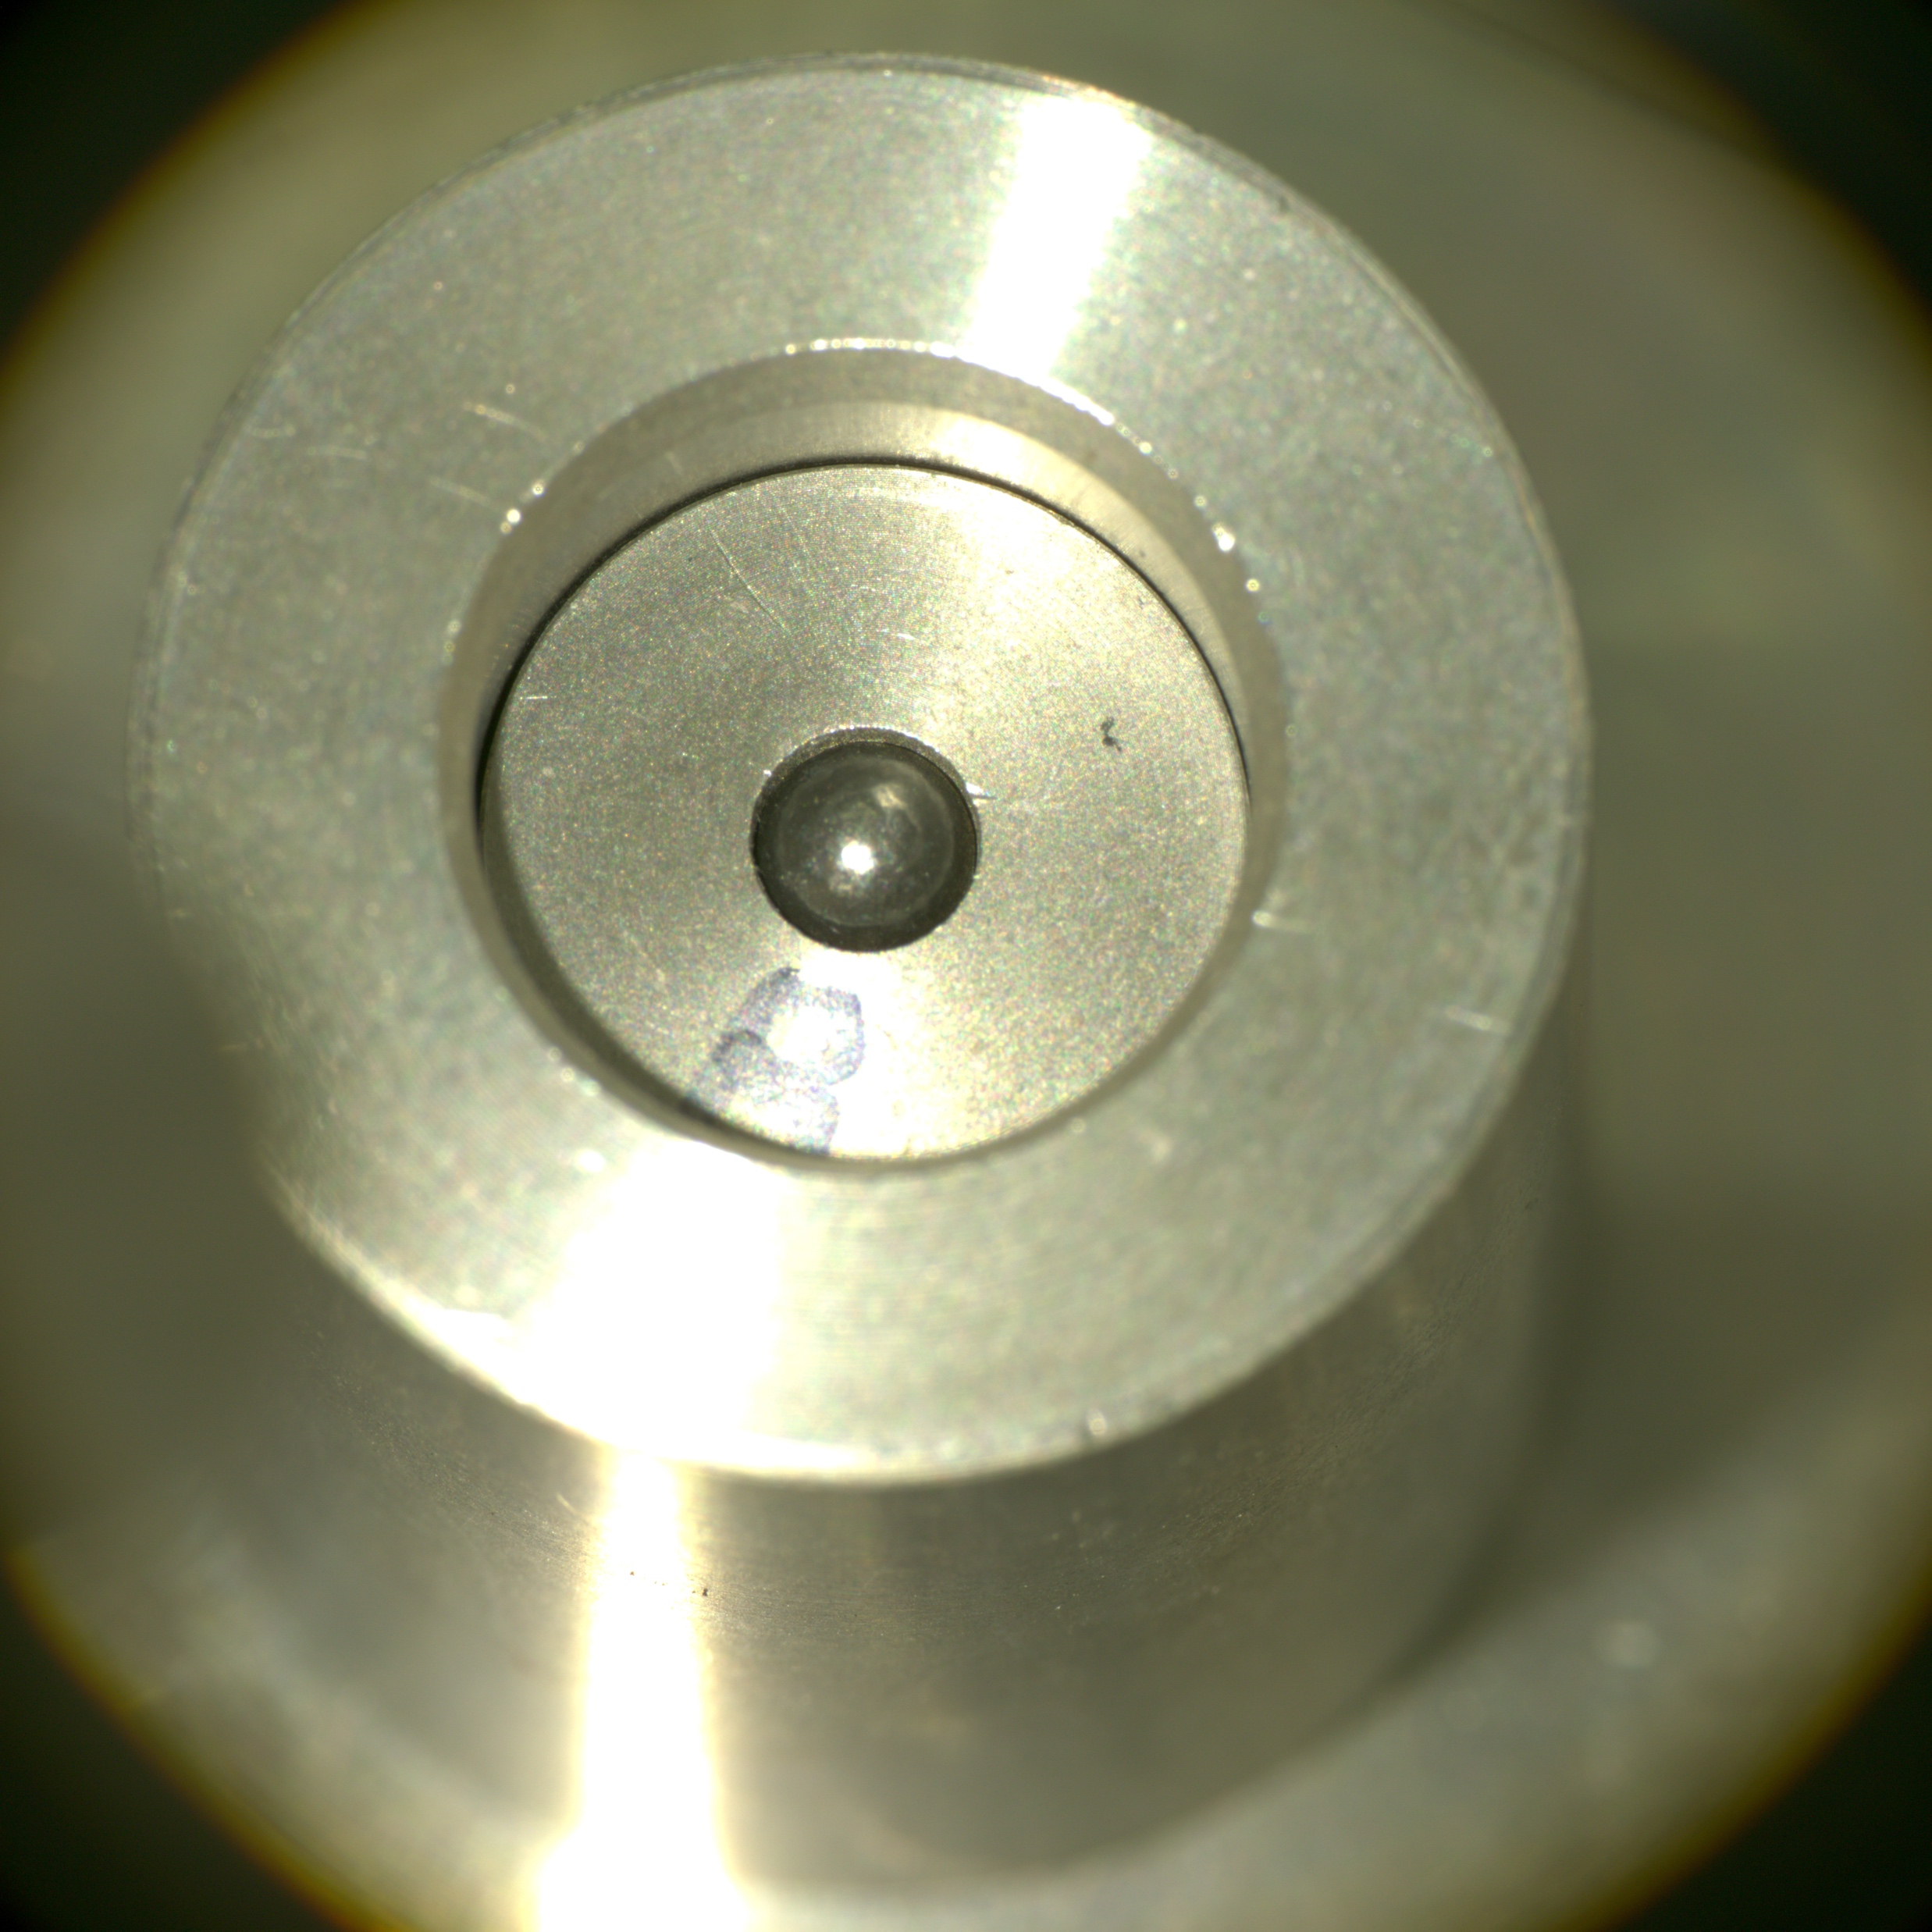
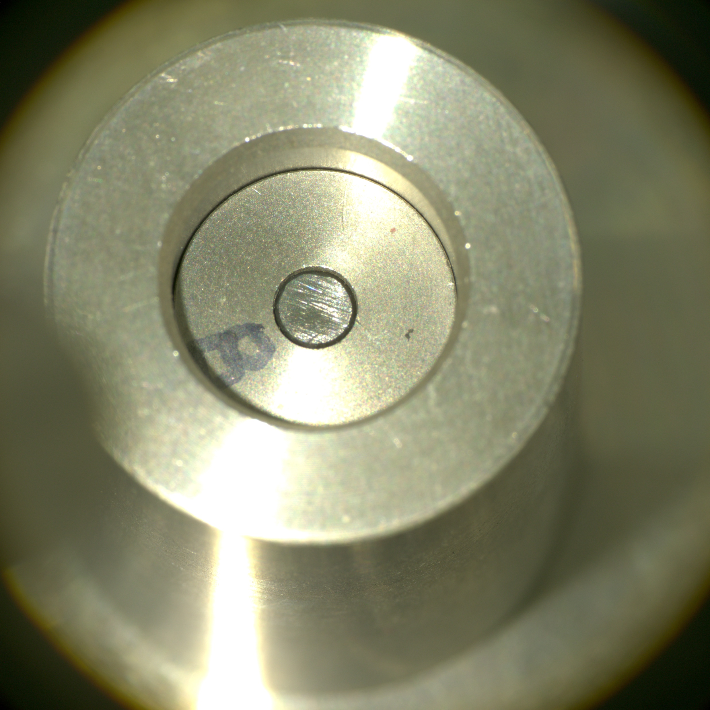
The Pb seal we used on the 88Zr sample
The press deformed the Pb shot

