Slide 1
Development of Radiochemical Techniques for Doping NIF Capsules with Radioactive Material
WANDA 2024
February 28, 2024
Samantha A. Labb, John Despotopulos, Kelly Kmak
Nuclear and Chemical Sciences Division

Slide 2
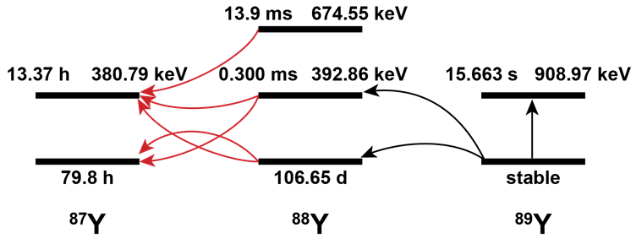
Developing NIF Platforms for Measuring (n,2n) Cross Sections on Radioactive Species
High neutron yield and small burn volumes result in neutron fluxes much larger than traditional neutron sources
Large neutron flux requires fewer target atoms to made a measurement (10¹³ atoms vs 100 times more material for an accelerator measurement)
Short burn time (~100 ps) means that short-lived, excited states are accessible at higher neutron yields
Notes:
The main goal of HED radchem is to develop platofrms to measure n,2n neutron capture cross sections at NIF which is a unique facility for measuring neutron induced reactions
Measurements at accelerator facilities require ug – mg of dopant which is fractions of a Ci to 10s of Ci of material, but the large flux at NIF allows for measurement with only ~10^13 atoms or ng of material

Slide 3
Known reference reactions are used to determine unknown cross sections
Target materials and associated collection tracers are added to NIF capsules and dried to a thin layer on the inner surface of the capsule
Reaction products are collected using Solid Radiochemistry (SRC) diagnostic at NIF and analyzed in the Nuclear Counting Facility (NCF)
Two target nuclides with a “known” and “unknown” cross section are co-loaded together
σ_{unknown}= σ_{known} (n⁰_{known}/n⁰_{unknown})(N_{unknown}/N_{known})
Platform developed for ⁸⁸Y(n,2n)⁸⁷Y measurement at 14 MeV at NIF
Notes:
To carry out these measurements we use a known/unknown method that adds a flux monitor into the dopant cocktail. In the case of Y, Tm-169 is used as the flux monitor since it has a well-known cross section that plateaus at 14.1 MeV
Since Tm and Y are REEs they behave identically chemically so they aren’t expected to fractionate during the explosion and transport to the collectors
Since they’re intimately mixed they see the same flux and we can measure the ratio of the ingoing atoms and outgoing n,2n reaction products
Different threshold - as we look at the data not be integrating all of the Tm and make a correctin
Can do at threshold of Y or at half max
INtegrate burn width and larger error in distribution

Slide 4
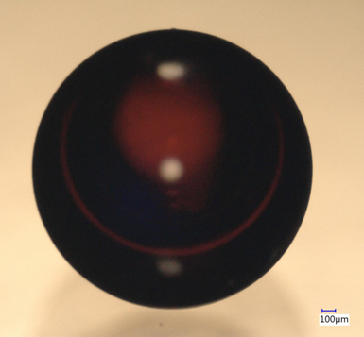
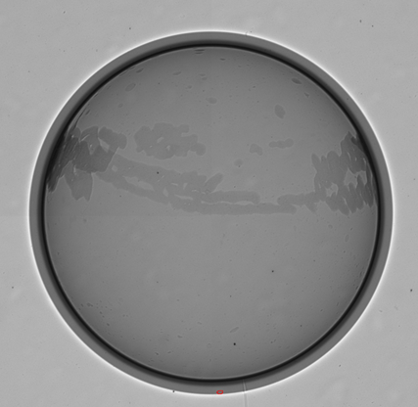
NIF Capsule Doping is an Interesting Challenge
Pre-drilled HDC capsule
  2 mm diameter, 10 μm diameter fill hole
Capsule is filled with dilute acid solution containing radionuclides of interest, centrifuged, and dried leaving a thin layer of material on inner surface
Isotopic and solution purity is necessary
  Clean solution free of salt as to not plug the fill-tube hole or deposit stable mass
Two capsule doping systems developed:
  Micro-injection
  Vacuum Assisted
Filled capsule prior to drying stage
X-ray image of capsule after cryo cycling
Notes:
However, doping a 2 mm capsule with a 10 um fill hole is a difficult challenge. While isotopic purity is traditionally the main concern, we also must consider solution cleanliness since even ng of salt like Na, K, and Ca which is in every liquid will plug the fill hole and won’t allow for DT fill.
A large amount of clean chemistry goes into this since decreasing the salt level to where it’s undetectable by MS is difficult, so we’ve developed tedious chemistry and 2 capsule doping systems to do this

Slide 5
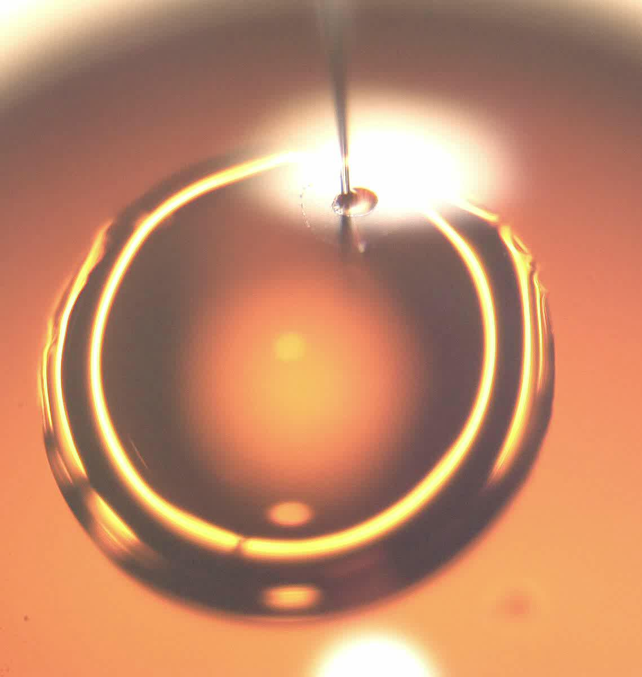
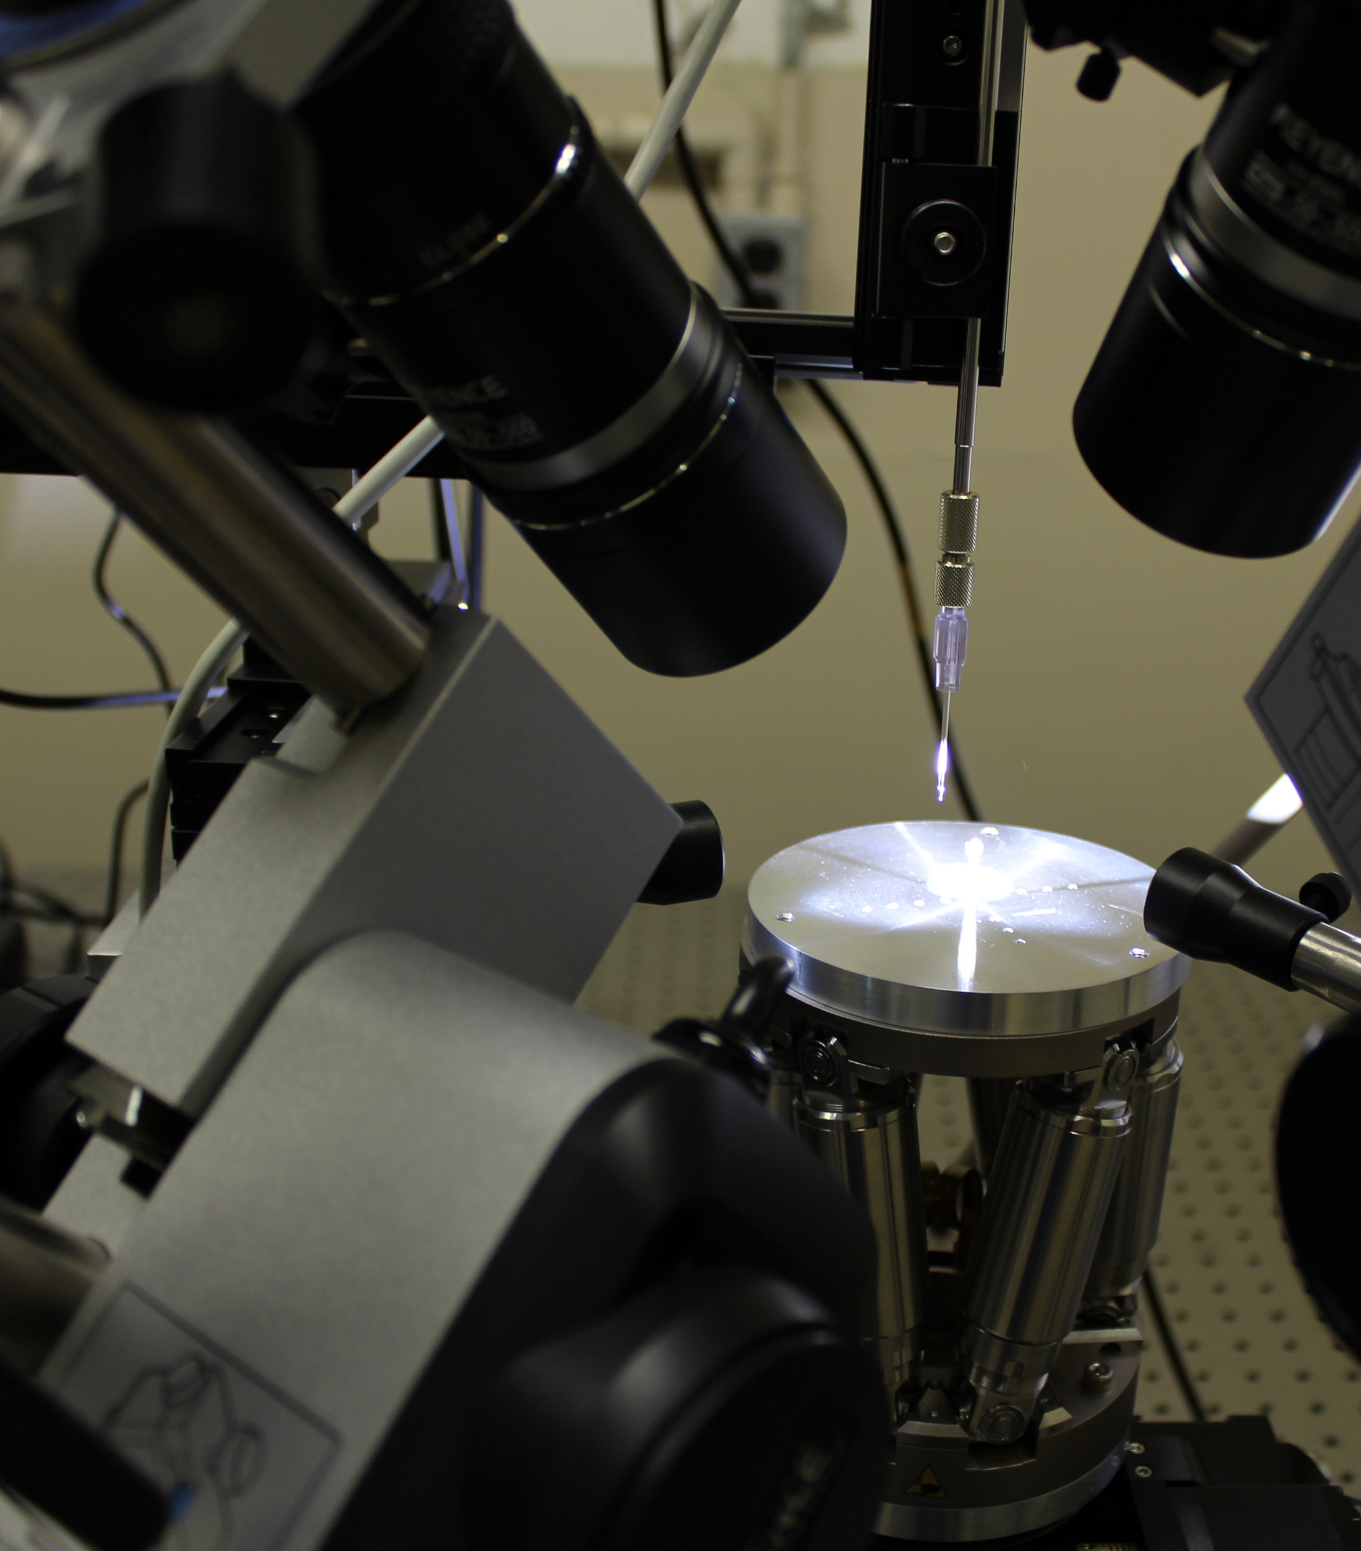
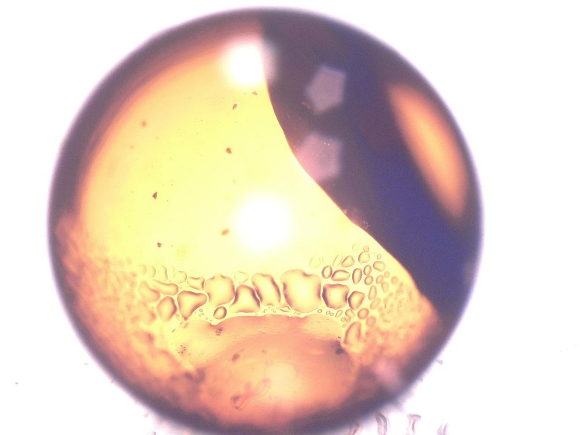
Apparatus for NIF Doping: Automated Robotic Injection System for Targets (ANDARIST)
System allows for precision alignment of microcapillary with fill-tube hole for injection
Each “cocktail” requires R&D to optimize the matrix and minimize mass loading
Used for radionuclides that cannot be obtained in large quantities
High efficiency doping of <1 μL volumes
Capillary entering fill-tube hole
10 μm
100 μm
Notes:
Andarist is a microinjection system that uses a manipulator to center the NIF capsule at the center of a miniature hexapod that uses pressure differences and capillary action to inject a small amount of solution onto the inner surface of the capsule
Volumes ranging from 1 pL to 10s of uL can be manipulated at near 100% efficiency so ANDARIST is useful for the doping of isotopes that you can’t produce much of; however, it’s extremely difficult due to the small scale

Slide 6
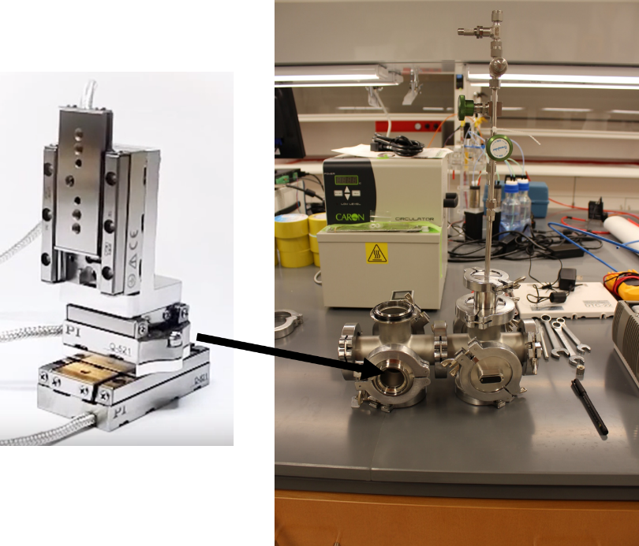
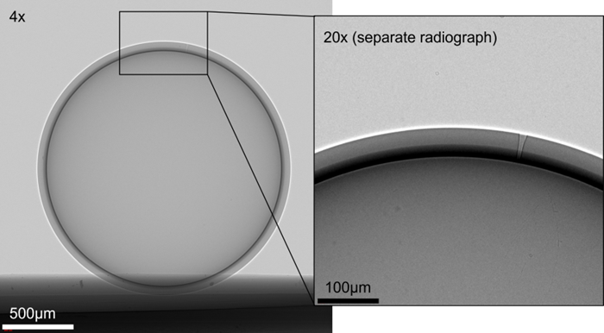
Vacuum Optimized Radionuclide Capsule Administer for NIF: VORCAN
Capsule filled via vacuum
Requires more target atoms than ANDARIST, but solution cleanliness standards are not as high
Used primarily for HDC capsules where the fill-tube hole is difficult to see
Notes:
VORCAN is a vacuum-based system that features a 1 cm x 1 cm vacuum micromanipulator. The capsule is suspended above a tiny beaker that can hold up to 10 uL of solution, vacuum is applied & beaker is lowered. When system returns to atmosphere the solution is sucked into the capsule. This system has a lower efficiency than ANDARIST and requires larger volumes, but is simpler to use and has less stringent solution cleanliness requirements
Can fill 6 capsules out of 10 mL, 3-4 uL lowest can go

Slide 7



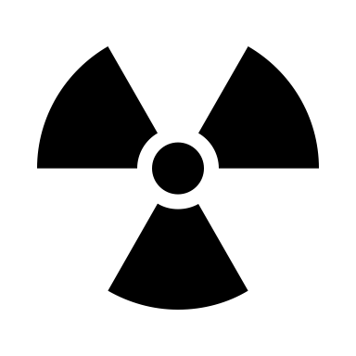

Simplified Capsule Doping Timeline
Years before shot
Finished 4 Months Prior
3 Months Prior
SHOT
Development
Purification
CFTA Assembly
Development of radionuclide cocktail for desired measurement
Radionuclide purification and production of dopant cocktail
Requires new chemical methods to produce ultra-clean samples
Capules sent back to GA for CFTA assembly
Production
Capsule Doping
Target Assembly
Production of radionuclides required for doping
Doping of NIF capsules received from GA
Characterization of materials added
Capsules to LLNL for target assembly
1 Year Prior to Shot
4 Months Prior
2 Months Prior
Notes:
Years before a shot we work on developing the optimal cocktail composition for the measurement we want to make and the year prior to the shot those radionuclides are produced. By 4 months of the shot we purify the radionuclides which can take several months depending on how similar the dopants are to salt impurities. 4 months the capsules are doped, centrifuged, dried in a vacuum oven, and metrology is performed before being returned to GA for the capsule fill tube assembly. The capsules are returned to LLNL for target assembly 2 months before the shot.

Slide 8
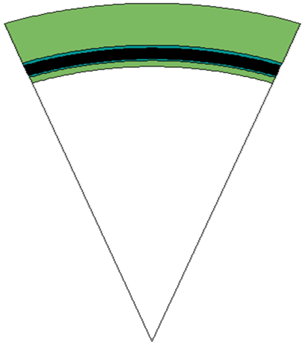
Fractionation Shot
10 μm fill tube hole
Use of a reference nuclide requires that the reactions products do not fractionate
Trivalent REEs typically have similar chemical behavior
2 shots designed to study condensation behavior of +3 ions from plasma onto SRC plates
High Density Carbon shell
1 mm radius
Nuclides deposited on inner surface:
⁹¹Y (t_{1/2}=58.5 d, 36.144 µCi)
¹⁷¹Tm (t_{1/2}=1.92 y, 2.705 µCi)
¹⁵²Eu (t_{1/2}=13.54 y, 0.747 μCi)
Notes:
If we’re applying the known/unknown method and assuming that the dopants see the same flux, we needed to determine whether fractionation occurs during transport from capsule to collector.
The capsule was doped with 3 radionuclides, Y-91, Tm-171, and Eu-152 to see if the ingoing ratio was the same as the collected ratio. So if there’s no fractionation there would be no corrections needed, but if the ratios were different each element would need a radiotracer for collection efficiency

Slide 9
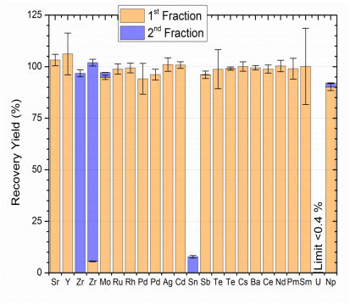
Preparation of Fractionation Tracers
Preparation of ⁹¹Y
Irradiation of 100 mg HEU at McClellen Nuclear Reactor (~e¹⁶ fissions)
Preparation of ¹⁷¹Tm
Irradiation of 100 mg Er₂O₃ at McClellen Nuclear Reactor
Final Preparation
Combine isolated ⁹¹Y, ¹⁷¹Tm and legacy ¹⁵²Eu and convert to 0.55 M HCl
Separation of Fission Products - LN Resin
Separation of ⁹¹Y from REEs - LN Resin
Single pass ultra clean ⁹¹Y fraction
Separation of ¹⁷¹Tm from bulk Er₂O₃ - LN Resin
Repeat separation of ¹⁷¹Tm from trace Er - LN resin
90+ % Tm in last two fractions, pass 1: 2.5 µg Er, pass 2: <0.02 µg Er
Separation of salts (Na, K, Ca etc.) - AG 50Wx8
Separation phosphate resin fines and final preparation - AG 1x8
Doping
Notes:
Shifting into more of the chemistry, we produced Y-91 from the irradiation of 100 mg of HEW at McClellen and purified it in a 2 step process using LN resin to first remove the bulk U and fission products. This has since been simplified to a 1 step process
Tm-171 was made by the n,g reaction on Er-170 and requires an adjacent lanthanide separation which is always difficult and took 100s of hours to complete. 3 LN columns were carried out and we were able to recover about 90% of the Tm with ~0.02 ug of Er which is good enough for the fractionation shot. However, for n,g experiments Er needs to be undetectable and could be achieved with 1-2 more passes
These radionuclides were combined into 1 solution with legacy Eu-152 and passed through a column to remove Na, K, and Ca followed by perchloric fuming to remove any residues from resins

Slide 10
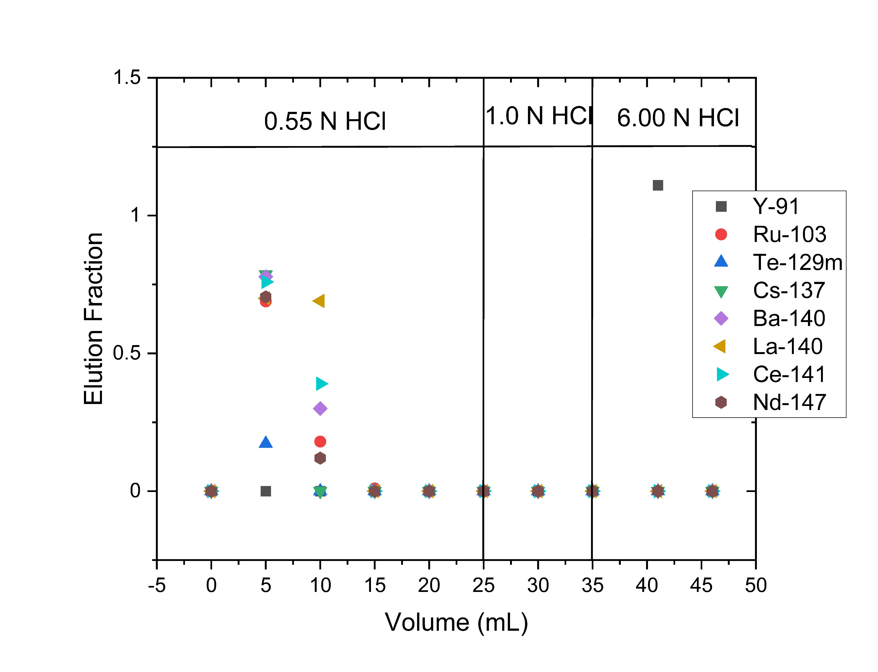
Preparation of Fractionation Tracers
Preparation of ⁹¹Y
Irradiation of 100 mg HEU at McClellen Nuclear Reactor (~e¹⁶ fissions)
Preparation of ¹⁷¹Tm
Irradiation of 100 mg Er₂O₃ at McClellen Nuclear Reactor
Final Preparation
Combine isolated ⁹¹Y, ¹⁷¹Tm and legacy ¹⁵²Eu and convert to 0.55 M HCl
Separation of Fission Products - LN Resin
Separation of ⁹¹Y from REEs - LN Resin
Single pass ultra clean ⁹¹Y fraction
Separation of ¹⁷¹Tm from bulk Er₂O₃ - LN Resin
Repeat separation of ¹⁷¹Tm from trace Er - LN resin
90+ % Tm in last two fractions, pass 1: 2.5 µg Er, pass 2: <0.02 µg Er
Separation of salts (Na, K, Ca etc.) - AG 50Wx8
Separation phosphate resin fines and final preparation - AG 1x8
Doping
Notes:
Shifting into more of the chemistry, we produced Y-91 from the irradiation of 100 mg of HEW at McClellen and purified it in a 2 step process using LN resin to first remove the bulk U and fission products. This has since been simplified to a 1 step process
Tm-171 was made by the n,g reaction on Er-170 and requires an adjacent lanthanide separation which is always difficult and took 100s of hours to complete. 3 LN columns were carried out and we were able to recover about 90% of the Tm with ~0.02 ug of Er which is good enough for the fractionation shot. However, for n,g experiments Er needs to be undetectable and could be achieved with 1-2 more passes
These radionuclides were combined into 1 solution with legacy Eu-152 and passed through a column to remove Na, K, and Ca followed by perchloric fuming to remove any residues from resins

Slide 11
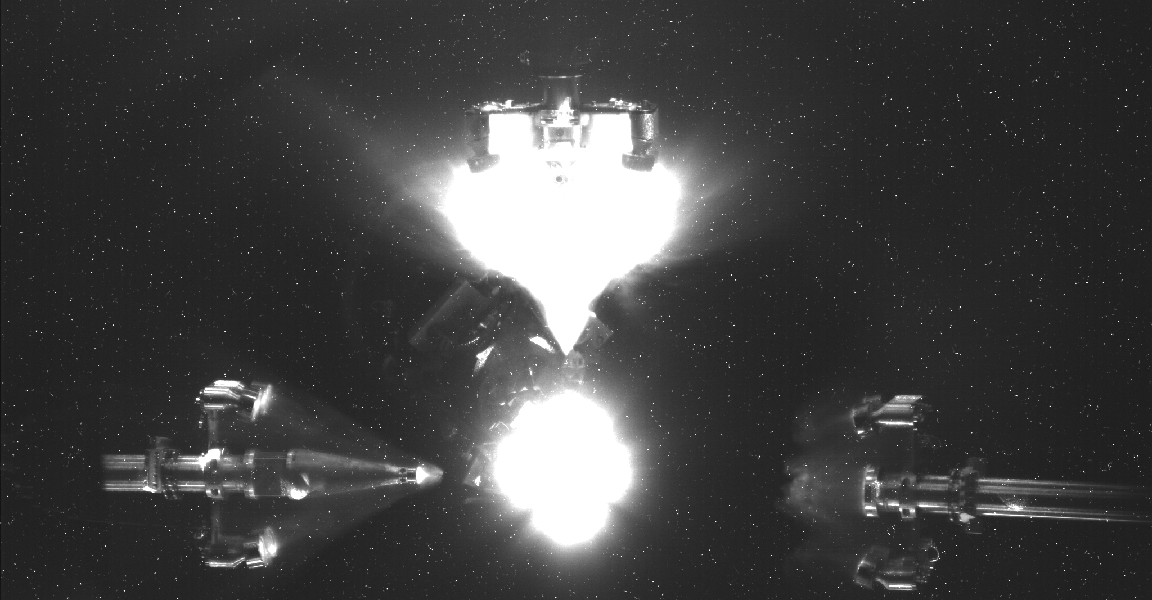
S04 (tracer shot): collected the same fractions of Y, Eu, and Tm as were doped into the capsule. No fractionation observed.
S05 (blank shot): measured nothing on the collectors, indicating negligible levels of radionuclide background and a good environment for upcoming layered shots
S06 was deferred due to time constraints imposed by deliberate operations. Losing S06 is mitigated substantially by getting an unambiguous result on S04.
N230328(29)-001 H_Burn_Sym_RadChem_S04(S05) Results
N230328-001 ⁹¹Y/¹⁵²Eu ratio | N230328-001 ⁹¹Y/¹⁵²Eu ratio
90-315 SRC1 | 47.1 ± 5.2
90-315 SRC2 | 50.8 ± 5.6
90-315 SRC3 | 53.3 ± 5.9
90-315 SRC4 | 51.5 ± 5.5
Ingoing ratio | 47.2 ± 0.5
SRCs
90-315
90-124
Disassembling target
Radchem data
NIF Shot Time Photography (Jedlovec)
Notes:
Preliminary data for Y/Eu shows that the ingoing ratio was equal to the outgoing ratio indicating the no fractionation occurs and no correction would need to be applied to an n,2n shot. The error has gotten tighter over time since they’ve worked through the data. 3 Shots were initially planned since the NIF chamber does have a background as they fire a lot of shots that leave FPs, but the blank shot showed no kickback of dopants from the chamber

Slide 12
Conclusions & Next Steps
Radiochemical & capsule doping platforms developed for neutron capture cross section measurements at NIF
No fractionation of dopant radionuclides observed during fractionation shot
Ongoing analysis of ⁸⁹Y(n,2n)⁸⁸Y cross section
  Preliminary data in agreement with reported 850 ± 50 mb cross sections
Investigation of the effect of dopant mass and ice layer quality on yield
Upcoming first attempt at ⁸⁸Y(n,2n)⁸⁷Y cross section measurement at NIF

