Slide 1
Emerging Combustion Synthesis Methods to Prepare Thin Targets for Nuclear Science Research
Khachatur Manukyan
Nuclear Science Laboratory
Department of Physics and Astrophysics
Workshop on Applied Nuclear Data Activities (WANDA)
Feb. 26 – Mar. 1, 2024, Hilton Arlington National Landing, Crystal City, VA

Slide 2
Outline
Solution Combustion Synthesis (SCS): SCS of Actinides
Thin-film target by SCS methods
Irradiation studies of targets
Conclusions
Acknowledgments

Slide 3
Solution combustion synthesis (SCS)
SCS is a rapid chemical reaction between metal nitrates (oxidizer) and solvent-soluble organic compounds (fuel) that produce nanoscale materials.

Slide 4
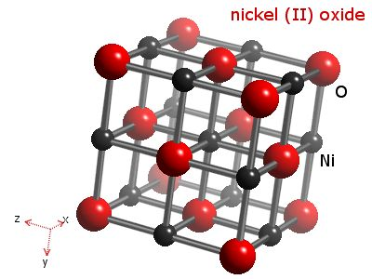
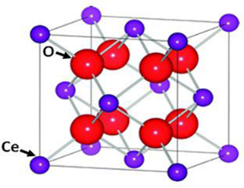
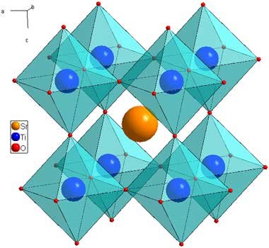
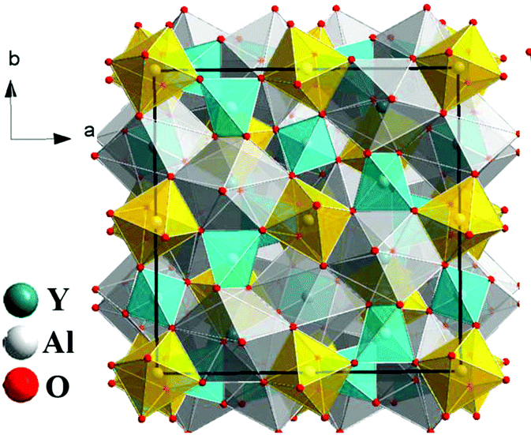
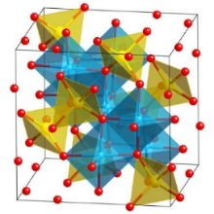
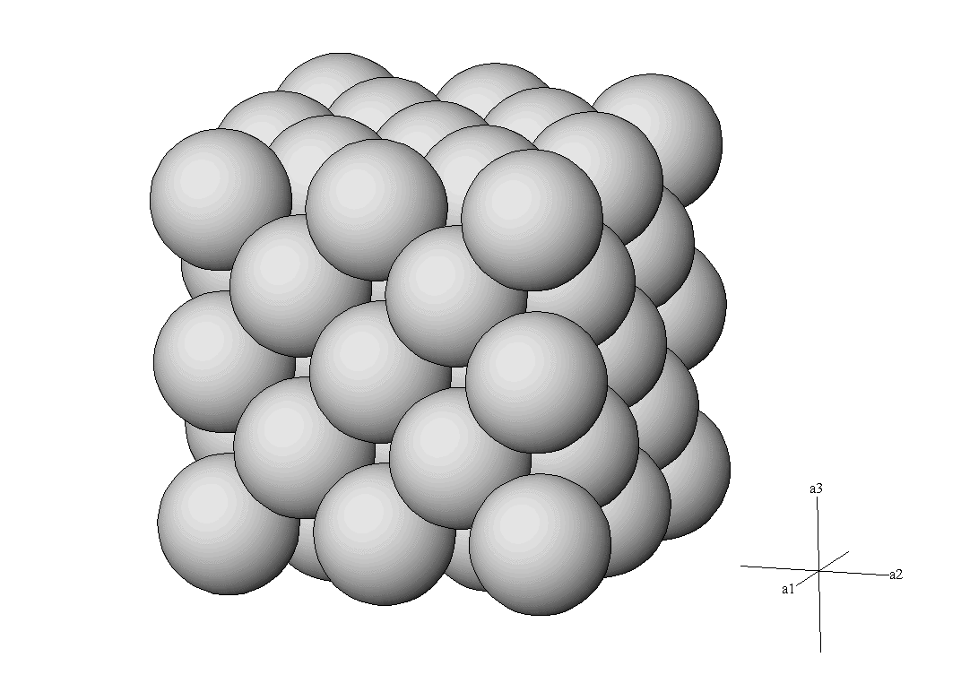
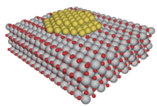
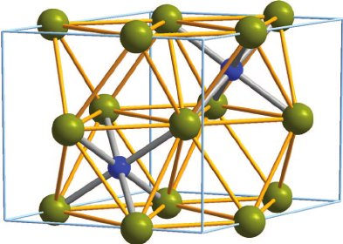
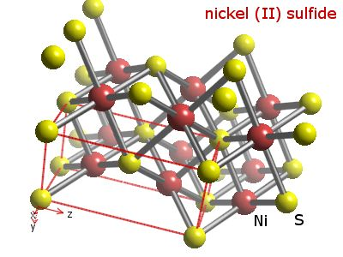
Materials prepared by SCS
Oxides
Ni(NO₃)₂
NiO
CeO₂
TiO₂
(Anatase)
Fe₂O₃
(Hematite)
Perovskites
(SrTiO₃)
Garnets
( Y₃Al₅O₁₂)
Silicates
(CaSiO₃)
Phosphates
(Ca₃(PO₄)₂)
Metals & Alloys
Metal-oxide Composites
Carbides
Sulfides
Nitrides
Ni
NiCu
Pt/CeO₂
Mo₂C
NiS
Fe₃N

Slide 5
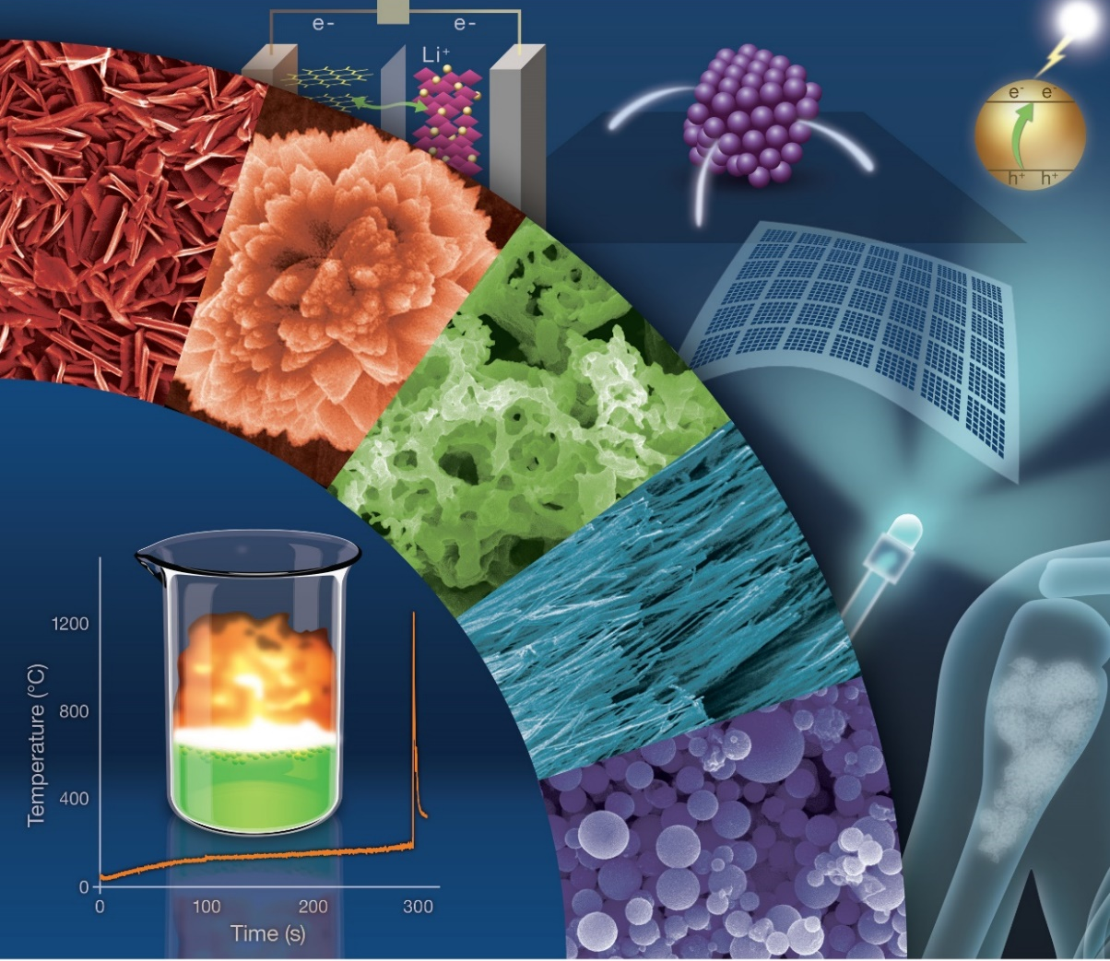
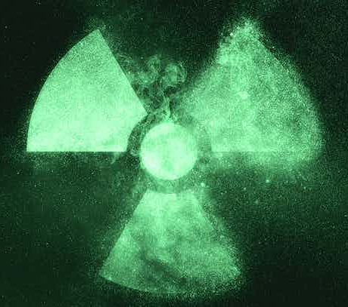
SCS in preparing nanoscale materials

Slide 6
SCS OF ACTINIDES
UO₂(NO₃)₂ + Glycine + H₂O
6

Slide 7
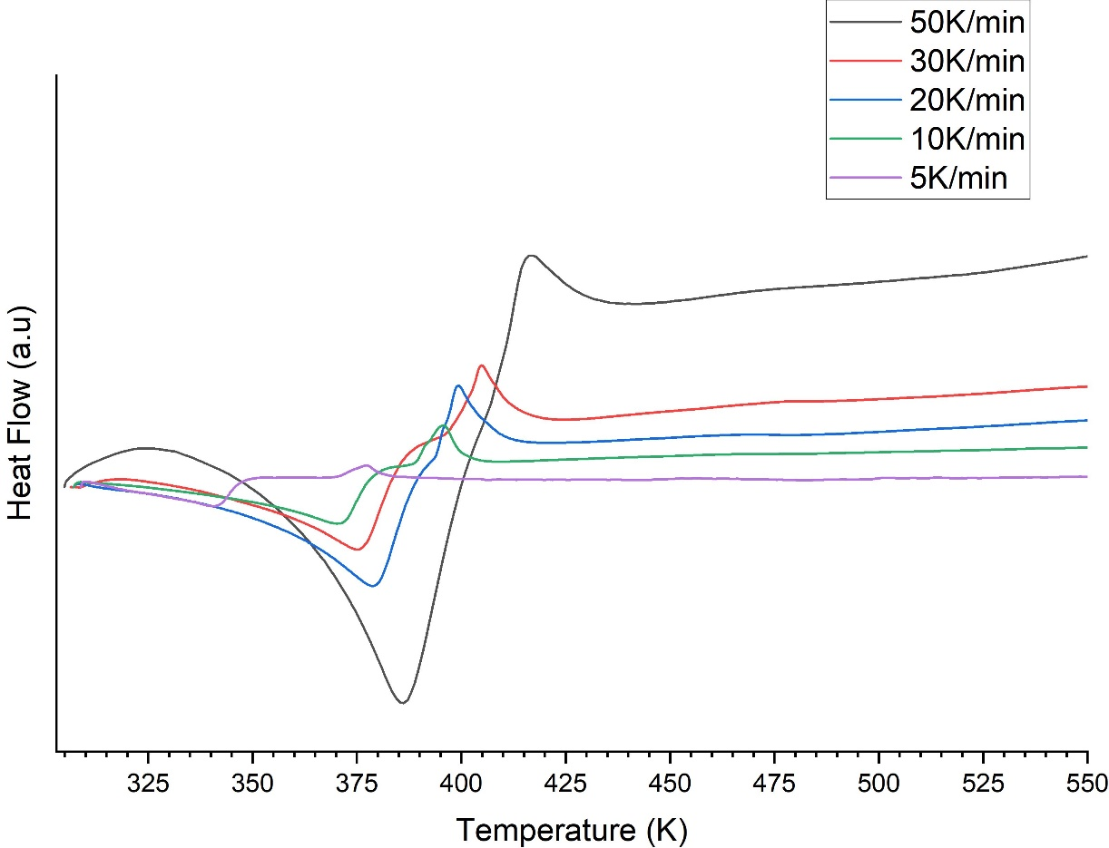
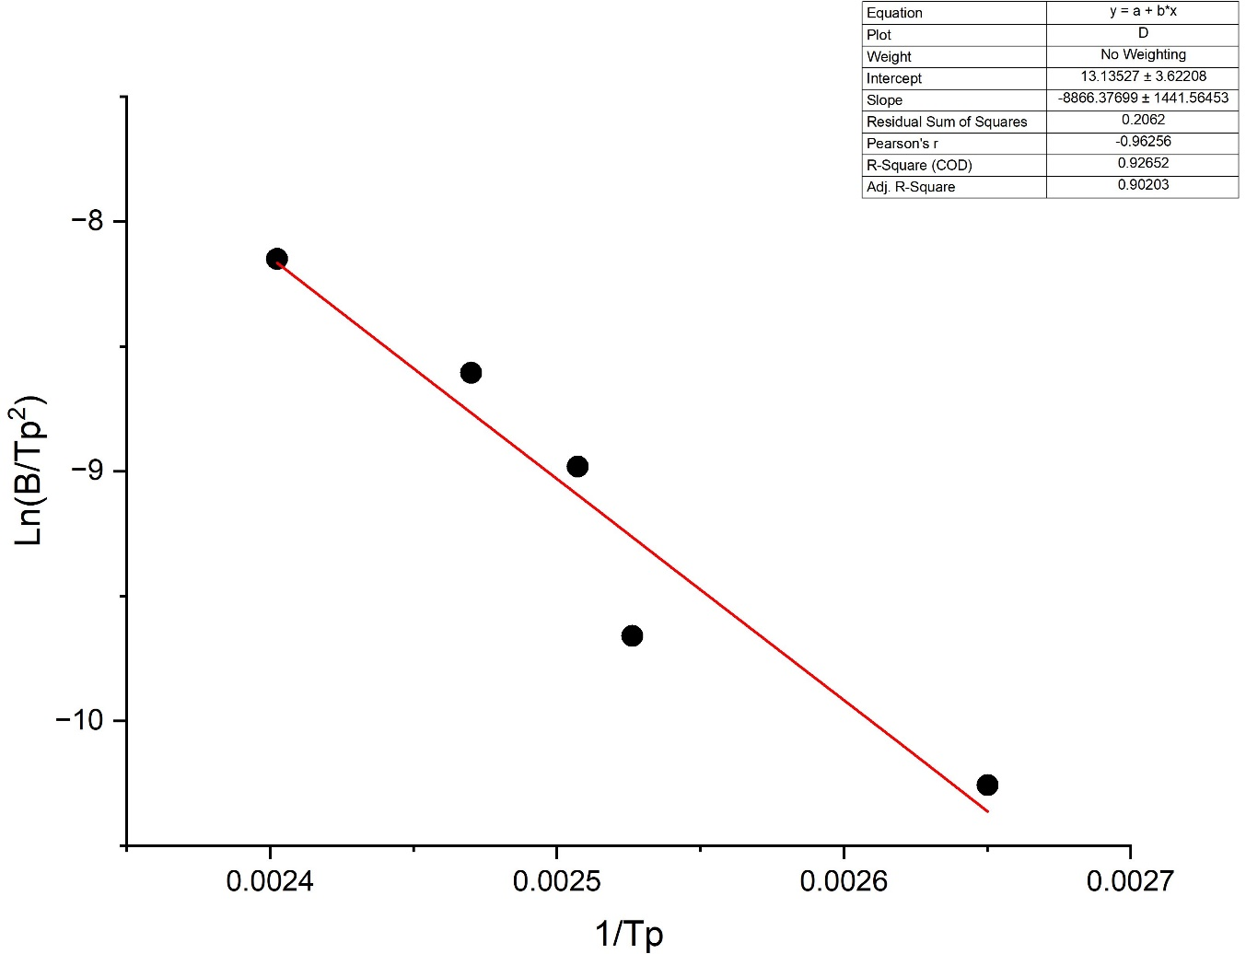
Kinetics of ThO₂ combustion synthesis reaction
Th(NO₃)₄ + $\left(φ\right)Acetylacetone+2−methoxyethanol$
$$E=−R\frac{d ln⁡(\frac{β}{T_{P}^{2}})}{dT_{p}^{2}}$$
$$73.7 ±11.9 kJ/mol$$

Slide 8
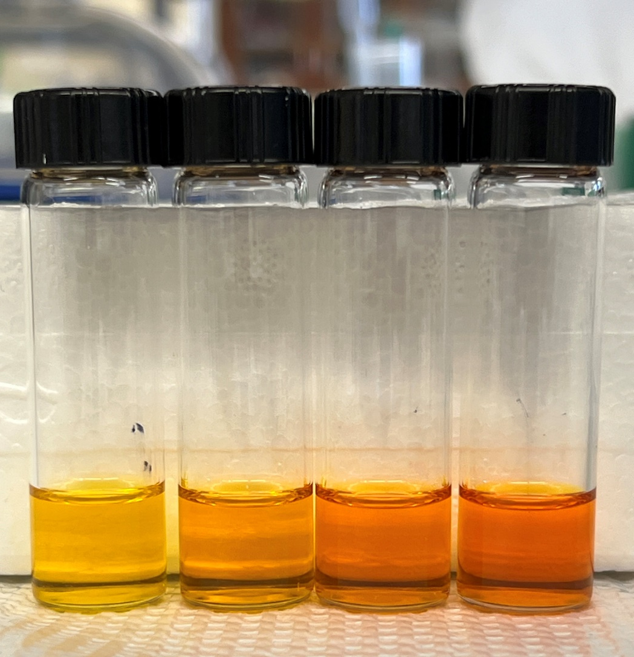
Complexation in the UO₂(NO₃)₂ + (φ)Glycine + H₂O solutions

Slide 9
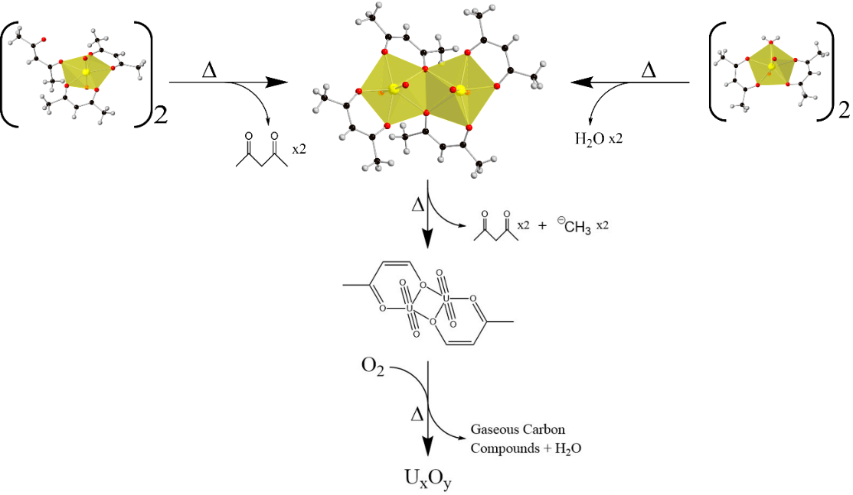
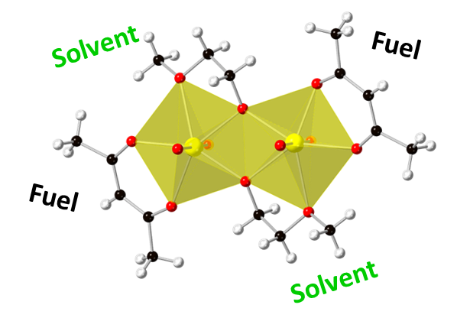
Mechanistic investigations of SCS
UO₂(NO₃)₂ + Acetylacetone + 2-methoxyethanol

Slide 10
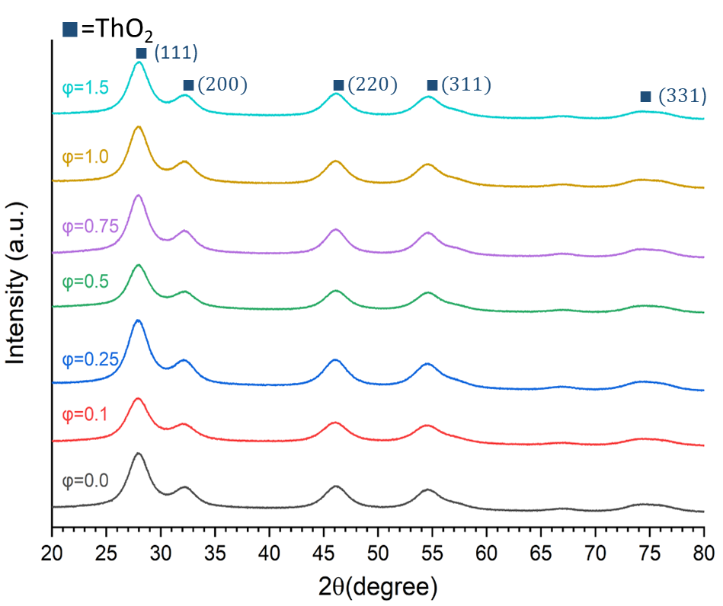
Characteristics of “bulk” combustion products
ϕ=1.5
ThO₂ nanoscale materials prepared by combustion of the Th(NO₃)₄ + $\left(φ\right)Acetylacetone$ solutions.
TEM image (A), selected area diffraction pattern (B), and high-resolution TEM images (C,D) for UO_{2+x}.

Slide 11
Outline
Outline
Solution Combustion Synthesis (SCS): SCS of Actinides
Thin-film target by SCS methods
Irradiation studies of targets
Conclusions
Acknowledgments

Slide 12
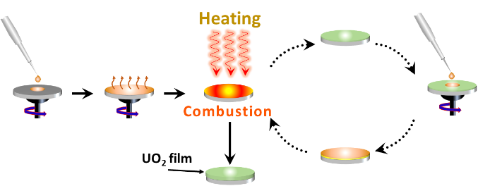
Target preparation methods: Spin-coating-assisted-SCS

Slide 13
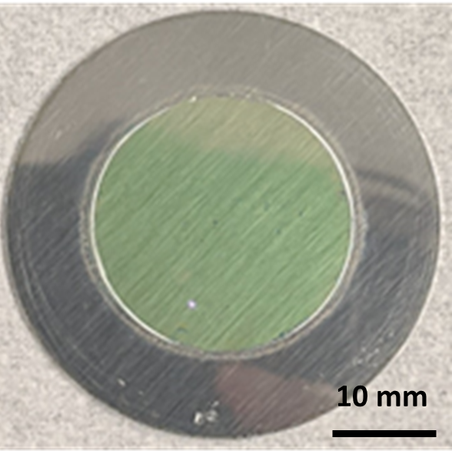
Thin-film uniformity
Al Kα
U Mα

Slide 14
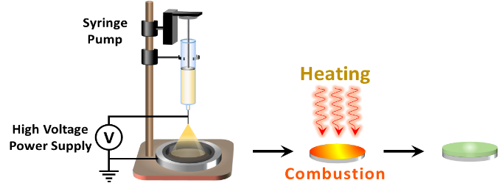
Target preparation methods: Spraying-assisted-SCS

Slide 15
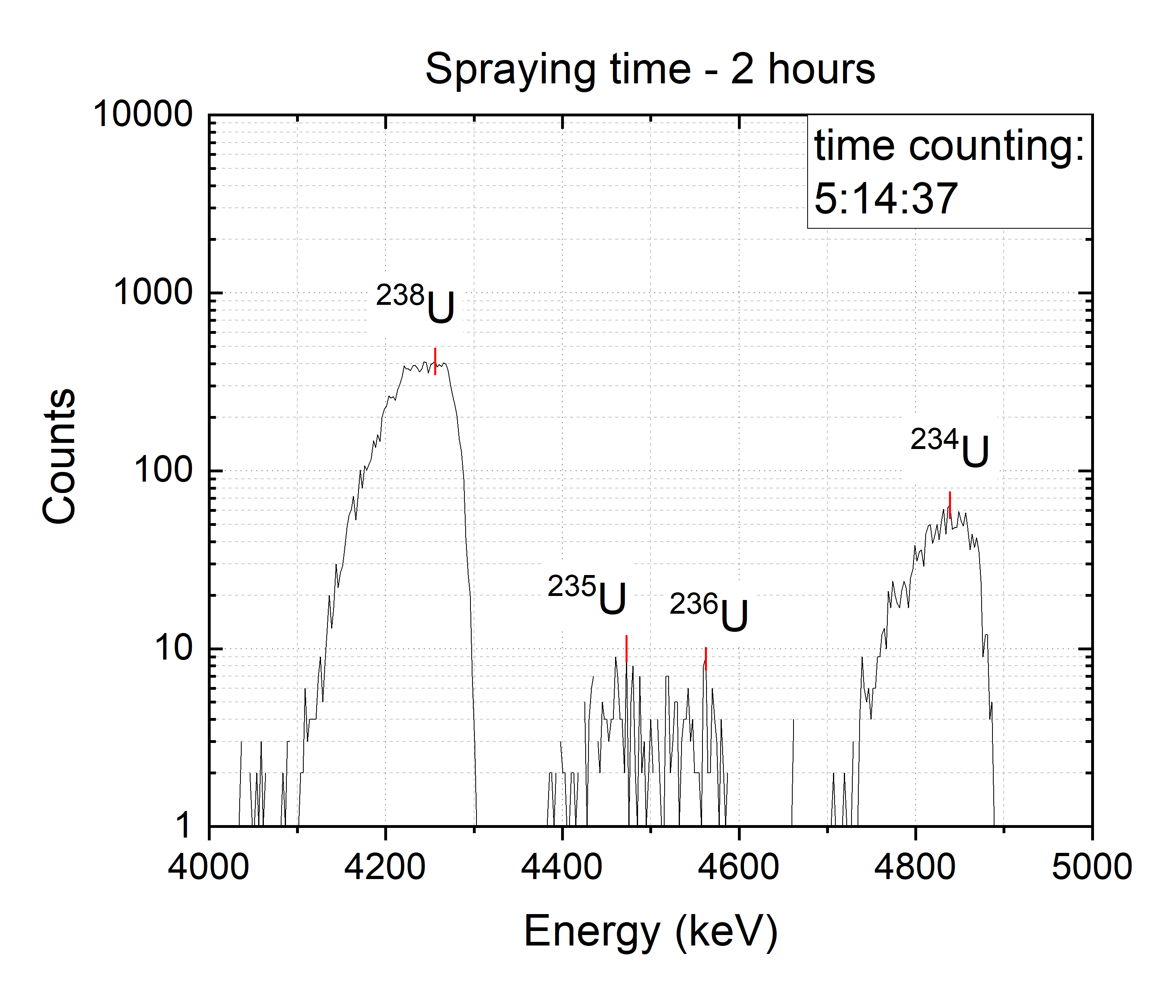
Tuning the target thickness
A
B
C
Representative a particle spectrum (A) and U amount vs. the solution flow rate (B) and the spraying time (C).

Slide 16
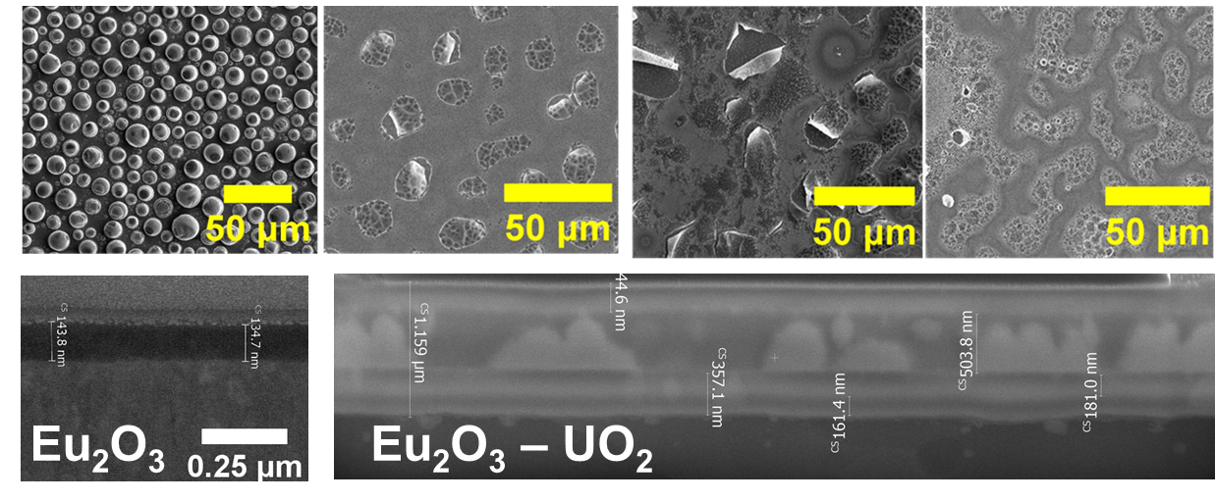
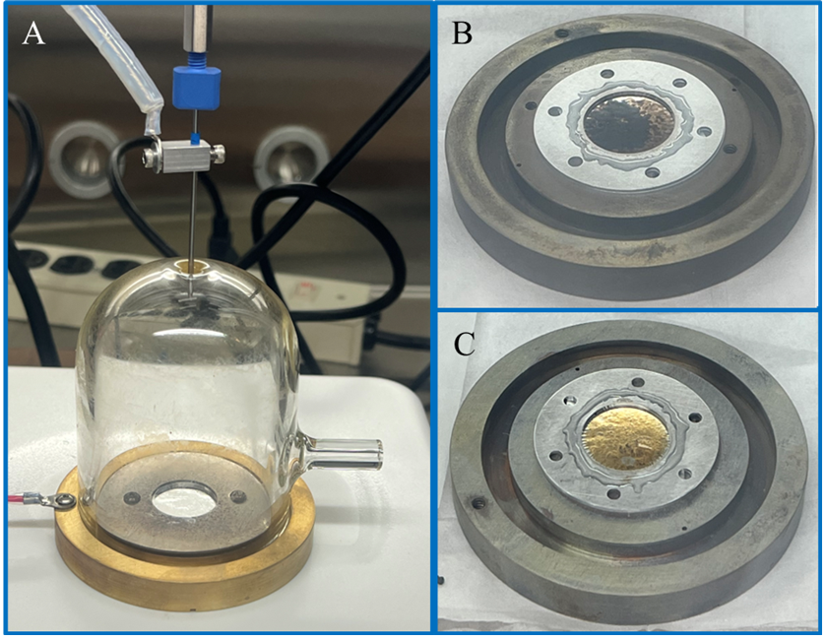
^{243A}m, and ²⁴³Am/²³⁵U Targets
Analogue material preparation
Deposition setup (A) and photos of the pure ²⁴³Am (B) and the ²⁴³Am/²³⁵U targets (C).

Slide 17
Target preparation methods: Printing-assisted-SCS

Slide 18
Eu₂O₃ target preparation with the inkjet method
0.0125 M Eu
0.125 M Eu

Slide 19
Outline
Solution Combustion Synthesis (SCS)
SCS of Actinides: Fundamentals
Preparation of thin-film target by SCS methods
Irradiation studies of targets
Conclusions
Acknowledgments

Slide 20
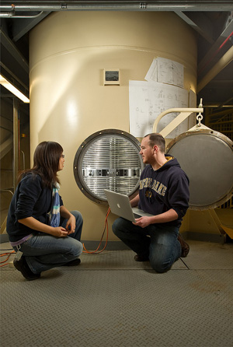
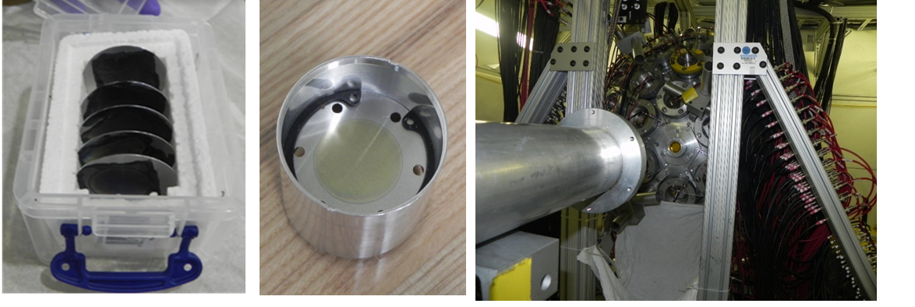
Target preparation and testing
Over 500 UO_{2,} ThO₂, and Th_{1-x}U_{x}O₂ targets on Al, C, and Si backings were prepared.
One ²⁴³Am and one ²⁴³Am/²³⁵U targets sandwiched between Al foils were prepared.
UO₂ targets on Al backings were irradiated at Notre Dame Nuclear Science Laboratory.
UO₂ targets on Al or C backings were tested in neutron measurements at LANL.
5U Sta. Ana accelerator at
Notre Dame Nuclear Science Laboratory
Detector for Advanced Neutron Capture
Experiments (DANCE) array at LANSCE

Slide 21
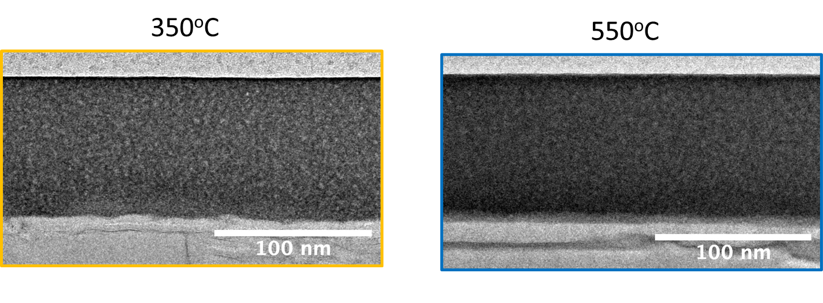
TEM images of targets (spraying)
Images: Dede S, Manukyan K V, Roach JM, Robertson D, Burns PC, Aprahamian A. Irradiation-induced Interactions at UO₂/Al₂O₃/Al Interfaces. J. Phys. Chem. C 2023, 127, 20, 9850–9857

Slide 22
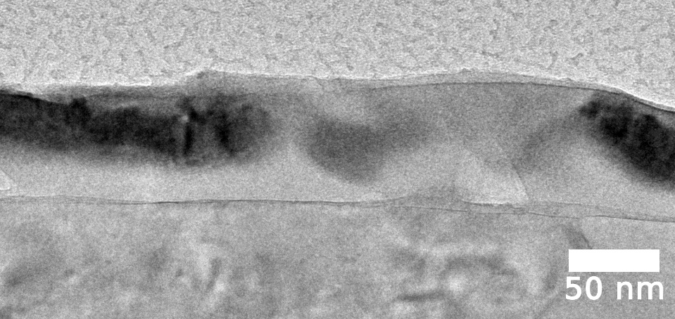
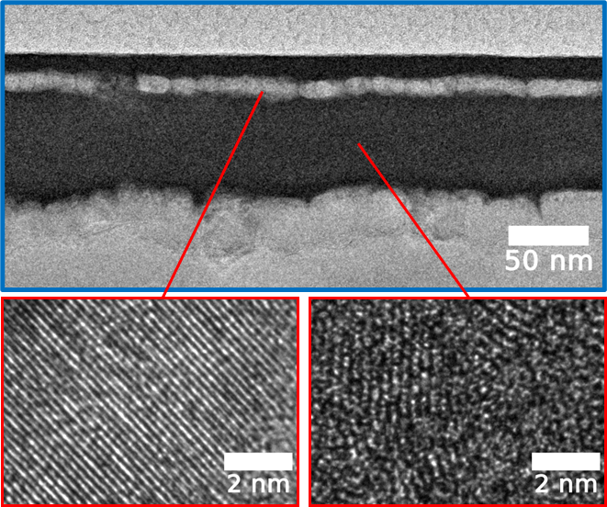
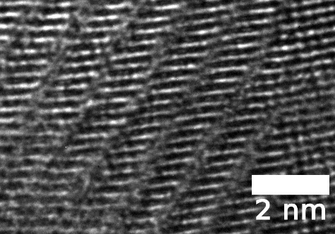
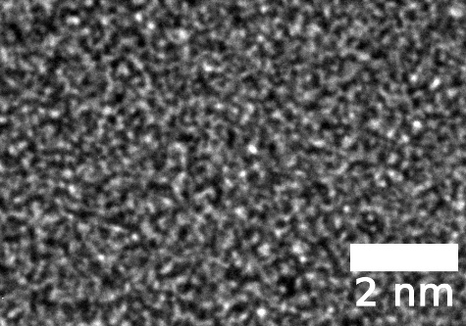
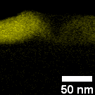
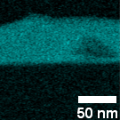
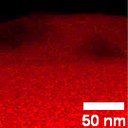
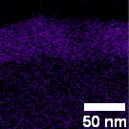
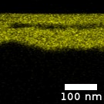
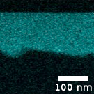
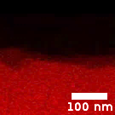
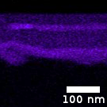
Major structural changes
Irradiation: Ar²⁺ (1.7 MeV energy) 1.3×10¹⁷ ions/cm²
Annealed at 350ºC
Annealed at 550ºC
U Mα1
O Kα1
Al Kα1
Mg Kα1_2
U Mα1
O Kα1
Al Kα1
Mg Kα1_2
Notes:
We see the UO2 layer before and after irradiation -> for the 550 it is definitely robust, 350 has
Further analysis of the layers
Diffusion of mg/al from the backing

Slide 23
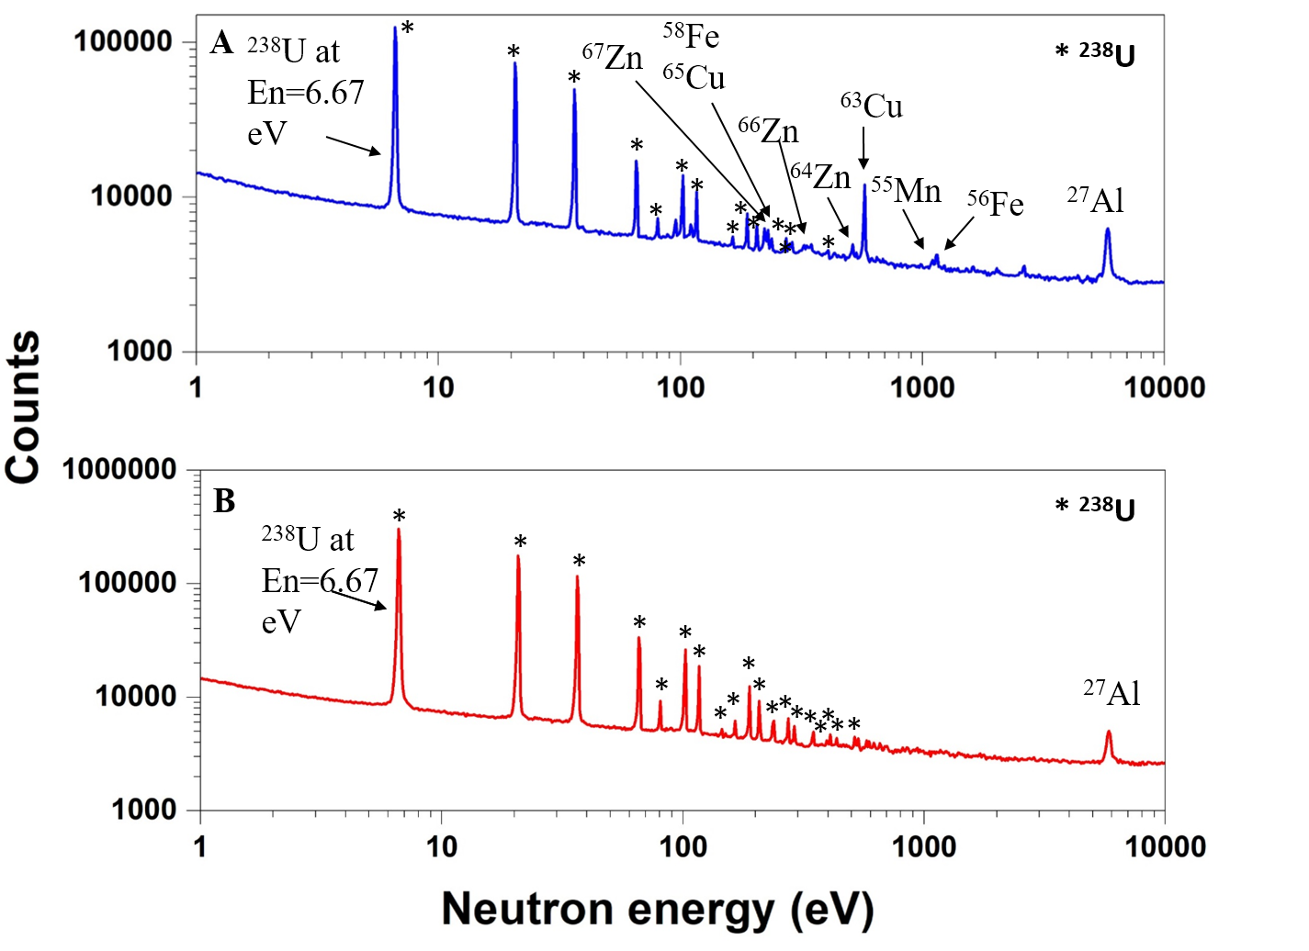
Neutron capture measurements at LANSCE
Pristine target
Neutron-irradiated target

Slide 24
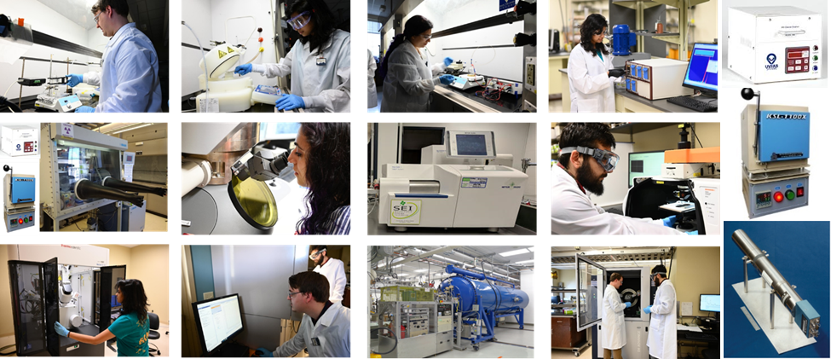
Student taring

Slide 25
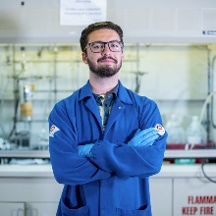
Current & Former Students
Noah Cabanas
PhD student
Raj Chilukuri
undergraduate student
Tomas Romero
undergraduate student
Konstantin Bauer
undergraduate student
Victor Williams
undergraduate student
Stefania Dede
LANL
Jordan Roach
ORNL
Bryce Frentz
Humana
Sabrina Strauss, CGG
Ashabari Majumdar
ND Physics
Jacob Galden
Myriad Neuroscience
Nathaniel Hiott
Northwestern
Michael Mlodzik
ND
Peter Guerra
Epic

Slide 26
Products
17 Published articles and 3 articles are in preparation
I.P. Borovinskaya, K.V. Manukyan, A.S. Mukasyan, SHS Ceramics: History and Recent Advances, Ceramics in Modern Technologies, 1, 3-19 (2019).
A.S. Mukasyan, S. Roslyakov, J.M. Pauls, L.C. Gallington, T. Orlova, X. Liu, M. Dobrowolska, J.K. Furdyna, K.V. Manukyan, Nanoscale Metastable ε Fe3N Ferromagnetic Materials by Self- Sustained Reactions, Inorganic Chemistry, 58, 5583−5592 (2019).
S.L. Kharatyan, H.A. Chatilyan, K.V. Manukyan, Kinetics and Mechanism of Nickel Oxide Reduction by Methane, J. Phys. Chem. C, 123, 21513-21521 (2019)
V.V. Baghramyan, A.A. Sargsyan, N.B. Knyzyan, V.V. Harutyunyan, A.H. Badalyan, N.E. Grigoryan, A. Aprahamian, K.V. Manukyan, Pure and cerium-doped zinc orthosilicate as a pigment for thermoregulating coatings, Ceramics International, 46, 4992-4997 (2020).
P. Sapkota, A. Aprahamian, K.Y. Chan, B. Frentz, K.T. Macon, S. Ptasinska, D. Robertson, K.V. Manukyan, Irradiation-induced reactions at the CeO2/SiO2/Si interface, J. Chem. Phys. 152, 104704 (2020).
N. Amirkhanyan, S.L. Kharatyan, K.V. Manukyan, A. Aprahamian, Thermodynamics and Kinetics of Solution Combustion Synthesis: Ni(NO3)2 + Fuels Systems, under review at Combustion and Flame, 221, 110-119 (2020).
M.K. Zakaryan, S.L. Kharatyan, A. Aprahamian, K.V. Manukyan, Combustion in the ZrF4-Mg-Si and ZrF4-Al-Si Systems for Preparation of Zirconium Silicides, Combust. Flame 232, 111514 (1-9), (2021).
B. Frentz*, A. Aprahamian, A.M. Clark, C. Dulal, J.D. Enright, R.J. deBoer, J. Goerres, S. L. Henderson, K.B. Howard, R. Kelmar, K. Lee, L. Morales, S. Moylan, Z. Raman, W. Tan, L. E. Weghorn, and M. Wiescher "Lifetime measurements of excited states in 15O". Phys. Rev. C 103, 045802 (2021).
A. Majumdar*, K.V. Manukyan, J.M. Roach*, S. Dede*, D. Robertson, P.C. Burns and A Aprahamian, Irradiation-Driven Restructuring of UO2 Thin Films: Amorphization and Crystallization, ACS Applied Materials & Interfaces. ACS Appl. Mater. Interfaces, 13, 35153−35164 (2021)
J.M. Roach*, K.V. Manukyan, A. Majumdar*, S. Dede*, A.G. Oliver, P.C. Burns, A. Aprahamian, Hyperstoichiometric Uranium Dioxides: Rapid Synthesis and Irradiation-Induced Structural Changes, Inorg. Chem. 60, 24, 18938–18949, (2021).
R. Kelmar, K.V. Manukyan, A. Simon, A. Aprahamian, Preparation and Characterization of Isotopically Pure Mo Targets for Nuclear Science Measurements, Nuclear Instruments and Methods A. 1034, 166763, 4 pages (2022).
S. Dede*, K.V. Manukyan, J.M. Roach*, A. Majumdar*, P.C. Burns, and A. Aprahamian, Irradiation-induced amorphization of UO2 films prepared by spraying-assisted combustion synthesis, Applied Surface Science. 603, 154437 11 pages (2022).
A. Majumdar*, K.V. Manukyan, W. Tan, S. Dede*, J.M. Roach*, A. Couture, P.C. Burns, A. Aprahamian, Neutron Capture of UO2 Targets Prepared by Spin Coating Assisted Combustion Synthesis, Nuclear Inst. and Methods in Physics Research, A 1045 167551 6 pages (2023).
J.M. Roach, K.V. Manukyan, S. Dede, P.C. Burns, A. Aprahamian, Combustion synthesis of Eu₂O₃ nanomaterials with tunable phase composition and morphology, Journal of Solid State Chemistry 326, 2023, 124235 (8 pages)
S. Dede, S.D. Essenmacher, P. Gastis, K.V. Manukyan, S.A. Kuvin, H.Y. Lee, J.M. Roach, P.C. Burns, A. Aprahamian, Electrospraying deposition and characterization of potassium chloride targets for nuclear science measurements, Nuclear Inst. And Methods in Physics Research, A1055 (2023) 168472 (6 pages).
S. Dede, K.V. Manukyan*, J. M. Roach, D. Robertson, P.C. Burns, and Ani Aprahamian, Irradiation-enhanced Interactions at UO₂/Al₂O₃/Al Interfaces, J. Phys. Chem. C 2023, 127, 20, 9850–9857
A. Majumdar, K.V. Manukyan, S. Dede, J.M. Roach, P.C. Burns and A. Aprahamian, UO₂ target preparation with spin coating assisted solution combustion synthesis, EPJ Web of Conferences 285, 03004 (2023) https://doi.org/10.1051/epjconf/202328503004
Two PhD dissertations, 14 Invited Talks, Seminars, and Colloquia, 13 Oral presentation, 23 poster presentations

Slide 27
Conclusions
The fundamental aspects of SCS of actinide oxides have been obtained.
Simple and efficient SCS-based methods of thin target preparation have been developed.
A large number of targets have been prepared, fully characterized, and tested.

Slide 28
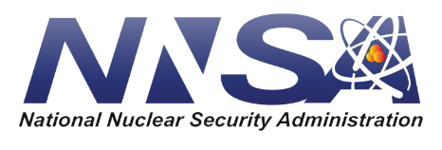
Acknowledgments
Aprahamian, Ani
Burns, Peter
Sigmon, Ginger
Szymanowski, Jennifer
Cabanas Noah (ND)
Dede, Stefania (TA&M and ND, now LLNL)
Majumdar, Ashabari (ND)
Roach, Jordan (ND, now ORNL)
LANL collaborators
Bredeweg, Todd
Couture, Aaron
Gastis, Panos
Kuvin, Sean
Lee, Hye Young

Slide 29
Thank you

Slide 30
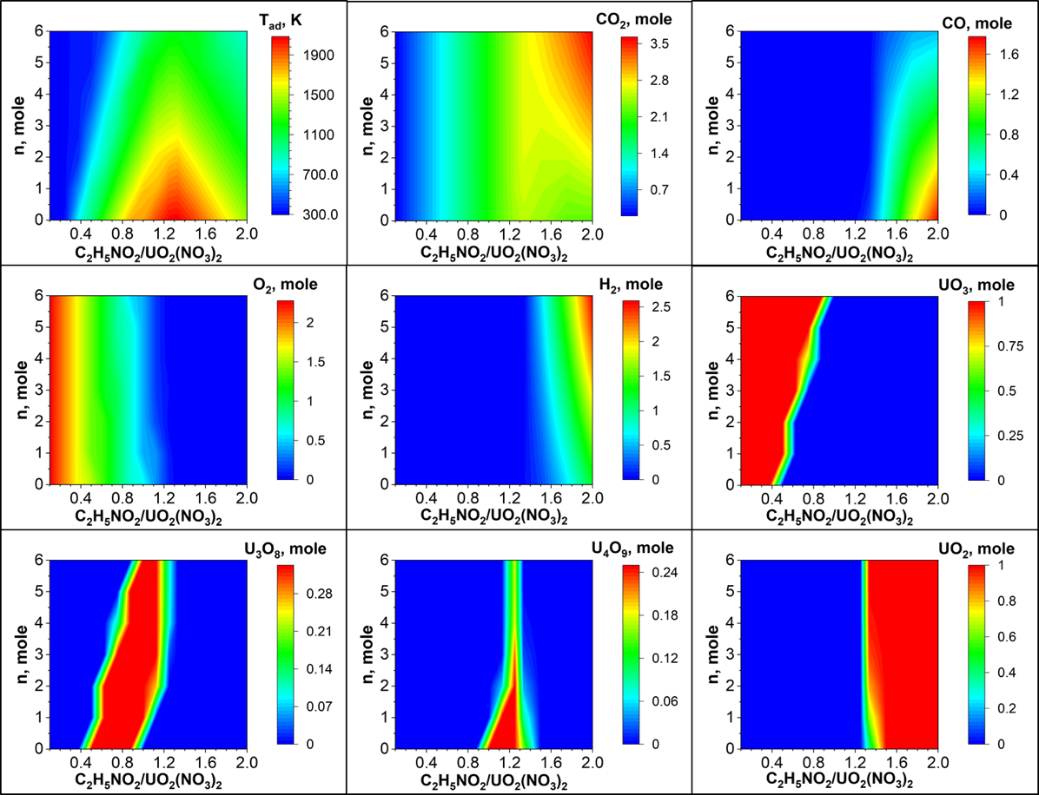
Thermodynamic modeling of SCS reactions
UO₂(NO₃)₂ + ϕC₂H₅NO₂ + nH₂O system
ϕ
ϕ
ϕ
ϕ
ϕ
ϕ
ϕ
ϕ
ϕ
Calculated adiabatic temperature (T_{ad}) and composition of equilibrium products as a function of ϕ (C₂H₅NO₂/UO₂(NO₃)₂) molar ratio and the number of water moles (n).

Slide 31
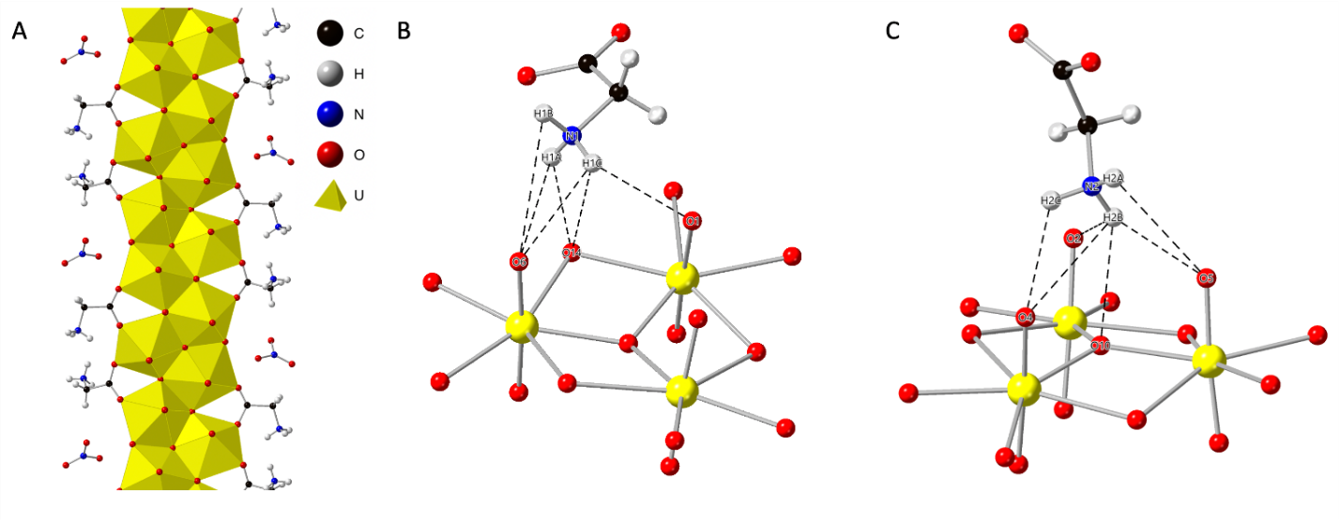
Mechanistic investigations of SCS: UO₂(NO₃)₂ + C₂H₅NO₂ + H₂O system
Visual representation of the precipitated complex structure obtained from reactive solutions (A), hydrogen bonding represented by black dotted lines between Gly-1 (B) and Gly-2 (C) ligands with neighboring chain structures.

Slide 32
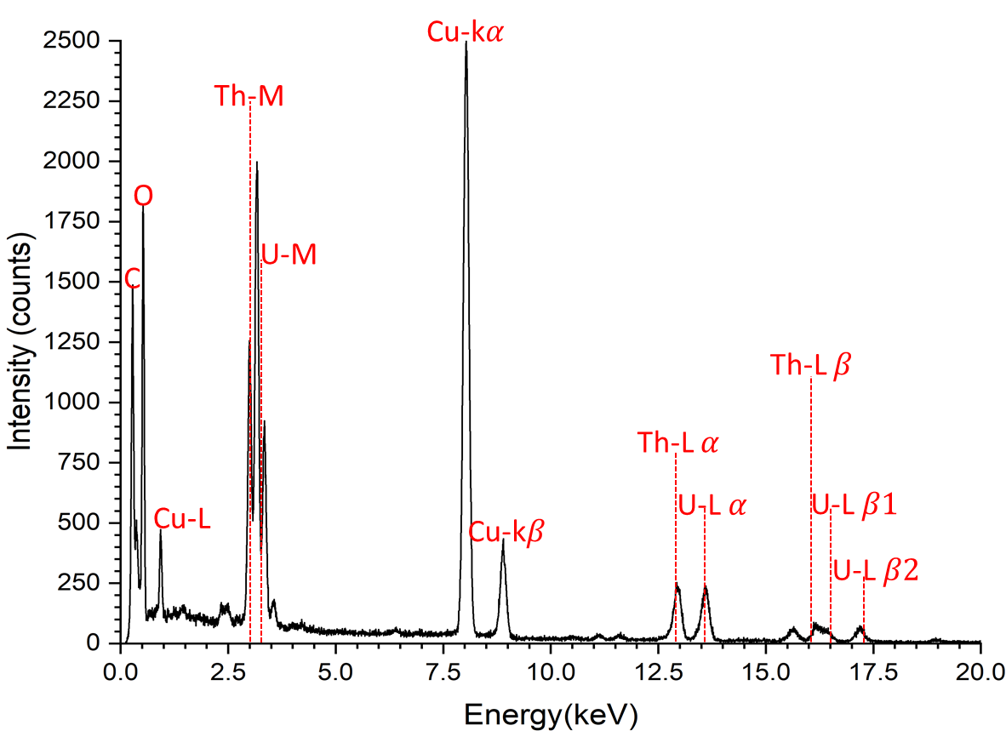
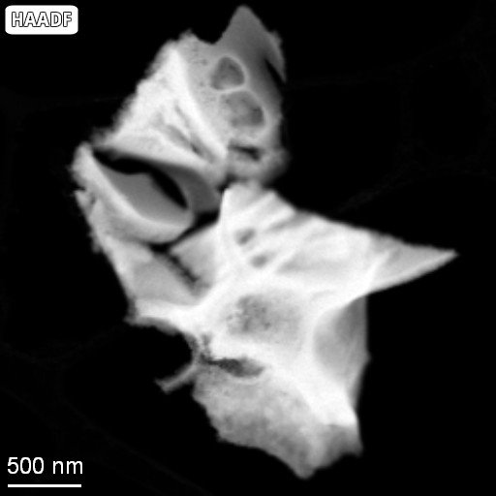
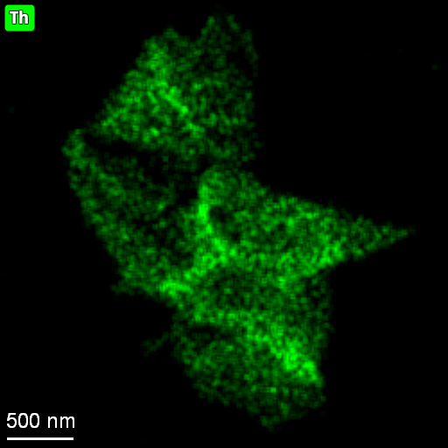
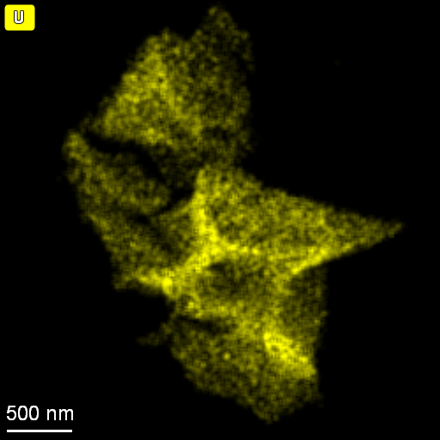
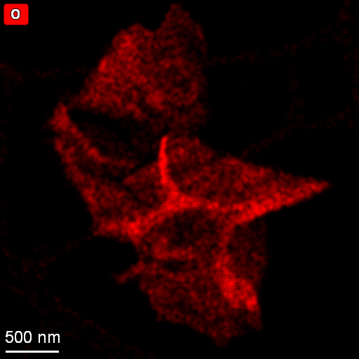
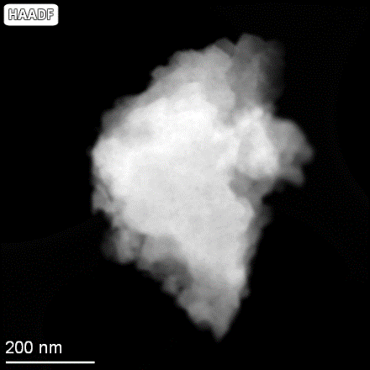
Elemental uniformity of oxides
Th_{0.25}U_{0.75}O₂
UO₂:1%Ni

Slide 33
Ion-irradiation-induced structural changes

