Slide 1
Nuclear data for neutron sources and diagnostics and electronics
Michael J Loughlin
Contributions from Universidad Nacional de Educación a Distancia (UNED), Escuela Técnica Superior de Ingenieros Industriales, Departamento de Ingeniería Energética, Madrid, Spain

Slide 2
Neutron Sources
For the study of damage and gas production
FPNS or IFMIF-DONES, Advanced Fusion Neutron Source (A-FNS, Japan) (D-Li stripping)
Reactor (e.g., HFIR)
Spallation Neutron Source
Component test facility
Operating tokamaks
What improved nuclear data is required to design and build a new neutron source?

Slide 3
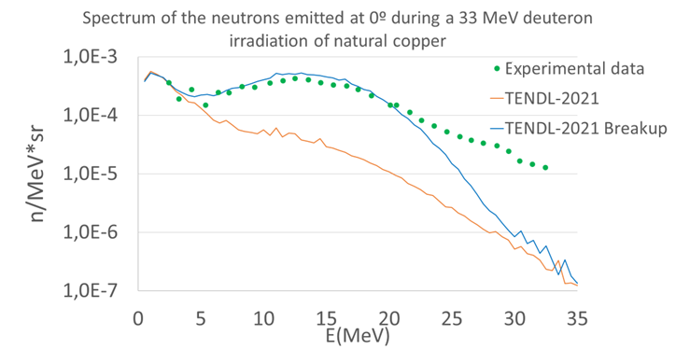
Breakup reactions
Breakup reactions cause the emission of a projectile fragment with an angular distribution strongly focused toward forward. Kalbach-Mann systematics [1] is not able to reproduce this peaked neutron emission.
Sauvan et al. [2] proposed a methodology to implement a new kinematics [3] in ENDF format and transport code.
The methodology requires
Independent consideration of breakup and other neutron-emitting reactions.
Angular emission of neutrons dependent on the reaction.
Talys code can provide these data.
In order to use this new emitting law
ENDF format documentation related with new kinematics needs to be updated
The NJOY code needs to be modified to allow this new formatted file being converted to ACE.
The MCNP6 transport code needs to be modified to read the new ACE files and reproduce the breakup angular distribution.
Much better fitting for neutron from 33-MeV deuterons
[1] C. Kalbach, “Systematics of continuum angular distributions: Extensions to higher energies” Phys. Rev. C 37, 2350 (1987)
[2] P. Sauvan et al. “Implementation of a new energy-angular distribution of particles emitted by deuteron induced nuclear reaction in transport simulations”, EPJ Web of Conferences, 146, 02010 (2017)
[3] C. Kalbach, “Phenomenological model for light-projectile breakup” Phys. Rev. C 95, 014606 (2017)

Slide 4
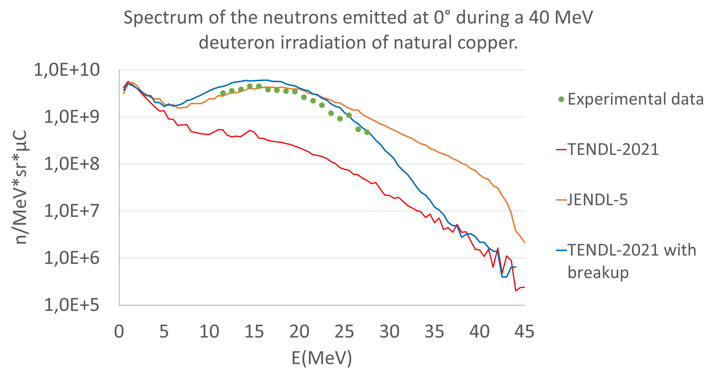
Recent activities for DONES – Nuclear data
Scarce experimental data concerning the neutron emission from 40 MeV deuteron irradiation.
JENDL-5 seems to be the most accurate deuteron library, but
Disparity of the results reveals the existence of large uncertainties [4].
Limited available nuclides.
Very large data files, since the angular distribution is tabulated.
These uncertainties will also have a direct impact on the residual doses.
Dose outside accelerator vault from neutrons emitted in the Beam Dump
Deuteron data library | Maximum outside dose
JENDL-5 | 57 µSv/h
TENDL-2021 with breakup | 16 µSv/h
[4] V. Lopez et al. “Sensitivity to nuclear data of the design of the IFMIF-DONES beam dump” Front. Phys. 11, 1144057 (2023)

Slide 5
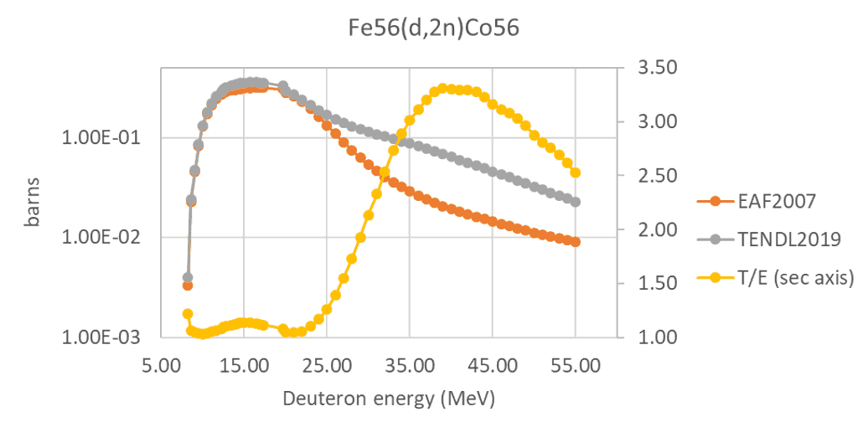
DONES: activation of beam tube
Stainless Steel as a beam facing material results in large activation and residual doses during maintenance.
⁵⁶Fe (d,2n) ⁵⁶Co is the mainly responsible.
Experimental data up to 20MeV and discrepant data in libraries from that energy.
The replacement of steel with aluminum alloy very much reduces residual doses after several days of cooling time [5]
One of the key missing nuclear data for DONES were the Nb cross sections for deuteron interactions. Niobium is present in accelerating cavities and is thus a beam-facing material.
[5] F. Ogando, et al. “Beam-facing material selection for mitigation of residual doses in the HEBT of IFMIF-DONES”, Journal Nucl Mat and Energy (2024)

Slide 6
Diagnostics
A wider range of materials are used then those encountered in first wall materials and shielding.
Nuclear heating, transmutation, gas production.
 | B | C | N | O | Al | Si | P | S | K | Ca | Ti | Cr | Mn | Fe | Co | Ni | Cu | Zr | Nb | Mo | Rh | W | Pt | Au
Aluminum Nitride Ceramic | • |  | • |  | •
Boron Nitride Ceramic | • |  | •
Gold |  |  |  |  |  |  |  |  |  |  |  |  |  |  |  |  |  |  |  |  |  |  |  | •
Inconel 718 | • | • |  |  | • | • | • | • |  |  | • | • | • | • | • | • | • |  | • | •
Nitronic-60 |  |  | • |  |  | • |  |  |  |  |  | • | • | • |  | •
Monel 400 |  | • |  |  |  | • |  | • |  |  |  |  | • | • |  | • | •
Molybdenum |  |  |  |  |  |  |  |  |  |  |  |  |  |  |  |  |  |  |  | •
Pascalloy |  |  |  |  | • |  |  |  |  |  |  |  | • |  |  | •
Platinum |  |  |  |  |  |  |  |  |  |  |  |  |  |  |  |  |  |  |  |  |  |  | •
Rhodium |  |  |  |  |  |  |  |  |  |  |  |  |  |  |  |  |  |  |  |  | •
TZM Alloy (Ti-Mo-Zr) |  | • | • | • |  | • |  |  | • |  | • | • |  | • |  | • |  | • |  | • |  | •
Tungsten |  |  |  |  |  |  |  |  |  |  |  |  |  |  |  |  |  |  |  |  |  | •

Slide 7
Neutron Diagnostics
The primary diagnostic for fusion power measurement will be neutron activation.
Nuclear data needs:
Radiation transport
Neutron sources
Dosimetry Standards
Uncertainty quantification
Use in breeder blankets
Reaction | Half-life |  | Eγ (MeV) | Threshold (MeV)
¹¹B(n,p)¹¹Be | 13.80 | s | 2.140 | 10.0
¹⁴N(n,2n)¹³N | 9.96 | min | 0.511 | 10.0
¹⁶O(n,p)¹⁶N | 7.13 | s | 6.130 | 10.0
⁵¹V(n,α)⁴⁸Sc | 43.67 | hr | 1.3145 | 10.1
⁶⁵Cu(n,2n)⁶⁴Cu | 12.70 | hr | 0.511 | 10.1
⁵⁵Mn(n,2n)⁵⁴Mn | 312.5 | d | 0.835 | 10.4
⁵⁹Co(n,2n)⁵⁸Co | 70.8 | d | 0.811 | 10.8
¹⁹F(n,2n)¹⁸F | 109.7 | m | 0.511 | 10.9
⁶³Cu(n,2n)⁶²Cu | 9.74 | m | 0.511, 1.173 | 10.9
⁸⁹Y(n,2n)⁸⁸Y | 107 | d | 1.836 | 11.5
⁴⁸Ti(n,d)⁴⁷Sc | 3.35 | d | 0.159 | 11.7
⁴⁵Sc(n,2n)⁴⁴Sc | 2.44 | d | 0.271, 1.159 | 11.9
⁹⁰Zr(n,2n)⁸⁹Zr | 78.4 | h | 0.909 | 12.0
⁵²Cr(n,2n)⁵¹Cr | 27.2 | d | 0.320 | 12.4
⁴⁷Ti(n,d)⁴⁶Sc | 83.8 | d | 0.889 | 12.5
⁵⁸Ni(n,2n)⁵⁷Ni | 36.1 | h | 0.026 | 12.5
⁶⁴Zn(n,2n)⁶³Zn | 38.1 | m | 0.669 | 12.5
²³Na(n,2n)²²Na | 2.6 | y | 1.275 | 13.0
⁹⁰Zr(n,2n)⁸⁹Zr | 4.18 | m | 0.588 | 13.0
³⁵Cl(n,2n)³⁴Cl | 32 | m | 0.511 | 13.1
⁴⁶Ti(n,2n)⁴⁵Ti | 3.08 | m | 0.511 | 13.2
³⁹K(n,2n)³⁸K | 7.71 | m | 0.511 | 13.5
⁵⁰Cr(n,2n)⁴⁹Cr | 41.9 | m | 0.153 | 13.5
¹⁷⁶Lu(n,3n)¹⁷⁴Lu | 3.3 | y | 1.342 | 13.5
⁵⁴Fe(n,2n)⁵³Fe | 8.53 | m | 0.153 | 13.9
²⁰³Tl(n,3n)²⁰¹Tl | 3.05 | d | 0.167 | 14.0
¹⁶⁹Tm(n,3n)¹⁶⁷Tm | 9.25 | d | 0.208 | 14.9
¹⁹¹Ir(n,3n)¹⁸⁹Ir | 13.1 | d | 0.245 | 16.0
¹⁹⁷Au(n,3n)¹⁹⁵Au | 183 | d | 0.099 | 16.0
¹⁰⁷Ag(n,3n⁾¹⁰⁵Ag | 41.3 | d | 0.443 | 17.5
¹²C(n,2n)¹¹C | 20.3 | m | 0511 | 18.8
⁵⁹Co(n,3n)⁵⁷Co | 271.6 | d | 0.122 | 19.1

Slide 8
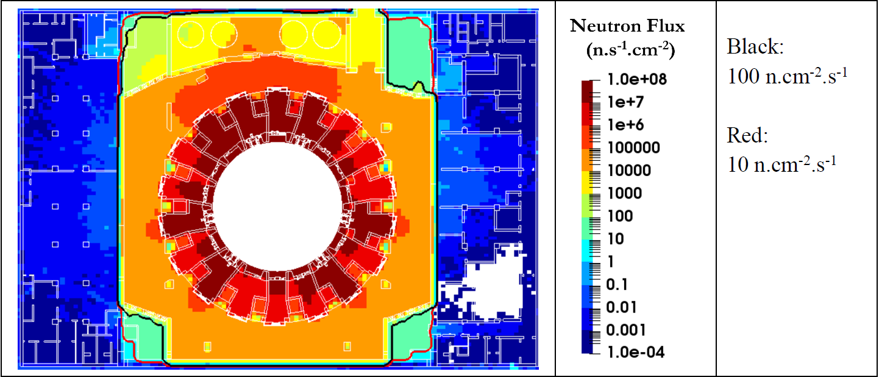
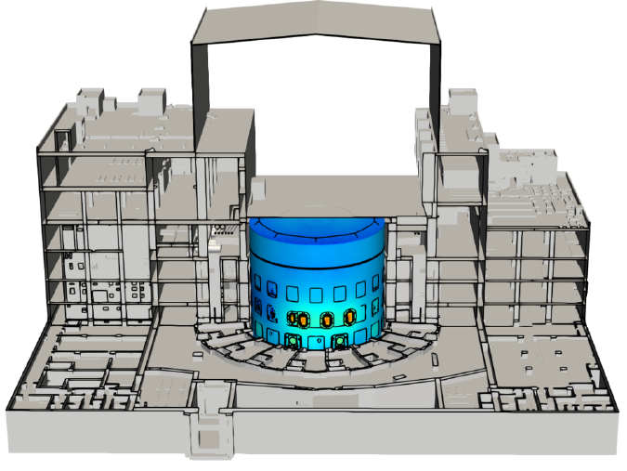
Electronics
Single event effects caused by neutrons can disable electronics. This is important for control and safety equipment.
Thermal neutrons (reactions in doping materials) and neutrons above 6MeV ((n,p) and (n,α), recoiling silicon nuclei)are the most important.
Important during operations and maintenance (remote handling)
The shielding problem:
ITER_D_3FM52L - Radiation environment for equipment during operations by R Juarez

Slide 9
Summary
Accelerator based neutron sources require improved nuclear data at energies for charged particle reactions at energies >/= 55MeV.
Diagnostics require nuclear data for a wide variety of materials shielding nuclear heating, gas production and transmutation.
Neutron diagnostics need dosimetry standards.
Improved radiation transport modelling for shielding design and qualification of electronics (if opted for).

