Slide 1
US Nuclear Data Program WANDA 2024
Keith Jankowski
Program Manager for Nuclear Data
February 2024
Notes:
Template Instructions: Please insert your name and title. You can also pull in information from the event you are attending – the organization's logo, etc. Doing so is inclusive.
Please don't forget ALT TEXT on your images. Use PowerPoint accessibility checker – preferably each time when you start a presentation. In the ribbon, go to VIEW > Accessibility Checker. Try to send slides (at least a draft) to attendees in advance, that also helps with accessibility.
Please remember – this is a template. You should be downloading a copy of it and then making it your own. Feel free to remove slides not relevant to your presentation and augment the presentation as you see fit.
Consider adding a picture of yourself or your team to the Welcome slide or at the end of the deck. Pictures of people who work at our Labs and for DOE and SC are excellent communication tools.
In this presentation, each slide is made so you can easily add to it. The footer at the bottom of the slide does not change. If you would like to use a more specific URL to your program or division, please include it in the body of the slide.

Slide 2
Topics
USNDP and NDIAWG updates
FY23 highlights
Plans for FY24 and beyond

Slide 3
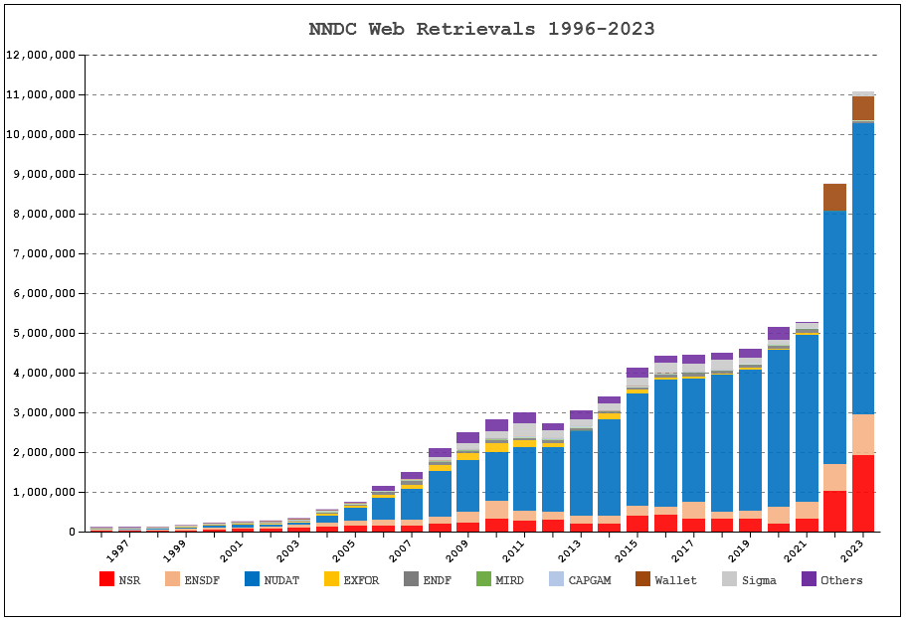
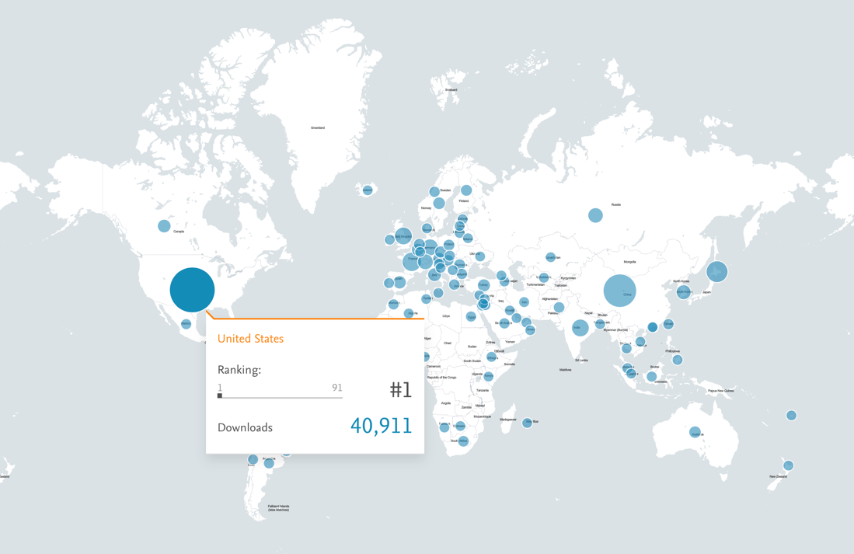
USNDP
Nuclear Data is clearly a global need
  NNDC site breaking 11M retrievals
    ~85,000 unique IP addresses
  Nuclear Data Sheets with 40,000 downloads from just the US
Stewarded by DOE/Office of Science/Nuclear Physics, the USNDP is responsible for the compilation, evaluation, and dissemination of nuclear data for use by those in nuclear science and applications
  Important! Not all applications understand the details of nuclear data…

Slide 4
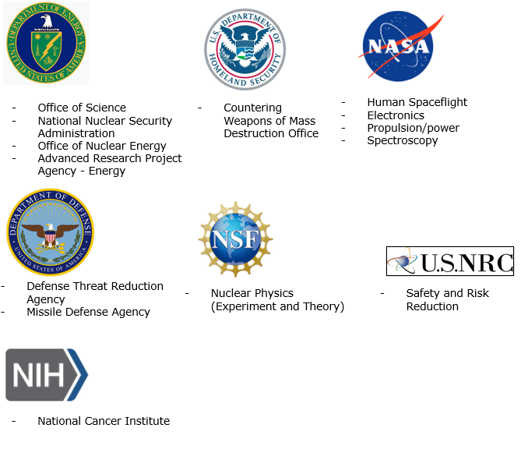
Nuclear Data InterAgency Working Group (NDIAWG)
The NDIAWG, led by NP, was formed jointly in 2016 with NNSA, DTRA, and DHS
The NDIAWG enables coordination and collaboration at the federal program level.
Representatives meet twice annually to discuss and provide updates.
Membership has increased from 8 to 17 since 2020 from continued outreach and identification of nuclear data needs.

Slide 5
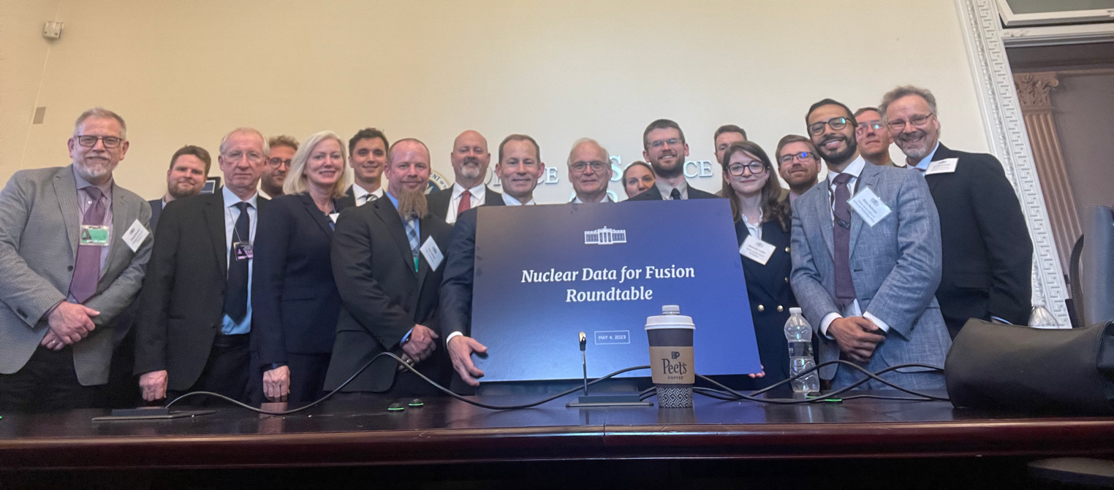
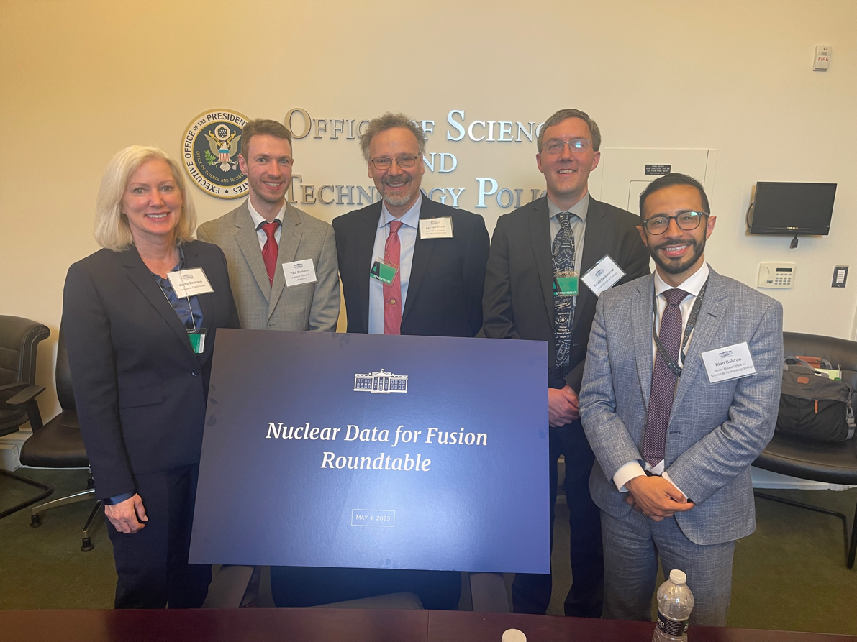
FY23 Highlights
WANDA23
Fusion
  OSTP workshop on fusion
  Discussions with ARPA-E on polarized fusion data collection

Slide 6

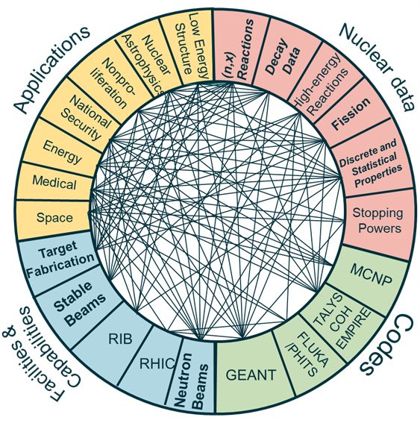
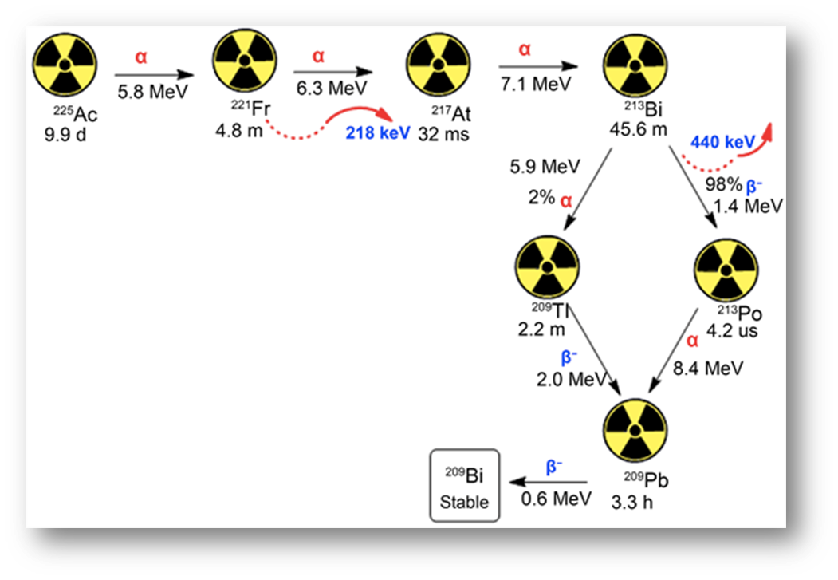
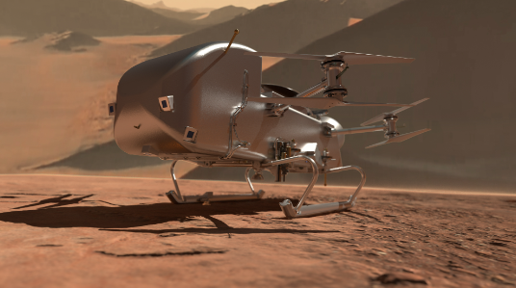
FY23 Highlights
2023 NSAC Long Range Plan for Nuclear Science & ND reports
NP started 5 new projects from the NDIAWG Funding Opportunity
  PNNL - Benchmarking and validating cosmogenic activation models
  ORNL – Impact of Nuclear Data on Advanced Energy Systems Safety and Operation
  JHUAPL – Berkeley Atlas
  BNL – Accelerated Decay Data Evaluation
  RPI – Development of Benchmark Measurements for Capture Gamma Cascades

Slide 7
Future Plans
Upcoming DOE/Nuclear Energy and NRC collaboration on criticality safety support for commercial-scale HALEU Fuel Cycles
  Nuclear Data staff will participate along with other interagency colleagues
  First workshop is this week
Description:
  “Demand for a fuel enrichment range known as high-assay, low-enriched uranium (HALEU) is rapidly increasing driven by potential new, advanced power reactors and performance enhancements to existing commercial power reactors. “
  “A significant component of that data is criticality benchmarks that are relevant for the specific proposed fuel forms, geometries, neutron absorbers, moderators for facility operations, and transportation at commercial scale.”
  “…assessment of gaps in validation and nuclear data for HALEU-based fuel cycles…”

Slide 8
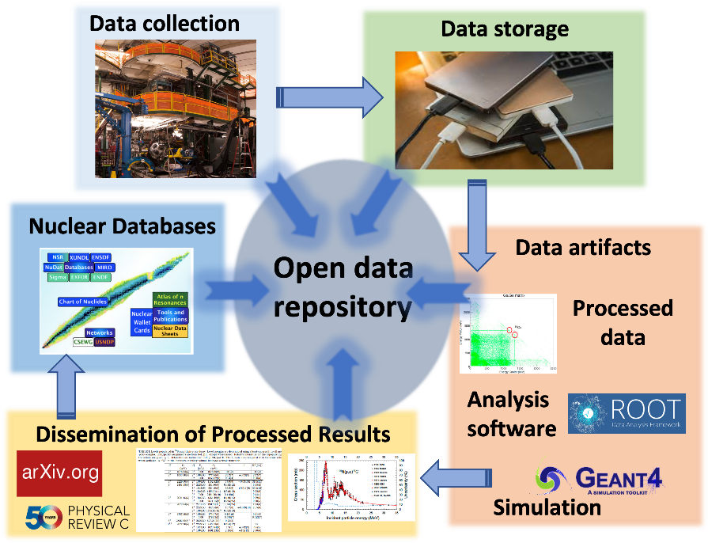
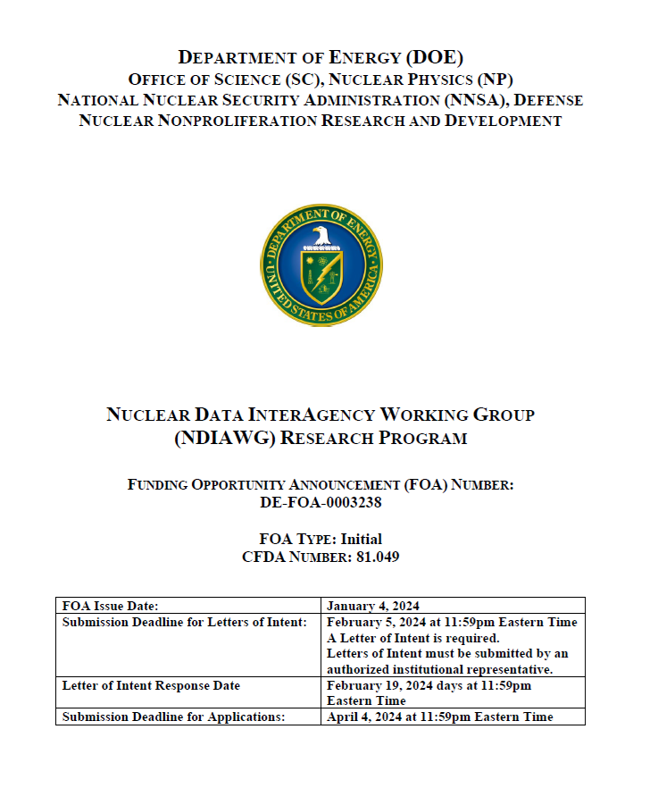
Future Plans
Development of implementation plans for NSAC LRP and NSAC-ND
Continue outreach
Continue modernization efforts for USNDP resources
FY24 NDIAWG FOA released (DE-FOA-0003238)
  Released Jan 4, Full proposals due April 4
  NP and NNSA with topics
  Received 37 Letters of Intent
  NP Topic for training nuclear data evaluators & hosting summer schools

Slide 9

SC Internship Programs and Opportunities
Science Undergraduate Laboratory Internships Program
The Community College Internships Program
Office of Science Graduate Student Research
Visiting Faculty Program
science.osti.gov/wdts
Notes:
Template Instructions: Please do not add text about the programs, instead tell all in the details in your presentation. And/or add a QR code.
Talking points can always go in the Notes section of your presentation.
During a presentation, a limited amount of text with engaging pictures and graphics work best.

Slide 10

Thank you!

Slide 11
