Slide 1
W. David Kulp
Nuclear Data Measurements at the Adelphi Pelletron Experimental (APEX) Facility
Distribution A: Approved for public release; distribution is unlimited

Slide 2
Agenda
Nuclear Data Measurements Focus
APEX Accelerator
APEX Facility
Progress to Date
Project Plans
Questions

Slide 3
Nuclear Data Measurements Focus
Increase fidelity of nuclear weapon effects modeling & simulation (M&S) capabilities
Uncertainties and covariances of non-fissile materials
Improve capabilities to characterize nuclear events
Advance nuclear explosion monitoring capabilities

Slide 4
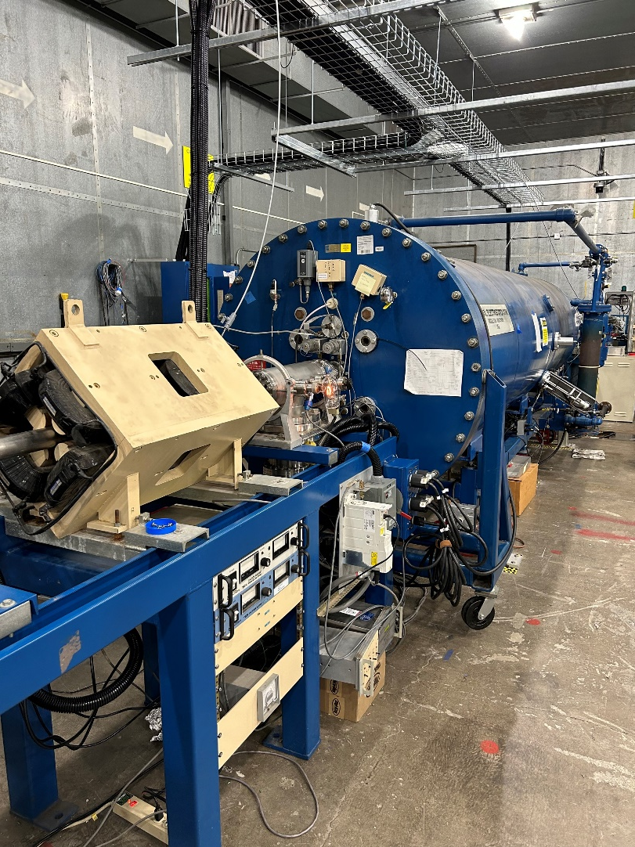
APEX Accelerator
Owned and operated by DEVCOM/ARL
PI: Dr. Jeff Carroll
NEC 9SDH-2 Pelletron
Tandem van-de-Graff ion accelerator
Light- and heavy-ion accelerator
Nominal 3 MV terminal potential (6 MeV p⁺)
Nominal 100 µA continuous beam (p⁺)
Ion sources
Toroidal Volume Ion Source (TORVIS)
Source of Negative Ions by Cs Sputtering (SNICS)

Slide 5
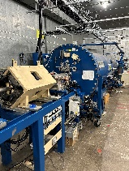
APEX Facility
Test Cell
11’ earthen and concrete walls
Dimensions: 66.5’ x 49’ x 16.5’
50- and 110-ton doors
Instrumentation
HPGe detectors, including 2 Clovers
γ-ray scintillators
Neutron detectors (new CLYC)
VME-based DAQ

Slide 6
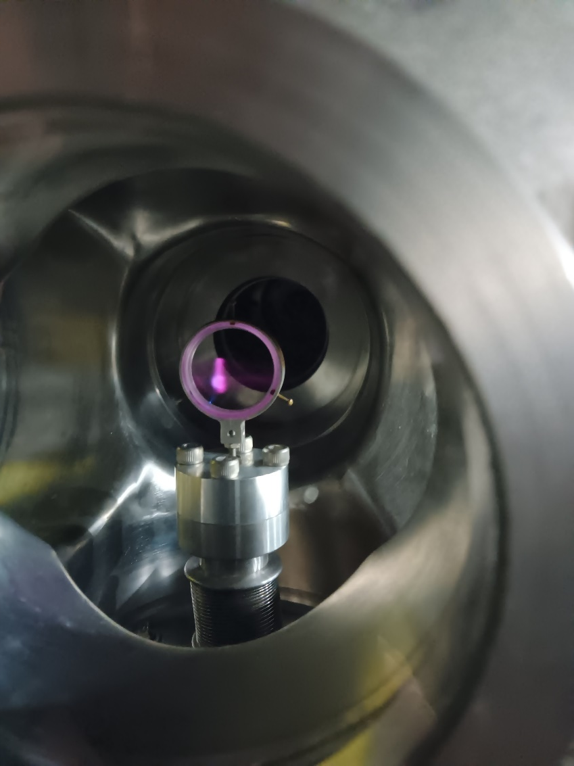
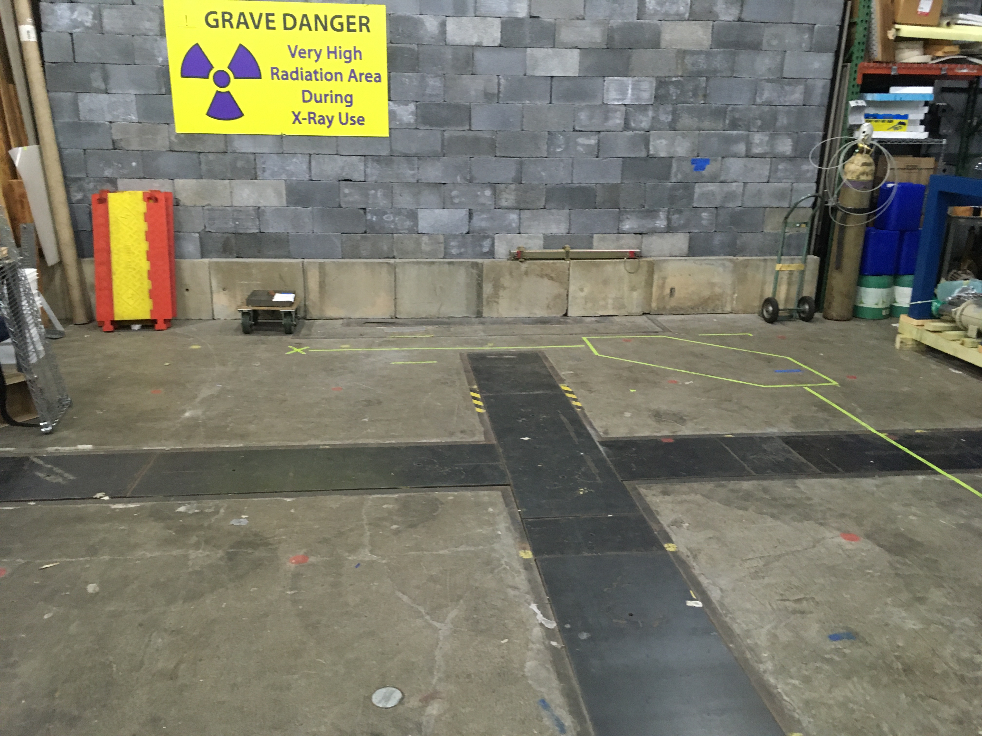
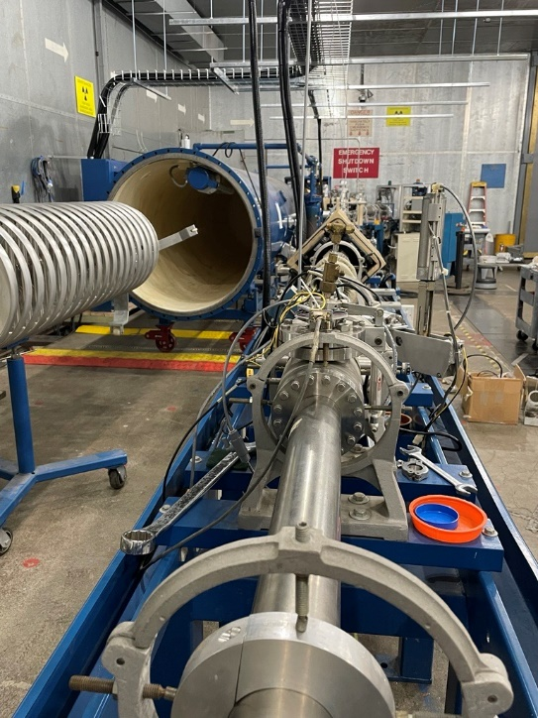
Progress to Date
Project started: JUL 2021
First beam: DEC 2023
Army Radiation Authorization in progress
August 2021
August 2023
December 2023

Slide 7
Project Plans
Fiscal Year 2024
Characterization & calibration
Commissioning experiments
Fiscal Year 2025
Reconfigure for chopper/buncher for pulsed beams
Fiscal Year 2026
Neutron time of flight beamline

Slide 8
QUESTIONS?

