Slide 1
DTRA Research and Development

Slide 2
Agenda
Mission and Functions
Research and Development (RD) Departments
  Chemical and Biological Technologies
  Counter Weapons of Mass Destruction (WMD) Technologies
  Nuclear Technologies
  Test and Assessment
  Operations
Wrap Up
2

Slide 3
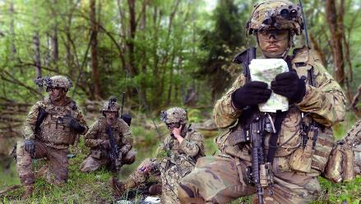
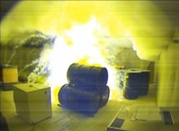
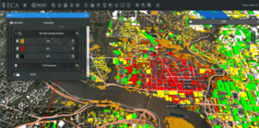
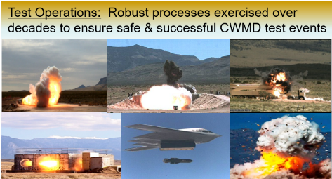
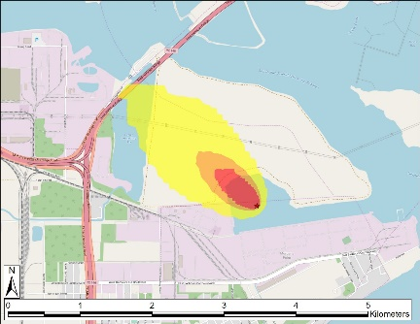





RD Mission and Functions
Provide science, technology and capability development investments that maintain the U.S. military’s technological superiority in countering weapons of mass destruction & emerging threats, mitigate the risks of technical surprise, and respond to urgent technical requirements from the Joint Force.
Chemical and Biological Technologies
Counter WMD Technologies
Nuclear Technologies
Test and Assessment
Operations
Insert picture
Insert picture
Insert picture
Insert picture
RD delivers innovative solutions that meet current mission requirements in a timely manner and anticipates and prepares for emerging and future threats with a balance of fundamental and applied research across the portfolio.
3

Slide 4




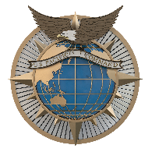


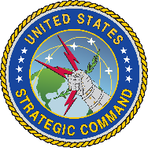

RD Strategic Partnership
RD partners with other U.S. Government agencies (such as National and Service Laboratories), and international S&T organizations to develop Combatting Weapons of Mass Destruction (CWMD) capabilities that address prioritized Combatant Command (CCMD) / Joint Force gaps.
4

Slide 5
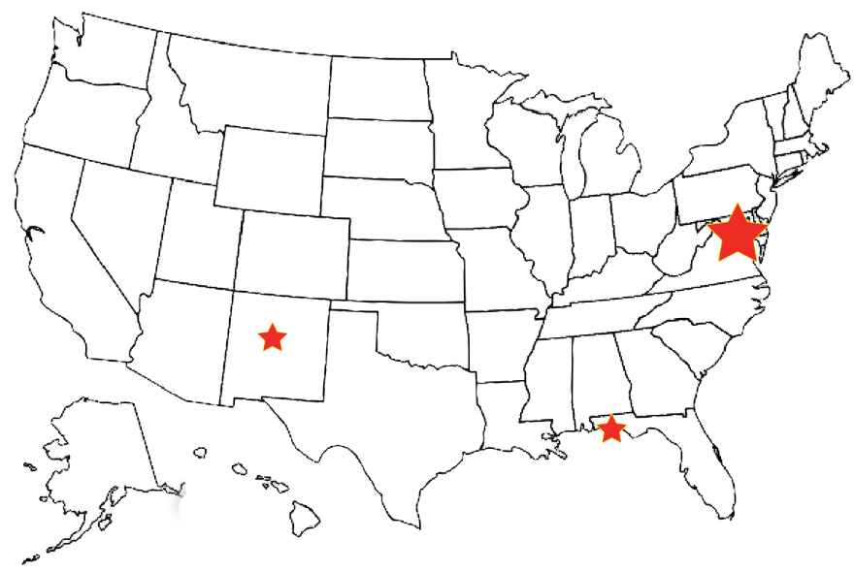
RD Workforce Locations
National Capital Region
Defense Threat Reduction Center (DTRC) / Fort Belvoir
New Mexico
Kirtland AFB
Florida
Eglin AFB
Some Additional Workforce Locations
West Point, NY; Las Vegas, NV; Fort Liberty, NC; and Edgewood/Aberdeen Proving Ground, MD
5
RD delivers innovative solutions that meet current mission requirements in a timely manner while anticipating and preparing for emerging and future threats with a balance of fundamental, and applied research across the portfolio

Slide 6
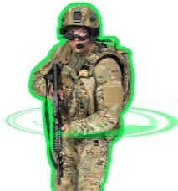
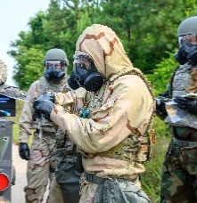


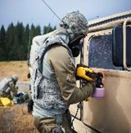

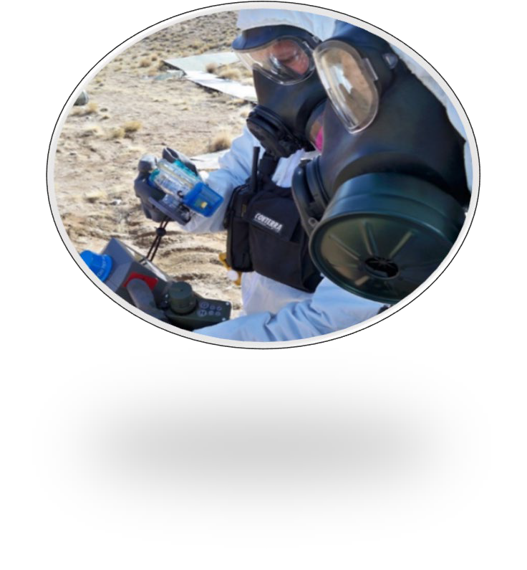
Chemical and Biological (CB) Technologies Department
Anticipates future threats & delivers capabilities that enable the Joint Force to survive, fight & win in chemical, and biological contested environments through a coordinated effort designed to neutralize adversarial CB threats
Detection and Diagnostics
Vaccines and Therapeutics
  Develops minimally invasive sampling methods to predict the severity of disease, and advanced sequencing technology
  Investments to support medical countermeasure products, and enable recovery from current and emerging biological threats
Digital Battlespace Management
Advanced and Emerging Threats
  Data fusion and analytics supporting situation awareness, decision-making, and threat management
  Develops and transitions products and information to address current. and emerging CB threats
Protection and Hazard Mitigation
Research Center of Excellence
Develops the next generation of Department of Defense (DoD) scientists
Conducts research in areas of interest to the Chem-Bio Defense Program and enhances Joint Force protection, and mission capabilities.
Develops full-spectrum physical protection and hazard mitigation technologies
Warfighter Integration
Provides technology, education, and develops the CB workforce
Research Operations
  Manages daily operations
6

Slide 7
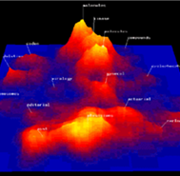
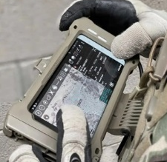

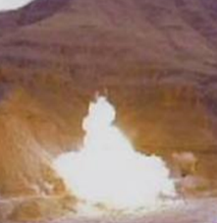
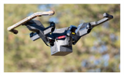

Counter WMD Technologies Department
Develops, demonstrates, and transitions innovative technologies and capabilities to actively counter the full spectrum of adversary activities across the WMD continuum
Target Assessment Technology
Counterforce Systems
Develop, apply, and transition innovative technologies to characterize and assess WMD threats and Hard & Deeply Buried Targets (HDBTs) in partnership with the Intelligence Community in support of Combatant Commands
Develop, integrate, demonstrate and transition CWMD advanced sensors, surveillance
Defeat target planning technologies in support of Joint Force operations
Urgent Solutions
Combating Terrorism
Execute collaborative research and timely capability development to illuminate threat WMD posture and capabilities
Develop options to deter, disrupt, prevent WMD development / use
Exploit adversary weaknesses
Ensure the Joint Force prevails in conflict
Provide Combatant Commanders improved offensive capabilities in support of counter-terrorism and counter-proliferation missions to combat WMDs
Advanced Research
Couples long-range fundamental and applied research with physical, life, and computational sciences to enhance the Offensive CWMD Capability Framework activities in combating emerging WMD threats
Weapons and Capabilities
Offensive weapons and other capabilities to combat WMD while mitigating collateral contamination
7

Slide 8
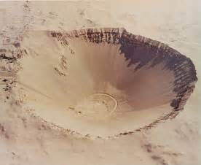
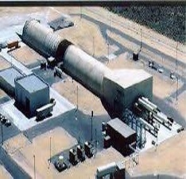
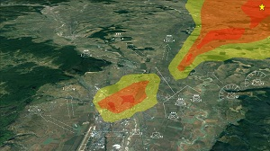
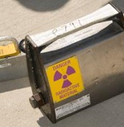
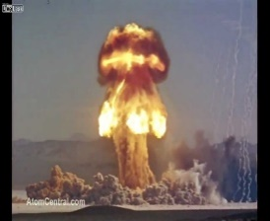
Nuclear Technologies Department
Researches, develops, and transitions nuclear weapons effects, survivability, detection, and monitoring capabilities to support and enable an effective nuclear deterrent
Nuclear Weapon Effects
Nuclear Survivability
  Modeling & simulation tools for nuclear targeting and consequence of execution assessment
  Use existing test data to certify new nuclear capabilities without nuclear testing
  Develop nuclear environments, protection standards, and handbooks
  Operate large pulsed-power machines to produce intense bursts of radiation simulating a nuclear weapon
  Mission-critical systems analysis to characterize nuclear survivability shortfalls
2
Nuclear Assessments
  Test concepts, capabilities, and plans through rigorous assessment and war gaming
  Integrate war gaming tools into exercises
  Nuclear Arms Control Technology Program and the U.S. International Monitoring System
Nuclear Technologies Integration
  Provide cloud-ready nuclear modeling interfaces and applications
  Deliver timely electronic access to nuclear testing archives
  Enable the Joint Force to visualize the nuclear battlefield through an integrated Common Operating Picture
Nuclear Threat Detection
  Sensors for characterization of the nuclear battlefield
  Technologies to collect, analyze, exploit, and attribute nuclear detonation data and signals

Slide 9
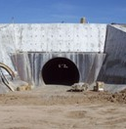
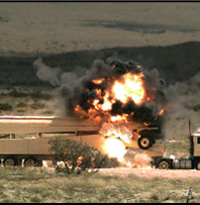
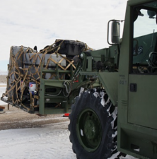
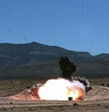
Test and Assessment Department
Provides objective evaluations of new capabilities to support the DTRA mission and national priorities through tests and assessments
Environmental & Safety
Test Division
Eliminate or mitigate hazards in the workplace to reduce or eliminate the exposure of our employees to hazards associated with testing and the construction environment
Conduct Test & Evaluation to maintain U.S. superiority in countering WMD and emerging threats
Mitigate the risks of technology surprise
Respond to Joint Force’s urgent requirements
Integration & Resource
Sensitive Assessments
Ensure effective and efficient use of resources
Conduct rapid assessments to enable the DoD to deter, prevent, and prevail against WMD-armed adversaries and emerging threats
9

Slide 10
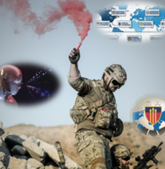

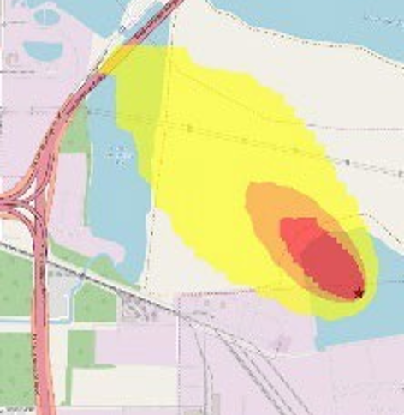
Operations Department
RD-OP integrates RDT&E operations, activities and investments (OAI) across the RD Departments and the Agency, as well as with external customers
Integration
Enabling Capabilities
Works across all RD departments and investments to ensure effective integration in areas including:
  Directorate-wide acquisitions
  Data visualization
  Customer request management
  International S&T Cooperation
  Small business (SBIR/STTR)
Manages DTRA’s basic research program and provides computational services, support, and coordination for the Directorate
Includes supporting software development, access to High Performance Computing (HPC), and coordinating across programs harnessing Artificial Intelligence (AI).
Technical Reachback
Provides 24/7 manned CBRNE decision support capability for planning, operations, and post-event analysis
Serves as the technical focal point for National CWMD Technical Reachback Enterprise analysis, modeling, and simulation
10

Slide 11



Technical Reachback
Technical Reachback provides 24/7 CBRNE (Chemical, Biological, Radiological, Nuclear, Explosives) subject matter expertise, decision support capability for planning, operations, and post event analysis to the Office of the Secretary of Defense (OSD), CCMDs, and other U.S. Government partners.
Modeling Tools used by Reachback:
Atmospheric Plume Modeling
Waterbourne & Natural Hazard Modeling
Reachback Priorities:
Operational support
Enabling activities
Epidemiological modeling
Nuclear modeling
Post event analysis
11

Slide 12
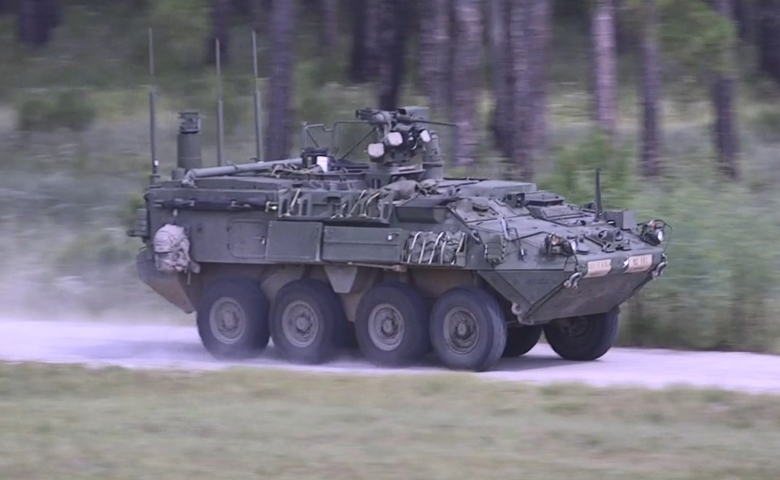
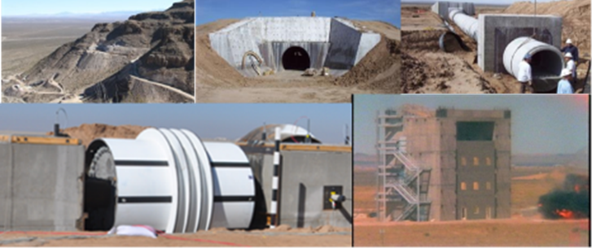
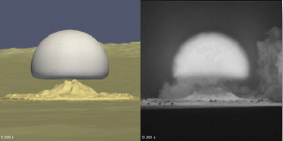
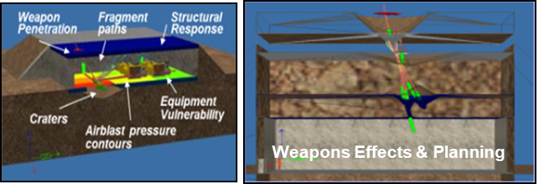
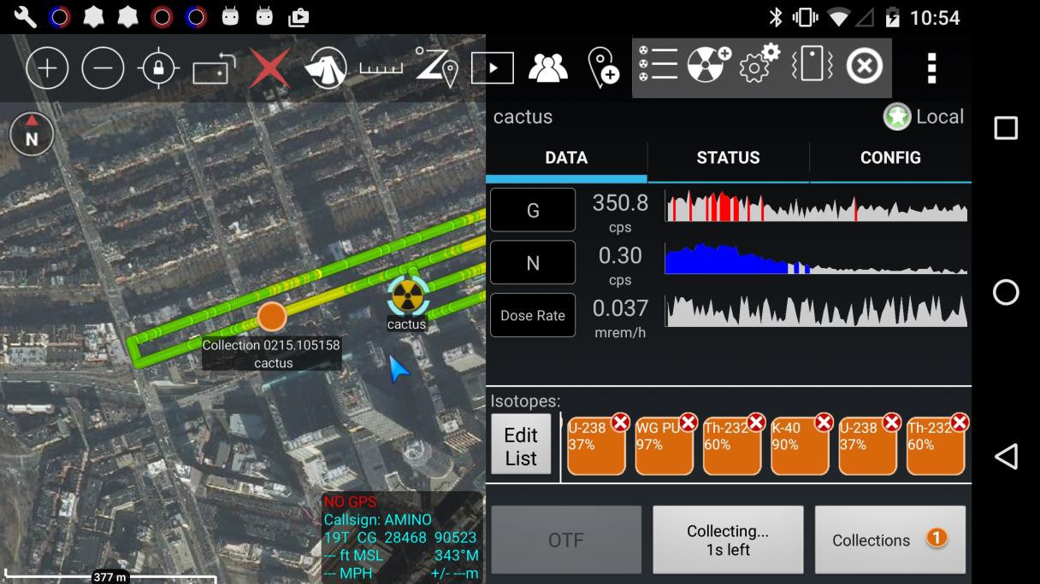
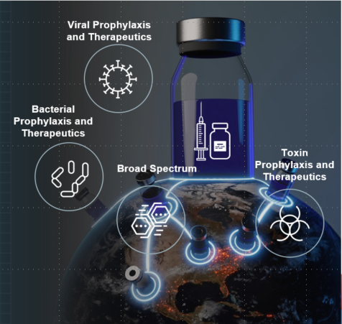

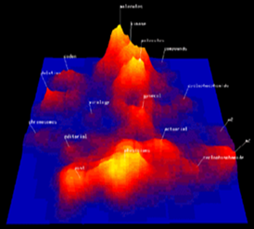
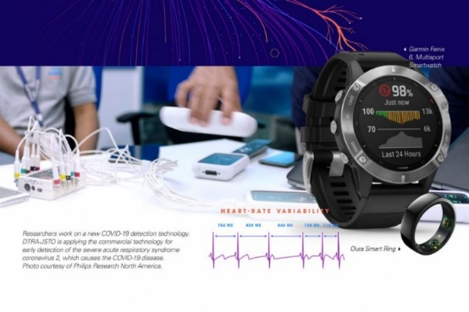
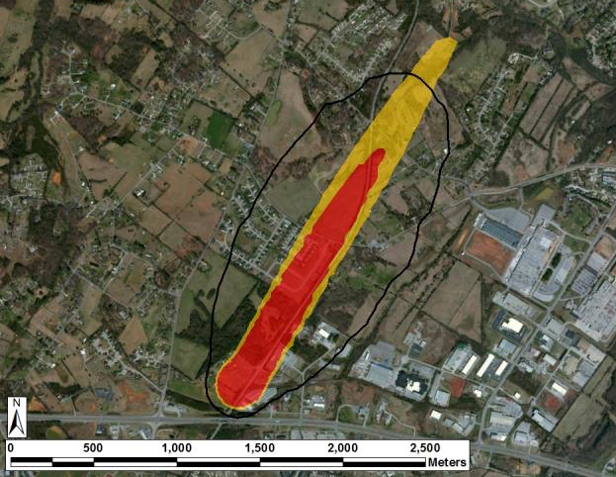
Developing Capabilities to Fight and Win on the CBRN Battlefield
Equip forces to operate effectively on the nuclear battlefield
Provide technologies, standards, historical data, and testing to ensure forces can survive and fight
Deliver tools that enable effective targeting of U.S. weapons and inform
the consequences of attacks
Nuclear Effects
Conventional Effects
Test concepts and plans through rigorous wargaming
Protect the U.S. Joint Force with advanced medical countermeasures and early warning capabilities
Deliver integrated, cloud-ready, AI-enhanced applications and data analysis
24/7 technical analysis of CBRNE questions
12

Slide 13
DTRA Research and Development Summary
DTRA Provides:
Science, technology, and capability development investments that maintain the U.S. military's technological superiority
An integrated and coordinated portfolio that leverages the DoD, Interagency, and international partners providing support to our U.S. Joint Forces.
Comprehensive research and development investment to increase agility, respond to new or changing CCMD requirements, as well as national, and DoD CWMD priorities
13

Slide 14



For more information, please visit us at
www.dtra.mil
Contact Information: RD Engagements Team
dtra.belvoir.rd.list.rd-opi-engagements-team@mail.mil
Visit us – Keyword: DTRA
14

