Slide 1
FES Overview
Workshop for Applied Nuclear Data Activities
2/26/24

Slide 2
Fusion Energy Sciences Mission
The mission of the Fusion Energy Sciences (FES) program is to expand the fundamental understanding of matter at very high temperatures and densities and to build the scientific foundations needed to develop a fusion energy source. This is accomplished by the study of the plasma state and its interactions with its surroundings.
Accelerate fusion development as a carbon-free energy source via public-private partnerships (FESAC LRP + Bold Decadal Vision). Advance the fundamental science of magnetically confined plasmas to develop the predictive capability needed for a sustainable fusion energy source.
Support R&D Fusion Centers (“FIRE” centers) to establish S&T basis of a Fusion Pilot Plant (FPP). Support the development of the scientific understanding required to design and deploy the materials needed to support a burning plasma environment.
Support discovery plasma science and technology. Improving the fundamental understanding of basic plasma science, including both burning plasma and low temperature plasma science and engineering
Broaden participation in fusion and DEIA activities to enable the program.

Slide 3
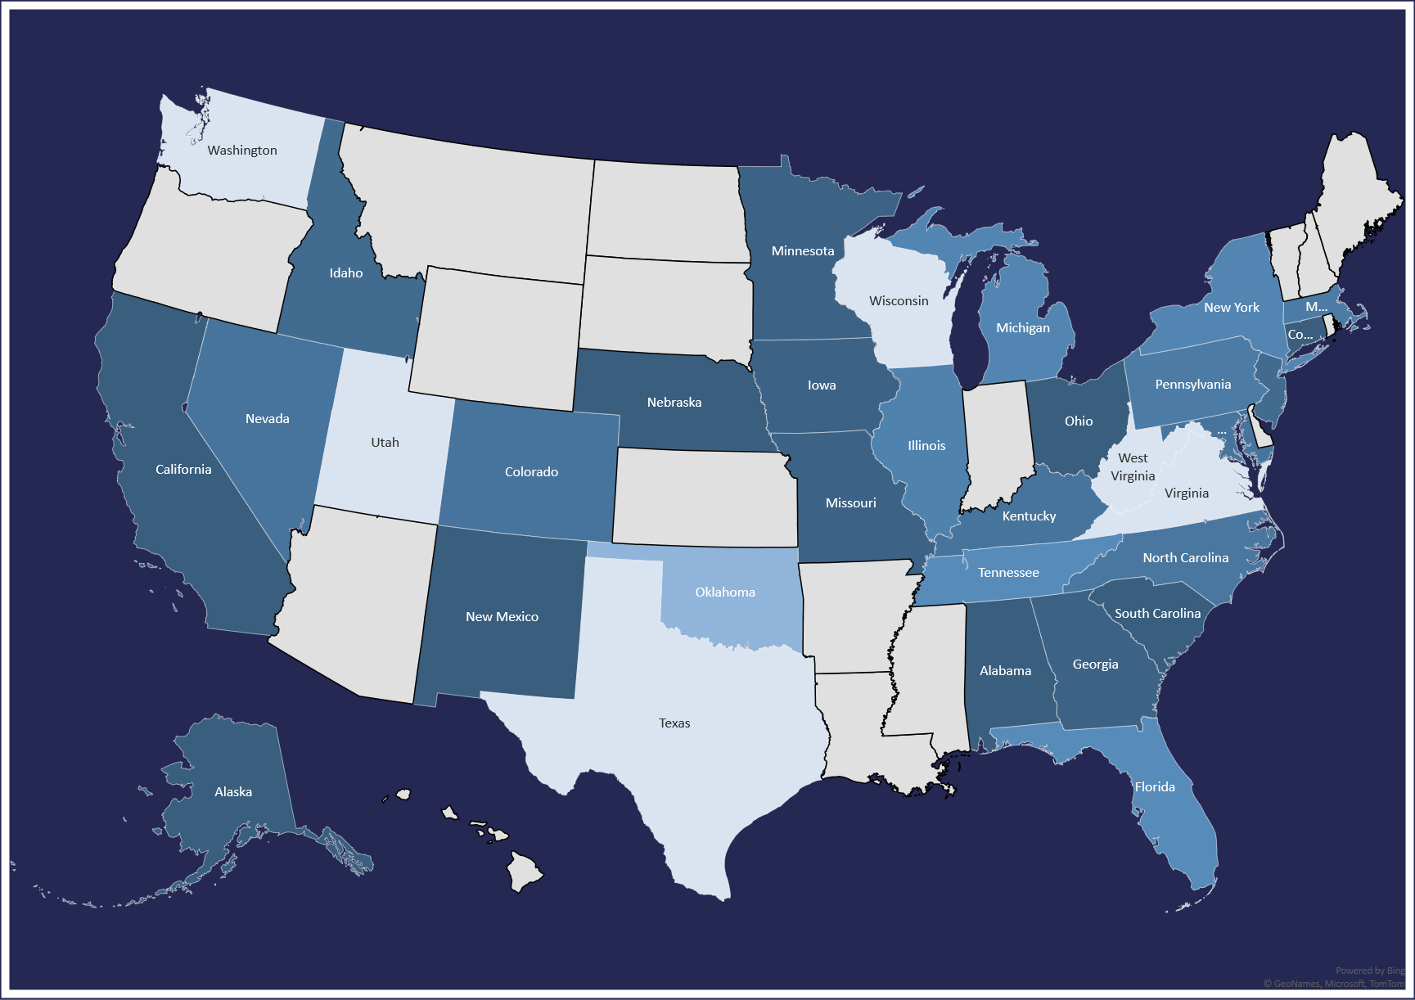
FES Mission Supports National Labs, User Facilities, Universities, and Private Industry Across the US
Institution Type | Number of Active Awards
For-Profit Organization (Other than Small Business) | 24
Hispanic-serving Institution | 36
Historically Black Colleges and Universities (HBCUs) | 8
Nonprofit (other than Institution of Higher Ed.) | 11
Other | 6
Private Institution of Higher Education | 106
Public/State Controlled Institution of Higher Education | 205
Small Business | 24
National Laboratories | 117
Notes:
Like slide - ☺

Slide 4
Fusion Approaches Vary Drastically in Plasma Parameters
Magnetic confinement fusion
Lowest fuel density: $n\sim {10}^{14}$ ions/cm³
Highest confinement time: $τ\sim$ seconds
Magneto-inertial fusion (MIF)
Intermediate density: $n\sim {10}^{17−23}$ ions/cm³
Intermediate confinement time: $τ\sim$ ns to ms
Inertial confinement fusion (ICF)
Highest density: $n\sim {10}^{25}$ ions/cm³
Lowest confinement time: $τ≤100$ ps

Slide 5
Fusion Energy Requires Nuclear Data for All Configurations
A common goal of fusion energy is to support the development of a secure an inexhaustible energy source that is economically competitive and environmentally attractive.
Doing this requires the scientific understanding of the various development paths. These development paths will result in high neutron wall loading and surface heat flux, which require the blankets, plasma facing components, and other material structures to be able to withstand this environment.
Additionally, reduction of long-lived radwaste volume is critical to the development of economically competitive and environmentally attractive fusion energy system.

Slide 6
Nuclear Data is Critical to Predictive Modeling Efforts
Nuclear data along with nuclear codes are essential to predicting and validating fusion nuclear phenomena.
Nuclear heating, activation and waste, shutdown dose rates, nuclear damage and gas production
Example: inventory codes using ND to predict neutron-induced activation and transmutation of materials which define the radiological hazards during operation, maintenance, and decommissioning
Example: Transmutation (e.g., gas production (He), neutron-induced displacement damage) will cause swelling and embrittlement limiting the lifetime of the component.
Thus, validation and accurate ND and inventory codes are critical.

Slide 7
High Quality Nuclear Data is Needed for Computational Predictive Capabilities for Any/All Nuclear Applications
Computational results for neutron irradiation damage to tungsten can vary by up to 66% depending on nuclear data.

Slide 8
While a Wealth of Nuclear Data for Fusion Exists, Critical Gaps Require Attention
There is a significant amount of historical nuclear data and benchmarks [1990 – current].
Japan Atomic Energy Agency FNS, ITER, F4E, UKAEA, IAEA, US (e.g., FISPACT, TENDL, JEFF, EAF, FENDL, ENDF/B-VX)
However, gaps remain for key fusion materials (e.g., RAFM steels – solid transmutants and gas production), benchmark measurements at longer irradiation times, and ND uncertainties for TBR (e.g., blanket design)
This is highlighting the critical need for a 14 MeV Fusion Prototypic Neutron Source – hard to fill in these ND gaps without this source.
IFMIF-DONES (Spain), FPNS (US)

Slide 9
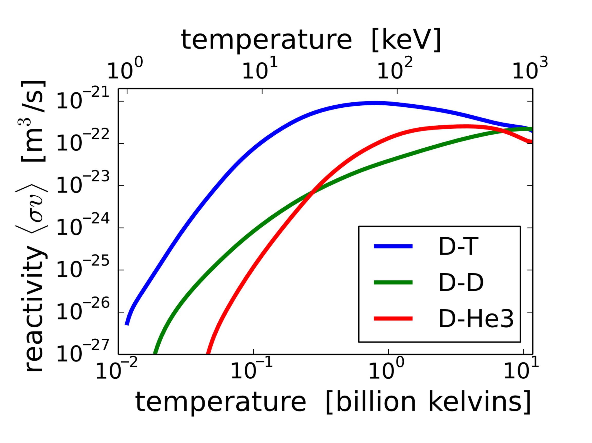
FES Nuclear Data Needs
Cross Sections from:
Neutrons (n):
2.74 MeV from D-D reactions
14 MeV from D-T reactions
Alphas (α):
3.5 MeV from D-T reactions
5.5 MeV from p¹¹B reactions
Notes:
Development of FENDL

Slide 10
Existing Projects within FES Leverage Nuclear Data
Theory and Simulation:
SciDAC
Center for Simulation of Plasma – Liquid Metal Interactions in Plasma Facing Components and Breeding Blankets of a Fusion Power Reactor (PI: Sergei Smolentsev)
Integrated Thermomechanical Model of First-wall Components Under Evolving Chemistry and Microstructure During Fusion Reactor Operation (PI: Jaime Marian)
Center for Advanced Simulation of RF-Plasma-Material Interactions (PI: Paul Bonoli)
Fusion Materials:
2018 – Current: Assessed the need for a Fusion Prototypic Neutron Source and produced performance requirements. Following an RFI, FES is coordinating an assessment of the 14 concepts submitted to RFI. The purpose is to understand and articulate the scientific risks and benefits of different types of concept approaches to FPNS.
Fusion Nuclear Science:
US-EUROfusion participation in the European Power Plant Physics and Technology (PPPT) programme (ORNL)
Fusion neutronics open source development and benchmarking (ANL, MIT)
US Fusion neutronics coordination – on going following Jan 2023 workshop

Slide 11
Summary
High quality nuclear data is essential to achieving a working nuclear fusion reactor.
Clear need for a Fusion Prototypic Neutron Source
Scientific issues still need resolution (high-energy tail, tolerable limits, non-prototypic fusion energy impurity generation in key fusion materials, needs for pulsed concepts)
Understanding that an FPNS may take time – what are the critical ND gaps that are dependent on FPNS, can we use existing capabilities to address those gaps, what is the impact of doing this, what is the uncertainty in material performance, …, etc.
Current FES projects are utilizing ND resources, with needs growing as experiments begin to come online and existing experiments explore new operational scenarios:
ITER, FPP’s, NIF, NSTX-U, DIII-D, W7-X, and etc. all require accurate nuclear data to optimize reactor performance.
Notes:
What do we hope to learn from this meeting?
ND community thoughts on targeted experiments?
Thoughts on developing ND codes to represent material damage and activation.
Plans for activation of relevant materials.
Guin’s presentation on material needs.

