Slide 1

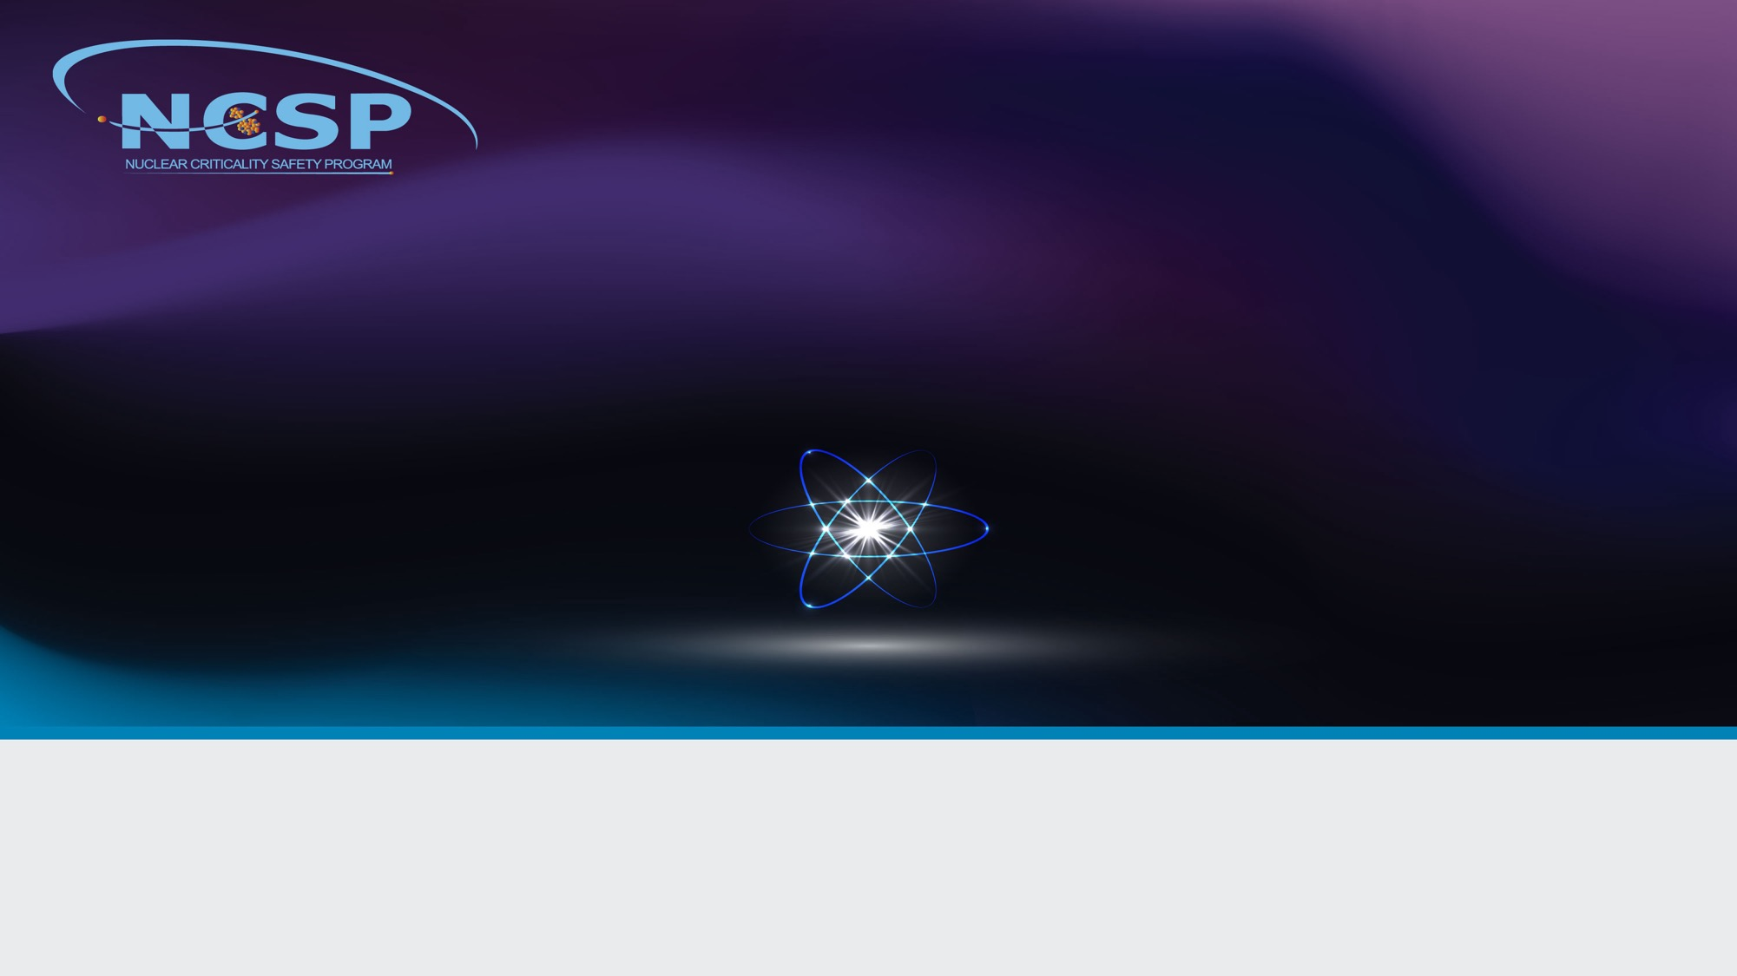
NCSP Nuclear Data Program
WANDA-2024 Workshop
Presented by:
Douglas G. Bowen, Ph.D.
NCSP Execution Manager
Section Head, Nuclear Data, Criticality Safety, and Radiation Transport
Oak Ridge National Laboratory

Slide 2
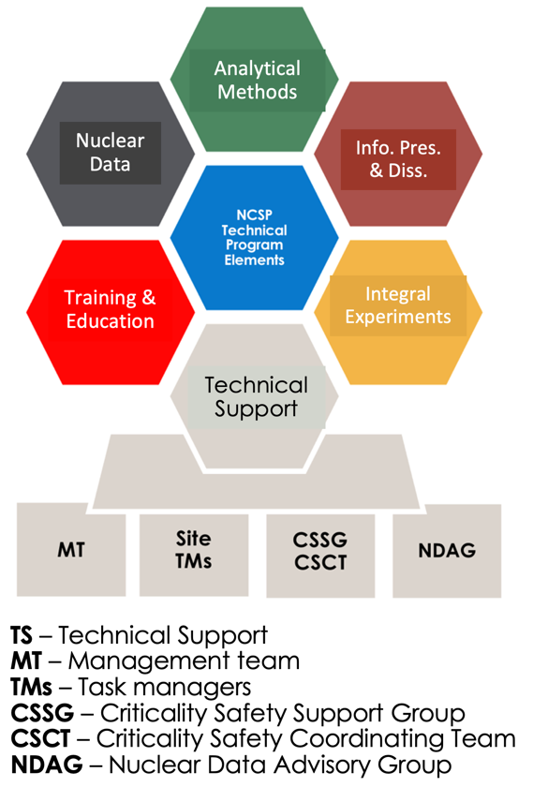
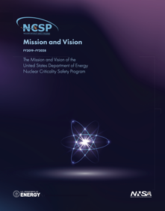
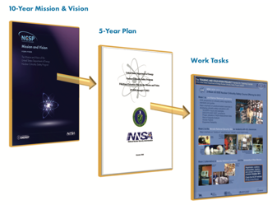

Background / History–Mission Vision–Organization
Early history
NCSP 5-year plan
NCSP organization
Defense Nuclear Facilities Safety Board (DNFSB) Recommendations:
  93-2 (3/23/1993): Need for a general-purpose critical experiment capability that will ensure safety in handling and storage of fissionable material.
  97-2 (5/19/1997): Need for improved criticality safety practices and programs to alleviate potential adverse impacts on safety and productivity of DOE operations.
DOE Implementation Plan for 93-2 and 97-2 recommendations resulted in establishment of the US NCSP
Mission
Provide sustainable expert leadership, direction and the technical infrastructure necessary to develop, maintain, and disseminate the essential technical tools, training, and data required to support safe, efficient fissionable material operations within DOE.
Vision
  Continually improving, adaptable, and transparent program that communicates and collaborates globally to incorporate technology, practices, and programs to be responsive to the essential technical needs of those responsible for developing, implementing, and maintaining nuclear criticality safety.
Page 1 of 13

Slide 3




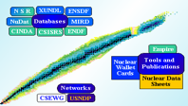
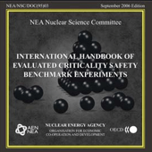
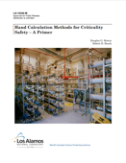
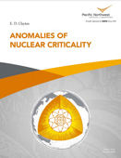
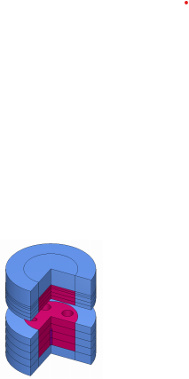

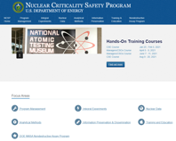
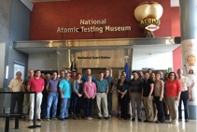
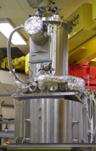
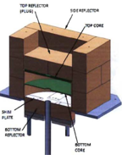
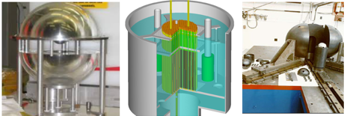

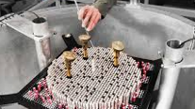
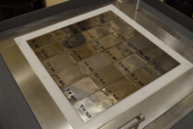


Technical Program Element Activities
AMPX
AM
ICSBEP
GELINA
NCS Handbooks & Reports
ND
IPD
SAMMY
NCSPGoals
NCSP Website
https://ncsp.llnl.gov
TE
IE
TS
Succession Planning
NDA
Program
Program Execution

Slide 4
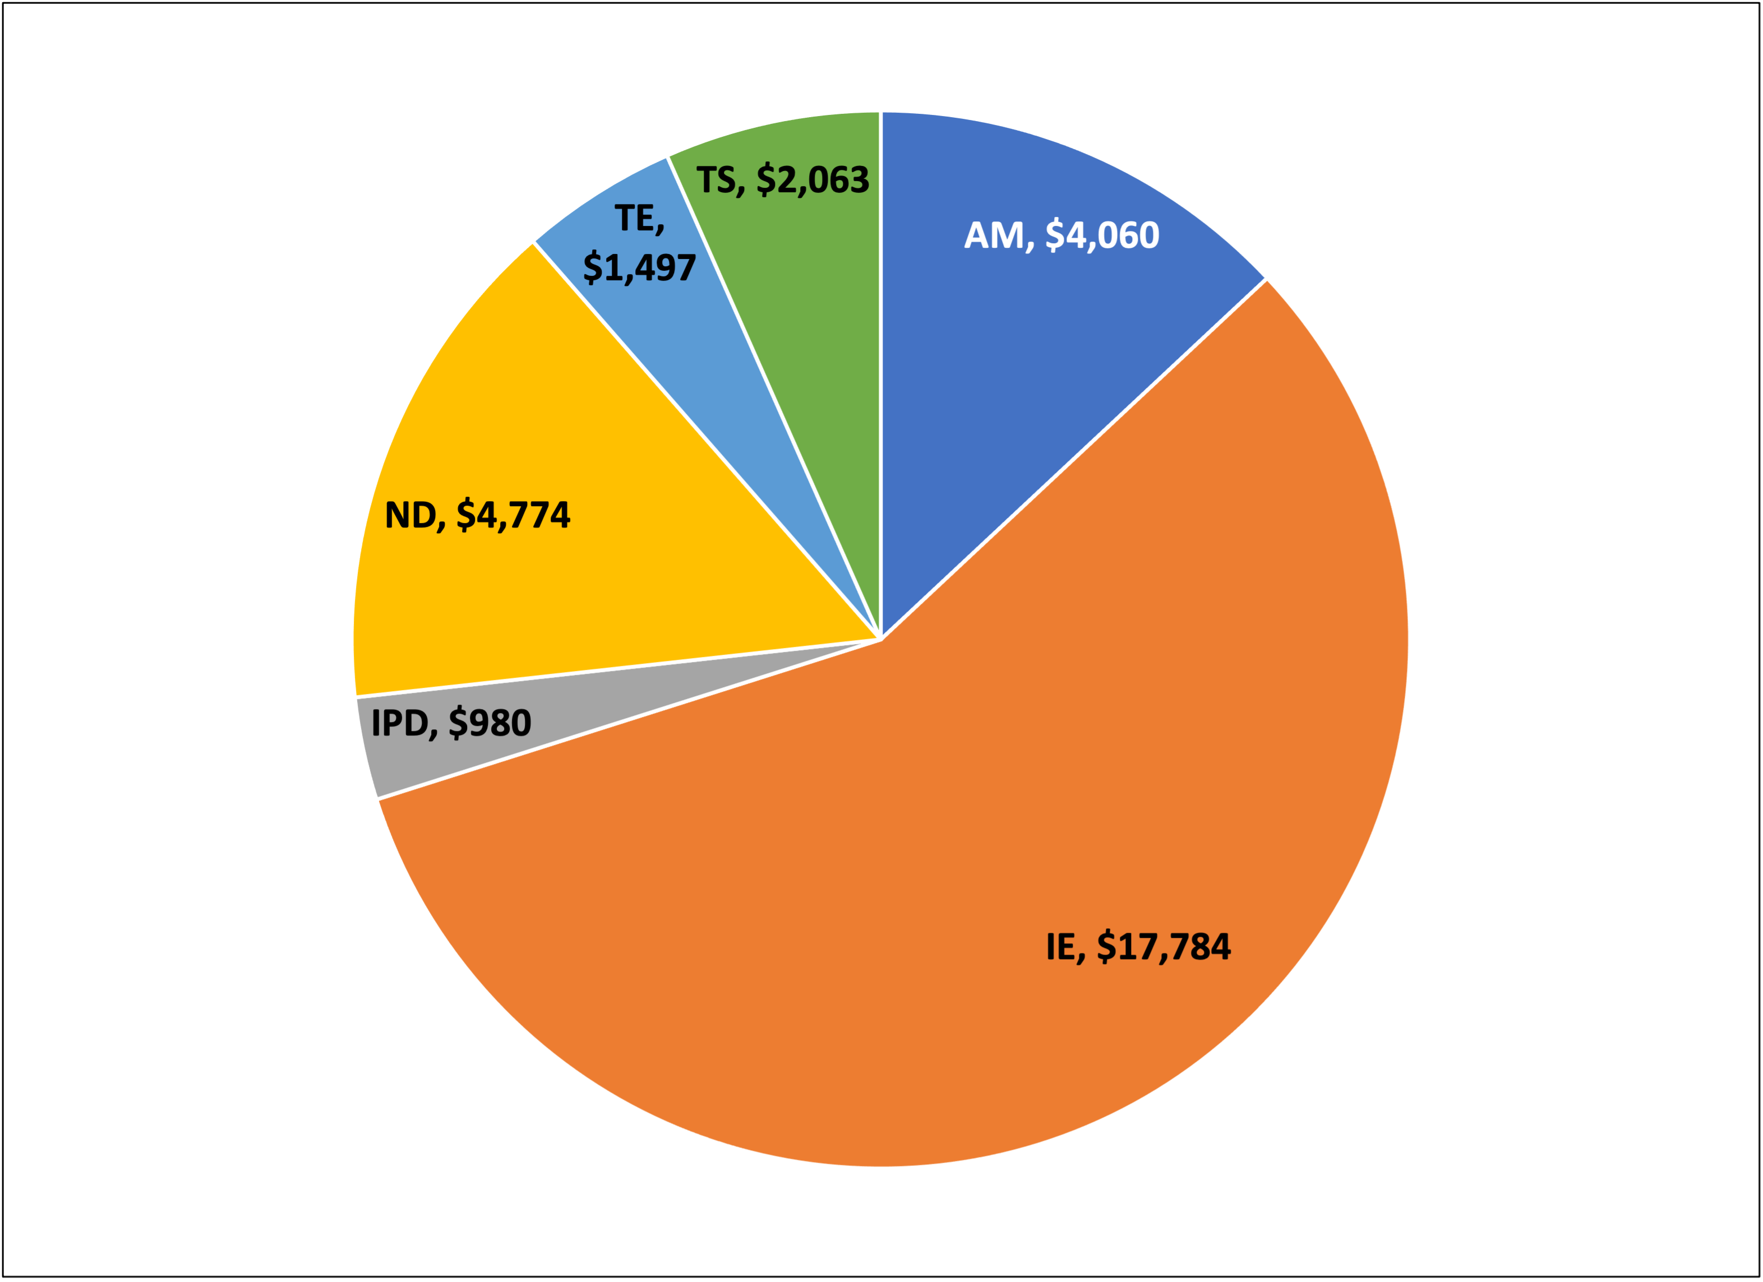
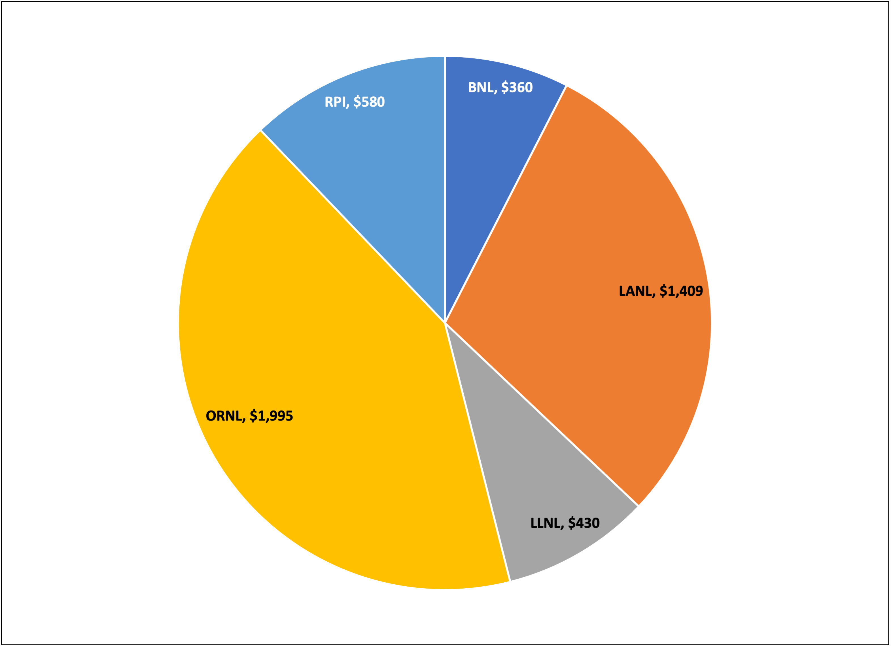
NCSP Nuclear Data Tasks and Budget (2024)
FY24 Budget $31,158k
NCSP Funding Distribution by Technical Program Element
NCSP Nuclear Data Funding Distribution by NCSP Site
FY2024 Nuclear Data Funding:
$4,774K (13%)

Slide 5
NCSP Nuclear Data Tasks and Budget (2024)
FY24 Budget $34,158k
NCSP Funding Distribution by Technical Program Element
NCSP Nuclear Data Funding Distribution by NCSP Site
FY2024 Nuclear Data Funding:
$4,774K (14%)

Slide 6
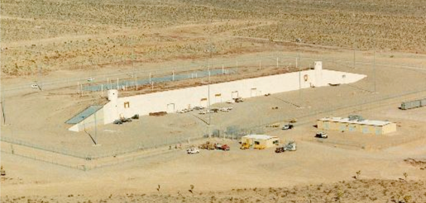
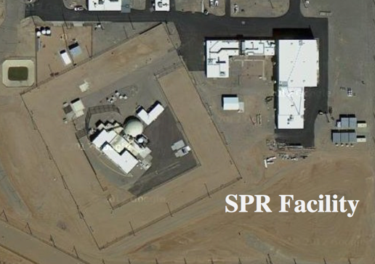
NCSP Integral Experiments
NCSP integral measurements are performed at
  Sandia National Laboratories (SNL) and
  National Criticality Experiments Research Center (NCERC), currently operated by Los Alamos National Laboratory
    NCERC is located at the Nevada National Security Site (NNSS) inside the Device Assembly Facility (DAF)
Types of experiments that can be performed
  Subcritical
    Rocky Flats shells, BeRP ball, Np-237 sphere, TACS shells, etc.
  Critical/Delayed Supercritical
    NCERC: Planet, Comet, Godiva IV, Flattop
    Sandia: Sandia Pulse Reactor critical assembly (2 fuel types, currently)
  Prompt Supercritical
    NCERC: Godiva IV (< 300 deg. C pulse)
DAF/NCERC
SNL/TA-V/SPR Facility
Delayed Critical Regime
k_{eff}=1+𝛽
k_{eff}
Subcritical Regime
Prompt Supercritical Regime
K_{eff}<1.0
k_{eff}=1

Slide 7




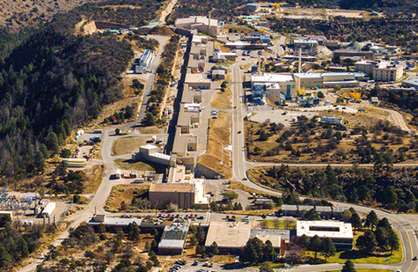
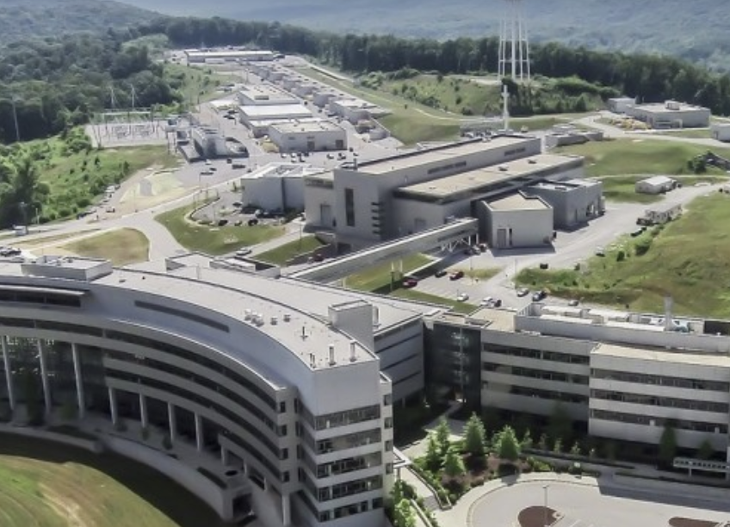
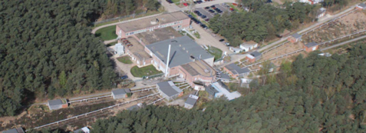
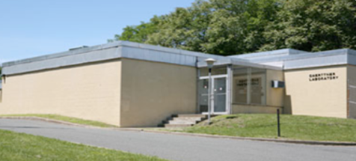
NCSP Differential Experiments
NCSP differential nuclear data measurements are performed at
  JRC-Geel GELINA Facility (Geel, Belgium)
    GELINA is available via collaboration between DOE/NNSA NA-20 and Euratom (JRC-Geel)
  ORNL Spallation Neutron Source (SNS) (Oak Ridge, TN)
  Rensselaer Polytechnic Institute Linear Accelerator (RPI LINAC) (Troy, NY)
  LANL (Los Alamos, NM) LANSCE/Lujan Neutron Scattering Center (LANSCE)
LANL LANSCE
ORNL SNS
JRC-Geel (GELINA)
RPI LINAC
Photos referenced from:
http://www.linac.rpi.edu/public_html/accelerator.html
https://neutrons.ornl.gov/sns
https://ec.europa.eu/jrc/en/research-facility/linear-electron-accelerator-facility
https://lansce.lanl.gov/

Slide 8
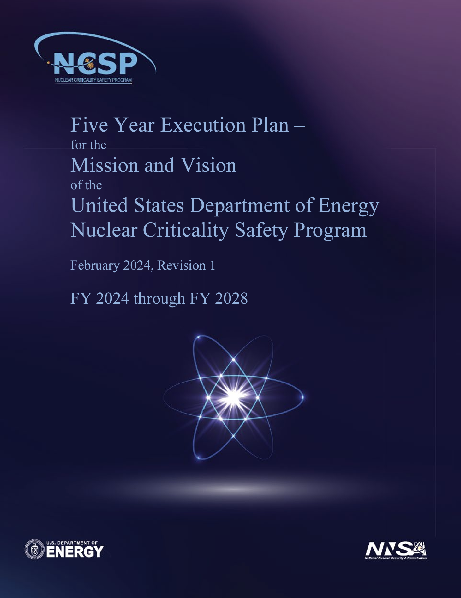
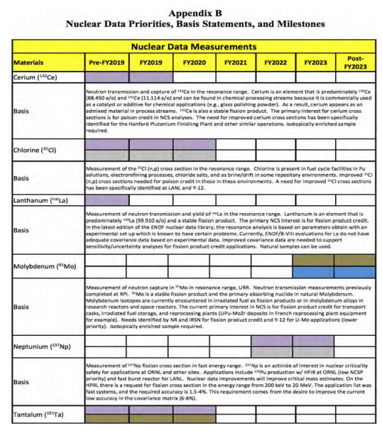
Nuclear Data Measurements &
Evaluation Work for NCSP
Objective: Provide measured and evaluated thermal, resonance, unresolved resonance, and fast region cross section data to address the priority NCSP nuclear data needs
Vision: Addresses multiple Nuclear Data 5- and 10-year goals and attributes identified in the NCSP Vision
Final product: Rigorous ENDF/B evaluations produced from cross section measurements and analyses.
Measurement work effort focused on NCSP priorities by NCSP Nuclear Data Advisory Group (NDAG)
NCSP 5-year plan provides a listing of Nuclear Data measurement and evaluation priorities for the program
DOWNLOAD FY2024 5-year plan:
  https://ncsp.llnl.gov/sites/ncsp/files/2024-02/ncsp_five-year_execution_plan_fy2024-2028_rev1.pdf

Slide 9
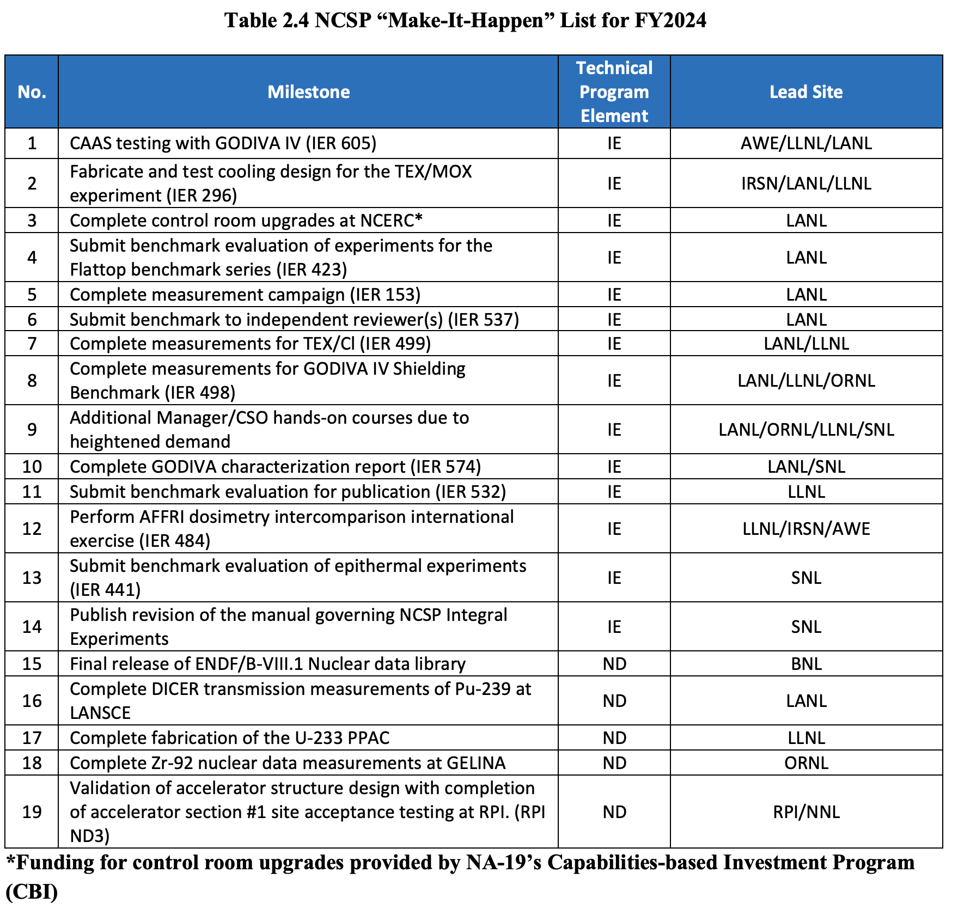
FY2024 NCSP ”Make It Happen List”

Slide 10
FY2024 NCSP ”Make It Happen List”
Notes:
BNL ND1 – May 2024 release scheduled
RPI ND3 – RPI/ORNL: LINAC 2020 Nuclear Data Capabilities Maintenance Plan
– Created a new project timeline based on financial constraints.
– Reached agreement with vendor on continued production of accelerator sections.
– Developed an accelerator control plan.
LLNL ND13 – PPAC Target Fabrication- MIHL
– The hardware was prepped for the electrodeposition and we are waiting for the enriched 233U from ORNL before the targets can be fabricated. The PPAC chamber purchase request has been made and the contract with a vendor is in progress. On track for MIHL item for completing fabrication of the 233U PPAC this year.
LANL ND2 – U-233 PFNS at Chi-Nu (experiment to be conducted during FY25). An order was placed for 233U from ORNL NIDC. Work on making foils at LLNL is ready to begin once this order is delivered, and the PPAC components are already purchased.
LANL ND2 – Pu-239 transmission measurements at DICER (experiment planned for FY24). A re-evaluation of the sample canisters was deemed necessary due to concerns that were raised during the experiment safety review. Instead of the Teflon canisters that were proposed, tungsten containers, sealed with Pb spherical plugs will be used. Those canisters were used in a previous experiment at DICER, and they appear to be resilient to corrosion and leakage. A cartoon of the canister is shown in the next figure. Effort was put into inspecting multiple W canisters and Pb plugs, that are within the engineering tolerances, suitable for an experiment at DICER.
ORNL ND3 - Isotopic Sample Leases to Support ND1 ND Measurements
– Extending the lease for 92Zr sample due to return end of FY24 Q2. o Zr94 lease approved by DOE. Sample fabrication started.
– No Zr-92 experiments performed due GELNA break down. RF window broke, no replacement, new windows are on order, expect to be delivered beginning 2024. No operation of GELINA is anticipated until spring.

Slide 11
NCSP Nuclear Data Measurements and Evaluations in
Progress – FY2024 5-Year Plan
Measurements
Materials | Site
Cesium (¹³³Cs) | LANL
Chlorine (³⁵Cl) | ORNL LANL
Chromium (^{50,53}Cr) | ORNL
Fluorine (¹⁹F) | ORNL RPI
Plutonium (²³⁹Pu) | LANL
Plutonium (²⁴⁰Pu) | LANL LLNL
Samarium (¹⁴⁹Sm) | LANL
Tantalum (Ta) | RPI
Uranium (²³³U) | LANL
Zirconium (^{90,91,92,94,96}Zr) | ORNL
Berylium (Be) | NNL
ZrH_{x} | NNL
Petrolatum | NNL
Evaluations
Materials | Site
Beryllium (⁹Be) | LANL
Chlorine (³⁵Cl) | ORNL, LANL
Copper (^{63,65}Cu) | ORNL, LANL
Fluorine (¹⁹F) | ORNL
Hafnium (^{176,177,178,179,180}Hf) | ORNL, NNL
Iron (^{54,56,57}Fe) | ORNL, BNL
Iron (⁵⁶Fe) | ORNL, BNL
Lanthanum (La) | ORNL, LANL
Lead (^{204,206,207,208}Pb) | ORNL, BNL, RPI, NNL
Lithium (⁶Li) | LANL
Molybdenum (⁹⁵Mo) | ORNL
Nitrogen (¹⁴N) | ORNL
Oxygen (¹⁶O) | LANL
Plutonium (²³⁸Pu, ²⁴⁰Pu, ²⁴¹Pu, ²⁴²Pu) | LANL
Plutonium (²³⁹Pu) | LANL, ORNL
Evaluations
Plutonium (²⁴⁰Pu) | ORNL, LANL
Rhodium (¹⁰³Rh) | ORNL, NNL
Strontium (⁸⁸Sr) | ORNL
Uranium-233 | ORNL, LANL
Uranium-234 | ORNL, LANL
Uranium-235 | LANL, ORNL
Uranium-236 | LANL
Uranium-238 | LANL, BNL
Zirconium (^{90,91,92,94,96}Zr) | ORNL, RPI, NNL, BNL
Uranium Metal (U) | LLNL, NCSU
Paraffin (C_{n}H_{2n+2}) | LLNL, NCSU
Plutonium Oxide (PuO₂) | LLNL, NCSU
Light Paraffinic Oil (Mineral Oil) | LLNL, NCSU
Uranium Silicide (U₃Si₂) | LLNL, NCSU
Zirconium Carbide (ZrC) | NNL
Beryllium Hydride (BeH₂) | NNL
Polystyrene (C₈H₈)_{n} | ORNL
Notes:
Slide 6, this is probably where you want to discuss cross-cutting nuclear data work. A clarification on the slide, the Cl-35 measurement is for the (n,p) reaction not (n,gamma).
The cross cutting ND work I would suggest mentioning is as follows:
Any improvement to U-235, U-238, Pu-239 are cross cutting for virtually all programs.
U-233, Pu-240, Np-237 of interest to NA10, NA20, NE, NRC
Pb and Fe are cross cutting for virtually all programs
Cl-35 cross cutting for NA10 (electrorefining) and NE/NRC (molten chloride salt reactors) where there a significant uncertainties associated with the (n,p) reaction.
Zr & Hf of interest to NR
Ta cross cutting with NA10 for pit production
HF TSL cross cutting with NA10, NA20, NE, NRC and being done to resolve a historical discrepancy impacting NCS for facility processing UF6

Slide 12
NCSP Cross-Cutting Nuclear Data Work
NCSP Nuclear Data work items support many different programs
  Improvements to U-235, U-238, and Pu-239 are cross-cutting for virtually all programs
  U-233, Pu-240, Np-237 of interest to NNSA (NA-10 & NA-20), DOE-NE, NCSP international collaborators, and the NRC
  Pb and Fe are cross cutting for virtually all programs
  Cl-35 cross cutting for NNSA NA-10 (electrorefining, Pu aqueous chloride processing) and DOE-NE/NRC (molten chloride salt reactors) where there a significant uncertainties associated with the (n,p) reaction. Needs for repository situations (DOE-EM/WIPP)
  Zr & Hf of interest to NNSA NA-30 (NR)
  Ta cross cutting with NNSA NA-10 for pit production
  Thermal Scattering Law work is cross-cutting with NNSA (NA-10, NA-20), DOE-NE, and NRC
Notes:
Slide 6, this is probably where you want to discuss cross-cutting nuclear data work. A clarification on the slide, the Cl-35 measurement is for the (n,p) reaction not (n,gamma).
The cross cutting ND work I would suggest mentioning is as follows:
Any improvement to U-235, U-238, Pu-239 are cross cutting for virtually all programs.
U-233, Pu-240, Np-237 of interest to NA10, NA20, NE, NRC
Pb and Fe are cross cutting for virtually all programs
Cl-35 cross cutting for NA10 (electrorefining) and NE/NRC (molten chloride salt reactors) where there a significant uncertainties associated with the (n,p) reaction.
Zr & Hf of interest to NR
Ta cross cutting with NA10 for pit production
HF TSL cross cutting with NA10, NA20, NE, NRC and being done to resolve a historical discrepancy impacting NCS for facility processing UF6

Slide 13
NCSP Benefits/Successes
NCSP support of each major ENDF/B library release supports reduced bias in eigenvalue (k_{eff}) computations to support nuclear criticality safety limit development
NCSP Integral experiment capabilities at NCERC and Sandia are funded by the NCSP to ensure facility availability for sponsor use (non-NCSP) and for new critical experiments to support the NCS community
NCSP performs differential measurements at RPI, LANL (LANSCE), ORNL (Spallation Neutron Source) and GELINA (Geel, Belgium)
NCSP funds all aspects of the nuclear data pipeline to support the NCS community
  Supporting process operations with hands-on operations with fissionable material
NCSP supports university proposals for our human resource pipeline – many success stories here
NCSP is helping to support a literature review on Nuclear Data needs for fusion at ORNL
Notes:
Slide 6, this is probably where you want to discuss cross-cutting nuclear data work. A clarification on the slide, the Cl-35 measurement is for the (n,p) reaction not (n,gamma).
The cross cutting ND work I would suggest mentioning is as follows:
Any improvement to U-235, U-238, Pu-239 are cross cutting for virtually all programs.
U-233, Pu-240, Np-237 of interest to NA10, NA20, NE, NRC
Pb and Fe are cross cutting for virtually all programs
Cl-35 cross cutting for NA10 (electrorefining) and NE/NRC (molten chloride salt reactors) where there a significant uncertainties associated with the (n,p) reaction.
Zr & Hf of interest to NR
Ta cross cutting with NA10 for pit production
HF TSL cross cutting with NA10, NA20, NE, NRC and being done to resolve a historical discrepancy impacting NCS for facility processing UF6

Slide 14
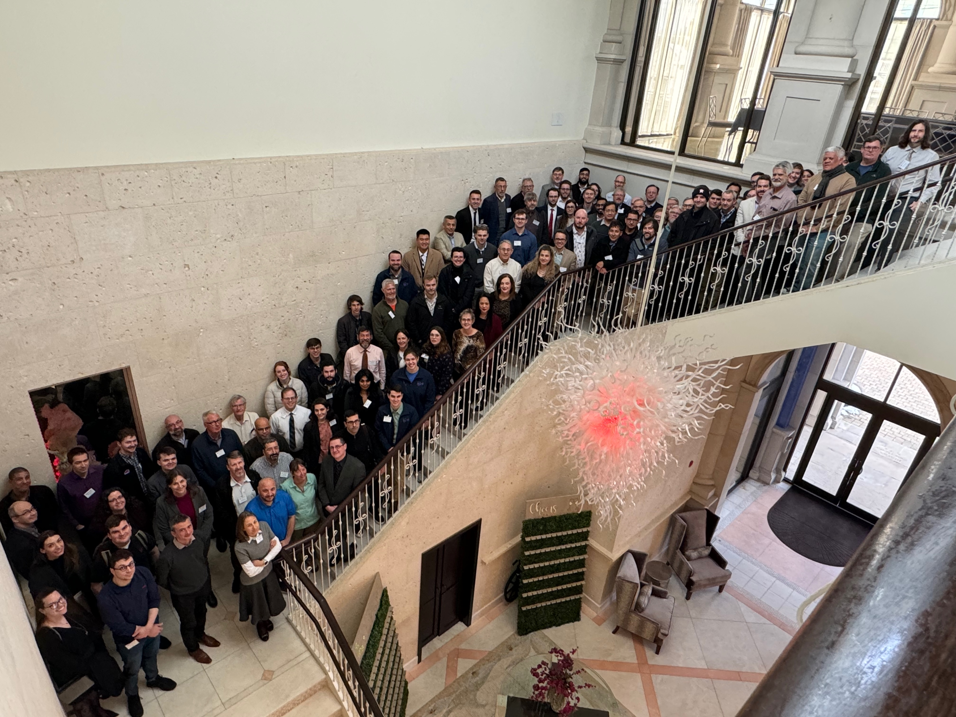
Questions
Photo from our 2024 Technical Program Review
Hosted by Brookhaven National Laboratory

