Slide 1
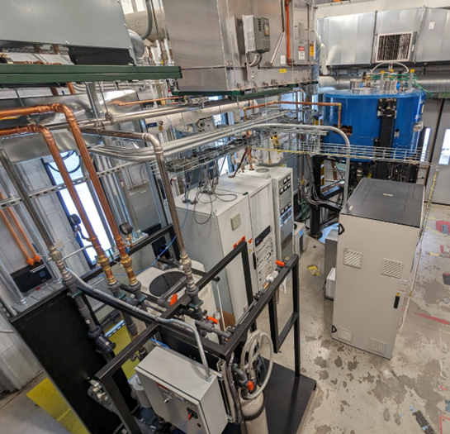
Fission product yield measurements using ²⁵²Cf spontaneous fission and neutron-induced fission on actinide targets at CARIBU
February 29th 2024
Guy Savard
Argonne National Laboratory and University of Chicago

Slide 2
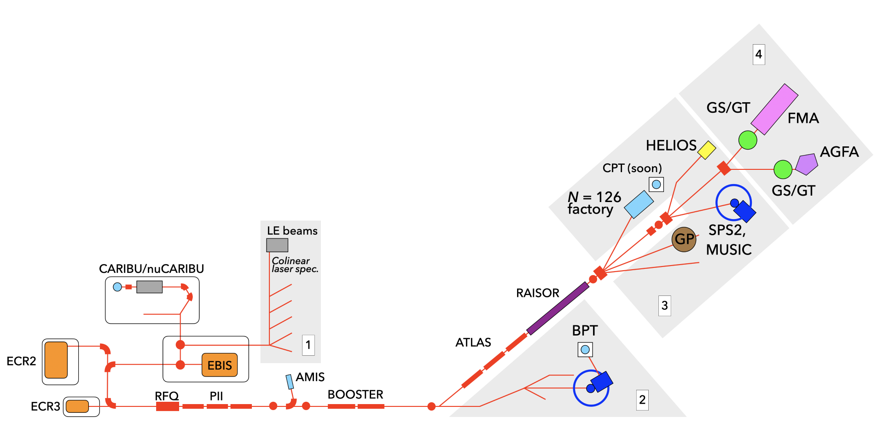
ATLAS/CARIBU facility
DOE Nuclear Physics national user facility
Stable beams at high intensity and energy up to 10-20 MeV/u
Light in-flight radioactive beams with RAISOR
  light beams, no chemical limitations, close to stability, acceptable beam properties
CARIBU beams
  heavy n-rich from Cf fission, no chemical limitations, low intensity, ATLAS beam quality, energies up to 15 MeV/u
State-of-the-art instrumentation for Coulomb barrier and low-energy experiments
Operating ~6000 hrs/yr (+ 2000 hrs/yr CARIBU stand alone) at > 90% efficiency
  Common PAC for ATLAS and CARIBU
  300-400 “single users” per year performing experiments at ATLAS

Slide 3
Fission fragment yield information
Fission produces hundreds of neutron-rich fission fragments. These isotopes have different lifetimes and chemical properties
The fission fragment distribution experimental information is mostly obtained on longer-lived isotopes through decay measurements. Yield for shorter-lived isotopes is mostly from modeling to reproduce the measurement on longer-lived isotopes.
Quantitative knowledge of the decay properties of these isotopes is critical for most of these measurements.
This data is at best unreliable … we have a number of projects (many at CARIBU) to improve this information on medium and shorter-lived isotopes to support the measurement techniques based on decay radiation detection, but this is not the topic of this talk.
We have developed a new approach for these measurements that works by detecting isobarically selected ions to directly determine the yield. This technique is essentially independent from the chemical properties of the isotope and can be applied to isotopes with half-life down to ~ 25 ms.

Slide 4
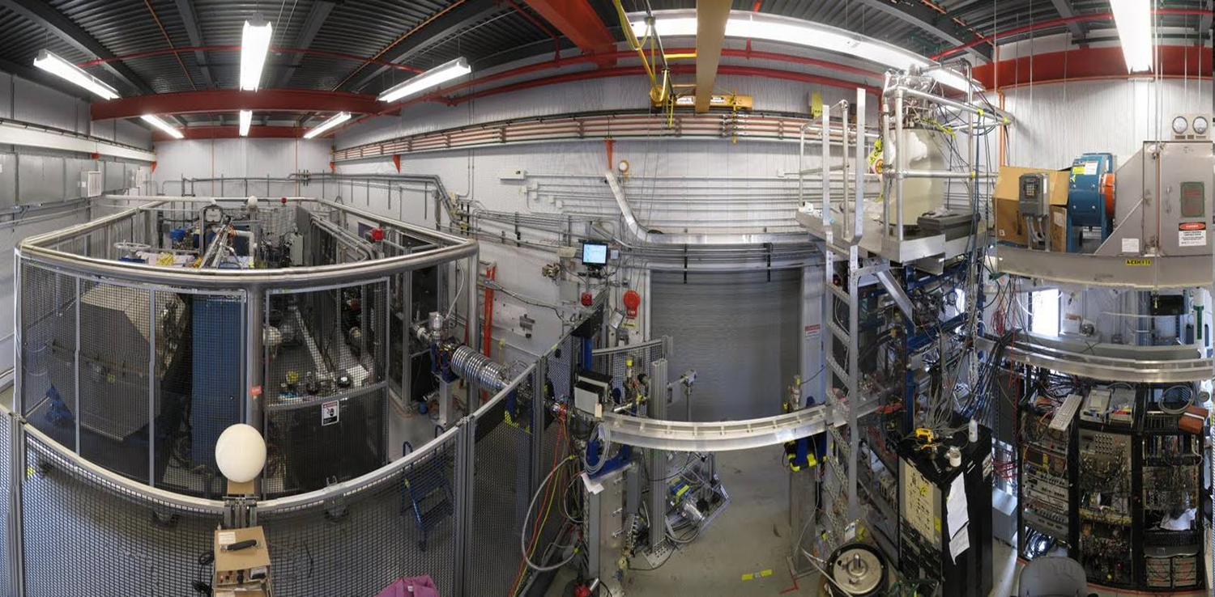
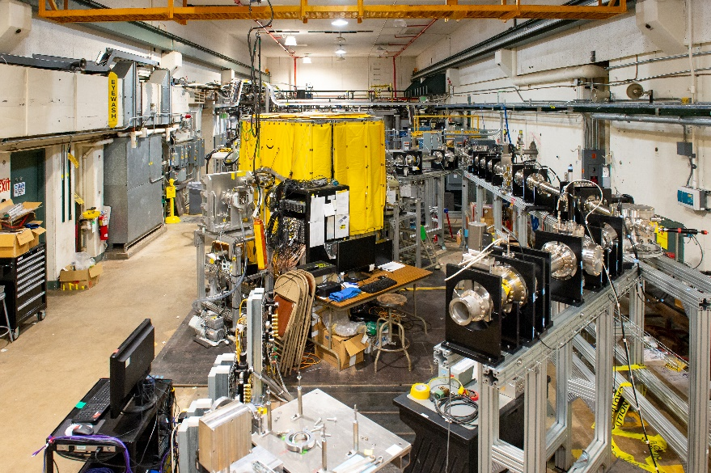
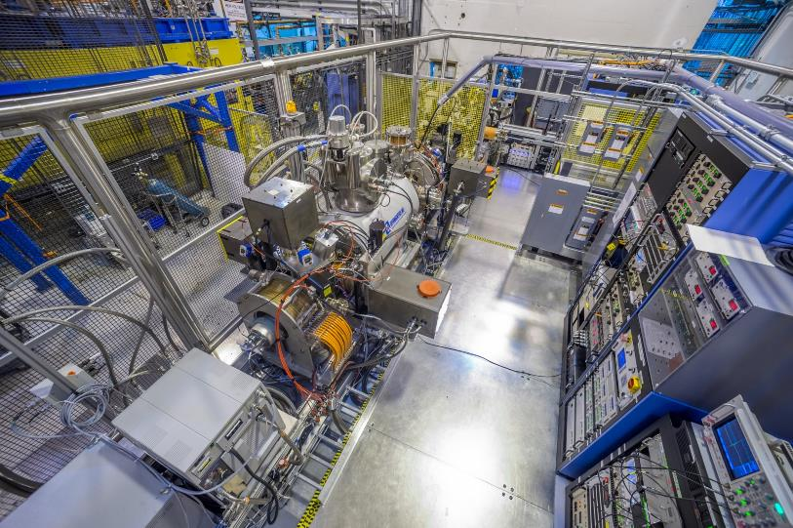
Of unique interest for nuclear data: Neutron-rich beam source for ATLAS
Main components of CARIBU
PRODUCTION: “ion source” is ²⁵²Cf source inside gas catcher
    Thermalizes fission fragments
    Extracts all species quickly
    Forms low emittance beam
SELECTION: Isobar separator and MR-TOF
    Purifies beam
DELIVERY: beamlines and preparation
    Low-energy buncher and beamlines
    Charge breeder to Increase charge state for post-acceleration
    Post-accelerator ATLAS and weak-beam diagnostics
Commissioned in 2012
Commissioned in 2020
Commissioned in 2017

Slide 5
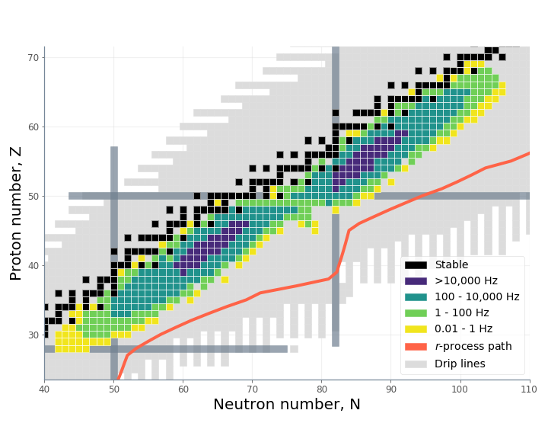

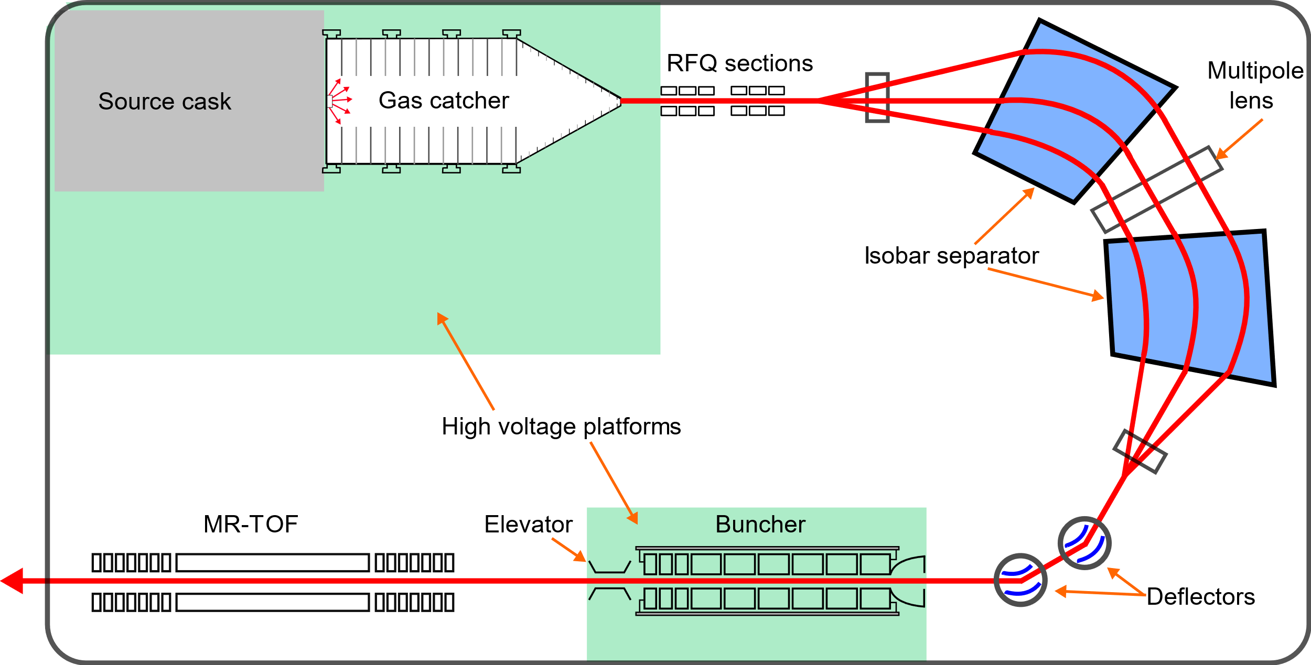

CARIBU
Californium rare isotope breeder upgrade
Position-sensitive MCP
R ~ 20,000,000
Penning
trap
²⁵²Cf
^{~0.5 Ci}
R = m/Δm ~ 10,000
RFQ prep trap
R ~ 100,000

Slide 6
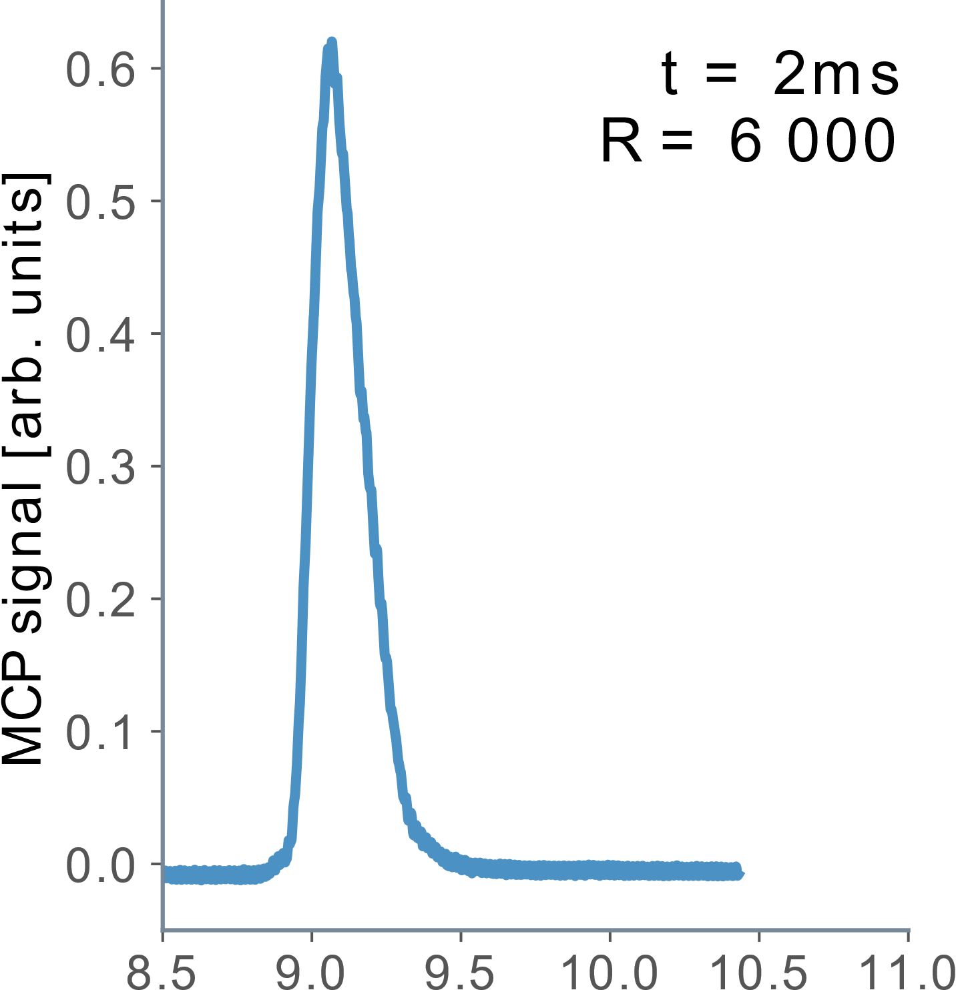

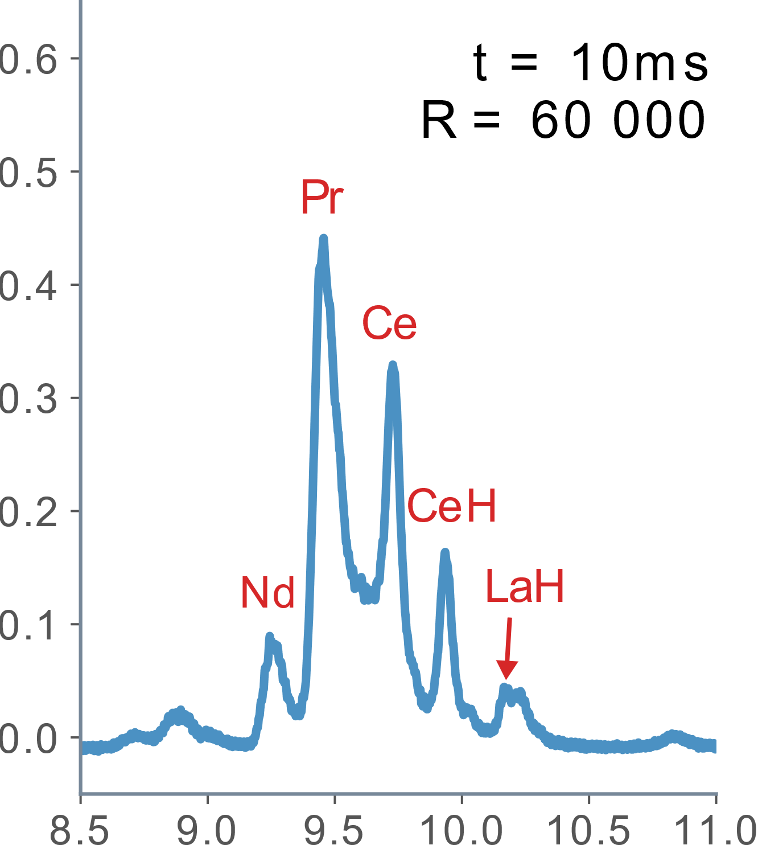
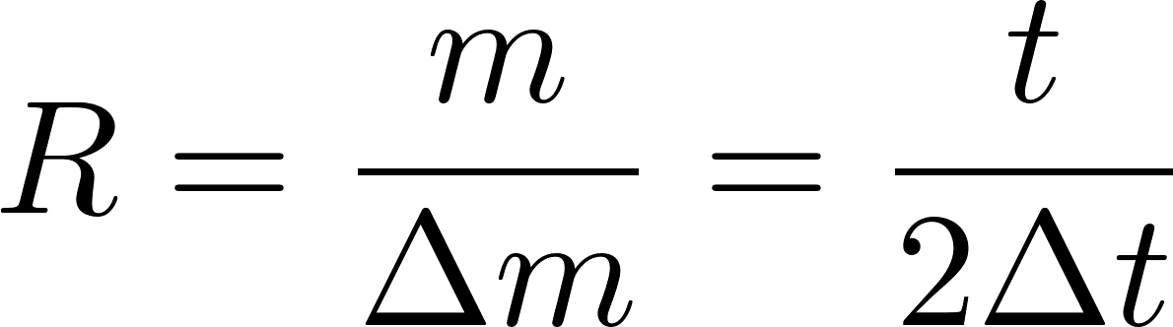
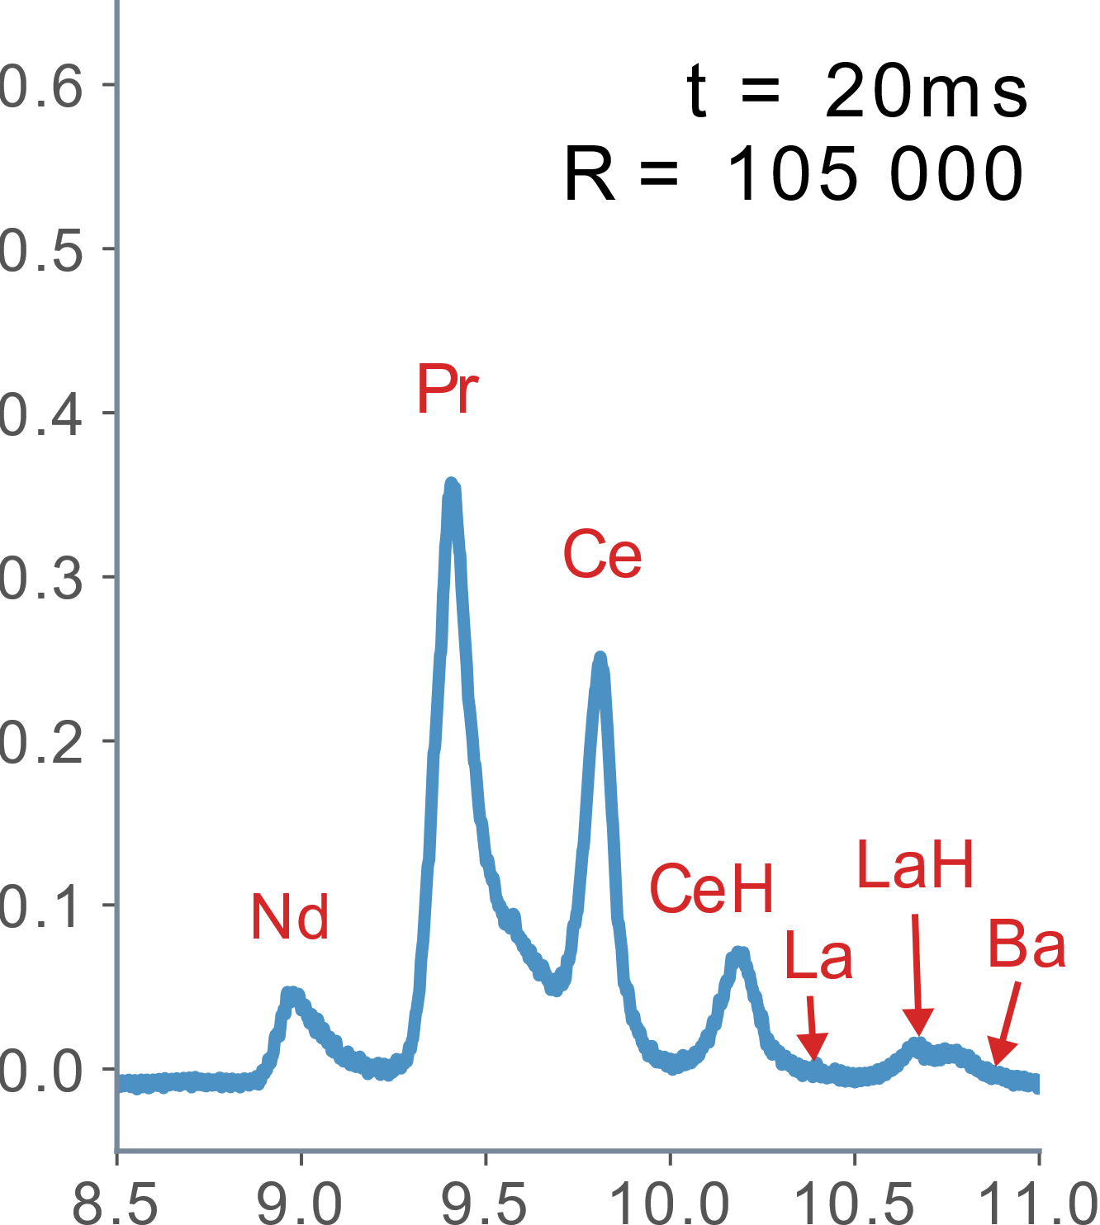
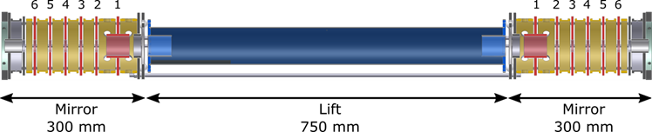
MR-TOF
Multi-reflection time-of-flight mass separator
System built to be isochronous with respect to energy …. i.e. Δt / ΔE = 0
Keep time dispersion from mass difference
V
E + ΔE
E
E - ΔE
d

Slide 7
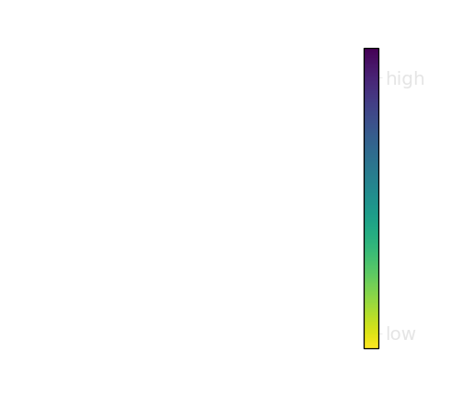
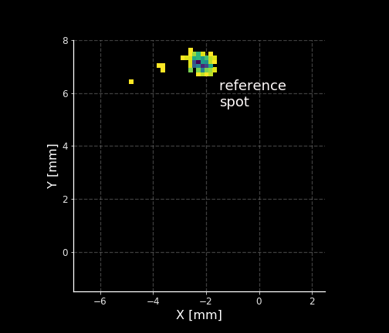
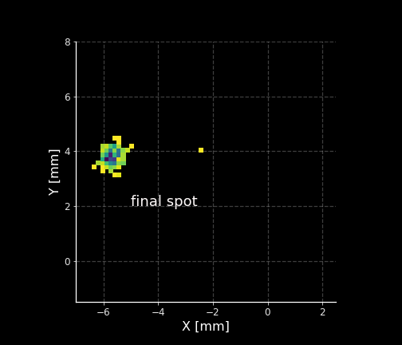
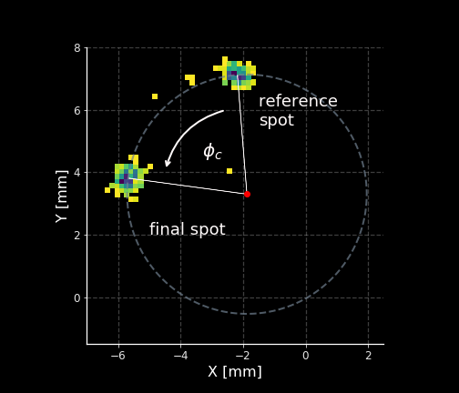
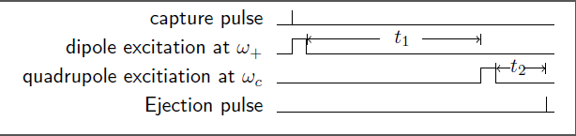
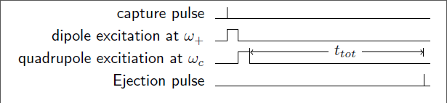


Phase-Imaging Ion Cyclotron Resonance (PI-ICR) method in the CPT Penning trap spectrometer
With this method we are measuring the sum of the two orbital frequencies.
Originally developed off-line by S. Eliseev et al, PRL 110 (2013) 082501
We have demonstrated resolution of over 10,000,000 allowing to easily separate isomers

Slide 8
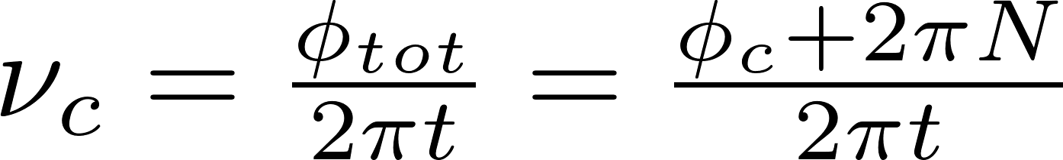
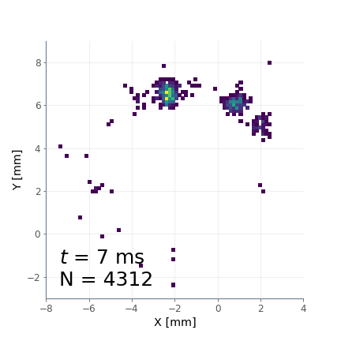
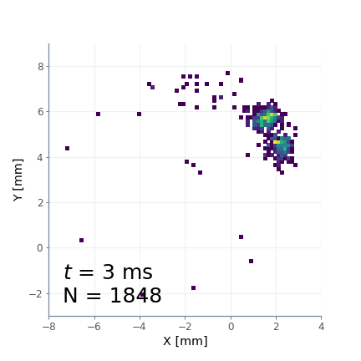
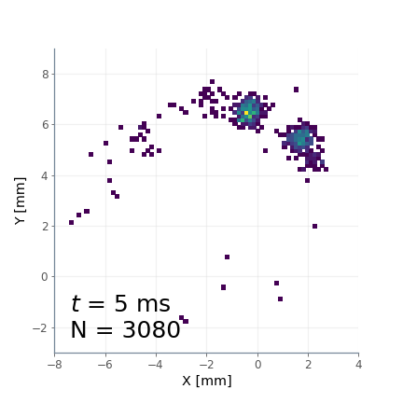
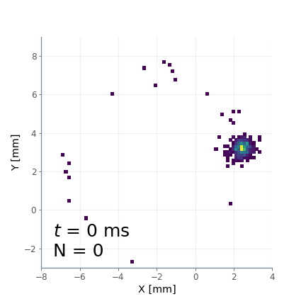
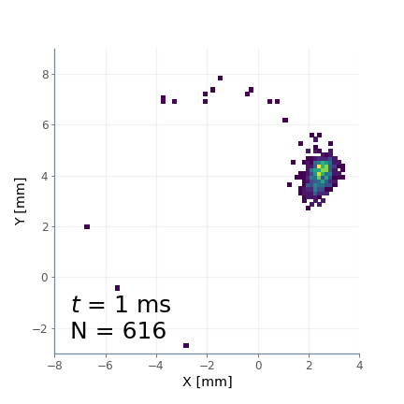
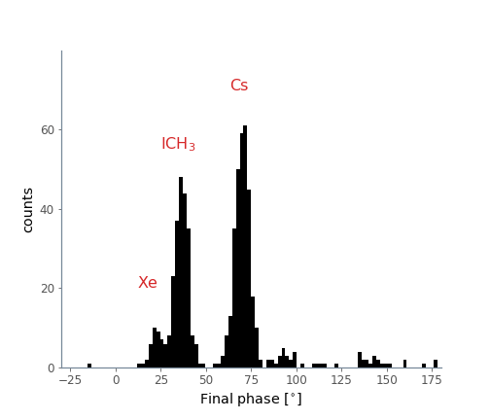
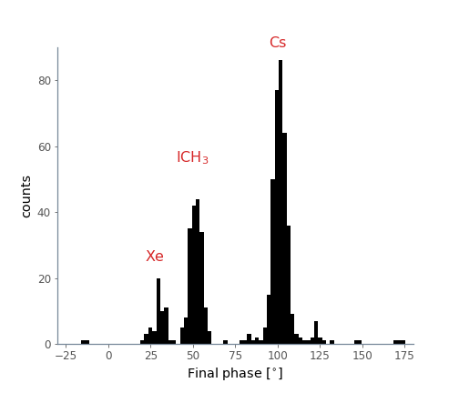
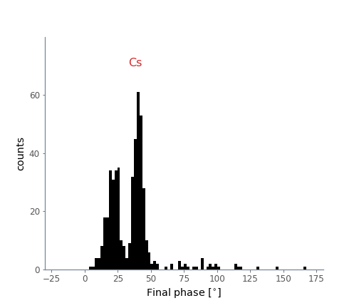
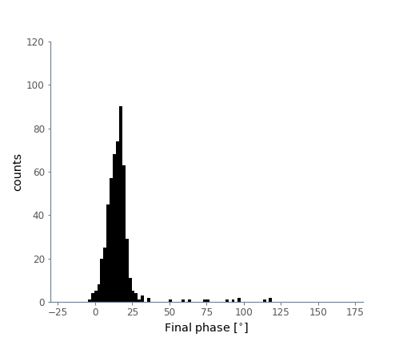
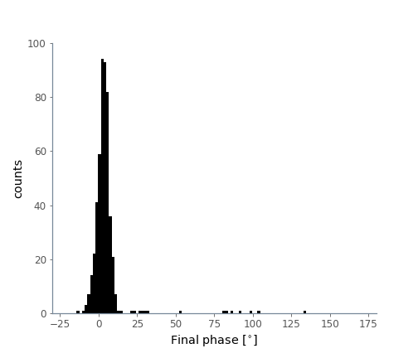
PI-ICR mass separation

Slide 9
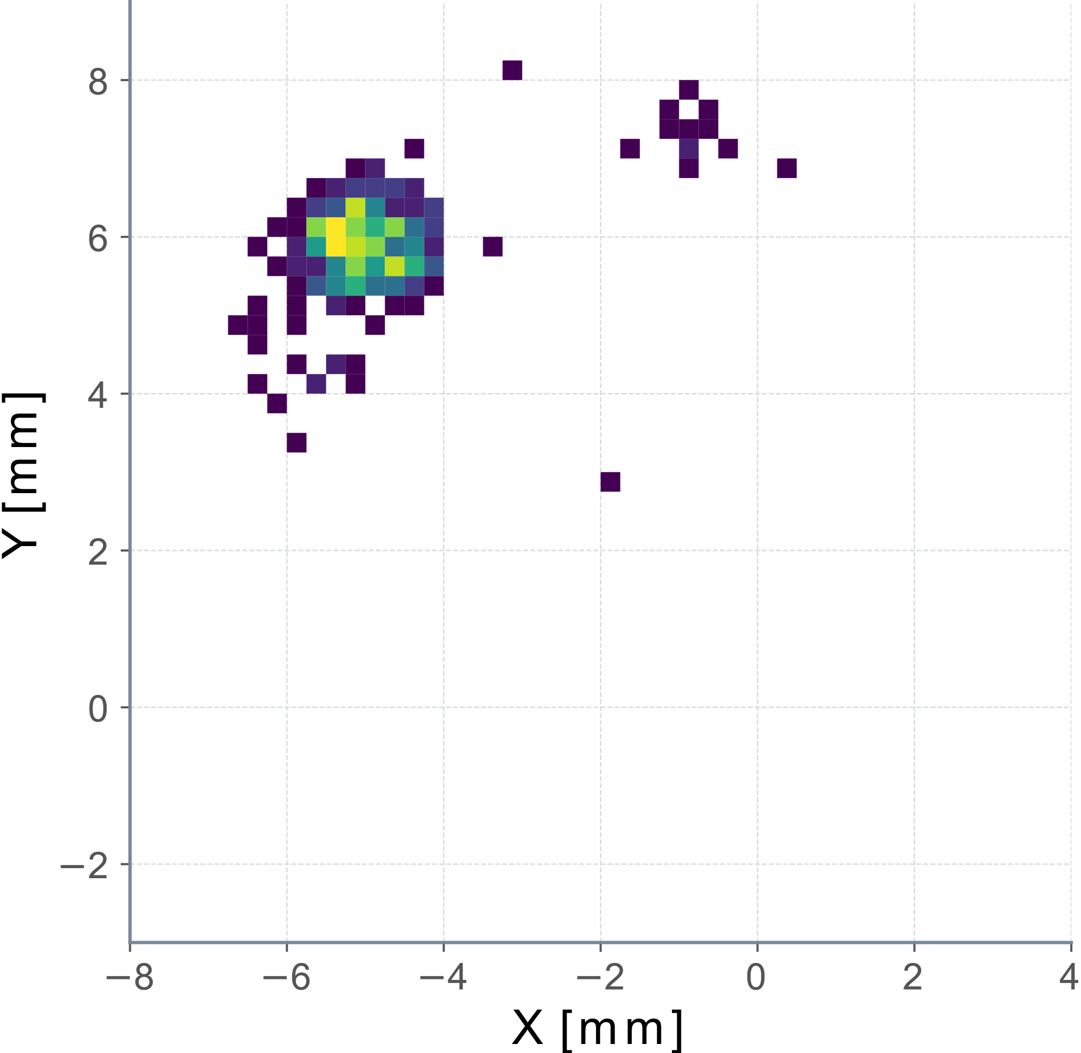
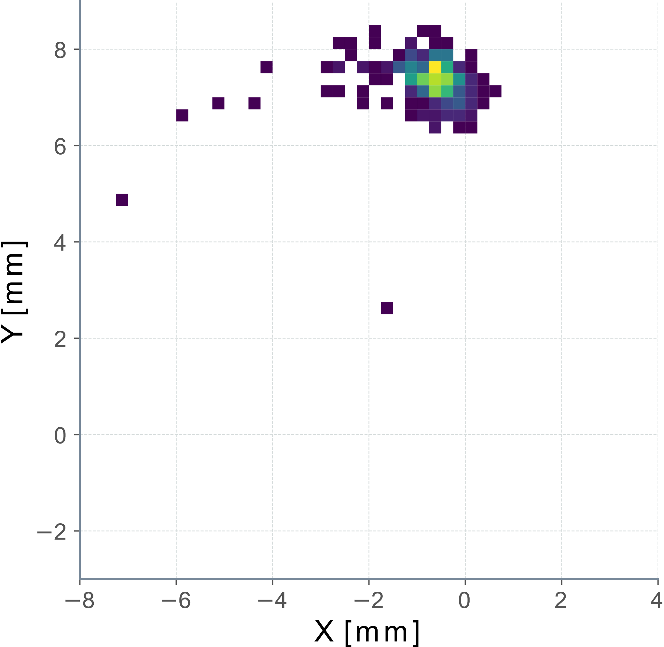
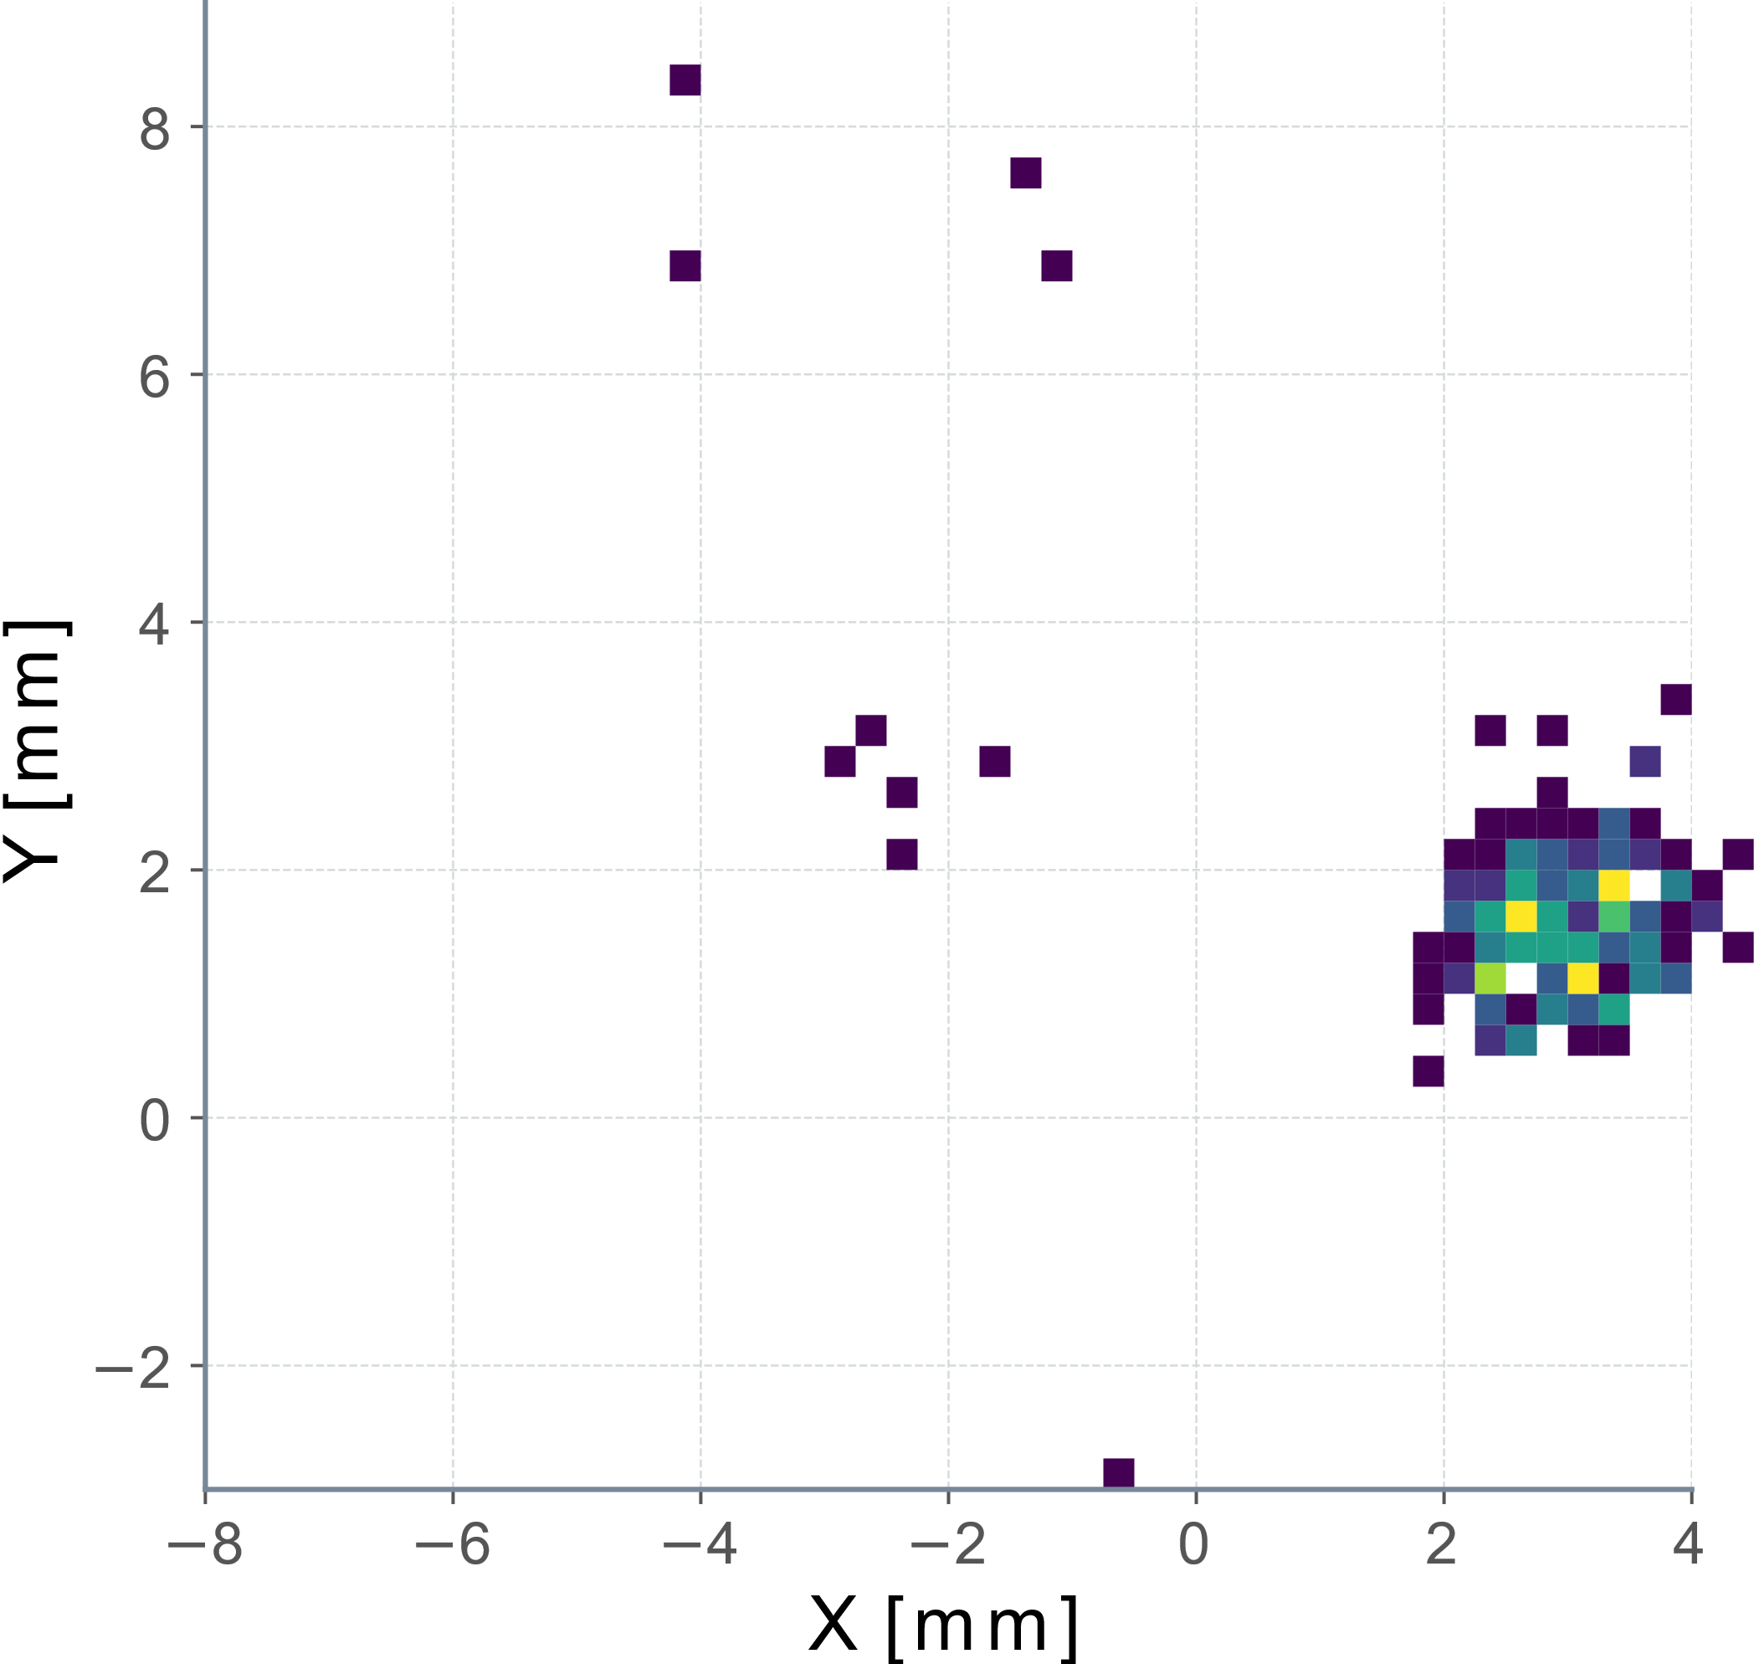
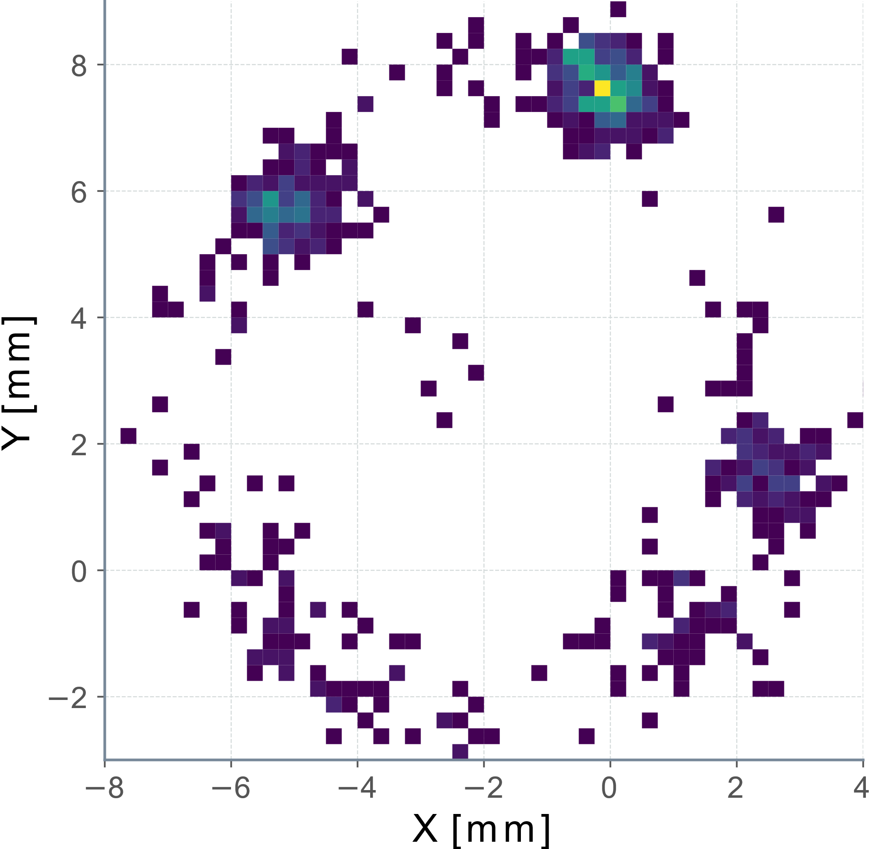
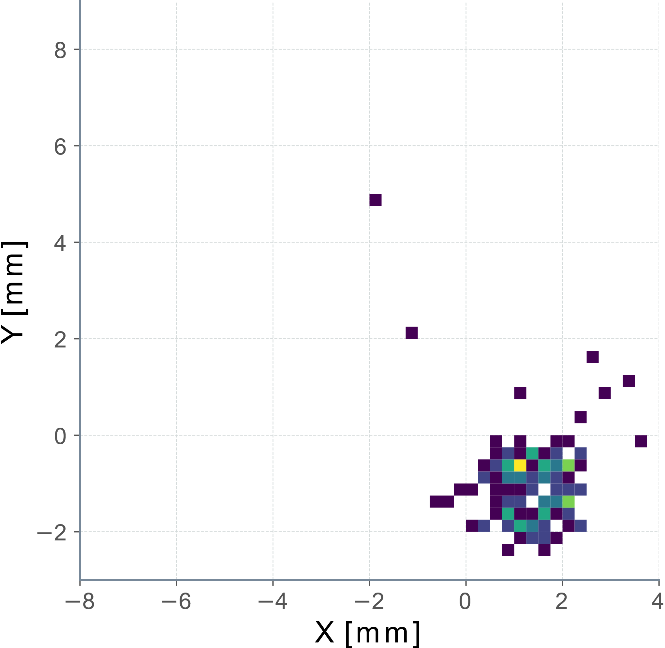
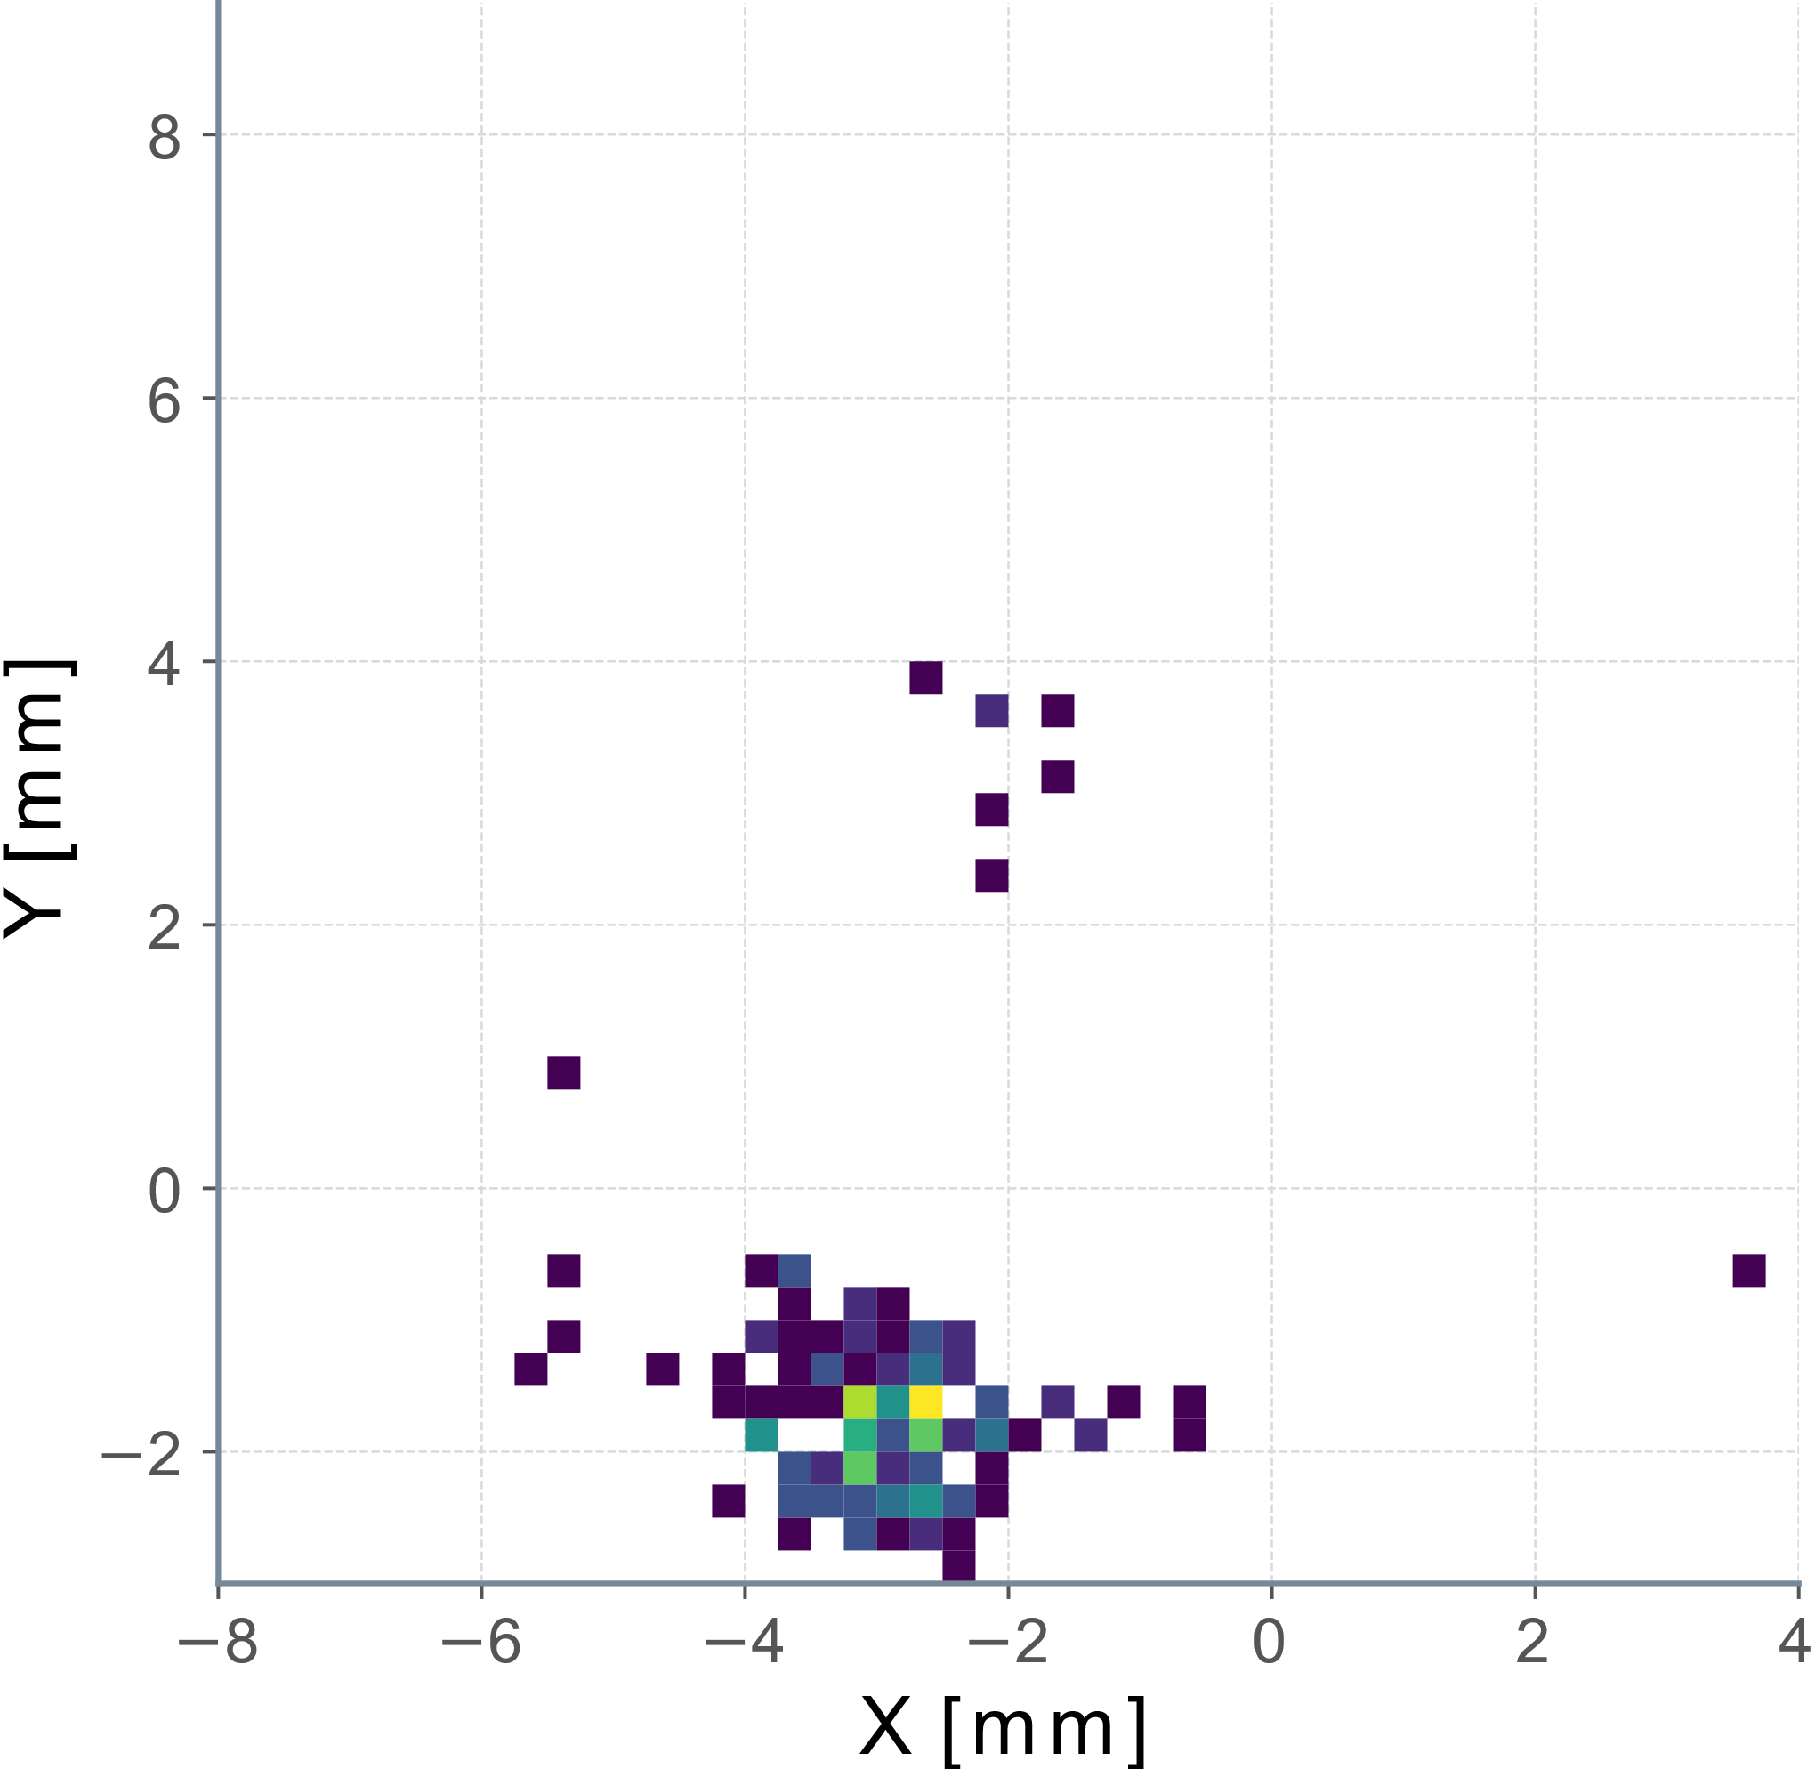
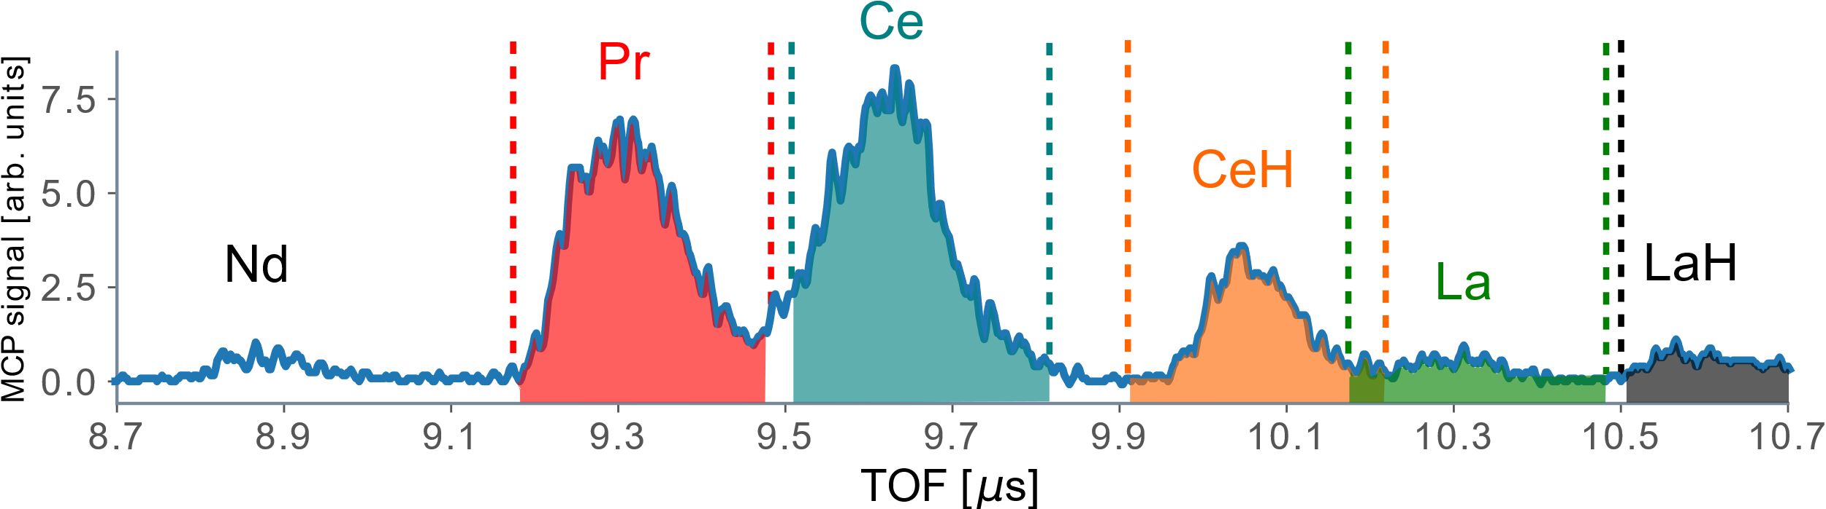
MR-TOF + PI-ICR
Beam of A/q = 150/2+
MR-TOF is a crucial device for the CPT
What does R = 100,000 really mean?
Moving 300ns BNG window around allows us to select a single isobar and suppress others
Pr
Ce
CeH
La
LaH

Slide 10
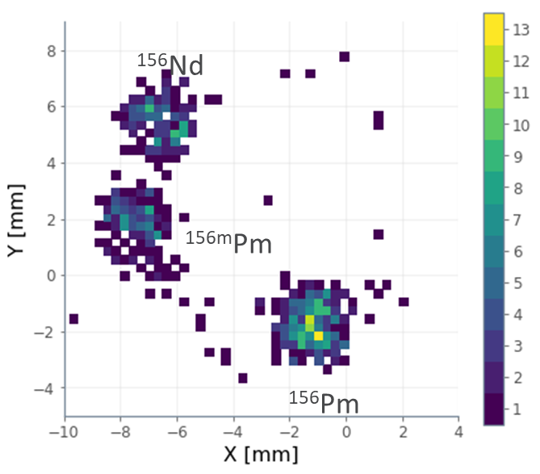
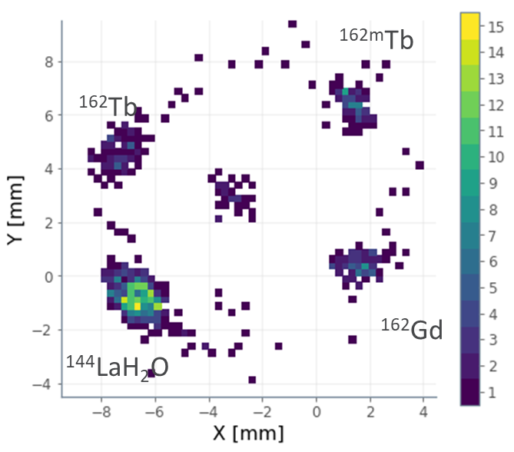
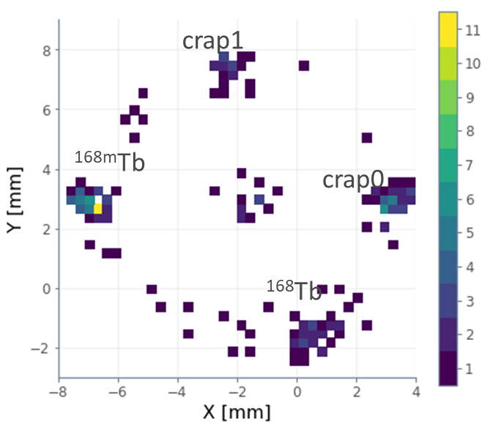
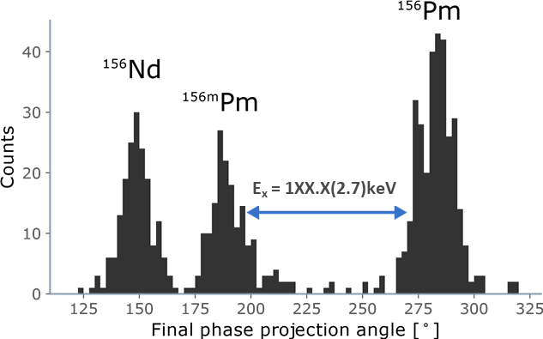
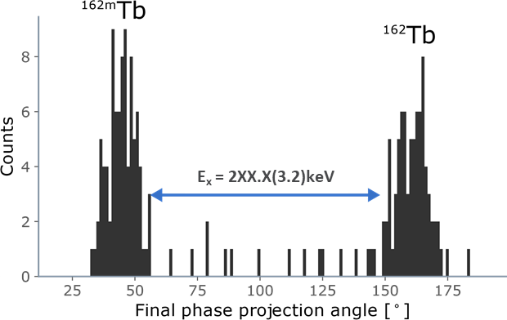
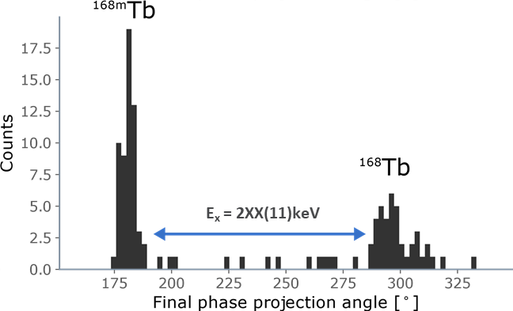
Ion counting Isomer measurements: fission yield, excitation energy, ….
¹⁵⁶Pm , Tacc = 234.705 ms
¹⁶²Tb, Tacc = 125.241ms
¹⁶⁸Tb, Tacc = 234.247ms
A number of results related to the influence of these isomers on nuclear structure and astrophysics (astromers) have already been published … a big compilation of ²⁵²Cf fission isomeric yield is coming.

Slide 11
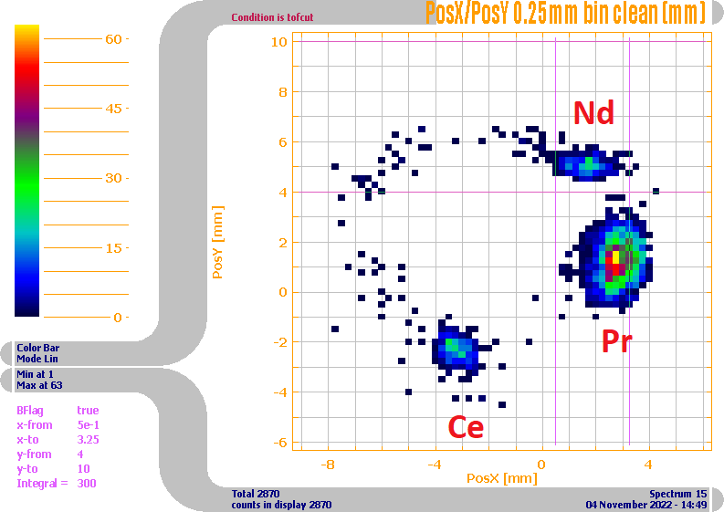
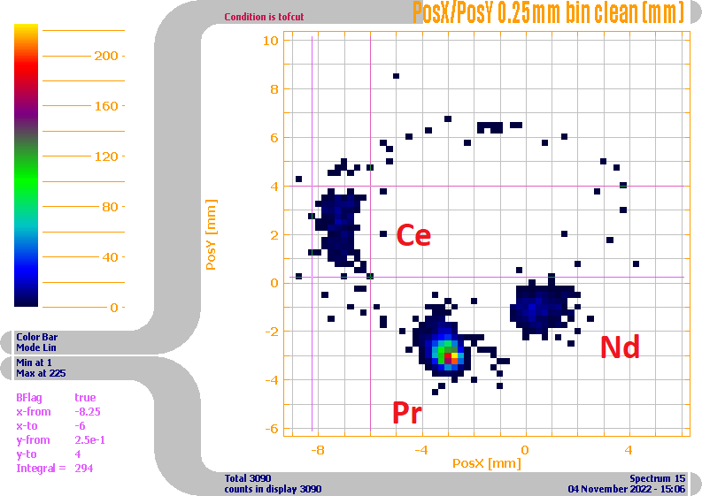
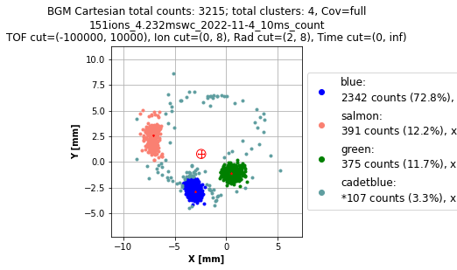
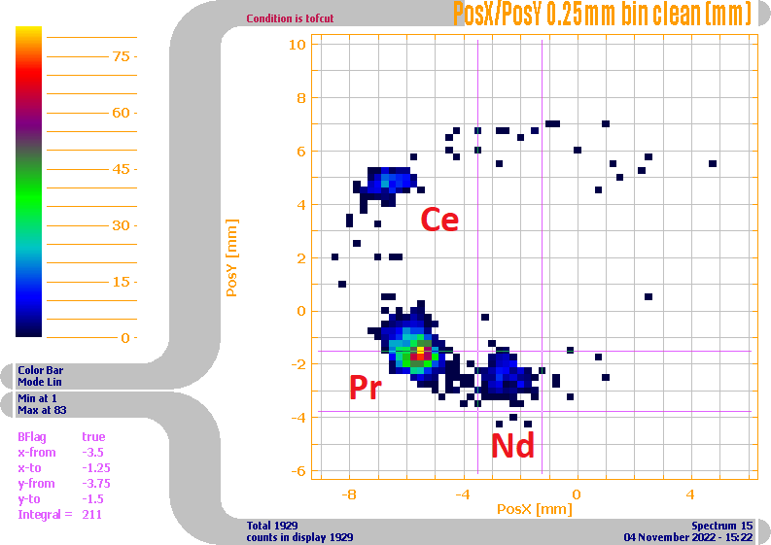
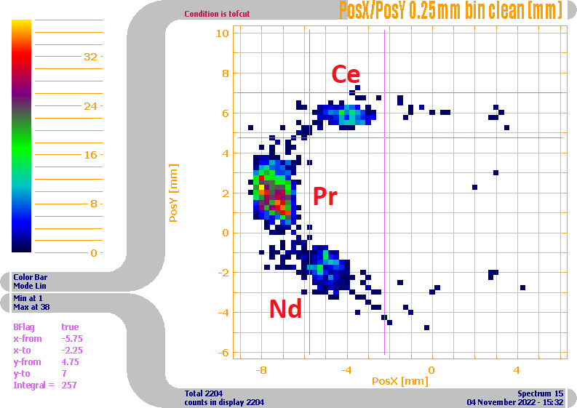
Ion counting for fission yield: use shorter excitation ( ~ 4 ms) and probe various angles
T_{acc} =4.212 ms
T_{acc} =4.232 ms
clustering algorithm
T_{acc} =4.242 ms
T_{acc} =4.252 ms

Slide 12
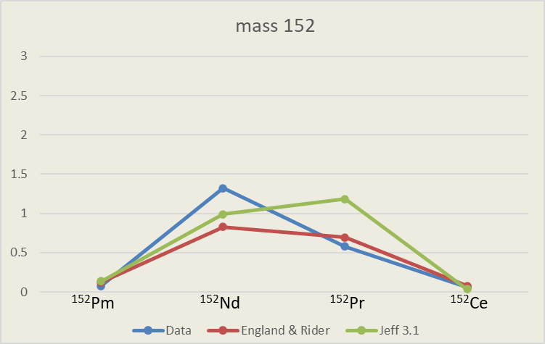
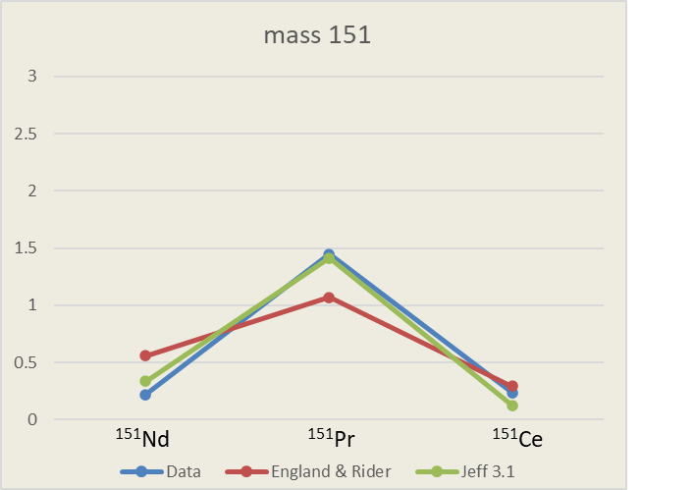
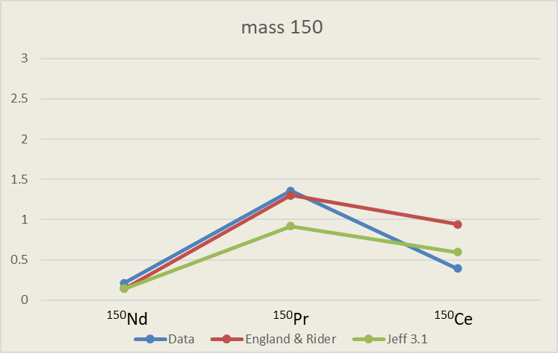




Completing analysis for spontaneous fission yield of ²⁵²Cf
Lots of data … still very preliminary, but looks like old E&R table as good as new table
Tables underestimate production of the most n-rich isotopes
Preliminary …

Slide 13


Next step is n-induced fission: nuCARIBU
nuCARIBU
Neutron induced fission of actinide foils
Replace the ²⁵²Cf source and infrastructure with p+ cyclotron, transport, and targets
p-⁷Li reaction for neutron production
Chicane provides room for cyclotron ion source and enables shielding at 180°

Slide 14



nuCARIBU progress
Cyclotron positioned in CARIBU June 2023

Slide 15



nuCARIBU progress
Mechanical and RF installation Nov-Dec 2023

Slide 16


nuCARIBU progress
Transport magnets delivered; chicane assembled off-line and ready for installation
Neutron production target heat exchanger fabricated and undergoing testing

Slide 17

Independent fission yield measurements status
The technique we have developed relies on the universality of the CARIBU extraction system and high-resolution mass separation followed by ion counting. The technique is fast and insensitive to lack of, or incorrect, decay information.
We are finishing the analysis of the isomer ratio yield and independent fission product yield for spontaneous fission of ²⁵²Cf. Still some data being taken to complete evaluation but essentially completed.
Preparing to shift to nuCARIBU where we can use the same technique to look at FPY for thermal neutron induced fission on ²³⁵U and ²³⁹Pu. This will allow direct measurements on n-induced fission fragments with sub-second lifetime … those are critical for a number of applications and have only been determined indirectly so far.
Isobar resolution with MR-TOF
Isomer resolution with Penning trap

Slide 18



Next big step for spectroscopy of fission fragments : Gammasphere move to area 1
Current status: Gammasphere is located in area 4 – reacceleration of the CARIBU beam through the ATLAS facility is needed
  loss of beam intensity – 10
  unable to use the unique MR-TOF capabilities – loss of unambiguous separation of isobars
What we are preparing: move Gammasphere to area 1 and perform dedicated studies of high-priority cases – WoNDRAM & IAEA high-priority lists

Slide 19
Supplementary material

Slide 20

CARIBU beams delivered to experiments so far
All of these beams now available in the new low-background low-energy area (Area 1)

