Slide 1
Accelerated Decay Data Evaluation and Development of an Adopted Decay Data Library
Modernization and Optimization of the Evaluated Nuclear Structure Data File
AND
Libby Ricard, Chris Morse, Donnie Mason
Andrea Mattera, Shuya Ota, Alejandro Sonzogni, Ben Shu, Jin Wu – BNL
Filip Kondev – ANL
Caleb Matton - LLNL

Slide 2
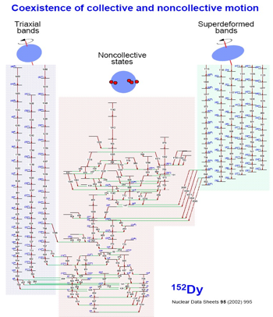
ENSDF : the ONLY comprehensive resource for
Nuclear Structure
Nuclear Decay Data
Discrete Quantized States
Excitation Energy
Half-life
Angular Momentum
Magnetic Moment
Configuration
…
For each decay type:
Half-life
Branching ratio
Energy
Intensity
Coincidences
…
Emitted Radiation
Energy
Intensity
Dipole, Quadrupole, …
Mixing ratio
Conversion coefficient
Data for more than 3,300 nuclides

Slide 3
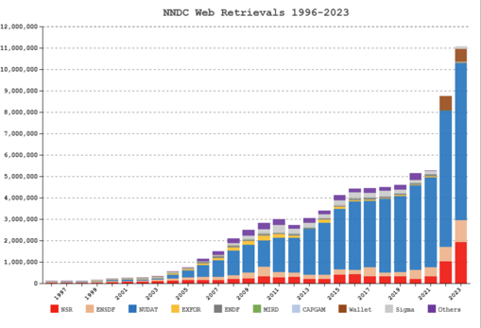
ENSDF Evaluated Nuclear Structure Data File
Unique :
Only database of its kind in the world
Complete:
Coverage of 100+ years of nuclear physics
Highly used:

Slide 4
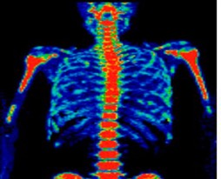
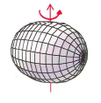
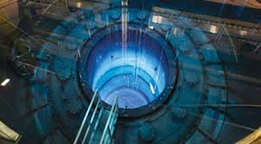
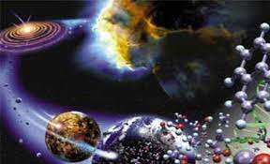
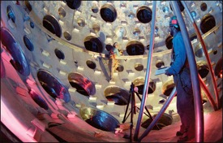
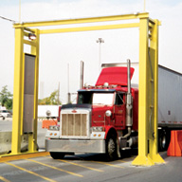
The Many Users of ENSDF Data
Nuclear Structure
Nuclear Medicine
Nuclear Power
Astrophysics
Stockpile Stewardship
Homeland Security

Slide 5
Modernization and Optimization of the
Evaluated Nuclear Structure Data File
AND

Slide 6
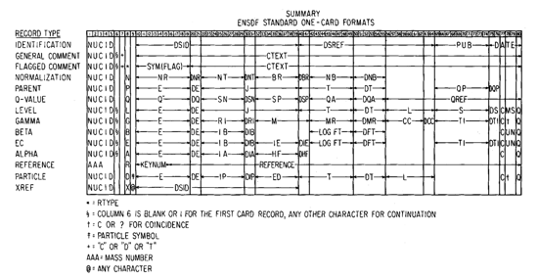
Current ENSDF format
80 Column ASCII format
Challenges
Nuclear Physics doesn’t fit in 80 columns
Not amenable to ML or AI
Hard to engage next-gen of nuclear scientists
80 column fields
“Continuation record”
A LOT of data stored in comments
Non-standardized entry

Slide 7
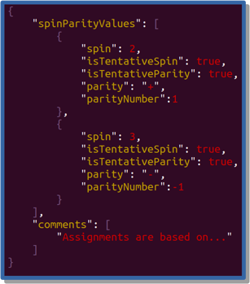
A new object-oriented database for ENSDF
We’ve migrated from 80 column ASCII to JSON based schema
And (for the first time!) designed an API for ENSDF
Developed a new Editor for ENSDF evaluators

Slide 8
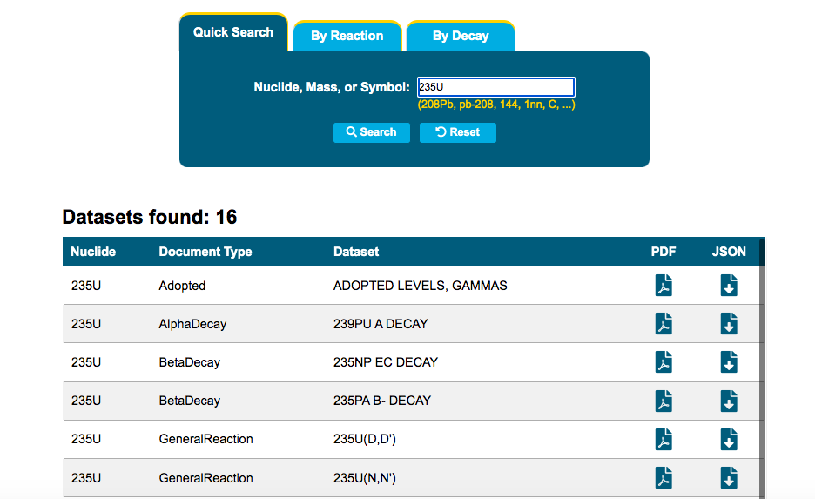
Beta JSON version now available
Feedback most welcome
cmorse@bnl.gov
https://www.nndc.bnl.gov/ensdf-json/

Slide 9
Accelerated Decay Data Evaluation and Development of an Adopted Decay Data Library

Slide 10
The Many Users of Decay Data
Nuclear Structure
Nuclear Medicine
Nuclear Power
Astrophysics
Stockpile Stewardship
Homeland Security

Slide 11
The Path of ENSDF Data
Average “age” of ENSDF is 10 years
Evaluations can be 1 year old or 20 years old
ENSDF is the bottleneck for downstream databases

Slide 12
What are we missing ??
Microcalorimeters are an exciting new development as applied to radiation measurements for NP
Likely to generate some of the highest precision decay data to date
In ENSDF – last evaluated 2006
6 new decay measurements since
A.S. Hoover et al., IEEE Trans. Nucl. Sci. 61, 2365 (2014).

Slide 13
Targeted Decay Data Evaluations
From 2023 NSAC report on Nuclear Data
One of 14 topics listed as “Challenges and Opportunities”

Slide 14
Targeted Decay Data Evaluations

Slide 15
Main Objectives of Proposal
Generate prioritized list of nuclides through consultation with user community
Please send any decay data requests: mccutchan@bnl.gov
Develop policies for recommended decay data evaluations
Train a postdoc to perform decay data evaluations
Postdoc hired and will start April 1st.
Expand NuDat to visualize and search new evaluations

Slide 16
Decay Data in ENSDF
Preserve Original Measurements
Provide “Best” Recommended Values
Try to maintain a delicate balance between philosophy of database and user needs

Slide 17
Practically Speaking …
ENSDF decay data are currently a hybrid
Combination of experimental data specifically from decay measurements + recommended data from the Adopted Levels/Gammas
With new format we can do both and increase efficiency !!

Slide 18
Timetable of Project
Year 1
Identify cross-cutting decay data needs and form expert panel to advise
Develop Evaluation Policies and JSON Schema
Hire and Train Postdoctoral Researcher
Year 2
Decay data evaluations (metric of ~20 ENSDF decay evaluations)
Publication of Evaluation Policies
Year 3
Decay data evaluations (metric of ~20 ENSDF decay evaluations)
Extension of NuDat to visualize and query Adopted Decay Data

Slide 19
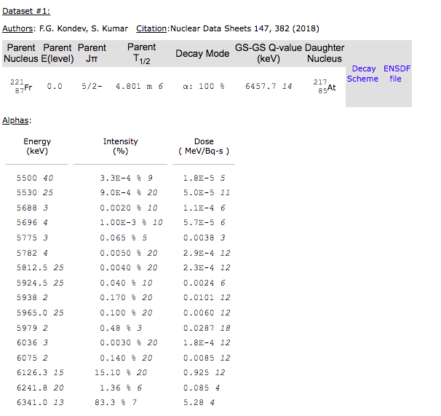
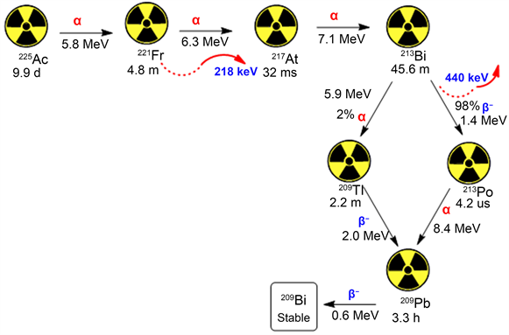
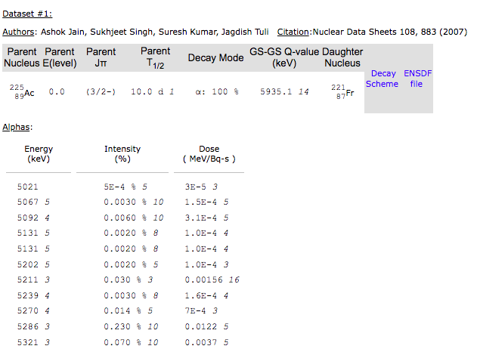
A Major Inconvenience in ENSDF
Not all nuclei are one decay from stability
Then search ²²¹Fr decay in NuDat
Search ²²⁵Ac decay in NuDat

