Slide 1
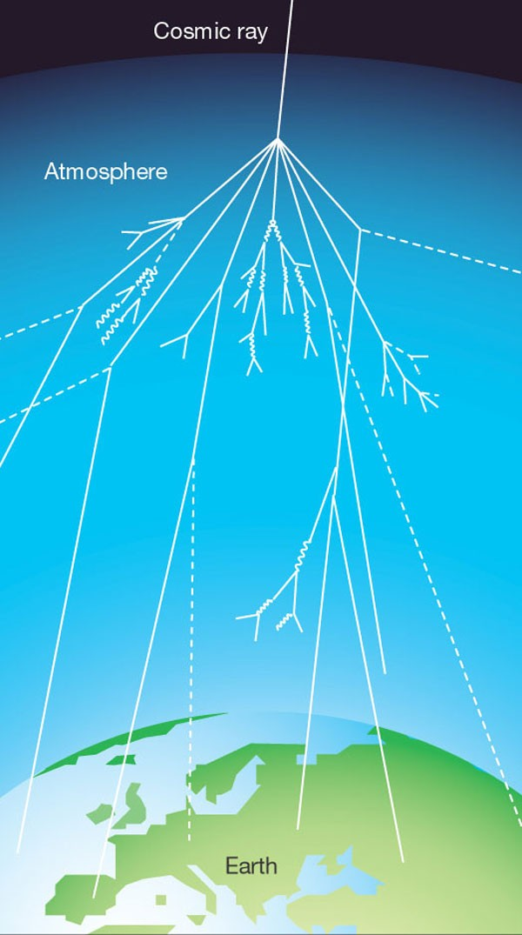
Benchmarking and validating cosmogenic activation models
Aaron Hellinger, PNNL
Steve Elliott, LANL
Ralph Massarczyk, LANL
Richard Saldanha, PNNL

Slide 2
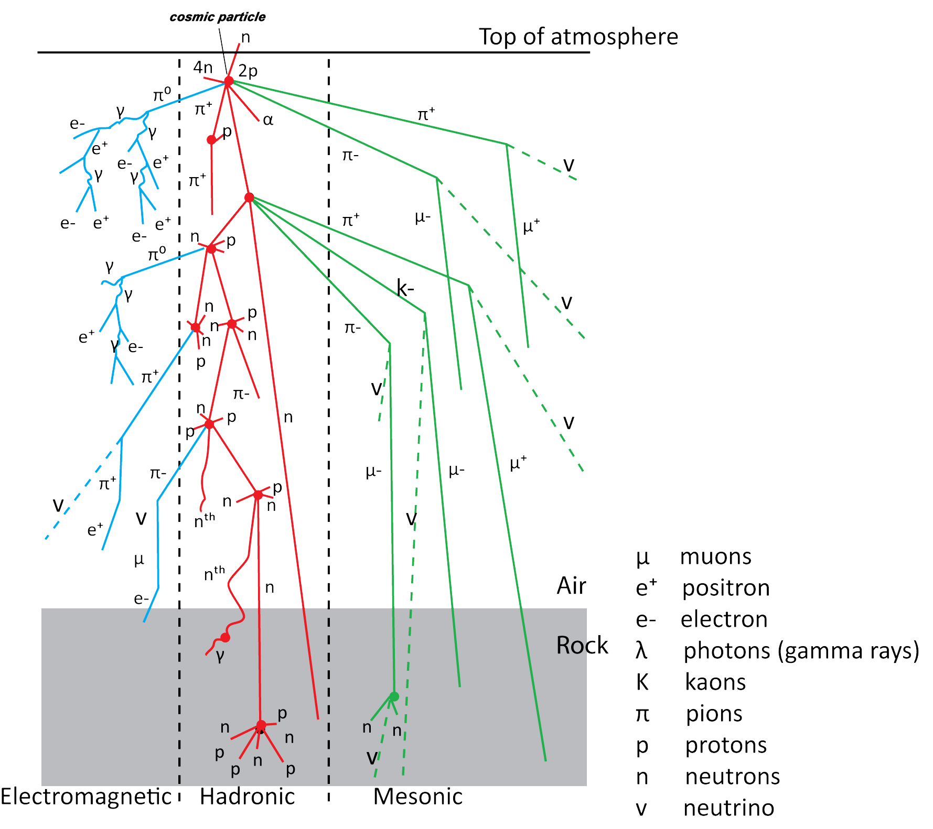
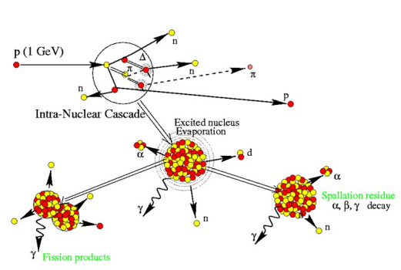
Cosmogenic Activation
Earth is constantly bombarded by high-energy particles from space
Primary cosmic particles (i.e. protons, alphas) can interact with the N₂ and O₂ in atmosphere to create secondary cosmogenic particles (protons, neutrons, etc.)
These secondary particles are absorbed by materials creating radioactive isotopes (cosmogenic activation)
Understanding production rates is important to evaluate the total surface residency time, transportation options, and storage requirements for low-background detector components
https://www.antarcticglaciers.org/glacial-geology/dating-glacial-sediments-2/cosmogenic-nuclide-dating/cosmic-rays/
https://irfu.cea.fr/dap/en/Phocea/Vie_des_labos/Ast/ast.php?t=fait_marquant&id_ast=4760

Slide 3
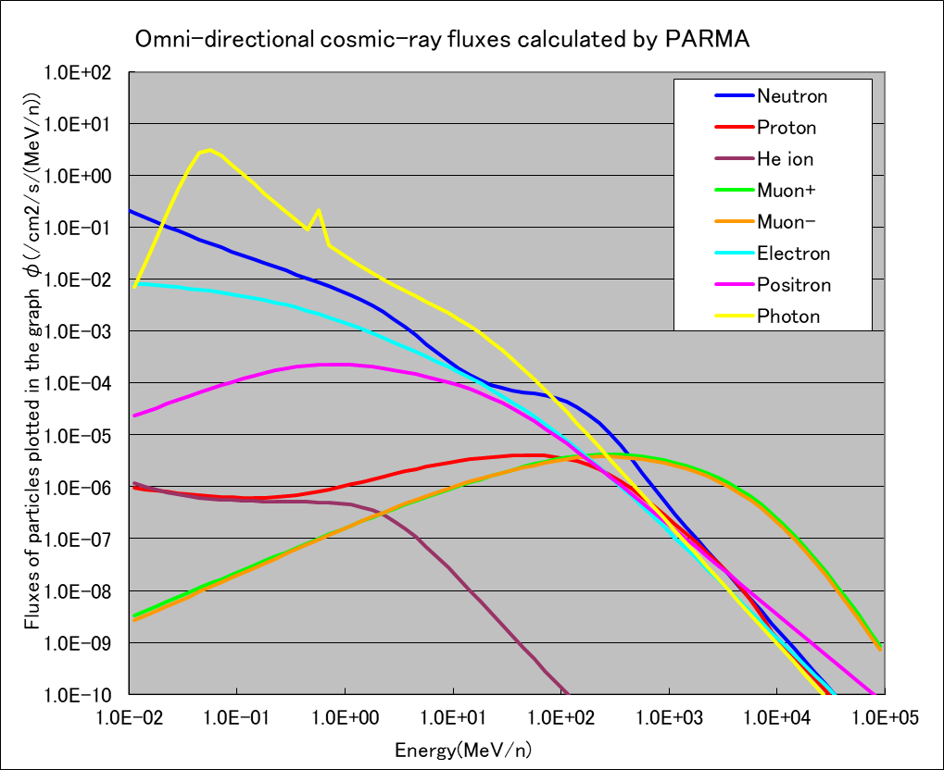
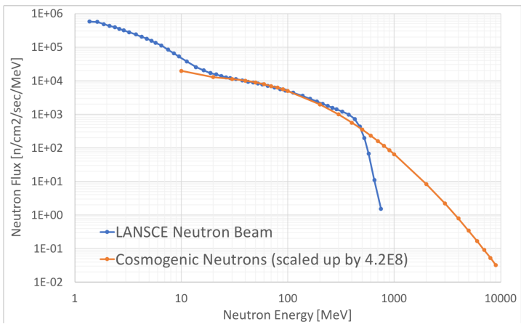
Project Objectives
Develop a software analysis package that estimates cosmogenic activation of materials in Earth’s atmosphere (latitude, longitude, altitude)
Benchmark analysis package, validate flux models, evaluate cross sections
Optimize witness samples to accompany detector materials during transport to verify exposure history

Slide 4
Quick look at calendar
Currently using NNDC and CMAC functionality to select and evaluate plausibility of specific isotopes acting as witness samples
(As of 02/21) LANSCE Nuclear Physics proposals calls have not come out
Starting in Q2-Q3:
Purchasing witness materials and storing them at PNNL’s Shallow Underground Laboratory
Fabricate beam targets and holders for irradiations
Full development of CMAC begins

Slide 5
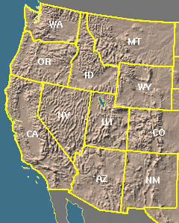
Witness Sample Selection Process
A wide range of possible target/product combinations have been gathered from NNDC
5 days < T_{1/2} < 90 days
Natural abundances > 20%
Reactions evaluated: (n,2n), (n,p), (n,np), (p,n), (p,2p), (p,np)
Gamma emitters: intensity > 25%, energy > 500 keV
Other reactions are currently being considered
CMAC used to gather production rates
Richland, WA coordinates and elevation (46.2804°N, 119.2752 °W @ 384 ft)
Used TENDL-2021 cross sections (0-200 MeV)
EXPACS neutron and proton flux
Currently investigating JENDL-HE library
Currently evaluating results from Los Alamos, NM coordinates and elevation (35.8800° N, 106.3031° W @ 7320 ft)
Materials with largest production rate to cost/kg ratio will be chosen
Richland, WA
Los Alamos, NM

Slide 6
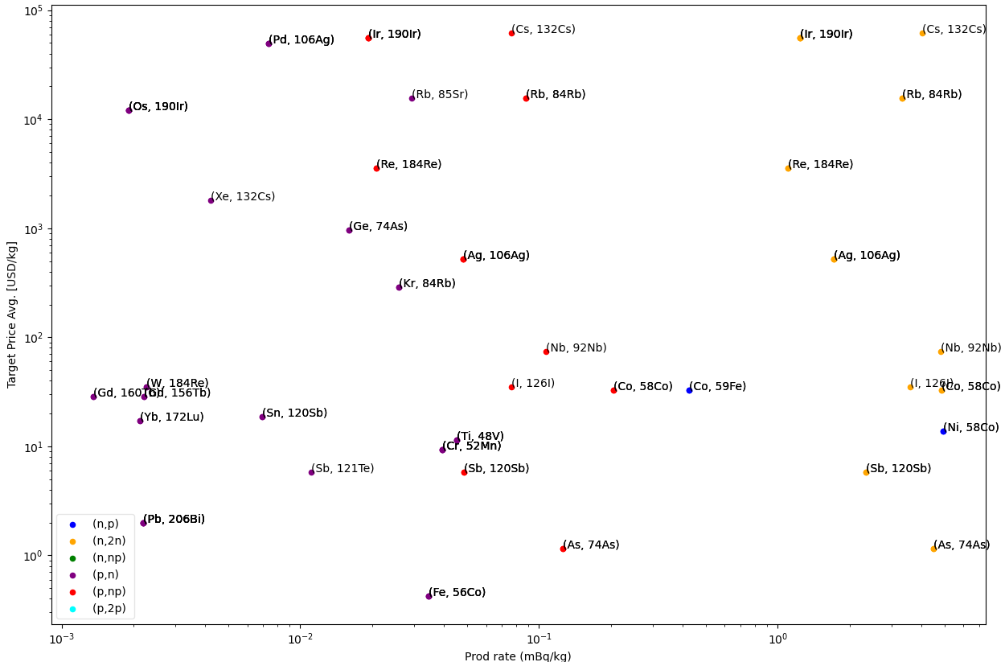
Material Candidates
(n, p) or (p,n) reactions are extremely useful since they would help us distinguish neutron and proton flux
Targets with multiple reactions can also help simultaneously measure both neutron and proton induced reactions

Slide 8
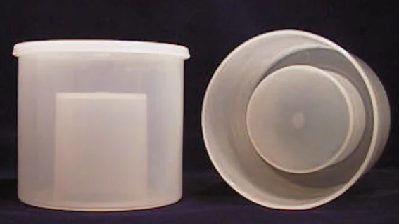
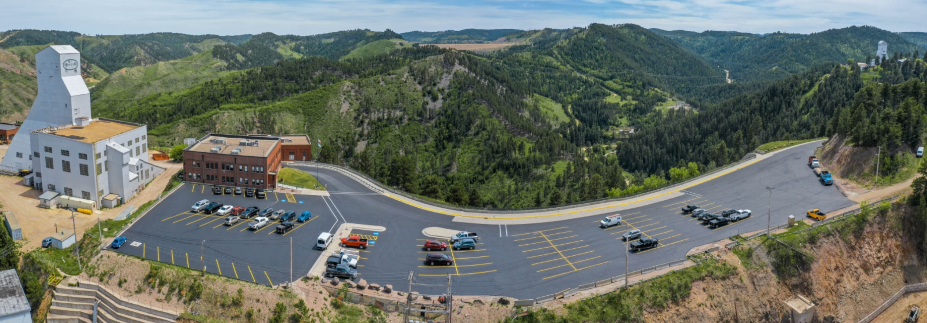
Possible Counting Facilities
Counting geometry will likely include Marinelli beaker and powder material
Counting Sensitivities (mBq/kg)
PNNL |  |  | SURF
ARGO-1 | SAGE-1 | RL-4 | BHUC
10 | 12 | 2 | 0.0005
If available, SURF will be the facility of choice. Backup will be HPGe in RL-4 in the SUL at PNNL

Slide 9
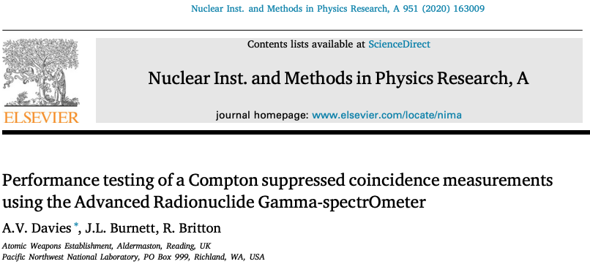
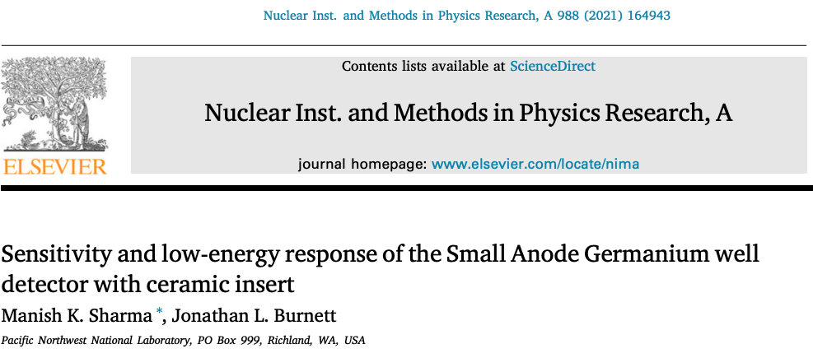
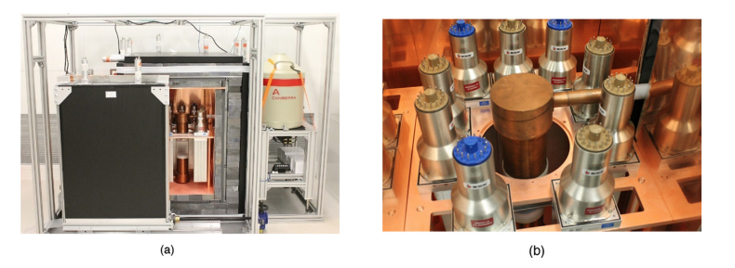
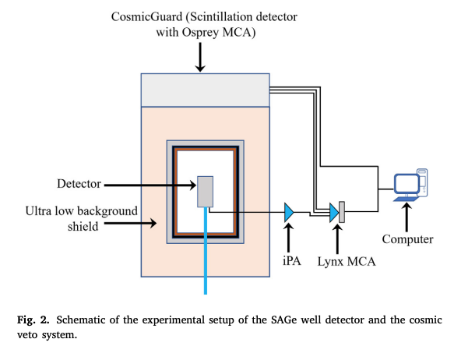
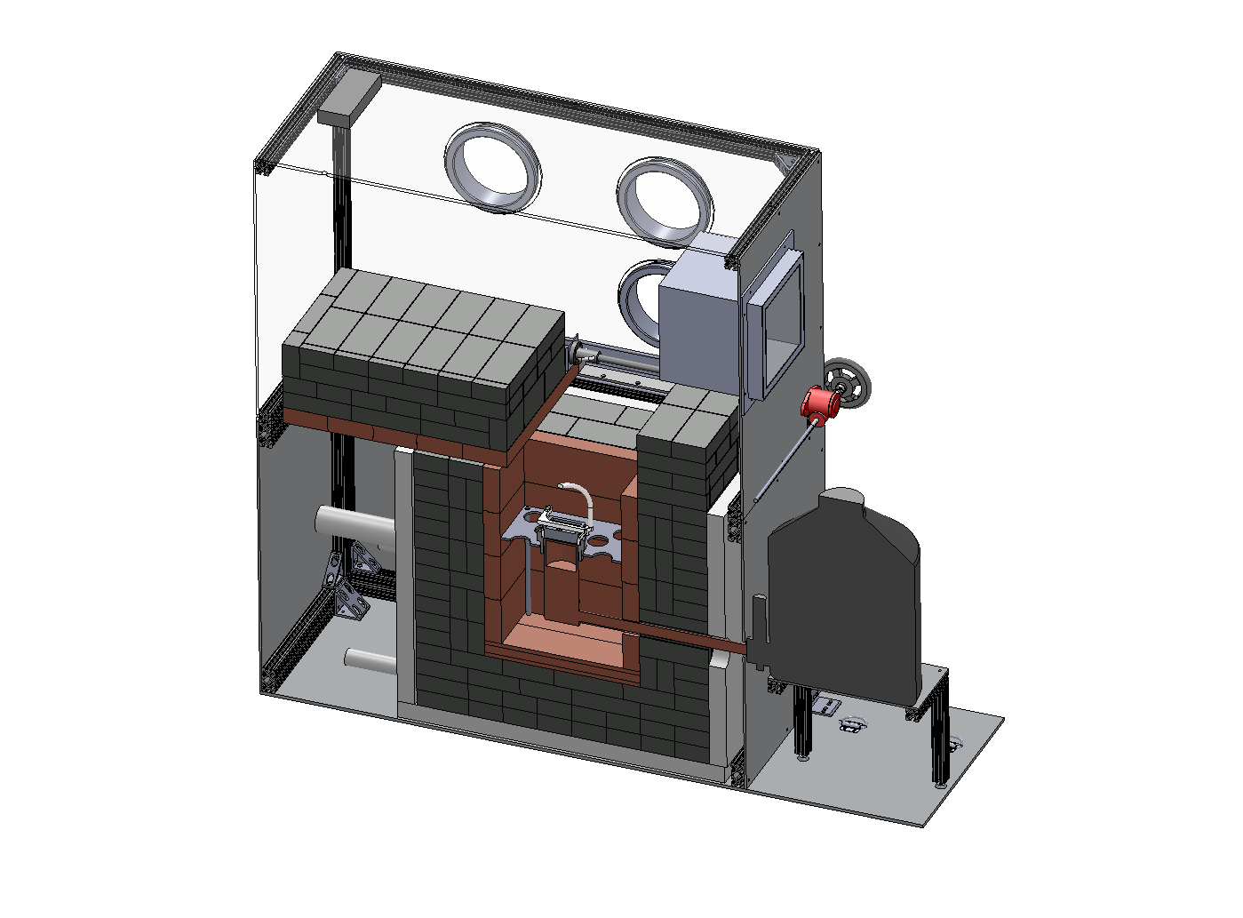
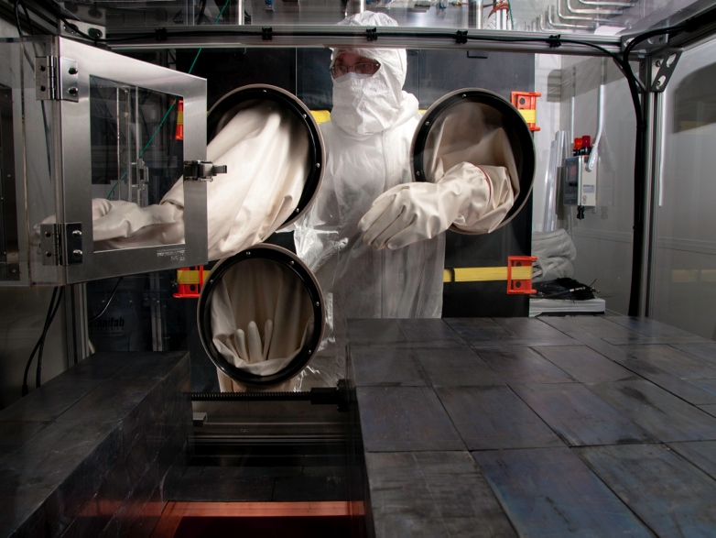
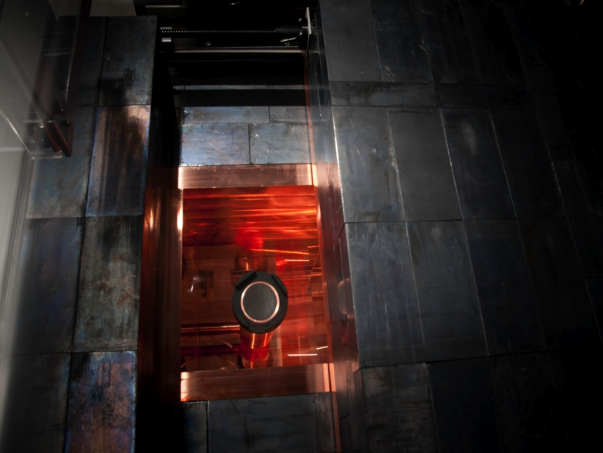
PNNL Ge Counting Facilities
Low-Background Gamma Spectrometry for the International Monitoring System

