Slide 1
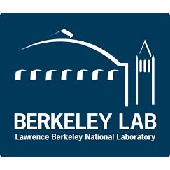
The Berkeley Atlas: A database of absolute cross sections for inelastic gamma-ray production with 14 MeV neutrons
Workshop for Applied Nuclear Data Activities (WANDA 2024)
Patrick Peplowski
Johns Hopkins University Applied Physics Laboratory
February 29, 2024

Slide 2
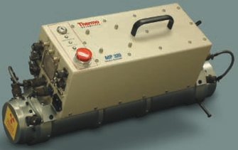
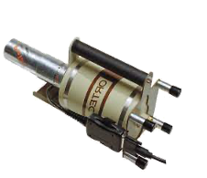
Applications of Neutron Inelastic Scattering
Excited nuclei decay to their ground states via gamma-ray emission
Neutron interrogation of an unknown material
Gamma-ray energies are isotope-diagnostic
Gamma-ray intensities provide material abundances, if:
Gamma-ray branching ratios and
Gamma-ray production cross sections are known.
Excited State (E = E₃)
Excited State (E = E₂)
Excited State (E = E₁)
Ground State
Ground State
???
Applications: Explosive detection, Buried land mines, Planetary Science, Chemical weapons, UXO analysis, Drug detection, In-Vivo body composition, Minerals mining and exploration, Bulk materials (coal, cement)
Counts
Energy

Slide 3
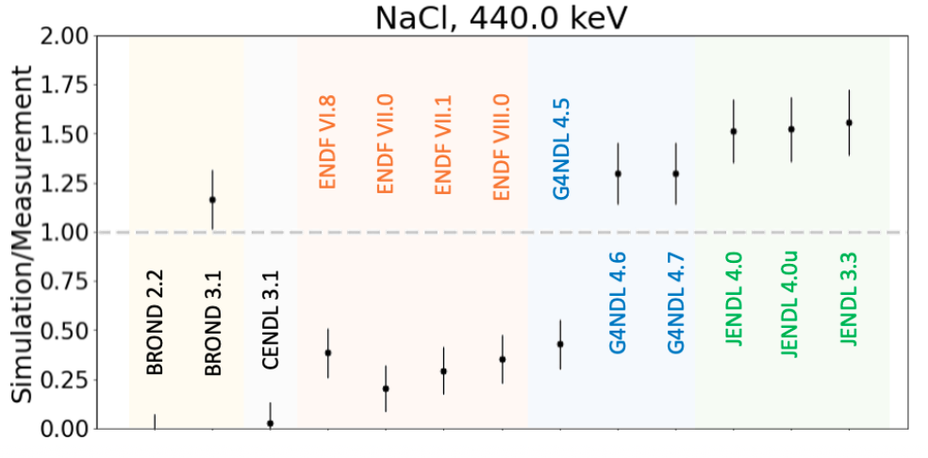
Motivation – Nuclear Data Deficiencies
Experimental work has revealed that nuclear data is not sufficient for many elements of interest. Improved nuclear data is required.
Prior efforts in this area have identified:
Spurious (not-real) gamma-ray peaks
Lim et al., (2017)
Mauborgne et al. (2020)
Unphysical gamma-ray emission energy distributions (peak shapes):
Prettyman et al. (2006)
Peplowski (2020)
Inaccurate gamma-ray production rates
Yamashita et al. (2003)
Bruckner et al. (2011)
Mauborgne et al. (2020)
Peplowski (2020).
GEANT4 fails to reproduced 440-keV gamma-ray production from Na, as measured during a benchmarking experiment detailed by Peplowski (2020).

Slide 4
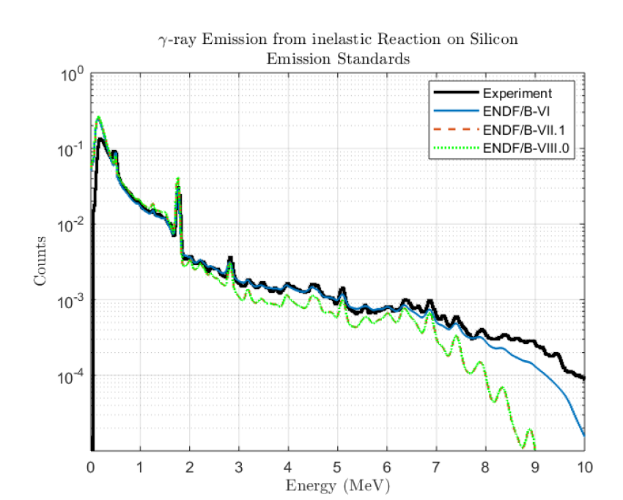
Motivation – Nuclear Data Deficiencies
Experimental work has revealed that nuclear data is not sufficient for many elements of interest. Improved nuclear data is required.
Prior efforts in this area have identified:
Spurious (not-real) gamma-ray peaks
Lim et al., (2017)
Mauborgne et al. (2020)
Unphysical gamma-ray emission energy distributions (peak shapes):
Prettyman et al. (2006)
Peplowski (2020)
Inaccurate gamma-ray production rates
Yamashita et al. (2003)
Bruckner et al. (2011)
Mauborgne et al. (2020)
Peplowski (2020).
SLB, Inc. uses measured gamma spectra from experiments to interpret data due to shortcomings in neutron cross section libraries (see example from Mauborgne et al., 2020)

Slide 5
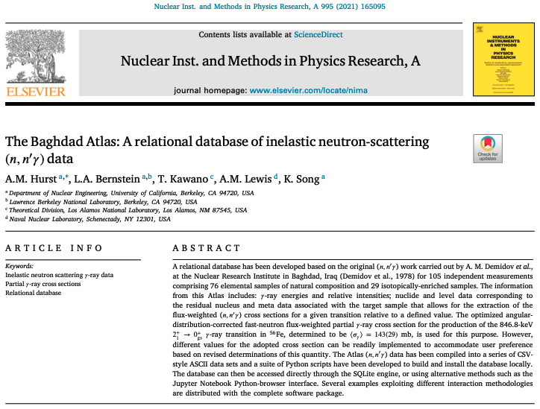
Berkeley Atlas Project
Produce an Atlas of cross sections, measured at 14 MeV neutron energy, for use developing improved neutron cross section libraries.
We have a new technique for making high-precision measurements of gamma-ray production cross sections using a DT neutron generator, paired with associated particle imaging (API).
Upgrades to existing API system
Perform identical measurements on a range of target material of interest for applied nuclear sciences.
Provide cross-section measurements to the NNDC for evaluation and incorporation into future neutron cross section libraries releases.

Slide 6
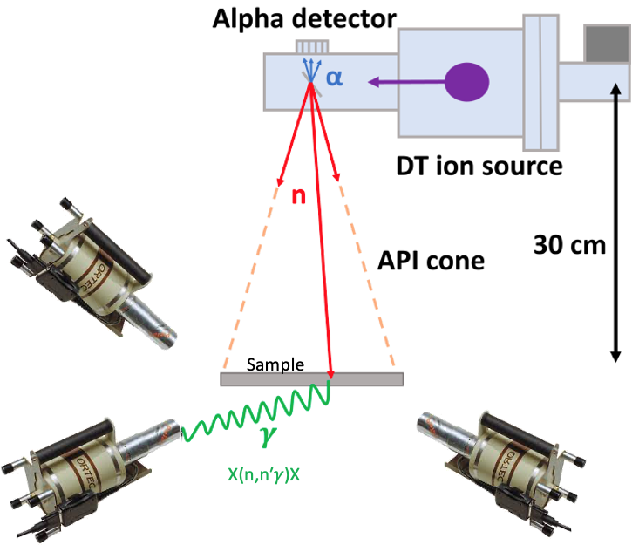
Berkeley Atlas Project
Produce an Atlas of cross sections, measured at 14 MeV neutron energy, for use developing improved neutron cross section libraries.
We have a new technique for making high-precision measurements of gamma-ray production cross sections using a DT neutron generator, paired with associated particle imaging (API).
Upgrades to existing API system
Perform identical measurements on a range of target material of interest for applied nuclear sciences.
Provide cross-section measurements to the NNDC for evaluation and incorporation into future neutron cross section libraries releases.

Slide 7
Berkeley Atlas Project
Produce an Atlas of cross sections, measured at 14 MeV neutron energy, for use developing improved neutron cross section libraries.
We have a new technique for making high-precision measurements of gamma-ray production cross sections using a DT neutron generator, paired with associated particle imaging (API).
Upgrades to existing API system
Perform identical measurements on a range of target material of interest for applied nuclear sciences.
Provide cross-section measurements to the NNDC for evaluation and incorporation into future neutron cross section libraries releases.

Slide 8
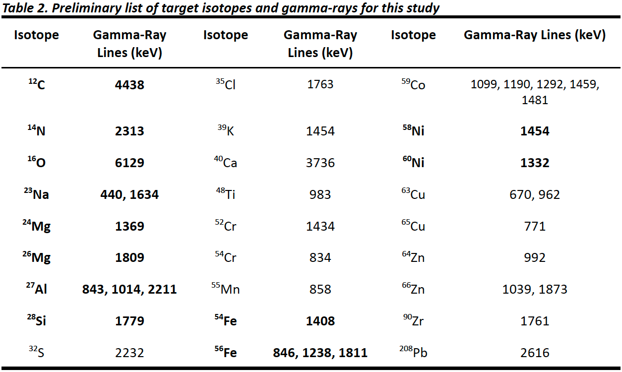
Berkeley Atlas Project
Produce an Atlas of cross sections, measured at 14 MeV neutron energy, for use developing improved neutron cross section libraries.
We have a new technique for making high-precision measurements of gamma-ray production cross sections using a DT neutron generator, paired with associated particle imaging (API).
Upgrades to existing API system
Perform identical measurements on a range of target material of interest for applied nuclear sciences.
Provide cross-section measurements to the NNDC for evaluation and incorporation into future neutron cross section libraries releases.
The Atlas will include gamma-ray production cross sections for 27 different isotopes (38 different gamma-ray emissions) for materials of interest to the wide variety of applied nuclear fields listed previously.

Slide 9
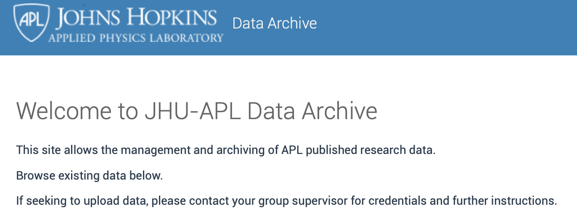
Berkeley Atlas Project
Produce an Atlas of cross sections, measured at 14 MeV neutron energy, for use developing improved neutron cross section libraries.
We have a new technique for making high-precision measurements of gamma-ray production cross sections using a DT neutron generator, paired with associated particle imaging (API).
Upgrades to existing API system
Perform identical measurements on a range of target material of interest for applied nuclear sciences.
Provide cross-section measurements to the NNDC for evaluation and incorporation into future neutron cross section libraries releases.

Slide 10
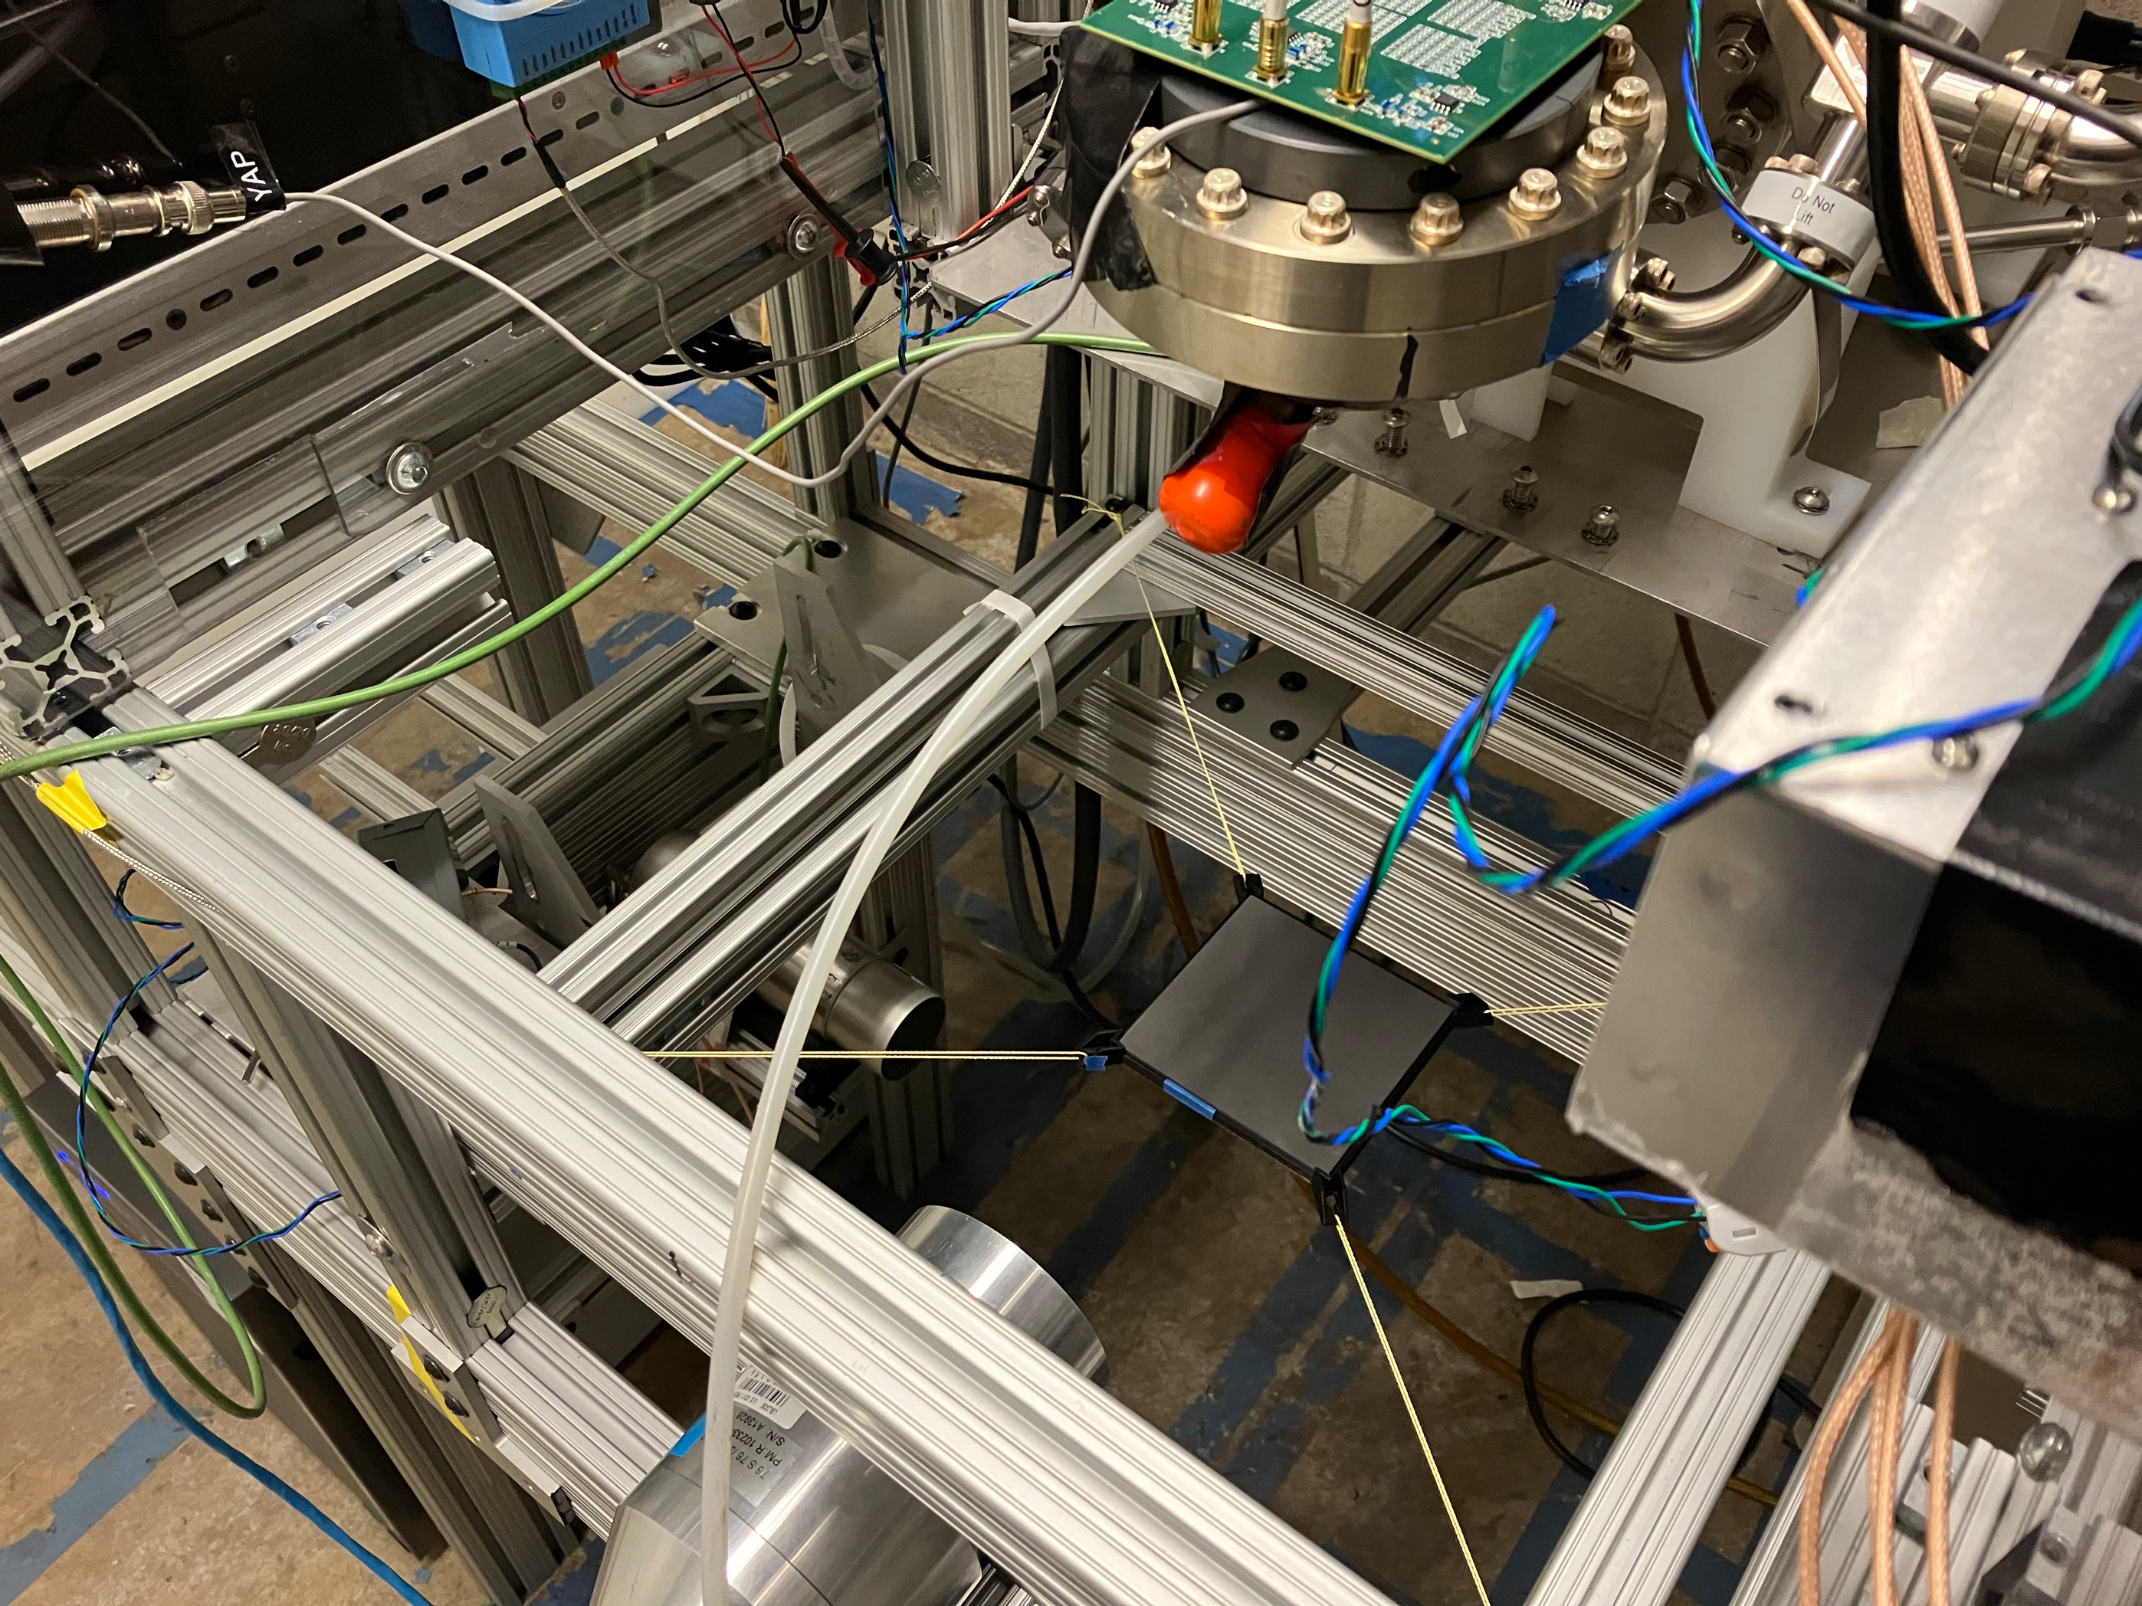
Proof-of-concept experiment
API Detector
DT Target
neutrons
Target
Gamma-Ray Detector

Slide 11
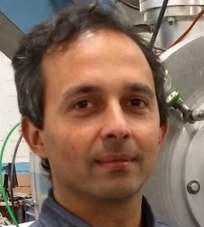
The Berkeley Atlas Team
Dr. Mauricio
Ayllon-Unzueta
NASA/Catholic University of America
Dr. Lee Bernstein
UC Berkeley
Dr. David Brown
Brookhaven National Laboratory
Dr. Emanuel Chimanski
Brookhaven National Laboratory
Caroline Egan
Lawrence Berkeley National Laboratory
Elettra Preosti
Lawrence Berkeley National Laboratory
Joe Henderson
UC Berkeley
Dr. Marie-Laure Mauborgne
SLB, Inc.
Dr. Patrick Peplowski
Johns Hopkins Applied Physics Laboratory
Dr. Arun Persaud
Lawrence Berkeley National Laboratory
Dr. Jack Wilson
Johns Hopkins Applied Physics Laboratory

Slide 12
The Berkeley Atlas Team
Institution | Team Members | Expertise
 |  | Measurements | Compilations | Evaluations | Processing | Validation | Applications
Johns Hopkins Applied Physics Laboratory (APL) | Patrick Peplowski (Project PI) Jack Wilson (Co-I)
NASA / Catholic University of America | Mauricio Ayllon-Unzueta (Institutional PI)
Lawrence Berkeley National Laboratory | Arun Persaud (Institutional PI) Caroline Egan (Post-Bach. Staff) Elettra Preosti (Post-Bach. Staff)
University of California, Berkeley | Lee Bernstein (Collaborator) Charles (Joe) Henderson (Graduate Student)
Brookhaven National Laboratory / National Nuclear Data Center | Emanuel Chimanski (Institutional PI) David Brown (Co-I)
SLB, Inc. | Marie-Laure Mauborgne (Collaborator)
The nuclear data pipeline, from Kolos et al. (2022), Current nuclear data needs for applications, Phys. Rev. Res. 4.

Slide 13
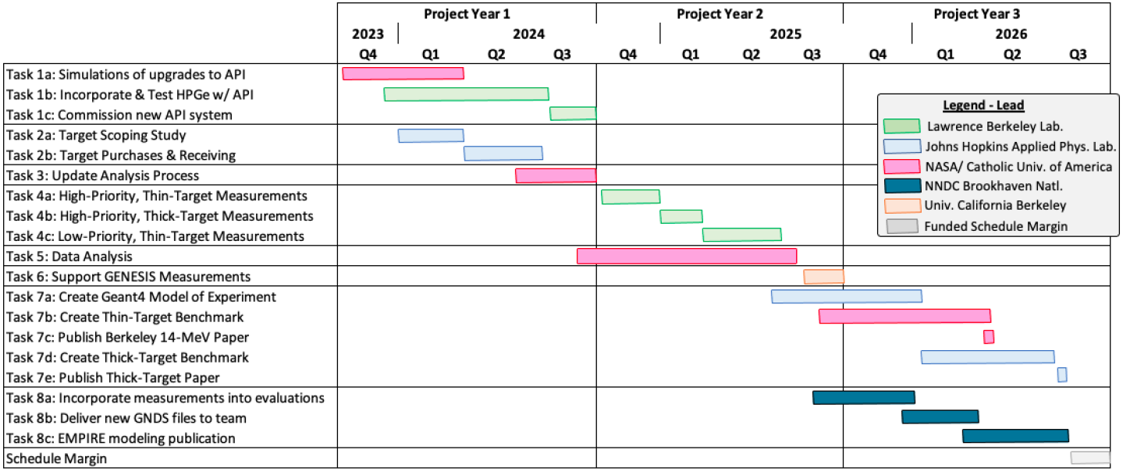
Schedule
1
2
Milestones:
Commissioning of improved API System
Completion of measurement campaign
Release of new neutron cross section library
Publication of thin-target benchmark ”The Berkeley Atlas”
Publication of thick-target benchmark
Publication of EMPIRE modeling
4
5
3
6
Note: Colors denote lead institutions, not sole responsibility for task. We are a highly integrated team.

