Slide 1
Fusion Energy Sciences: Tritium Production Session Introduction and Overview
Paul Humrickhouse
February 24, 2024

Slide 2
Overview
Tritium breeding- why and how much is required to support fusion?
Breeding blanket materials:
Breeder materials
Neutron multipliers
Structural materials
Coolants
Other materials
Blanket concepts
Discussion Topics

Slide 3
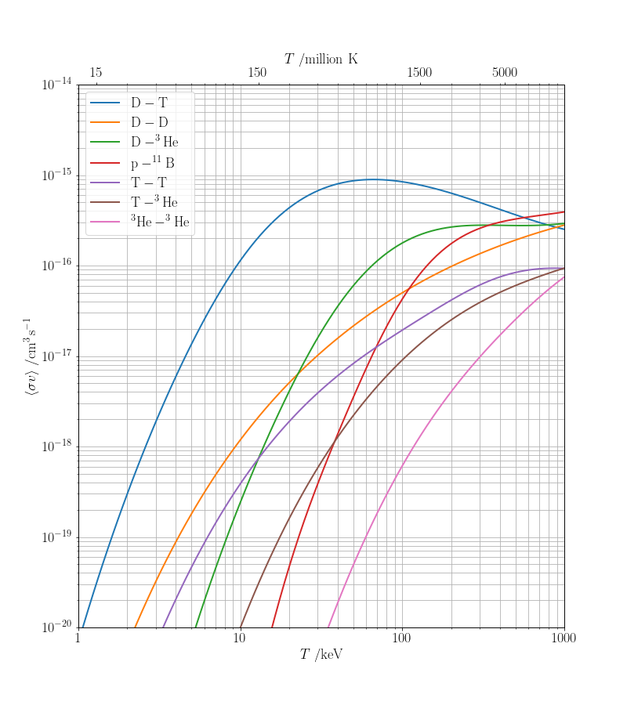
The need for tritium breeding
$$D+T→{}_{ }^{4}{He}+n$$
The D-T fusion reaction is the most achievable
But tritium decays with a 12.3 year half-life, and therefore has no natural supply
Small amounts produced by fission reactors can supply short-pulse research devices
But 55.6 kg T/GW_{f}-yr is required for sustained operation
This will require that it use the fusion neutrons to breed its own tritium supply, with a tritium breeding ratio (TBR) > 1

Slide 4
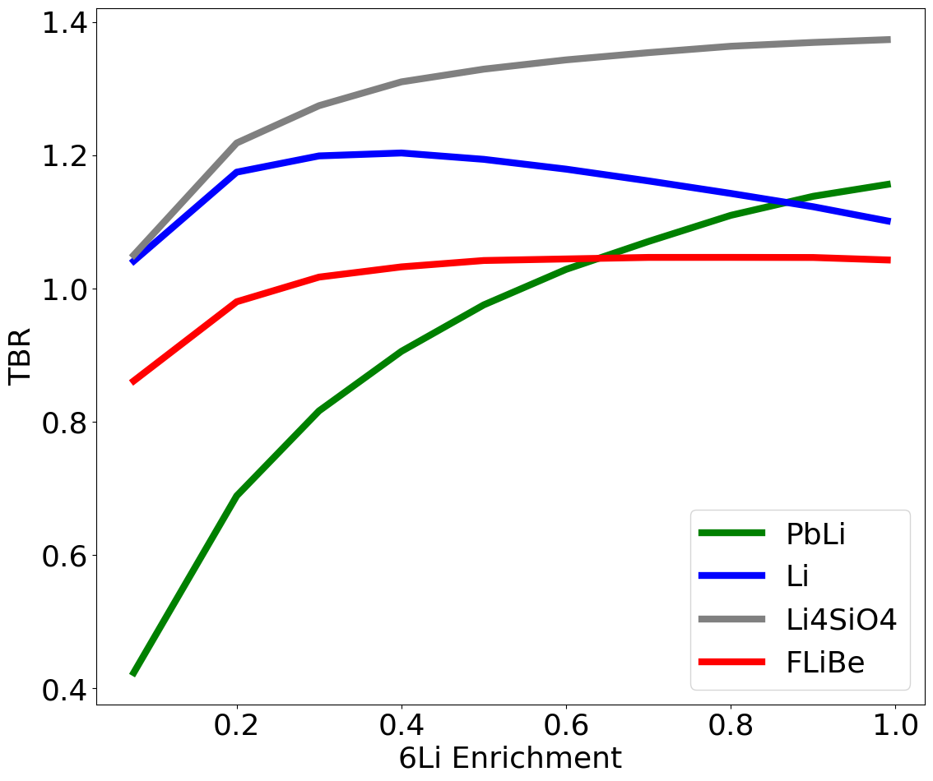
T breeding from Li
$$T+D→{}_{ }^{4}{He}+n$$
F. Hernandez, Fusion Engineering and Design 137 (2018) 243-256.
$$T+{}_{ }^{4}{He}←Li+n$$
Fusion neutrons can produce lithium from both naturally occurring isotopes:
n + ⁶Li → ⁴He + T + 4.785 MeV
Large cross section at thermal energies
Exothermic: produces additional energy!
n + ⁷Li → ⁴He + T + n’ - 2.5 MeV
Produces tritium and a neutron
It is advantageous to enrich in ⁶Li to an extent (typically 40-90%) that depends on the blanket concept and other materials present

Slide 5
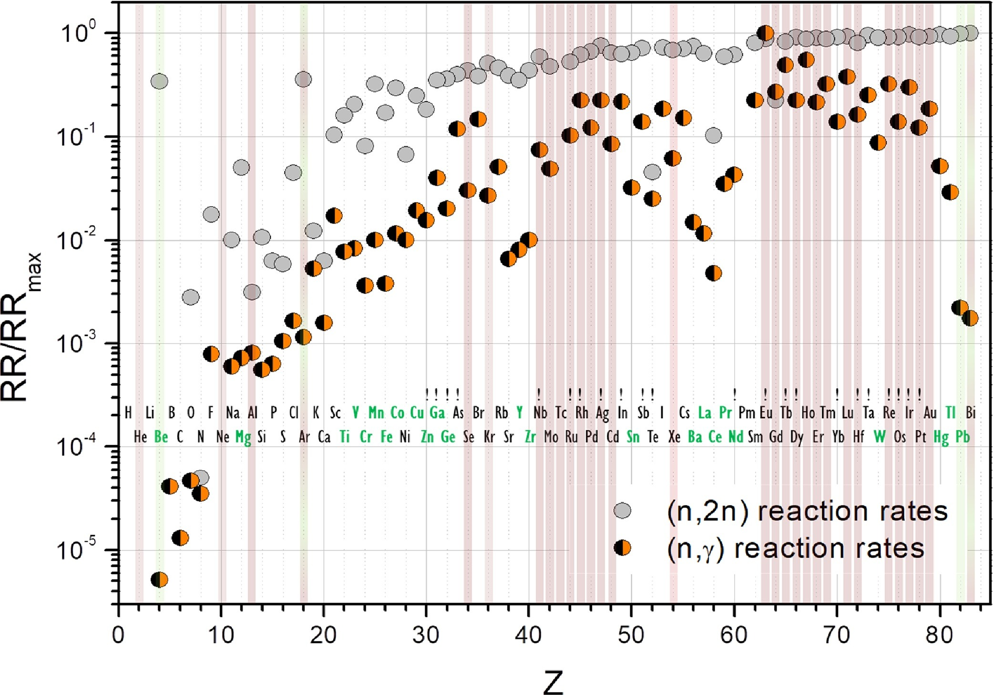
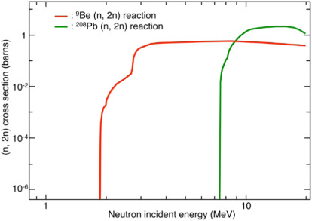
Neutron multipliers
F. Hernandez, Fusion Engineering and Design 137 (2018) 243-256.
TBR = 1 is achieved when every fusion neutron produces a triton from lithium
The multitude of other structures and components necessarily present in a fusion reactor will also absorb neutrons
This can be compensated for by incorporating neutron multipliers, elements that undergo (n,2n) reactions
Good multipliers have a high (n,2n) cross section and low total absorption cross section- Be and Pb are primary candidates
Beryllium is a superior multiplier but has drawbacks (toxicity, supply chain, U impurities)
M. Nakamichi, in Comprehensive Nuclear Materials 2nd ed (2020).

Slide 6
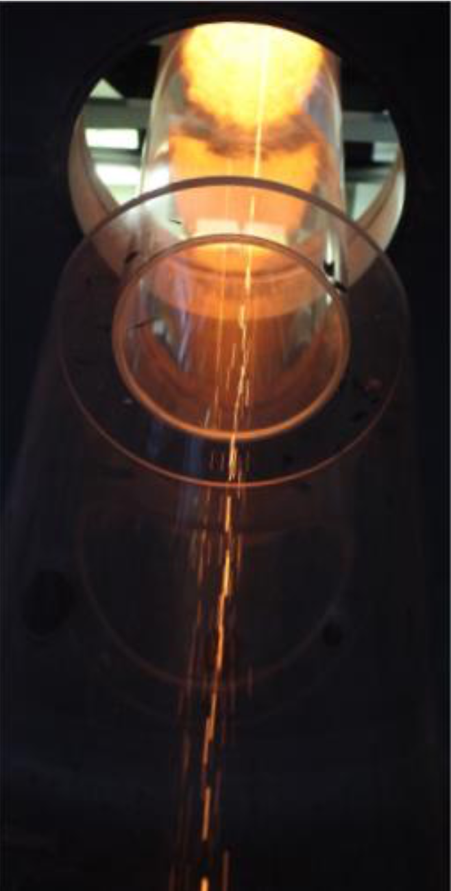
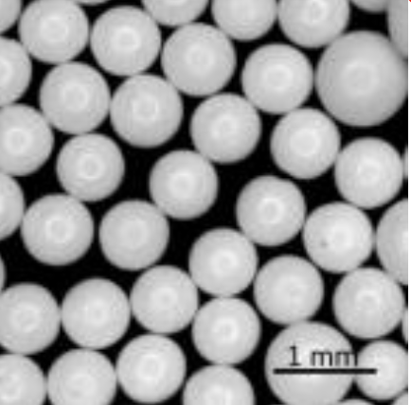
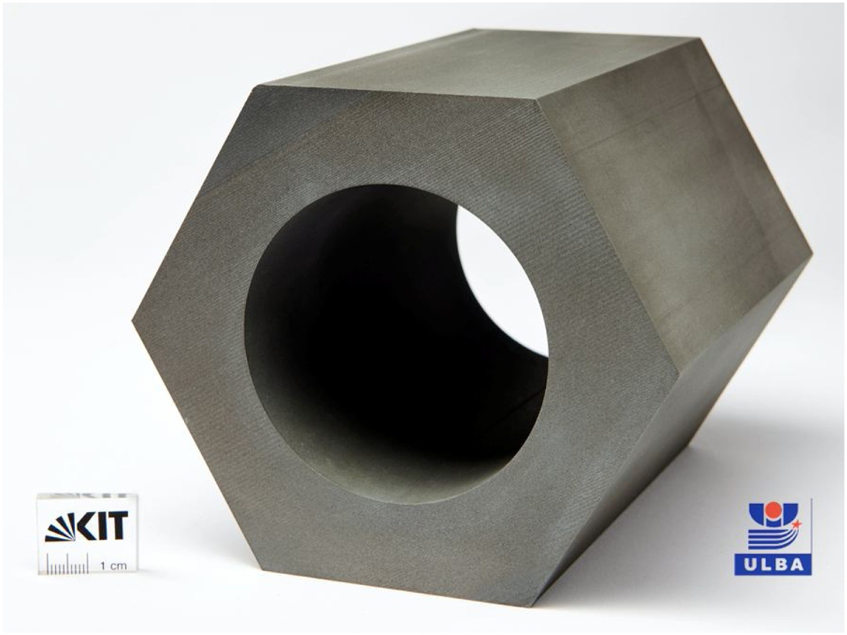
Candidate breeder/multiplier materials
Solid ceramic breeders
F. Hernandez, IEEE Transactions on Plasma Science, 2018
Breeders
Liquid Metals:
Lithium (T_{melt} = 180 ºC)
Pb_{84.3}Li_{15.7} (T_{melt} = 235 ºC)
Solids: separate breeder and multiplier
Ceramic breeders: Li₂TiO₃, Li₄SiO₄
Others with less favorable absorption/neutron activation possible
Multipliers:
Be (metal)
Beryllide intermetallics: Be₁₂Ti, Be₁₂V, Be₁₂Cr
Others with less favorable absorption/neutron activation possible
Molten Salts:
FLiBe [2LiF + BeF₂] (T_{melt} = 459 ºC)
FLiNaBe [LiF + NaF + BeF₂], (T_{melt} = 305 ºC)
Beryllide intermetallic multipliers
R. Gaisin, Fusion Engineering and Design 161 (2020) 111862.

Slide 7
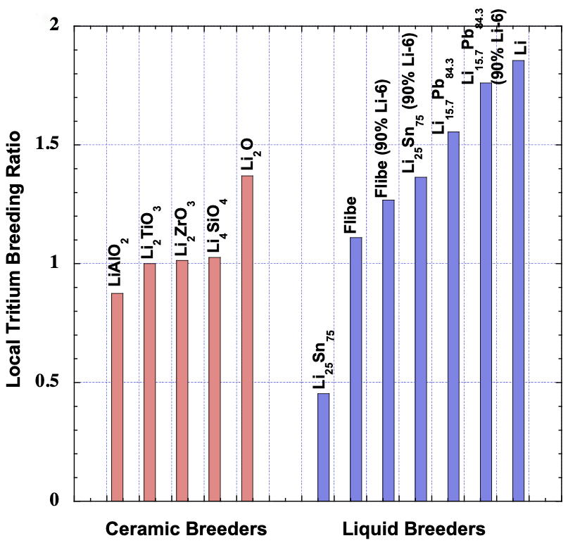
Can we achieve TBR > 1(+ε)?
Clearly yes in idealized configurations
Whether achievable in a fusion reactor is a question of design integration…
Multipliers need to offset neutrons lost through penetrations and absorption in all other components and materials,
e.g. FW, blanket structure, divertor, pellet injectors, heat & current drive components, diagnostics, etc.
These go higher with multiplier addition
L. El-Guebaly, in “Fusion Energy and Power: Applications, Technologies and Challenges” (2015)

Slide 8
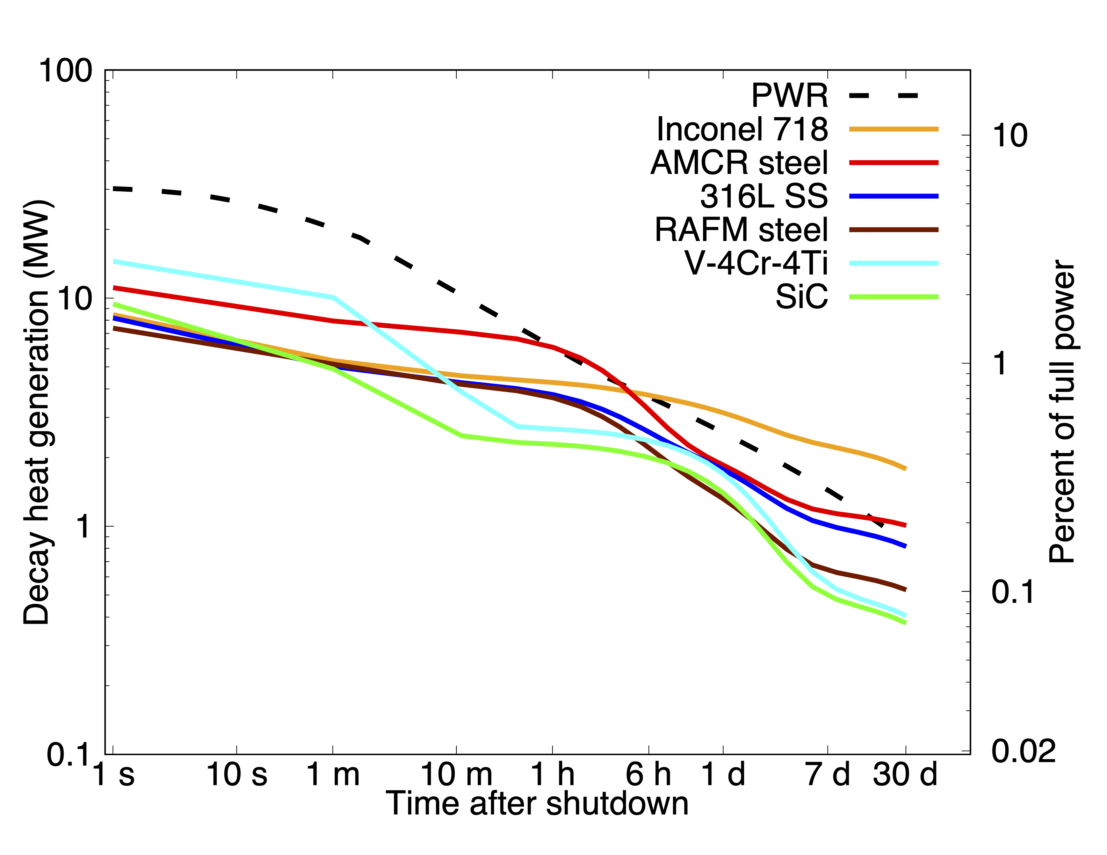
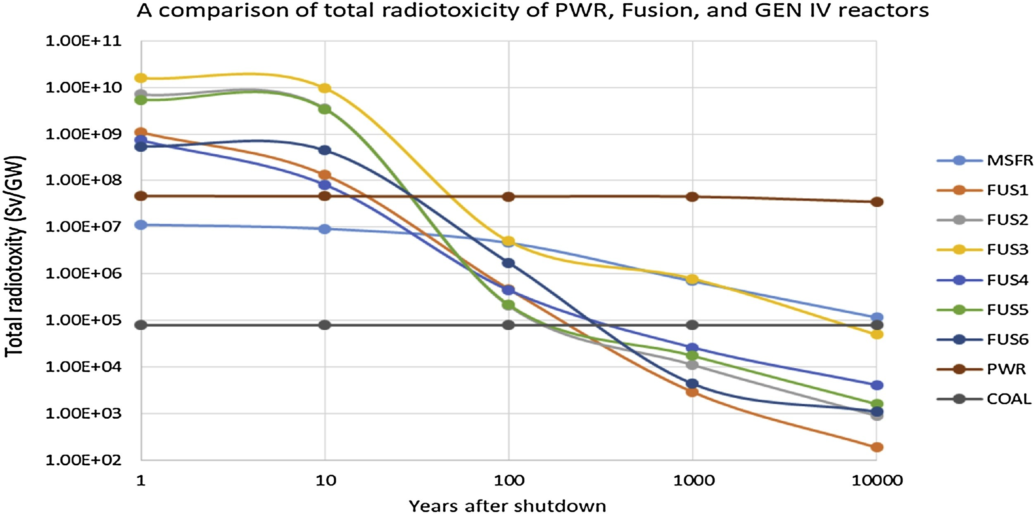
Neutron activation considerations
When considering other elements in breeder, multiplier, or structural materials, neutron activation is a primary consideration
All D-T fusion reactors will create significant quantities of radioactive material
Avoidance of long-lived waste and high decay heat (active cooling) requires low-activation materials
Many common alloying elements (Ni, Co, Mo, Nb, etc.) need to be avoided
P. W. Humrickhouse, Fusion Science and Technology (2024, submitted)
= V alloy, Li₂O
= RAFM steel, PbLi
= RAFM steel, Li₄SiO₄
= SiC composite, PbLi
= RAFM steel, PbLi
= SiC composite, Li₄SiO₄
M. Zucchetti, Fusion Engineering and Design 136 (2018) 1529-1533.

Slide 9
Structural Materials
The need to reduce short (decay heat) and long (waste) term activation has driven the development of structural materials for fusion
Three primary candidates:
Reduced-Activation Ferritic/Martensitic (RAFM) Steel
Most mature option, likeliest for near-term deployment; examples:
F82H (Fe-8Cr-2W-0.2V-0.04Ta)
EUROFER-97 (Fe-9Cr-1W-0.2V-0.12Ta)
Vanadium Alloys
V-4Cr-4Ti
Silicon Carbide (SiC) composites

Slide 10
Other materials
Coolants
Solid breeders require a coolant
Liquid breeders can in principle also act as a coolant, but have some drawbacks for this purpose
High pressure drops due to magnetohydrodynamic forces (liquid metals) or high viscosity (molten salts) at high flow rates
Other undesirable properties such as low thermal conductivity in molten salts
In both cases, primary coolant candidates are:
Helium
Water
Tungsten
Tungsten appears in many components in and around the breeding blanket:
Plasma facing materials in the divertor
Armor on the FW/blanket
Conducting shells used to stabilize the plasma
Shielding
Its effect on breeding may be mixed; it’s a strong thermal absorber but can also multiply at high energy*
*B. Sorbom et al., Fusion Engineering and Design 100 (2015) 378-405.

Slide 11
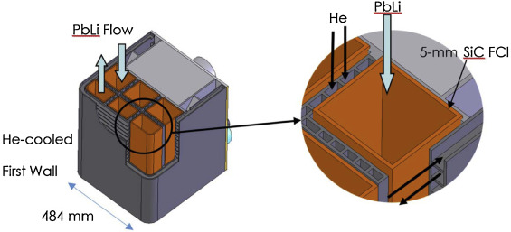
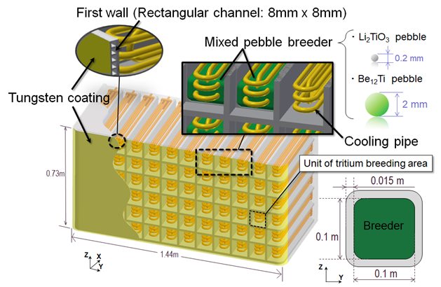
Blanket Concepts
US Design – Dual Cooled Lead Lithium (DCLL)
M. Abdou et al. / Fusion Engineering and Design 100 (2015) 2–43
Blanket concepts pair breeder/multiplier with structural and other materials and coolants based on their compatibility
PbLi, solid breeders typically paired with RAFM steel structure and helium or water coolant
These are the most studied designs
Lithium traditionally paired with vanadium
It may help getter impurities (O, H, T) that would otherwise significantly impact vanadium
Poor or questionable compatibility with other candidate structural materials
Material solution for FLiBe unclear
High melt temperature (459 ºC) leaves little/no temperature window for operation with RAFM steel (< 550 ºC)
Corrosion compatibility with all materials a concern
JA DEMO Design – Water Cooled Ceramic Breeder (WCCB)
Y. Someya, 2018 US-JA Workshop

Slide 12
Discussion topics for the session
Fusion reactors are anticipated to breed the tritium needed to fuel energy production. However, quantities of this isotope will be needed during reactor startup, and it may be in short supply. Are there production processes or reactor materials that can be used to establish a source of tritium for fusion energy applications?
Which nuclear data are necessary to support testing and operation of liquid blankets? Ceramic blankets?
What are the uncertainties and sensitivities to tritium breeding ratio?
Is the accuracy of nuclear data sufficient to predict activation of breeder blankets?
Nuclear reactions will contribute to chemical changes in breeder blankets. Can nuclear cross sections be used to accurately predict transmutation of materials in blankets?

