Slide 1
NNSA Tritium Modernization Program
Importance of Nuclear Data in Tritium Production
February 27, 2024
Richard Pagh, PhD, PE
Senior Nuclear Engineer
Production Design Manager

Slide 2
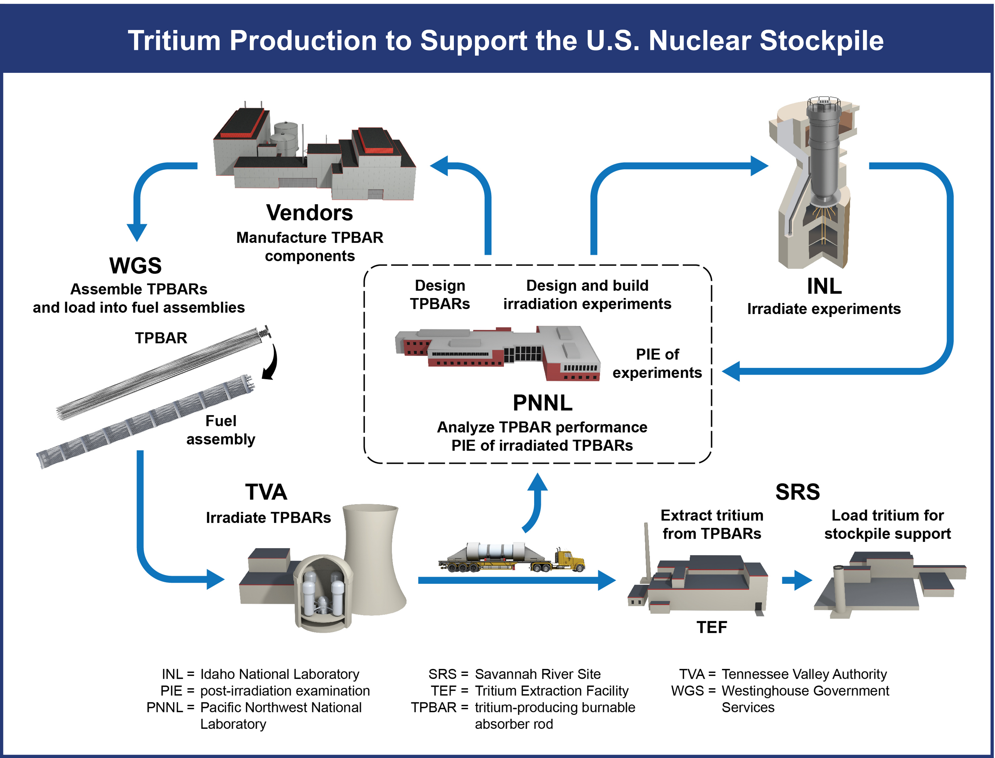
The NNSA Tritium Modernization Program (TMP)
TMP organization scope spans from target design through manufacture and production to deployment of tritium in the field
Numerous national laboratories, manufacturers, vendors and DOE sites contribute to the success of the tritium mission.

Slide 3
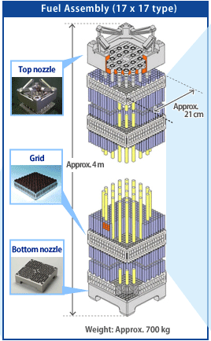
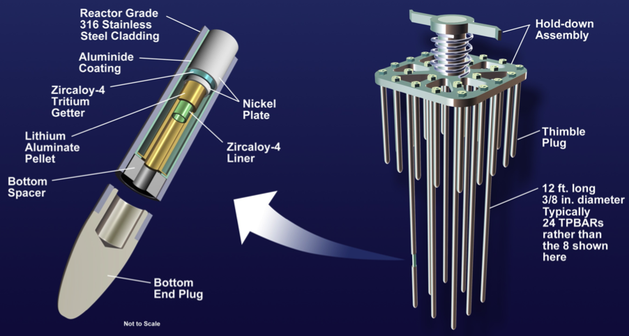
Tritium Producing Burnable Absorber Rod (TPBAR)

Slide 4
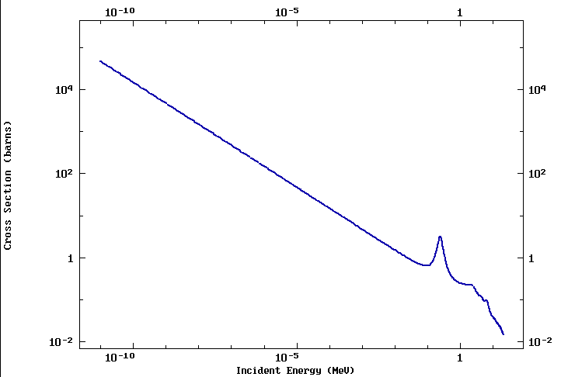
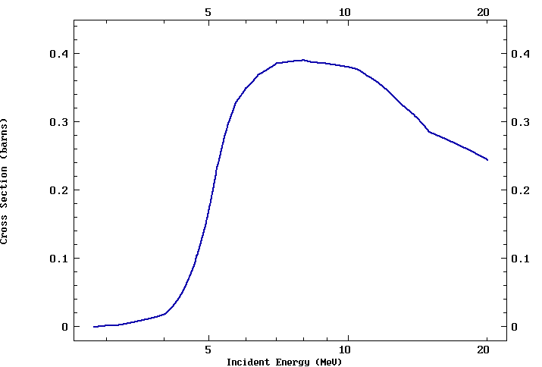
Main Tritium (T) Reactions in TPBARs
⁶Li(n,T)α ⁷Li(n,n′α)T

Slide 5
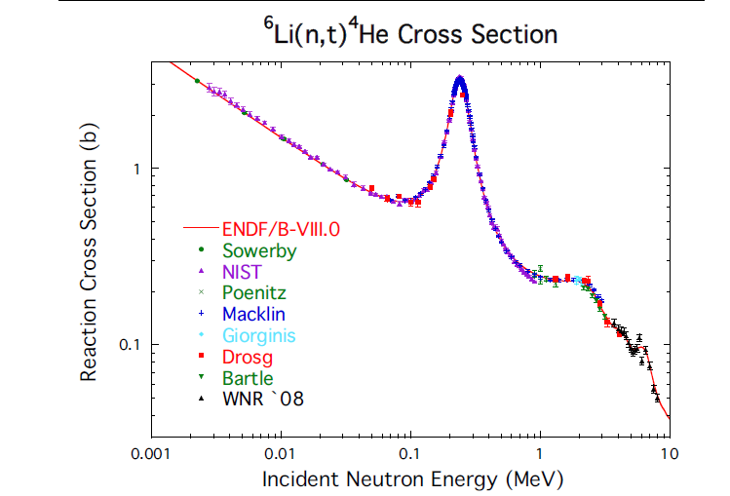
Latest Evaluation - ENDF/B-VIII.0 (2018)
New evaluations of cross section standards for:
  ⁶Li(n,t)
  ¹⁰B(n,α)
  ¹⁰B(n,α₁γ)
For Li - “The differences with ENDF/B VII.1 are generally small, and good agreement with the experimental data was maintained. The version VIII.0 cross sections were matched to those of version VII.1 at around 3.8 MeV, and they are identical to VII.1 above that energy.”
For B – “…new work extends the measurements to about 3 MeV. At the higher energies there is concern since there are large deviations from the 2006 standards evaluation.”

Slide 6
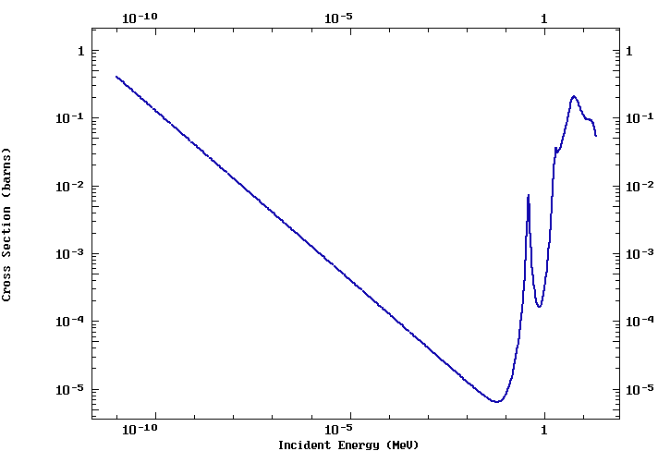
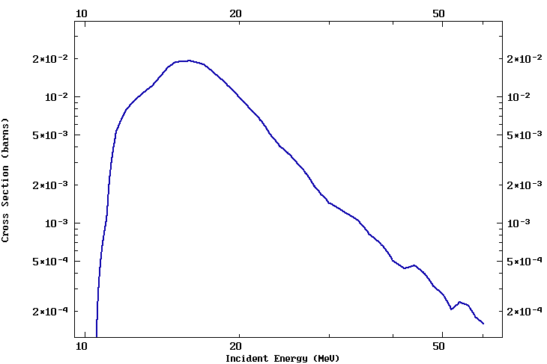
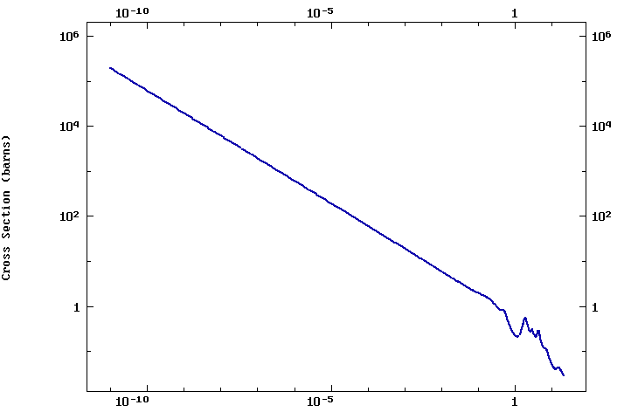
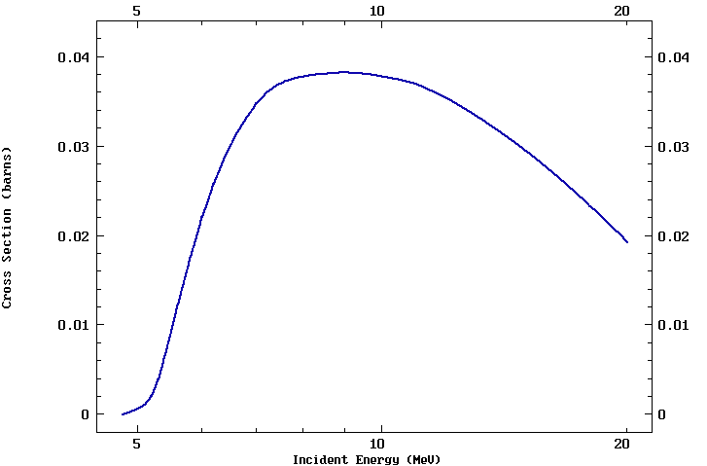
Additional PWR T Reactions - Boron
(1)
(2)
¹⁰B(n,T)⁸Be
¹¹B(n,T)⁹Be
¹⁰B(n,α)⁷Li
¹⁰B(n,D)⁹Be
(3)
(4)

Slide 7
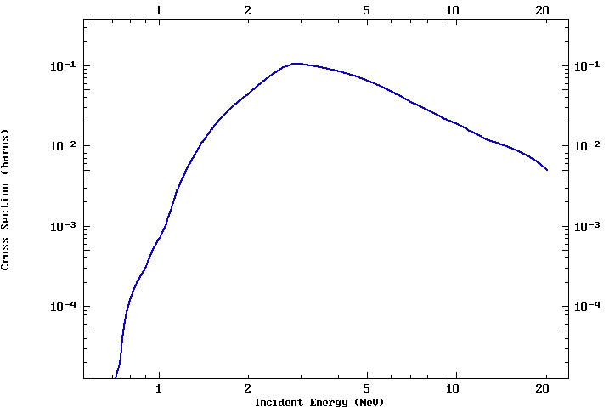
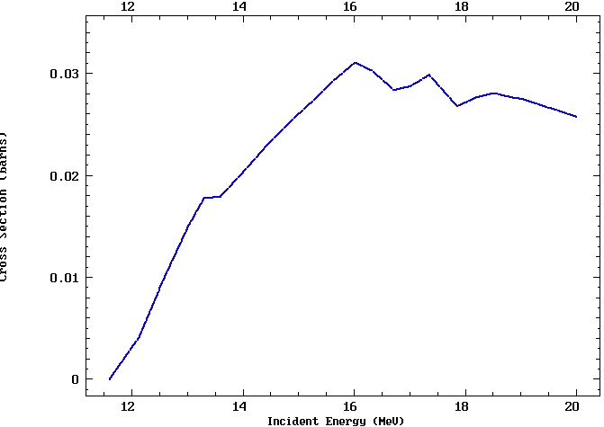
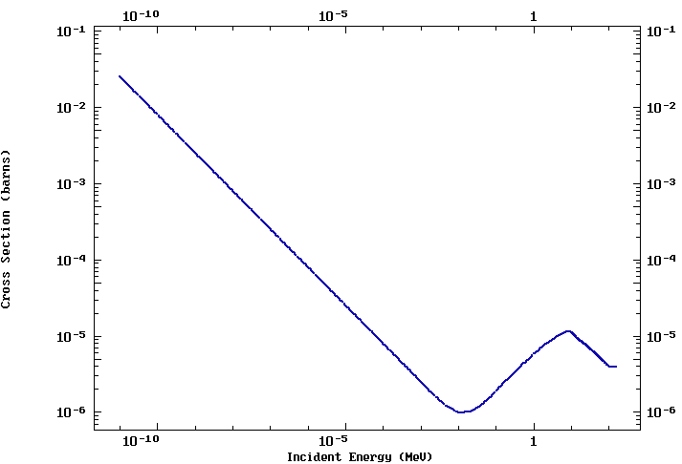
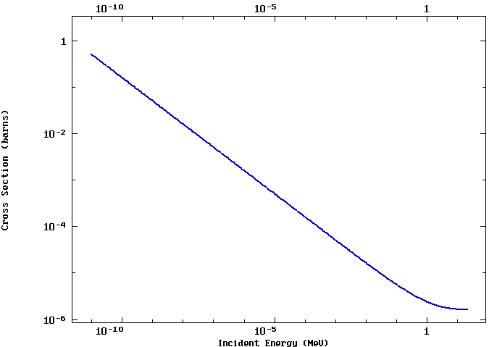
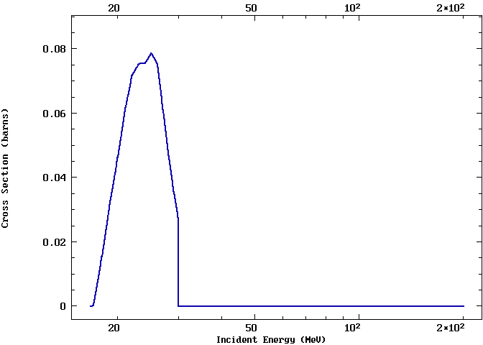
Additional PWR T Reactions -Deuterium and Beryllium
⁹Be(n,α)⁶He _{β} ⁶Li ⁹Be(n,T)⁷Li
⁹Be(n,γ)¹⁰Be ¹⁰Be(n,T)⁸Li
D(n,T)

Slide 8
TPBAR T Releases to Reactor Coolant System (RCS)
Permeation of T through the TPBAR cladding (TPBAR Release) occurs during operation, but cannot be directly measured in-core
TPBAR releases are inferred by subtracting expected T concentrations in RCS from measured concentrations
  C_{TPBAR} = C_{measured} – C_{nonTPBAR}
  C_{nonTPBAR} = C_{soluble} + C_{reactor components}
Soluble species in the RCS include boron, lithium, and deuterium (from protium)
Reactor components include secondary neutron startup sources, burnable absorber rods, fuel rods with integral burnup control, and control rods

Slide 9
TPBAR Challenges to Lattice Physics Codes
Predictions of T production and nuclear fuel management are produced from fuel supplier lattice physics codes
Presence of TPBARs in many of the fuel assemblies adds additional neutron poison to the standard nuclear plant
This influences,
  Numbers of fresh fuel assemblies per cycle
  Enrichments of fresh fuel assemblies (higher)
  Neutron energy spectrum (harder/shift to epi-thermal)
  In-core instrumentation response
  Pin power distributions (radial and axial)
Nuclear industry looking to expand the historical operation box (higher fuel enrichments, longer cycle lengths, new fuel designs,…)

Slide 10
Critical Experiments for Code Validation
Establish a new series of experiments which mimic regions (center/periphery) of PWR core
Extend fuel enrichments (greater than 5%)
Utilize B and Gd fuel burnable poisons of several patterns
Include presence/absence of TPBAR
Measurements:
  Radial pin power
  Axial pin power
  Reactivity (criticality)
Cut-away view of the core tank of the critical assembly with a 7uPCX core installed

