Slide 1
OFFICE OF SCIENCE
Pressing The Effort to Advance Nuclear Data
A Perspective from DOE NP
February 26, 2023
Tim Hallman
SC AD for Nuclear Physics

Slide 2
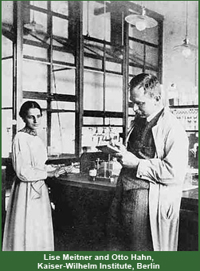
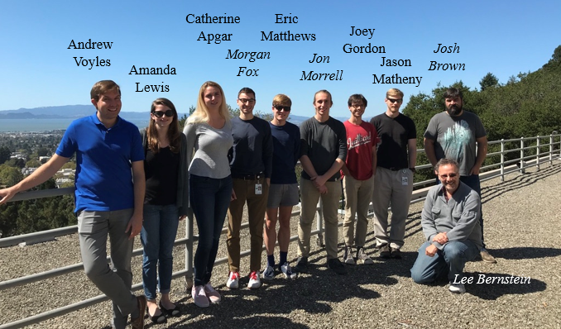
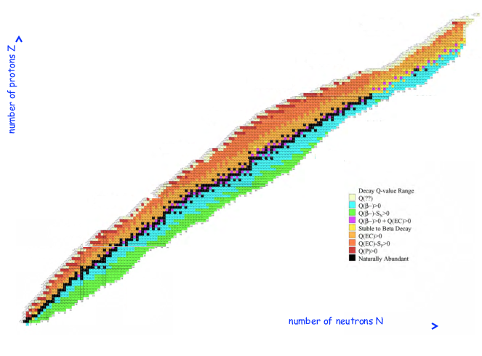
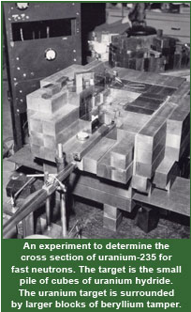
Nuclear Data Is Foundational to So Many Important Things
Nuclear Data:
  Is the collection of information on the properties of nuclei, their decays, and how they interact. Its origin dates to the discovery of radioactivity and the Manhattan Project, but today’s Nuclear Data is not “your grandfather’s Nuclear Data
The NP led US Nuclear Data Program (USNDP): Is a primary POC for the community and for work to get updated nuclear data into libraries for users. It covers the entire table of the isotopes and serves a critical role in basic research and applied missions across the entire Fed.
Nuclear Data group at UC Berkeley covering isotope production, nuclear energy, decay data, non-proliferation, and space applications
Discovery of fission, 1939

Slide 3
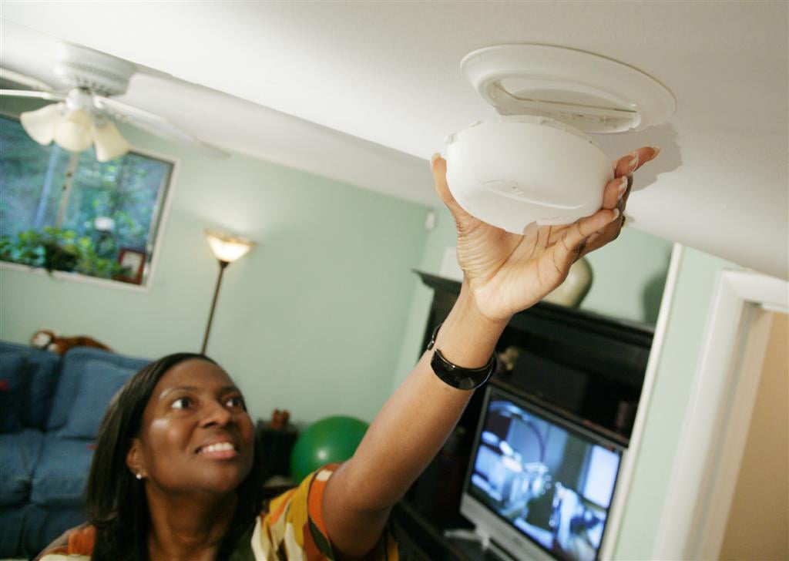
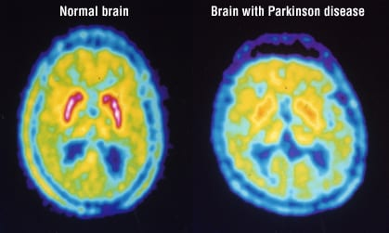
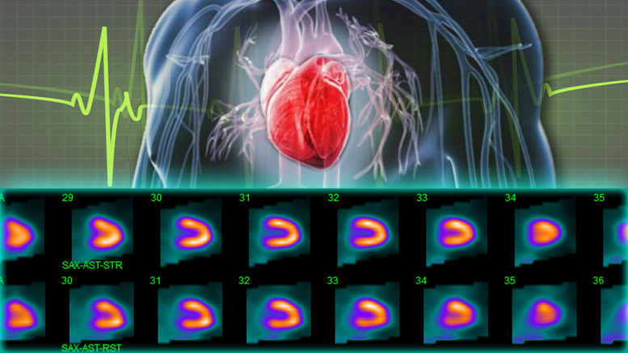
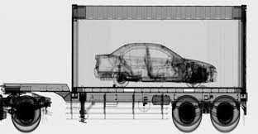
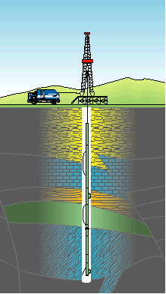
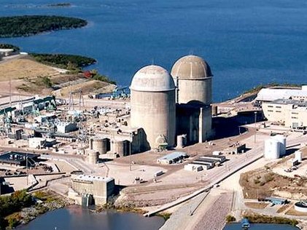
You & “Everyday” Nuclear Data? A Few Examples..
Fire safety in your house
Heart Health
Food safety
Medical Diagnosis
Carbon free electricity generation
Port of entry security
Metastasized cancer treatment
Oil and gas prospecting
Deep space exploration
Lasting joint replacements
National Security

Slide 4
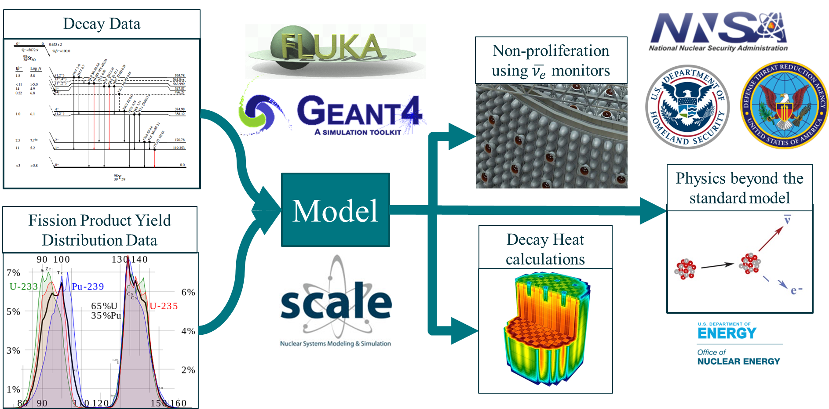
A Major Challenge In Addition to Data Acquisition/Curation
The role of nuclear data is often hidden deep inside codes and end users don’t know what they don’t know
“Modeling and simulation tools will still give an answer, even if there is only a theoretical extrapolation”
Only recently has greatly improved nuclear data provided much needed improved precision for:
Decay heat in reactors
Reactor anti-neutrino spectra
Beta decay data for “pandora” fission fragments
Users most often interact here

Slide 5
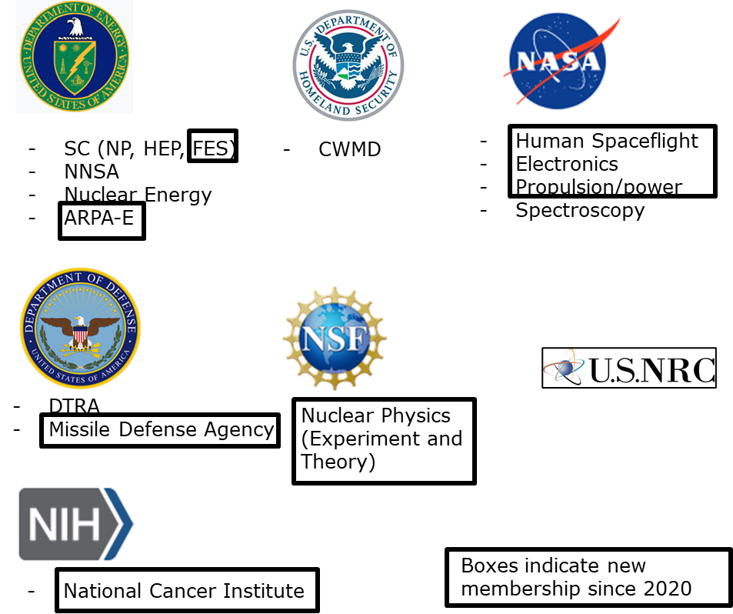
Nuclear Data Is Central to an Ever-Increasing Number of Federal Missions
Increased outreach:
  To Federal Programs and applications communities since March 2020
  Increased Nuclear Data Inter-Agency Working Group (NDIAWG) membership from 8 to 16
  NDIAWG meets quarterly to coordinate and prioritize needs
  Annual workshop with targeted sessions on needs

Slide 6
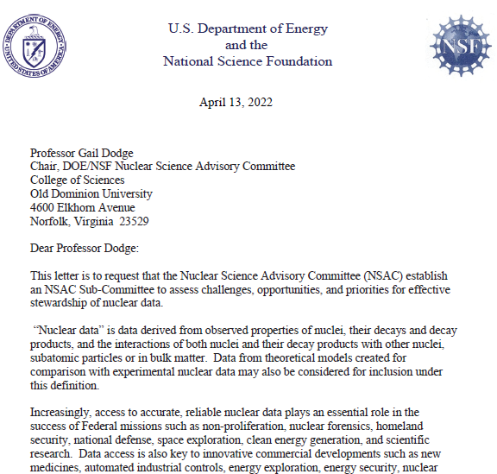
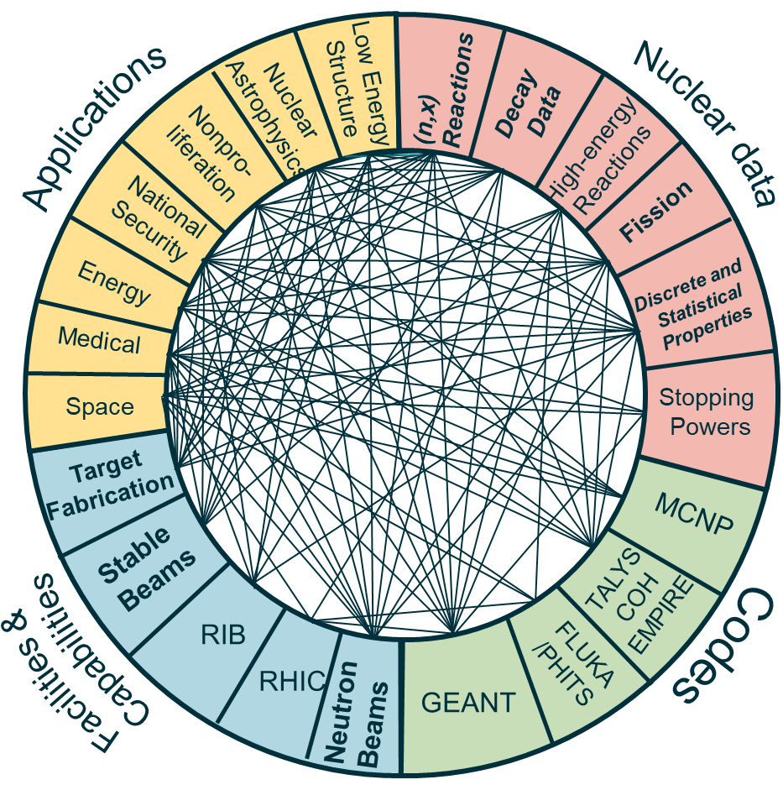
NSAC Nuclear Data Charge
The Nuclear Science Advisory Committee (NSAC)
  was charged to form a subcommittee to address current status and opportunities in nuclear data
Two reports requested:
  1) detail the current status of the USNDP, both domestic and internationally, and 2) articulate opportunities to enhance nuclear data for basic nuclear science and applications
Charge to NSAC on nuclear data
The cross-cutting nature of nuclear data is readily apparent

Slide 7
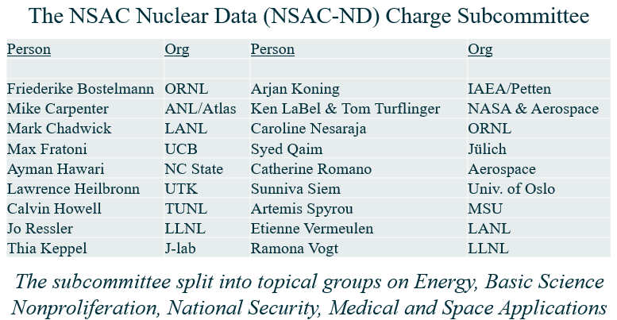
The NSAC Nuclear Data (ND) Subcommittee
Diverse expertise and panelists formed the NSAC-ND subcommittee covering areas of interest by federal programs

Slide 8
“Walking the Walk…”

Slide 9
Keyword Indicators

Slide 10
New Initiatives

Slide 11
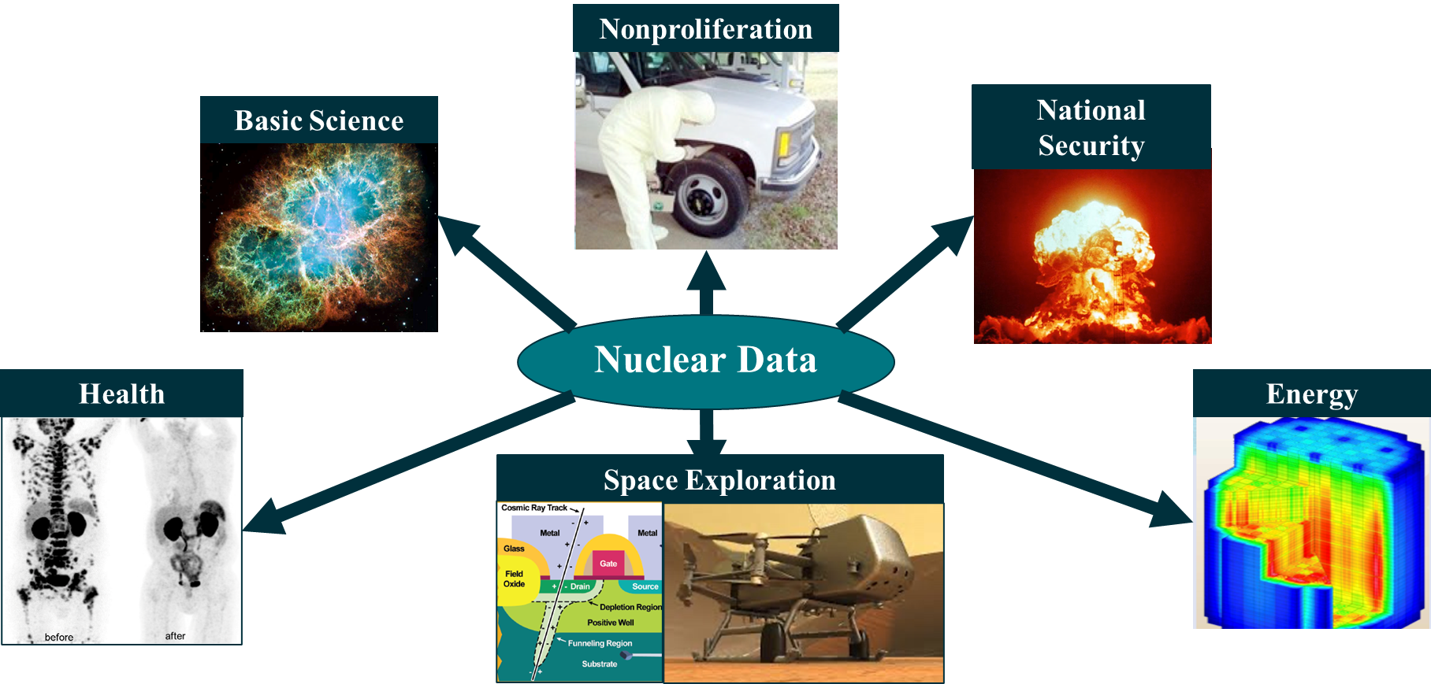
Opportunities Identified For Increased Impact/Stewardship
Cross-cutting themes emerged that are used by many applications
  Workforce development
  On-going fission evaluations
  Accelerated decay data evaluations
  Improved reaction modeling with better links to nuclear structure
  Neutron induced data from low- to mid-energies
  High energy reactions and material stopping power

Slide 12
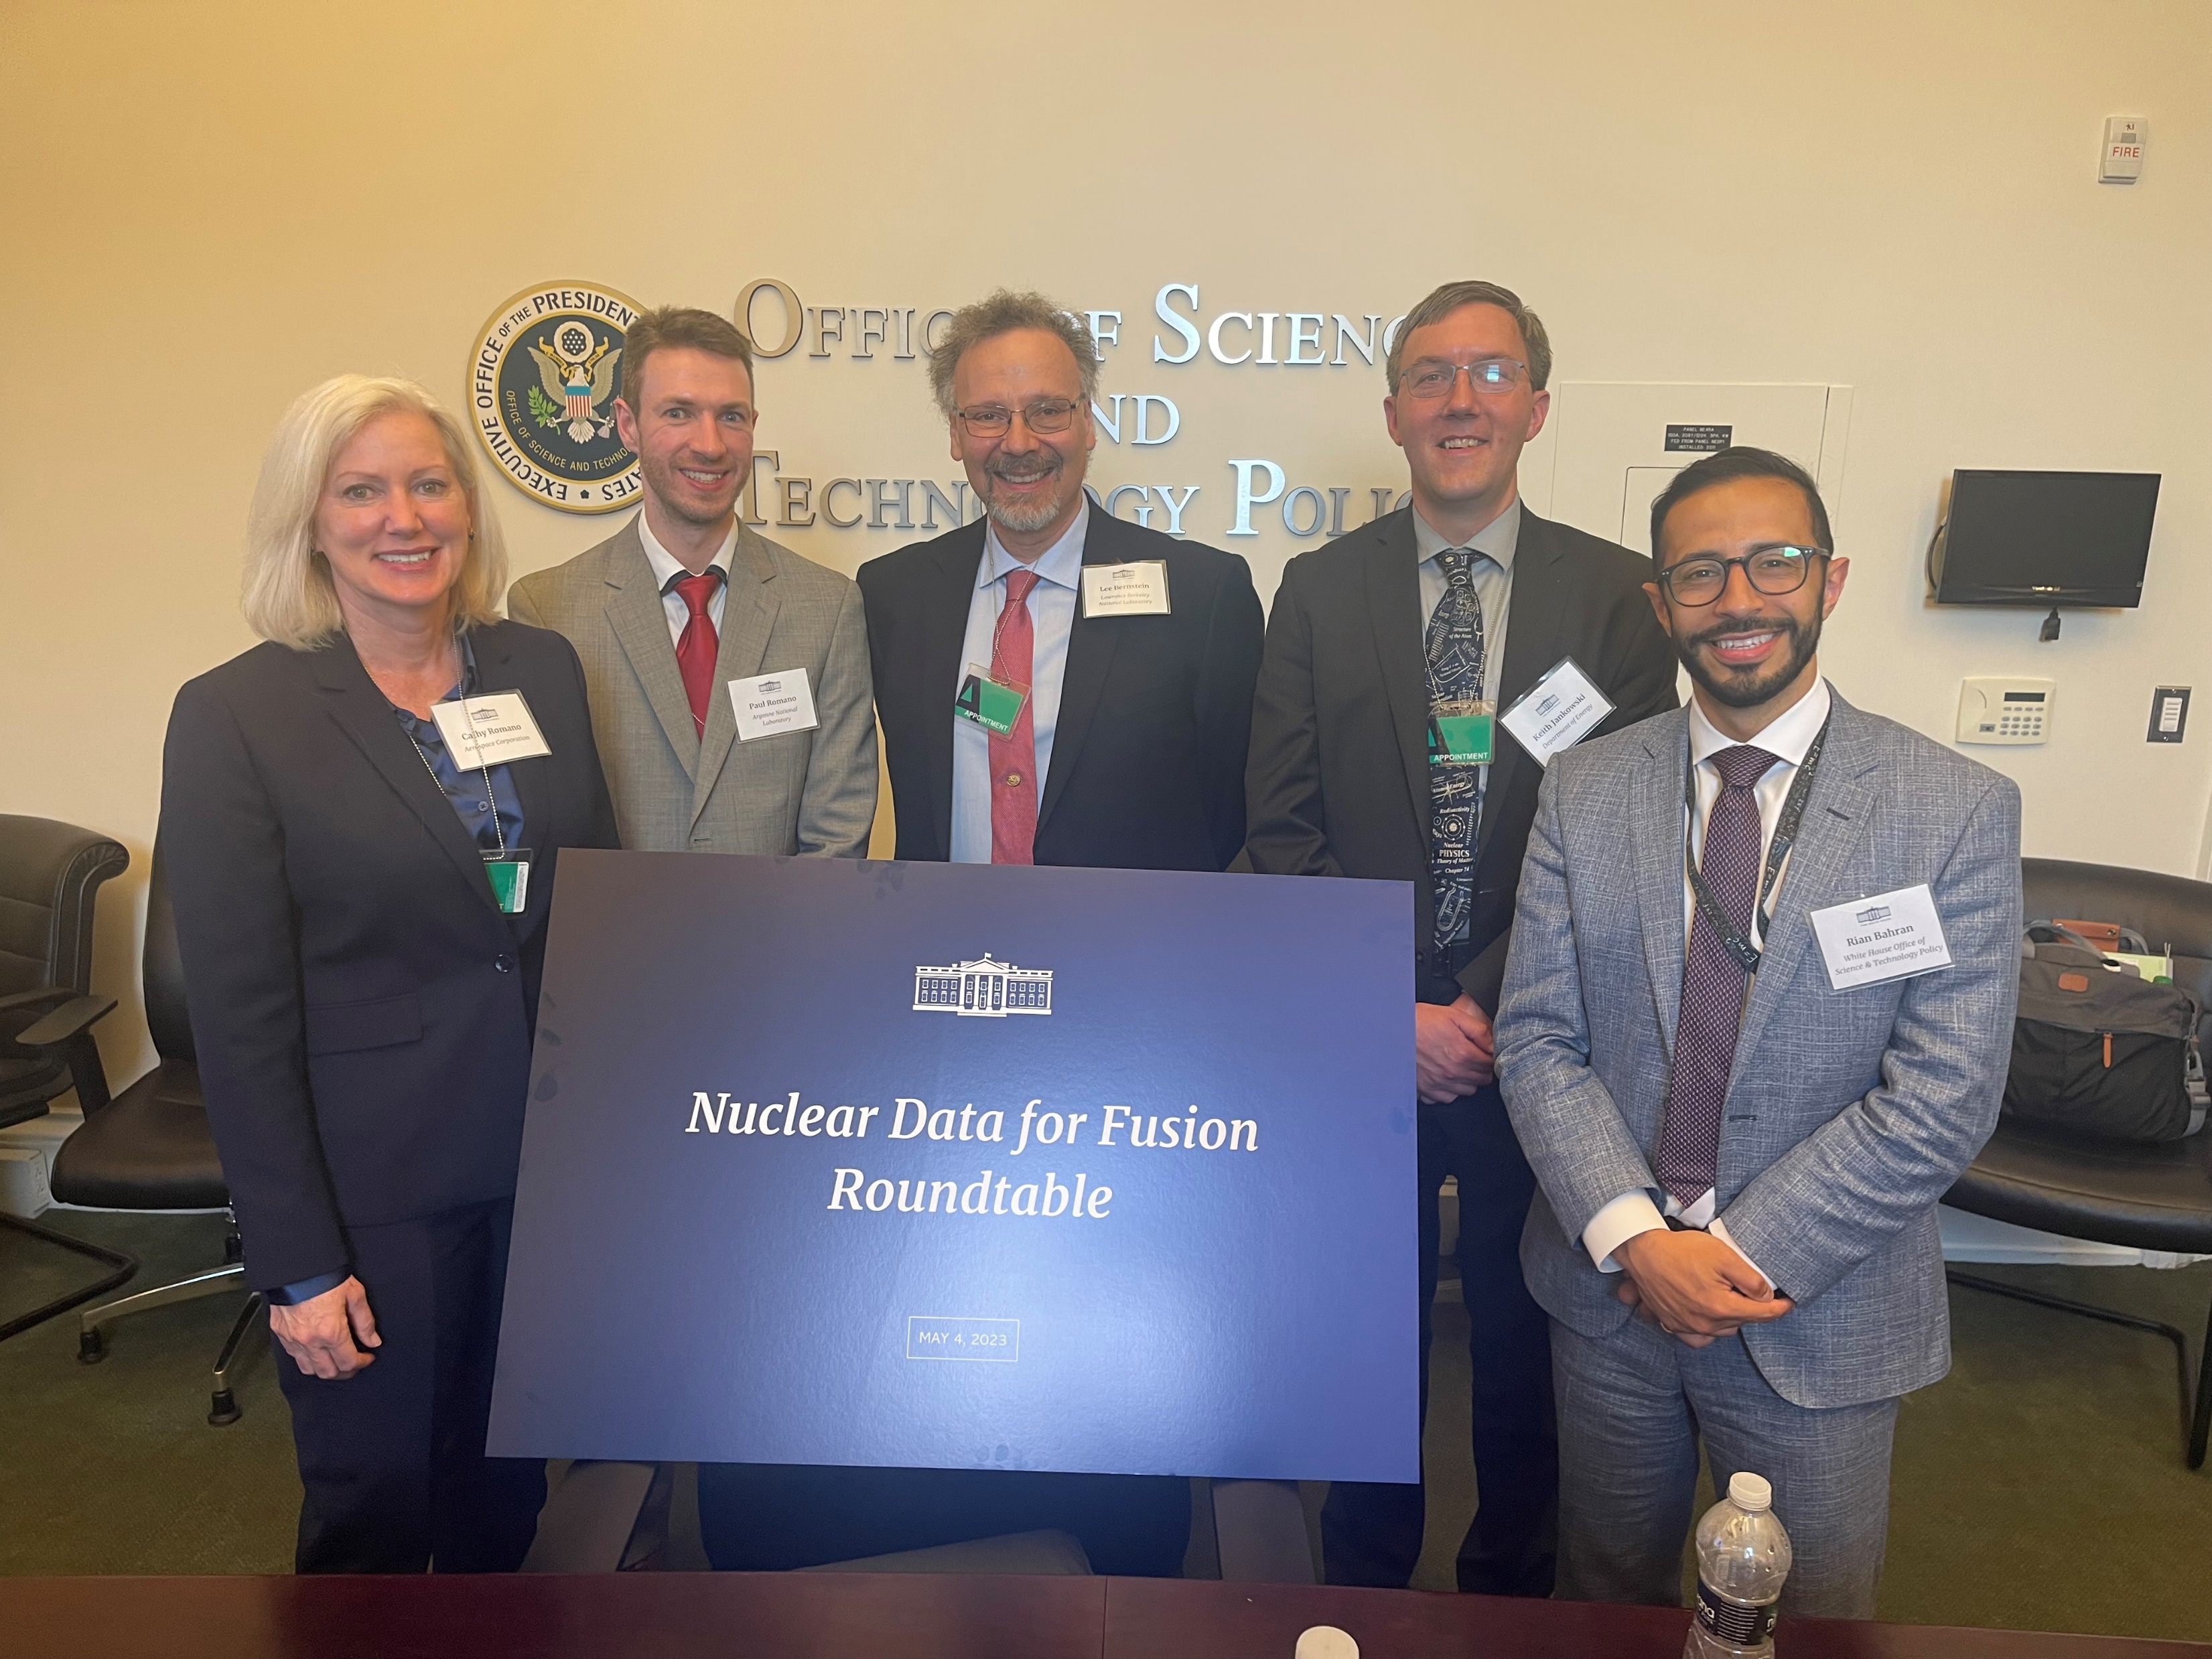
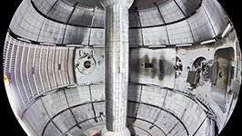
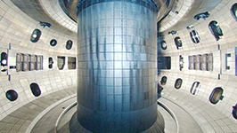
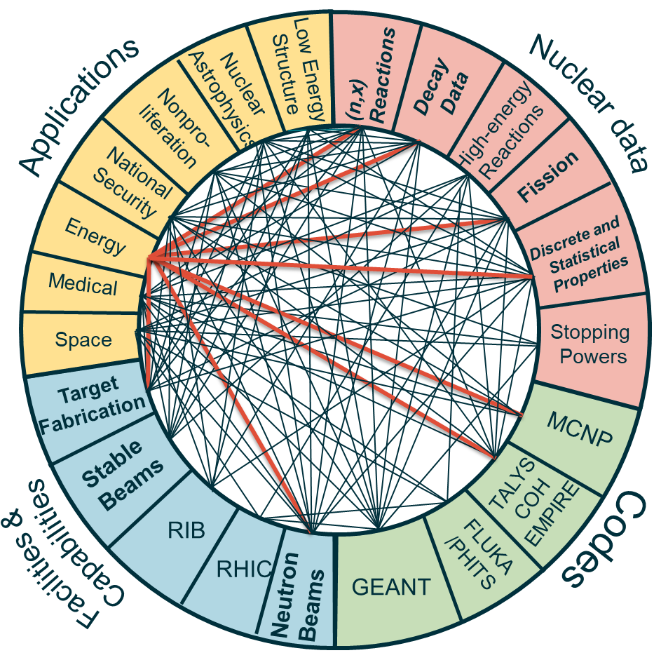
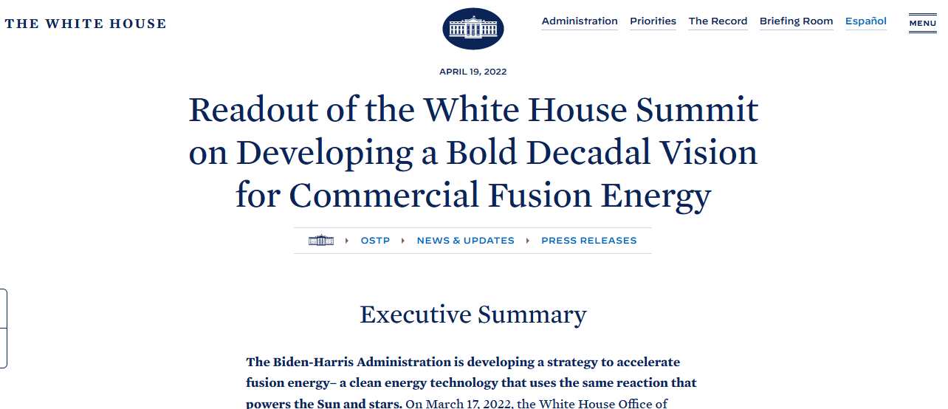
Opportunity 1: Fusion Energy
OSTP driven workshop on May 4 to discuss nuclear data needs for fusion
  Follow-up planned to dive into more details
Urgent need for data on structural and superconducting magnet materials
  Materials damage due to high energy neutrons → similar needs in other applications (fission, space)
Aligns with Administration Priority for developing a bold decadal vision for commercial fusion energy
NSTX-U
DOE/SC/FES User Facilities
Workshop planning committee – Cathy Romano (Aerospace Corp), Paul Romano (ANL), Lee Bernstein (LBNL/UCB), Keith Jankowski (DOE/SC/NP), Rian Bahran (OSTP)
DIII-D

Slide 13







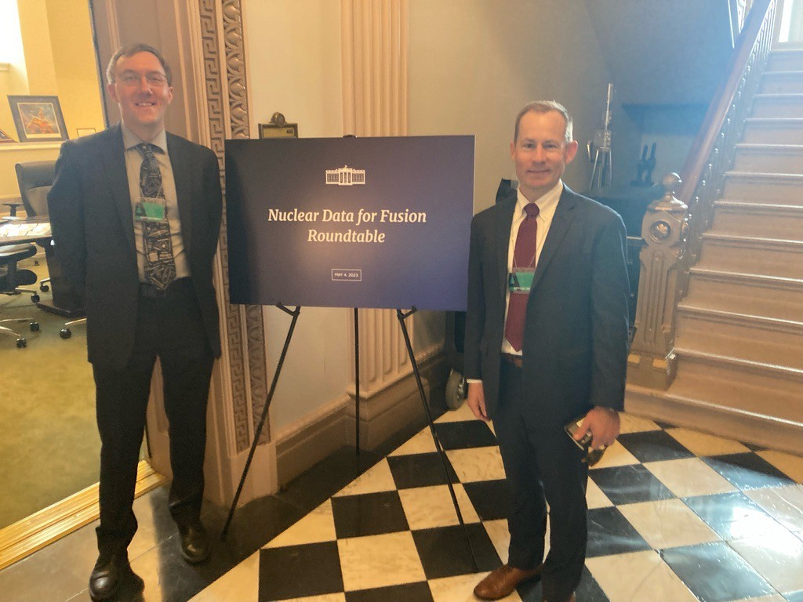
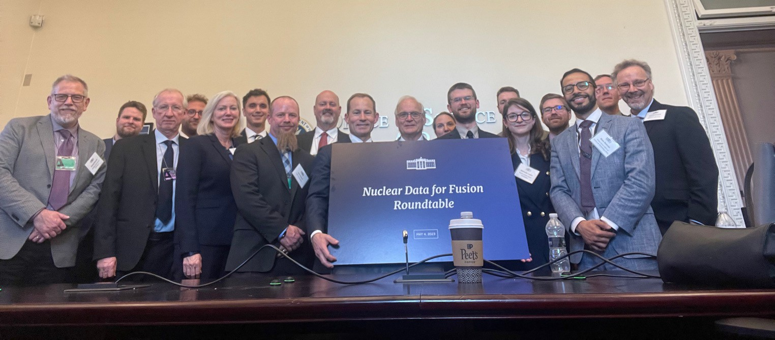
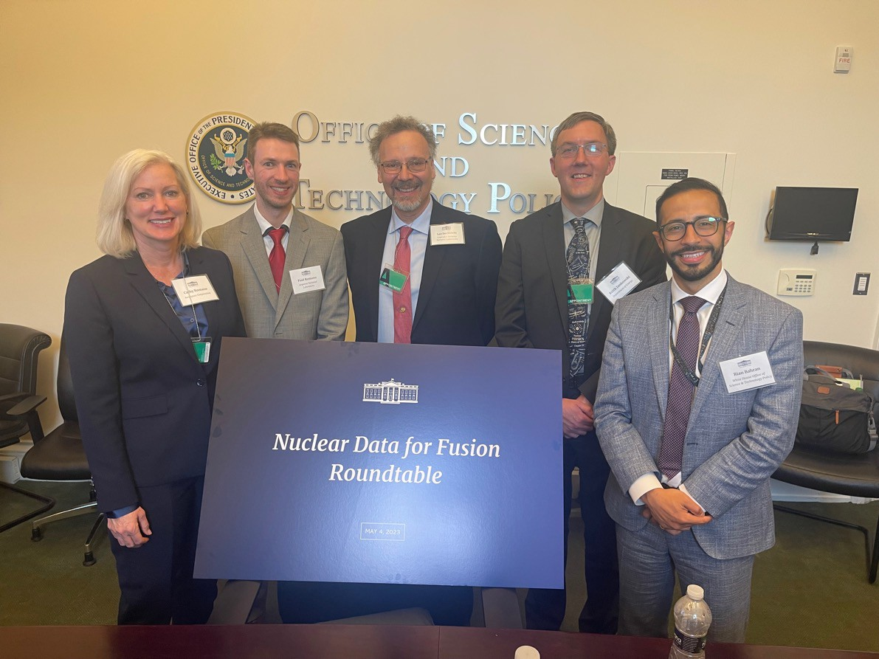
The USNDP was very well-represented!
Keith Jankowski
Lee Bernstein
Dave Brown
Ian Thompson
Fusion Nuclear Data Roundtable
Office of Science & Technology
Policy
  May 4, 2023
USNDP Budget Briefing – February 13th, 2024

Slide 14
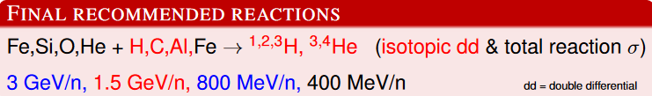
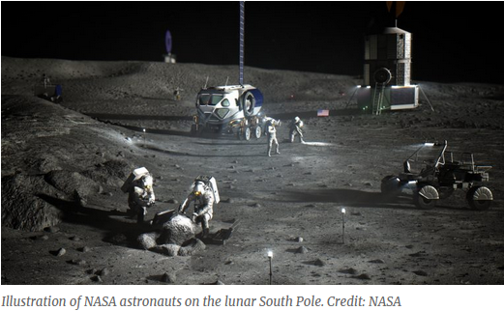
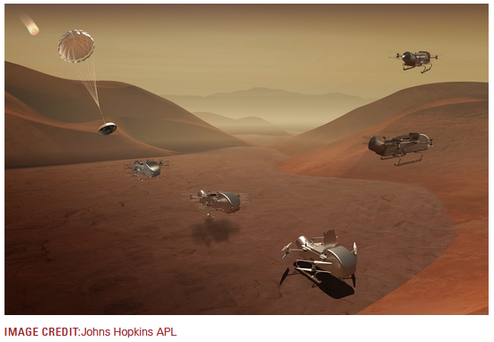
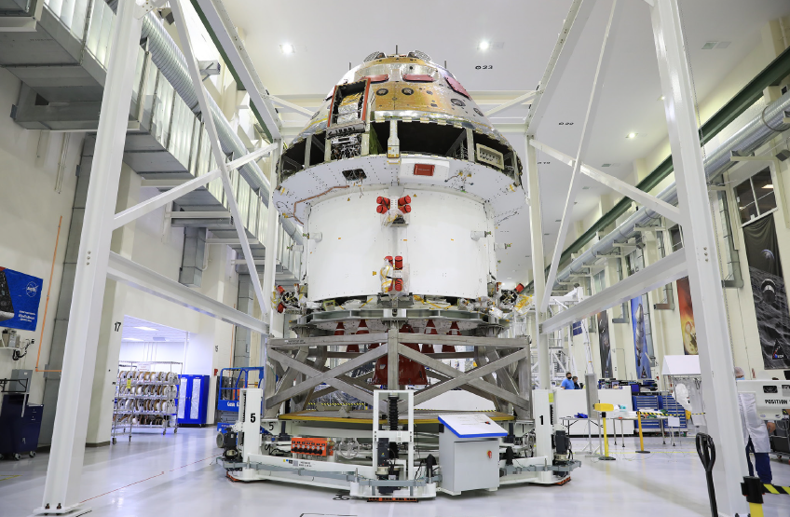
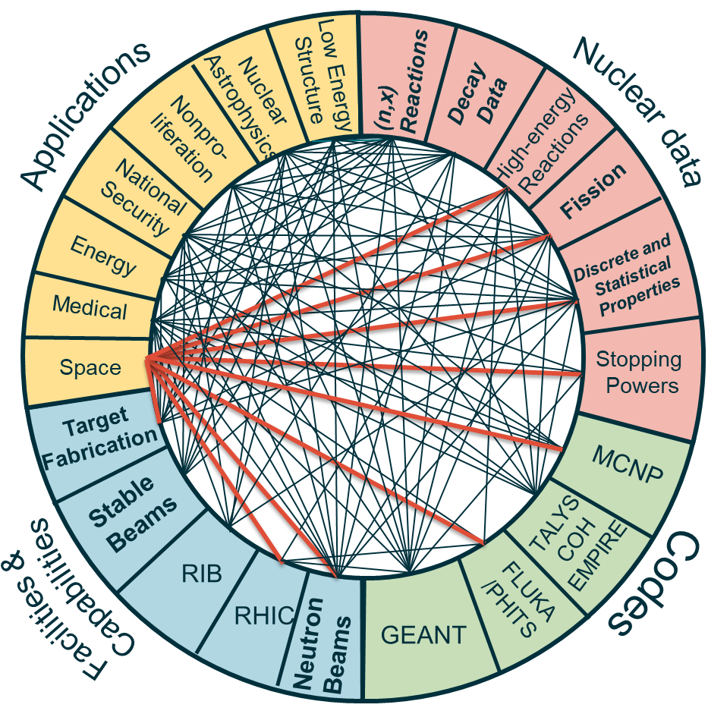
Opportunity 2: Space Exploration
Recent NP outreach to NASA led to needs in space exploration in human spaceflight, electronics protection, and planetary exploration
Human Spaceflight requires high energy data due to galactic cosmic rays hitting spacecraft → dose to astronauts
  Data collection is planned at BNL/RHIC/STAR
Electronics Protection requires data on advanced electronics materials (GaAs)
Planetary Exploration requires data on a variety of elements that could be found on the Moon, Mars, and beyond
Aligns With Administration Priority on return to the moon and on to Mars
Graphics from presentation by J. Norbury (NASA), WANDA2022
Illustration of NASA moon mission
NASA Dragonfly mission to Saturn’s moon Titan, 2026
Orion spacecraft crew module

Slide 15
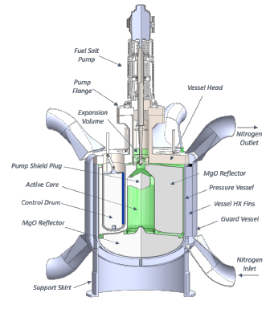
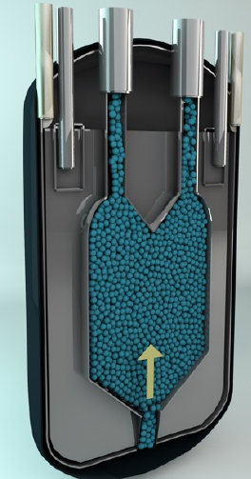
Opportunity 3: Nuclear Energy (Fission)
Actively working with DOE/NE and NRC to prioritize data needs
  NE and NRC budgets are very modest for ND projects, so SC Nuclear Data must lead
  A win! NE funded a data collection effort via their GAIN voucher system with TerraPower and LANL collaborating
  NP is also considering a system where applicants can submit proposals for “high priority nuclear data”
Aligns with Administration Priority for carbon-free energy
Part of DOE/NE strategy on advanced reactors - https://www.energy.gov/ne/articles/infographic-advanced-reactor-development
Left: TerraPower Molten Chloride Salt Experiment, WANDA 2021
Right: Kairos Power Fast Reactor Core, WANDA 2021

Slide 16




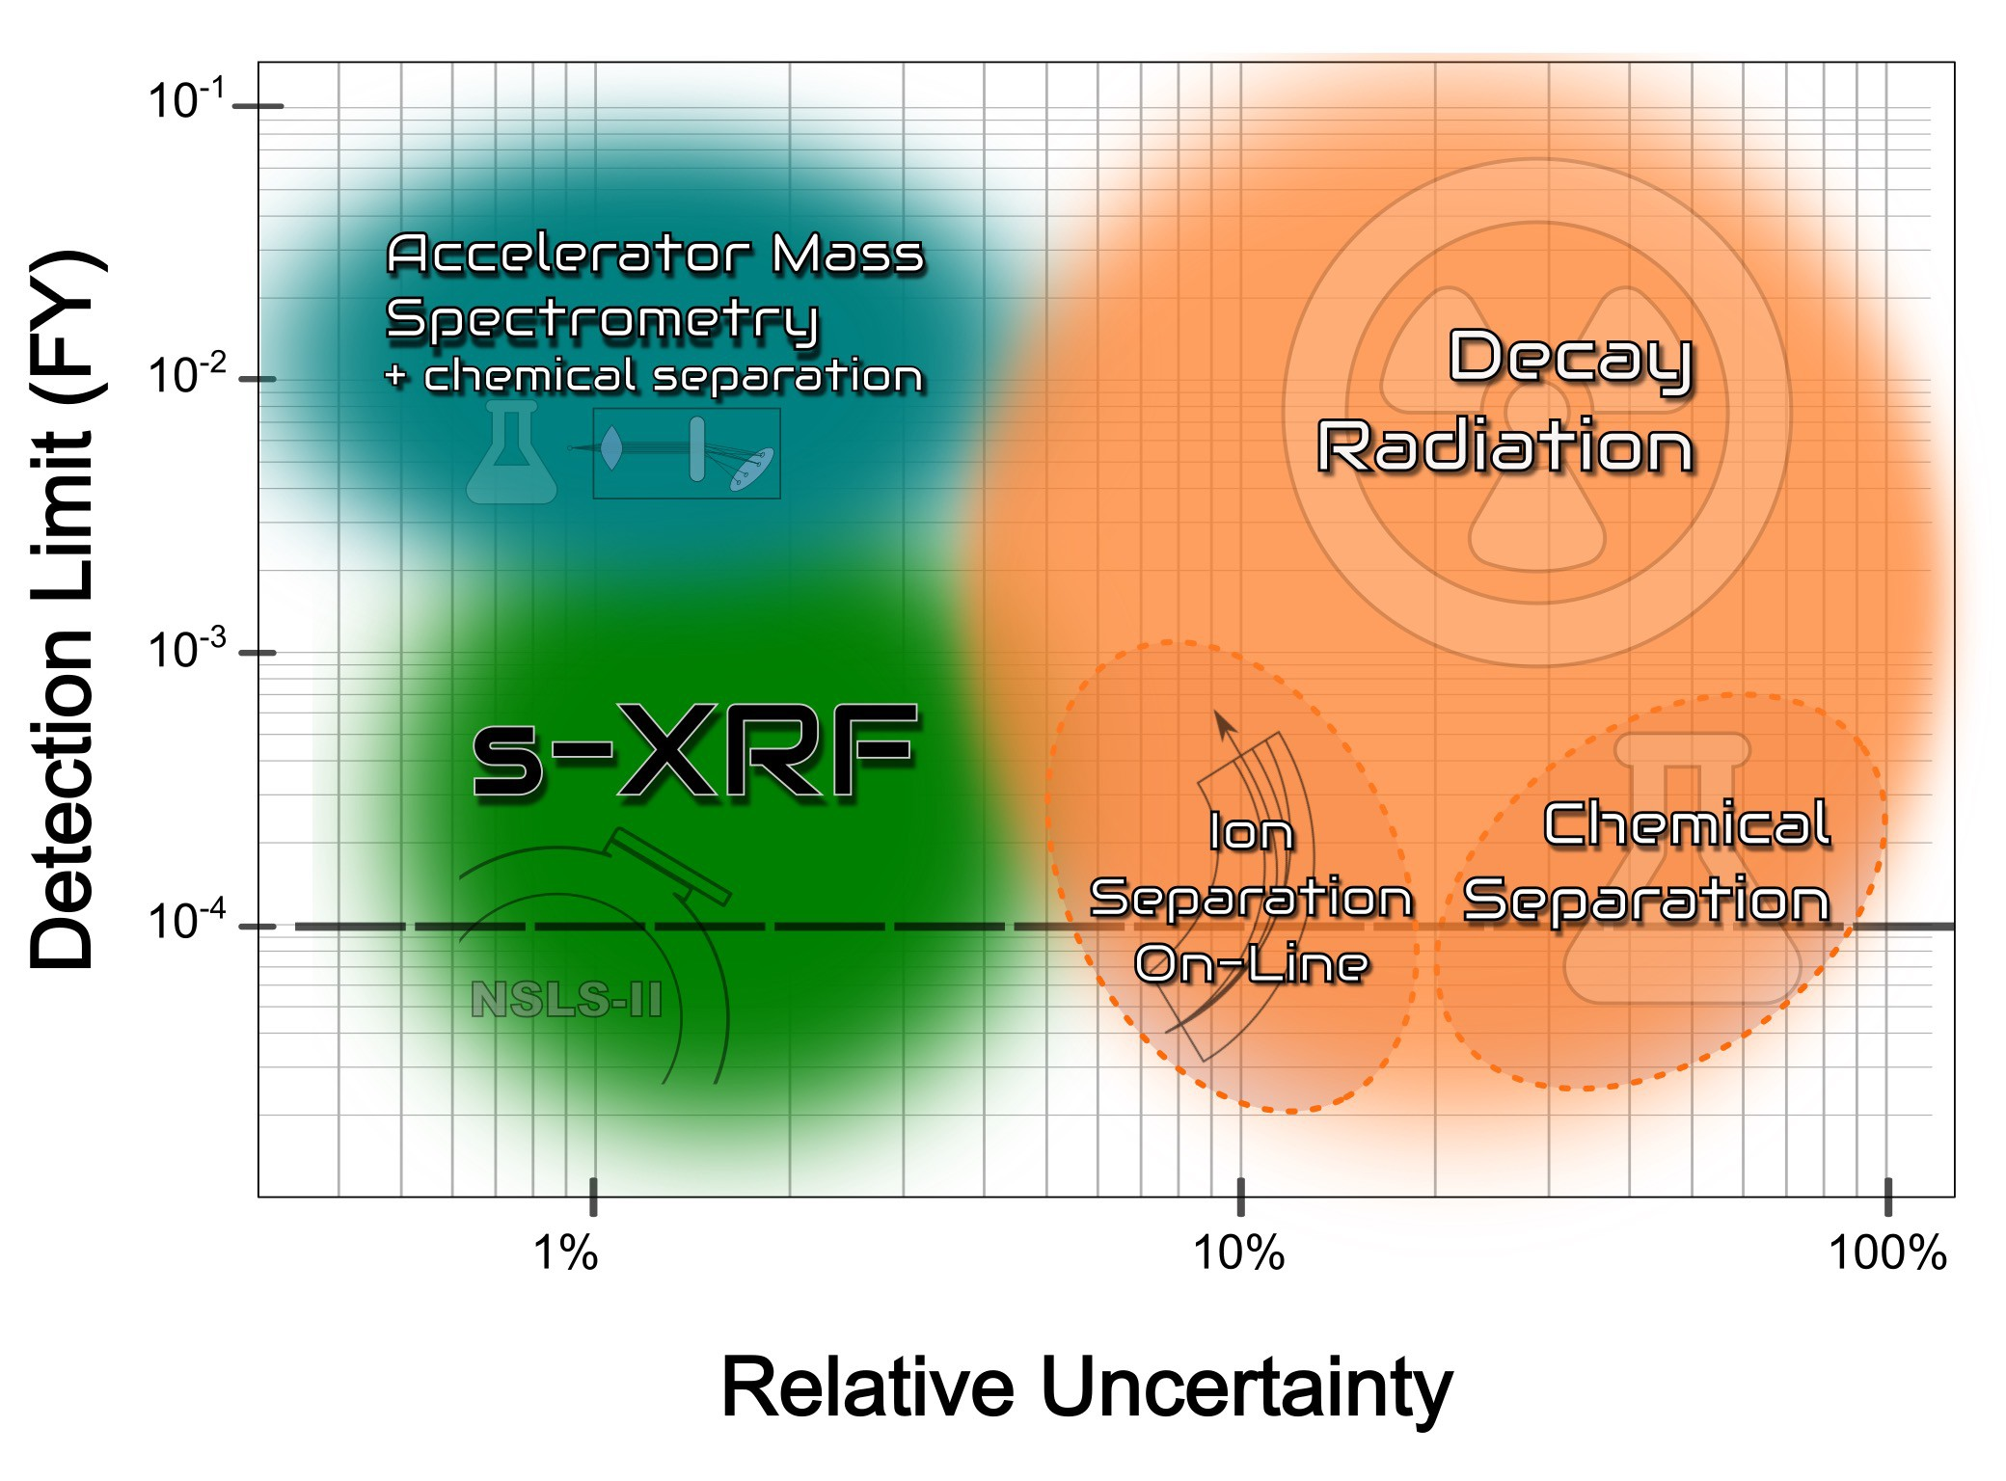




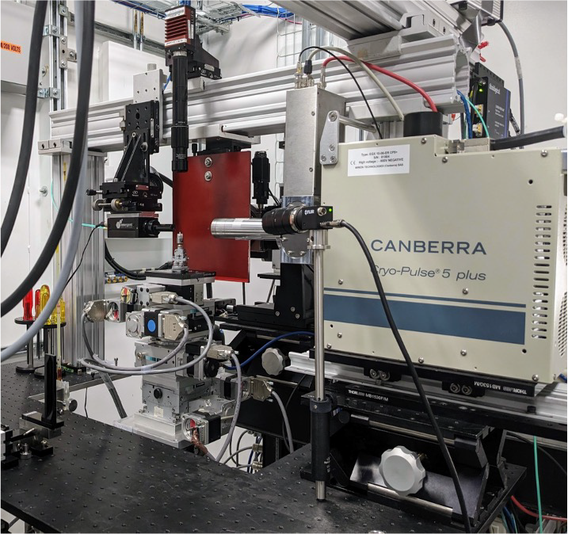

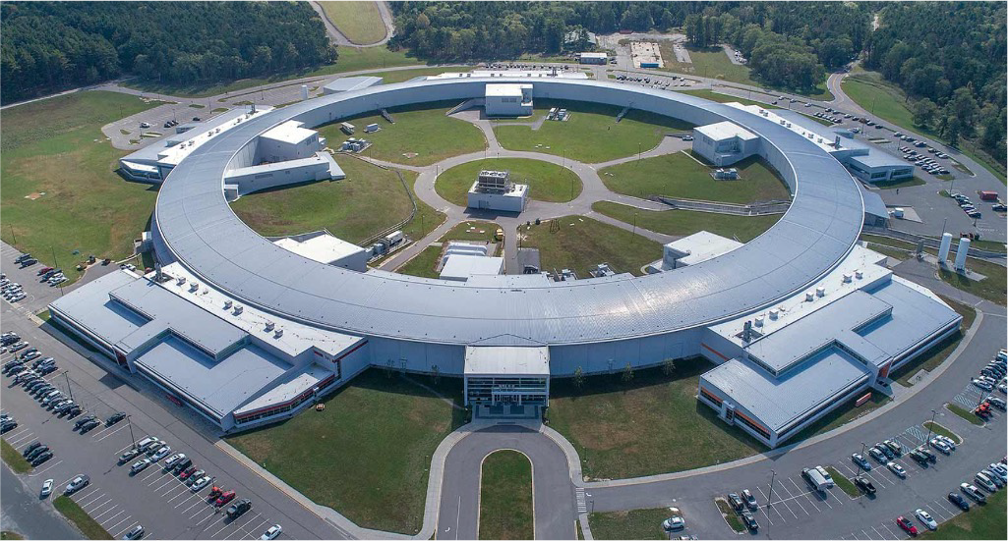
USNDP Fission Highlight
Precise fission yield measurements at NSLS-II using X-ray fluorescence, A. Mattera & M. Topsakal
Our recommended fission yields are based on Atomic Mass Spectrometry (AMS) measurements from the 1970s never published in a peer-reviewed journal.
Activation methods rely on nuclear data which introduce additional uncertainty to the yield determination.
Synchrotron-based x-ray fluorescence can achieve similar precision to AMS but much lower detection limit thanks to NSLS-II brightness.
Two-year LDRD project, taking advantage of the bright X-ray beams and advanced detectors at NSLS-II to precisely measure charge yields of long-lived fission products from neutron-induced fission of ^{235,238}U and ^{239,241}Pu using synchrotron-based X-ray Fluorescence (s-XRF).
Proof of concept:
Transmutation of Rh into Pd following neutron capture.
USNDP Budget Briefing – February 13th,
2024
National Synchrotron Light Source - II @ BNL

Slide 17
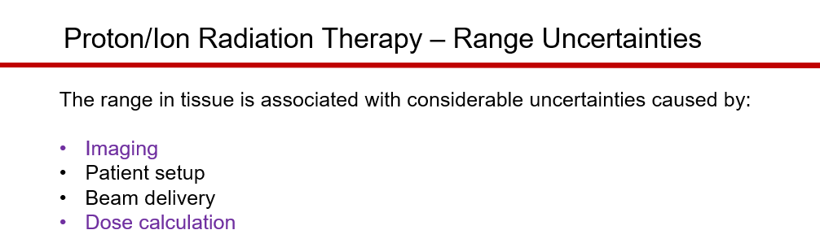
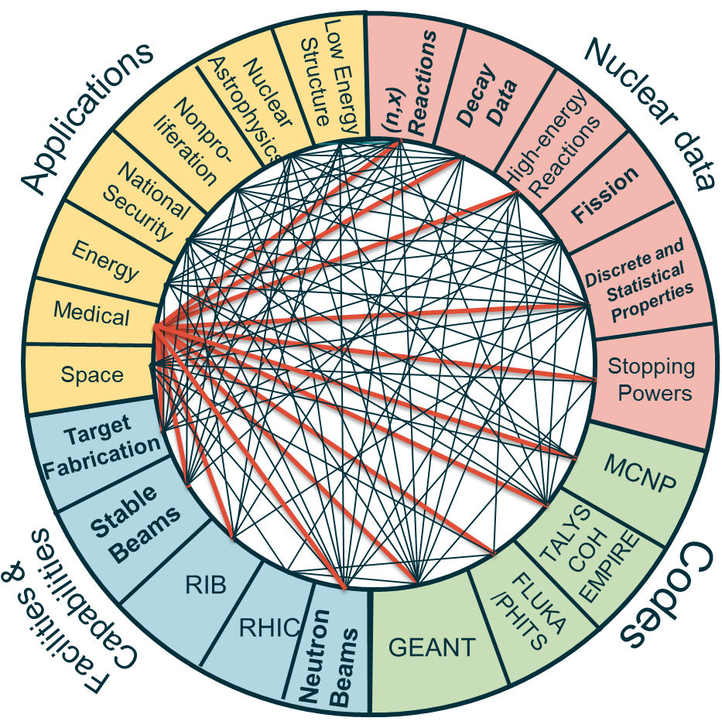
Opportunity 4: Medical Applications
Discussions with NIH showed a lack of certain nuclear data that helps with determining patient dose during cancer treatments
NIH presented at WANDA 2022 and NP is coordinating additional discussions to see where there may be overlap
NP/NIH hosted a workshop in March 2023 on applications of nuclear physics for medicine
Align with Administration Priority related to Cancer Moonshot
From WANDA 2022 highlighting the areas of uncertainty –

Slide 18
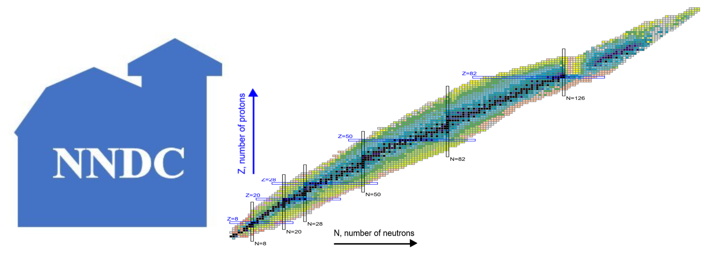

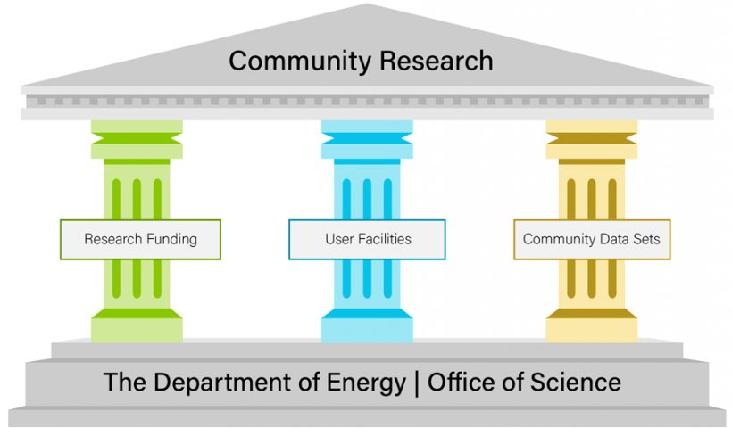
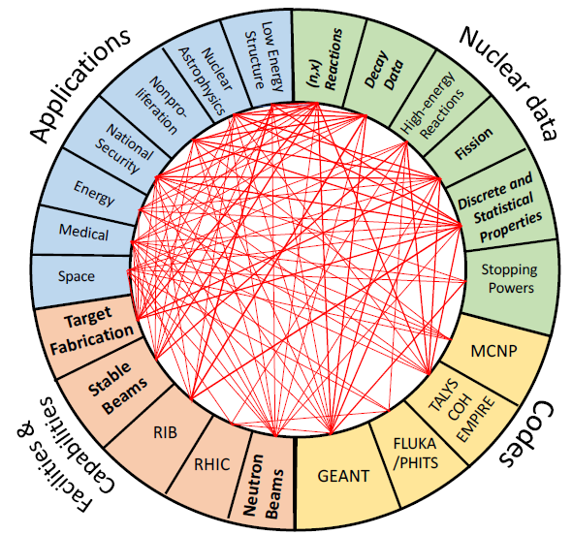
Opportunity 5: Infrastructure
Planned FOA to boost nuclear data workforce and help keep up with pace of incoming data. A special focus on evaluators and embedded ND staff is planned.
Incorporation of AI/ML methods into the nuclear data production pipeline to reduce timeline from beginning to end
Modernize databases to accommodate modern data sets to enable data preservation and sharing as well as improved/facilitated access
Aligns with Administration priorities related to AI/ML and DEIA
https://science.osti.gov/Initiatives/PuRe-Data/Resources-at-a-Glance
Sponsored by the office Nuclear Physics (NP)
https://www.nndc.bnl.gov/

Slide 19
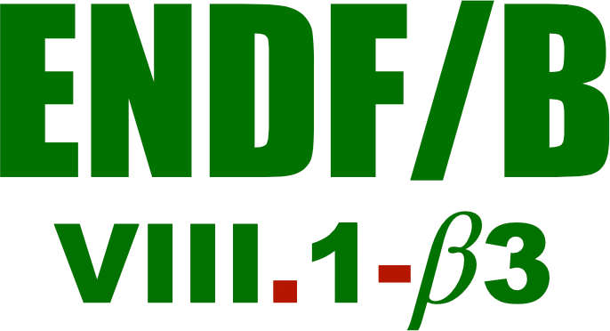

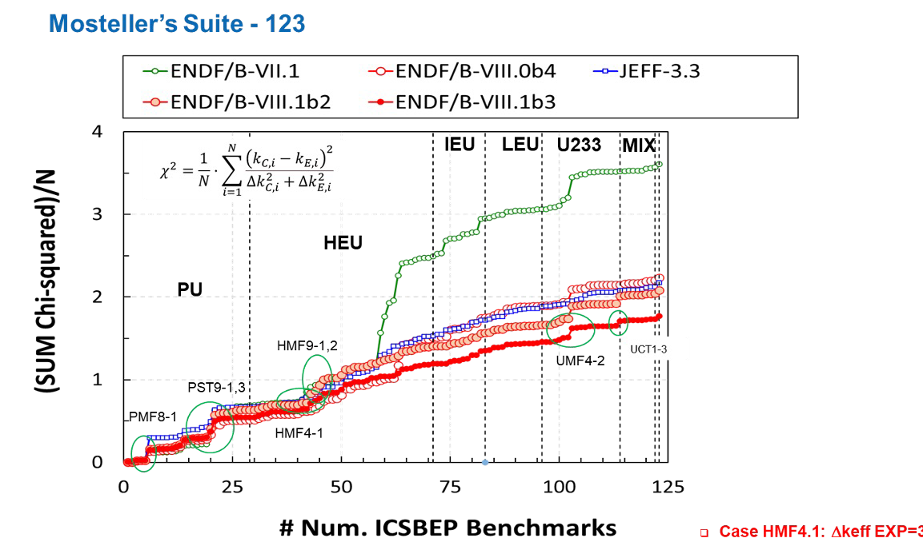
ENDF/B-VIII.1 release
USNDP Highlight
Recommended cross sections and distributions for all nuclear applications
Multiple Beta versions released in FY23!
The next release is scheduled for May 2024!
It will have major impact in the whole community!.
Many, many important and substantial changes are on the way!!
Updates to all major and some minor actinides
Updates and new evaluations for structural materials, and many others
Corrects degraded performance on depletion benchmarks from VIII.0
Many new and updated evaluations for thermal neutron scattering
Updates to photonuclear, charged particle, atomic libraries, etc.
Preliminary validation indicates that this will be the best-performing library ever!
USNDP Budget Briefing – February 13th, 2024
66

Slide 20


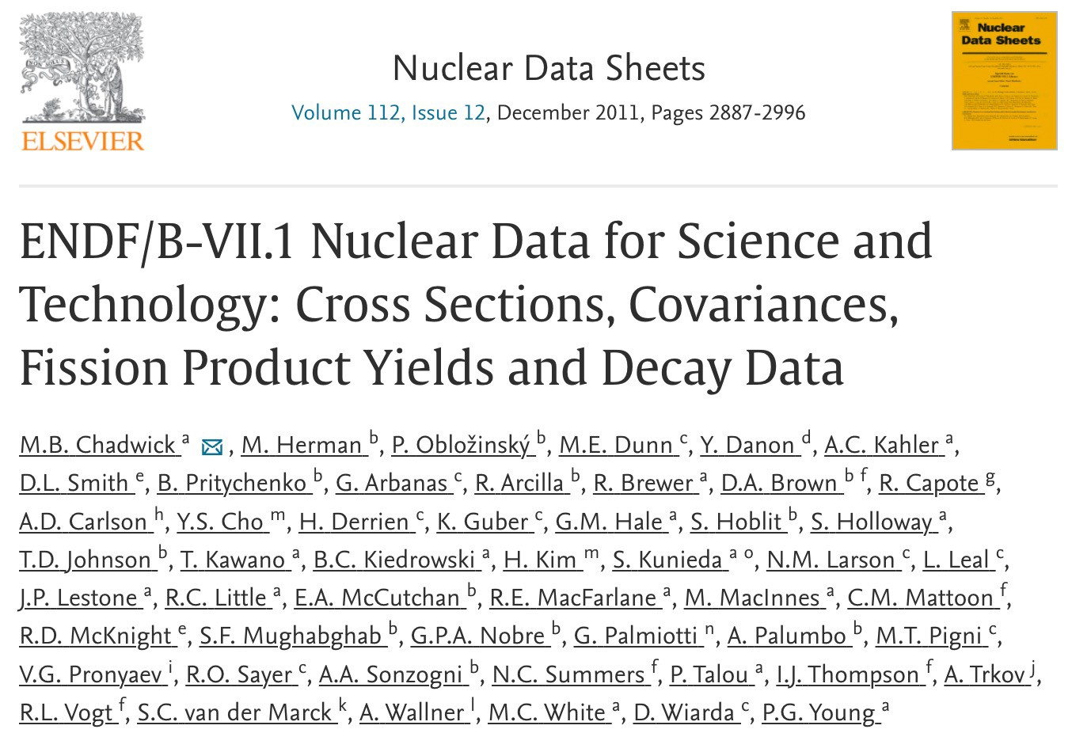
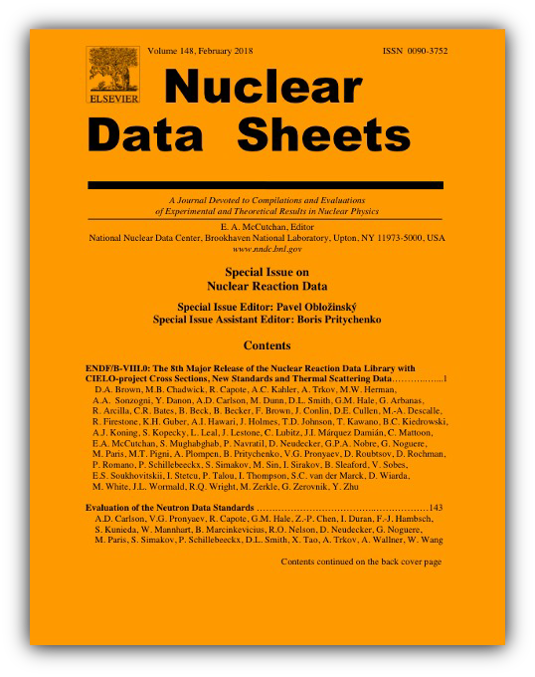

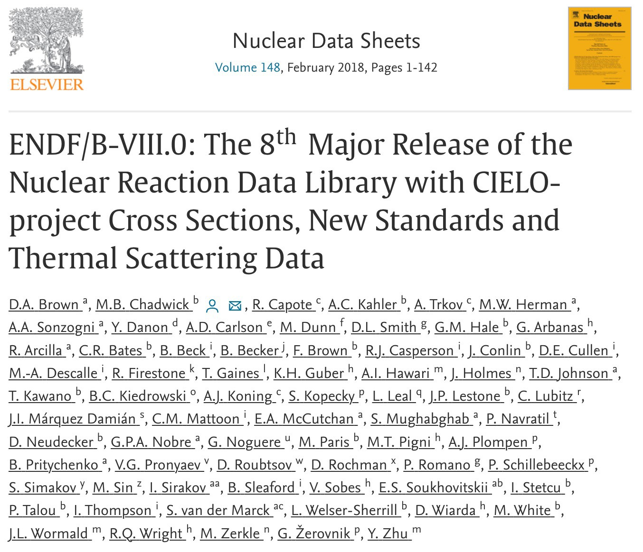
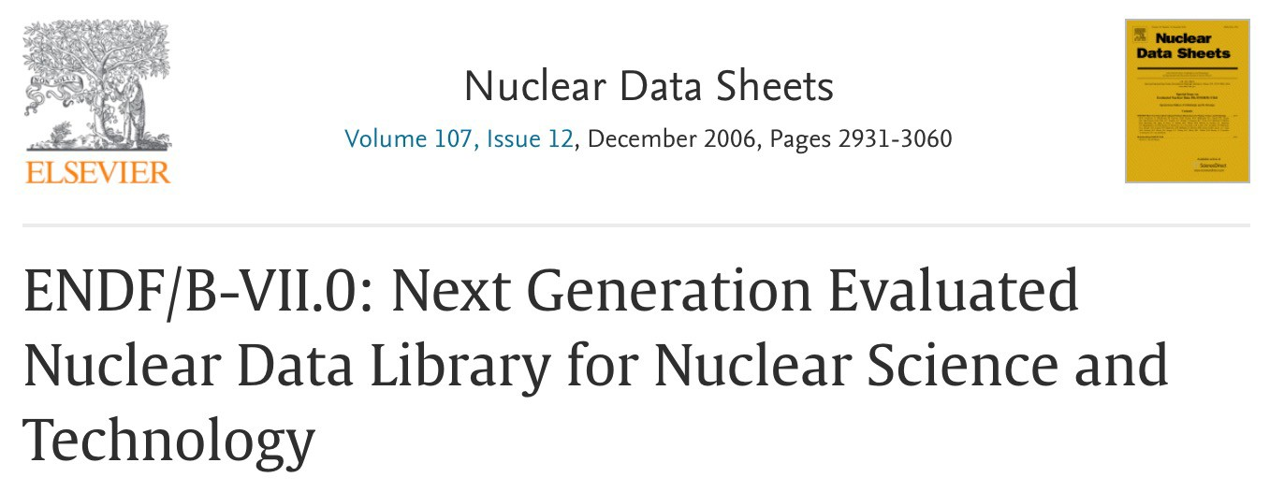
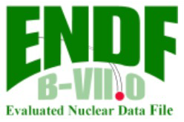
ENDF/B-VIII.1 accompanying paper
USNDP Highlight
"Big Paper" to be published together with library release
Past ENDF/B releases published accompanying article in Nuclear Data Sheets
Cited 3,138 times!
Cited 1,658 times!
Cited 2,753 times!
This is really, really impactful!!
USNDP Budget Briefing – February 13th, 2024
67

Slide 21
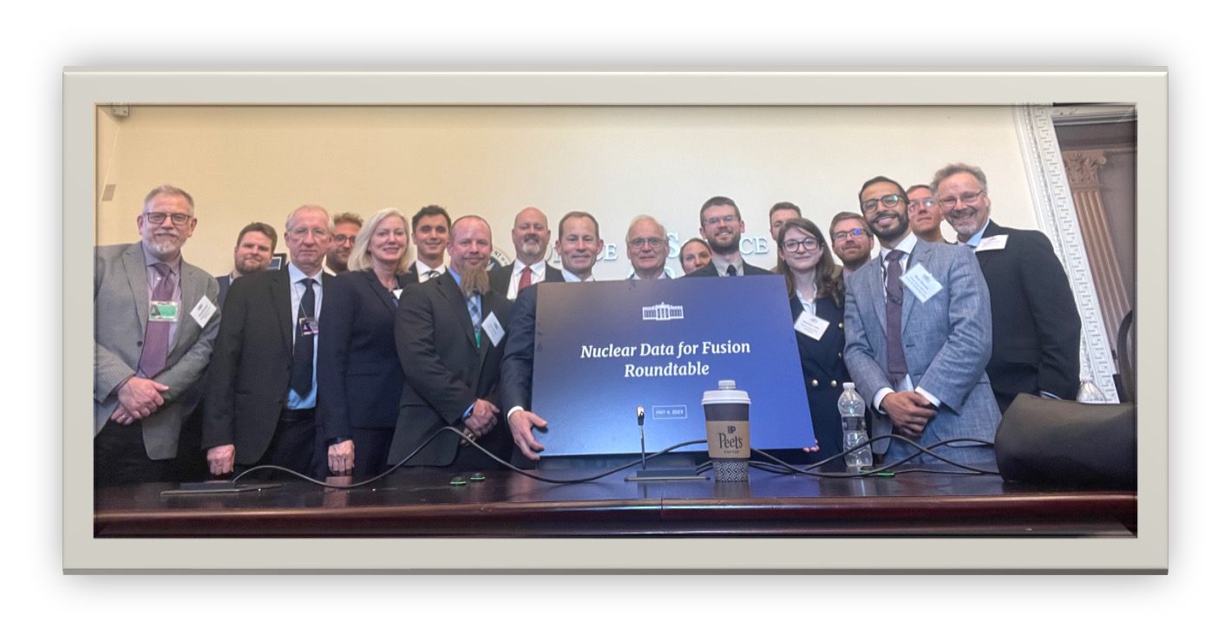





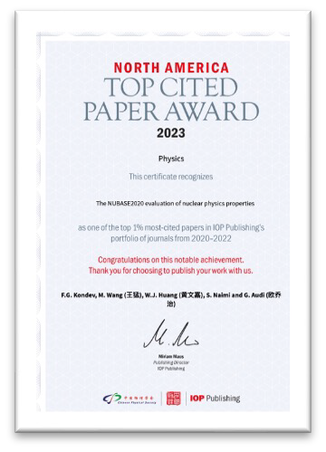
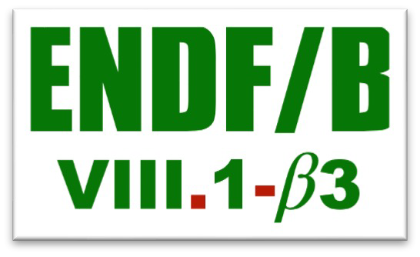
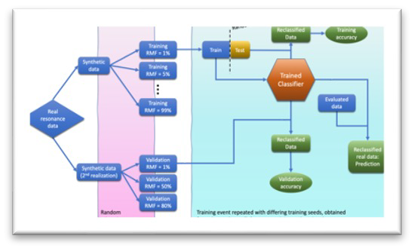




Final words from USNDP Chair
Great work was done in FY23!
The USNDP has a well-developed growth plan
that implements
recommendations from NSAC reports and is consistent with the Nuclear Physics Long Range Plan
USNDP Budget Briefing – February 13th, 2024
74

Slide 22
Outlook
Nuclear data plays a critical role in all areas of nuclear science, nuclear engineering, and applications of nuclear technology
Specific targets for increased investment and enhanced stewardship include:
    Workforce development
    On-going fission evaluations
    Accelerated decay data evaluations
    Improved reaction modeling with better links to nuclear structure
    Neutron induced data from low- to mid-energies
    High energy reactions and material stopping power
The role of nuclear data is often hidden by layers of abstraction (i.e., modeling/sim tools) so users can have difficulty knowing the quality going into their models
  This needs to be worked through increased outreach, and
  Infrastructure modernization to facilitate improved access and information for users
Nuclear Data is inherently cross cutting and NP is strongly promoting inter-agency cooperation, the SC Nuclear Data Program helps anchors this activity

Slide 23
OFFICE OF SCIENCE
Thank you!

