Slide 1
Challenges with Improving the Nuclear Data Pipeline for Nuclear Fusion
Office of Advanced Simulation and Computing and Institutional Research and Development

Slide 2
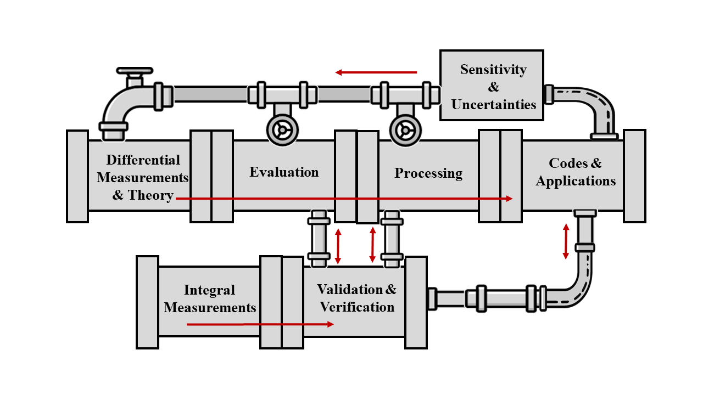
Nuclear Data Pipeline (NA-114 perspective)
NA-114 has demonstrated strong support for efforts across the nuclear data pipeline: critical activities supporting the nuclear deterrent mission
Collaboration is key for maintaining and strengthening our capabilities
Anticipate shared goals with new efforts in the commercial fusion industry
Both LLNL and LANL maintain a complete and integrated nuclear data pipeline to achieve Defense Program goals – NA-114 directly funds multiple technical activities
Notes:
Between PEM, V&V and IC NA-114 really is a critical supporter of the overall nuclear data effort

Slide 3
Software quality is increasingly important
Software capabilities continue to grow: need for improved software engineering and quality
  Extends software lifetime
  Key component of modern V&V
  Helps with correctness on new HPC architectures
Entire software stack needs to support for “design iteration” timescales:
  Required to meet NA-10 goals
  Utilize advanced architectures
  Develop robust workflows
Increased sharing provides critical leveraging and peer review
GPU-enabled ab initio evaluation of n+⁶Li; Kravvaris et al.

Slide 4
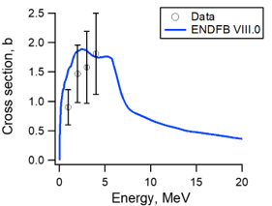
Evaluations remain a key activity
Evaluation of reactions: Use nuclear theory reaction codes, constrained by measured differential data and validated against integral data, to determine accurate mean values and uncertainties
Identify priorities based on sensitivity and uncertainty studies, specific requests, and available capabilities (both experiment and theory)
Strong need to revisit evaluation/processing/code/benchmark workflow to become more agile and robust
Should we be tuning evaluations to specific benchmarks?
Evaluation community is unique to the Nuclear Science community, representing a significant advantage
²³⁹Pu(n,n’)
Neutron inelastic scatter measurements (points with error bars) and evaluated cross section from ENDF/B_VIII.0
Notes:
The plot on the right is for Pu-239 inelastic scatter and demonstrates an area where theory is filling in large gaps.
Uncertainty studies is bold here because that is an area that nuclear data leads over other scientific communities – and we see prioritization moving away from expert judgement and toward quantifiable needs. For example xx reaction at yy energy with zz% accuracy.

Slide 5
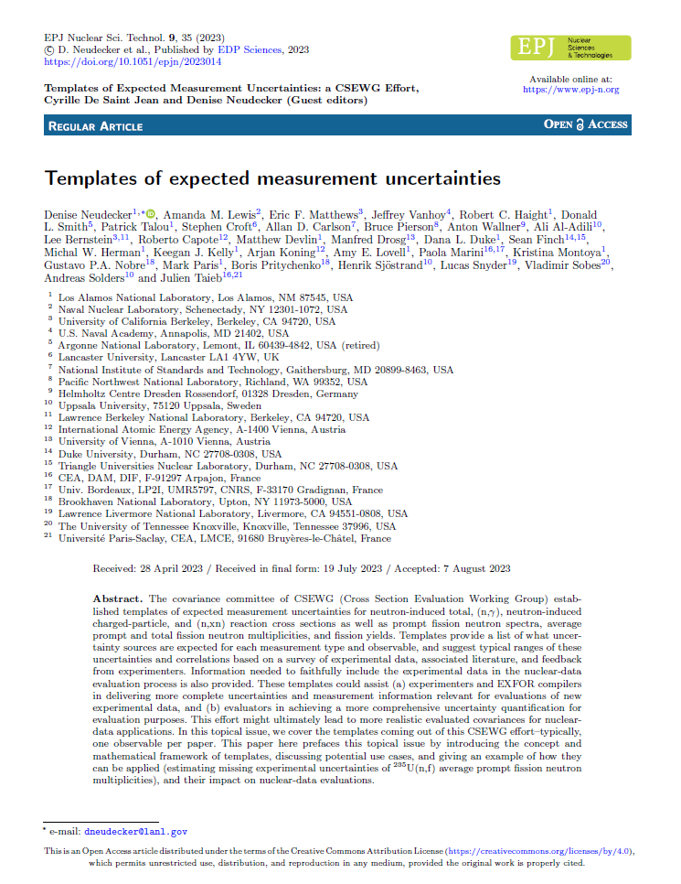
Data science efforts continue to grow
Nuclear data community continues to expand and improve uncertainty efforts
Activities across the pipeline support uncertainty analysis and reduction -- templates for differential measurements an excellent example
Community has developed unique infrastructure to enable machine learning investigations
Common formats (e.g. GNDS, ENDF) a significant success, representing another unique effort for the Nuclear Science community
How can we expand these benefits to other scientific communities?
(n,tot); (n,xn); (n,γ) and (n,z); PFNS and nu-bar:
EPJ Nuclear Sciences and Technologies 2023
(D. Neudecker et al.)
Notes:
The paper on the right is the overview paper by Denise Neudecker. In the journal there are specific papers for different reactions and reaction products.
How can we expand these benefits to the fusion community?

Slide 6
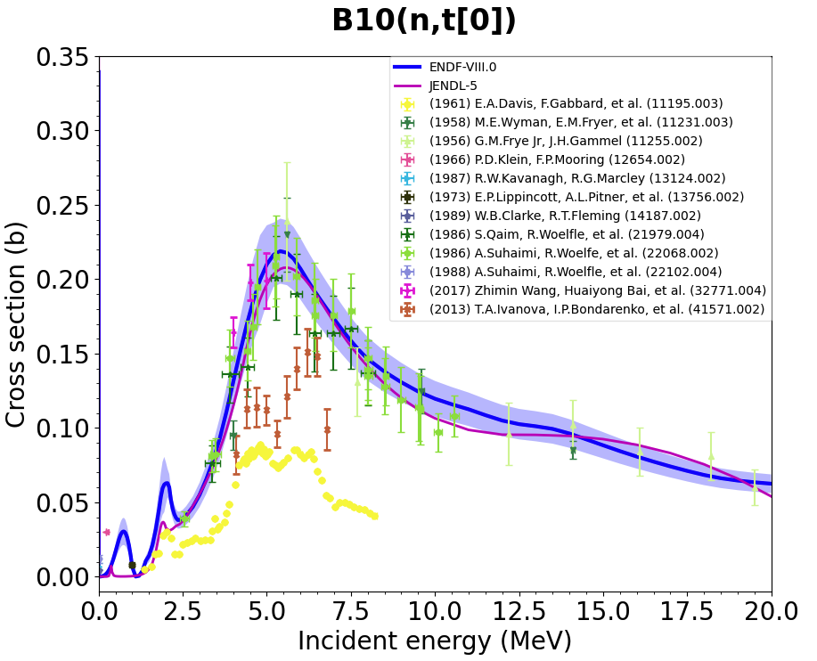
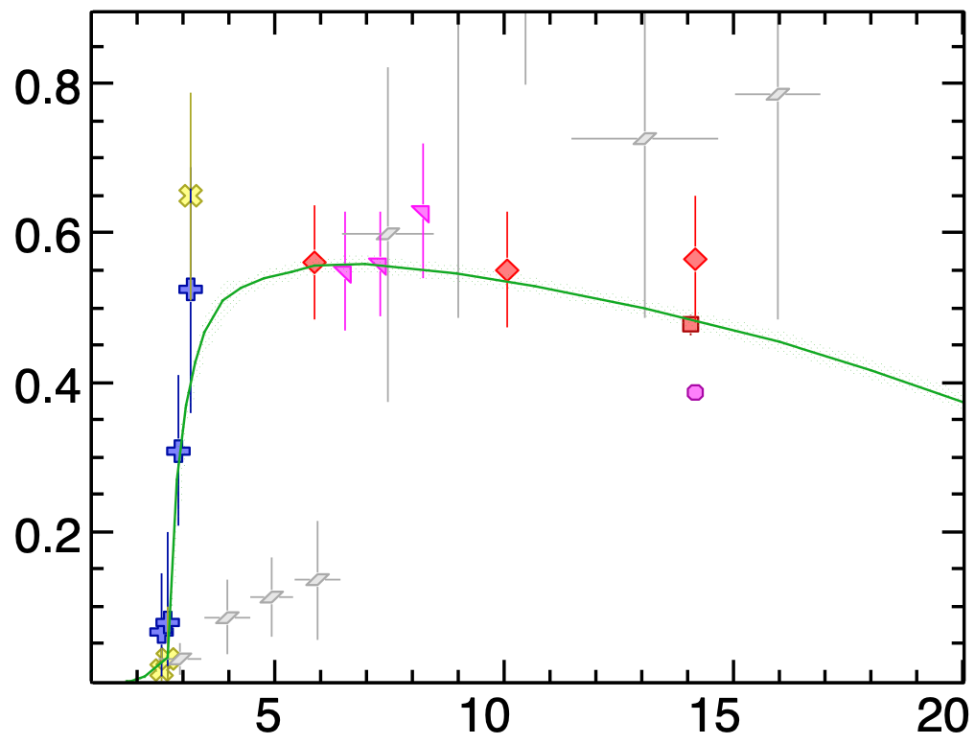
Fusion activities provide an opportunity for collaboration
Partnerships are mutually beneficial
Common data challenges for light ion reactions – needs include:
  Improved evaluations
  Theory advancements
  Additional data measurements
Understand decays and/or reactions on products, which may be unstable
  T (T_{1/2} = 12 y)
  ⁸Be → α + α
  ⁸Li (T_{1/2} = 840 ms) → ⁸Be → α + α
Uncertainty quantification will require accurate covariances
Evaluation, covariance above 4 MeV
⁶Li(n,T)
⁷Li(n,n+T)
Improved
covariance
¹⁰B(n,T)
⁹Be(n,2n)
Also (related) multi-product reactions like 9Be(n,2n) and
Measurements,
Evaluation
Cross Section (b)
Cross Section (b)
Evaluation
Example data needs
Neutron Energy (MeV)
Neutron Energy (MeV)
(S. Quaglioni, C. Mattoon)

Slide 7
NA-11 faces special challenges
Much of the capability developed in these programs are subject to controls, particularly Export Controls
IFE startup companies are requesting access to NA-11 developed technology at an unprecedent rate
NNSA mission challenges have focused effort on other applications outside of our traditional research scope, causing our staff to be stretched thin
Right now, the future of many of these issues is unknown, but likely to be resolved in the next 1-2 years

