Slide 1
Nuclear Data Toward Predictive Capabilities
Office of Experimental Science

Slide 2
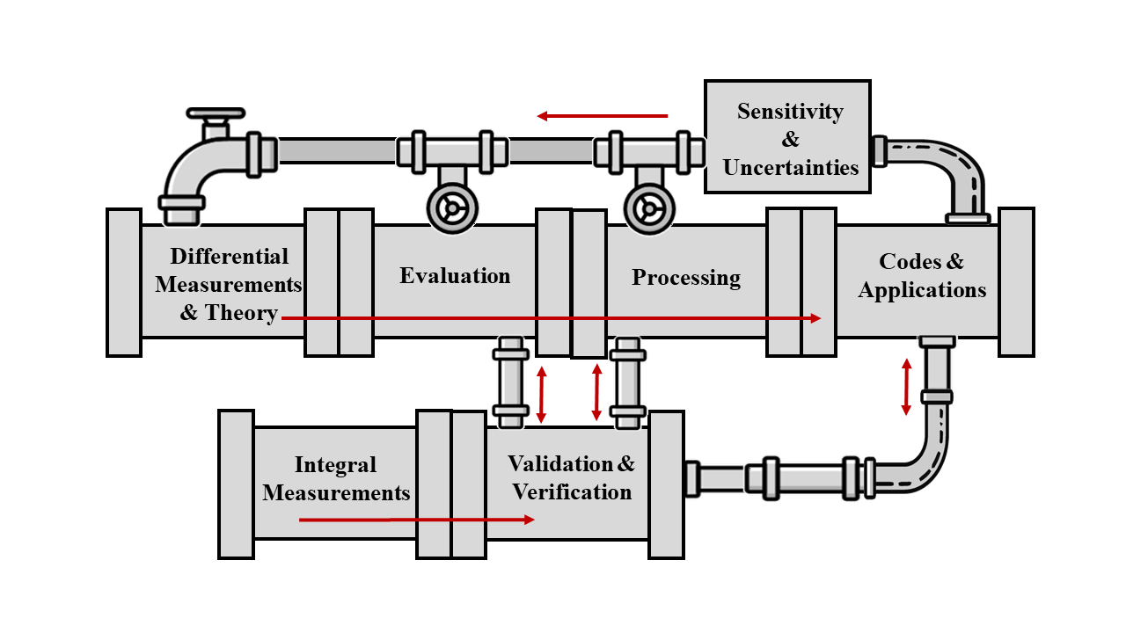
Nuclear Data Pipeline (NA-113 perspective)
NA-113 oversees critical activities in the nuclear data pipeline supporting the deterrent mission
Collaboration is key for maintaining and strengthening our capabilities
Uncertainty Quantification is key toward identifying priorities
Anticipate shared goals with new efforts in the commercial fusion industry
Both LLNL and LANL maintain a complete and integrated nuclear data pipeline to achieve Defense Program goals – NA-113 directly supports foundational and applied activities

Slide 3
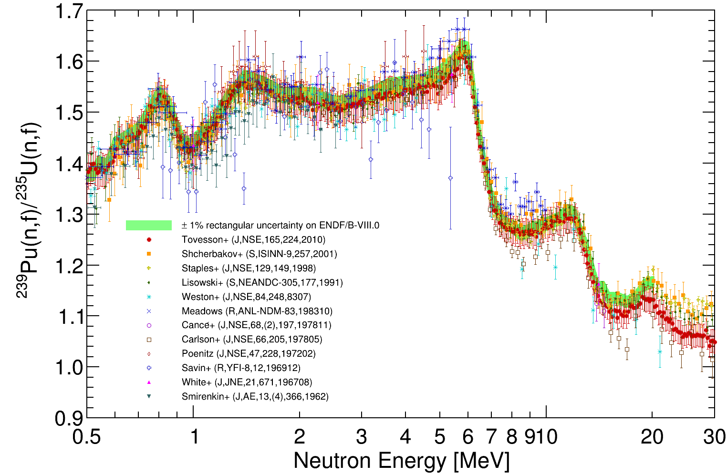
High-precision fission measurements incorporated into ENDF/B data library
Fission Time Projection Chamber (fissionTPC) was developed for precision cross-section measurements
  New data for ²³⁵U, ²³⁸U, and ²³⁹Pu neutron-induced fission with unprecedented uncertainty analysis
  NIFFTE collaboration includes LLNL, LANL, Oregon State U., Colorado Sch. Mines, Abilene Christian U., Cal Poly
Chi-Nu was developed to reduce uncertainties of prompt neutron emission spectrum following fission
  New data for ²³⁵U, ²³⁸U, and ²³⁹Pu fission neutrons
  Collaboration includes LANL, LLNL
FissionTPC
Chi-Nu
ENDF/B-VIII.1 in 2024
These efforts were long-term investments that provided excellent data and were achieved through a collaboration between LLNL, LANL, and multiple universities

Slide 4
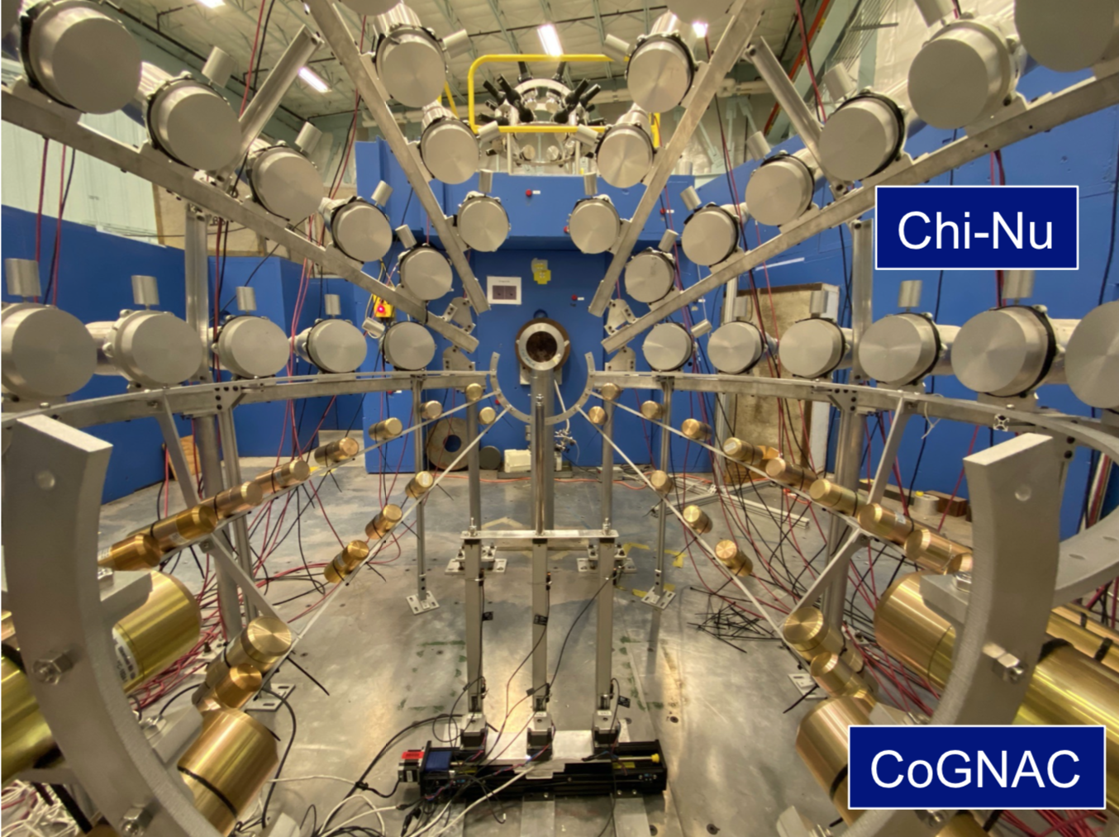
Neutron scatter measurements have been identified as a priority
Scattering is a difficult neutron reaction channel to measure and poorly constrained
  Limited reaction observables: neutrons, γ rays
  Neutrons are very hard (but necessary) to measure, generally rely on time-of-flight for energy measurement (>>10 ns flightpath)
Actinides present more obstacles:
  Significant neutron background from fission
  Low γ−ray energies/intensities in actinides make neutrons the only reliable probe
  Actinide material difficult to work with
Active efforts underway to collect these important data
Monoenergetic neutron source: LLNL with TUNL
Broad-energy neutron source: LANL at LANSCE with CoGNAC

Slide 5
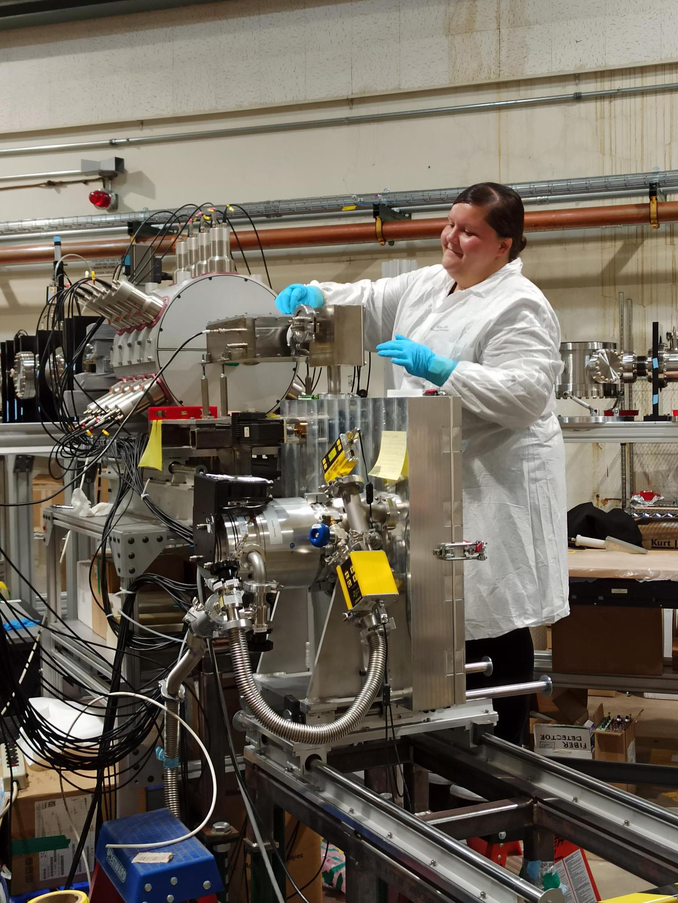
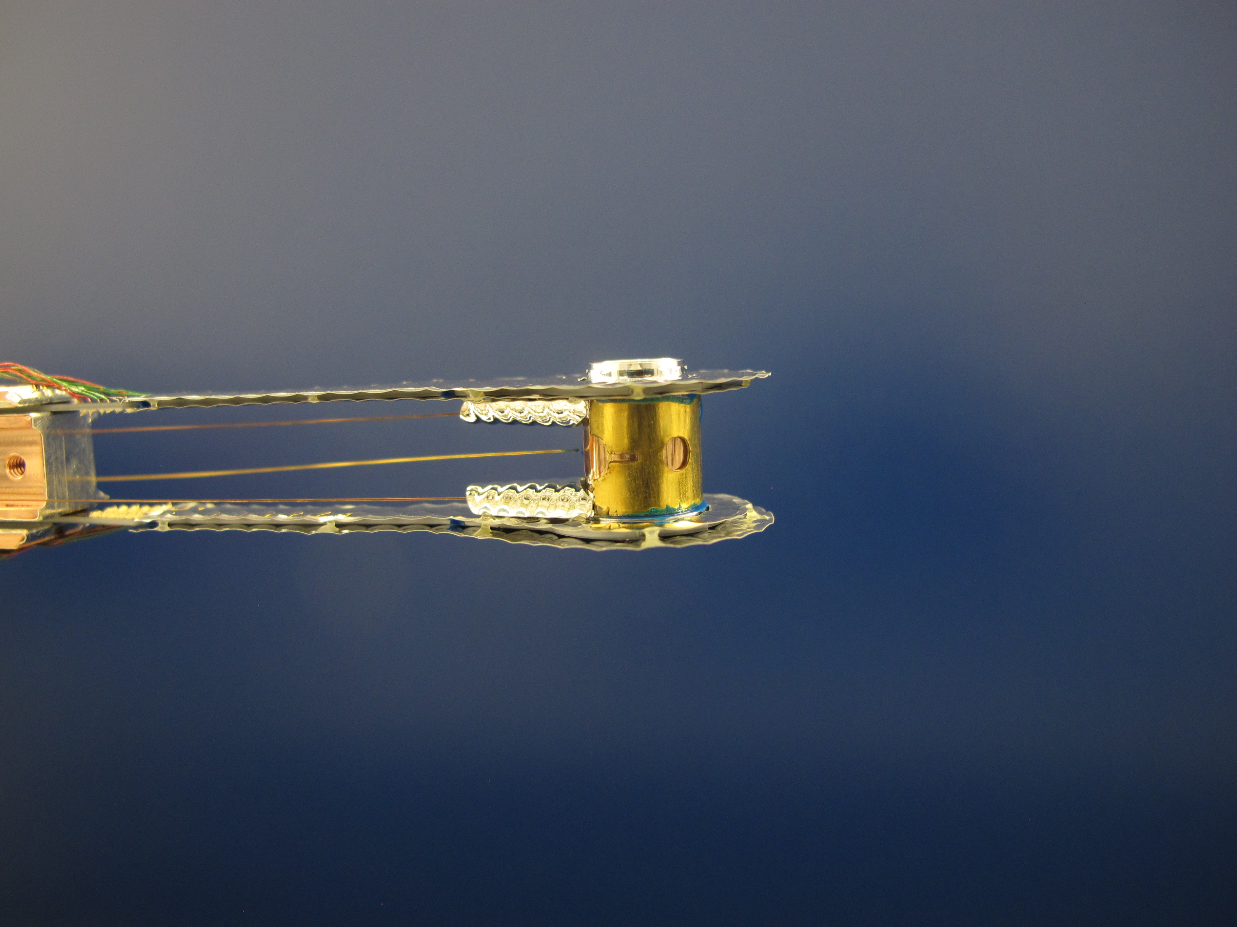
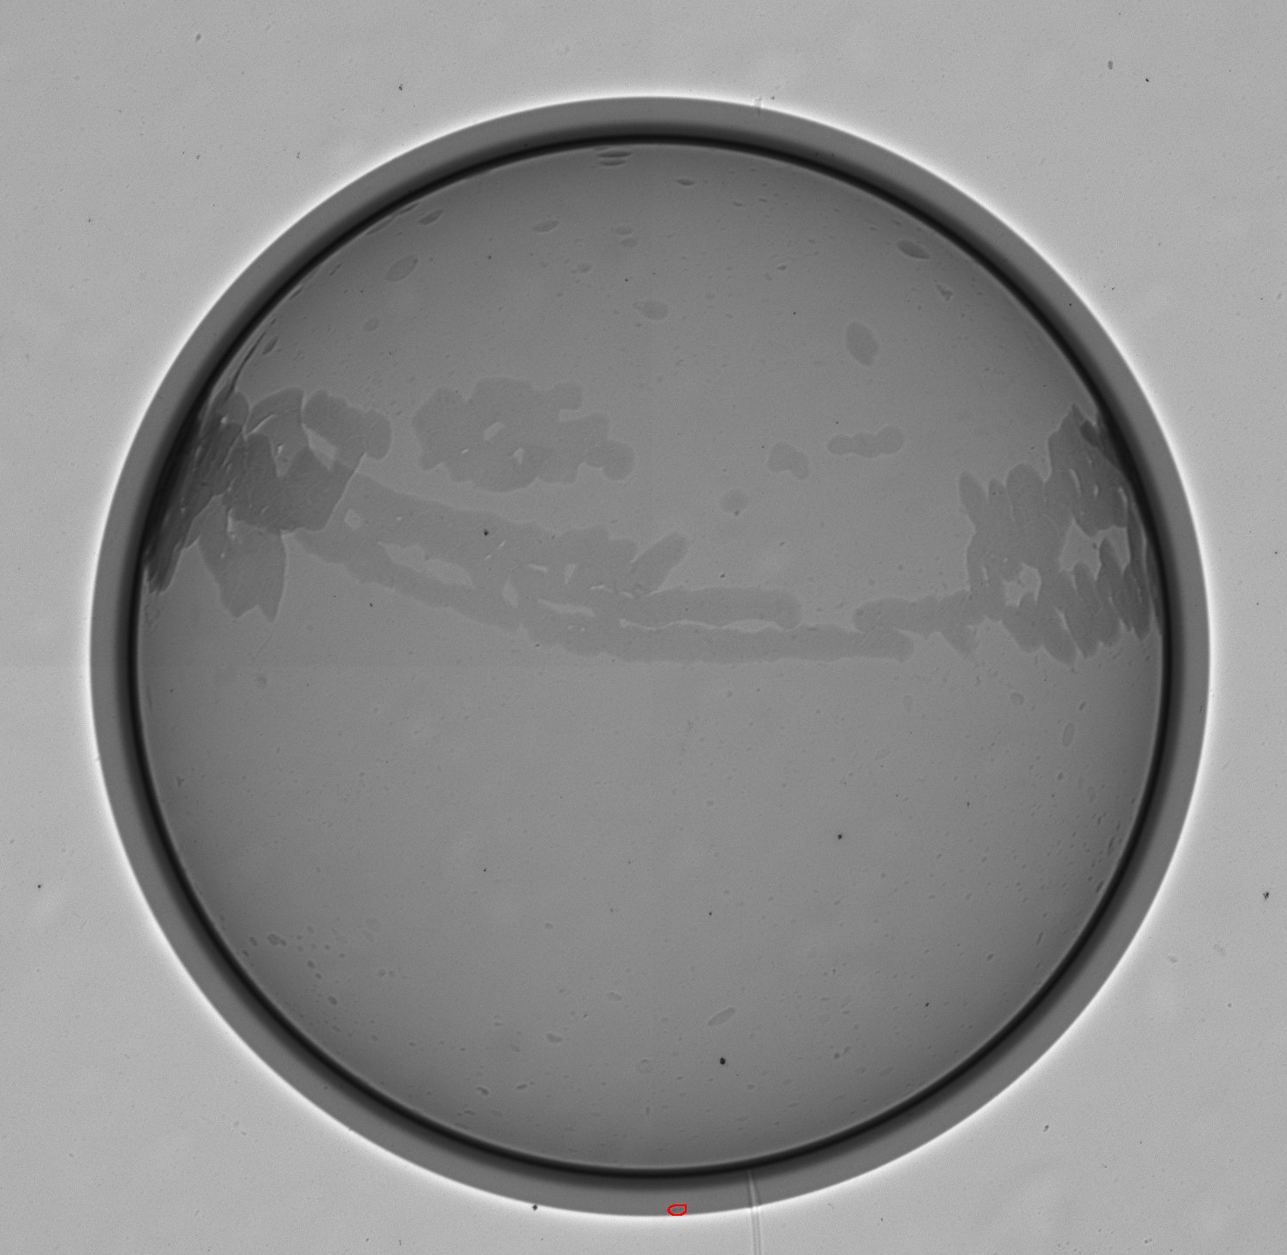
Improved reaction cross sections with unstable isotopes require new measurements and theory
Reactions on fission products
Radiochemical diagnostics
Challenging measurements
  Indirect techniques with LLNL at ANL, MSU, and TAMU
  Direct techniques at NIF and LANSCE
Prof. Andrea Richard with the SuN detector at ANL, indirect neutron capture measurements on A=95 fission products
88
(n,2n)
89
(n,2n)
90
83.4 d
78.4 hr
51%
(n,γ)
(n,γ)
Example: simplified Zr reaction network, where many reactions are on unstable nuclei (few to no measurements)
Successful demonstration of direct reaction measurements at the NIF with capsules doped with radioisotopes

Slide 6
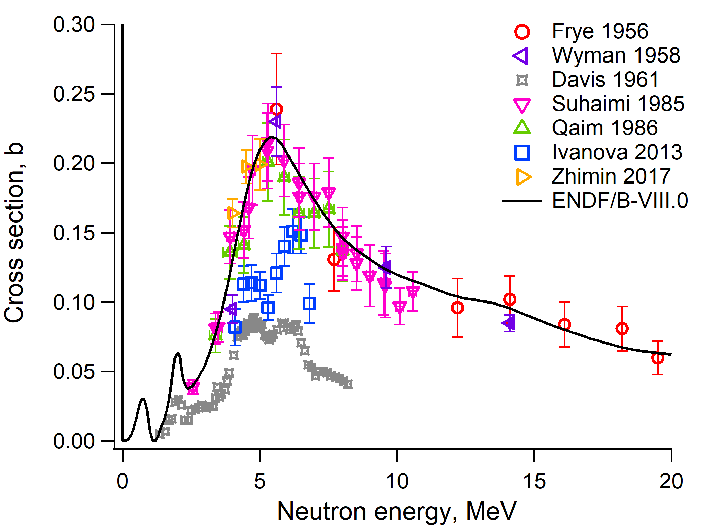
Fusion activities provide an opportunity for collaboration: light ion reactions
Overlap with fusion energy industry interests: light ion reactions (cross sections and reaction products)
Leverage current activities toward:
  Designing experiments and data collection platforms at facilities
    National Ignition Facility (NIF) at LLNL
    Z at SNL
    Omega in Rochester, NY
  Understanding observables from experiments
Light ions break up and are a challenge to measure and calculate
  D (²H), ⁶Li, ⁷Li, and ⁷Be all break up easily
  ⁸Be, ⁸Li have short lifetimes
Reactions creating more than two charged products are difficult to experimentally measure and theoretically describe
¹⁰B + n → ⁸Be + T → α + α T

Slide 7
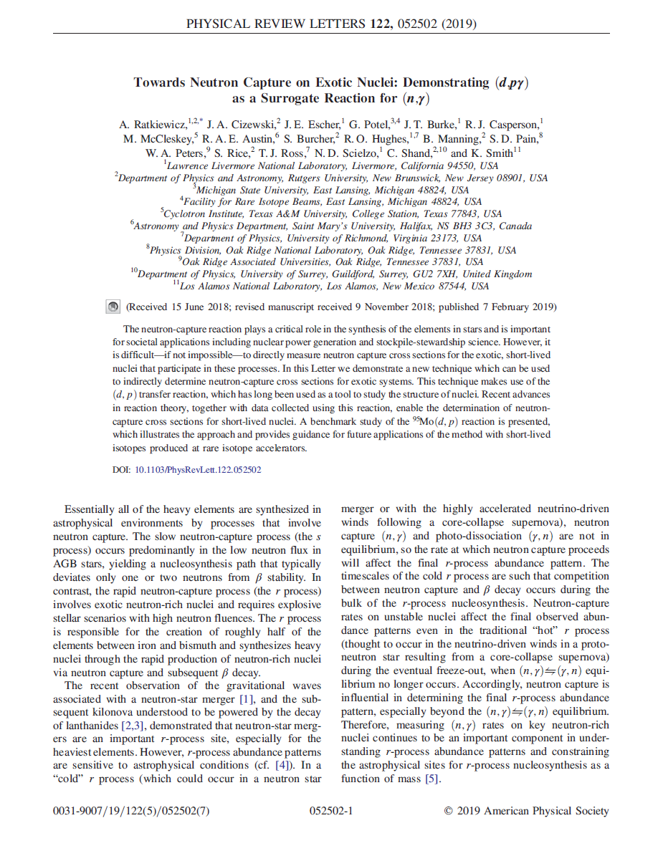
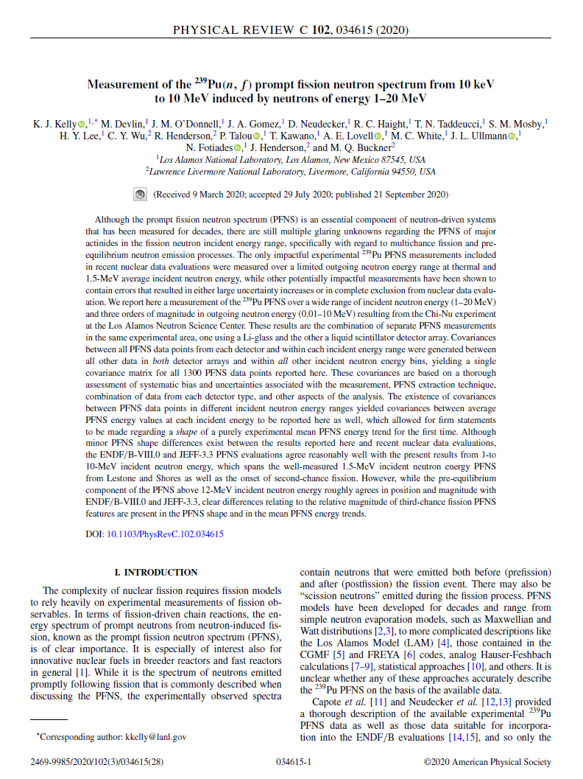
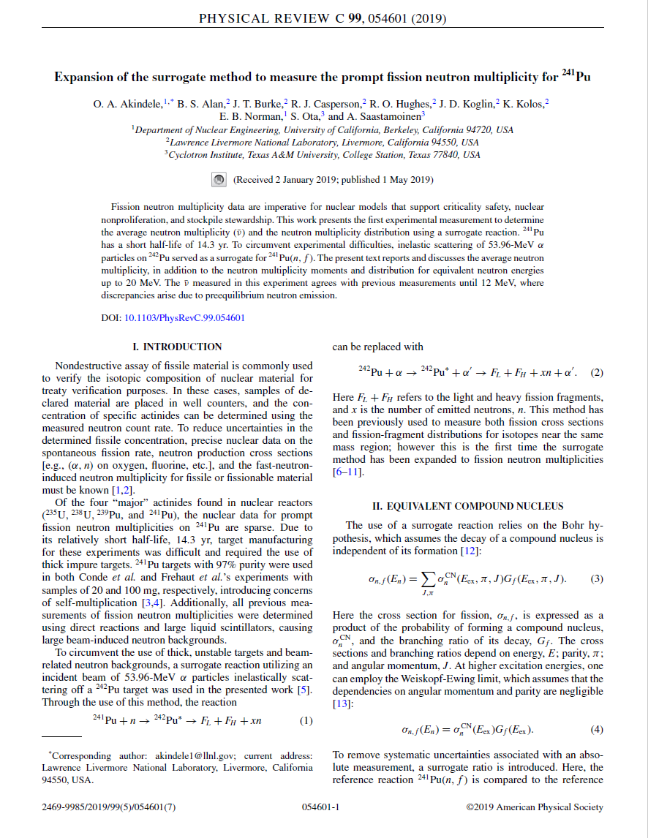
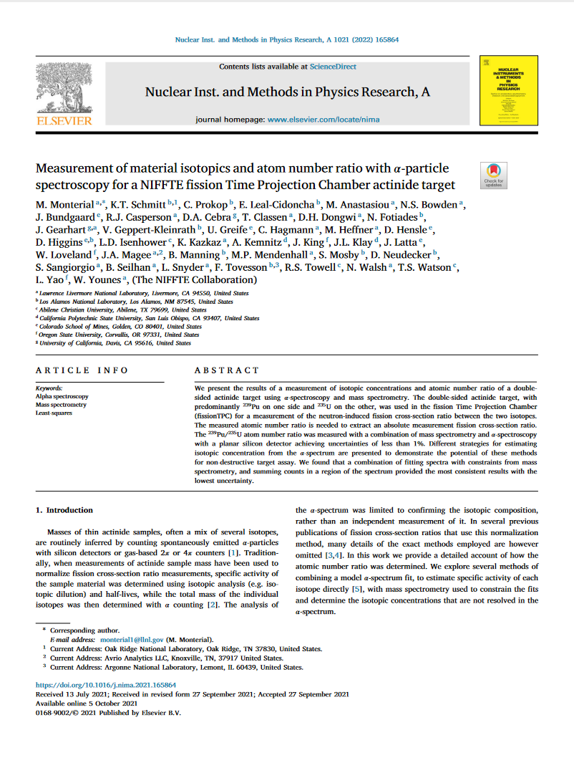

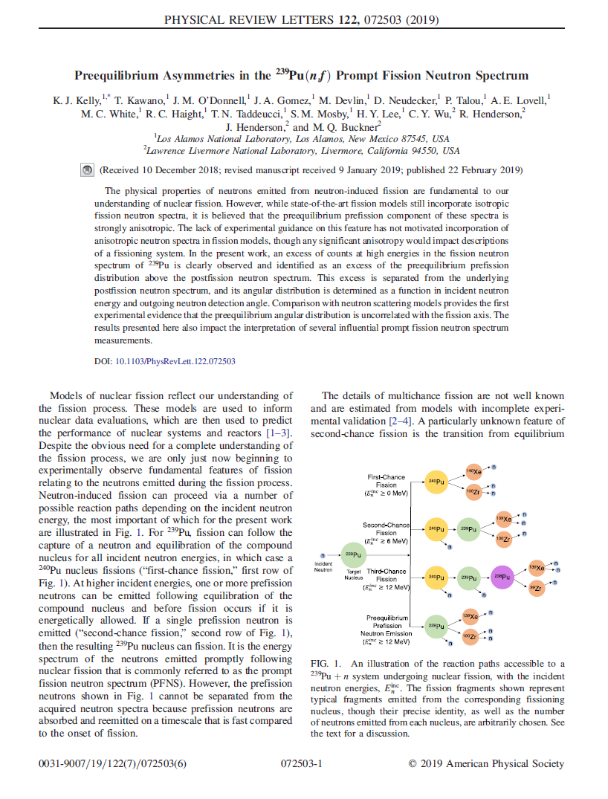
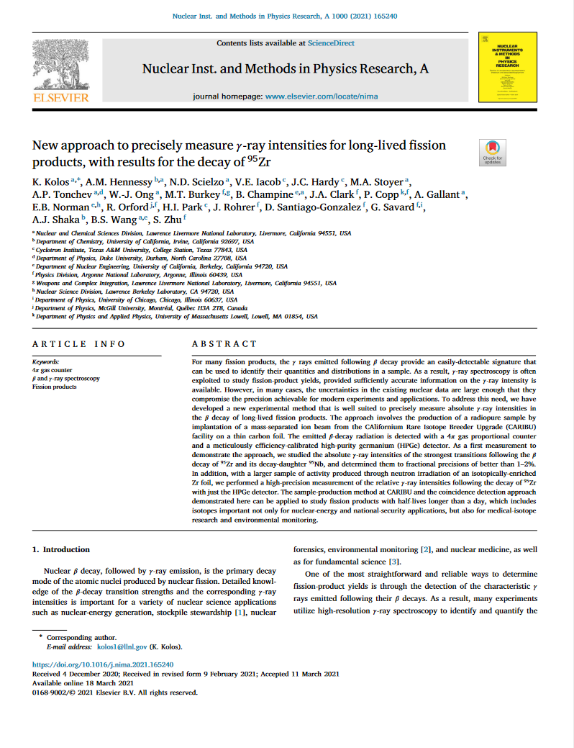
OES supports multiple experimental efforts driven by applications needs
Data needs identified through sensitivity studies and connections across NNSA offices
Challenging measurements taken on by diverse teams
  Data are shared with the broader community – improves foundational science understanding
  Expanding capabilities for challenging reaction measurements
Collaborative effort toward new measurements may be mutually beneficial for NNSA and fusion energy industries
Applications
Delivery
Needs
Nuclear Data
Library
Foundational Data
Experiment/Theory
Evaluation
Reaction Theory

