Slide 1
Fusion Material Damage
FES Perspective
Dr. Guinevere Shaw
February 27, 2024
*Thanks to B.D. Wirth et. al.
**See P. Humrickhouse and M. Loughlin discussions for additional information

Slide 2
FES Mission and Strategic Priorities
MISSION
The mission of the Fusion Energy Sciences (FES) program is to expand the fundamental understanding of matter at very high temperatures and densities and to build the scientific foundations needed to develop a fusion energy source. This is accomplished by the study of the plasma state and its interactions with its surroundings.
The Energy Act of 2020 expanded the scientific mission of FES to support “the development of a competitive fusion power industry in the U.S.”
FES PROGRAM PRIORITIES
Accelerate fusion development as a carbon-free energy source via public-private partnerships (FESAC LRP + Bold Decadal Vision)
Support R&D Fusion Centers (“FIRE” centers) to establish S&T basis of a Fusion Pilot Plant (FPP)
U.S. participation in ITER to leverage engineering and study burning plasma science technology at power plant scale while expanding Inertial Fusion Energy (IFE) program
Support discovery plasma science and technology
Broaden participation in fusion and DEIA activities to enable the program
2

Slide 3



Vision for the DOE FES: Key Elements
Workforce Development and Sustainment: ensuring we establish sustainable and resilient pathways for diverse and exceptional talent
Bridging Gaps: Creating innovation engines with national laboratories, universities, and industry to resolve R&D gaps and support domestic supply chains for fusion energy
Transformational Science: Nurturing plasma science and technology discovery translating to innovation impact
Foundational Science will always play a role in a vibrant private fusion industry

Slide 4
Vision for a balanced and bold FES program
“Fulfilling the [fusion] energy mission demands a shift in the balance of research toward FM&T (Fusion Materials and Technology), which connects the three science drivers: Sustain a Burning Plasma, Engineer for Extreme Conditions, and Harness Fusion Energy.” pg. 6 FESAC-LRP
U.S. National Fusion Science and Technology (S&T) Roadmap
Focus: critical science and technology gaps
Support public-private partnerships (PPPs)
Leverage international collaborations
Sustain a Burning Plasma
Engineer for Extreme Conditions
Harness Fusion Energy
FPP
2020 FESAC
Long-Range Plan (LRP)
LRP Science Drivers

Slide 5
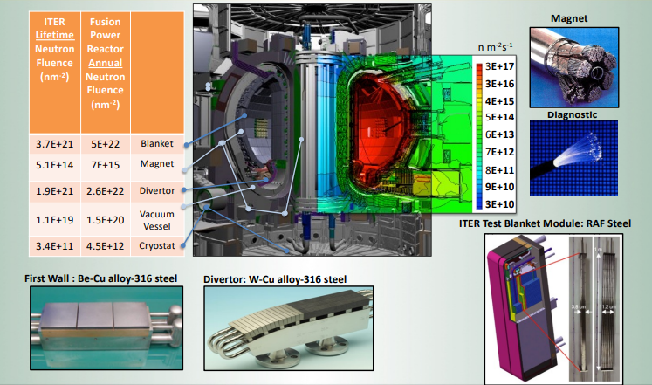
Scientific & Technical Challenges for Fusion Materials are Significant
Future D-T fusion reactors represent a uniquely hostile operating environment:
  High temperatures
  Reactive coolants
  Large time-dependent thermal-mechanical stresses
  Intense radiation (both plasma and neutrons)
Materials selection will strongly impact the Technical Viability, Safety, and Economics of future fusion reactors
Neutron irradiation leads to atomic displacements:
  Is expressed in terms of displacements per atom – dpa
  Lifetime exposures are expected to be greater 100 dpa (10 MW-y/m2)
  Atomic displacements lead to significant microstructural evolution and bulk property degradation
Higher neutron energy (14.1 Me) results in:
  Much higher gaseous transmutation (He and H)
  Different solid transmutations (material system dependent)

Slide 6
Fusion Materials Development Challenges
Plasma – materials interactions
  Sputtering, re-deposition & tritium implantation/retention
  High heat flux
  Varying thermomechanical stress
Nuclear & non-nuclear degradation to materials and structures
  Structural stability to intense fusion neutron exposure (including transmutant H/He)
  Reduced activation mandate
  Corrosive environments, with possible radiation enhanced corrosion
  Large, time varying thermomechanical stresses and high temperatures
Harness fusion energy
  Minimize tritium inventory in blanket structures, PFCs, etc.
  Efficiently extract tritium from hot coolant
  Thermohydraulic and magnetohydrodynamic instabilities

Slide 7
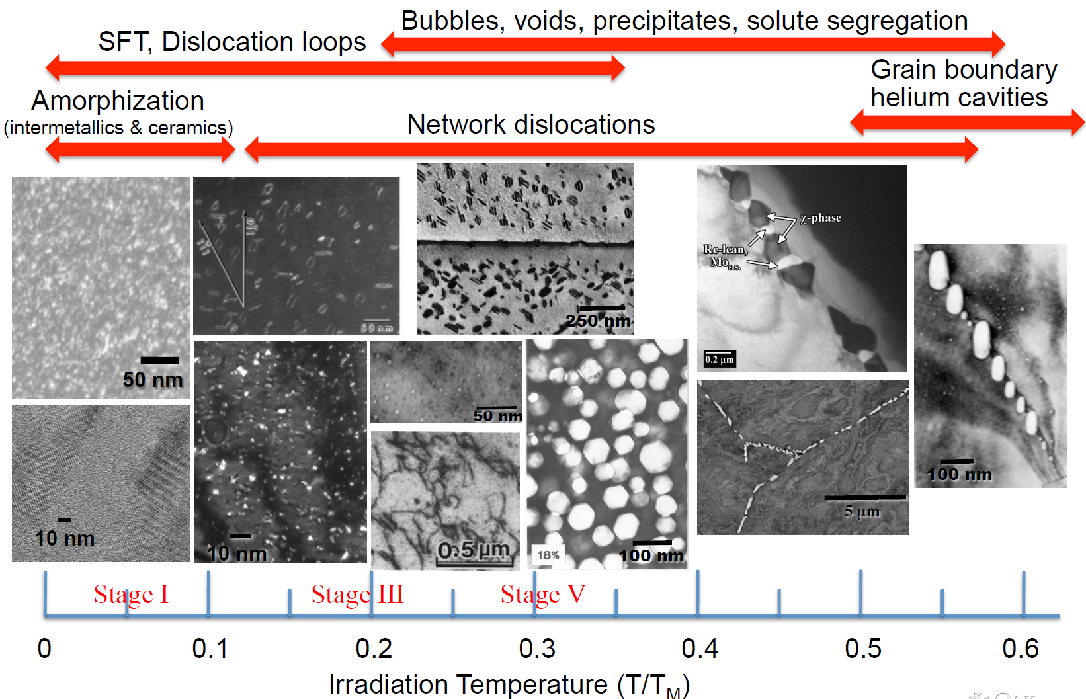
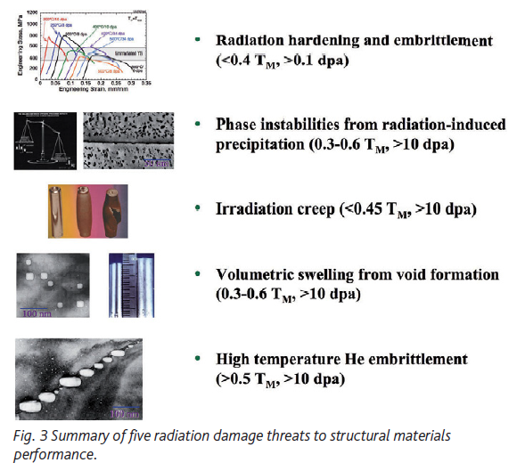
Materials Degradation in the Fusion & Advanced Fission Environments
Fundamental radiation materials science is ubiquitous across the two fields

Slide 8
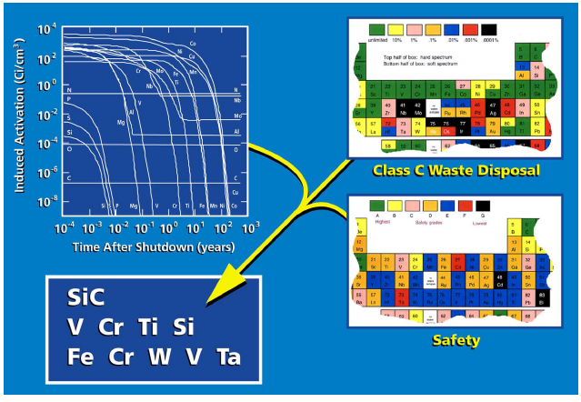
Fusion Materials: Low-induced radioactivity
Materials strongly impact environmental and safety aspects of fusion
Many materials are not suitable for various technical:
  Performance
  Safety
  Waste
Leading candidate materials:
  RAFM and Advanced Steels
  SiC composites
  Tungsten alloys

Slide 9
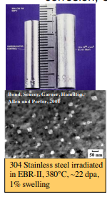
Irradiation effects on structural materials
Exposure to neutrons degrades the mechanical performance of structural materials and impacts the economics and safety of current & future fission power plants:
  Irradiation hardening and embrittlement/decreased uniform elongation (< 0.4 Tm)
  Irradiation (<0.45 Tm) and thermal (>~0.45 Tm) creep
  Volumetric swelling, dimensional instability & growth (0.3 - 0.6 Tm)
  High temperature He embrittlement (> 0.5 Tm); Specific to fusion & spallation accelerators
Additional environmental degradation due to corrosive environments (SCC, uniform/shadow corrosion, CRUD)
Variables
Structural Materials (Fe-based steels, Vanadium and Ni-based alloys, Refractory metals & alloys, SiC) and composition
Zr alloy cladding
Initial microstructure (cold-worked, annealed)
Irradiation temperature
Chemical environment & thermal mechanical loading
Neutron flux, fluence and energy spectrum
  materials test reactor irradiations typically at accelerations of 10^2 – 10^4
Synergistic Interactions

Slide 10
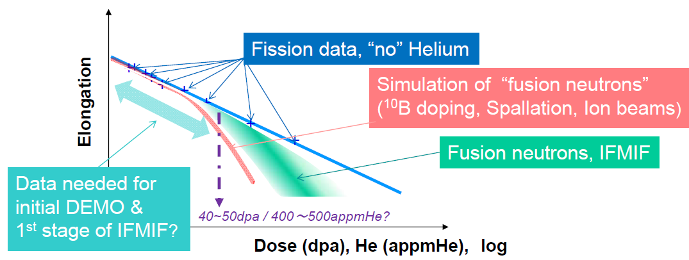
He Effects on and our current understanding
Reduced Activation
for ferritic martensitic alloy
elongation / fracture toughness
There is limited data and understanding if this performance degradation occurs in other proposed structural materials plus limited understanding of higher temperature helium embrittlement effects (creep and creep+fatigue loading)
Notes:
indication of a ‘cliff’ of decreasing performance for reduced activation ferritic martensitic alloy elongation/fracture toughness at intermediate to low temperatures and helium concentration on the order of a few hundred ppm He (may be order 500 appm, or lower or higher) and there is a lack of systematic data.
I would also call out that we have very limited data and understanding whether this type of performance degradation cliff exists in other proposed structural materials and that higher temperature helium embrittlement effects (combined with creep and/or creep + fatigue loading) is almost entirely unexplored in advanced materials

Slide 11
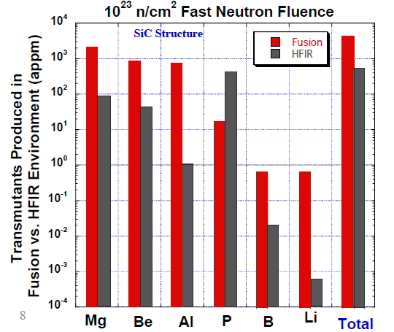
Solid Transmutations
In addition to the significant gaseous transmutations, some materials such as SiC experience significant solid transmutations in a fusion spectrum
  Burn-in: Variety of nuclear reactions with different threshold energies (En > 3 MeV) produce 6 transmutants: Mg (58%), Be (22%), Al (20%), P, B, Li.
  Also results in non-stoichiometric burn-out
Consequences are largely unknown, but will likely impose significant effects, especially in combination with gaseous transmutation production
These are fusion-specific issues which cannot be readily simulated using existing techniques
Uncertainties in ND/cross sections at/above 10 MeV
Comparison of solid transmutations in SiC in a Fusion vs thermal fission reactor environment
M. Sawan, Y. Katoh, and L. L. Snead, ‘‘Transmutation
of Silicon Carbide in Fusion Nuclear Environment,’’
J. Nucl. Mater., 442, 1–3, S370 (2013).

Slide 12
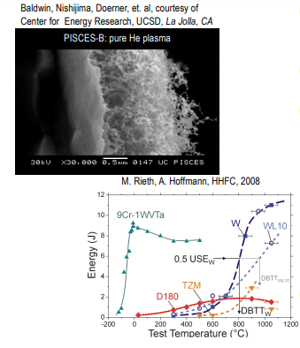
Plasma Facing Components*
Typical materials considered for PFM include graphite, beryllium and tungsten -- although this list has been modified by considerations at ITER
Tungsten alloys leading candidates as divertor structural materials due to their excellent thermo-physical properties.
However, critical issues need to be addressed:
  Creep strength
  Fracture toughness (DBTT)
  Microstructural stability (Recrystallization)
  Low & high cycle fatigue • Oxidation resistance
  Effects of neutron irradiation (hardening & embrittlement, composition changes, He, H)
Several computational and experimental efforts to explore ways to predict & improve the performance of tungsten PFCs are now underway
* Road mapping Plasma Facing Materials For FPP – B. D. Wirth et al. – Presented 2023 Materials Road-mapping workshop

Slide 13
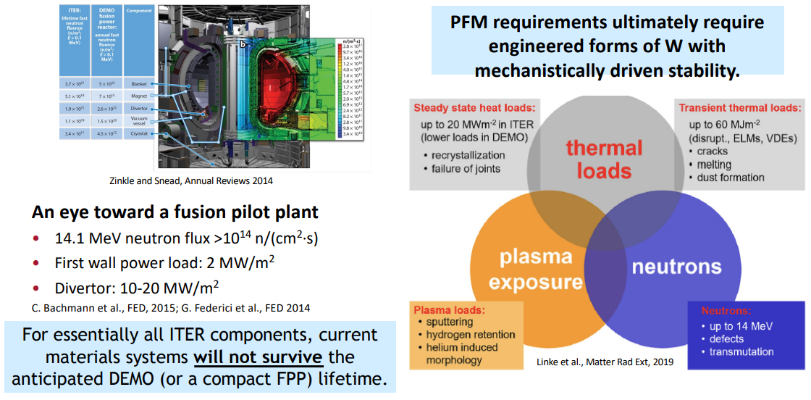
Plasma facing materials and the fusion environment
* Road mapping Plasma Facing Materials For FPP – B. D. Wirth et al. – Presented 2023 Materials Road-mapping workshop

Slide 14
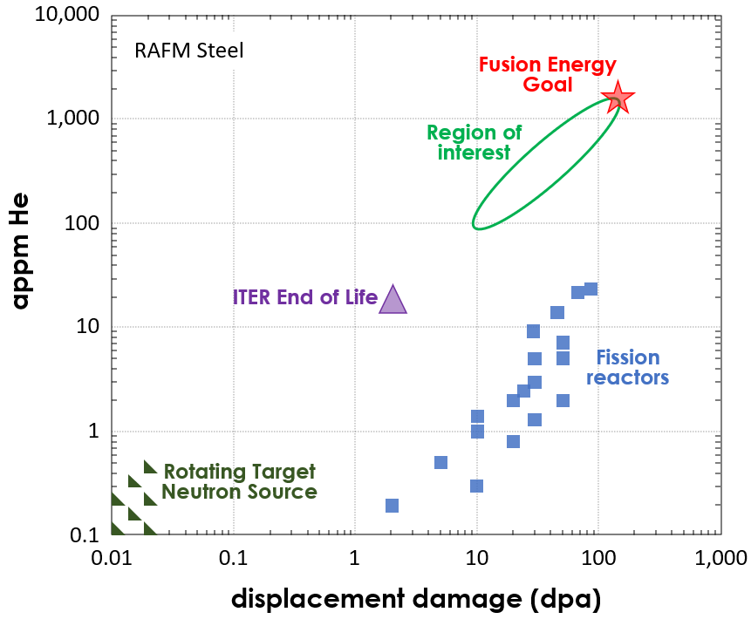
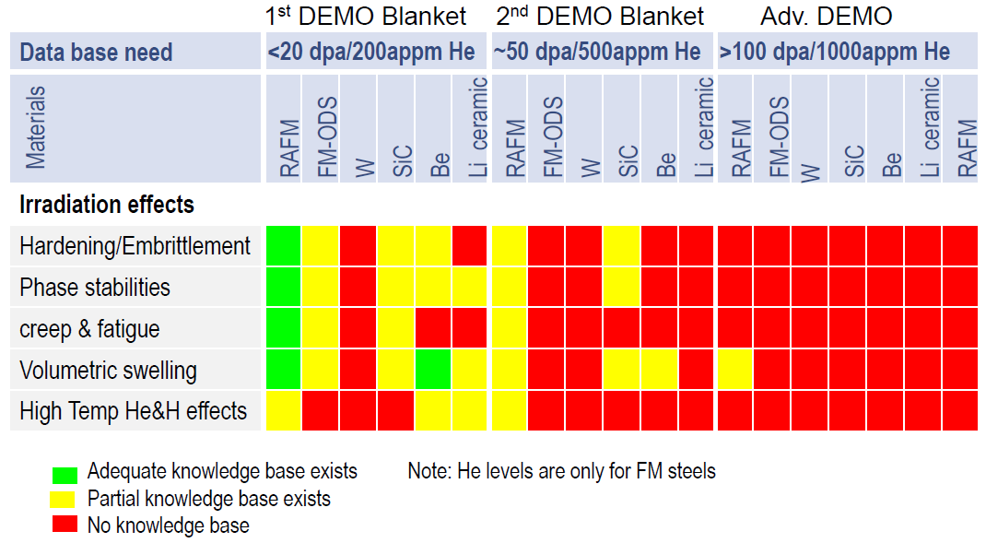
Fusion Materials knowledge base
Key Point: Fusion materials development requires both displacement damage and transmutation generation in BULK samples
  Iron based materials (RAFM steels) are used as a reference material (10 appm He/dpa)
  Generally, need to reach damage levels greater than 10 dpa/100 appm He to see effects

Slide 15
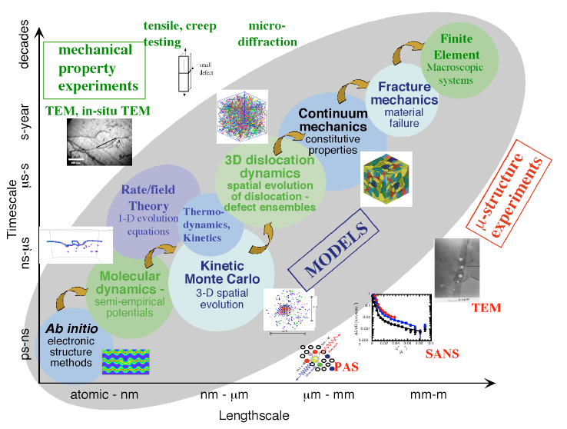
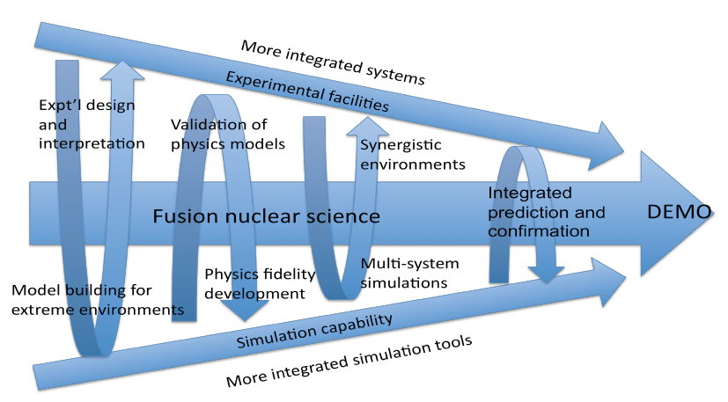
Fusion Materials theory and modeling
General premise is to apply complementary modeling, experimental and theoretical techniques at appropriate scales to determine underlying mechanisms
Given the lack of experimental facilities that fully represented loading environments – data gaps and uncertainties still exists.
Uncertainties and errors are found – and ideally must be quantified – at every level
Significant opportunities for examples of computational thermodynamics to tailor improved material properties (advanced ferritic/martensitic alloys, Cu-based alloys, etc.)

Slide 16
Integrated simulation for Fusion Technology
Engineering and physics systems integration modeling and simulations are required to support the engineering design of an FPP.
Physics, system and process models can be combined into comprehensive full device models which will likely contribute to evaluating the operations and maintenance of the pilot plant
Modeling and simulations incorporating multiple physics and multiscale phenomena with increasing fidelity into simulations to evaluate the refine design options
  High fidelity simulations will benefit from exascale computing and enable reduced models including via artificial intelligence
Engineering computer aided design, structural analysis and process and control modeling will provide an important opportunity to optimize the design and integration of the FPP
Given the lack of prototypic experimental facilities

Slide 17
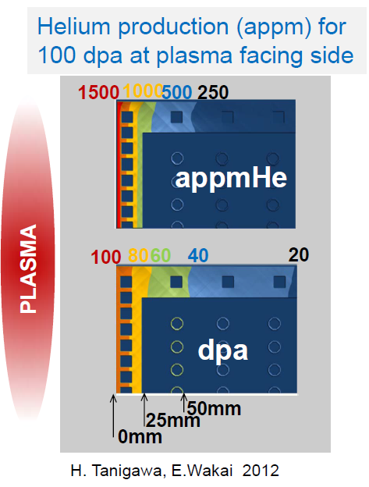
Fission Irradiations Still Play a vital role
The high He/dpa ratio regime is “limited” to the first few centimeters of the first wall
This part of the blanket carries the highest thermo-mechanical loads and a dedicated fusion neutron source is indispensable to understanding materials degradation in this regime
However:
  Fission reactor irradiations (especially fast spectrum irradiations) are still meaningful for a significant fraction of in-vessel components
  Given limited volume and damage rates in an FPNS, fission irradiations are still imagined to play critical “work horse” role in the fusion materials program even after an FPNS is constructed and operational

Slide 18
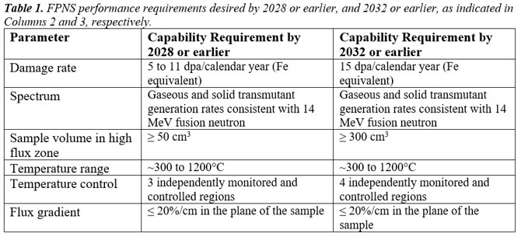
2022 FPNS Community Workshop Outcome
Program on Technology Innovation: 2022 Fusion Prototypic Neutron Source (FPNS) Performance Requirements Workshop Summary
Notes:
This is highlighting the need for solid transmutant in additional to gaseous

Slide 19
Summary: Fusion Materials development status and needs
Recent community prioritization has emphasized the need, and the urgency, for expanding efforts in fusion technology related to materials development for applications in PMI, blankets, structural components, functional materials (shielding, diagnostics), including the use of multiscale-multiphysics modeling & simulation
Most significant development needs include Blanket technology, structural materials development for blankets, including environmental degradation and tritium permeation/retention, and 14 MeV prototypic neutron source
  Biggest modeling challenges relate to multiscale time integration across rare dynamics and modeling multicomponent alloys with transmutant impurities
  Defect production physics well established, and transmutation cross-sections known, but uncertainties exists above ~10MeV in some elements
    Solid in addition to gaseous transmutants
  Lack of prototypic experimental facilities

Slide 20
Thank you!
Guinevere Shaw
guinevere.shaw@science.doe.gov

