Slide 1
Nuclear data applications to integrated modelling of materials damage
Mark Gilbert
Workshop for Applied Nuclear Data Activities (WANDA 2024)
February 27, 2024

Slide 2
Outline
Integration need for fusion materials modelling
PKA distributions as an input to integrated modelling and the derivation from nuclear data
Example integrations to modelling
  Material examples
Future and Summary

Slide 3
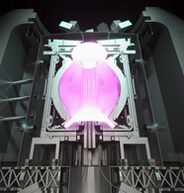
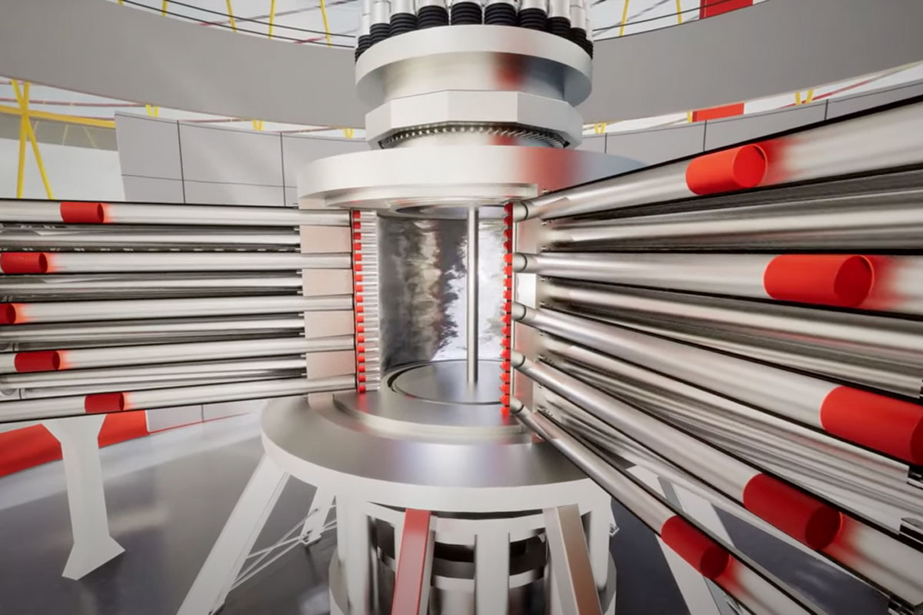
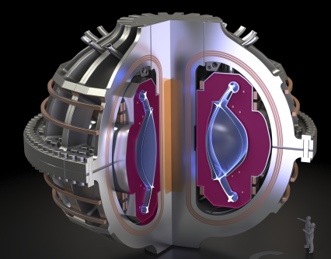
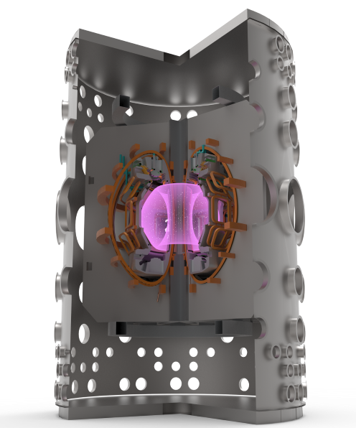
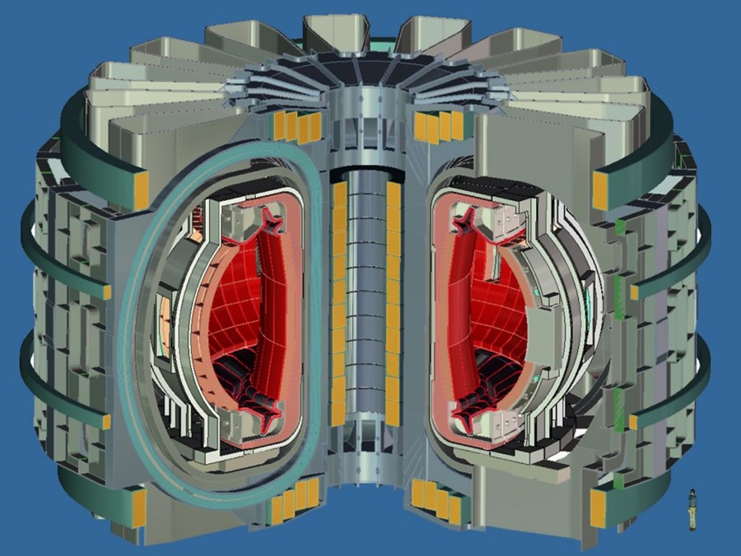
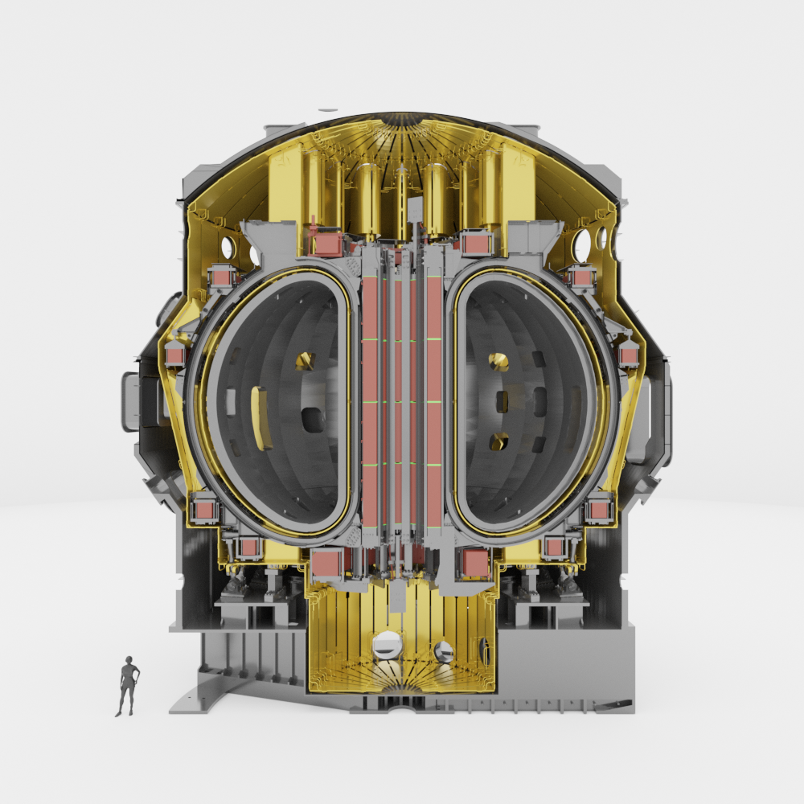
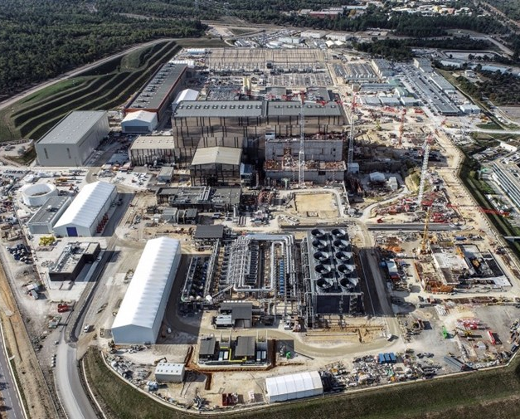
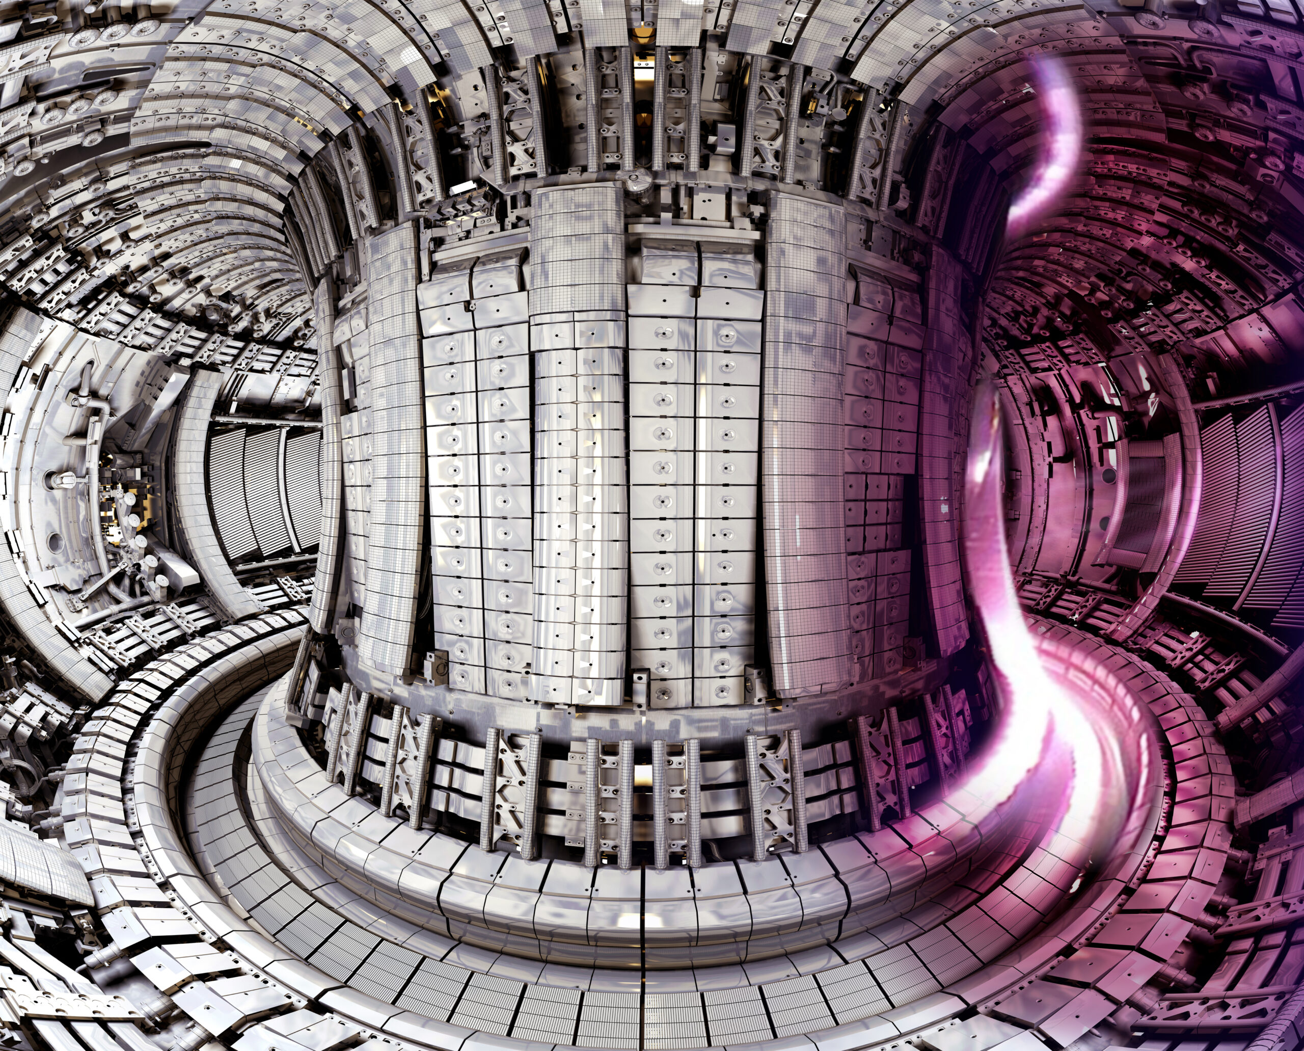
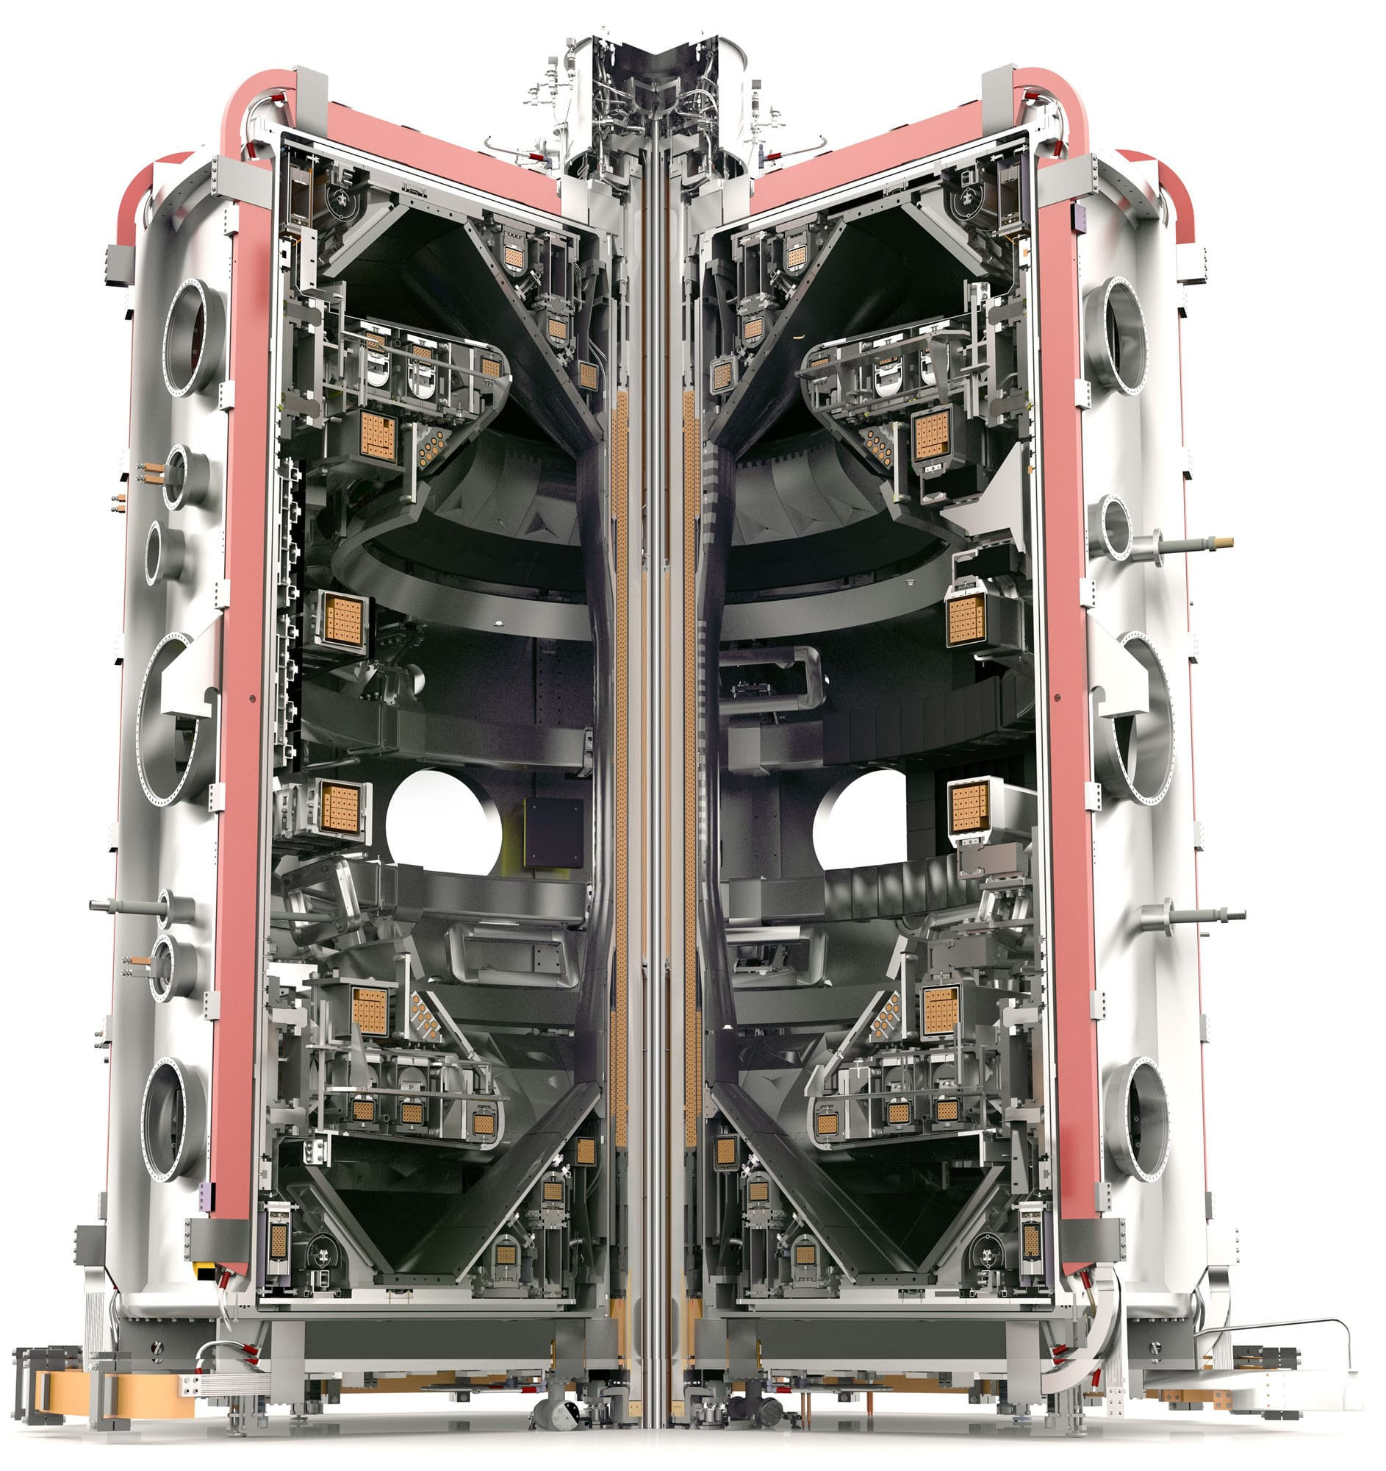
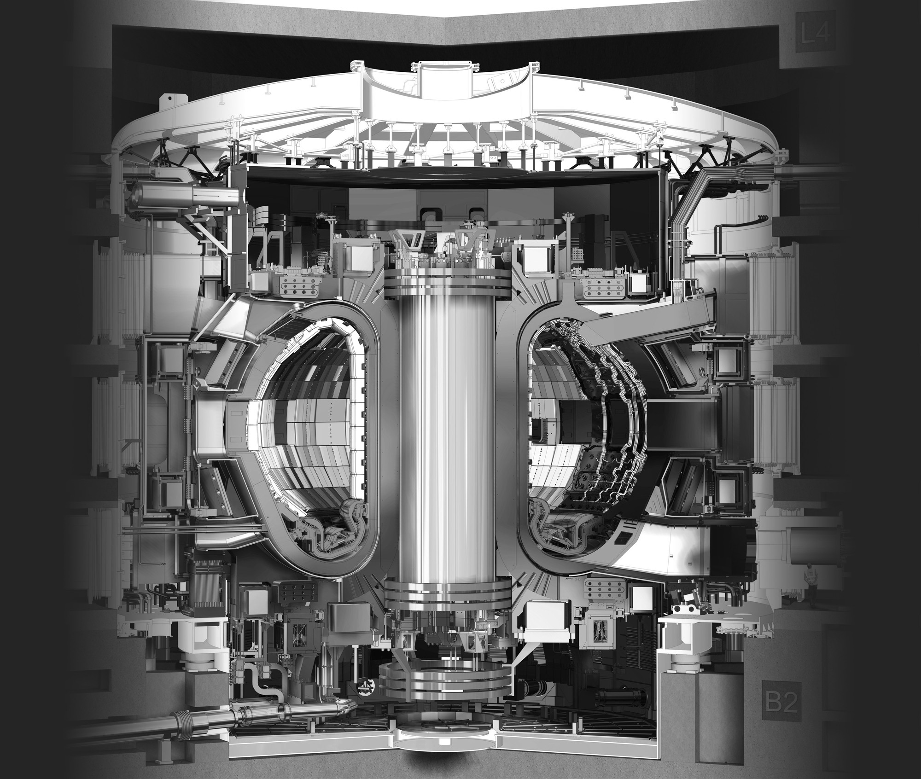
Fusion development is accelerating
Commercial Fusion
Fusion commercial plants
UK-STEP
2050s
2040s
JT-60
2030s
DEMOs
JET
Prototype and near-commercial fusion reactors to be developed in the next 10-15 years
Now
ITER
MASTU

Slide 4
Material challenge for fusion
The acceleration puts renewed urgency on solving one of the key outstanding challenges for fusion:
Development of materials that can withstand the harsh fusion environment for sufficient time to make reactor operation commercially viable
  Material choices must be sufficiently abundant
  Low cost, financially and energetically – to produce, manufacture, and handle after operation (low waste)
To facilitate the design and selection of materials, as well as predict their performance, must have reliable predictions of the response of materials to the fusion environment
  including neutron interactions → inventory evolution → transmutation and activation
  including neutron interactions → damage creation → evolution in material properties
  Modelling needs to get a head of the physical systems to be useful

Slide 5
Integration need beyond DPA
For material, component, and reactor design and engineering in fusion, the critical need is integrated modelling
DPA is useful for correlating damage dose to changes in behaviour in experiments, but cannot be easily applied as a quantity in material modelling
Even modified DPA (arc-dpa, cdpa, etc.) versions do not help much
Nuclear physics, through data and simulations, needs to (and can) feed directly into integrated damage modelling…
Image courtesy of
J.-C. Sublet

Slide 6
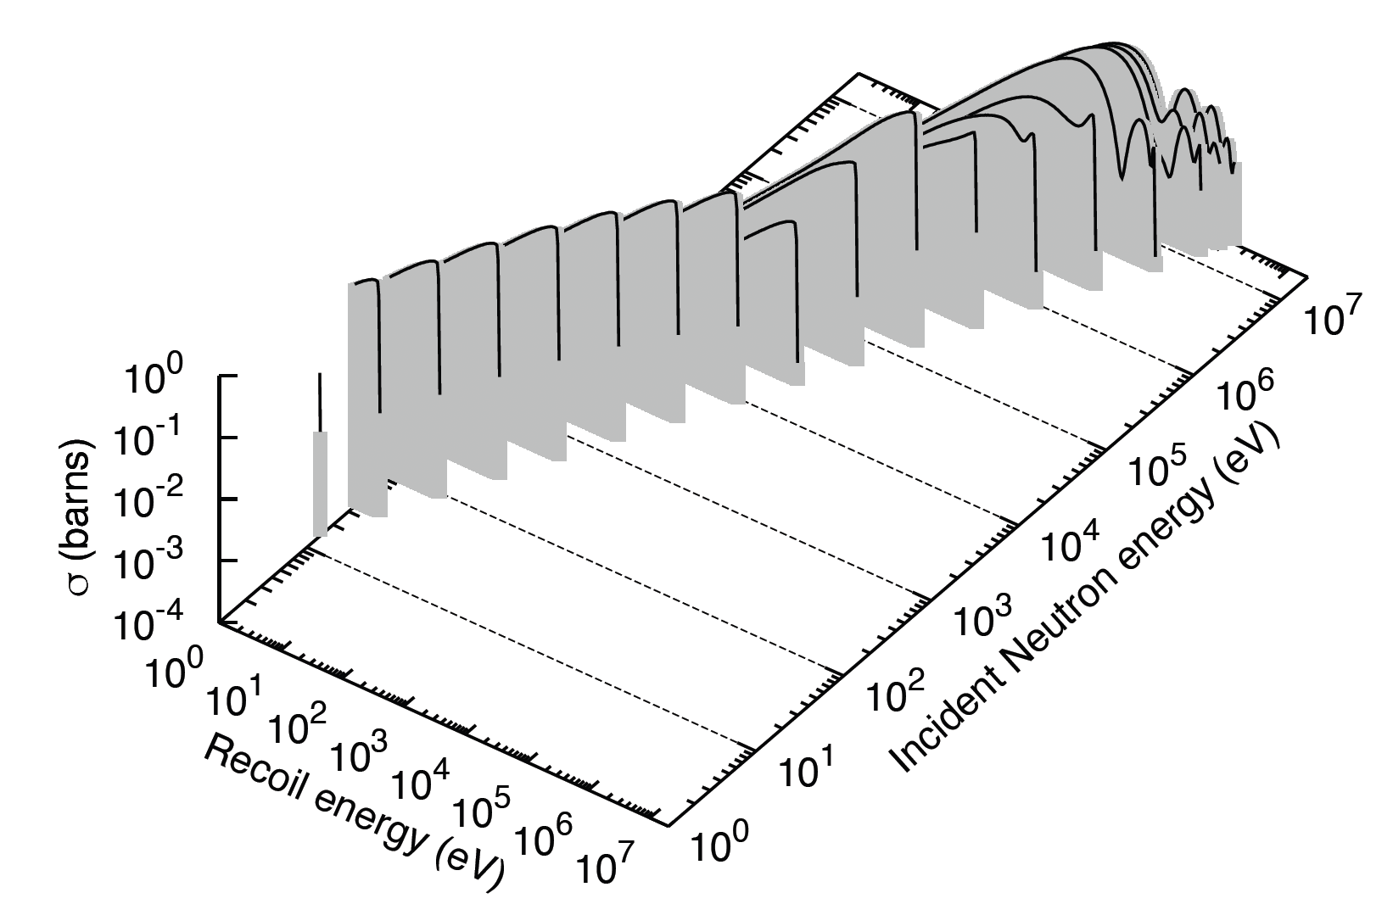
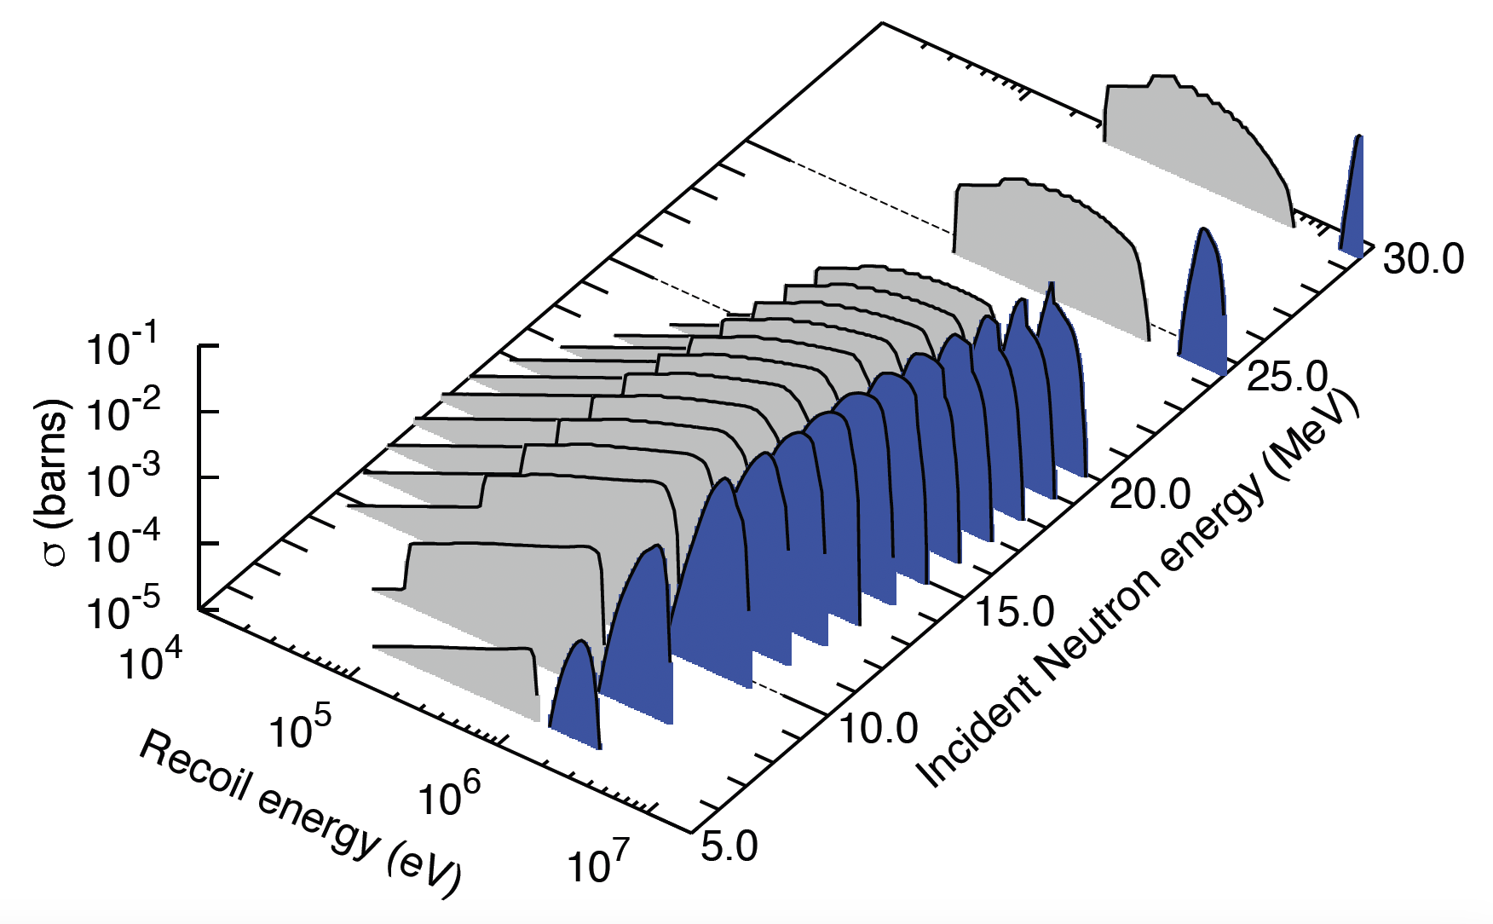
Nuclear data defining damage events
SPECTRA-PKA is a tool developed to supply data to materials modelling community
Using same nuclear data as inventory and transport simulations, but explicitly uses energy dependence of recoiling species as groupwise
matrix data
⁵⁶Fe(n,elast)
Typically obtained from NJOY
²⁷Al(n,α)²⁴Na

Slide 7
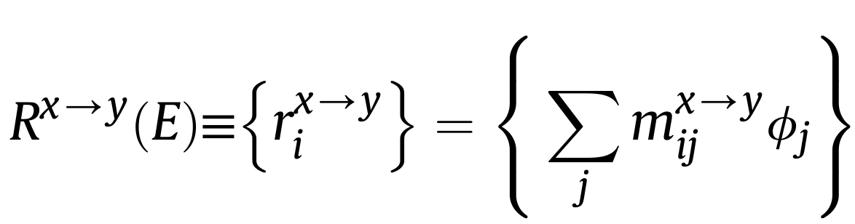
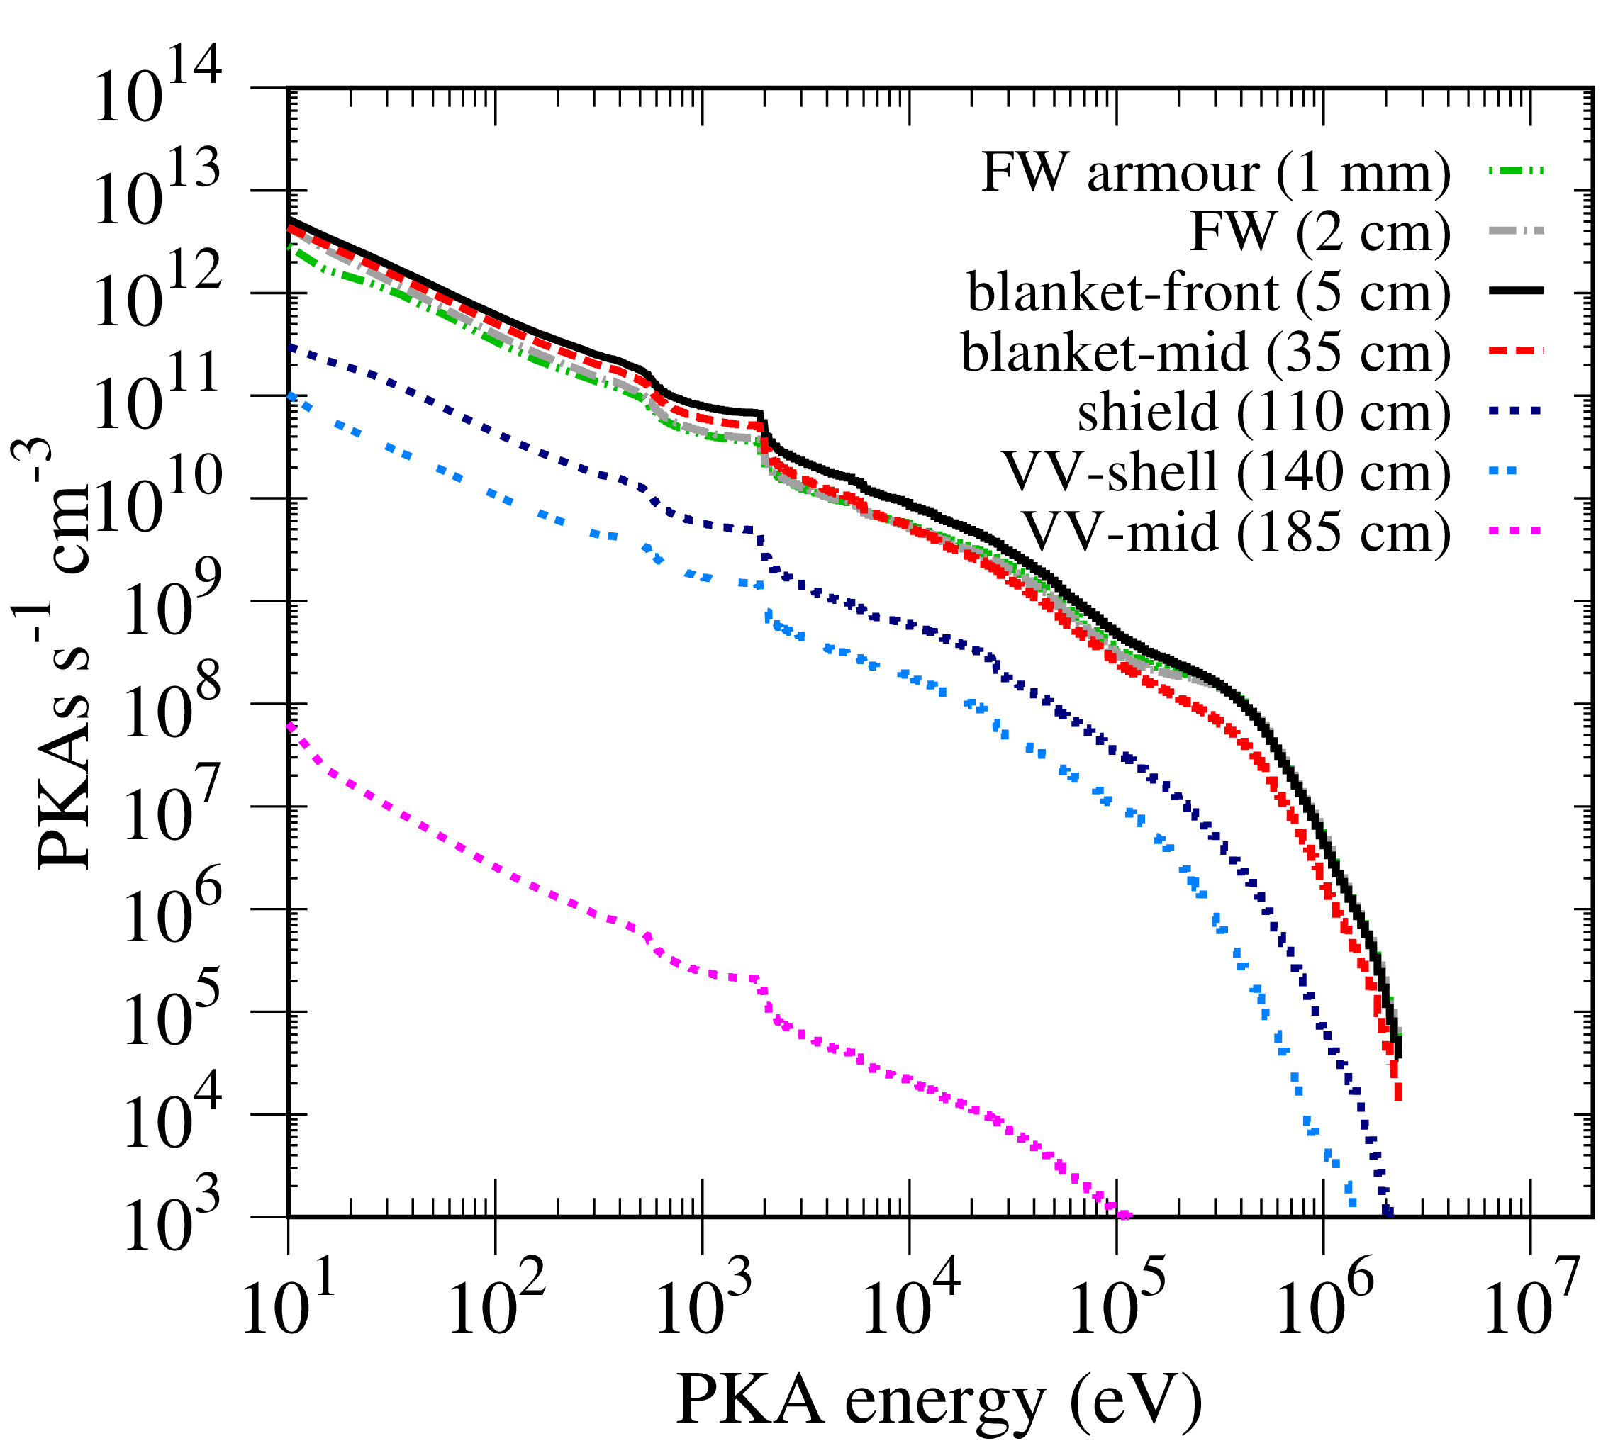
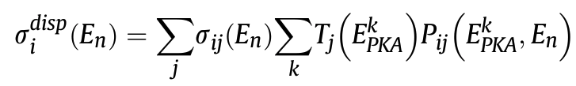
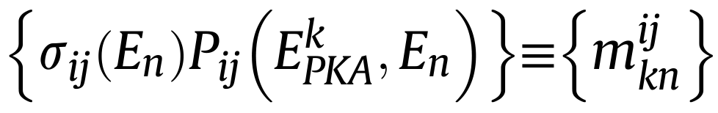
PKA distributions from SPECTRA-PKA
Predicts the distribution of primary knock-on atoms (PKAs)
  Vector of PKA energies of daughter y due to reaction on parent x:
  i.e. source term for damage creation in materials
This energy distribution is also the starting point for the formulas that derive DPA:
https://github.com/fispact/SPECTRA-PKA
(2015 paper notation)
deca-eV⁻¹
Variation in Fe PKAs with depth into a fusion reactor wall
PKA energies
(2018 paper notation)
Displacement cross section is proportional to DPA xs
Gilbert, Marian, Sublet, JNM 467 (2015) 121-134
Gilbert, Sublet, JNM 504 (2018) 101-108

Slide 8
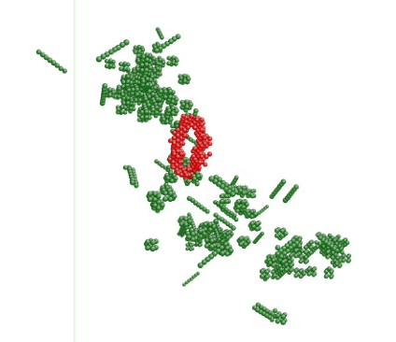
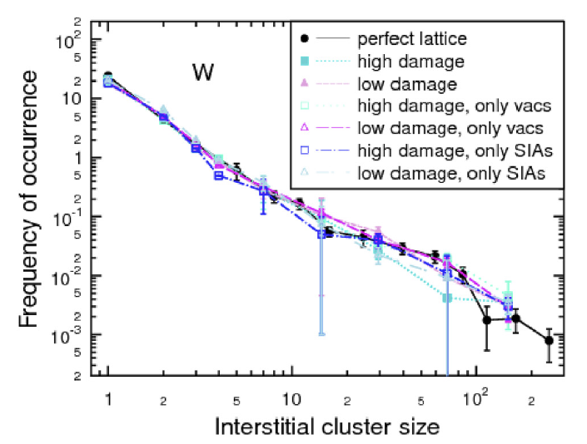
Atomistic integration
150keV PKA cascade in W
(A. Sand 2012)
An obvious application of PKA distributions is as a source term for dynamic simulations (e.g. MD) of damage cascades
MD simulations typically only consider single cascades
  or overlapping cascades of the same energy in artificially high dose scenarios
SPECTRA-PKA provides nuclear physics-based energy and time distributions of PKA events
  Could enable better-informed dynamics simulations of damage creation and evolution
  But integration into a modelling framework is needed …
Defect populations in overlapping 150 keV PKA cascades in W
(Sand et al. JNM 2018)

Slide 9
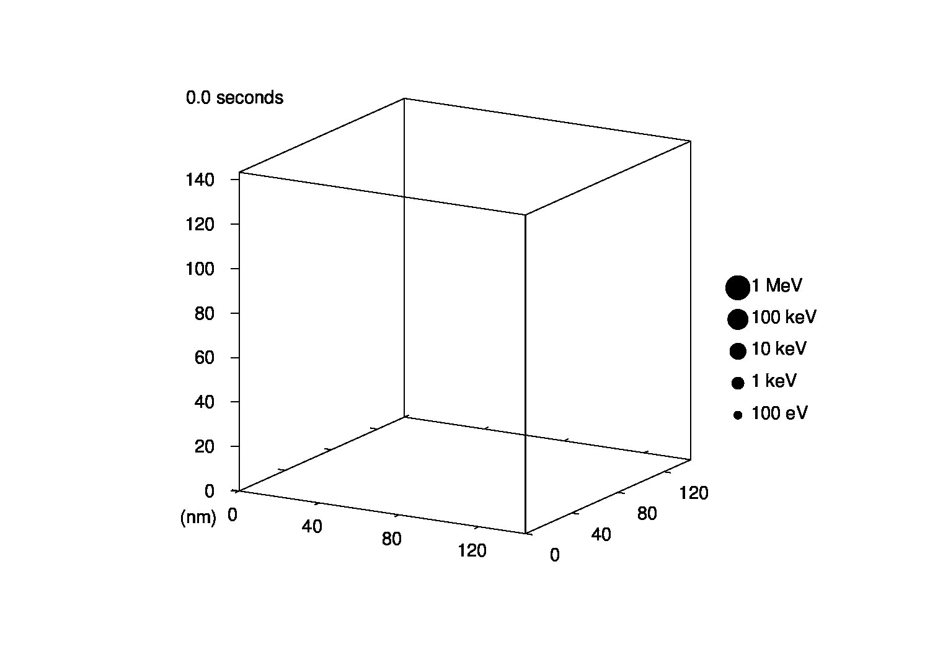
Framework: Sampling
Cumulative distributions for sampling
PKA distributions in materials under fusion conditions
PKA event sequence
Fe
Starting point:
Statistical sampling of cumulative PKA distributions to build up a spatial and temporal sequence of PKA events

Slide 10
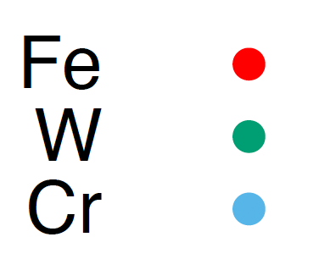
Interpretation example
Can easily explore complex materials
  E.g. Fe-50 W-25 Cr-25
While W dominates total PKA rates, the majority are small and will contribute little to damage
Highest energy events (leading to extended cascades) are Fe/Cr dominated
Simple analysis of distance between events is already something that can be related to atomistic modelling

Slide 11
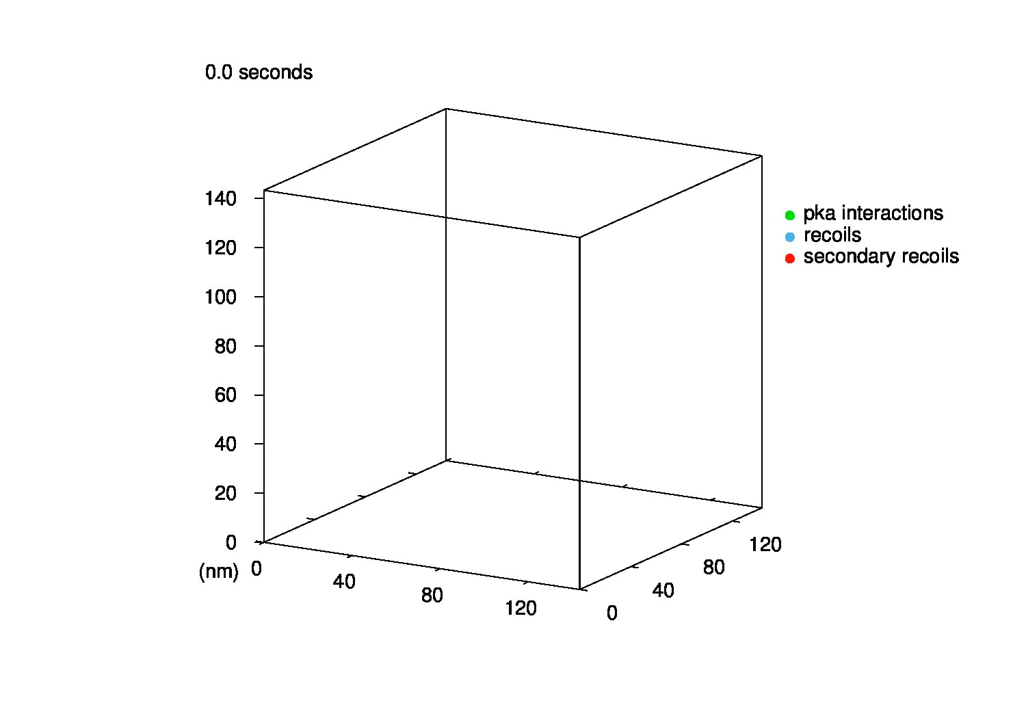
Prototype next step: BCA
Fe
Simple binary collision approximation simulations to predict sequence of displacements due to each PKA event

Slide 12

Coding details
SPECTRA-PKA has been integrated with the BCA code SDTrimSP
Initial processing:
  PKA probability distributions (separated by reaction type, target and recoil isotope) calculated by combining nuclear data and input neutron spectrum
Time and spatial sampling:
  For given ideal atomic lattice
  (future development will allow read-in of pre-existing atomic configurations)
  Statistical sampling of PKA distributions
  Random event: PKA type, location, time, direction
For each PKA^{i} predicted
  Call an instance of SDTrimSP
    input parameters for material and PKA^{i}
    BCA cascade simulation
  Process SDTrimSP output
Energy
position
time
direction
https://github.com/fispact/SPECTRA-PKA

Slide 13
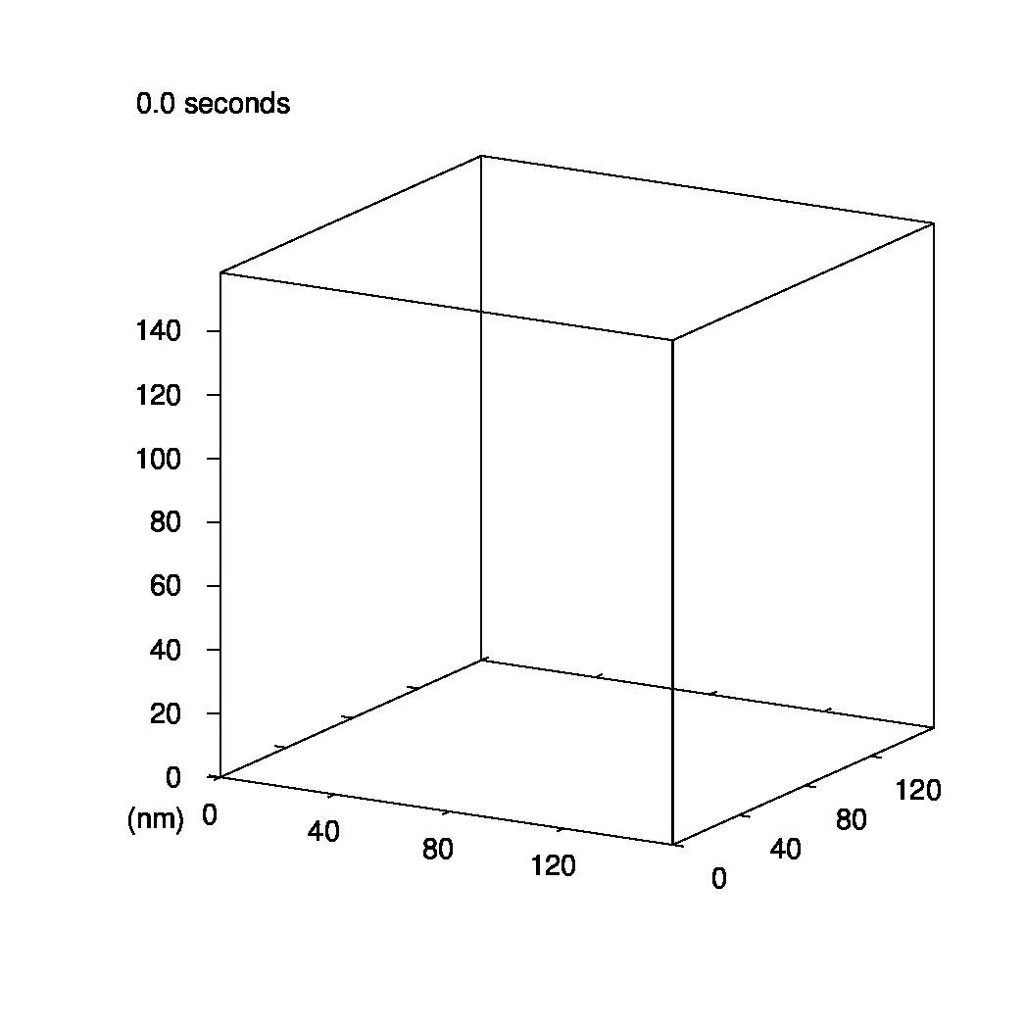
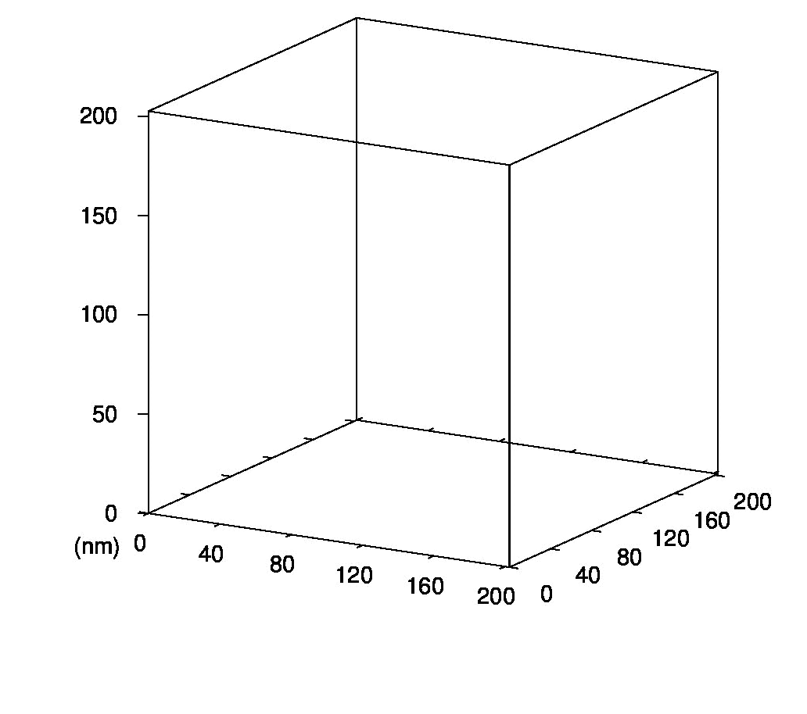
W
Fe
Even without defect evolution and interaction, integration with BCA reveals differences between materials
More examples
Al

Slide 14
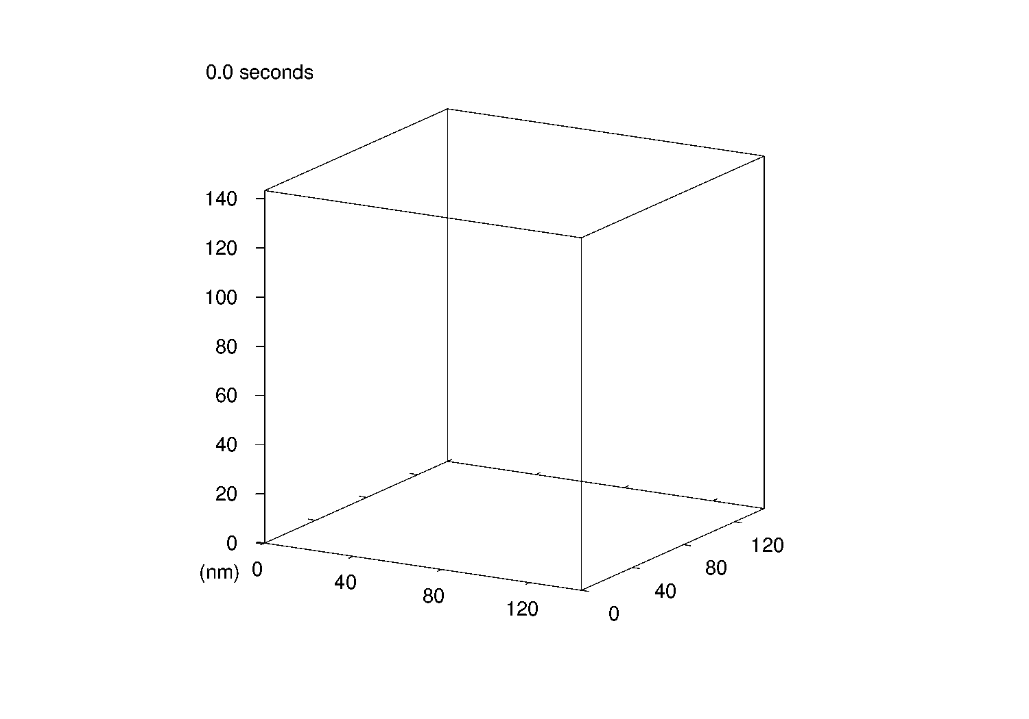
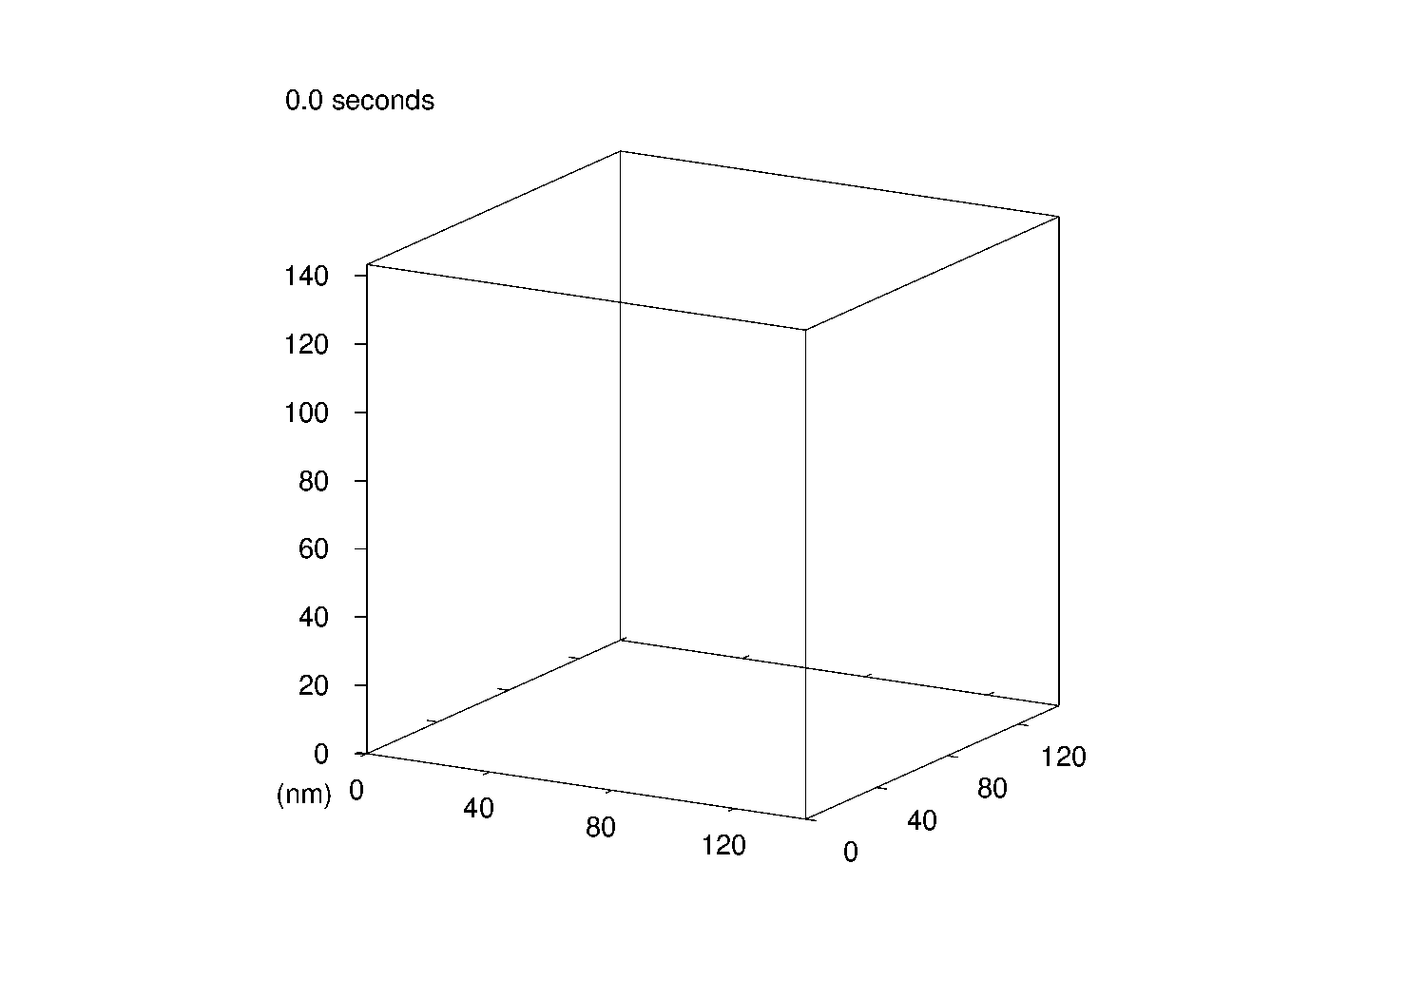
Iron at different depths from plasma
First wall
Blanket (~0.3 m)
Vacuum vessel (+1 m)
On this timescale, nothing seen in VV
Can start to understand the differences that materials will experience as a function of location with a nuclear system

Slide 15
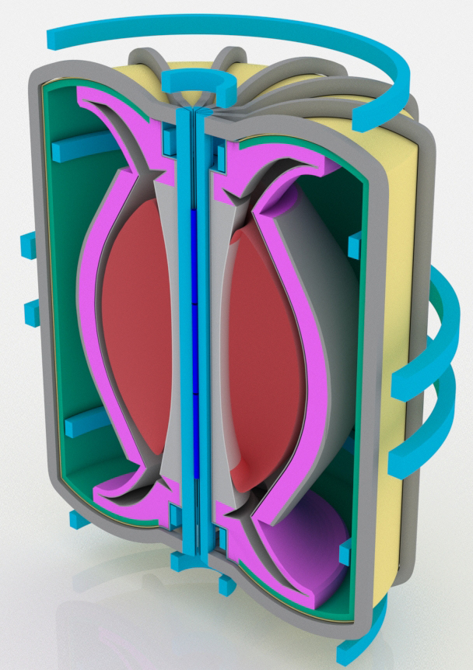
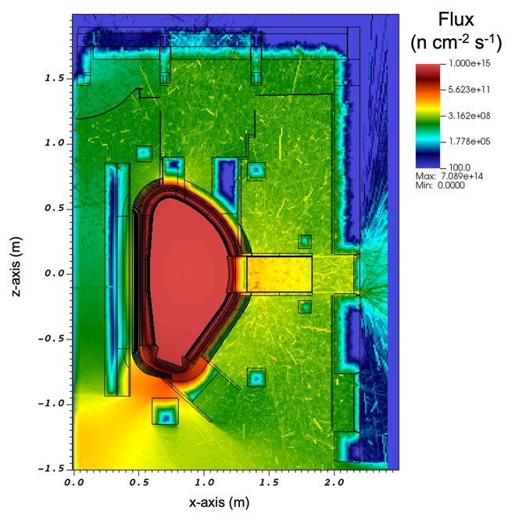
Integration outlook
Reactor model
PKA rates & energy distributions from nuclear data
Damage creation:
BCA and other methods
PKA events in space & time
Particle transport
Defect evolution & material changes
Analysis of cascades from BCA
Neutron fluxes and energy spectra
Time-dependent variation in damage source terms
Per reaction analysis (including DPA)
Inventory evolution
(FISPACT-II)
SPECTRA-PKA

Slide 16
Summary
PKA distribution generator (SPECTRA-PKA) allows for the potential of using the full complexity of nuclear-data-based predictions of damage source terms (PKAs) in modelling of irradiation damage in materials
Avoids the need to reduce the complexity of data transfer using integral metrics like DPA
(DPA is nonetheless are helpful for comparing experiments, and in the future relating back to modelling)
Provides data that can be related to quantities/events in atomistic modelling
Provides the integration link between nuclear engineering designs and materials modelling of damage evolution
Prototype framework involving BCA simulations demonstrates potential
  Future developments should adopt alternative or additional techniques to include defect interactions and evolutions in-between PKA events – e.g. dynamics using MD
Input nuclear data for PKA evaluation is already available, albeit via additional processing

Slide 17
Thank You
M. Gilbert | WANDA 2024

Slide 18
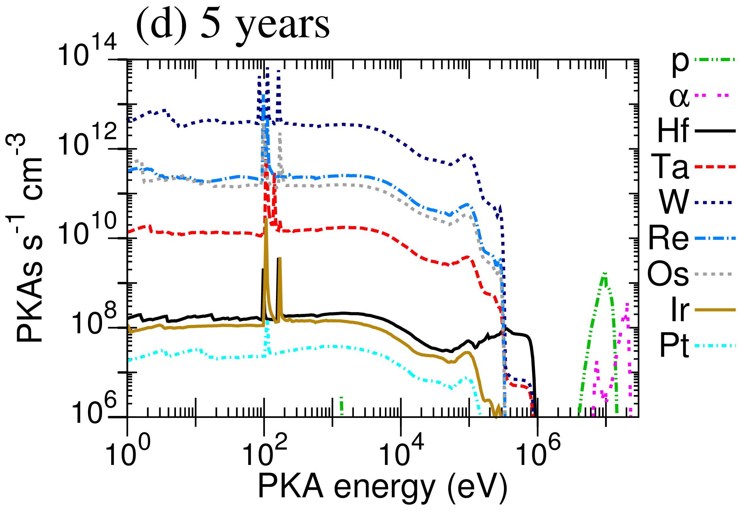
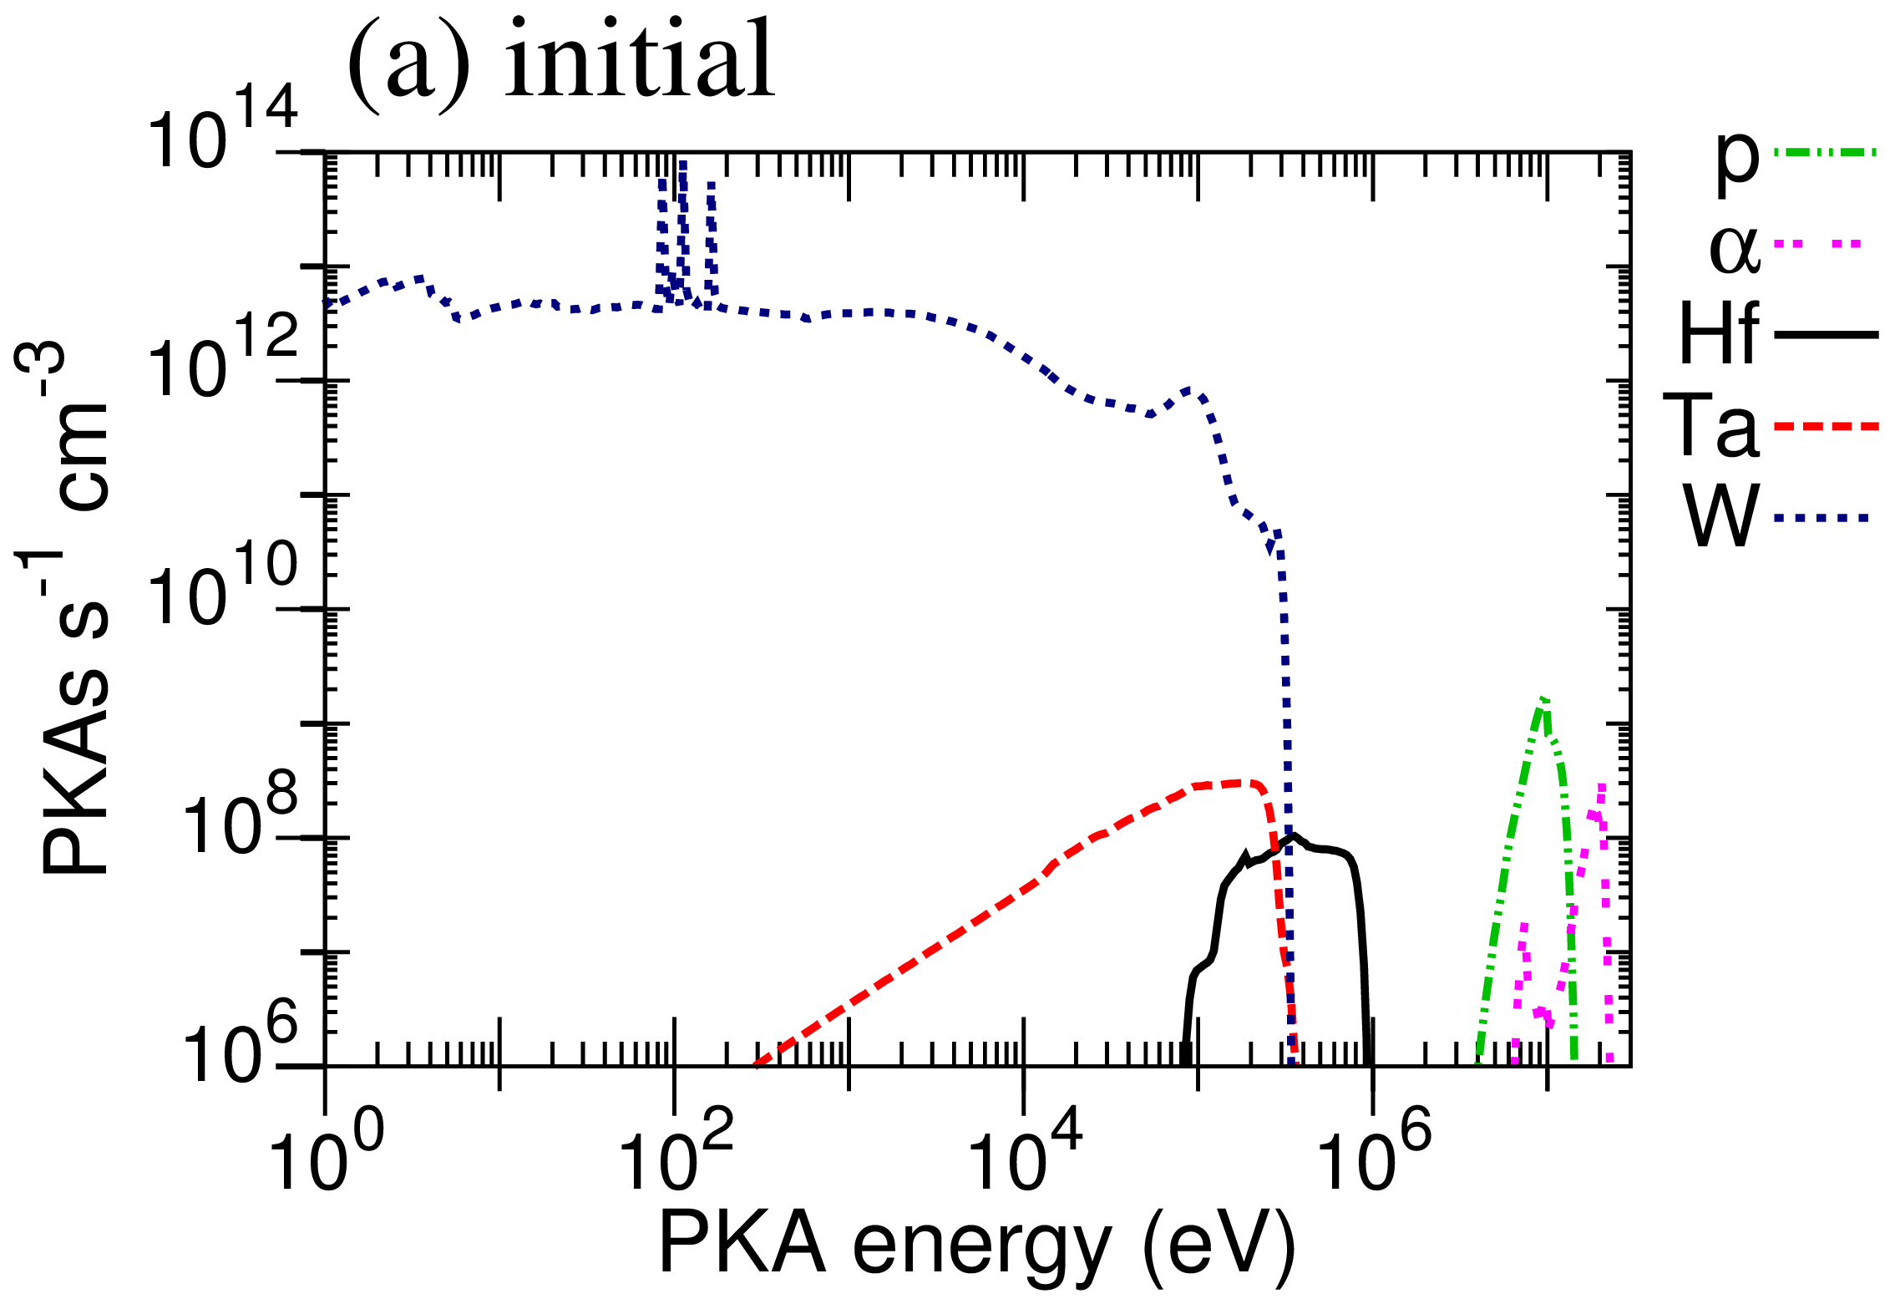
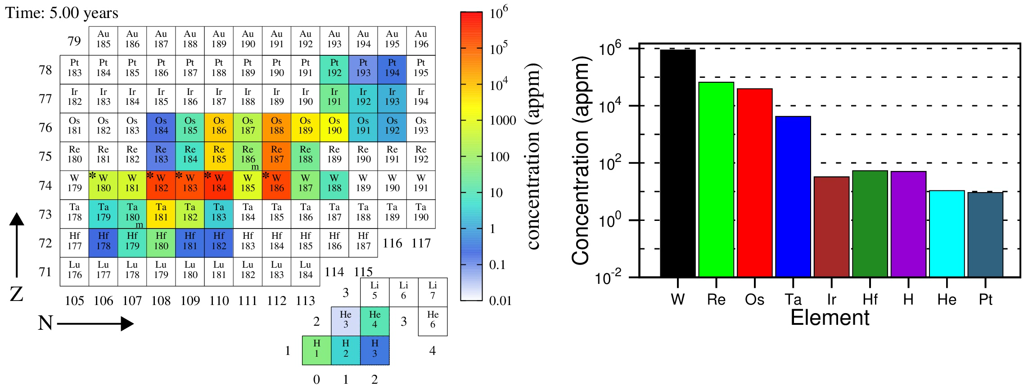
Link to inventory evolution (burn-up)
Inventory simulations predict how the composition of a material changes with time under (neutron) bombardment
SPECTRA-PKA currently only considers a zero-time snapshot of composition
Future: linking to UKAEA FISPACT-II inventory simulator to consider time evolution in PKA distributions
Likely to only be important at long (months, years) timescales
(Gilbert, Sublet, NME 9 (2016) 576-580)
Concentration evolution in W

Slide 19
Example Application
Stochastic cluster dynamics modification of standard rate theory approach
  Cluster populations only added to system of equations as they are populated (to avoid computational explosion)
Sampling cumulative distribution functions for Fe and W derived from PKA spectra
  simulations highlight the delayed onset of clustering in Fe due to increased annihilation (at 300K) compared to in W
Gilbert, Marian, Sublet, JNM 467(2015) 121-134

Slide 20
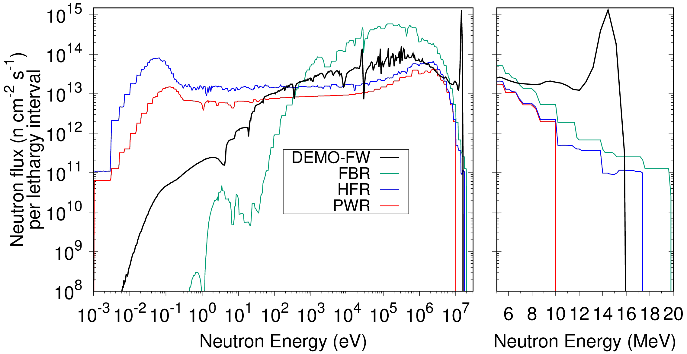
Neutron damage
The energy delivered to materials by the neutron bombardment is more severe than from fission
  and the materials have higher functional requirements
Fusion first wall
PWR
Displacements per atom (DPA/dpa) is an atomic-level measure of neutron dose
1 DPA means that enough “displacement” energy has been absorbed by a material to displace every atom from their lattice sites once

