Slide 1


Status of complete neutron-induced displacement damage cross section data
A.Yu. Konobeyev, D. Leichtle

Slide 2
Content
Introduction
Methodology, Codes, Data, Assumptions
Summary and Data

Slide 3
Introduction
Nuclear analysis support for design and safety of nuclear and accelerator facilities demand accurate and validated nuclear data.
Specific interest in fusion technology applications, i.e. DT 14-MeV neutrons and d-Li neutron sources (IFMIF-DONES)
Radiation damage due to irradiation with neutrons poses limitations on material performances and systems’ lifetimes.
European effort on provision of recommended nuclear data libraries, in particular nuclear response files – displacement damage.
Libraries should cover a wide range of elements and energies.
  Joint Evaluated Fission and Fusion (JEFF) nuclear data library.
  JEFF Nuclear Data Library - NEA (oecd-nea.org)

Slide 4
Methodology, Codes, Data, Assumptions
Damage models and parameters
Production of displacement cross sections
Uncertainty propagation
Processing to nuclear data libraries

Slide 5
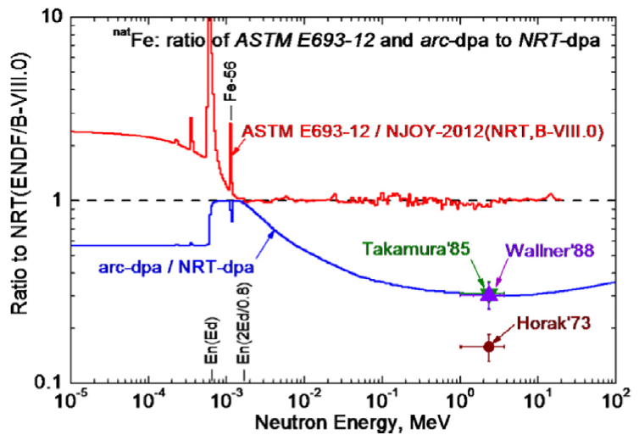
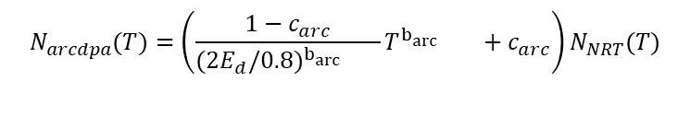

Damage Models and Parameters
NRT
athermal recombination corrected dpa
(arcdpa)
M.J. Norgett et al. (1975)
K. Nordlund et al. (2015)
$$N_{NRT}(T)=\frac{0.8}{2E_{d}}\frac{T}{1+k_{L}g({T/E}_{L}{)}}$$
$$N_{arcdpa}(T)=\left(\frac{1−c_{arc}}{(2E_{d}/0.8)^{b_{\operatorname{arc}{}}{}}}T^{b_{\operatorname{arc}{}}{}}+c_{arc}\right)N_{NRT}(T)$$
g(ε)= α₁ ε^{1/6} + α₂ ε^{3/4} + α₃ , α₄ = E_{d}
α₁ = 3.4008, α₂ = 0.40244, α₃ = 1.0
α₅ = b_{arc} , α₆ = c_{arc}
S.P. Simakov et al. (2018)

Slide 6
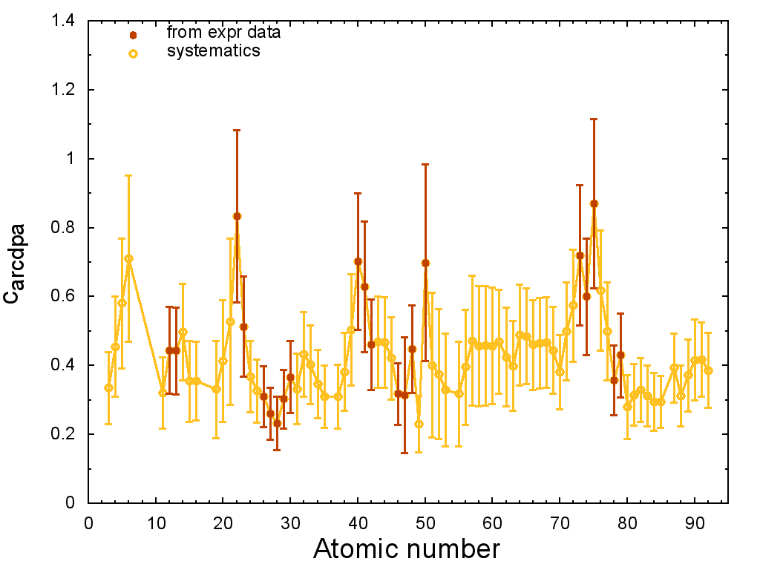
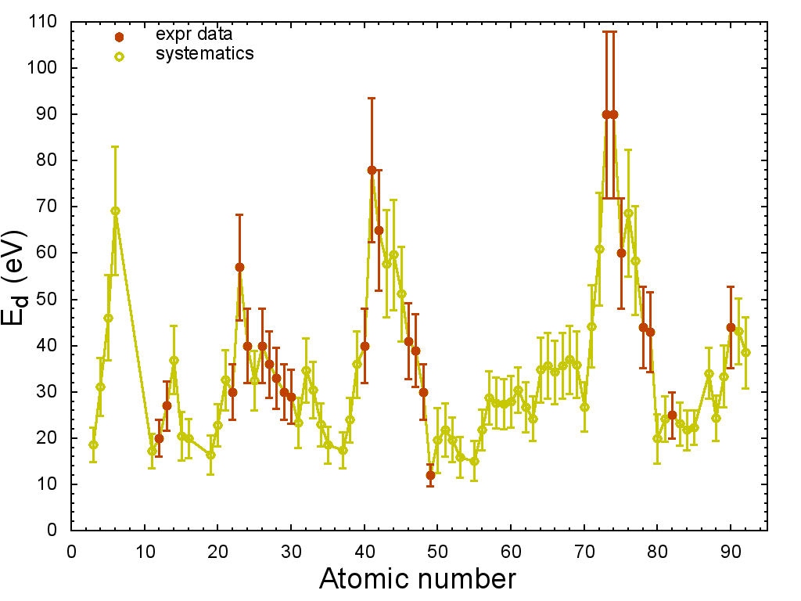
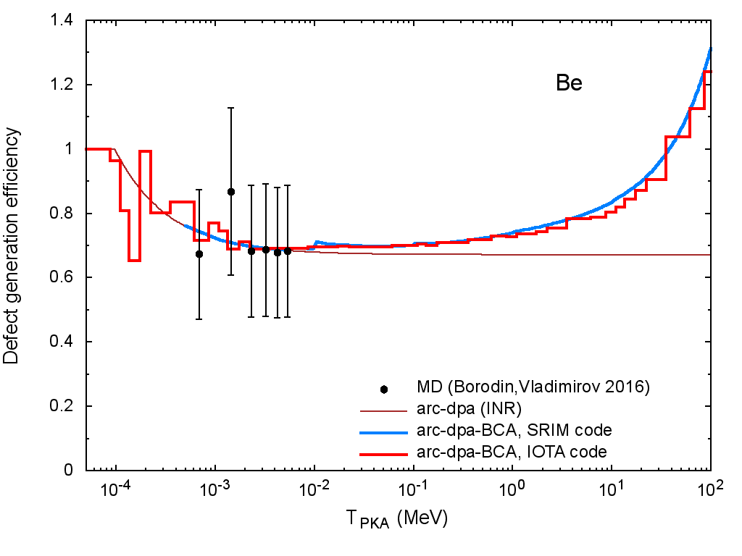
Damage Models and Parameters
arc-dpa parameters
  From experimental data
  and systematics
BCA-(MD/NRT/arcdpa) simulations
  SRIM/IOTA codes
  Combination of BCA simulations and
  MD/NRT/arcdpa Frenkel pair defect numbers
b_{arcdpa}= -0.82

Slide 7
Production of Displacement Cross Sections
NJOY
RECONR/BROADR
HEATR
BEKED
NJOY
ACER
PREPRO
other
Elemental cross sections NRT/arcdpa
arcdpa
MF3, MT900, MT901
Data processing via NJOY2016, and other tools (e.g. PREPRO 2021)
78 Elements (Be…Bi) from JEFF-4T2.2 (also: JENDL-5, TENDL-2021, ENDF/B-VIII.0)
  Unphysical jumps in a series of cross-sections (Mg, Al, Si, P, S, Ar, K, Ca, Sc, Ti, Cr, Ni, Zn, Ga, Ge, As, Se, Pd, Sm, Tb, Er, Tm, Yb)
  Extension to 200 MeV, where necessary

Slide 8
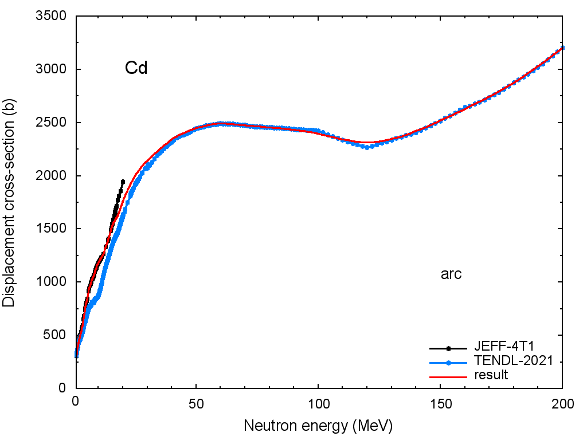
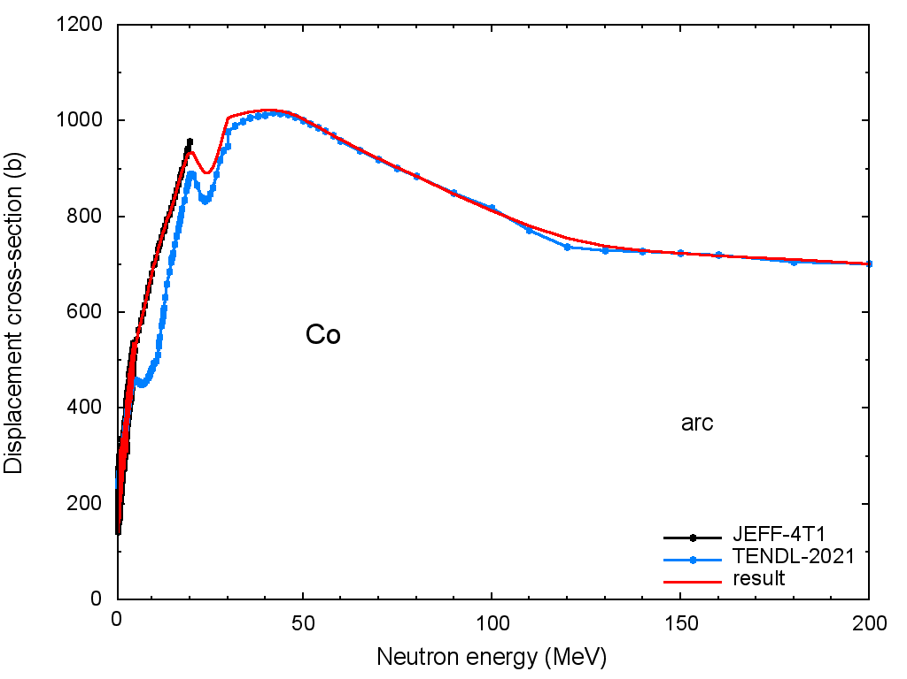
Production of Displacement Cross Sections
Extension to 200 MeV, where necessary
Bridging and smoothing
JEFF-4T1 all data: 22 %, 3 ≤ Z ≤ 83: 13.5 %
TENDL-21 all data: 0.8 %, 3 ≤ Z ≤ 83: 0.5 %
JENDL-5 all data: 27 %, 3 ≤ Z ≤ 83: 20 %
ENDF/B-VIII all data: 92 %, 3 ≤ Z ≤ 83: 91 %

Slide 9

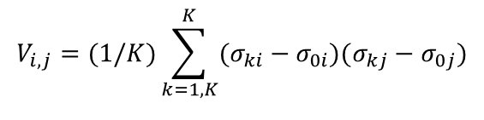

Uncertainty Propagation
MC Method (D.L. Smith, 2004)
  Choice of basic set of model parameters
  Estimation of standard deviations
  MC sampling of input data sets
  Calculation of output data sets
  Statistical evaluation
$$\text{p}\text{k}\text{=\{}\text{p}\text{01}\text{±} \text{D} \text{p}\text{k}\text{1,,..…,}\text{p}\text{0}\text{L} \text{±} \text{D} \text{p}\text{kL}\text{\}}$$
$$V_{i,j}=(1/K)\sum_{k=1,K}^{K}{(σ_{ki}−σ_{0i})(σ_{kj}−σ_{0j})}$$
$${∆σ}_{d,ii}=\sqrt{V_{ii}}$$

Slide 10
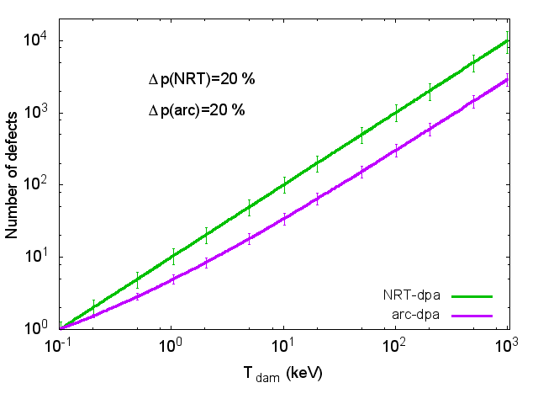
Uncertainty Propagation, Assumptions
Atomic displacement models
Nuclear data uncertainties
  Covariance matrices from current JEFF/TENDL
  (light targets: previous TENDL)
  Random sampling from cross section covariances
ΔE_{d} /E_{d} = 20%
NRT: Δα₁/α₁ = Δα₂/α₂ = Δα₃/α₃ = 15%
Arc-dpa: Δb_{arc}/b_{arc} = Δc_{arc}/c_{arc} =20%

Slide 11
Uncertainty Propagation, Sampling
BEKED
NJOY
HEATR
ACER
PREPRO
other
Displacement cross section covariances
Random files from cov-data
Random sampling parameters
MF33, MT900, MT901
Covariance matrices for displacement cross-sections from parameter uncertainties
  Atomic displacement models
  Covariance matrices from current JEFF/TENDL (light targets: previous TENDL)

Slide 12
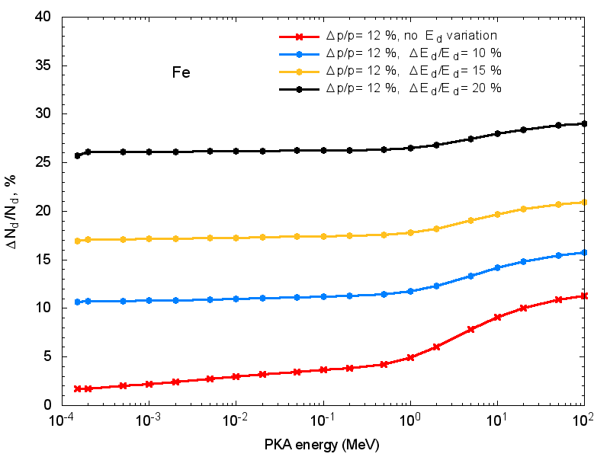
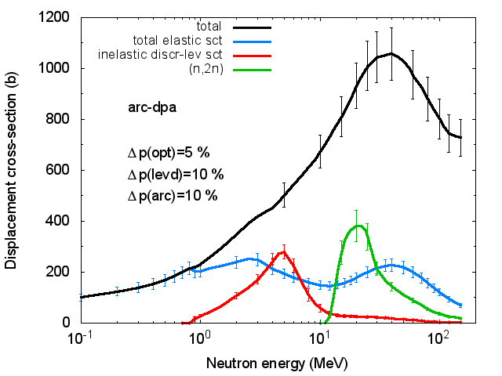
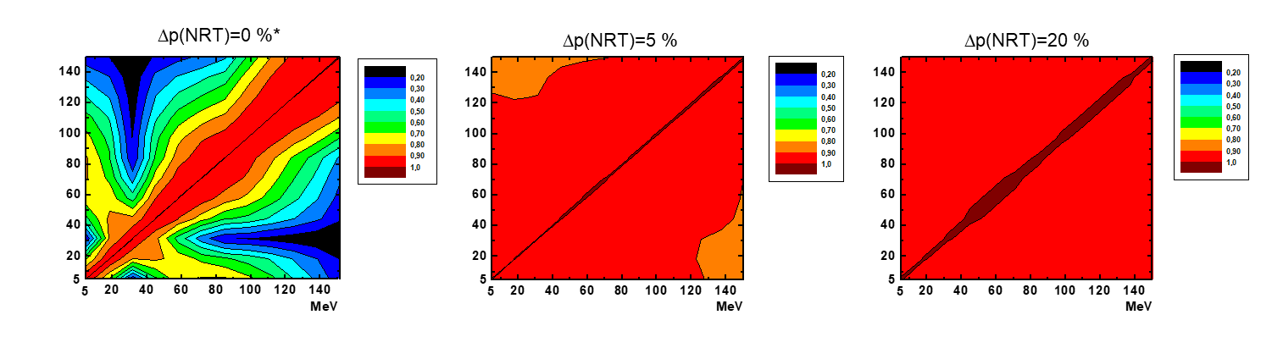

Uncertainties and Correlations
Example: 56-Fe
Perturbation of damage model
Correlations dominated by
damage model
Uncertainty dominated by E_{d}
n+⁵⁶Fe
*only nuclear data uncertainty

Slide 13
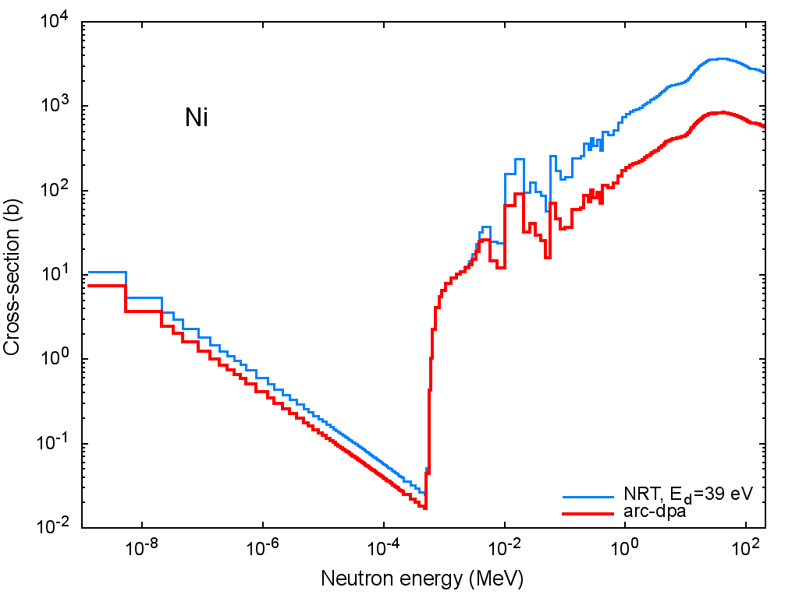
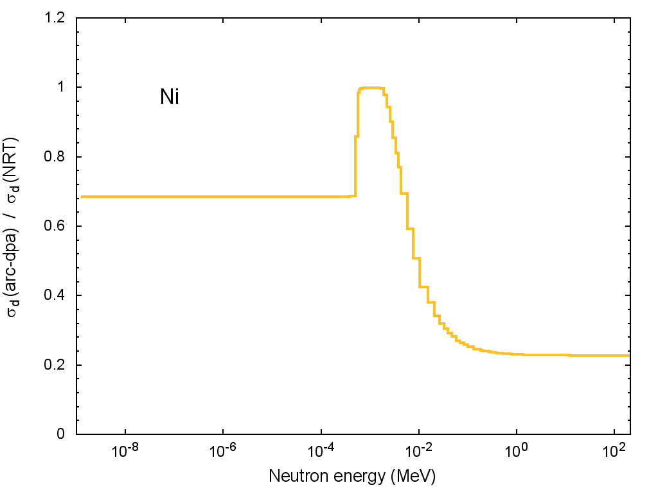
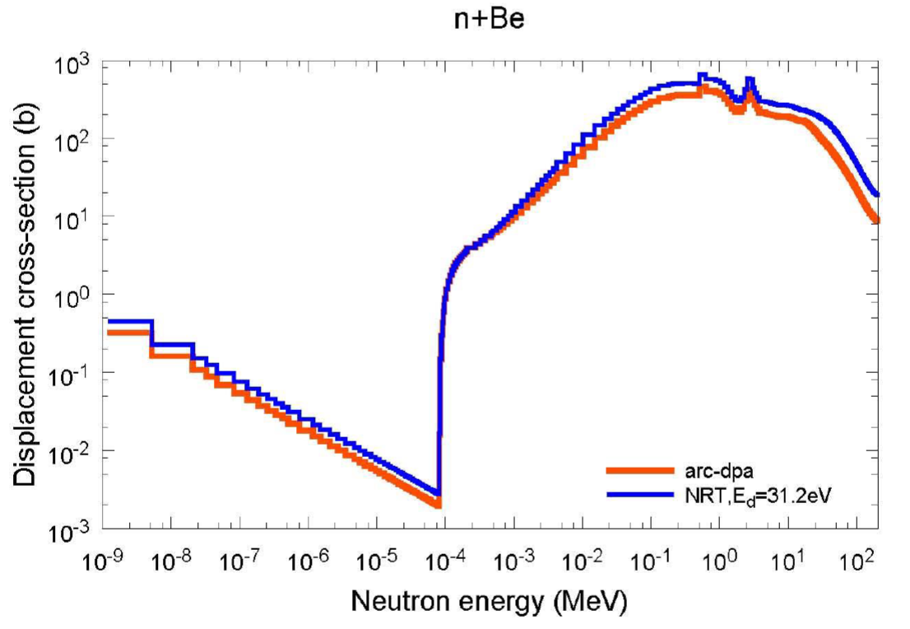
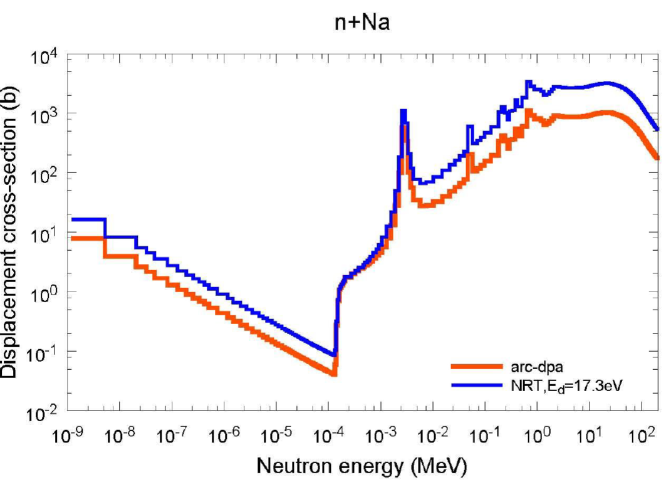
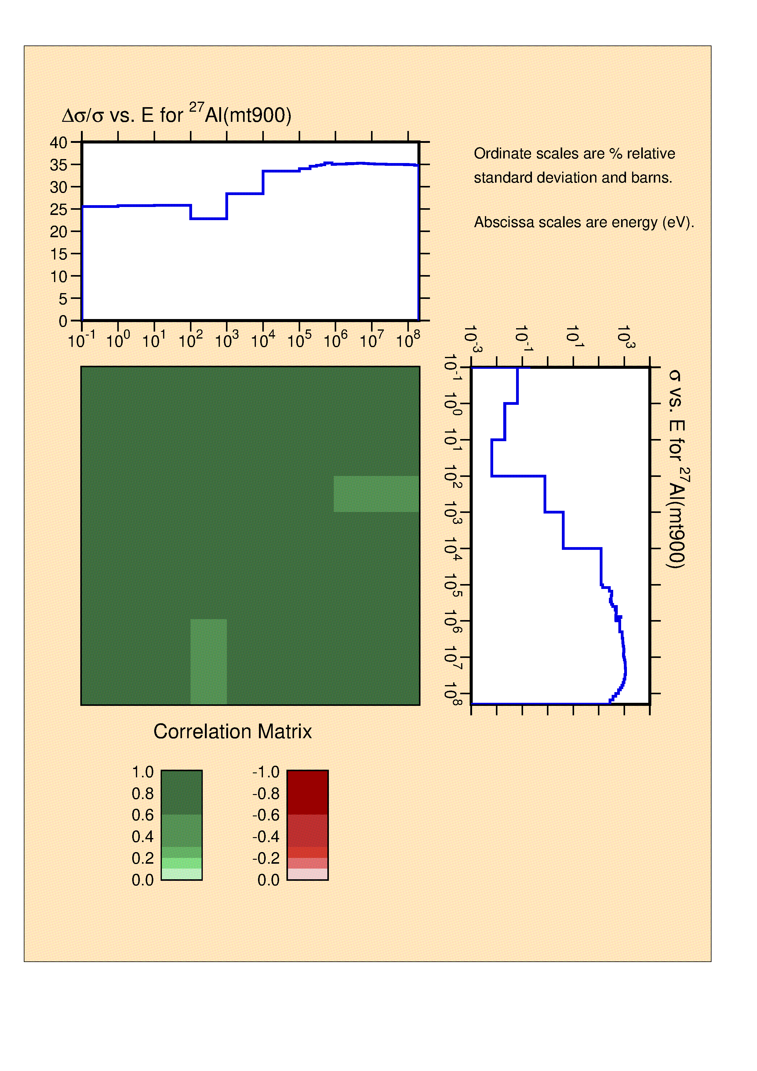

Summary and data
NRT and arc-dpa displacement cross sections with covariance matrices
  Be…Bi (76 Elements)
  ENDF-6, ACE format
  MT 900: arcdpa, MT 901: NRT
  JEFF-4T2.2: https://t1p.de/8toxr
  Other nuclear data: https://bit.ly/3L8ZlHQ

