Slide 1


REBCO and BSCCO fast neutron irradiations at the LBNL 88-Inch Cyclotron
Lee A. Bernstein
Department of Nuclear Engineering
University of California – Berkeley
Nuclear Science Division
Lawrence Berkeley National Laboratory
http://nucleardata.berkeley.edu
Andrew S. Voyles
13 June 2018 – Program Review for NSSC2 – TA1

Slide 2

Thick target deuteron breakup has been known as an effective source of fast, forward focused neutrons and was even considered for ²³⁹Pu production in the 1940s*
10+ barns/sr
$$\frac{dσ_{BU}}{dθ}$$
Low-Z targets are particularly good since they have the lowest dE/dx and therefore the longest effective target thickness
Thick target deuteron breakup (TTDB) neutron beams on light targets are also strongly forward focused (the neutrons follow the direction of the deuteron beam)
*Thanks to Ian Thompson (LLNL)

Slide 3
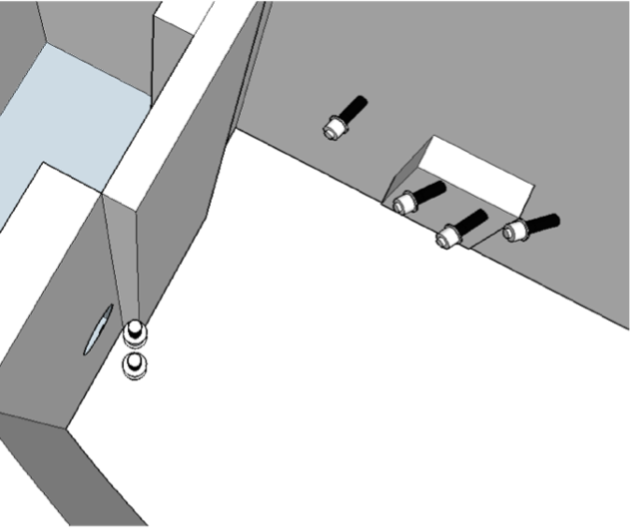
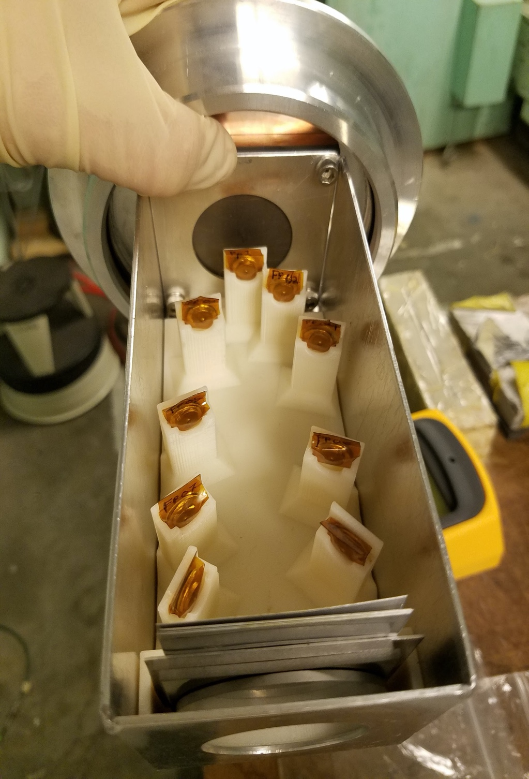
We’ve quantified our Thick Target Deuteron Breakup Neutron Source (TTDBNS) using both Time-of-Flight* and foil activation
Double Time-of-Flight*
Neutrons scatter off a target cell neutron scintillator and into an array of scatter cells allowing for energy determination down to ≈0.5 MeV without contributions from temporally adjacent beam pulses.
Time-of-Flight (TOF)
Mounted Foil Holder
Our goal was to develop a physics-based
model of neutron production
*K.P. Harrig et al., Nuclear Inst. and Methods in Physics Research, A 877 (2018) 359–366
Foil Activation
Arrays of activation foils are located at defined angles with respect to the breakup target and the spectrum is determined via spectral decomposition.

Slide 4
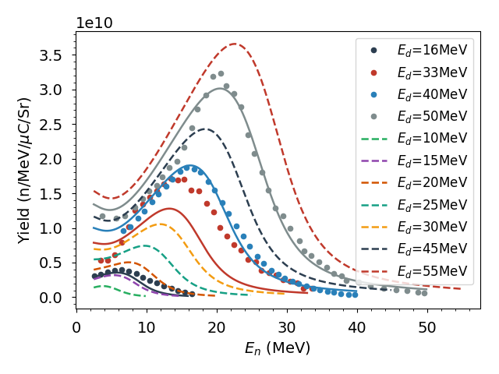
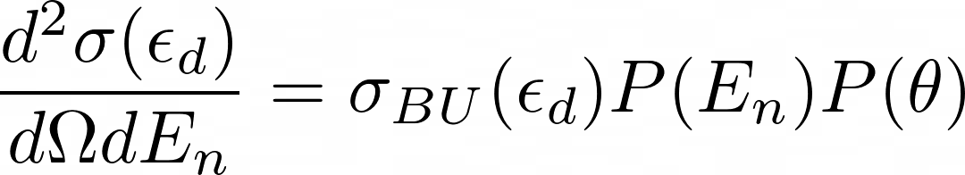
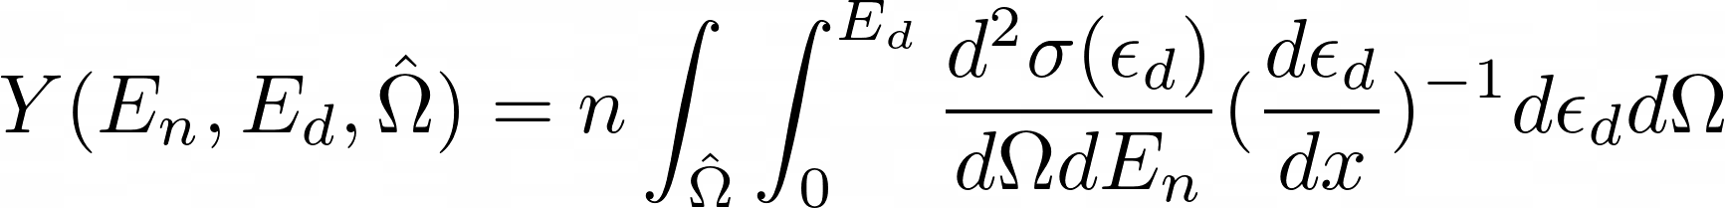

Jon Morrell* developed a combined 5 parameter model that describes the double-differential TTDB neutron production cross section
P(E_{n},𝛳) from R. Serber¹ (Phys. Rev. 72, 11 (1947)
Pre-equilibrium cross section from Kalbach²
Talys Maxwell-Boltzmann evaporation
One flat background parameter
Slowing (dε_{d}/dx) from SRIM
Fit yields to measurements and literature data^{3,4}
¹R. Serber, Phys. Rev 72, 11 (1947)
²C. Kalbach Phys. Rev. C 95, 014606 (2017).
³Meulders (1975) - 16, 33, 50 MeV
⁴Saltmarsh (1977) - 40 MeV
1 parameter each
Shape & Magnitude
Our Results were just published: J.T. Morrell et al., Phys. Rev. C 108, 024616 (2023). https://doi.org/10.1103/PhysRevC.108.024616
*UCB Ph.D. 2021, now at LANL
Jon Morrell

Slide 5
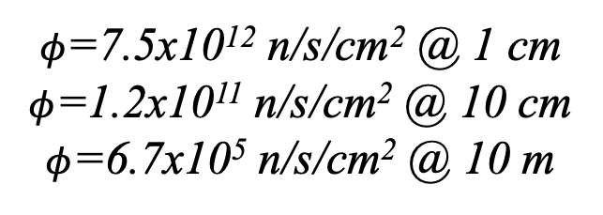
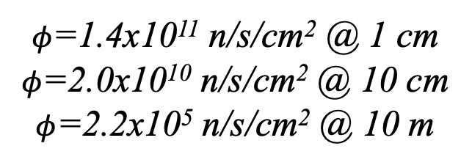
We benchmarked the model for 40 MeV deuterons on a thick Be breakup target
40 MeV deuterons*
$φ$=1.4x10¹¹ n/s/cm² @ 1 cm
$φ$=2.0x10¹⁰ n/s/cm² @ 10 cm
$φ$=2.2x10⁵ n/s/cm² @ 10 m
50 MeV deuterons*
$φ$=7.5x10¹² n/s/cm² @ 1 cm
$φ$=1.2x10¹¹ n/s/cm² @ 10 cm
$φ$=6.7x10⁵ n/s/cm² @ 10 m
Spectral variation as a function of angle allows for simultaneous measurements
*Assumes 20 µA beam and 0°

Slide 6
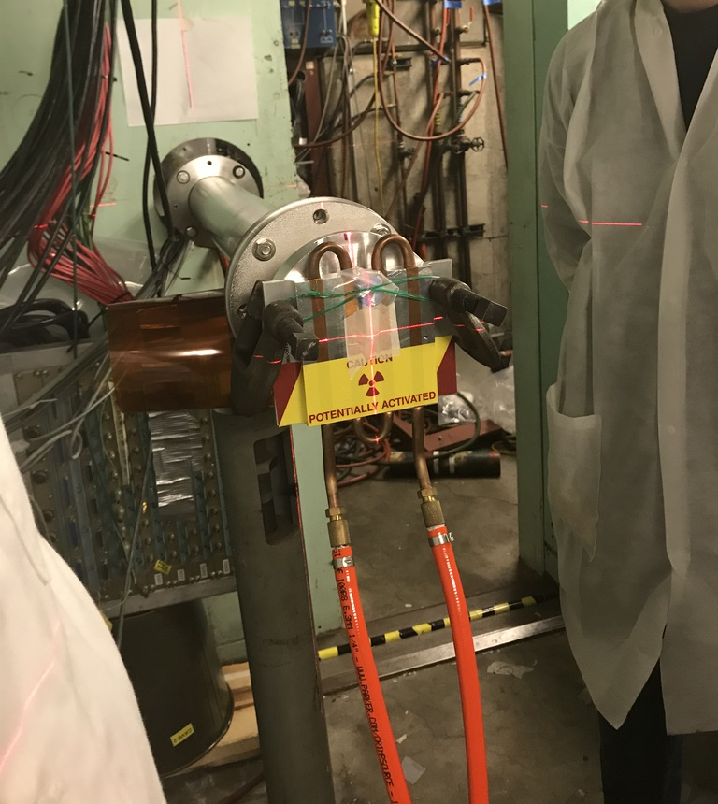
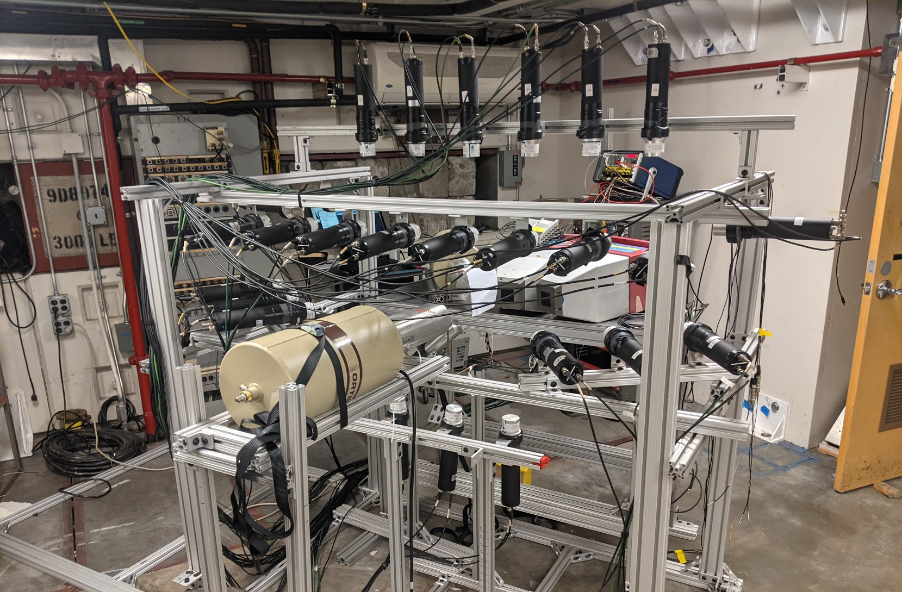
TTDB neutron beams are available at two caves at the 88-Inch cyclotron*
Cave 0 (This talk)
High-level cave capable of running up to 1.5 kW of beam power (ASE limit).
Breakup in Vault or Cave.
Max flux : 10¹² n/s/cm²
Cave 5 (See J.A. Brown’s talk)
“TOF Quality” flight path from 7-22 m.
Irradiation Jig
GENESIS
*The 88-Inch Cyclotron: A one-stop facility for electronics radiation and detector testing. M.Kireeff-Covo et al.,. Measurement, 127, (2018), p. 580-587.https://doi.org/10.1016/j.measurement.2017.10.018 .

Slide 7
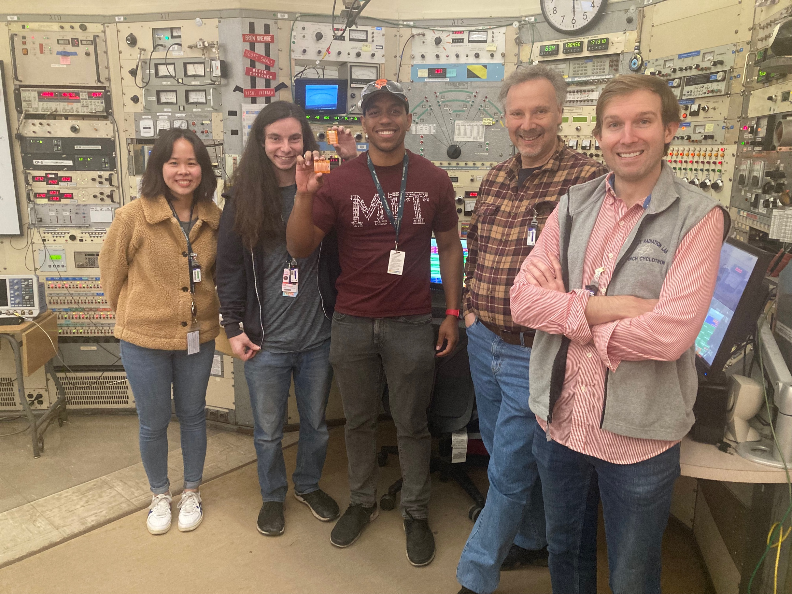
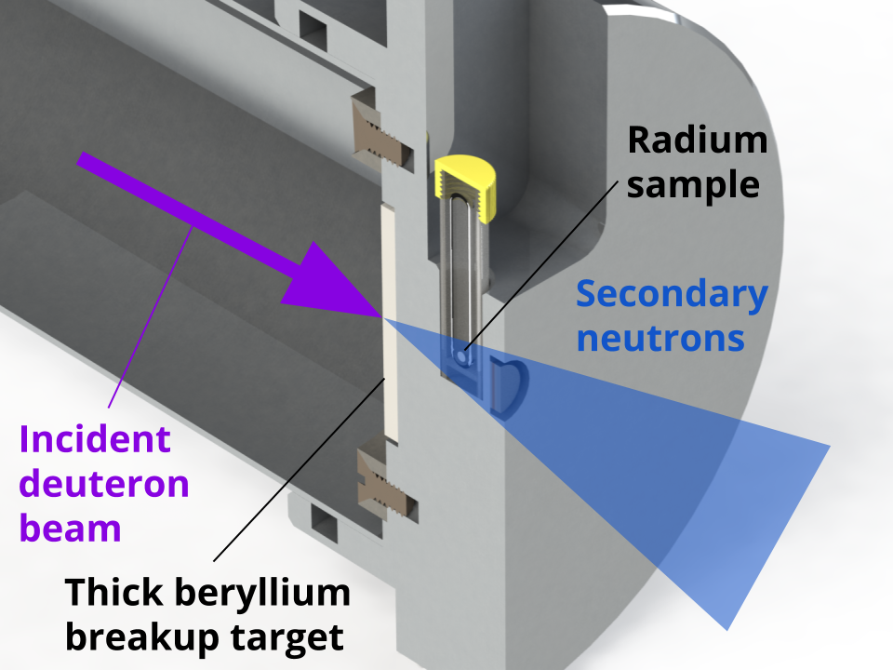
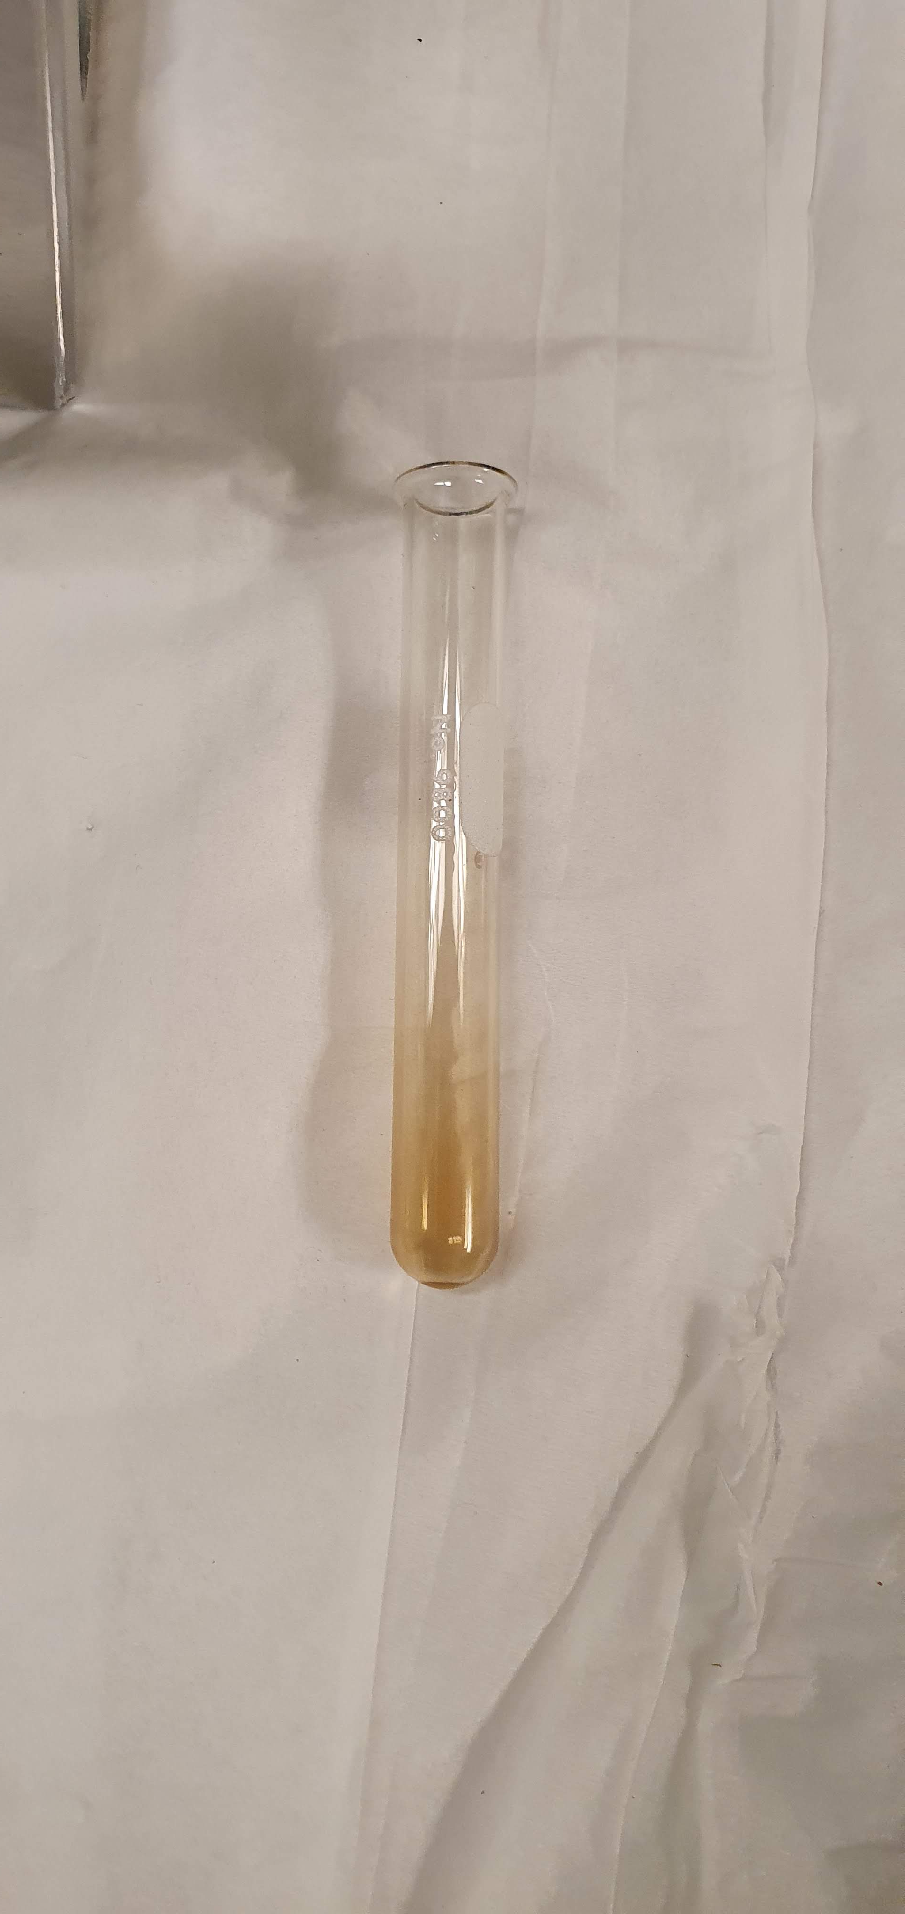
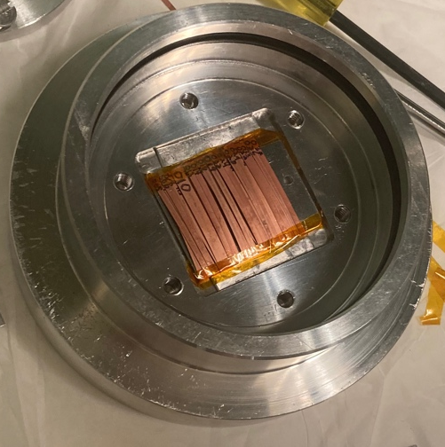
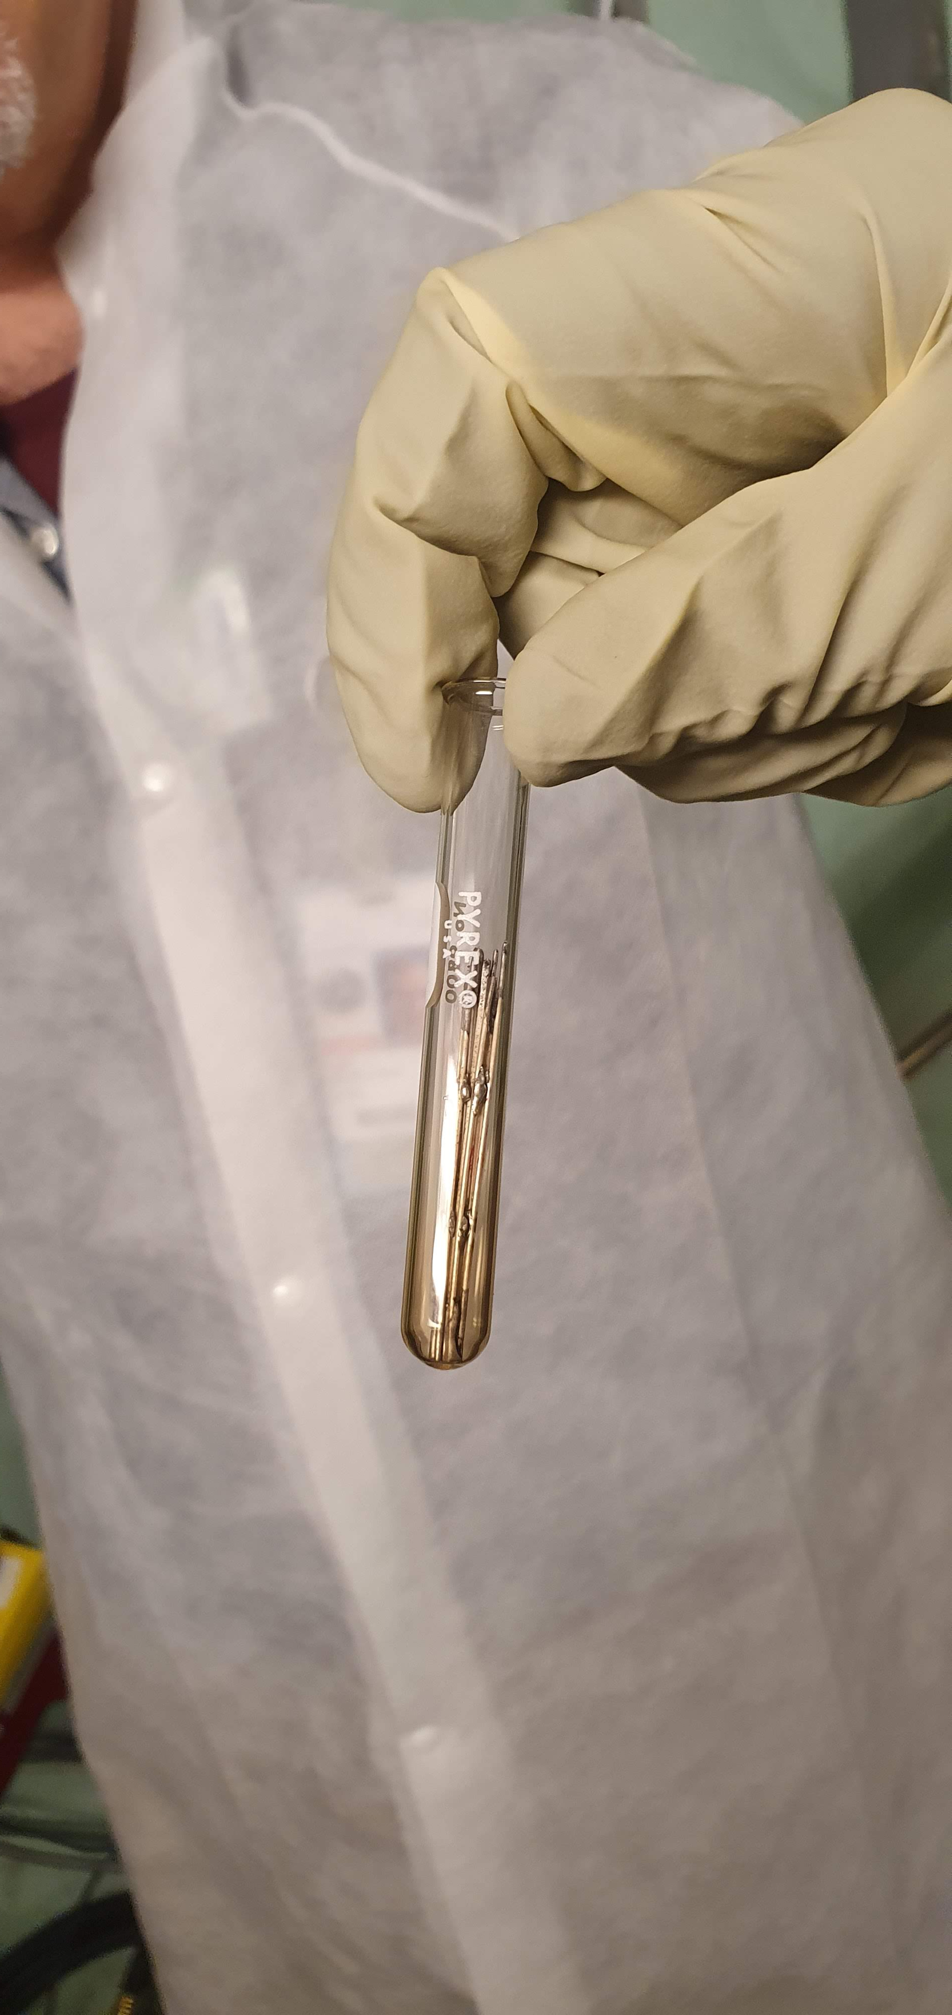
REBCO and BSCCO Irradiation “Volunteers” at the 88-Inch cyclotron
(20 hours @ a total integrated charge of 0.2 Coulomb)
BSCCO
samples
Elan
Park-Bernstein
(UG)
Chris Reis
(GS)
Andrew
Voyles (Staff)
Abby Lee
(GS)
Lee
Bernstein
REBCO
BSCCO
BSCCO

Slide 8
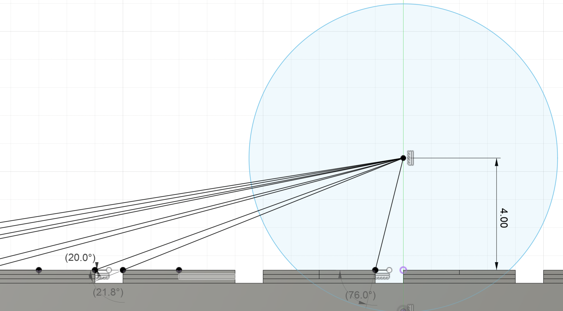
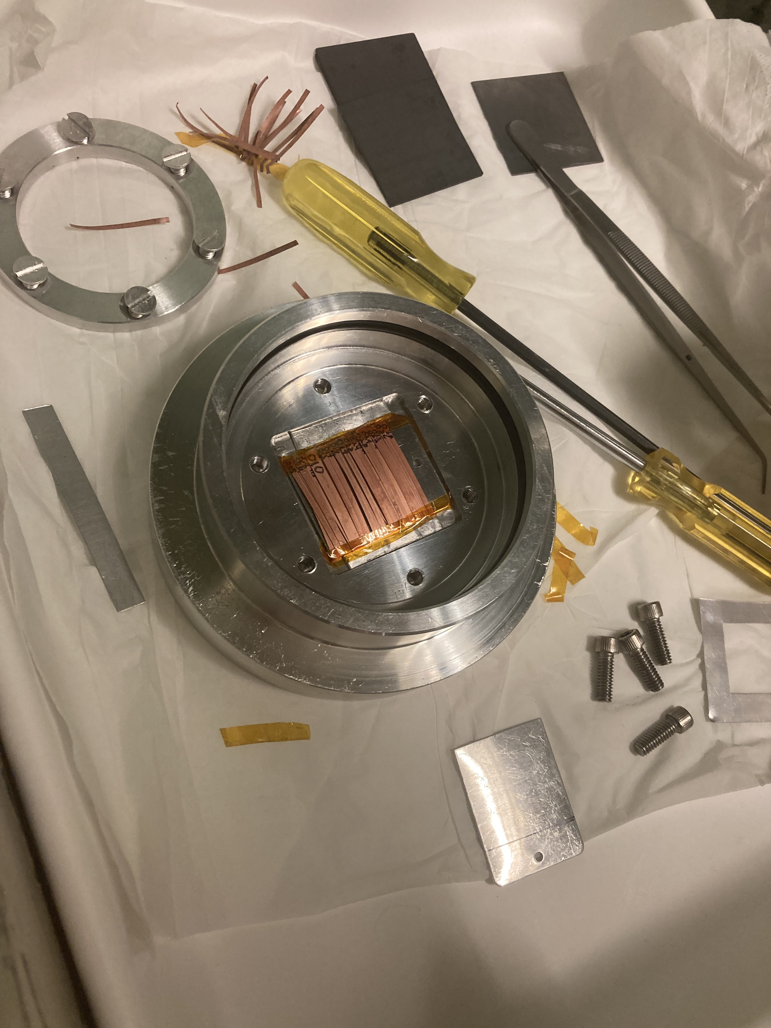
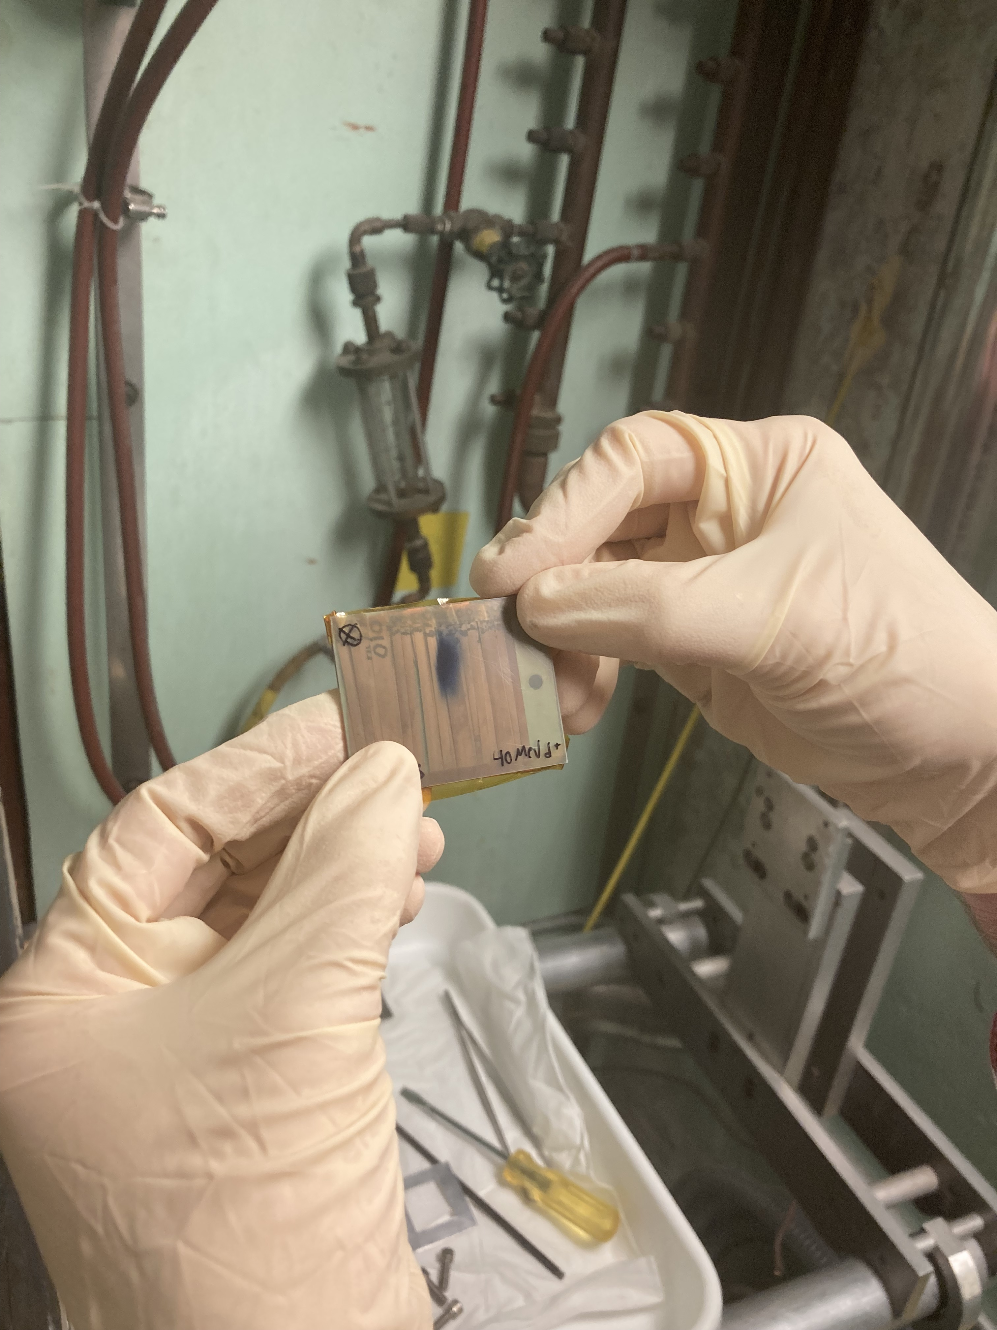
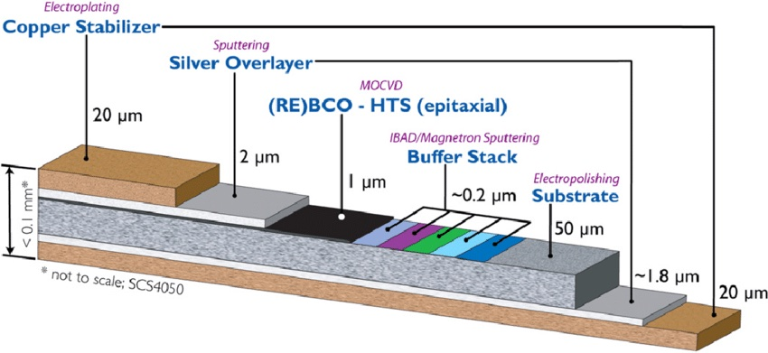
There is significant variation in flux across the different REBCO strips due to their proximity to the deuteron beam
REBCO Strips in HEIFER
Gafchromic Overlay
Approximately ½ of each foil is in-line with the deuteron beam
REBCO
Elan is developing a Monte-Carlo integration code to calculate the spectrum over each REBCO strip
Hastelloy (mostly Ni)

Slide 9
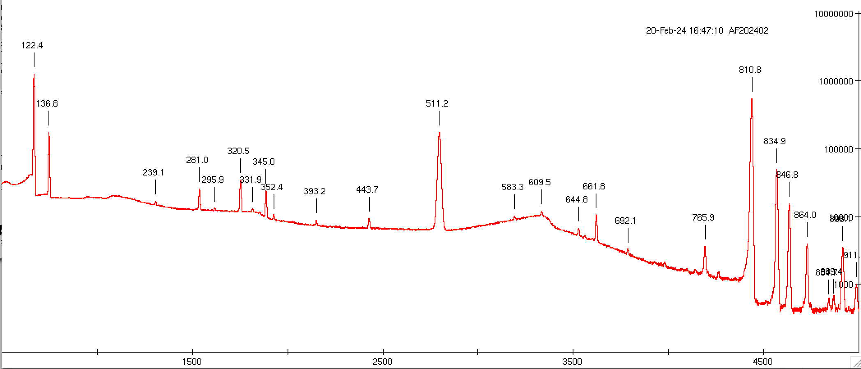
REBCO Low Energy (14° < θ < 68°)
⁵⁷Co
⁵⁸Co
¹³⁷Cs from
¹³⁸Ba(n,pn)
⁵⁶Co
0.2 A•s irradiation @ E_{d}=40 MeV

Slide 10
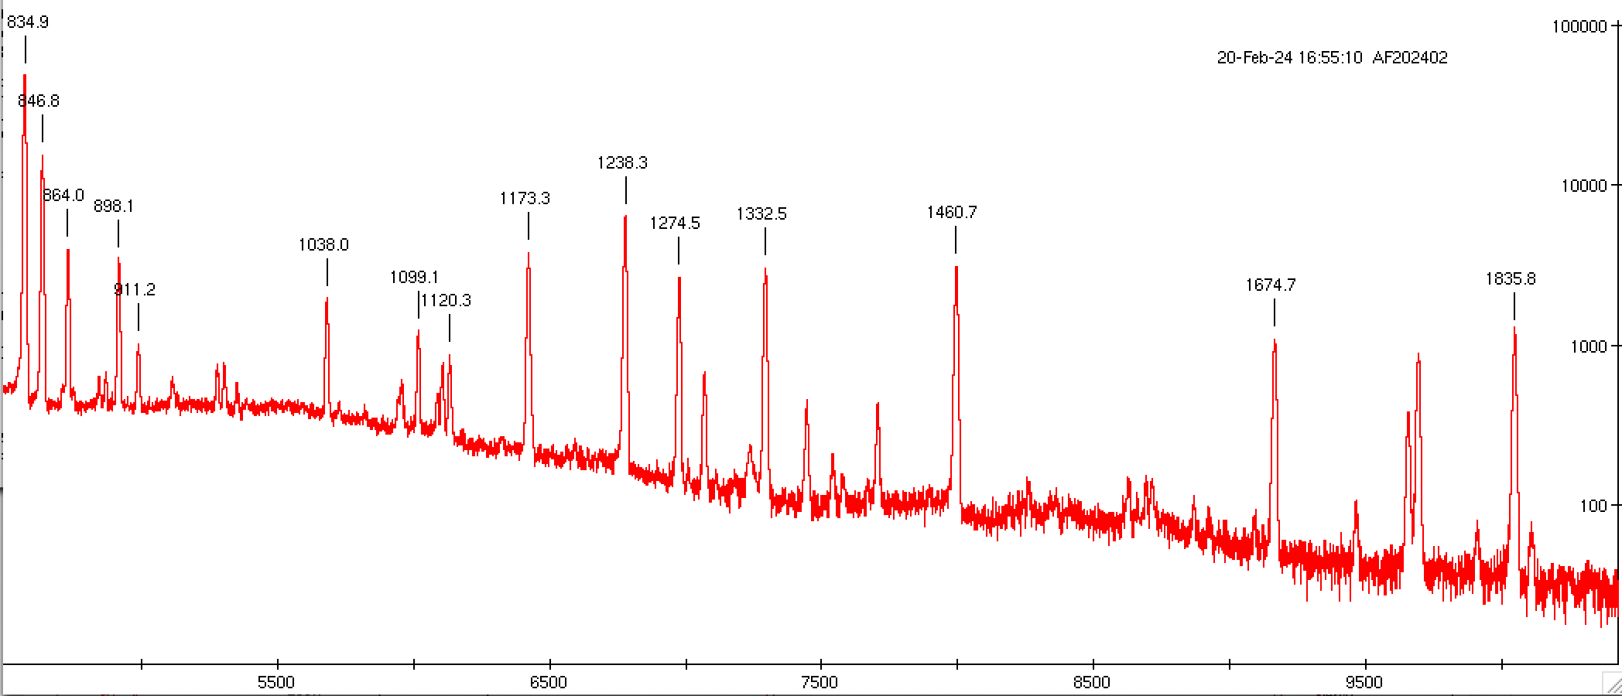
REBCO Low Energy (14° < θ < 68°)
⁶⁰Co from
⁶³Cu(n,α)
⁵⁶Co
⁸⁸Y
⁸⁸Y
⁴⁰K (bg)
⁵⁹Fe
⁵⁹Fe from
⁶²Ni(n,α)
0.2 A•s irradiation @ E_{d}=40 MeV

Slide 11
How do our measured conversion fractions compare to predictions from our neutron model?
Can assay H production from ⁵⁶⁻⁵⁸Co
(n,p) data above 20 MeV is essential
He production can be calculated
IFMIF & FPNS use 40 MeV deuterons
This energy might be too high!
VERY Preliminary !!!
θ₁ | θ₂ | ⁵⁶Co (x1000) ppb | ⁵⁷Co (ppb) | ⁵⁸Co (ppb)
80 | 81 | 0.68 | 0.04 | 0.12
76 | 79 | 1.34 | 0.07 | 0.19
79 | 80 | 1.16 | 0.06 | 0.16
70 | 75 | 2.68 | 0.14 | 0.34
14 | 68 | 61.52 | 1.72 | 2.12
Similar values (0.7 ppb) were seen in the BSCCO from ¹⁰⁷Ag(n,2n)¹⁰⁵Ag
ENDF +
Simple Geometry
1.46
1.81

Slide 12
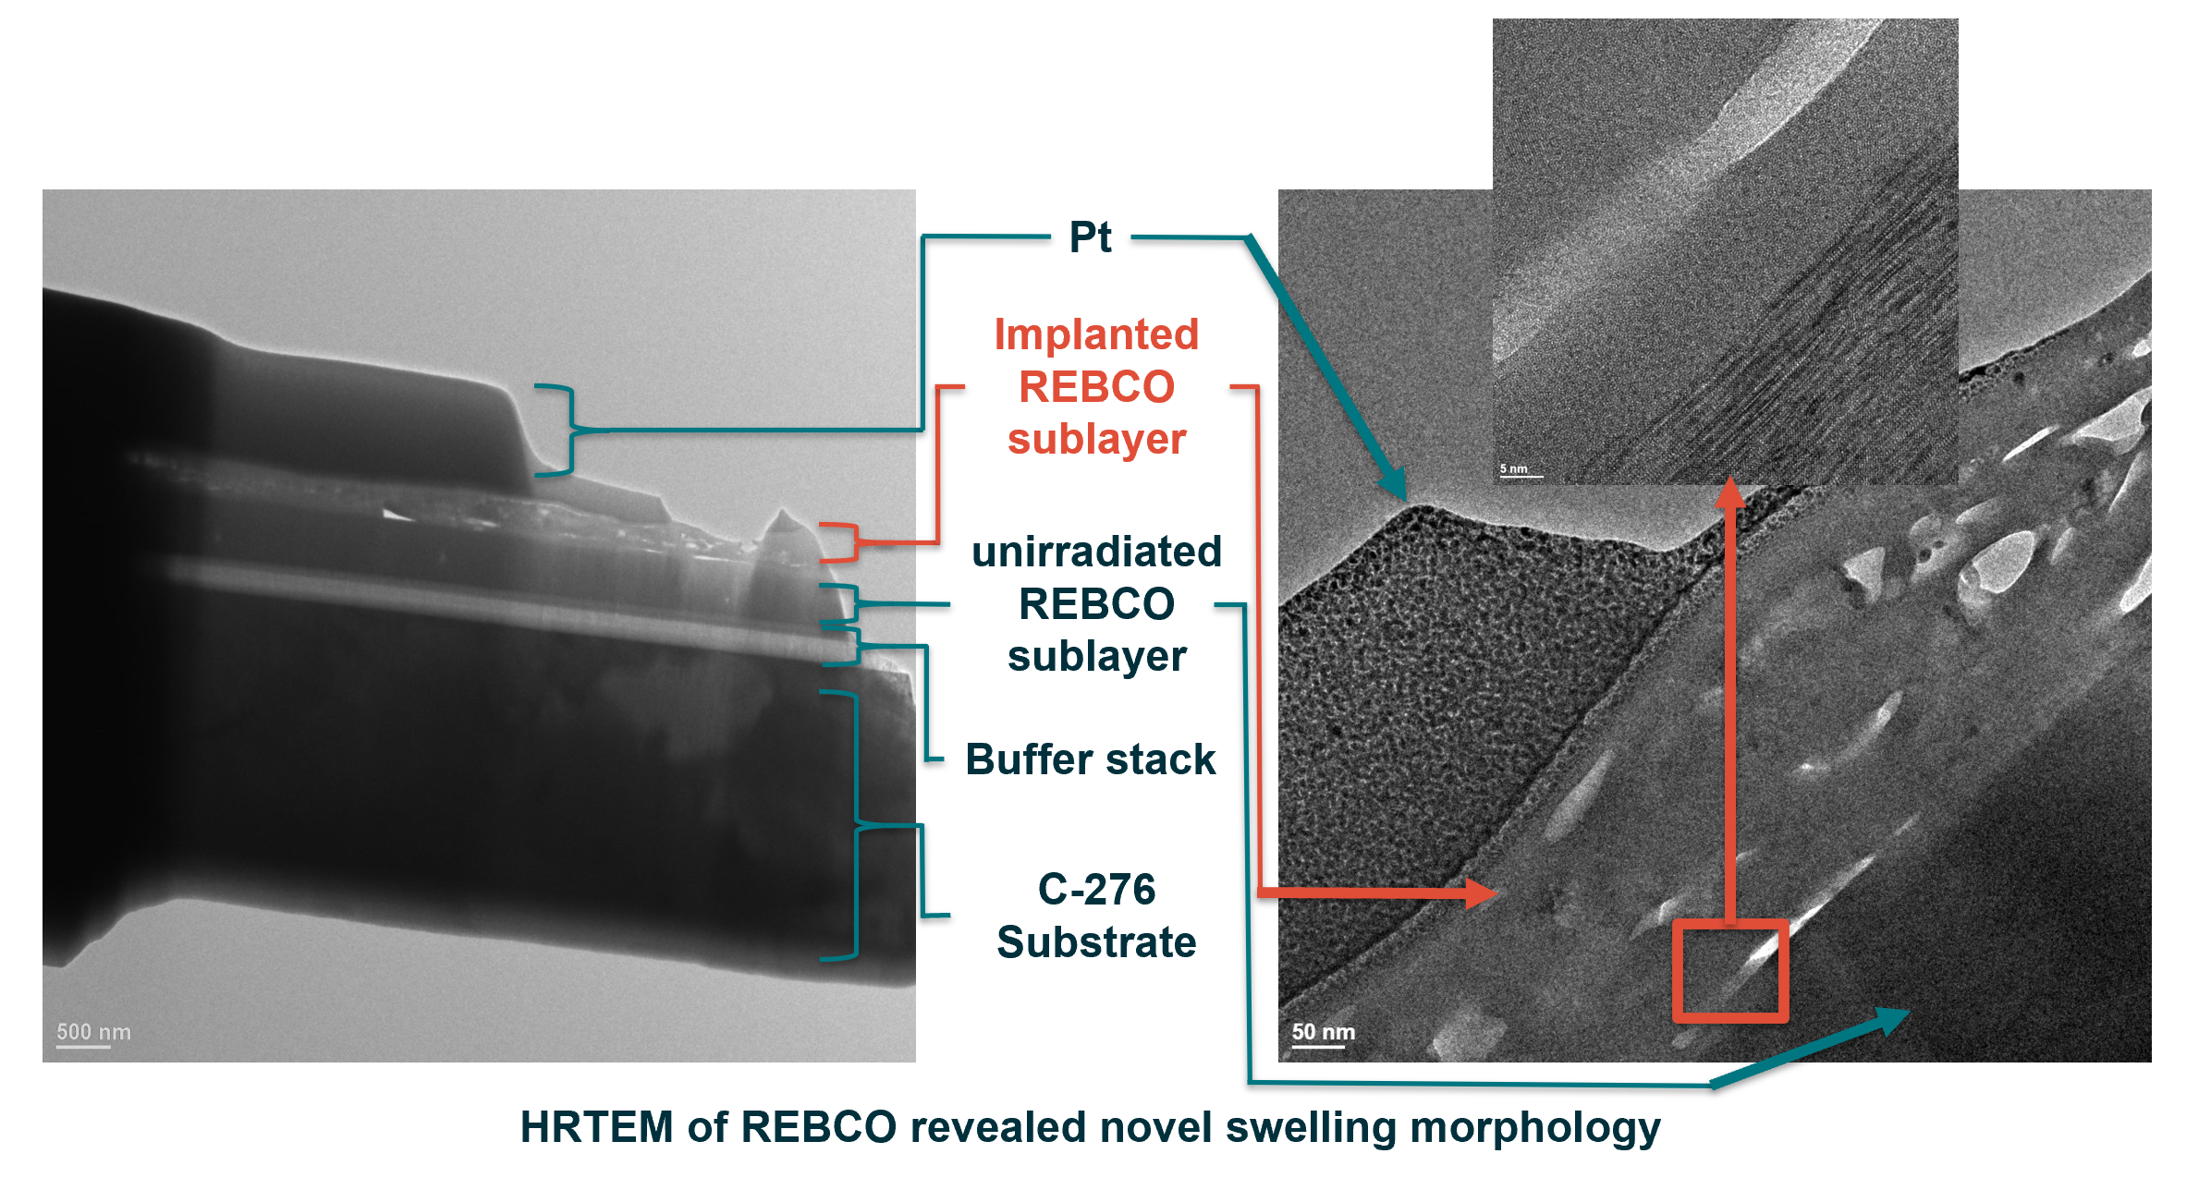
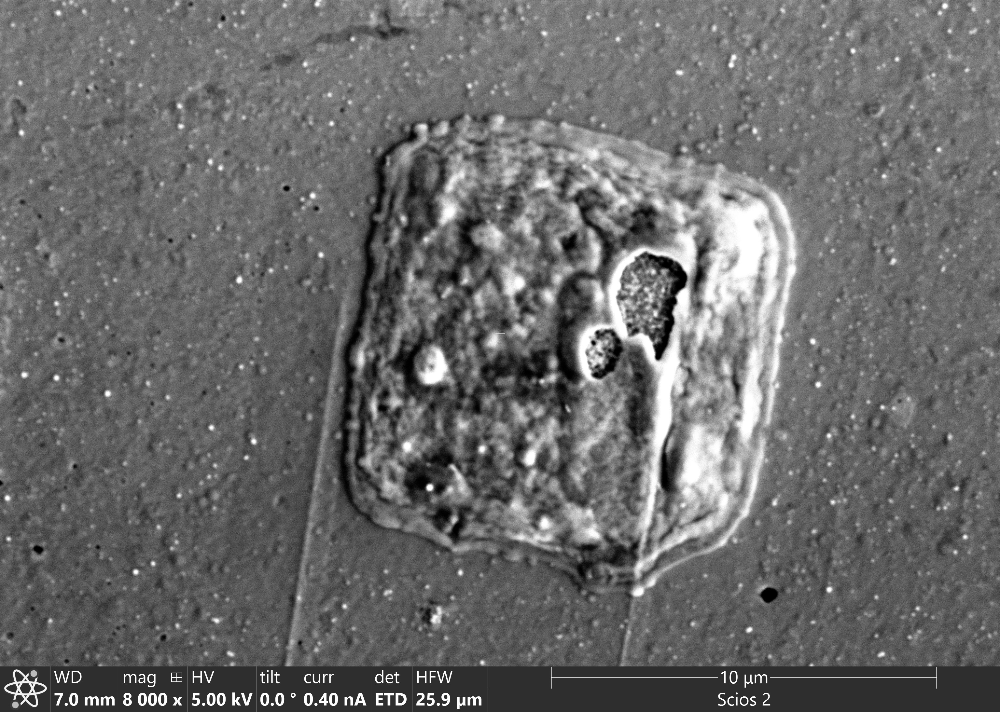
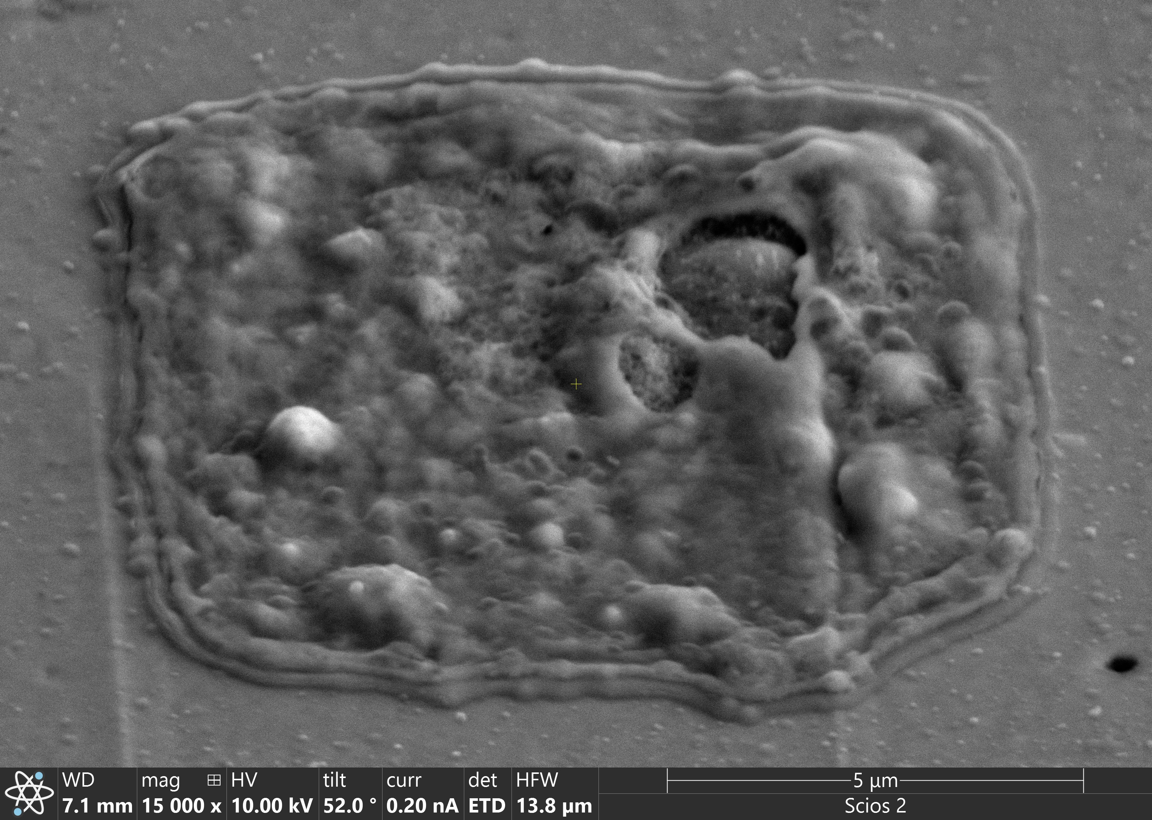
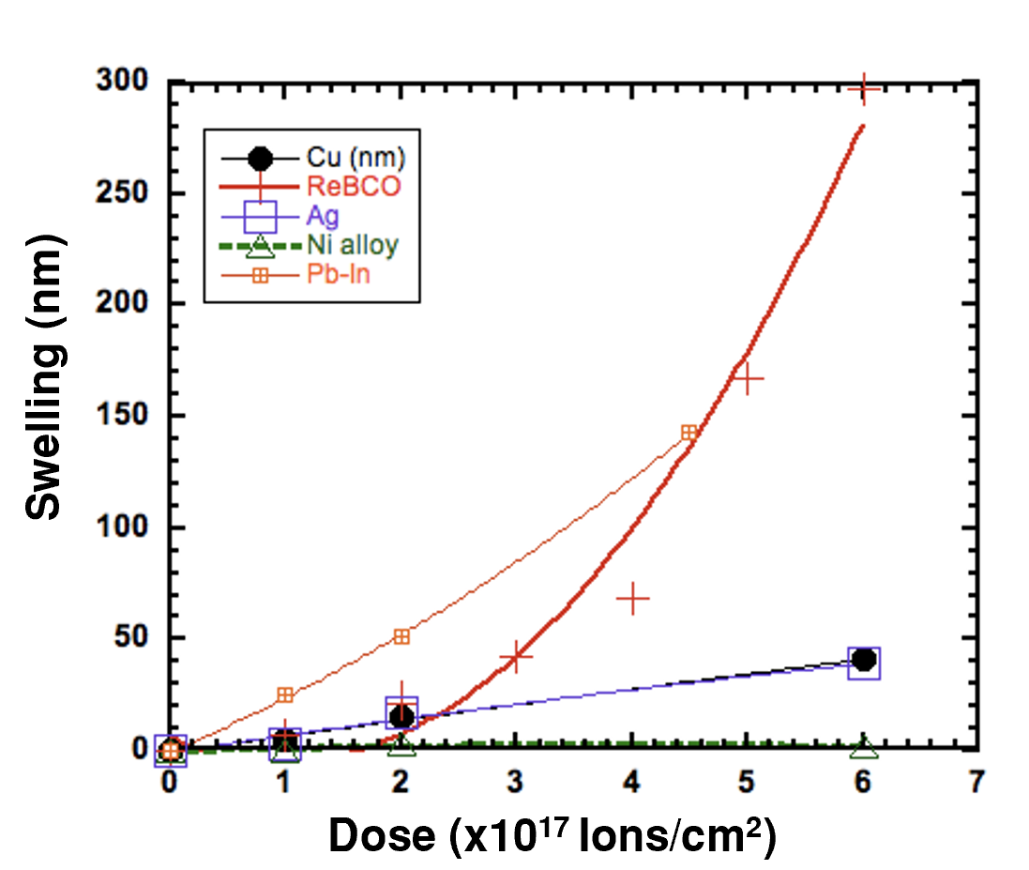
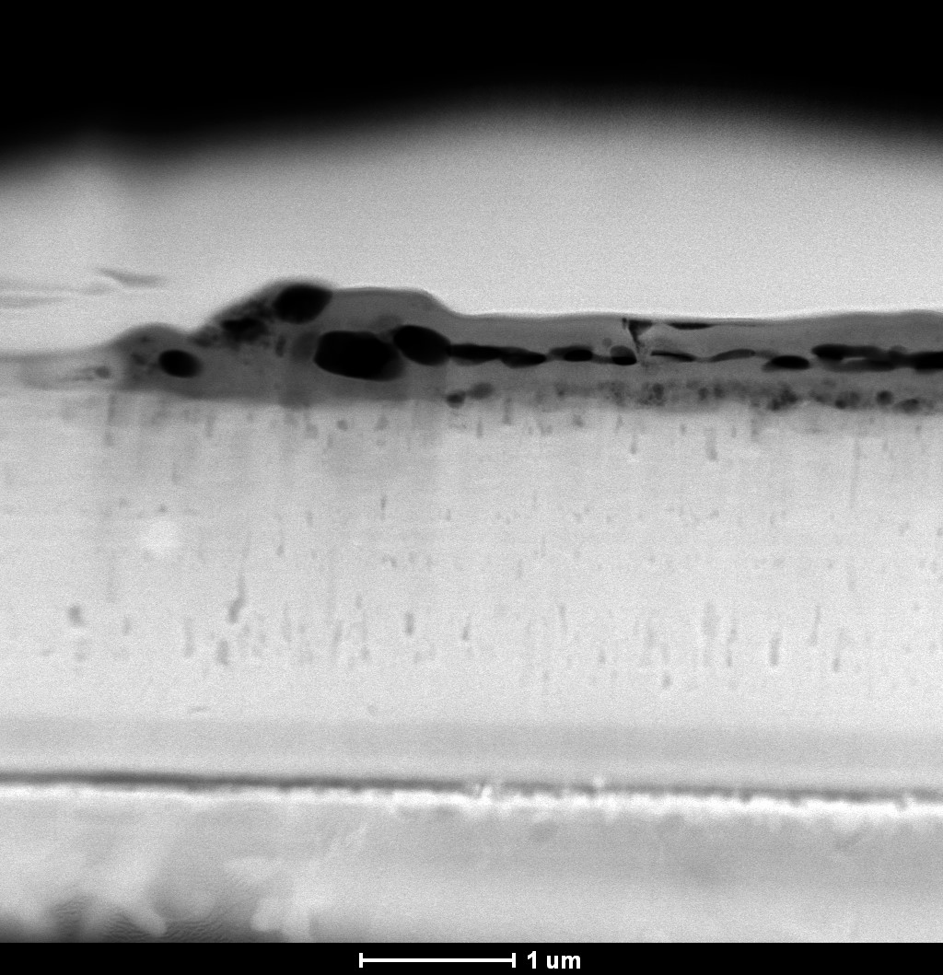

Chris Reis is spearheading Gas Production/Materials Characterization at UC Berkeley with Hosemann Nuclear Materials Group and LBNL’s Molecular Foundry
Work at the Molecular Foundry was supported by the Office of Science, Office of Basic Energy Sciences, of the U.S. Department of Energy under Contract No. DE-AC02-05CH11231.

Slide 13
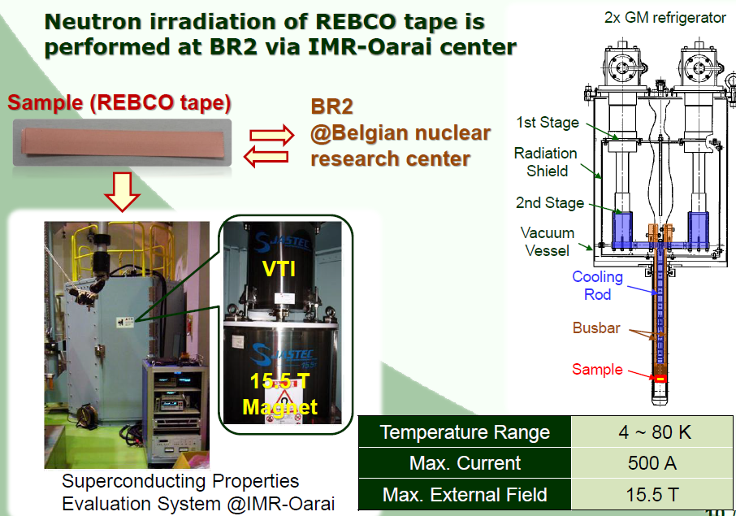





US-Japan High Energy Physics Collaboration to aid with superconductivity measurements using VTI Probe at IRCNMS
US-Japan HEP collaboration LBNL Leads Chris Reis, Tengming Shen, et. al coordinating with KEK collaborators Toru Ogitsu, Masami Iio, et. al to assess radiation effects on superconductivity
15.5 Tesla Variable Temperature Insert (VTI) specially designed for hot samples to be used at International Research Center for Nuclear Materials Science (IRCNMS)
Changes to Critical Current, Critical Temperature, n-value, Irreversibility field, etc., are key parameters to be assayed.
Members of the US Magnet Development Program
Notes:
IRCNMS - International Research Center for Nuclear Materials Science
VTI - Variable Temperature Inserts

Slide 14
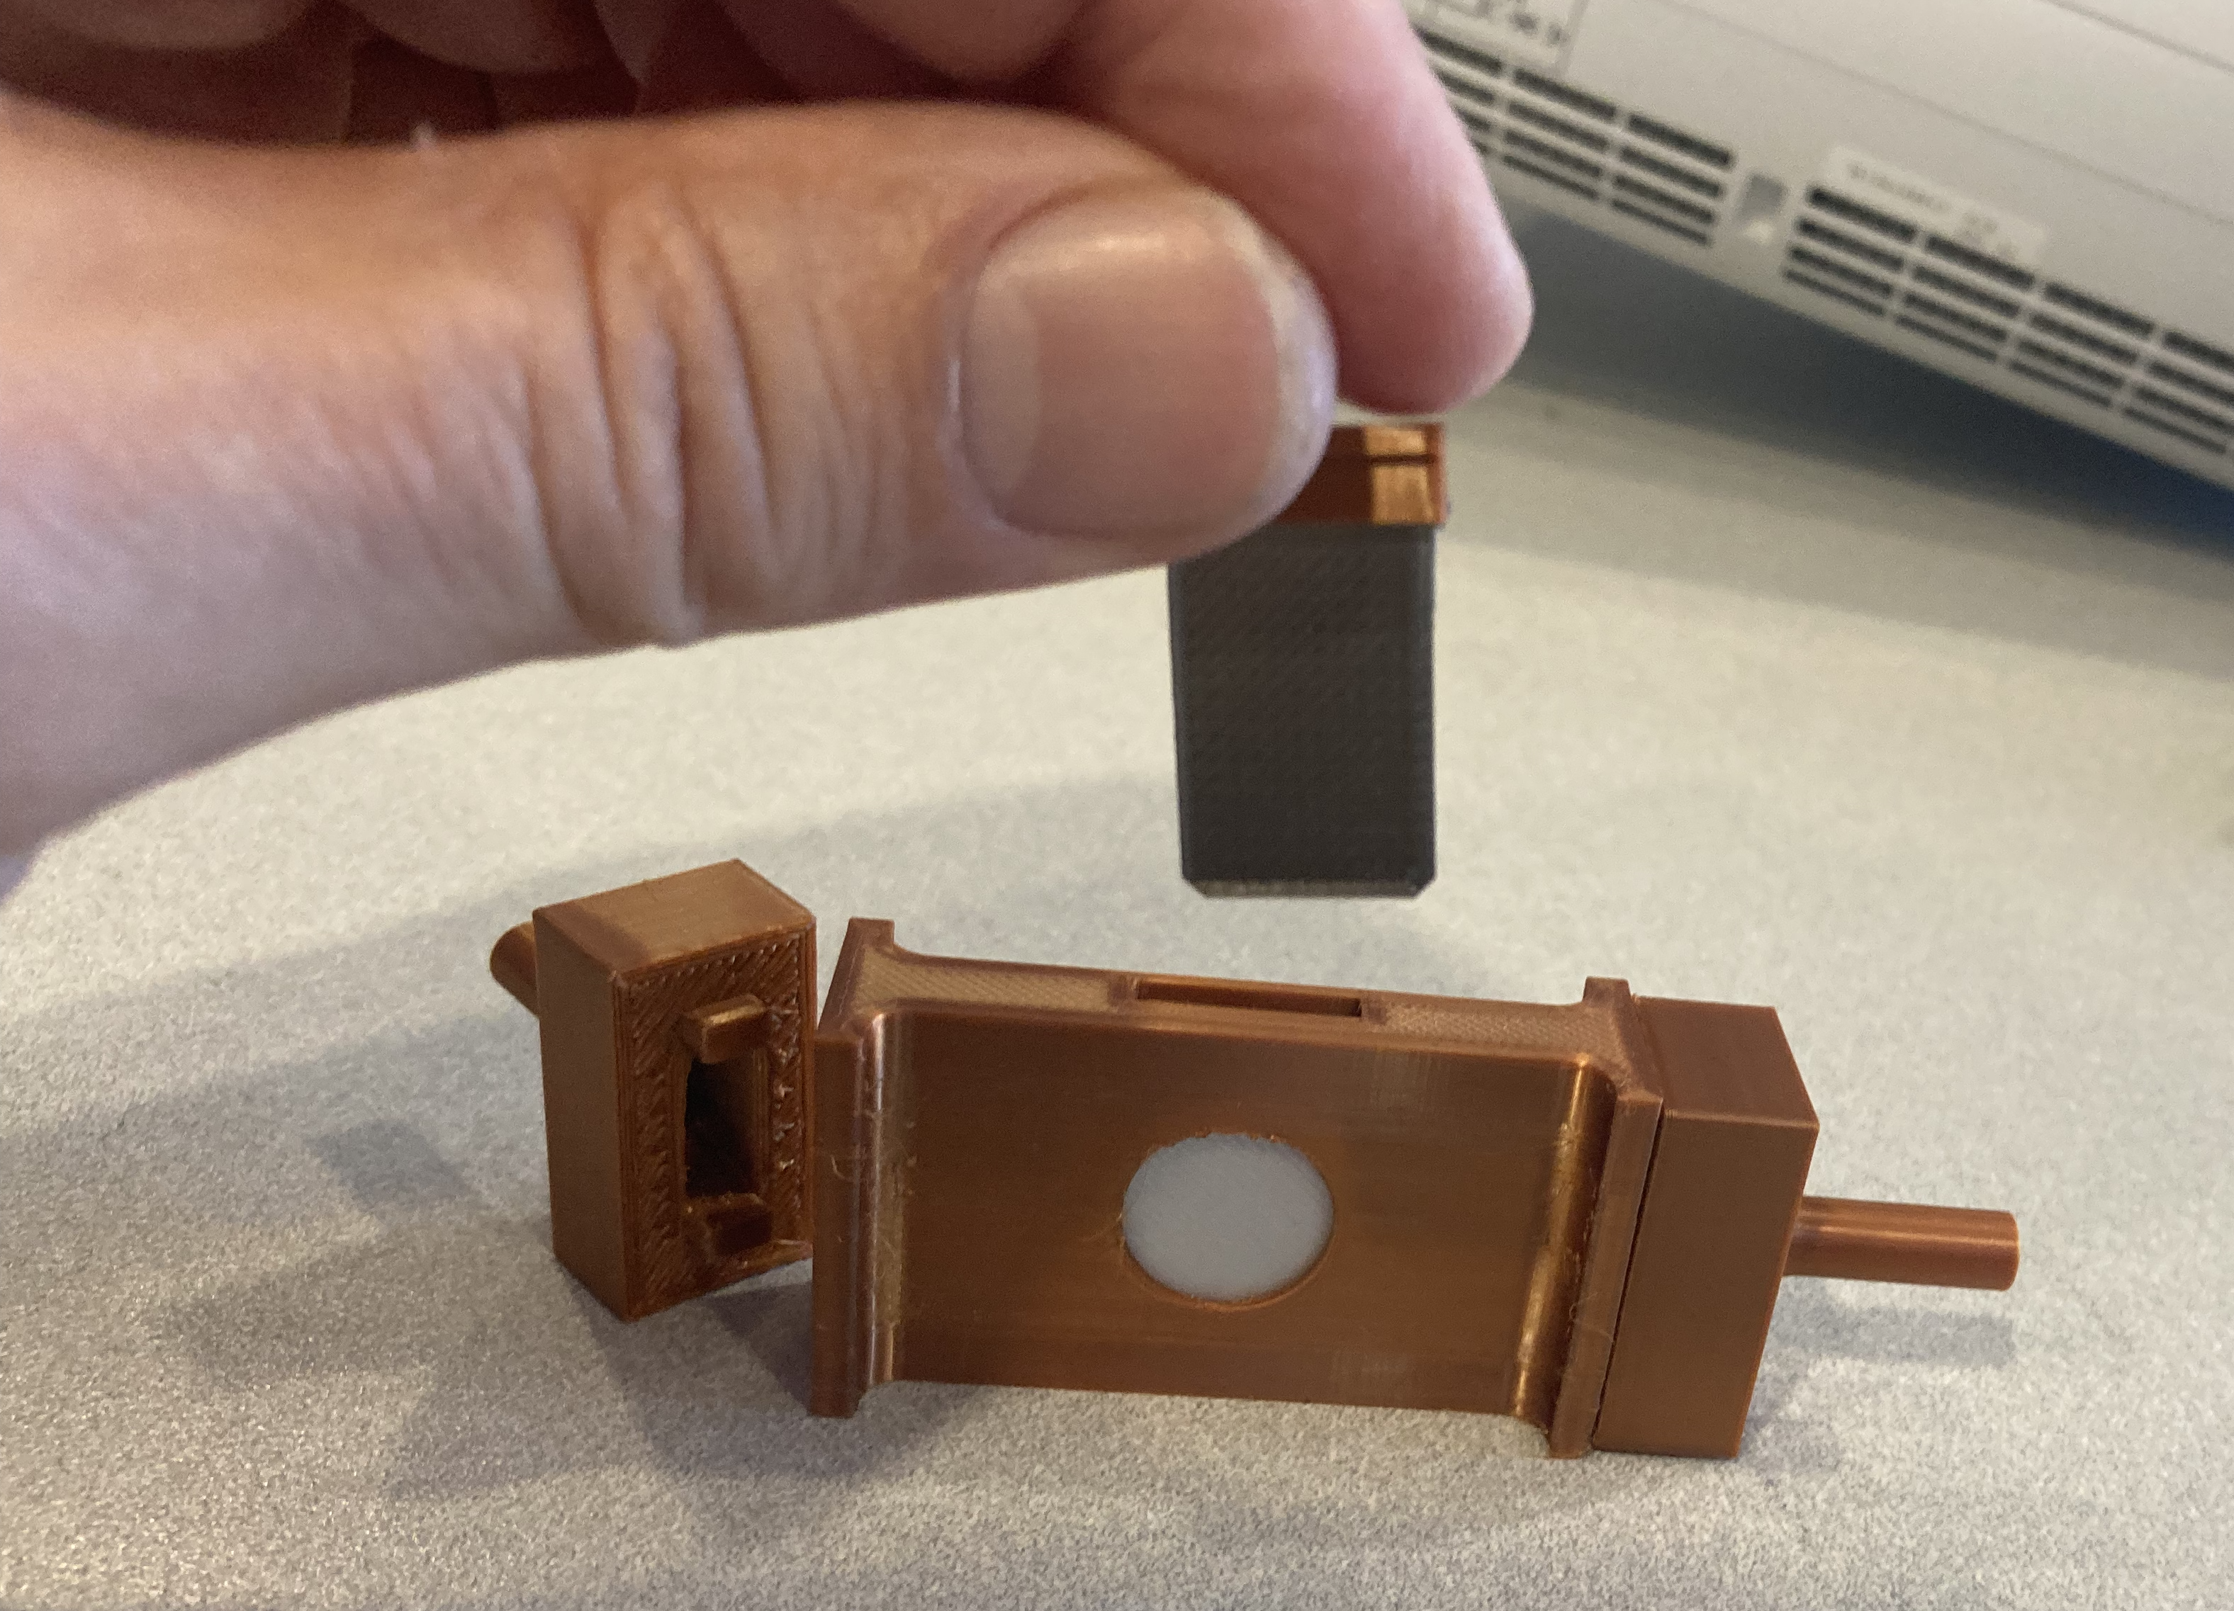
Conclusions
Summary
Several ppb of the Ni in the sample were transformed to Co during a short low-intensity run, making H in the process. Helium production would be similar.
Lots of Y reactions products (Is this a big problem?)
A full scale run (x25 integrated charge at 0°) would yield 0.1-0.2 ppm gas production plus lots of displacements and secondary particle production
Future plans
Perform cryogenic (LN) irradiations using a new jig being designed by the Hosemann/Prestemon group
Test a new high-intensity Beryllium target developed with a corporate partner (NorthStar)
Irradiate NIF final stage optics as part of the new IFE-STARFIRE collaboration

Slide 15




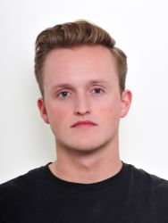

Collaborators and Acknowledgments
L.A. Bernstein^{1,2}, C. Gesteland¹, P. Hosemann¹, Y.-H. Lee¹, M. Nair¹, E.B. Park-Bernstein¹, S. Prestemon², C. Reis^{1,2}, T. Shen², A.S. Voyles¹
¹University of California – Berkeley Department of Nuclear Engineering
²Lawrence Berkeley National Laboratory
Mehul Nair
Peter Hosemann
This work has been performed under the auspices of the U.S. Department of Energy by Lawrence Berkeley National Laboratory under contract No. DE-AC02-05CH1123 and the US Nuclear Data Program
Tengming Shen
Soren Prestemon
Chase Gesteland

