Slide 1
Resolving ³⁵Cl Nuclear Data Uncertainties
Tommy Cisneros
February 28, 2024

Slide 2
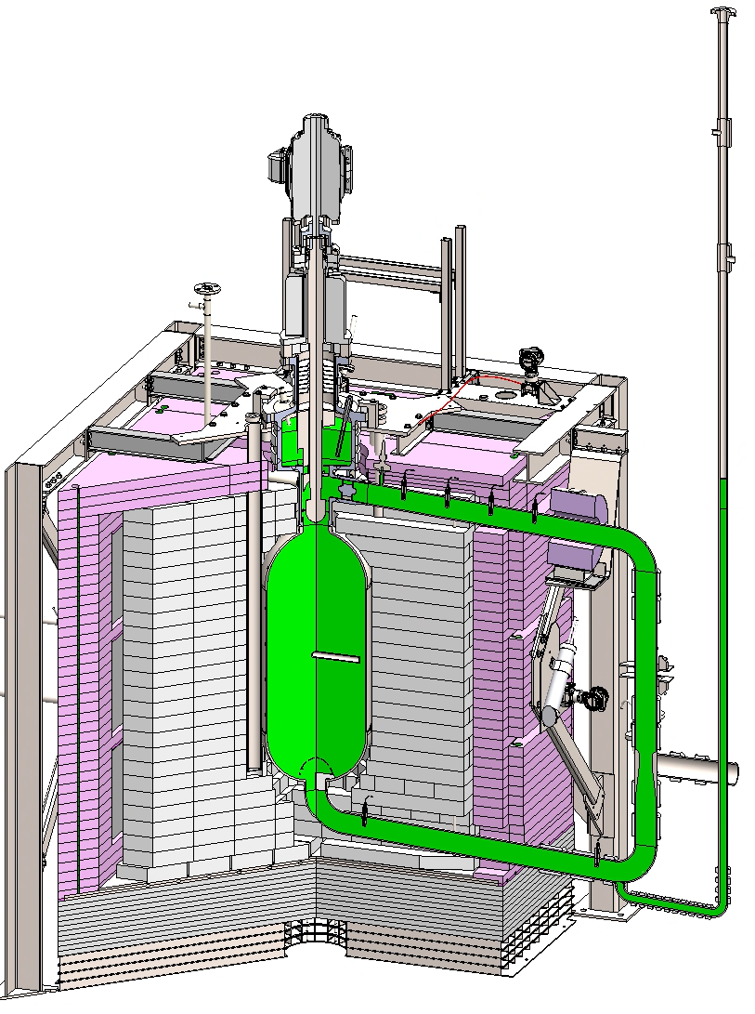
Molten Chloride Reactor Experiment
Molten Chloride Reactor Experiment (MCRE) is a chloride salt fuel, fast neutron spectrum, molten salt reactor.
MCRE is fueled with a NaCl-UCl₃ eutectic fuel salt with natural chlorine.
Preliminary analysis shows that reactivity in MCRE may change by ~2200 pcm depending on which ³⁵Cl evaluation used – this sensitivity is driven primarily by the ³⁵Cl(n,p) cross section.
Risk Reduction
Notes:
From MCRE-ENG-PRSNT-0034

Slide 3
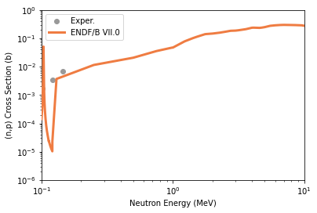
Recent History of Chlorine Nuclear Data
Separate Cross Sections for ³⁵Cl and ³⁷Cl respectively
?
Covariance
2006
2011
2019
2020
2021
2021
2022-2024
ENDF/B VII.0
ENDF/B VII.1
Batchelder et al
Kuvin et al
Warren
Berkeley NEUP
LANL/TP GAIN

Slide 4
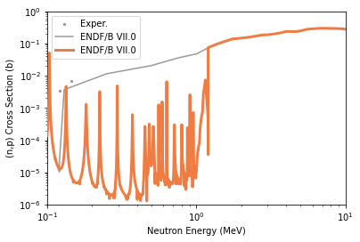
Recent History of Chlorine Nuclear Data
Resonance update between 100 keV and 1.2 MeV
Covariance Matrices added to evaluation
Covariance
2006
2011
2019
2020
2021
2021
2022-2024
ENDF/B VII.0
ENDF/B VII.1
Batchelder et al
Kuvin et al
Warren
Berkeley NEUP
LANL/TP GAIN
Notes:
ENDF/B VII.1 updated the resonance parameter evaluation in the resolved resonance regions with the multilevel Reich-Moore R-matrix formalism – that evaluation used new capture and transmission measurements from the Oak Ridge Electron Linear Accelerator (ORELA) which produced data up to 1.2 MeV.
This evaluation focused on the 35Cl(n,p) up to the 103.5 keV resonance and the 35Cl(n,gamma) resonances, and the 35Cl(n,p) cross section was unconstrainted between 103.5 keV and 1.2 MeV.
This evaluation gave uncertainties in the resonance parameters from which an uncertainty matrices could be derived – this evaluation did identify large uncertainties for the 35Cl(n,p) reaction.

Slide 5
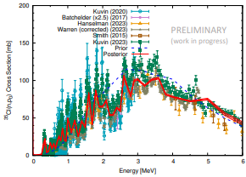
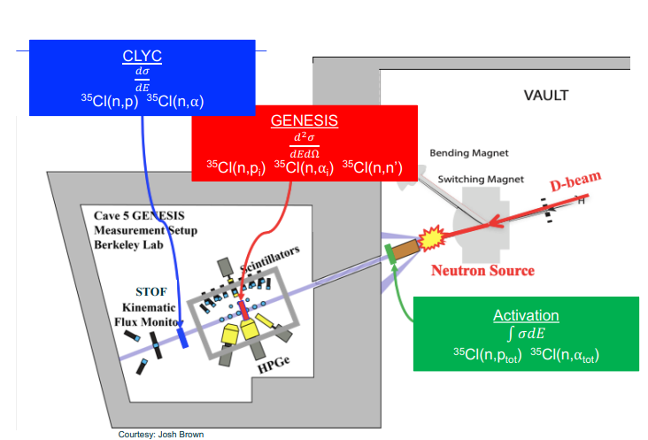
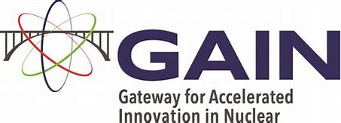
Progress in Chlorine Nuclear Data
Edwards Accelerator Lab

Slide 6
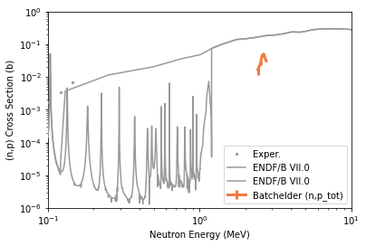
Recent History of Chlorine Nuclear Data
Non-Statistical Structure Observed
Large discrepancy where there is no covariance
Covariance
?
2006
2011
2019
2020
2021
2021
2022-2024
ENDF/B VII.0
ENDF/B VII.1
Batchelder et al
Kuvin et al
Warren
Berkeley NEUP
LANL/TP GAIN

Slide 7
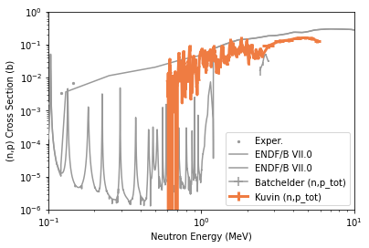
Recent History of Chlorine Nuclear Data
Non-Statistical Structures Corroborated
Covariance
?
2006
2011
2019
2020
2021
2021
2022-2024
ENDF/B VII.0
ENDF/B VII.1
Batchelder et al
Kuvin et al
Warren
Berkeley NEUP
LANL/TP GAIN

Slide 8
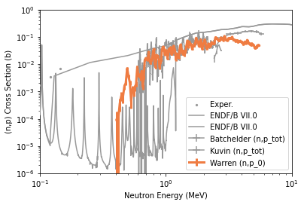
Recent History of Chlorine Nuclear Data
Non-Statistical Structures and Cross Section Scale Corroborated
Covariance
?
2006
2011
2019
2020
2021
2021
2022-2024
ENDF/B VII.0
ENDF/B VII.1
Batchelder et al
Kuvin et al
Warren
Berkeley NEUP
LANL/TP GAIN

Slide 9
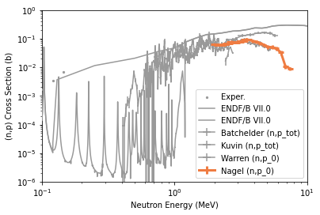
Recent History of Chlorine Nuclear Data
Cross Section Scale Corroborated
Covariance
?
2006
2011
2019
2020
2021
2021
2022-2024
ENDF/B VII.0
ENDF/B VII.1
Batchelder et al
Kuvin et al
Warren
Berkeley NEUP
LANL/TP GAIN

Slide 10
Uncertainty Analysis with ENDF/B VII.1 Data
MCRE reactivity is most sensitive to the nuclear data in the region where there are known discrepancies.
The discrepancies below 1.2 MeV are not bounded by the covariance matrix and there is no covariance estimate above 1.2 MeV
Uncertainty calculated using traditional methods resulted in ±55 pcm where as k-eff calculated using different evaluations resulted in differences of ±2200 pcm

Slide 11
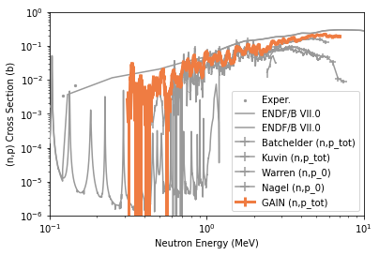
Recent History of Chlorine Nuclear Data
Non-Statistical Structures and Cross Section Scale are Corroborated
Updates to Cross Section Evaluation
Updated Covariance
Covariance
?
2006
2011
2019
2020
2021
2021
2022-2024
ENDF/B VII.0
ENDF/B VII.1
Batchelder et al
Kuvin et al
Warren
Berkeley NEUP
LANL/TP GAIN

Slide 12
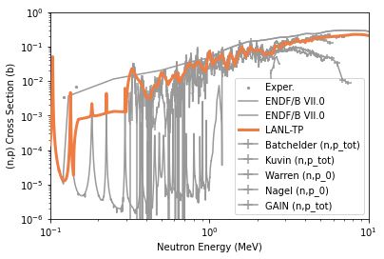
Recent History of Chlorine Nuclear Data
Non-Statistical Structures and Cross Section Scale are Corroborated
Updates to Cross Section Evaluation
Updated Covariance
Covariance
2006
2011
2019
2020
2021
2021
2022-2024
ENDF/B VII.0
ENDF/B VII.1
Batchelder et al
Kuvin et al
Warren
Berkeley NEUP
LANL/TP GAIN

Slide 13
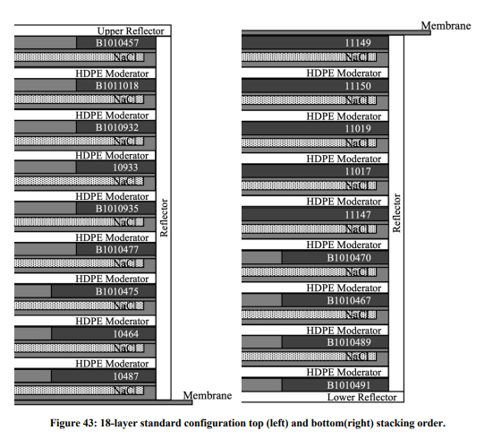
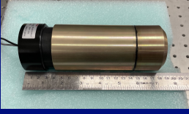
Future of Chlorine Nuclear Data
Theory & Experiment
Evaluation
Data Processing
Transport Codes
Verification & Validation
User

Slide 14
Conclusions
TerraPower needed better ³⁵Cl nuclear data than what is currently available in ENDF
³⁵Cl (n,p) cross sections,
Updated covariance matrix
The nuclear data community has performed a lot of really good work to measure this cross section
Los Alamos National Laboratory
UC Berkeley
University of Ohio
Los Alamos has produced an updated ³⁵Cl nuclear data evaluation including an updated ³⁵Cl covariance matrix in the fast energy region
These updates should be incorporated in future releases of nuclear evaluation data evaluation libraries
It is important to continue supporting measuring ³⁵Cl nuclear data and experiments that will validate new ³⁵Cl evaluations.
Notes:
From MCRE-ENG-PRSNT-0034

Slide 15
This material is partially based upon work supported by the Department of Energy under Award Number DE-NE0009045 and Gateway for Accelerated Innovation in Nuclear (GAIN) Voucher NE-22-28590: Chlorine Nuclear Data Measurement and Evaluation. This content was prepared as an account of work sponsored by an agency of the United States Government. Neither the United States Government nor any agency thereof, nor any of their employees, makes any warranty, express or implied, or assumes any legal liability or responsibility for the accuracy, completeness, or usefulness of any information, apparatus, product, or process disclosed, or represents that its use would not infringe privately owned rights. Reference herein to any specific commercial product, process, or service by trade name, trademark, manufacturer, or otherwise does not necessarily constitute or imply its endorsement, recommendation, or favoring by the United States Government or any agency thereof. The views and opinions of authors expressed herein do not necessarily state or reflect those of the United States Government or any agency thereof.

Slide 16
References
Walter, D., et al "MCRE Overview for 2023 ORNL MSR Workshop" Molten Salt Reactor Workshop 2023 (MSR 2023) (2023)
Cisneros, T., et al "Reactivity Impact of Updated 35Cl Nuclear Data on the Molten Chloride Reactor Experiment" PHYSOR 2024 (2024)
Chadwick, Mark B., et al. "ENDF/B-VII. 1 nuclear data for science and technology: cross sections, covariances, fission product yields and decay data." Nuclear data sheets 112.12 (2011): 2887-2996.
Sayer, R. O., et al. "R-matrix evaluation of cl neutron cross sections up to 1.2 mev." ORNL/TM-2003/50 (2003).
Hanselman, K., et al Update on New 35Cl(n,Z) Fast Reaction Measurements to Guide Data Evaluation LA-UR-23-32833 , et al 2023, CSEWG 2023
Bernstein, L., Nuclear Data Needs for Advanced Nuclear Applications in Space, Power and Other Applications - Winter ANS 2021
Warren, Justin N. 35 Cl (n, p) reactions in a 6 Li enhanced CLYC detector. Diss. Ohio University, 2021.
Ogállar, F., et al. "Nuclear data program for Neutron Capture Therapy at the n TOF facility at CERN." Il nuovo cimento C 42.2-3 (2019): 1-4.
Batchelder, J. C., et al. "Possible evidence of nonstatistical properties in the Cl 35 (n, p) S 35 cross section." Physical Review C 99.4 (2019): 044612.
Kuvin, Sean Andrew, et al. "Nonstatistical fluctuations in the Cl 35 (n, p) S 35 reaction cross section at fast-neutron energies from 0.6 to 6 MeV." Physical Review C 102.2 (2020): 024623.
Cisneros, T., et al "Resolving Key Uncertainties for the Molten Chloride Reactor Experiment" LANSCE Users Group 2022
Chambers, A "Five Year Execution Plan -- for the Mission and Vision of the United States Department of Energy Nuclear Criticality Safety Program Feb 2024, Rev 1 FY2024 - FY2028" DOE NNSA (2024)
Aboud, E., et al. Final Design for Thermal/Epithermal eXperiments (TEX) with Chloride Absorbers to Provide Validation Benchmarks for Y-12 Electrorefining Facility. No. LLNL-TR-855077. Lawrence Livermore National Laboratory (LLNL), Livermore, CA (United States), 2023.
Notes:
From MCRE-ENG-PRSNT-0034

