Slide 1
The BAND Software Framework
Kyle Godbey
Slides with videos:
https://docs.google.com/presentation/d/1XdE1vG8VEe97BCzEaW8fgwQkZimLL2gJcubDXwzl4XE/edit?usp=sharing

Slide 2
Introducing: BAND
Supported by the NSF CSSI program under grant OAC-2004601

Slide 3
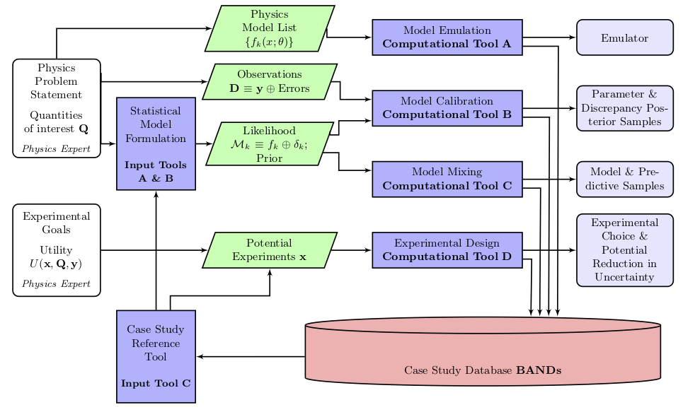
The Framework

Slide 4
The Framework

Slide 5
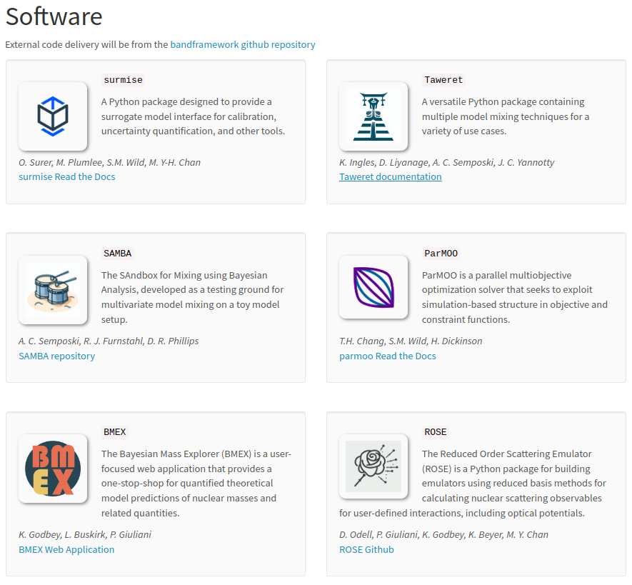
The Framework
Online:
https://bandframework.github.io/
On GitHub:
https://github.com/bandframework/bandframework

Slide 6
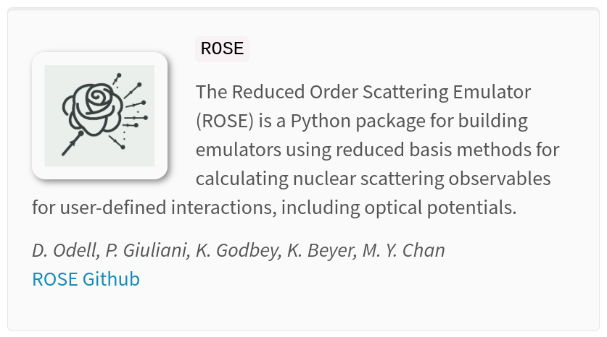
The Focus
ROSE – A scattering emulator for fast theoretical simulation without sacrificing accuracy
Use cases include model calibration, quick evaluation, efficient model mixing, experimental design, science gateways, and more (presumably)

Slide 7
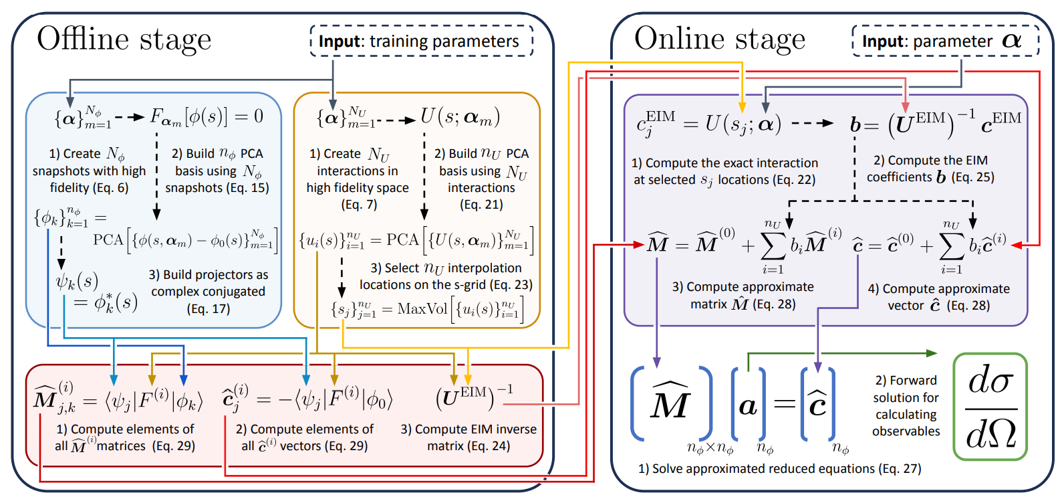
The Focus

Slide 8
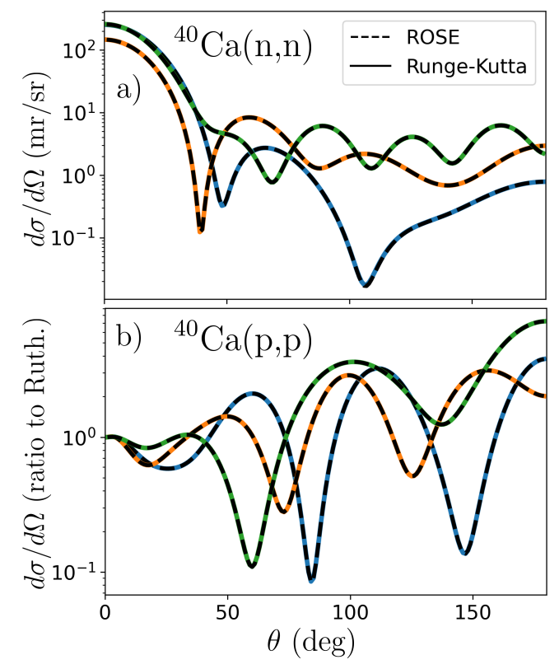
The Goal
Supplementing high-fidelity simulations with ‘almost as good’ replacements

Slide 9
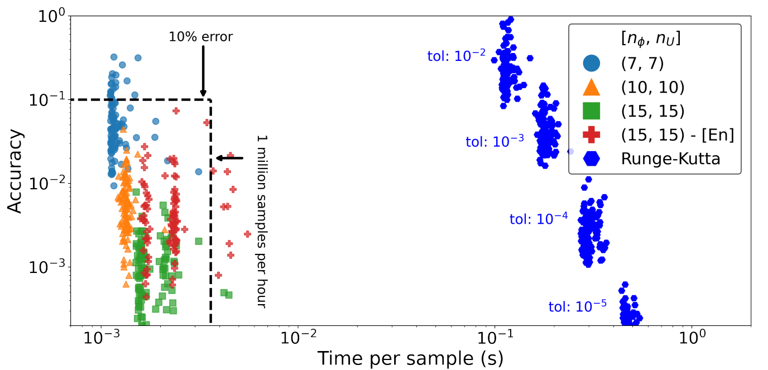
The Goal

Slide 10
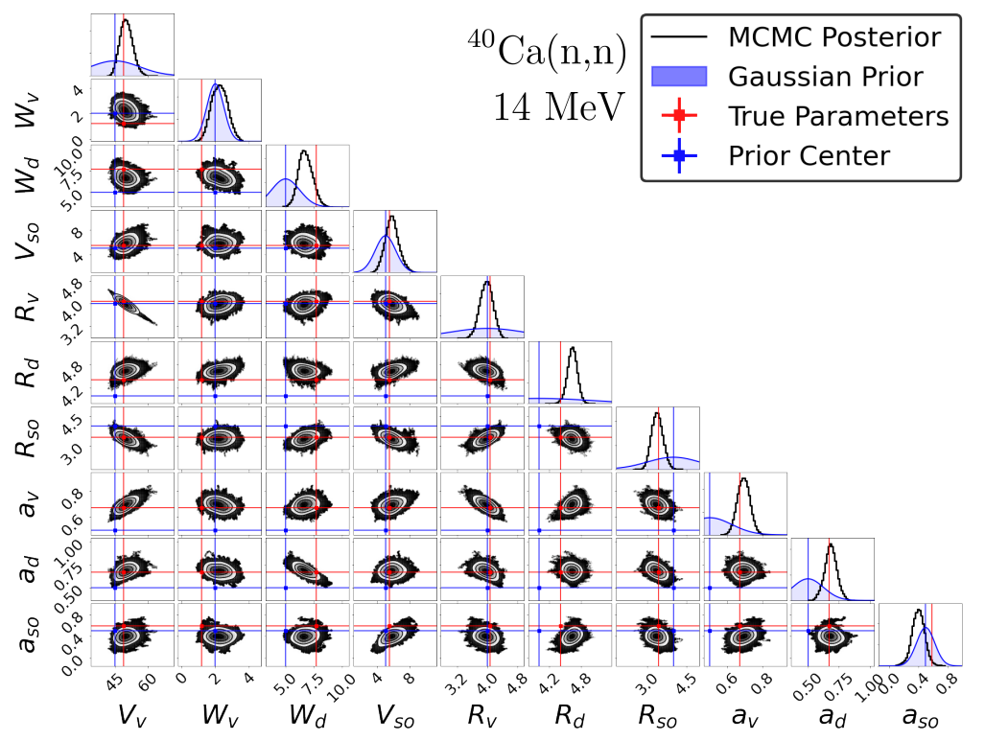
The Outcome
Principled Bayesian calibration is more accessible than ever before

Slide 11
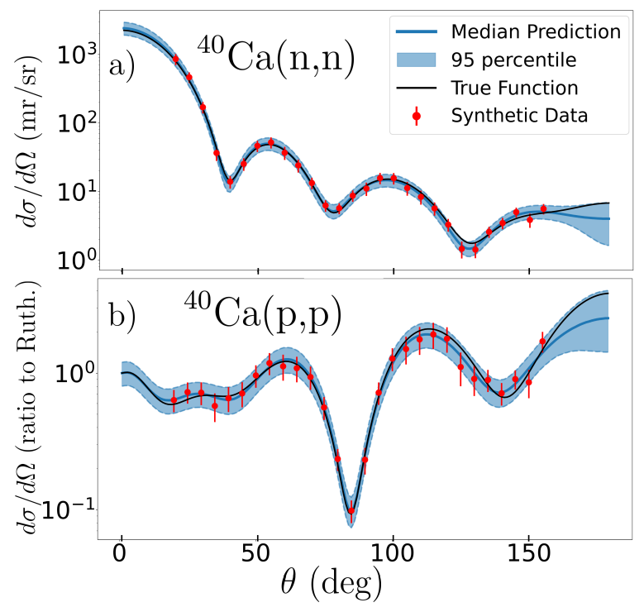
The Outcome
The point is to get predictions, uncertainties, and covariances quickly
Integration with model mixing tools will help consider the wisdom of many models

Slide 12
Outlook
Coupled-channels emulation
Continued feature development in both physics and emulation
Black-box dimensionality reduction
Expanded integration within and without the BAND framework
Bayesian model mixing
Explore novel applications and user interaction modality
Cloud-enabled backends
Web applications

Slide 13
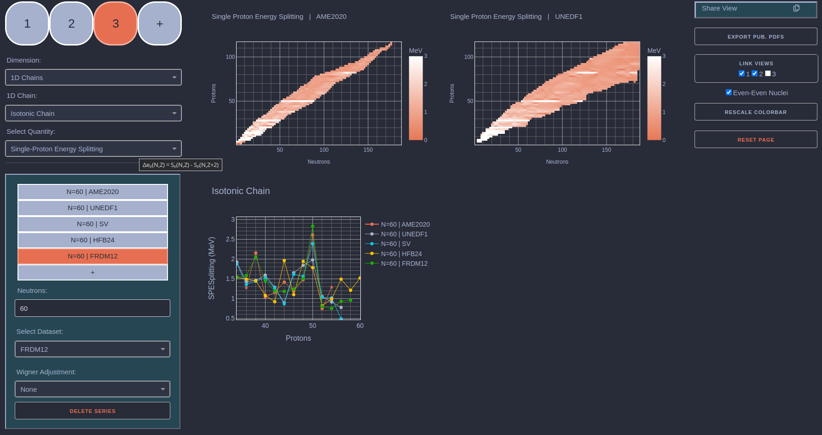
https://bmex.dev

Slide 14
The Outlook

Slide 15
Our Request
?
What features are needed? What models are highest impact?
Continued feature development in both physics and emulation
Please
?
What does harmonious integration look like?
Expanded integration within and without the BAND framework
?
Explore novel applications and user interaction modality
What tools have the highest potential for impact across the pipeline?

Slide 16
Conclusion
We want to build a broadly useful, open-source framework that meets the needs of the community
To that end we welcome suggestions, feedback, critiques, requests, code, etc.

