Slide 1
Shortcomings in EXFOR hindering experimental UQ and AI/ML analysis
B. Pritychenko¹,
1 National Nuclear Data Center, Brookhaven National Laboratory, Upton, NY 11973-5000, USA

Slide 2
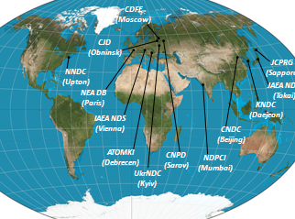
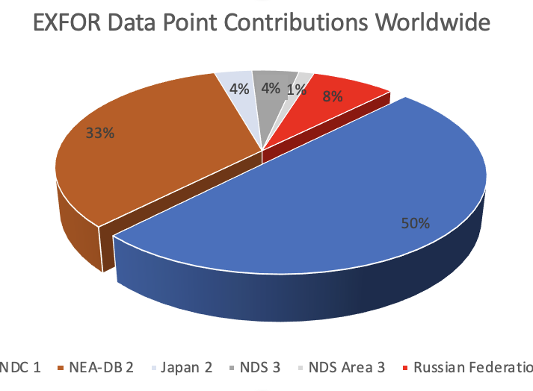
EXFOR - Experimental Nuclear Reaction Data
The largest experimental nuclear reaction database (www.nndc.bnl.gov/exfor) or (www-nds.iaea.org/exfor).
24,788 experiments (multiple publications are grouped into a single measurement), 167,817 subentries, 185,520 data sets as of February 2, 2024.
EXFOR is a starting point for Evaluated Nuclear Data File (ENDF) libraries evaluations (many evaluated but a single experimental data library), it includes the uncertainties used by evaluators.
Presently run by the Nuclear Reaction Data Centres (NRDC) internationally. This is an IAEA network which is coordinated by the IAEA.
Two largest contributors: NNDC & NEA-Databank: Every second, third and sixth data points in the library were contributed by the NNDC, NEA-Databank and the rest of NRDC network, respectively.
EXFOR philosophy is to compile data as they were published (in consultation with authors) unless obvious errors are found. Published nuclear reaction data contain outliers and discrepancies.
NEA-DB
NNDC

Slide 3
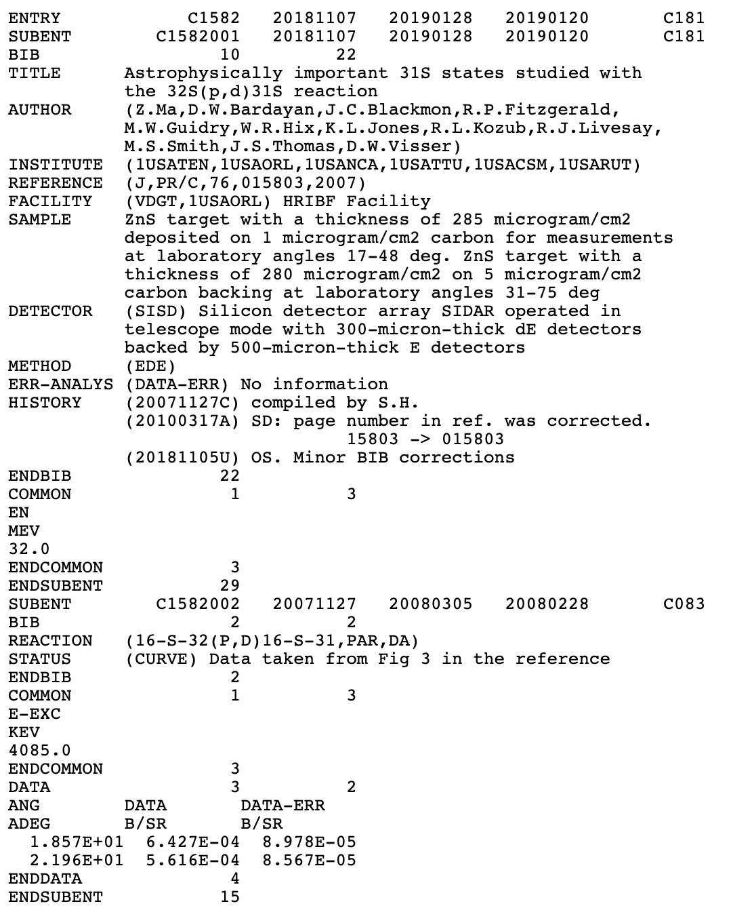
Well-Structured Format
EXFOR system identifiers (ENTRY, DATA, …) may be combined with the modifiers (ENDENTRY, ENDDATA, NODATA,…).
EXFOR had XML-like structures since 1970.
Modern computer language (Java, ….) with advanced string handling is needed. Please forget about earlier languages like FORTRAN because it was designed for numbers only.
Drawbacks:
(DATA-ERR) No information, art of evaluation to assign uncertainties.
It is human-readable but we need more keywords and codes.

Slide 4
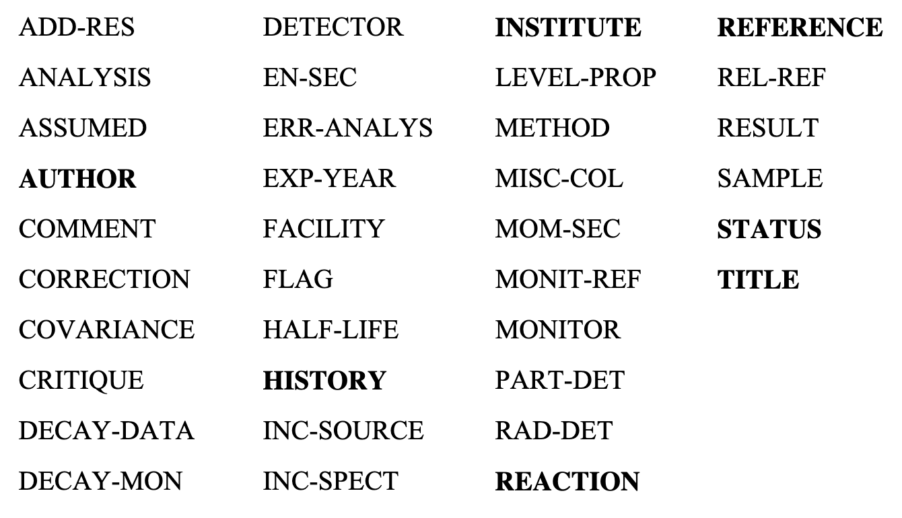
Keywords & Codes
The text part (bibliographic, experimental and bookkeeping information) is specified in variable length The information attached to a keyword may consist of "codes" (standard abbreviations taken from a "dictionary”, i.e. DATA-ERR) and/or unstructured English "free text".
Codes for use with a specific keyword are found in the relevant dictionary.
We need keywords/codes for everything in EXFOR.
Complementary approach is AIACHNE (AI/ML Informed cAlifornium CHi Nuclear data Experiment): Los Alamos/BNL/NIST.

Slide 5
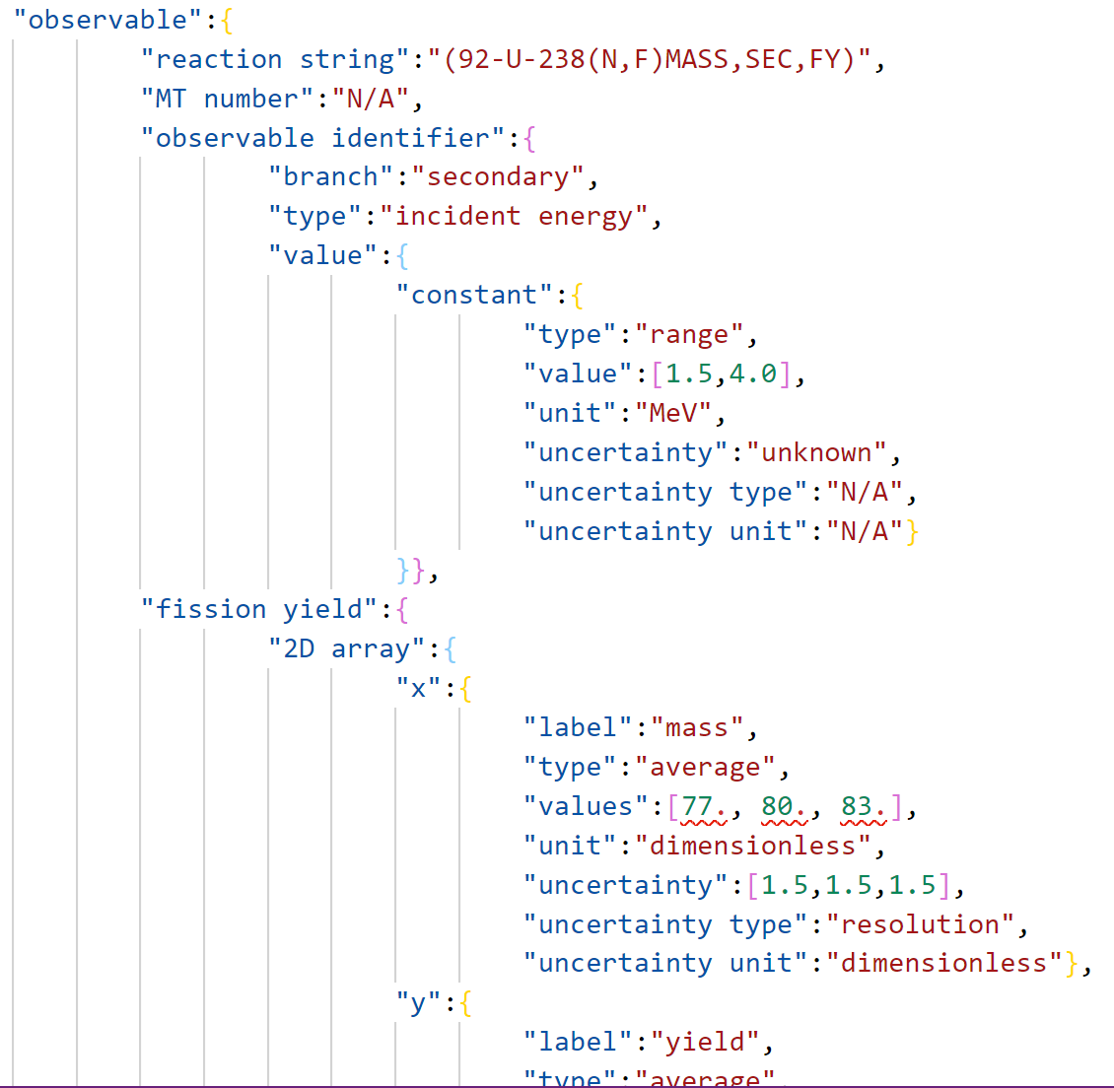
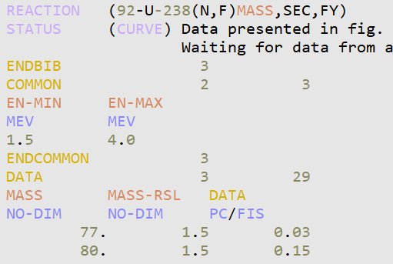
Inelastic Scattering Gamma Production and Fission Yields (Courtesy of Amanda Lewis)
5
Fission yields: Duke et. al., PRC 94 (2016), Entry 14463
5
Notes:
And in the fission yield case, the incident energy is used as the reaction identifier and the mass is the x-axis. Now it’s possible that it should be the other way around, but this is just an example of how the more complicated data tables will require more complicated data structures for this database.

Slide 6
EXFOR Machine Readability
EXFOR format was well ahead of its time.
Good readability using modern computer languages for text string handlings.
EXFOR format/interface by V.Zerkin (IAEA)
C4 (X4toC4), X4$±$, C5, JSON, …
IAEA/NNDC Web Interfaces, Java/C/HTML/SQL technologies + wrapping of old FORTRAN codes.
NEA-DB JANIS and EXFOR checking.
Complementary format developments by G.Schnabel, S.Okumura (IAEA), D.Brown (BNL).
Results are as good as an overall quality of underlying compilations.

Slide 7
A few comments on EXFOR Data
EXFOR rules were evolving over the last 50 years; however, compilations were not always updated because of the lack of man/womanpower.
In the past, the origin of data set was not documented. Quite often EXFOR STATUS is SCISRS, it indicates that data were taken from Pre-EXFOR NNDC library Sigma Center Information Storage and Retrieval System (SCISRS).
Another problem, is HISTORY field. In an ideal world, all compilation updates can be described there in free text with a time stamp. Unfortunately, compiler would place a time stamp and write “data were corrected” without any explanations.
EXFOR compilers encounter activation data sets without published DECAY-DATA. How to evaluate cross sections in such cases?
….

Slide 8
EXFOR Uncertainties
DATA-ERR: No details on sources of uncertainties, experimental errors, 48%. In the past, this header was used too often, uncertainties details were not compiled.
ERR-T: Errors are clearly defined, 19.9%.
ERR-S: Statistical errors, probable errors, 14.1%.
ERR-SYS: Systematic errors, 2.1%.
No ERRORS, 15.9%.
~15% of EXFOR subentries do not have data uncertainties, and ~85% of EXFOR subentries do not have incident beam uncertainties (considering spontaneous fission subentries: Subentries:1,585 => 0.1447).
``In the past scientists were conducting precise measurements,” Mark Chadwick, CW 2014, Santa Fe, NM.
ERR-1, ERR-2, … systematic uncertainties are not ordered.
Published data may contain only ERR-S, no ERR-SYS.

Slide 9
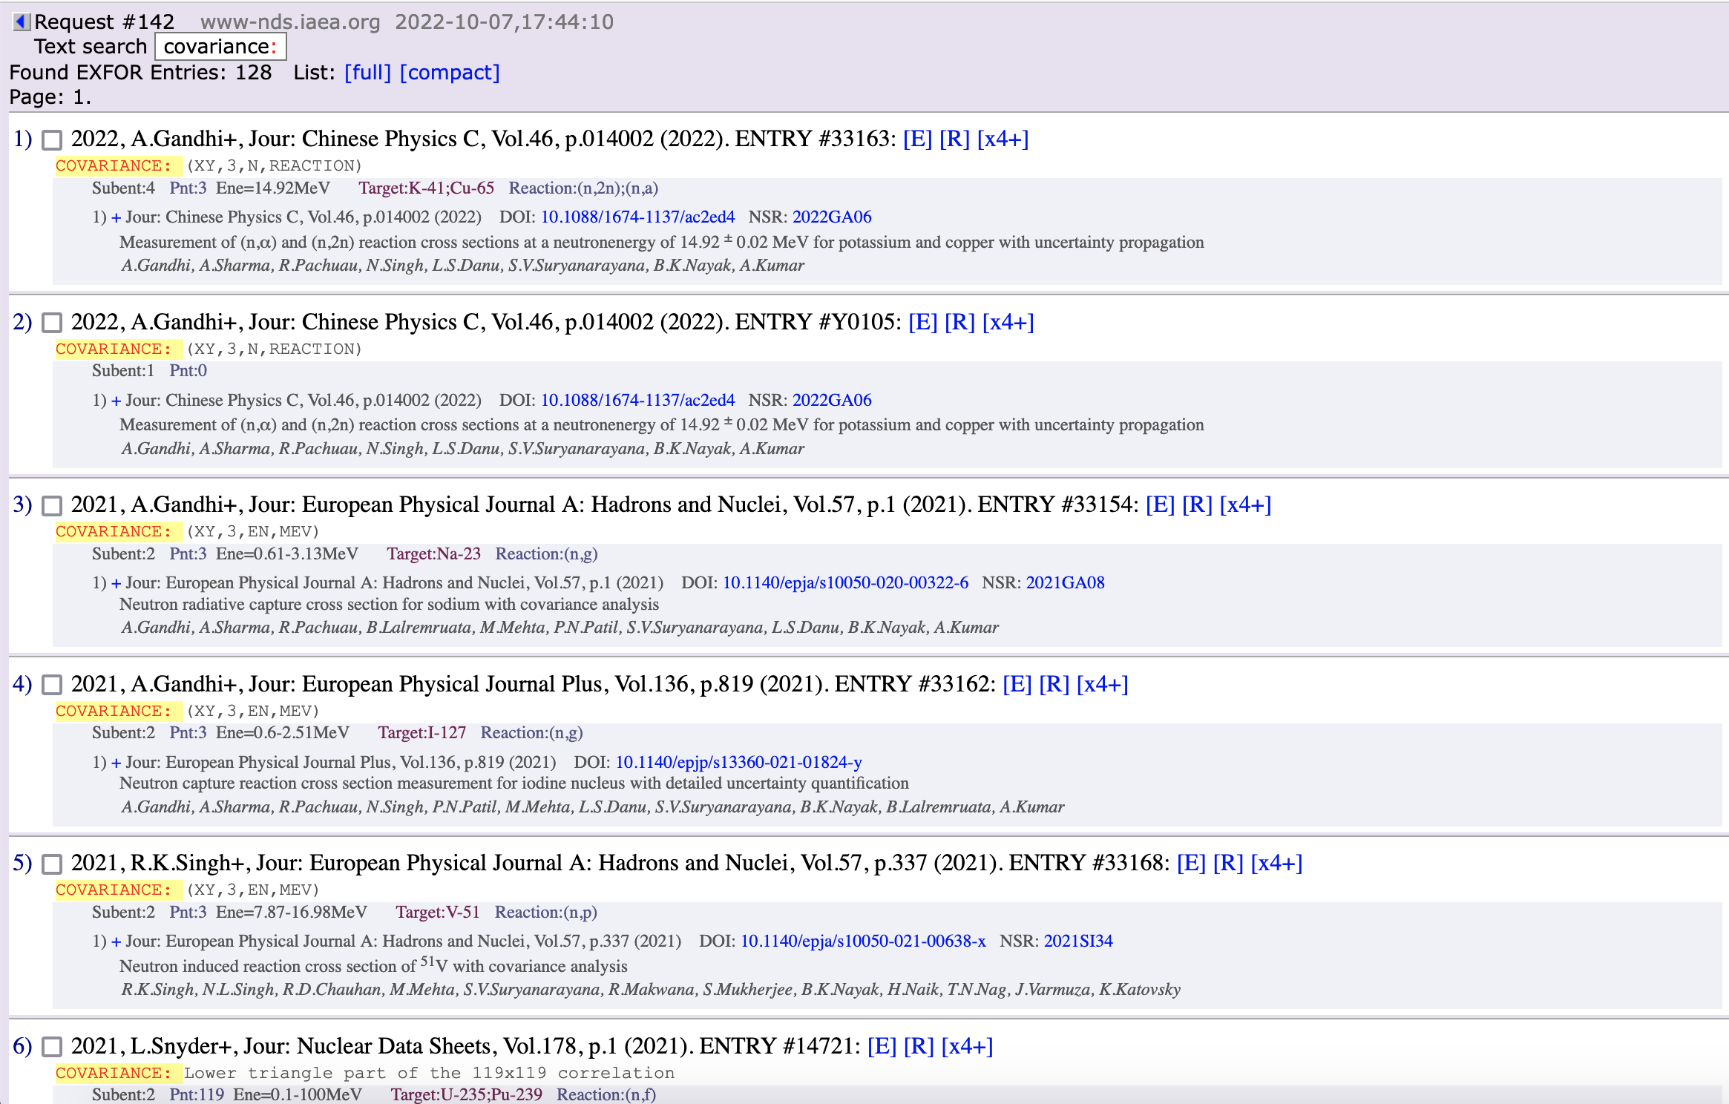
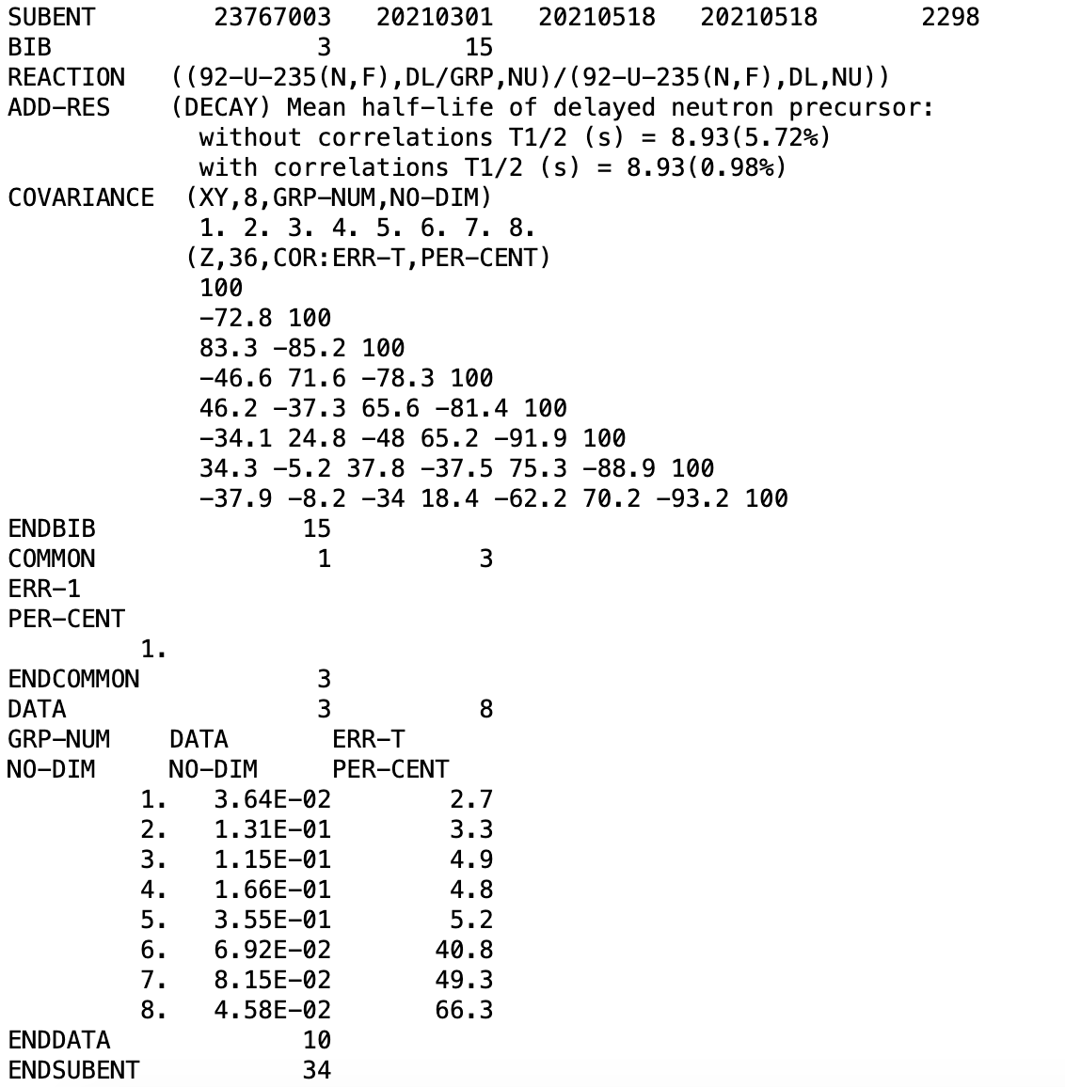
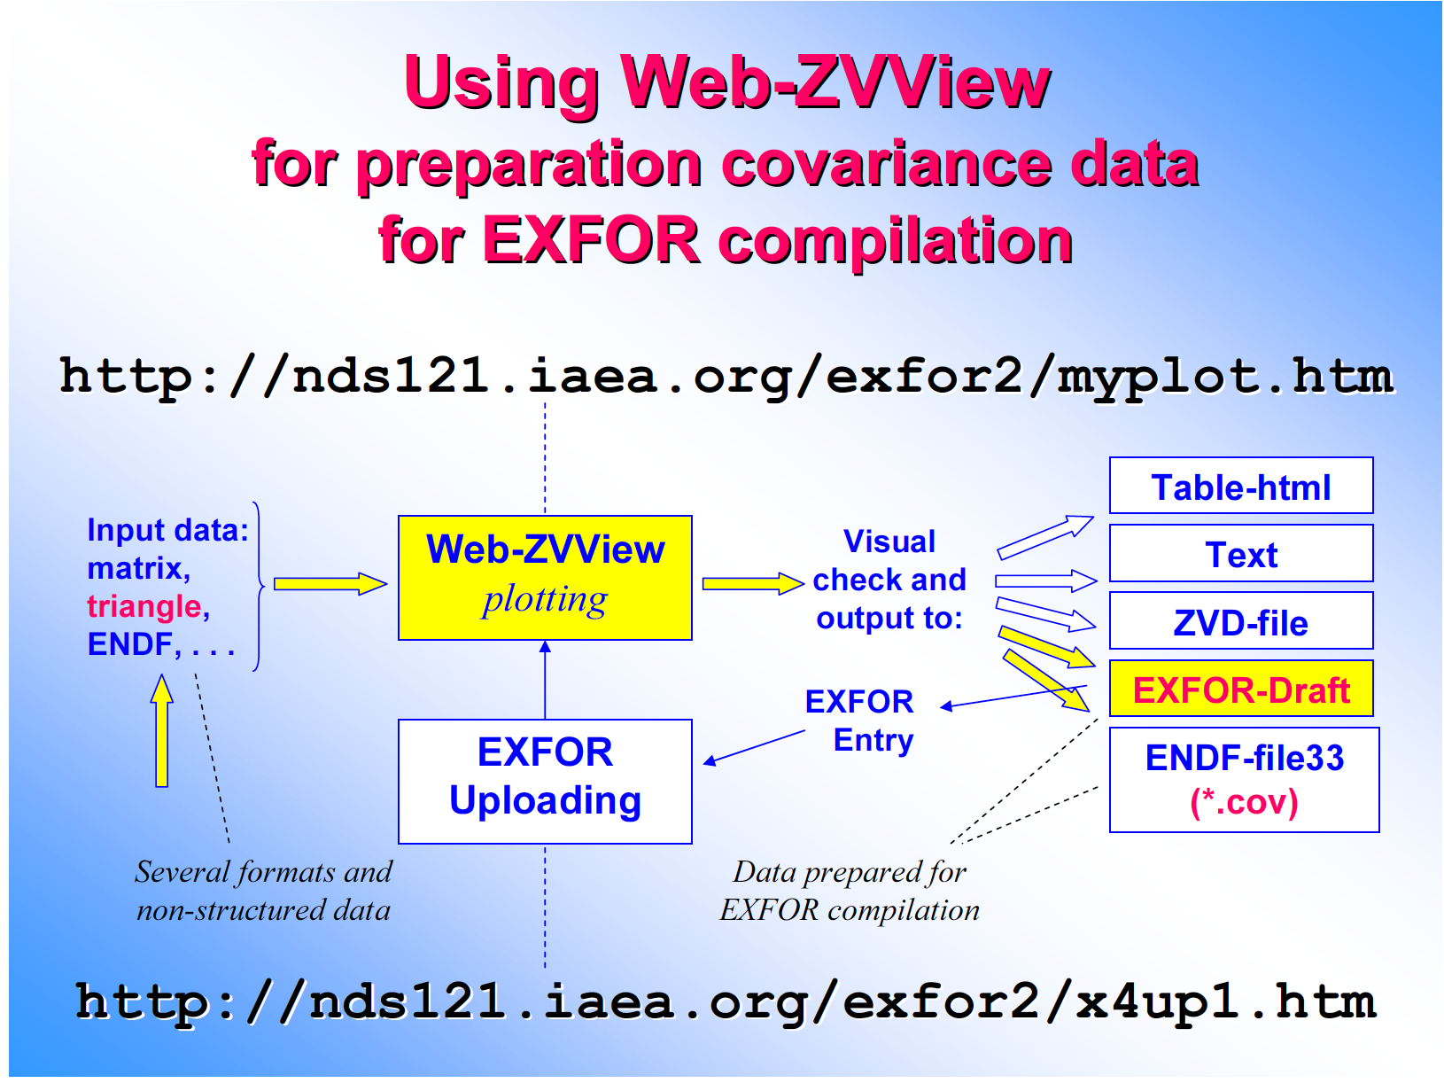
EXFOR Covariances
COVARIANCE: EXFOR Entries: 128 out of 24,390 experiments, 0.525%.
Viktor Zerkin (IAEA) developed tools for covariance generation based on published uncertainties.
Uncertainties are incomplete in EXFOR, users have to use templates developed by D.Neudecker et al.
EXFOR is a good starting point, evaluators go beyond the EXFOR scope to produce realistic uncertainties.
There is a need for automatized recognition of uncertainties and deduction of missing uncertainties.
We have to preserve additional information developed by evaluators in a parallel to EXFOR verified database (SG-50 findings and recommendations).
Courtesy of V. Zerkin
Courtesy of D. Neudecker

Slide 10
EXFOR Summary
EXFOR format has been used since early 1970s, during this time compilation rules were evolving, and AI/ML needs became a priority recently.
Unfortunately, EXFOR maintenance was not systematic, quite often EXFOR entries stay in the database as they were compiled.
Many entries need to be updated to comply with the new rules; fix typos and incorporate comments from advanced users.
We need resources for EXFOR modernization and preservation of developed by evaluators information for EXFOR entries (EXFOR DB stores only information from experimentalists).
The SG50 effort should create a parallel to EXFOR database that preserve these data and will be useful for UQ, ML/AI analysis.

