Slide 1
Safety-significant covariance?
B.J. Marshall
WANDA
Hilton Arlington National Landing
February 28, 2024

Slide 2
Outline
Safety case for validation gap
Brief summary of a case study*
* Taken from W.J. Marshall, “Lost and Found Opportunities Around the Chlorine Worth Study,” ICNC 2023, Sendai, Japan, Oct. 2023.

Slide 3
Safety case for a validation gap (1/4)
Validation gap or weakness:
Material present in safety analysis model and
Absent from validation benchmark set OR
Not well represented in validation benchmark set
Could neglect presence of material if absorber
Could perform additional experiments to fill gap
Could assess a reactivity margin to apply to the upper subcritical limit (USL) to account for gap

Slide 4
Safety case for a validation gap (2/4)
Methods to determine magnitude of margin:
Guess a margin large enough to satisfy reviewers/regulators
Engineering judgement based on prior similar experience
Safety analysis model calculations to estimate impact of potential error in unvalidated material
S/U-based uncertainty propagation
Same as option #3 but way fancier

Slide 5
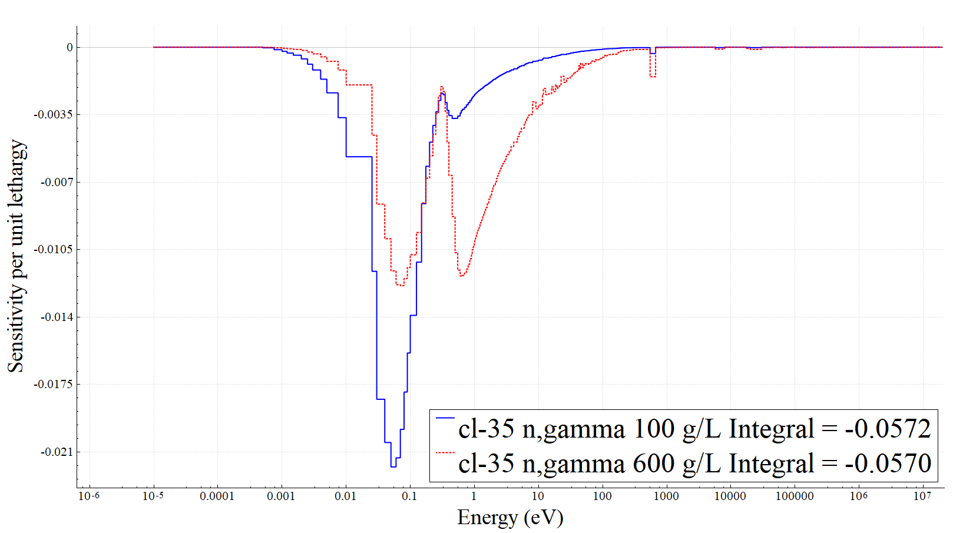
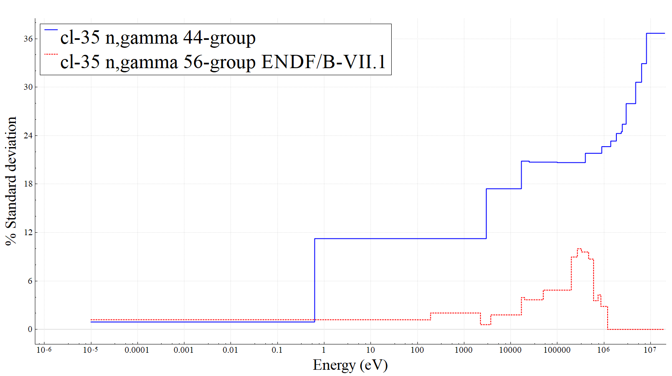
Safety case for a validation gap (3/4)
Application system sensitivity to missing nuclide, generated by TSUNAMI in SCALE or KSEN in MCNP
Generic covariance data, here ³⁵Cl (n,γ) from SCALE 44-group library and 56-group ENDF/B-VII.1 library
Uncertainty is believed to bound the bias, so propagating it to the system of interest estimates the potential bias from the unvalidated material

Slide 6
Safety case for a validation gap (4/4)
Defense needed to accept margin based on covariance data
Options:
Argue it’s better than arbitrary guesses or engineering judgment
Use different libraries to examine variability of margin
Look at different covariance estimates qualitatively
Find the evaluator and discuss

Slide 7
Case study for option #2: Impact of multiple libraries
Two ²³⁹PuCl₃ application systems:
100 g ²³⁹Pu/L
600 g ²³⁹Pu/L
³⁵Cl (n,γ) sensitivities very different
Covariance estimates very different:
Library | 100 g/L model (pcm) | 600 g/L model (pcm)
44-group SCALE 6 | 78 | 264
56-group ENDF/B-VII.1 | 68 | 66

Slide 8
Now what?
Magnitude of the difference is system dependent and will surely be nuclide dependent as well
Large fluctuations between covariance evaluations do not inspire confidence with practitioners or regulators
Need to identify rigorous tests of covariance data
Must move towards passing these tests and providing basis for safety-significant use of covariance data

Slide 9
Acknowledgment
This presentation was supported by the Department of Energy and Nuclear Regulatory Commission Collaboration for Criticality Safety Support for Commercial-Scale HALEU (DNCSH) Fuel Cycles.

Slide 10
Questions?

