Slide 1
Integral Experiment Correlations: The Needs and the Challenges
Presented at the Workshop on Applied Nuclear Data Activities
February 28, 2024
Catherine Percher,
International Criticality Safety Benchmark Evaluation Project (ICSBEP) Chair

Slide 2
International Criticality Safety Benchmark Evaluation Project
Critical Experiments- Controlled assemblies of nuclear material designed to just achieve the critical point (or slightly lower/higher)
Critical Benchmarks- Computer simulations of the real critical experiment
Uncertainties
Experimental: How certain are the experimenters of the k_{eff} reported?
Uncertainty in measurement technique, reproducibility measurements, etc
Usually small contribution
Benchmark Model Uncertainties: How certain are the evaluators of the benchmark model k_{eff}? Model vs. Reality
Uncertainties from mass (are all masses or densities well known?), dimensions (were all parts measured? How do they fit together?), and composition (what are the constituents of all parts, including impurities?)
Usually majority contribution
2021 Handbook Edition
28 contributing countries
>5,000 critical or near critical configurations

Slide 3
Shared Components Generate Correlations Between Benchmarks
Critical experiments are often part of a series of experiments with multiple configurations evaluated as part of one benchmark with multiple cases
Usually have many shared components
Limited number of critical facilities and available fuels, so benchmarks not part of the same experimental series can also have shared components
Correlations due to shared uncertainty are not usually calculated as part of the benchmark evaluation process

Slide 4
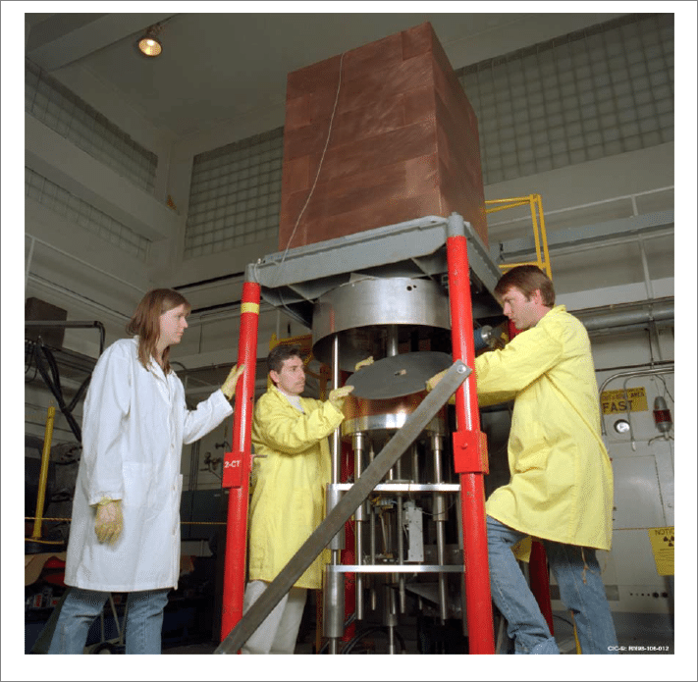
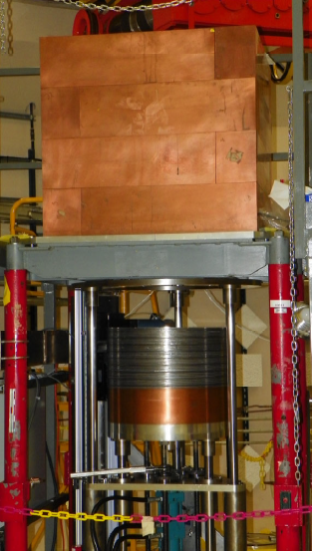
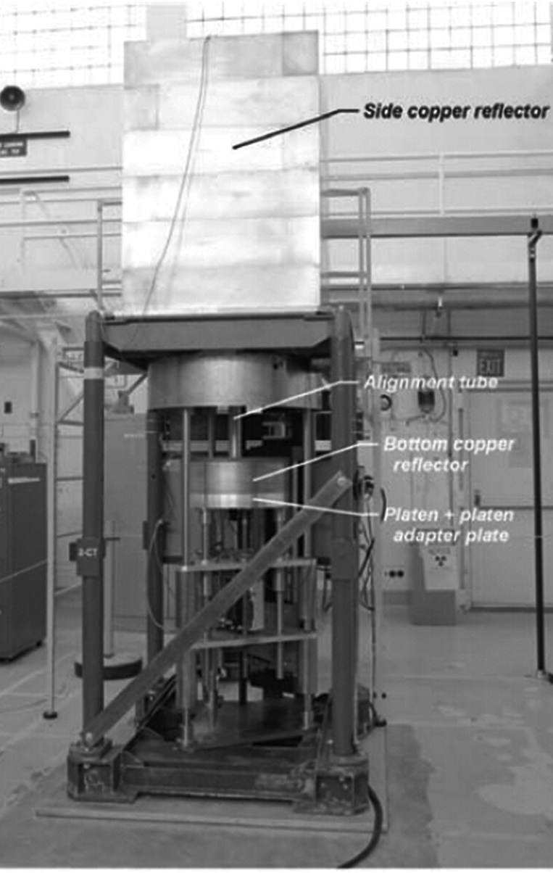
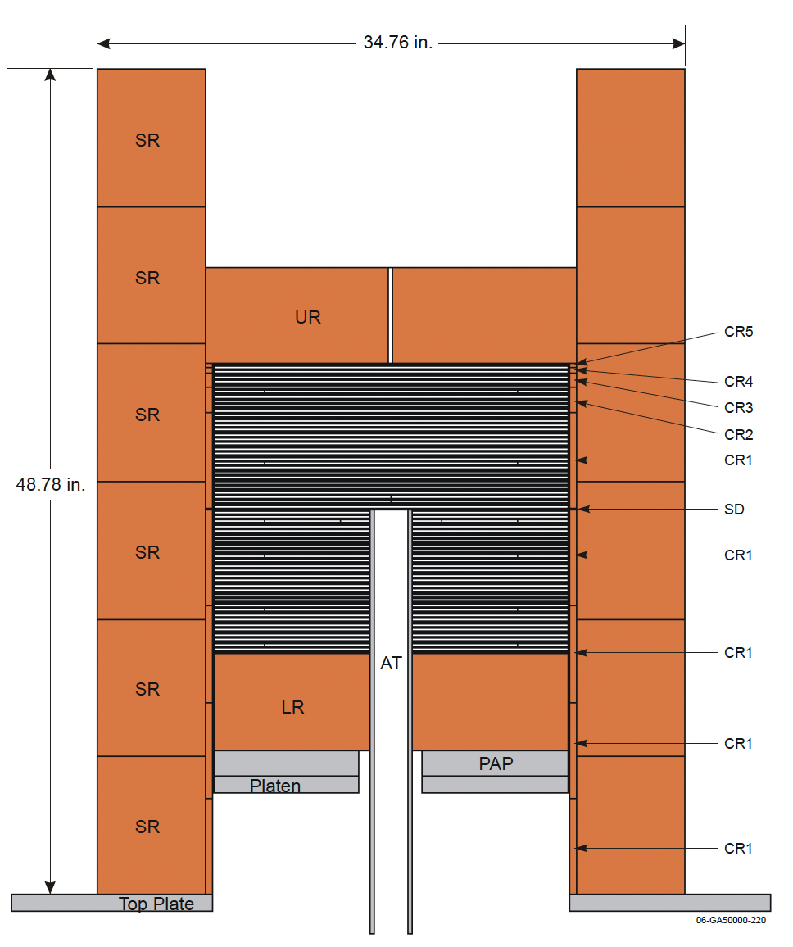
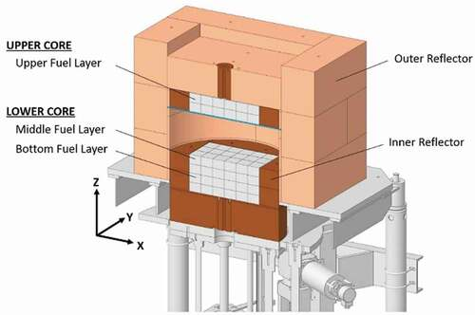
Experiments Share Components
HEU-MET-INTER-012
HEU-MET-FAST-102
HEU-MET-INTER-011
PU-MET-FAST-047
HEU-MET-INTER-006
HEU-MET-FAST-072

Slide 5
Challenges Associated with Determining Correlations
Over the past 20 years, there have been many attempts to determine experiment correlations
Some completed by experimenters for their benchmarks
OECD/NEA Working Party for Nuclear Criticality Safety (WPNCS) Expert Group on the Uncertainty Analysis for Criticality Safety Assessment (UACSA) and follow-on subgroups
NEA staff generating low-fidelity correlations that are currently distributed with ICSBEP
For modern benchmarks, a rigorous mathematical evaluation of correlations is possible, although not desirable for many benchmark evaluators
For the majority of the benchmark cases (probably between 50-75%), the benchmark does not contain enough data about the uncertainties for a rigorous evaluation
Many major uncertainty contributions are missing

Slide 6
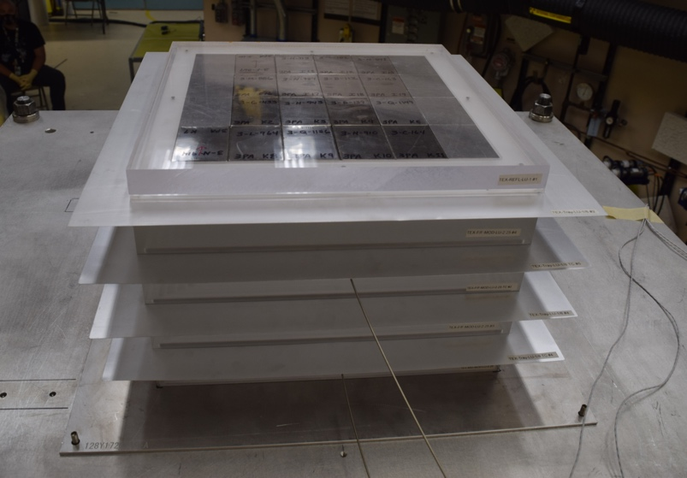
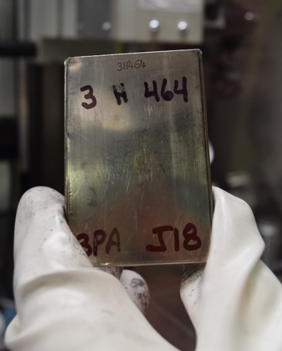
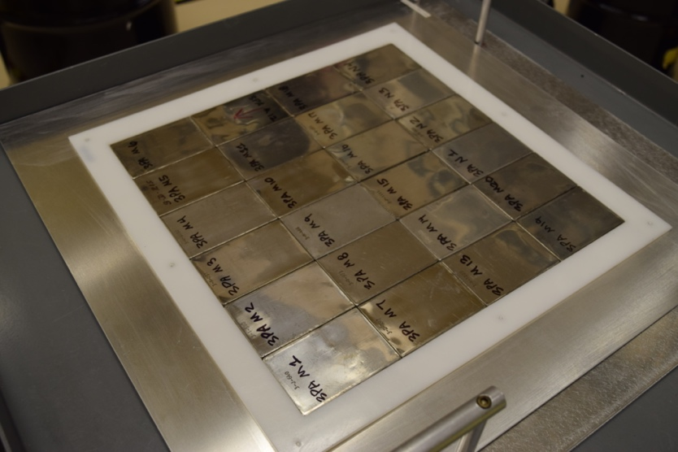
Example: PU-MET-FAST-033 and PU-MET-THERM-004

Slide 7
PMF-033 vs PMT-004 Uncertainty

Slide 8
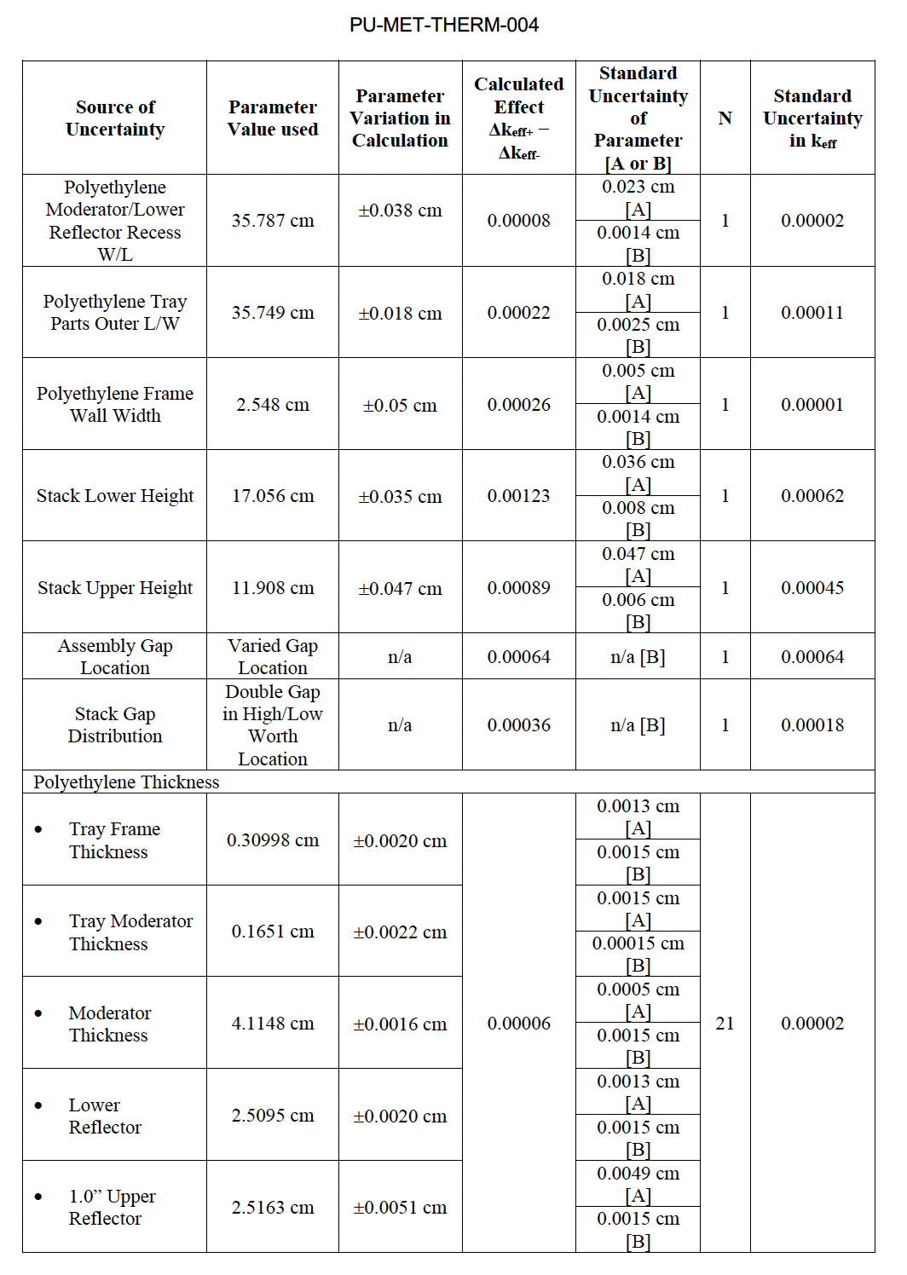
PMF-033 vs PMT-004 Uncertainty

Slide 9
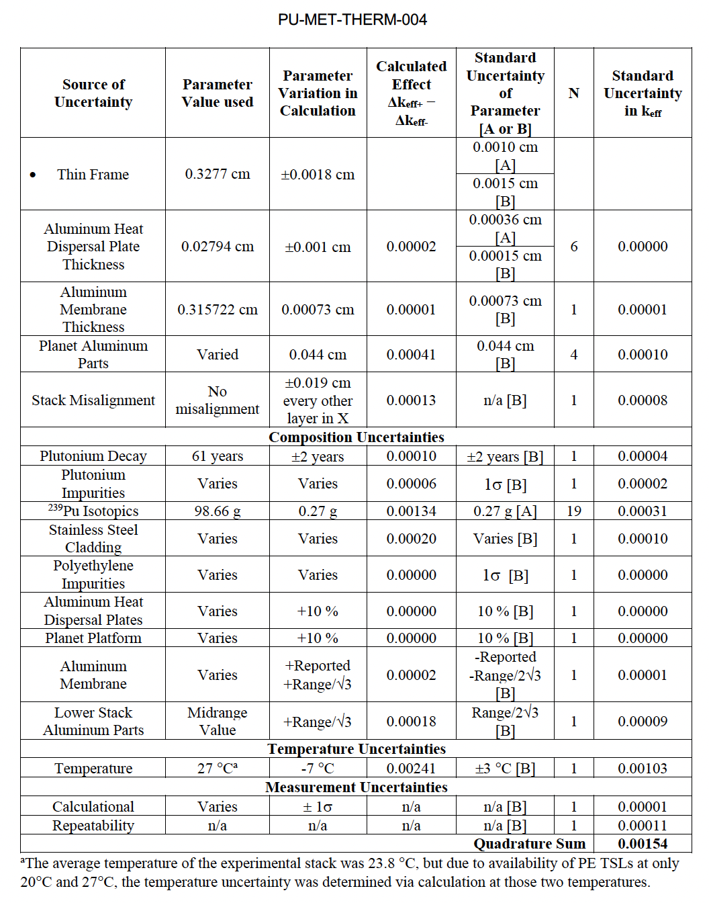
PMF-033 vs PMT-004 Uncertainty

Slide 10
PMF-033 and PMT-004

Slide 11
What Fidelity in Correlations are Needed from the Users?
The ICSBEP community wants to be responsive to the integral data user’s needs
For each evaluation, calculating correlations to dozens or hundreds of potentially related benchmark cases might be daunting (or impossible), depending on the ultimate precision required by users
Could a more expert-based, documented determination of correlations be acceptable?
Example: None (0), Low (<.25), Medium (.25-0.75), Medium High (.75-0.9), High (0.9-0.95), Very High (>0.95)

Slide 12
Upcoming ICSBEP Meeting- April 16-17, 2024
Livermore Open Valley Campus (LVOC) Building, Livermore, California, USA with virtual option
Joint meeting with SINBAD (April 18) and IRPhEP (April 19)
Tours of LLNL experimental facilities- Inherently Safe Subcritical Assembly (ISSA), Pulsed-Neutron Die-Away laboratory, and the National Ignition Facility (NIF)- on Wednesday afternoon
Registration Deadline March 1
https://ncsp.llnl.gov/icsbepsinbadirphep-meetings-llnl

