Slide 1
Integral Experiments for Tritium Production Validation
Presented at the Workshop on Applied Nuclear Data Activities
February 25, 2024
Catherine Percher,
International Criticality Safety Benchmark Evaluation Project (ICSBEP) Chair

Slide 2
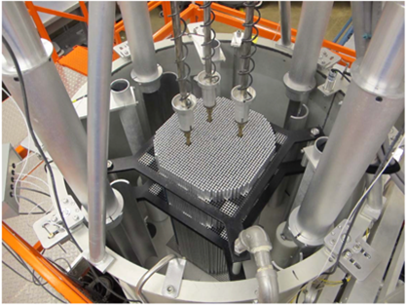
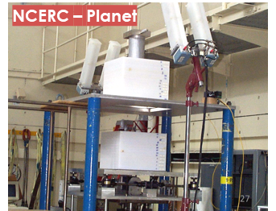
Benchmarking: Comparison to Experimental Truth
Validation that analytical method adequately represents reality for a given application
Integrated test of:
Evaluated nuclear data
Nuclear data processing codes
Transport codes
Sensitivity (/Uncertainty) Study
Experiment
Theory & Evaluation
Data Processing
Transport Codes
Benchmarking
User

Slide 3
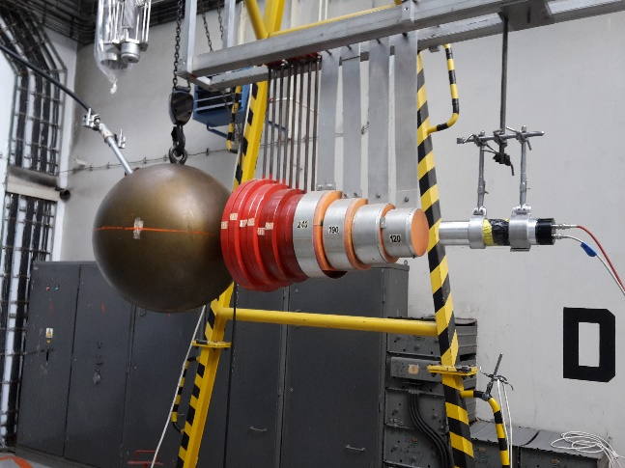
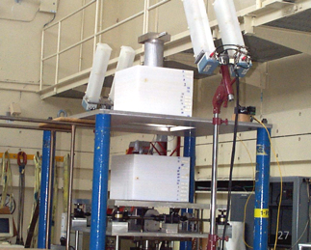
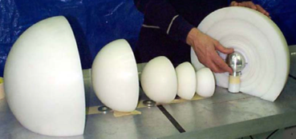
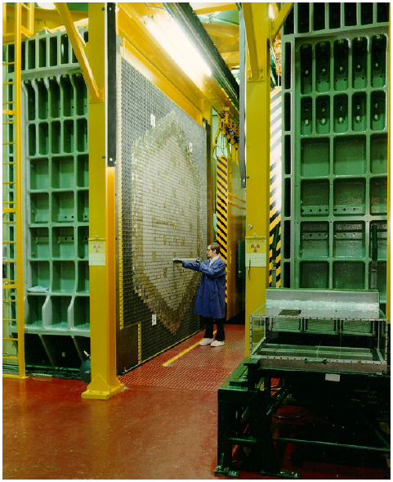
Integral Experiments
Tests multiple data (isotopes, reactions, energies) at once
May be designed to be particularly sensitive to one piece of data
Examples:
Critical assemblies
Subcritical assemblies
Reactor operation data
Shielding experiments
Post Irradiation Examination
NCERC – Planet
NCERC – BeRP Ball
Notes:
Images of SNL 7up critical assembly, LANL Planet critical assembly, LANL BeRP ball subcritcal experiment, stock photo of commercial LWR, INL ZPPR engineering mockup critical experiment, and Fe sphere shielding experiment from Rez.

Slide 4
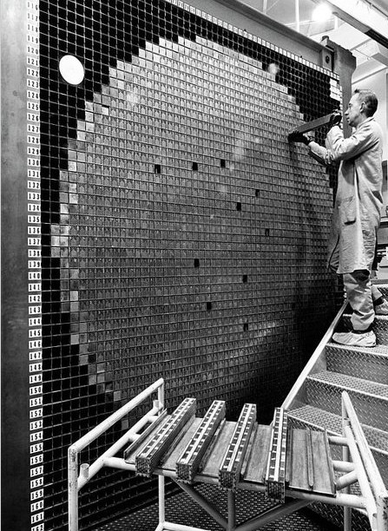
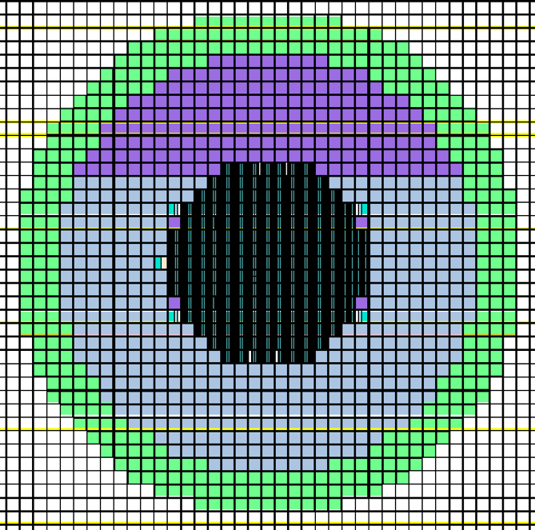
Benchmarks Are Evaluated Integral Experiments
Well characterized experiments
Evaluate all experimental uncertainties
Bias and uncertainty for model simplifications
Geometry simplifications
Room return
Material impurities
Describe benchmark model
Sample calculation results
Disseminate for broader use

Slide 5
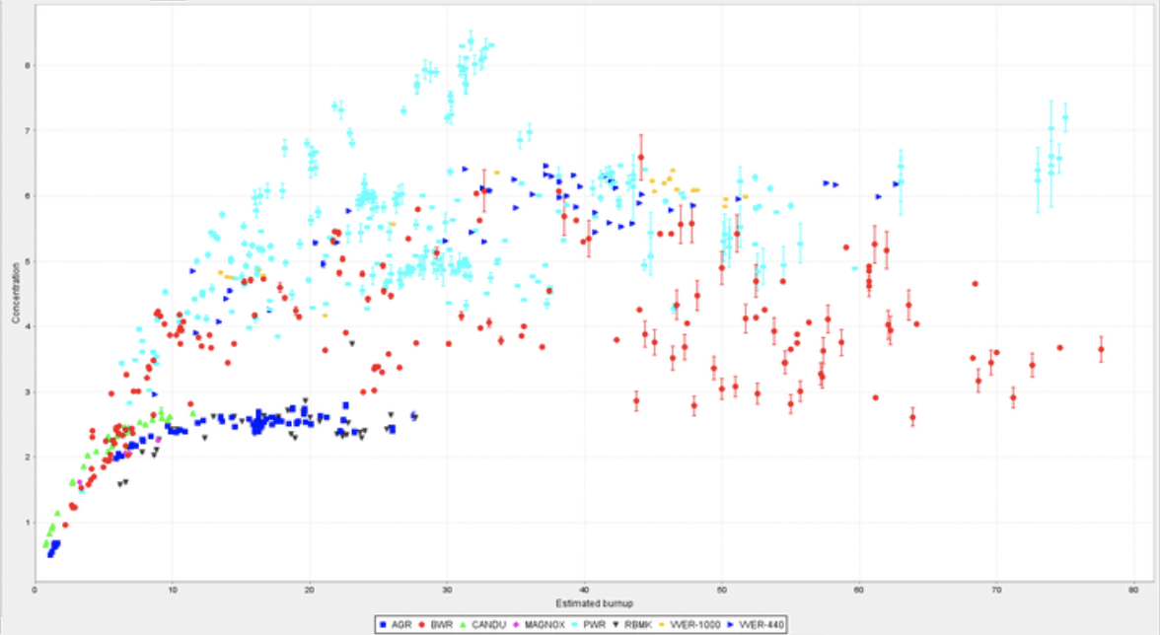
Established Integral Benchmark Handbooks
International Criticality Safety Benchmark Evaluation Project (ICSBEP)
>5000 Critical, subcritical, and physics configurations
International Reactor Physics Evaluation Project (IRPhEP)
200 Reactor benchmarks
200 Spectra benchmarks
Shielding Integral Benchmark Database (SINBAD)
Reactor shielding (46)
Fusion neutronics shielding (31)
Accelerator shielding (23)
Spent Fuel Composition (SFCompo)
700 Samples

Slide 6
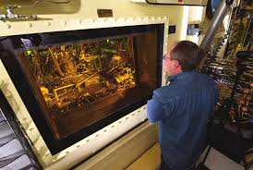
Ideal Benchmark for Tritium Production: Post Irradiation Examination (PIE)
Irradiate production targets or samples in a known neutron flux (reactor)
After irradiation, take samples to a hot cell facility for disassembly and characterization
Benchmark would be a combination of irradiation history and before and after compositions of targets
Better benchmark would include reactor geometry, sample geometry, and high fidelity modeling of irradiation history
No current data on ³H production in SFCOMPO, but modern PIE experiments have been conducted by PNNL (not published as benchmarks)
TMIST experiments at the Advanced Test Reactor (ATR) at INL

Slide 7
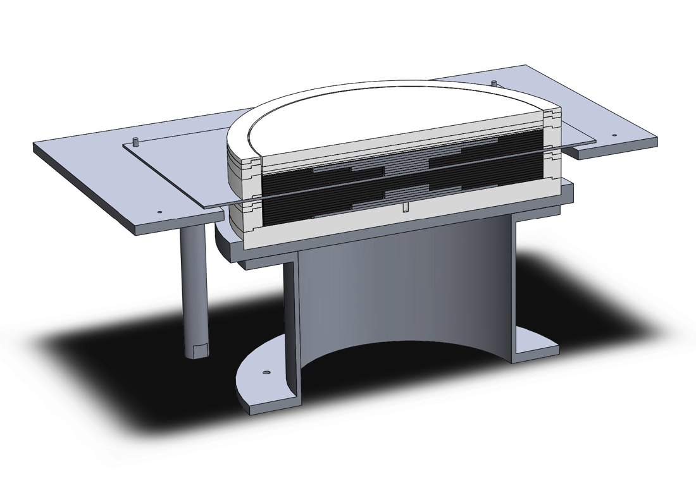
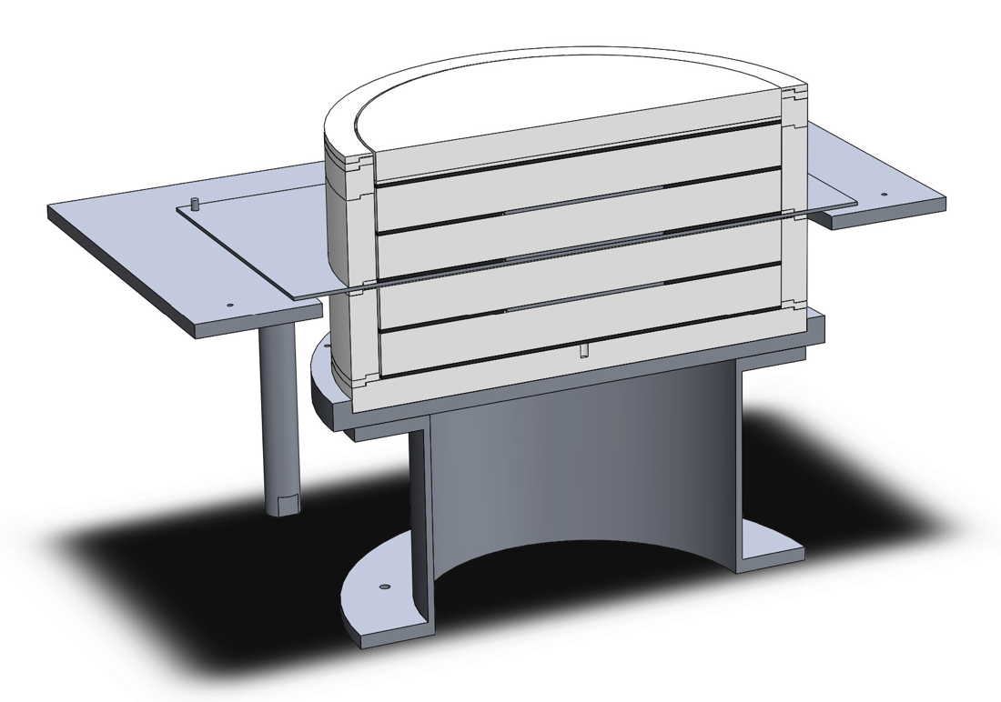
⁶Li Integral Experiment Planned
The Nuclear Criticality Safety Program has funded the design of an integral critical experiment to test ⁶Li thermal absorption
Variation of HEU Thermal Epithermal eXperiments (TEX)
Critical experiment testbed that provides critical assemblies at multiple neutron spectra (fast, intermediate, mixed, thermal) by varying thicknesses of polyethylene moderator between HEU plates
Experiments conducted on Comet critical assembly machine at the National Criticality Experiments Research Center (NCERC)
Assemblies designed to be easily modified to test materials of interest
Baseline cases benchmarked as HEU-MET-MIXED-021
Experiment currently not scheduled for execution due to limited facility time, but could be prioritized if other programs have interest

Slide 8
Upcoming Meeting- April 16-17, 2024
Livermore Open Valley Campus (LVOC) Building, Livermore, California, USA with virtual option
Joint meeting with SINBAD (April 18) and IRPhEP (April 19)
Tours of LLNL experimental facilities- Inherently Safe Subcritical Assembly (ISSA), Pulsed-Neutron Die-Away laboratory, and the National Ignition Facility (NIF)- on Wednesday afternoon
Registration Deadline March 1
https://ncsp.llnl.gov/icsbepsinbadirphep-meetings-llnl

