Slide 1
SDF Technology Qualification & Datasets

Slide 2
SDF Technology Qualification:
To develop and get scene-data-fusion into the field, the community needs common benchmark datasets and evaluation metrics to:
develop/refine technologies, and
communicate their efficacy to end users.
What are the application areas?
Benchmark Datasets:
Need published datasets for the community to train and evaluate approaches using a common benchmark
Evaluation Metrics:
How do we evaluate different approaches?

Slide 3
SDF Technology Qualification – Application Areas
Question: What are the potential application areas for scene data fusion?
Potential Application Areas (from Day 1)
Radiological Search
Wide-area search, set locations (borders, ports, etc).
Environmental Mapping & Consequence Management
Accident/attacks, legacy contamination, geological
Nuclear Facilities
Operations, safeguards, inspections/compliance, decommissioning
Criticality safety and stockpile stewardship
Facility familiarization, change detection, specific materials, configurations, and quantification
Emergency Response
How would one use this technology in each area?
How would qualification vary between application area?

Slide 4
SDF Technology Qualification – Application Areas
Application Area | Primary Observables/Reported Quantities | Key Qualification Areas
Radiological Search
Consequence Management
Nuclear Facilities (Domestic) Crit safety, stockpile stewardship
Nuclear Facilities (Foreign) Safeguards, verification teams
Emergency Response
Others?

Slide 5
SDF Technology Qualification – Evaluation Metrics
Question: How do we evaluate various methodologies and communicate their efficacy to end users?
How should we evaluate scene data fusion technologies?
Efficacy – what does that mean for a SDF technology?
What is needed for each application?
What is the minimum uncertainty?
Radiation quantification?
Mapping accuracy?
Improvement over currently deployed techniques
Fieldability – cost and difficulty to implement
Do we need formal standards?

Slide 6
SDF Technology Qualification – Application Areas
Application Area | Primary Observables/Reported Quantities | Key Qualification Areas | Key Qualification Metrics
Radiological Search
Consequence Management
Nuclear Facilities (Domestic) Crit safety, stockpile stewardship
Nuclear Facilities (Foreign) Safeguards, verification teams
Emergency Response
Others?

Slide 7
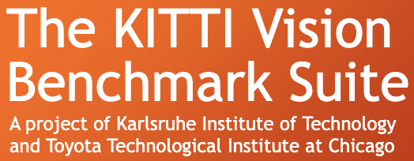
SDF Technology Qualification – Benchmark Datasets
Question: How do we spur innovation in new algorithm development and how do we compare different approaches?
What datasets exist?
Are they public?
What modalities do they contain?
What should new datasets contain?

