Slide 1
20 T Hybrid Magnet – Cos(θ) Design
M. D’Addazio, P. Ferracin, V. Marinozzi, G. Vallone

Slide 2
Design criteria of 20 T hybrid magnet
Coil and magnet parameters
  Free coil aperture (diameter) 50 mm
  Operational bore field 20 T
  load-line fraction @ 1.9K: I_{op}/I_{ss} <= 87 %
  2D Geometrical harmonics b_{n}<3 units for n<10 (at R_{ref}=17 mm)
Quench protection
  All coils powered in series
  Maximum hot spot temperature 350 K
Mechanics
  Maximum Nb₃Sn coil stress <180 (<150) MPa at 1.9 (293) K
  For the HTS <120 MPa

Slide 3
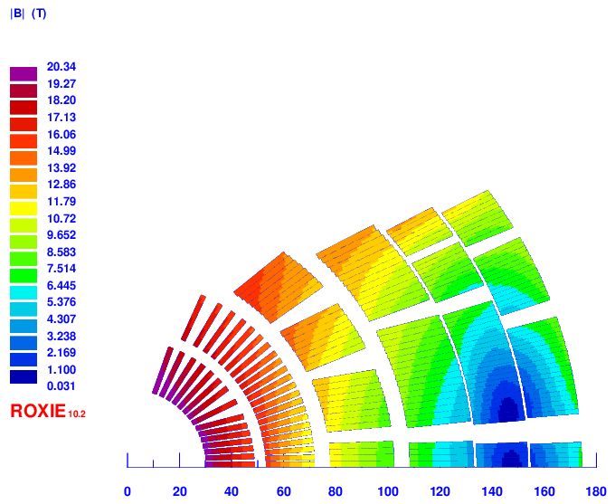
Magnetic Analysis - I
Version 28
Layer 1-2: HTS (Bi2212)
Layer 3-4: LTS1; layers 5-6: LTS2 – Both Nb3Sn
Strands [mm]: 0.9 – 1.1 – 0.8
Turns[-]: 36 – 40 – 44
Cable width [mm]: 18.59 – 24.38 – 19.50
Stabilizer/Superconductor [-]: 3 – 1 – 1.8
Coil width [mm]: 143
Current [A]: 13500
Peak field [T]: 20.45 – 15.95 – 13.6
Margin [%]: 87 – 84 – 87
J_{cu} on LTS [A/mm²]: 950

Slide 4
Magnetic Analysis - II
Version 28
Layer | Bpeak | Jo | Lorentz Stress
/ | [T] | [A/mm2] | [Mpa]
1 | 20.3 | 360 | -110
2 | 18.0 | 360 | -138
3 | 15.8 | 229 | -128
4 | 13.7 | 229 | -129
5 | 13.2 | 379 | -175
6 | 12.0 | 379 | -145
Assumed Mechanical Limits:
  Bi2212 (layer 1, 2): 125 MPa
  Nb3Sn (layer 3 to 6): 175 MPa
Notes:
Dati simulazione magnetico G. Vallone con versione v28 (struttura infinitamente rigida)

Slide 5
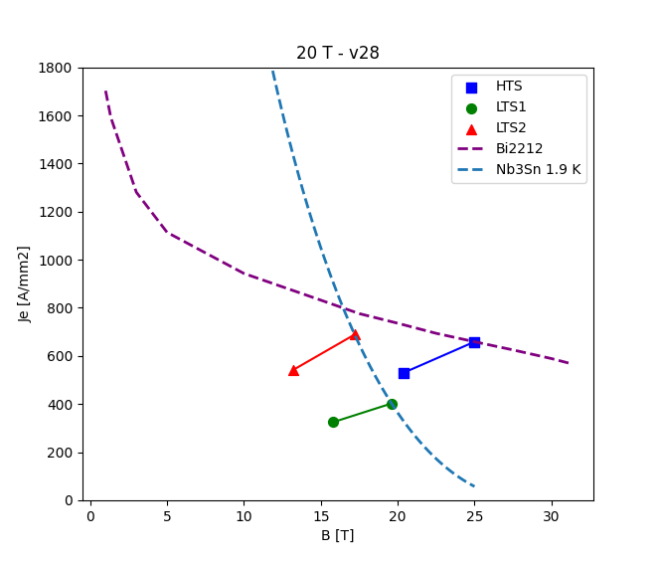
Magnetic Analysis - III
Version 28
B_{bore} [T] = 19.99
B_{peak} [T] = 20.35, 15.82, 13.18
Margin [%]: 80.3, 80.8, 78.5
Notes:
Margin diversi, probabilmente differenza Ansys-Roxie (verificare)

Slide 6
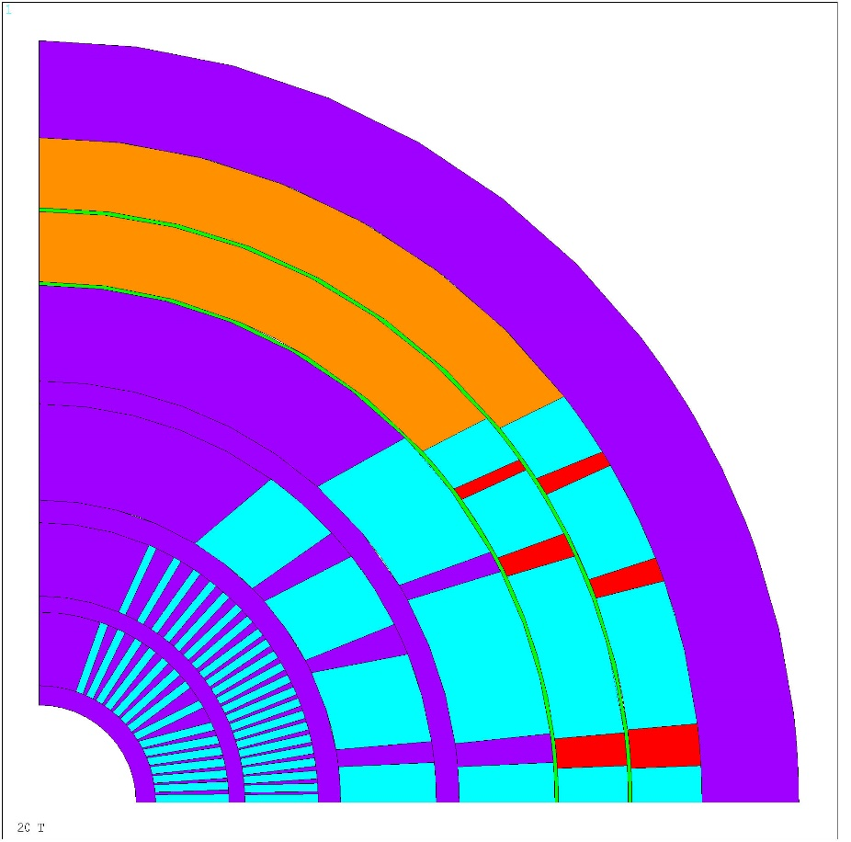
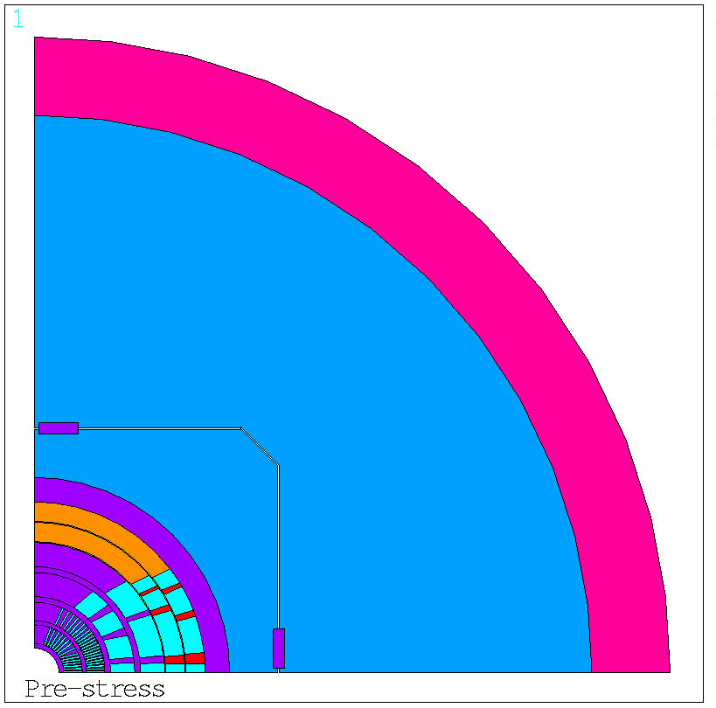
Mechanical Analysis - I
Version 28
Thickness:
Collar – 25 mm
Pad – 50 mm
Yoke – 320 mm
Shell – 80 mm
Key x2 – 10x40 mm
Poles
Collar
Shell
Spare + ribs
Yoke
Characteristic:
Friction: 0.2
Layers 1 – 4: Spar + ribs
Layers 5 – 6: Pole + Wedges
Wedge
Pad
Collar
Notes:
Assunzioni sui contatti tra bobina e mandrino/wedge/poli.

Slide 7
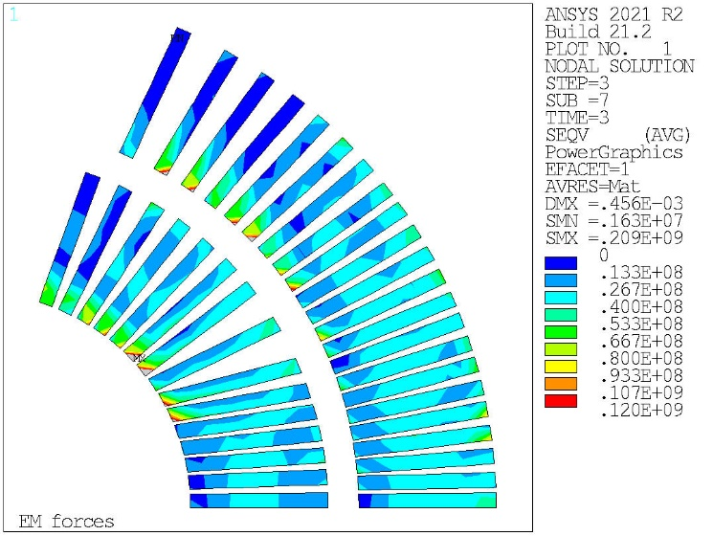
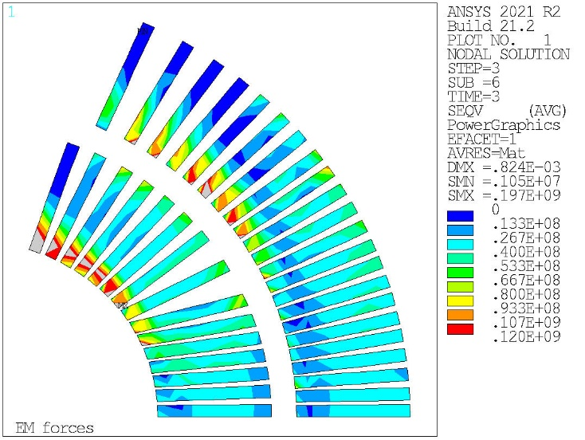
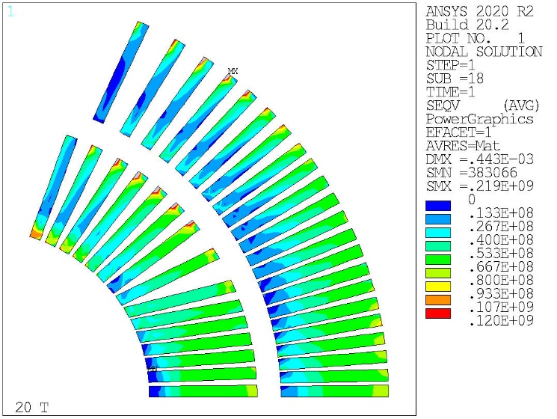
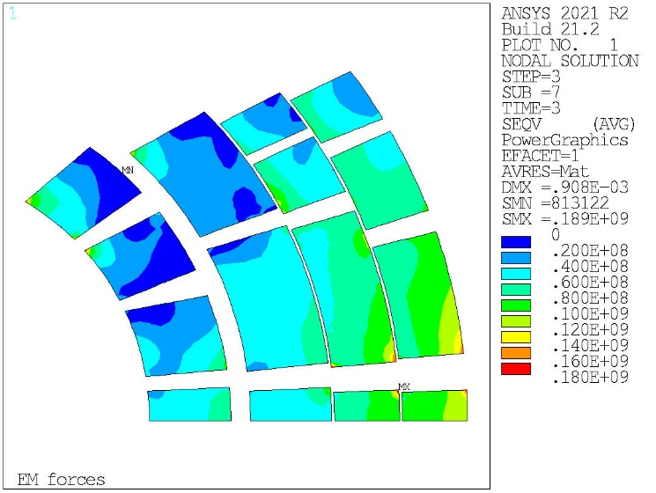
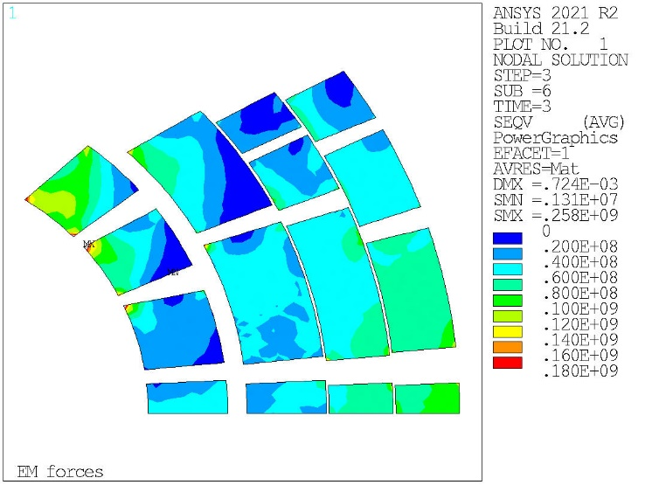
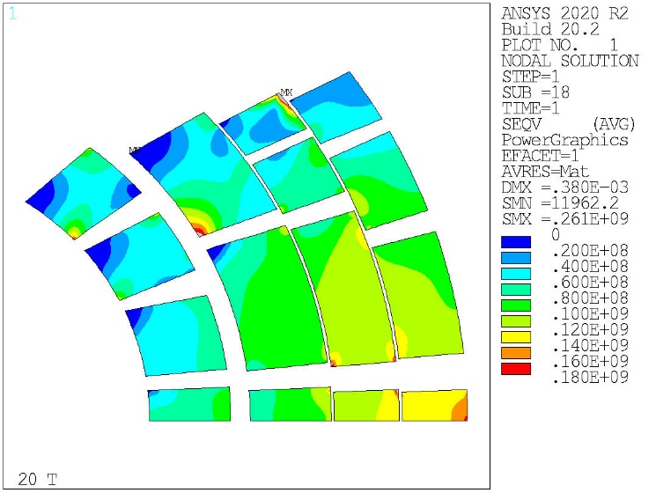
Mechanical Analysis – II
Mechanical Structure: Interference 3 mm
Mechanical Structure: Interference 100 micron
Infinitely Rigid Structure
HTS
Equivalent Stress
LTS
Notes:
Aggiungere stress a RT e Cold.

Slide 8
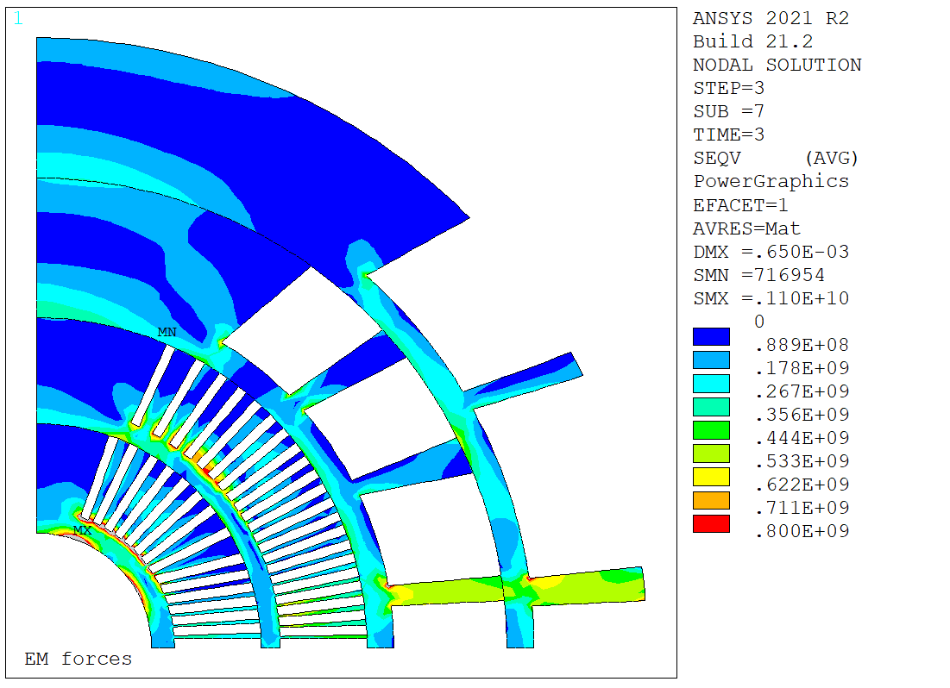
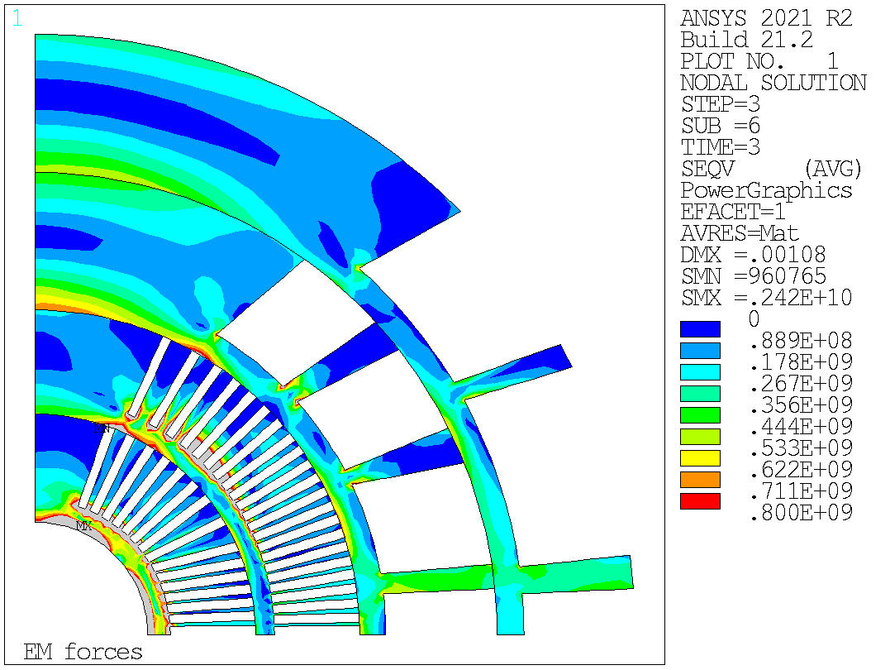
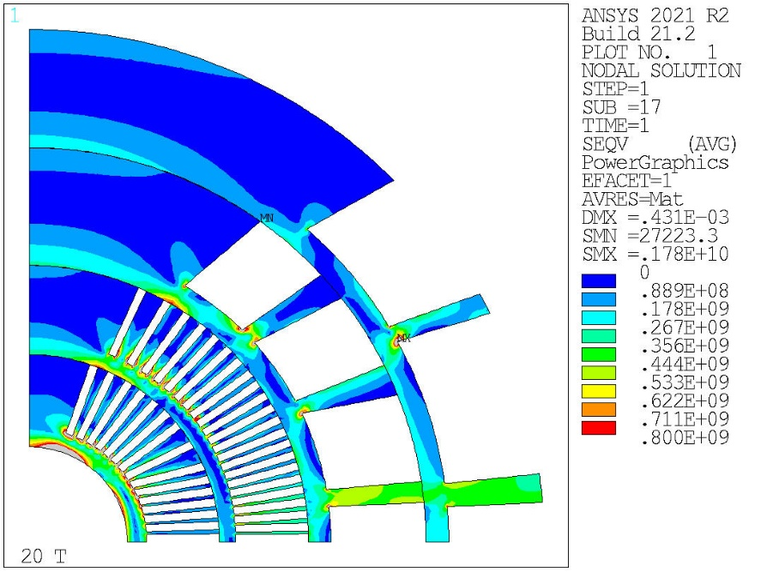
Mechanical Analysis – III
Mechanical Structure: Interference 3 mm
Mechanical Structure: Interference 100 micron
Infinitely Rigid Structure
Equivalent Stress

Slide 9
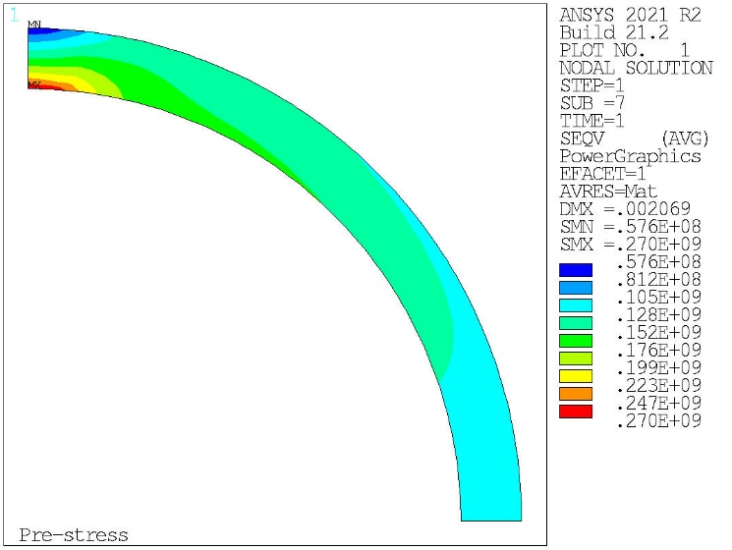
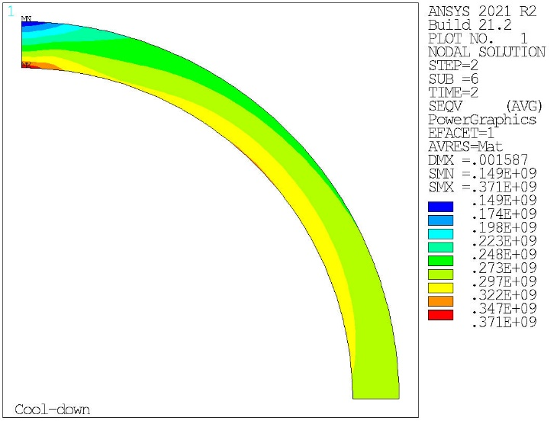
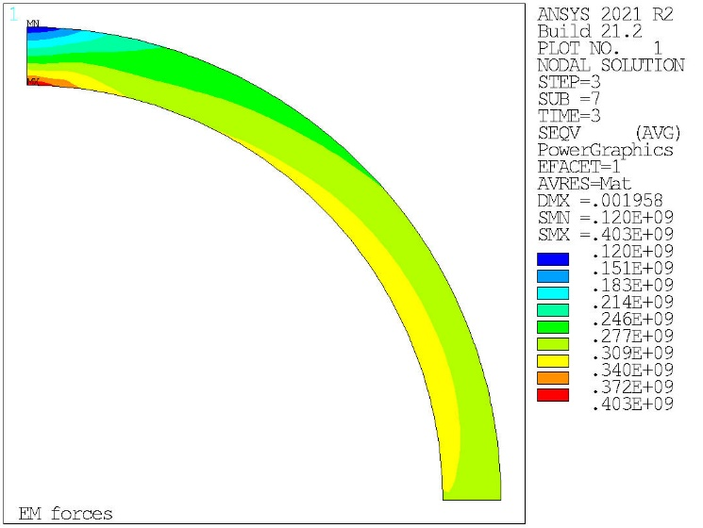

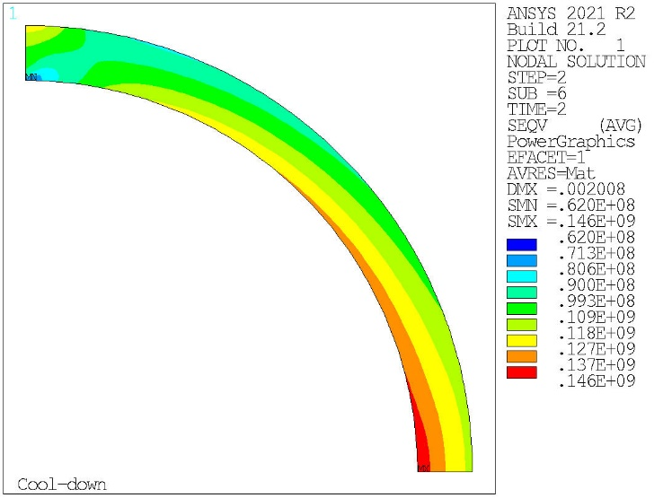
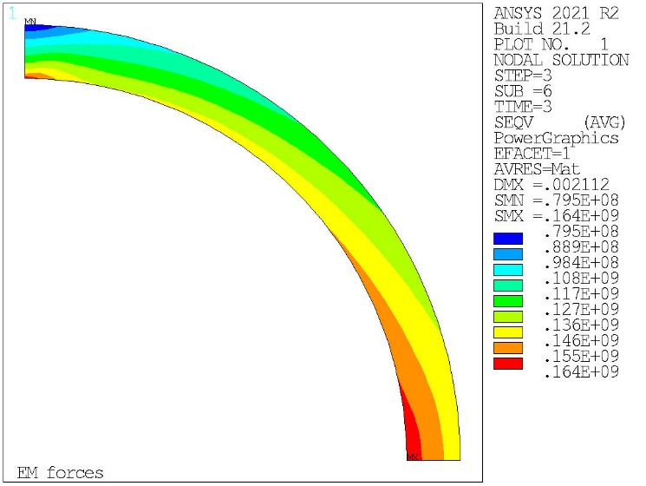
Mechanical Analysis – IV
Pre-stress
Cool down
EM forces
Mechanical Structure: Interference 3 mm
Equivalent Stress
Mechanical Structure: Interference 100 micron

Slide 10
Next Steps
Mechanical structure optimization:
Influence of the interference
Influence of the key position
Dimensions of the mechanical structure

