Slide 1
MDP timeline for hybrid magnets (HM) with Bi2212 (HMB) and REBCO (HMR) inserts
2024
2025
2026
2027
LBNL HMB1
FNAL HMB1
Bi2212 CCT Bin5c insert (1.6 T, 30 mm)
Nb₃Sn CCT5 outsert (8-9 T, 90 mm)
Test late 2023
Bi2212 SMCT insert (4 T, 15 mm)
Nb₃Sn SMCT+MDPCT1-inner outsert (14-15 T, 60 mm)
Test in in 2025
LBNL HMB2
Bi2212 CCT Bi-CCT1(3-5 T, 40 mm)
Nb₃Sn CCT6 outsert (12-13 T, 120 mm)
To be tested in 2026
LBNL HMR1
LBNL HMB3
STAR CCT S1 (~1-2 T, 50 mm)
Nb₃Sn CCT5 outsert (8-9 T, 90 mm)
Test in 2024-2025
Bi2212 CCT Bi-CCT1(4-7 T, 40 mm)
Nb₃Sn CCT6 outsert (12-13 T, 120 mm)
To be tested in 2027
FNAL HMR1
LBNL HMR2
CORC COMB (~5 T, 100 mm)
Nb₃Sn SMCT outsert (11 T, 120 mm)
Test in 2025
CORC CCT C4 (5 T, 50 mm)
Nb₃Sn CCT6 outsert (12-13 T, 120 mm)
To be tested in 2027

Slide 2
MDP timeline for hybrid magnets (HM) with Bi2212 (HMB) and REBCO (HMR) inserts
2024
2025
2026
2027
LBNL HMB1
FNAL HMB1
Bi2212 CCT Bin5c insert (1.6 T, 30 mm)
Nb₃Sn CCT5 outsert (8-9 T, 90 mm)
Test late 2023
Bi2212 SMCT insert (4 T, 15 mm)
Nb₃Sn SMCT+MDPCT1-inner outsert (14-15 T, 60 mm)
Test in in 2025
LBNL HMB2
Bi2212 CCT Bi-CCT1 (3-5 T, 40 mm)
Nb₃Sn CCT6 outsert (12-13 T, 120 mm)
To be tested in 2026
LBNL HMR1
LBNL HMB3
STAR CCT S1 (~1.2 T, 50 mm)
Nb₃Sn CCT5 outsert (8-9 T, 90 mm)
Test in 2024-2025
Bi2212 CCT Bi-CCT2 (4-7 T, 40 mm)
Nb₃Sn CCT6 outsert (12-13 T, 120 mm)
To be tested in 2027
FNAL HMR1
LBNL HMR2
CORC COMB (~5 T, 100 mm)
Nb₃Sn SMCT outsert (11 T, 120 mm)
Test in 2025
CORC CCT C4 (5 T, 50 mm)
Nb₃Sn CCT6 outsert (12-13 T, 120 mm)
To be tested in 2027

Slide 3
MDP timeline for hybrid magnets (HM) with Bi2212 (HMB) and REBCO (HMR) inserts
2024
2025
2026
2027
LBNL HMB1
FNAL HMB3
Bi2212 CCT Bin5c insert (1.6 T, 30 mm)
Nb₃Sn CCT5 outsert (8-9 T, 90 mm)
Test late 2023
Bi2212 SMCT insert (4 T, 15 mm)
Nb₃Sn SMCT+MDPCT1-inner outsert (14-15 T, 60 mm)
Test in in 2025
FNAL HMB2
LBNL HMB4
Bi2212 SMCT insert (2-4 T, 15 mm)
Nb₃Sn 11 T outsert (11 T, 60 mm)
Test in in 2024
Bi2212 CCT Bi-CCT1 (3-5 T, 40 mm)
Nb₃Sn CCT6 outsert (12-13 T, 120 mm)
To be tested in 2026
LBNL HMR1
LBNL HMB5
REBCO STAR CCT S1 (~1.2 T, 50 mm)
Nb₃Sn CCT5 outsert (8-9 T, 90 mm)
Test in 2024-2025
Bi2212 CCT Bi-CCT2 (4-7 T, 40 mm)
Nb₃Sn CCT6 outsert (12-13 T, 120 mm)
To be tested in 2027
FNAL HMR2
LBNL HMR3
REBCO CORC COMB (~5 T, 100 mm)
Nb₃Sn SMCT outsert (11 T, 120 mm)
Test in 2025
REBCO CORC CCT C4 (5 T, 50 mm)
Nb₃Sn CCT6 outsert (12-13 T, 120 mm)
To be tested in 2027

Slide 4
MDP timeline for hybrid magnets (HM) with Bi2212 (HMB) and REBCO (HMR) inserts
2024
2025
2026
2027
LBNL HMB1 (9 T)
FNAL HMB3 13 T
Bi2212 CCT Bin5c insert (2 T, 30 mm)
Nb₃Sn CCT5 outsert (9 T, 90 mm)
Test late 2023
Bi2212 SMCT insert (3 T, 15 mm)
Nb₃Sn MDPCT1-inner+SMCT outsert (14 T, 60 mm)
Test in in 2025
FNAL HMB2 10 T
LBNL HMB4 14 T
Bi2212 SMCT insert (2 T, 15 mm)
Nb₃Sn 11 T outsert (11 T, 60 mm)
Test in in 2024
Bi2212 CCT Bi-CCT1 (4 T, 40 mm)
Nb₃Sn CCT6 outsert (12 T, 120 mm)
To be tested in 2026
LBNL HMR1 (9 T)
LBNL HMB5 16 T
REBCO STAR CCT S1 (2 T, 50 mm)
Nb₃Sn CCT5 outsert (9 T, 90 mm)
Test in 2024-2025
Bi2212 CCT Bi-CCT2 (7 T, 40 mm)
Nb₃Sn CCT6 outsert (12 T, 120 mm)
To be tested in 2027
FNAL HMR2 12 T
LBNL HMR3 15 T
REBCO CORC COMB (5 T, 100 mm)
Nb₃Sn SMCT outsert (11 T, 120 mm)
Test in 2025
REBCO CORC CCT C4 (5 T, 50 mm)
Nb₃Sn CCT6 outsert (12 T, 120 mm)
To be tested in 2027

Slide 5
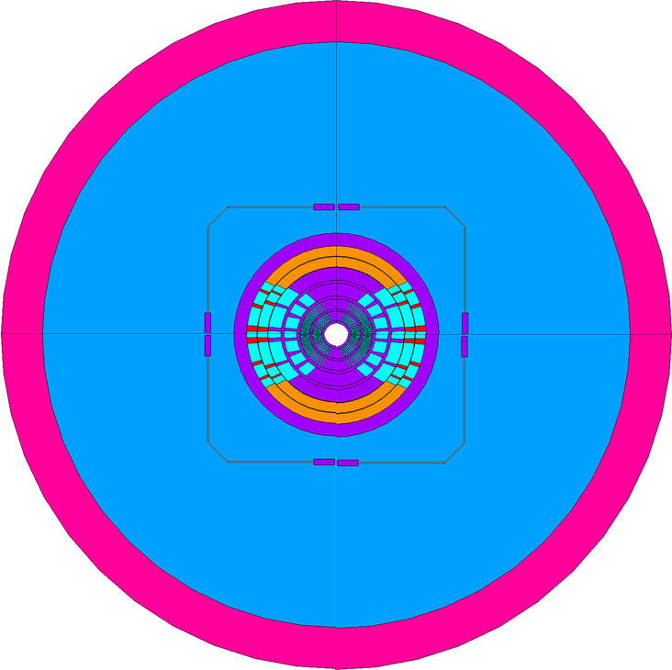
20T hybrid

