Slide 1
A short literature review on liquid hydrogen: A high-potential 20 K cryogen for superconducting magnets
SMP Technical Meeting
Jean-Francois Croteau
2023.09.05

Slide 2
Outline
01
Important Topics:
Liquid hydrogen fundamentals
80 years of (relevant) Liquid Hydrogen Work:
A short literature review
Cooling Superconducting Magnets with LH₂:
An overview of our LDRD proposal
02
03

Slide 3
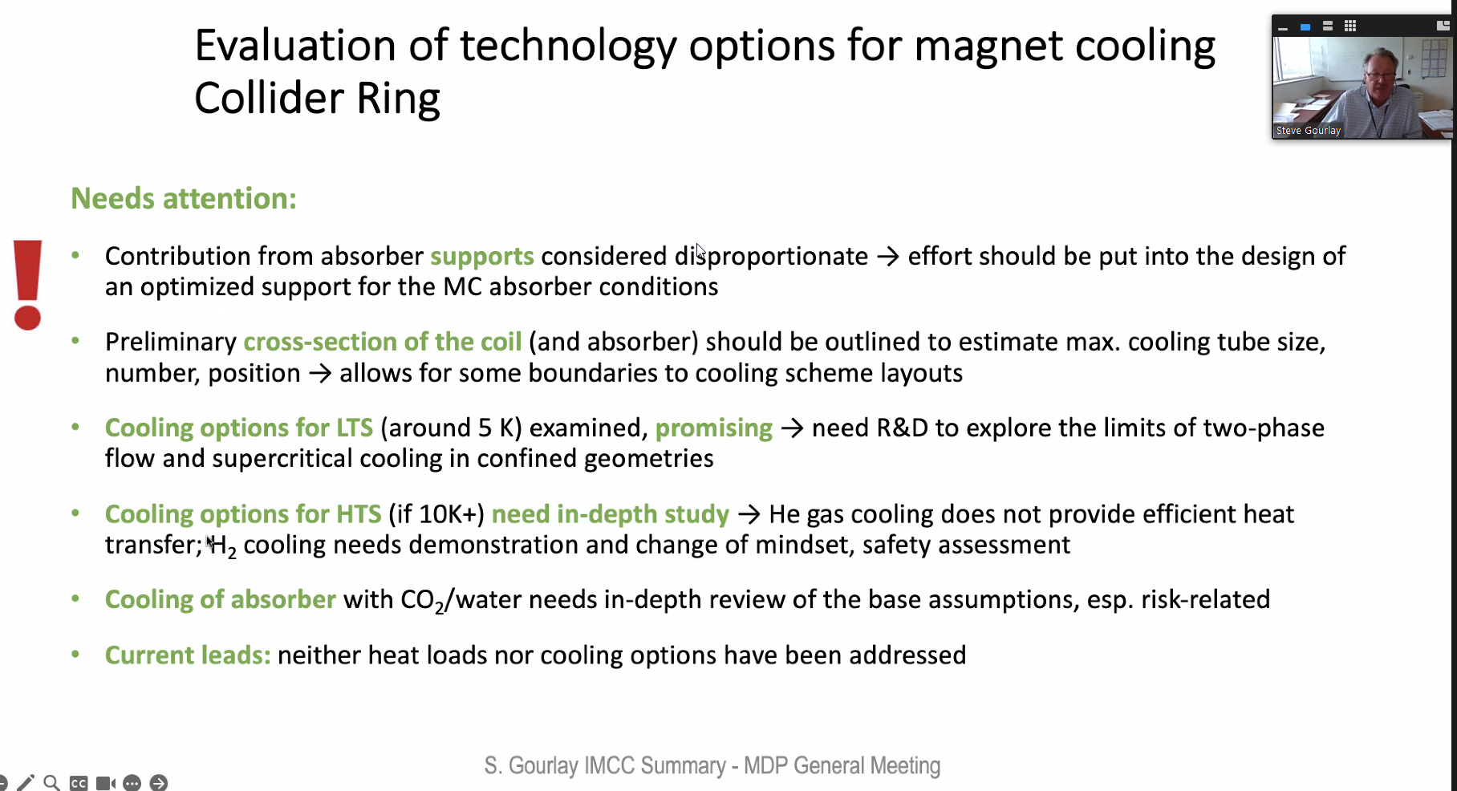
Main Objective
For everyone to consider LH₂ as a serious cryogenic coolant for (1) large-scale projects and (2) low-cost applications
Main advantages
Known drawbacks
Operating at 20 K is more efficient
LH₂ as a much larger latent heat
H₂ is abundant, cheap, and will be more available with the H₂ economy
Magnets at 20 K will have a lower maximum field than at 1.9 K (higher conductor requirement and coil size)
Learning curve and safety concerns to overcome

Slide 4
Important Topics
Liquid hydrogen fundamentals

Slide 5
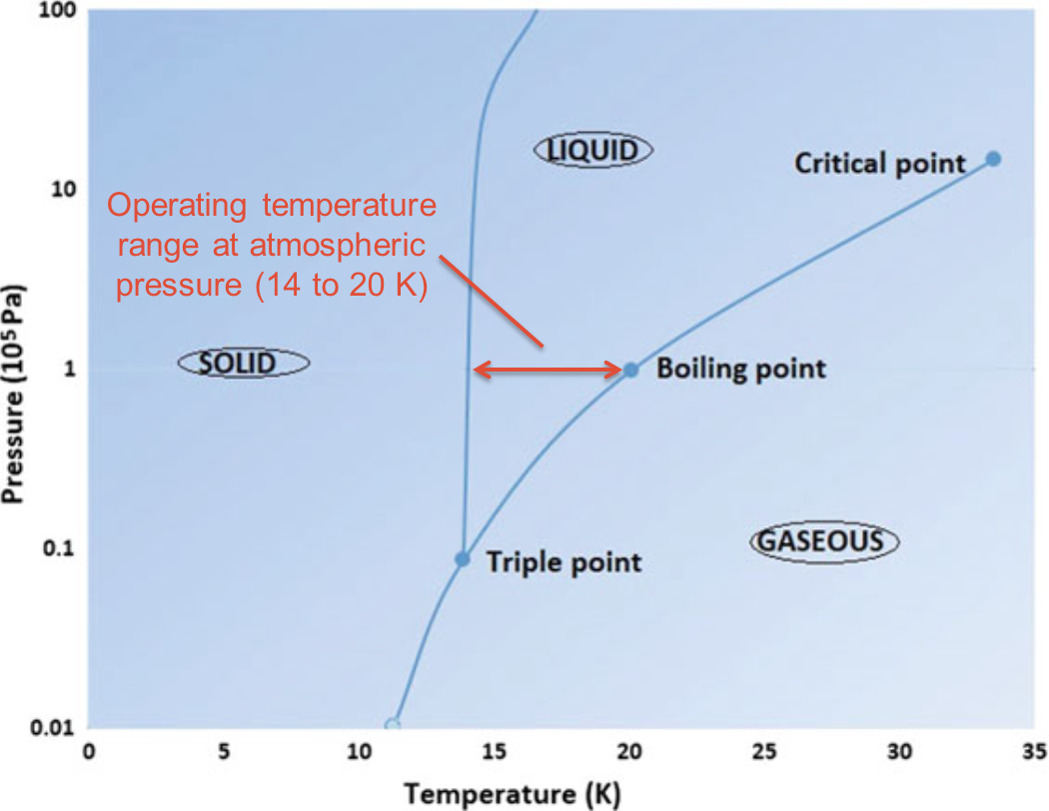
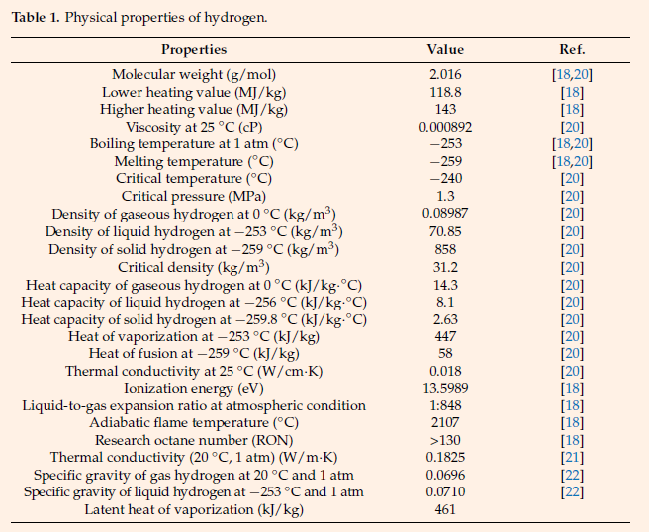
Liquid Hydrogen – Properties
(value for helium)
Phase diagram
Boiling point at atmospheric pressure (~100 kPa): 20.3 K (4.2 K)
Melting point at atmospheric pressure: 14.0 K
Critical point at ~1 MPa and ~33 K (slush storage)
Important properties
Low viscosity and high thermal conductivity
Low molecular weight: 2.016 (4.003)
High latent heat of vaporization: 446 kJ/kg (20.3 kJ/kg)
  LNe: 85.90 kJ/kg @ 27 K
  Per liter: 31.36 kJ/L (2.55 kJ/L) – LNe: 103.71 kJ/L ($$$)
Liquid density: 70.8 kg/m³ (124.9 kg/m³)
(Aziz, 2021)

Slide 6
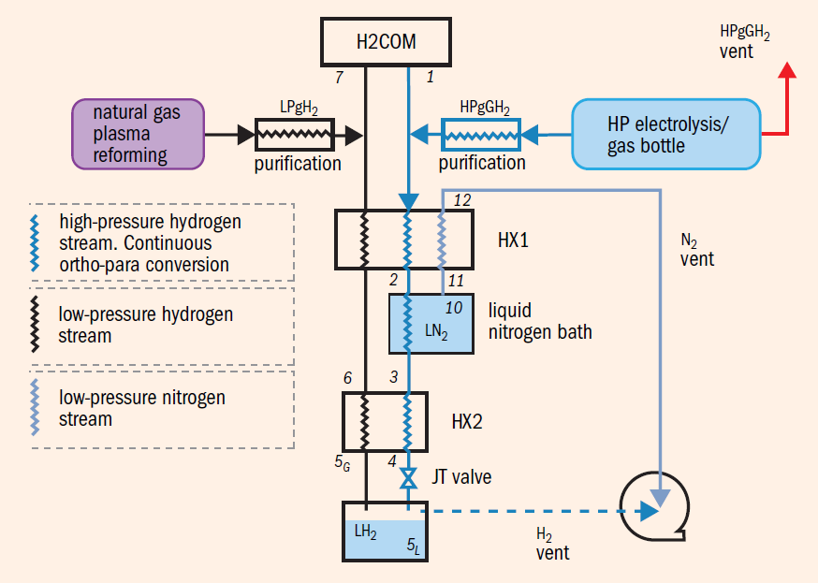
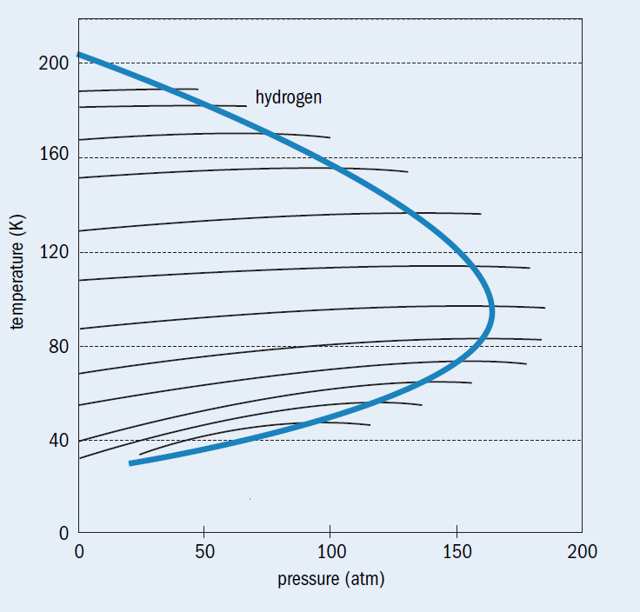
Liquid Hydrogen – Liquefaction
Schematic of the proposed pre-cooled Linde-Hampson system for hydrogen liquefaction. Ortho-para hydrogen conversion takes place in HX1 and HX2 zones
1: Pure hydrogen enters the cycle and is compressed by a
hydrogen compressor (H2COM)
HX1: cold gases pre-cool high-pressure hydrogen stream
3: LN2 bath removes heat from the hydrogen
HX2: Pre-cooled compressed hydrogen flows through
hydrogen–hydrogen heat exchanger
4: compressed stream is reduced to the final temperature by
expansion of the gas through a Joule-Thompson valve
  Maximum inversion temperature with a J-T valve 205 K
  Pre-cooling with liquid nitrogen (77.4 K) or liquified natural
  gas (112 K) can be used
(Nuttall, 2016)
The family of the iso-enthalpic lines on the temperature vs pressure diagram for hydrogen
See Aziz, 2021 for a more detailed and recent review
(Nuttall, 2016)

Slide 7
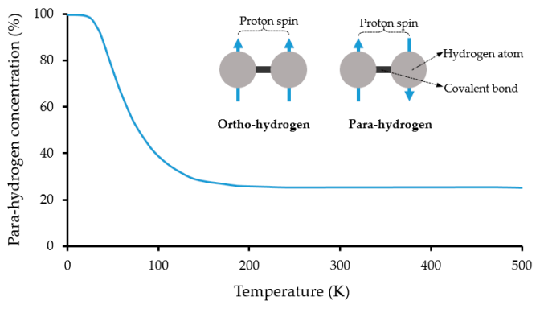
Liquid Hydrogen – Ortho-Para Conversion
Orthohydrogen vs Parahydrogen: difference in the proton
spin directions
  Studied in the 60s (see NIST, 1967 for list of papers)
Equilibrium concentrations at different temperatures
  300 K: 75% ortho vs 25% para
  20.3 K: 0.21% ortho vs 99.79% para
  Large energy requirement during the conversion from ortho to para (525 kJ/kg)
    More energy than the heat of vaporization (446 kJ/kg)
Time dependent process (can be problematic for long-term storage)
  10 hours after liquefaction, para. conversion can be x_{p-H2} = 0.31 (generating ~50 J/g);
  1000 hours after liquefaction, x_{p-H2} = 0.92 (generating ~400 J/g)
Possible to accelerate part of the conversion with catalytic converters (e.g. Cr₂O₃)
(Aziz, 2021)
Important consideration for storage and long-operating cycle projects

Slide 8
Liquid Hydrogen – Storage
Very similar to helium for storage
  Standard stainless steel dewars designed for liquid helium are identical to those intended for liquid hydrogen in terms of construction and welding materials
  Liquid-hydrogen dewar cannot have wheels when it is filled with hydrogen
Fuel-cell cars store high-pressure H₂ gas (challenges with liquid, e.g. refueling, warm tank, …)
See Aziz, 2021 for a more detailed and recent review

Slide 9
Safety
Risk categories (Aziz, 2021)
  physical (embrittlement, failures, and phase change)
  physiological (frostbite, suffocation, hypothermia, asphyxiation, and respiratory problems)
  chemical (fire, explosion)
Hydrogen fire
  Can be ignited at relatively low concentration
  Hydrogen fire burns directly upward
  Hydrogen fires are difficult to see in daylight compared to more typical incidents
Risk mitigation
  Leak avoidance is key (subject to leak due to low viscosity and molecular weight)
  Robust design of storage and distribution piping
  Relief paths to a vent box
  Gaseous nitrogen jacket
H₂ vs petrol fire
More readings: Ricci et al. 2010’s book chapter, Aziz 2021 section 5, NREL safety report

Slide 10
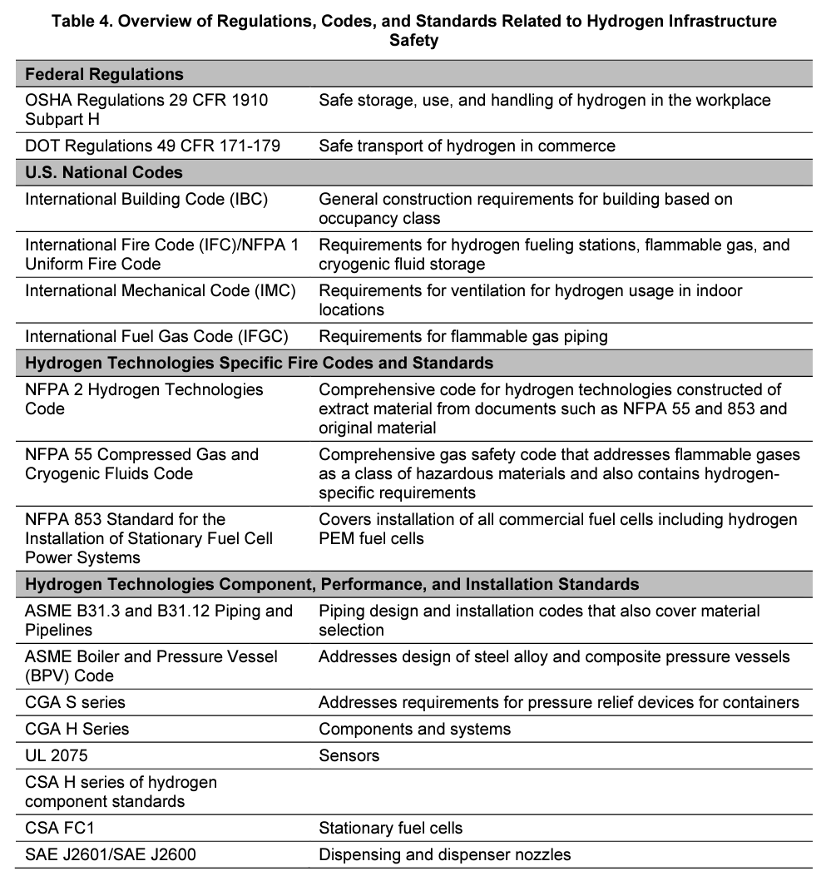
Safety – Standards
See NREL report for more details and the adjacent
table (Rivkin, 2015)
  List of standards for storage, material selection,
  component selection, permitting process, safe
  distances, fire safety, …
List of some standards
  ISO Technical Committee 197, ISO/TR 15916:2015
  (only access to preview)
  National Fire Protection Association: NFPA 2 and 55
  CGA P-28: OSHA PSM and EPA RMP Guidance
  Document for Bulk Liquid Hydrogen Systems
  CGA P-12
  CGA H-3
  …
More readings: Ricci et al. 2010’s book chapter, Aziz 2021 section 5, NREL safety report

Slide 11
Hydrogen at Scale
Existing hydrogen industry is based on fossil fuels and supplying a chemical feedstock for industries such as ammonia production and oil refining
  Foreseen future hydrogen economy is with hydrogen as
  an energy carrier (e.g. fuel-cells: energy storage and cars)
Liquefactions gains in efficiency at large scale
  Desire to have centralized liquefiers with a distribution
  network, e.g. pipeline and trucks
Hydrogen “colors”
  Grey: mainly from natural gas or methane
  Blue: mainly from natural gas with carbon capture and
  storage
  Green: electrolysis of water using a renewable energy
  source (no harmful greenhouse gas emission)
  Other: black/brown, pink, turquoise, yellow, and white
Near-term
Long-term
(Original reference available in Nuttall, 2020)

Slide 12
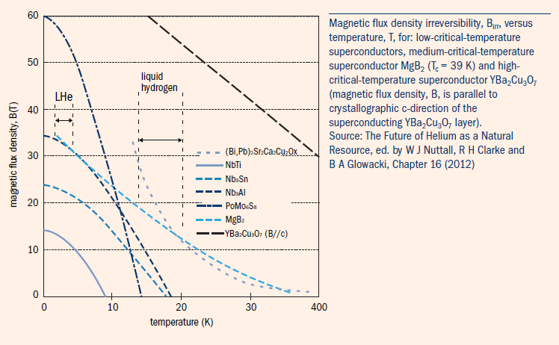
Cryomagnetics
“hydrogen cryomagnetics”: when liquid H₂ is used in high-field and high-efficiency magnets
  Expression from Bartek Glowacki (SMP Materials Seminar 2023.02.07)
In competition with mechanical recirculating cryo-coolers (different heat transfer mode)
Interest for the use of MgB₂ (T_{c} = 39 K) for medium-field and high-current applications
Other materials
  LaSCO (39 K)
  YBCO (92 K)
  Bismuth-based (2212 (91 K), 2223 (110 K))
  Thallium-based (90 to 125 K)
  Mercury-based (95 to 133 K)
  Iron-based (26 to 56 K)
  NCCO (25 K)
hole-doped
electron-doped

Slide 13
References
ASC2022 course on HTS materials and their application, presentation from C. Senatore
M. Aziz, “Liquid Hydrogen: A Review on Liquefaction, Storage, Transportation, and Safety,” Energies, vol. 14, no. 18, p. 5917, Sep. 2021, doi: 10.3390/en14185917.
G. Biswal and K. L. Mohanta, “A recent review on iron-based superconductor,” Materials Today: Proceedings, vol. 35, pp. 207–215, 2021, doi: 10.1016/j.matpr.2020.04.503.
National Grid Group, “The hydrogen colour spectrum | National Grid Group.” https://www.nationalgrid.com/stories/energy-explained/hydrogen-colour-spectrum (accessed Nov. 22, 2022).
National Bureau of Standards (NIST), “1967 Technical Highlights of the National Bureau of Standards,” 1967. [Online]. Available: https://www.govinfo.gov/content/pkg/GOVPUB-C13-4e5770400e63fd581388492c3c4d8d12/pdf/GOVPUB-C13-4e5770400e63fd581388492c3c4d8d12.pdf
W. Nuttall and B. Glowacki, “Next Steps for Hydrogen: Physics, technology and the future,” Next Steps for Hydrogen: Physics, technology and the future | Institute of Physics., 2016 https://www.iop.org/about/publications/next-steps-for-hydrogen (accessed Nov. 21, 2022).
W. J. Nuttall and A. T. Bakenne, Fossil Fuel Hydrogen: Technical, Economic and Environmental Potential. Cham: Springer International Publishing, 2020. doi: 10.1007/978-3-030-30908-4.
M. Ricci, P. Bellaby, and R. Flynn, “Hydrogen Risks: A Critical Analysis of Expert Knowledge and Expectations,” Hydrogen Energy, p. 24.
C. Rivkin, R. Burgess, and W. Buttner, “Hydrogen Technologies Safety Guide,” NREL/TP--5400-60948, 1169773, Jan. 2015. doi: 10.2172/1169773.

Slide 14
80 years of (relevant) Liquid Hydrogen Work
A short literature review

Slide 15
Overview

Slide 16
1940s–60s
LH₂ cooled normal conducting high-field magnets

Slide 17
Overview
In the 40s to the 60s, much work was done on the use of cryogens to reduce the resistance of normal conducting magnets to produce high magnetic fields for both pulsed and continuously operating magnets
  Water was (and is) also used for its higher cooling efficiency, but higher magnet operating temperature
High purity materials were used (mostly copper and aluminum), but materials studied revealed that work hardening of both materials, required to prevent the coil from deforming under the large Lorentz forces, was increasing the resistance and limiting the improvements of low T operation
Many labs did not operate magnets in liquid hydrogen due to concerns with safety, but many did with no record (to the best of my knowledge) of major incidents
  1946, University of Leyden: test of a Cu coil in LH₂
  1950s–1960s, Los Alamos: lots of work conducted by Henry Louis Laquer with Al coils, a significant amount of LH₂, a small-sized plant, and more
Indirect cooling of gaseous He with LH₂ has been proposed and used in many labs

Slide 18
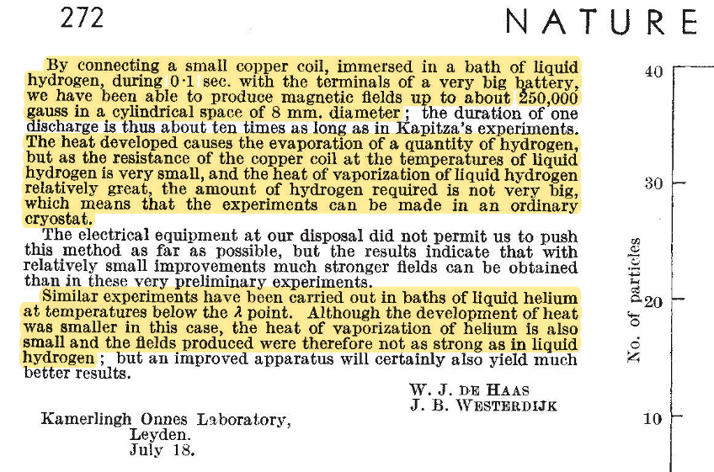
Netherlands – Leyden 1946
Nature paper (de Haas, 1946)
Test of a normal conducting Cu coil in a liquid hydrogen bath in 1946 in Kamerlingh Onnes Laboratory in Leyden
  Pulsed magnet
Discusses the advantage of the larger
heat of vaporization of H₂ compared to He

Slide 19
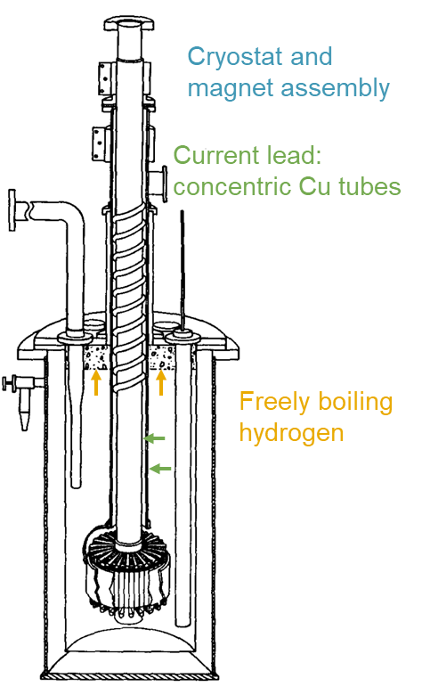
LH₂ was Previously Used to Cooldown Normal Conducting Magnets (1940s–1960s)
Freely boiling LH₂
Henry L. Laquer (Los Alamos) conducted many experiments with LH2-cooled magnet (copper coils) with a current of up to 7,300 A
Report on 3 years of work handling 5500 L batches of LH₂ at LANL: transportation, transfer, instrumentation, and safety
Venting outside of the building with tall pipe and strong winds
NBS (now NIST) was liquefying large amounts of H₂ (300 L/h with 6000 L storage) and
shipping dewars to LANL for magnet testing

Slide 20
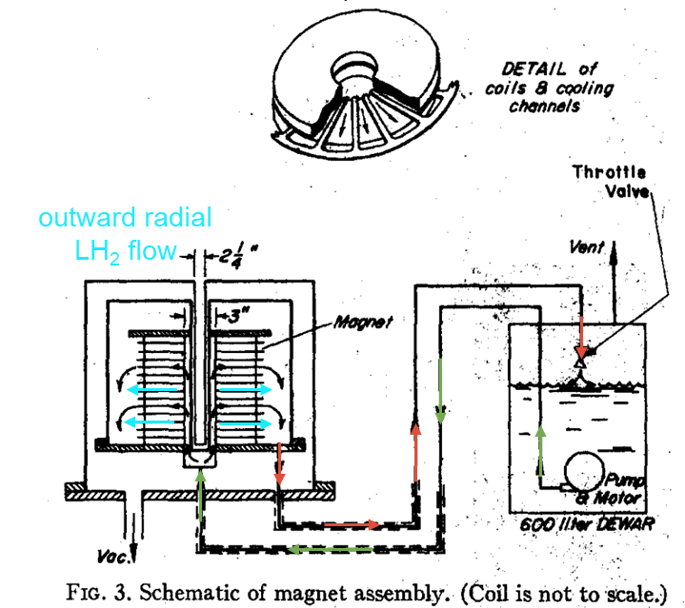
LH₂ was Previously Used to Cooldown Normal Conducting Magnets (1940s–1960s)
LH₂ Forced Flow
Magnets with forced LH₂ flow were designed to increase the cooling capacity
H. Laquer (LANL) forced convection cooling, LH₂ rate
of ~4 L/s
Purcell (NBS) forced flow with aluminum coils
Demonstration of the safe operation of electromagnets with high currents immersed in LH₂,
but safety standards have evolved since the 60s

Slide 21
1950s–70s
LH₂ bubble chamber for particle detectors

Slide 22
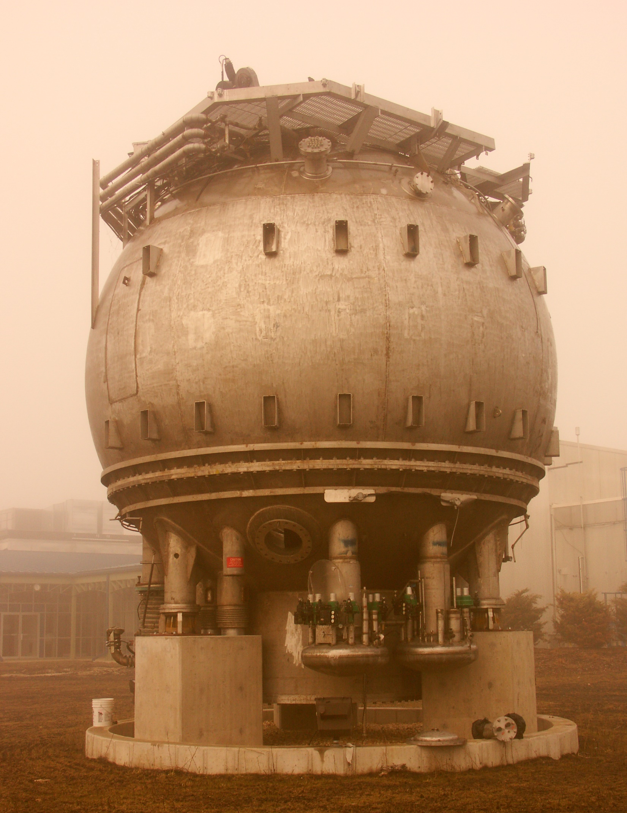
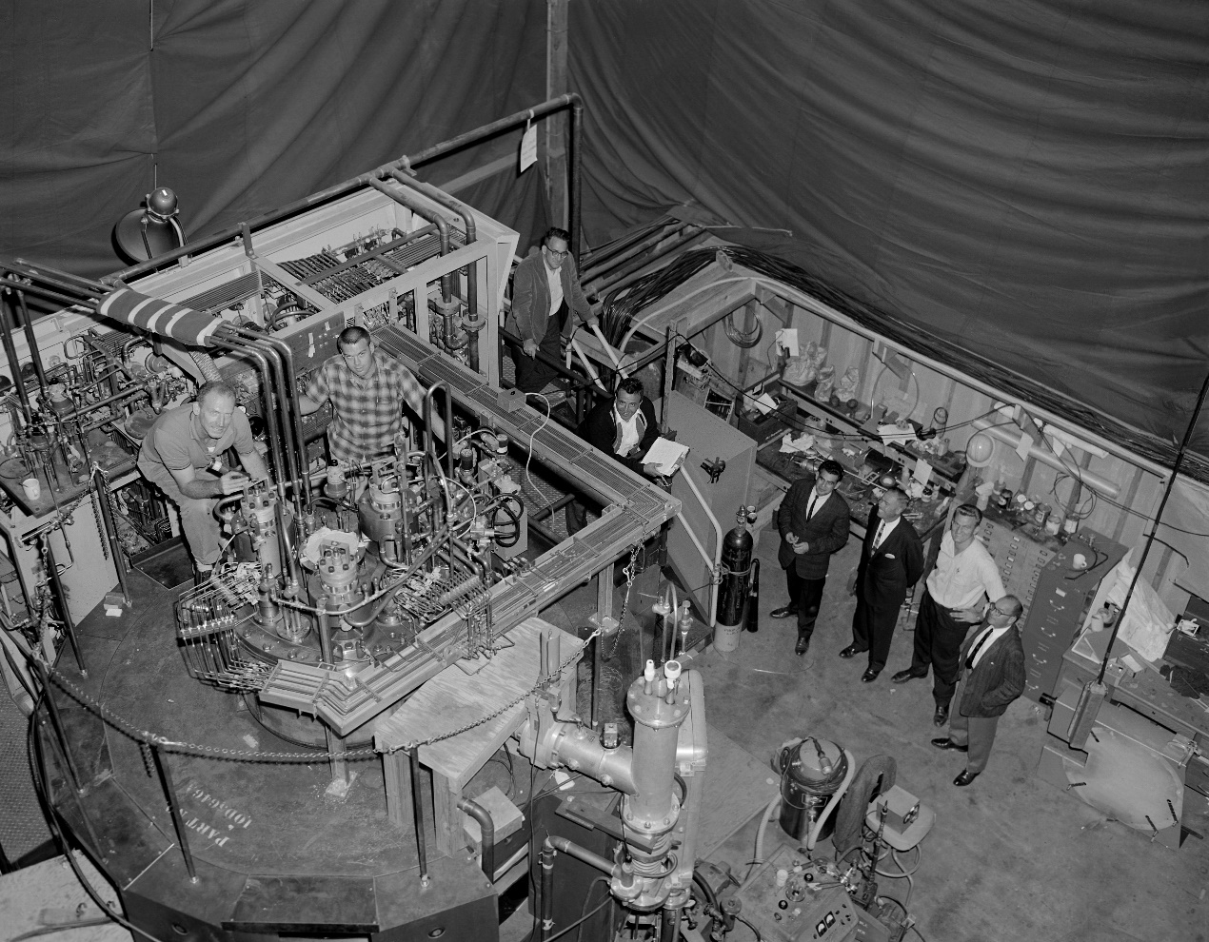
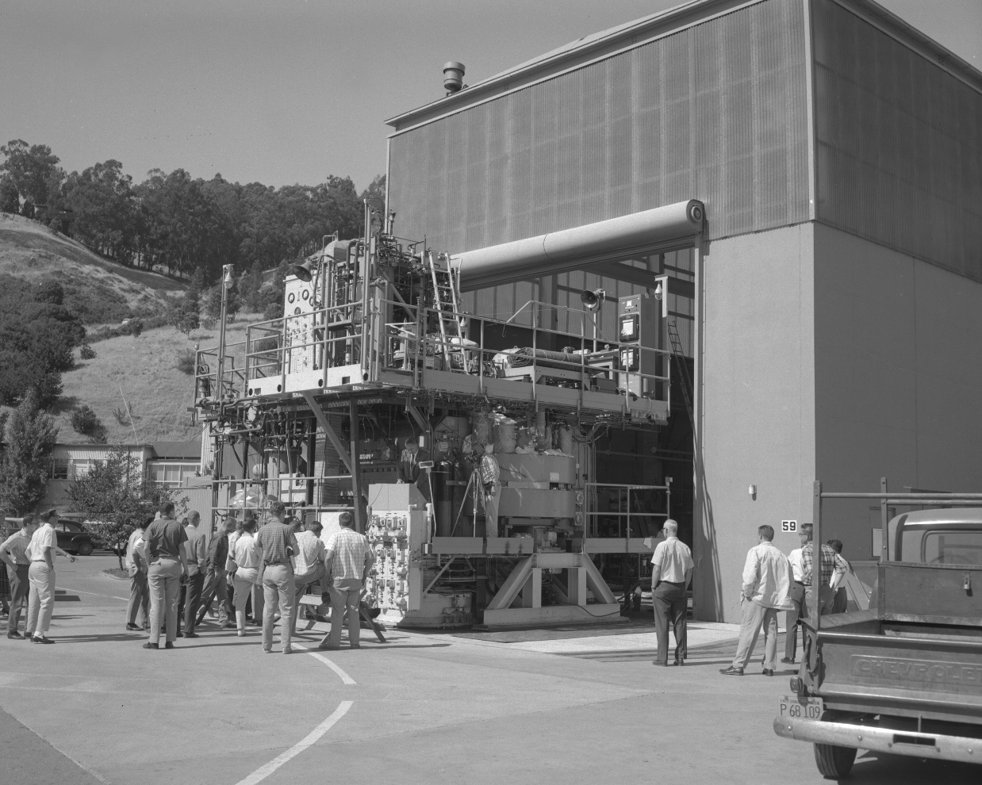
USA, CERN, and France
Bubble chambers use LH₂ at close to the boiling point (superheated liquid), so that particles entering
the chamber create bubbles that are imaged and tracked. Installed in the Bevatron
  These chambers lead to the discovery of many particles and Nobel Prizes
Luis Alvares 1956 with a liquid hydrogen bubble chamber at LBL for particle detection
ANL, FNAL, Saclay and CERN all had LH₂ bubble chambers (it was also likely used elsewhere)
FNAL’s bubble chamber
Archive pictures of liquid hydrogen bubble chambers used at LBL

Slide 23
1990s–today
LH₂ cooled superconductors

Slide 24
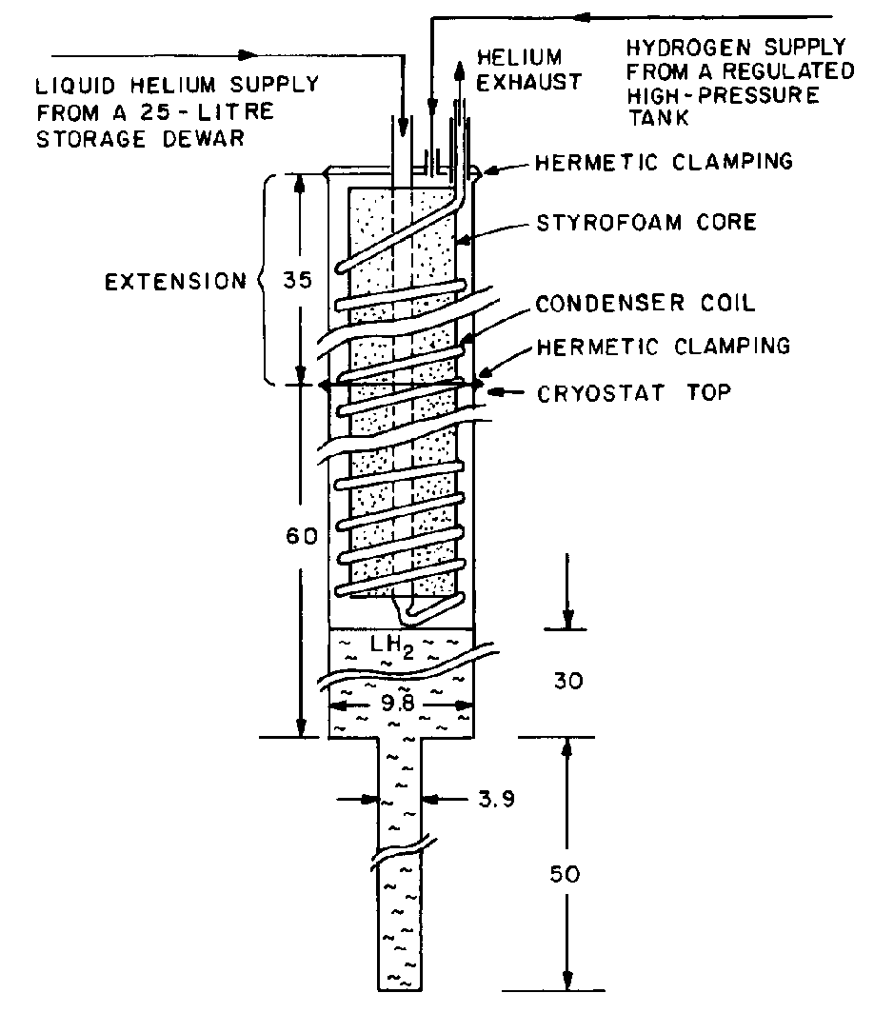
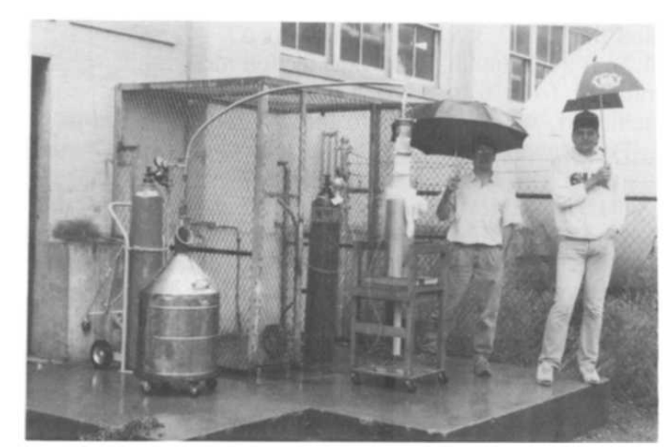
LH₂ Liquefaction at MIT for Superconducting Wire Characterization
Prof. Y. Iwasa at MIT (1990)
Y. Iwasa liquefied small amounts (~3 L) of H₂ at MIT to measure the critical current of HTS materials in boiling LH₂ (similar to our objective)
  The liquefier was built after a supplier stopped selling small quantities of LH₂ to the lab
Bi2223 tape characterization conducted with this setup at 15 and 20 K in an applied field of 19.75 T at 215 A
(K. Sato et al. 1990) and for small double-pancake coils (K. Sato et al. 1992)
A LNe setup was built in 1992 because of safety concerns
at MIT’s high magnetic field lab

Slide 25
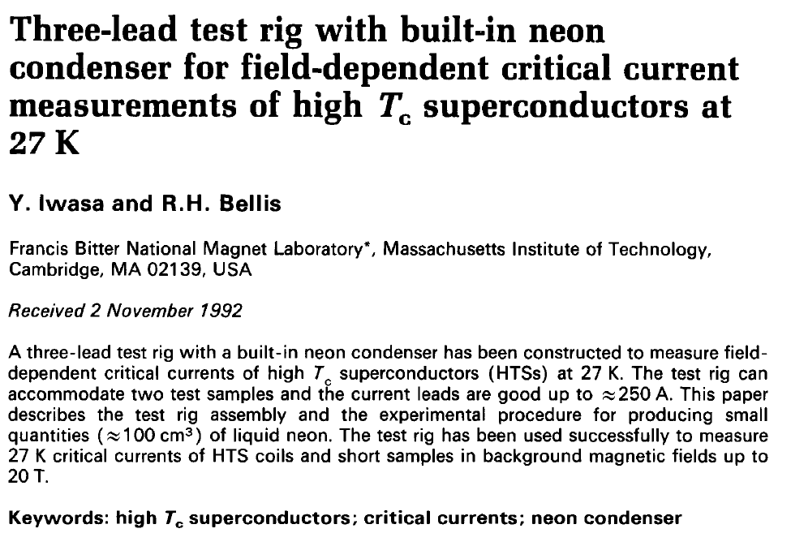
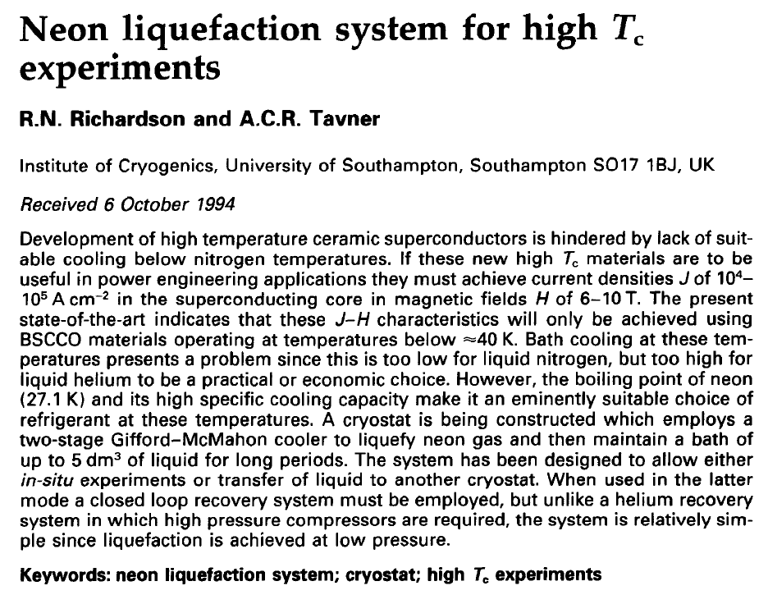
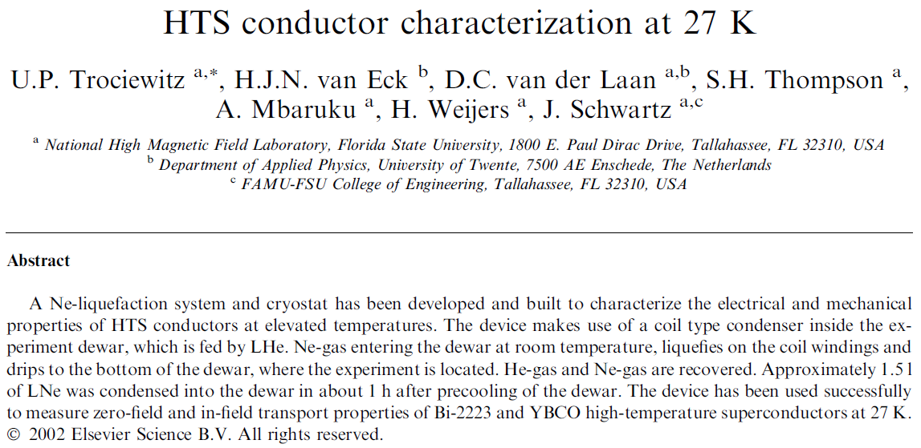
LNe Experiments with HTS
MIT 1992: Bi-based superconductors and
small coils were characterized in field
(up to 20 T)
UK institute of cryogenics 1994: liquefaction
system only
NHMFL 2002: Ulf Trociewitz, Danko et al.,
HTS conductor characterization at 27 K
in-field (LNe dewar and samples
were inserted in 20 T resistive
magnet)
Main issue: very high cost of Ne

Slide 26
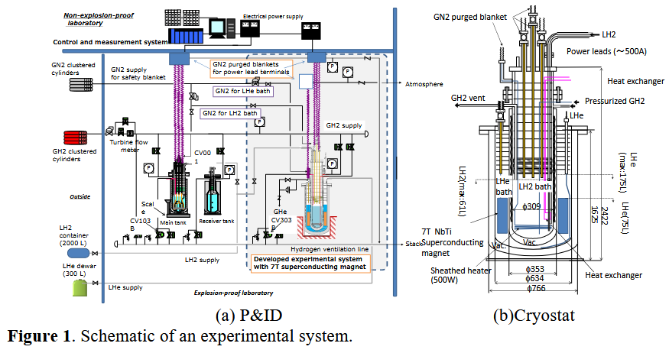
HTS Characterization in LH₂ is Currently Happening in Japan
Ongoing Work in Japan
Y. Shirai et al. have been working on a setup to measure the critical current of HTS materials (MgB₂) immersed in LH₂ (61 L) and under an applied field
  Project started in 2008
  Heat transfer properties of
  free-boiling and forced flow LH₂
All work is conducted in an
explosion-proof room, i.e. a bunker,
and measurements are remotely
conducted

Slide 27
United Kingdom – 2016 Cryomagnetics and Hydrogen Economy
William Nuttall (The Open University) and Bartek Glowacki (Cambridge) wrote review articles on coined the term Cryomagnetics
  Discussing the dual use of LH₂ as (1) an energy carrier and (2) as a coolant
Strong desire to work with MgB₂ due to the low material cost and T_{c} of 39 K

Slide 28
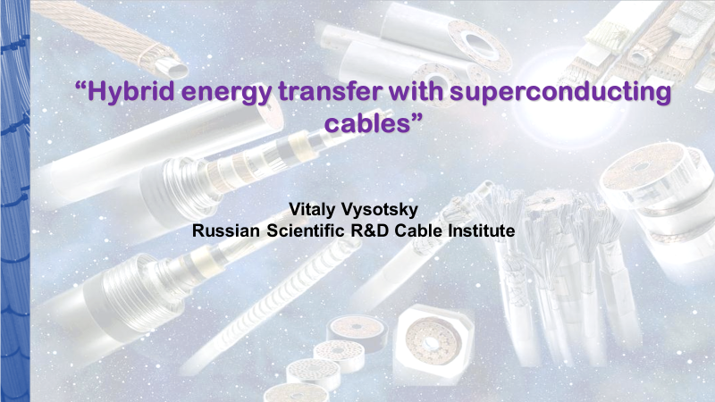
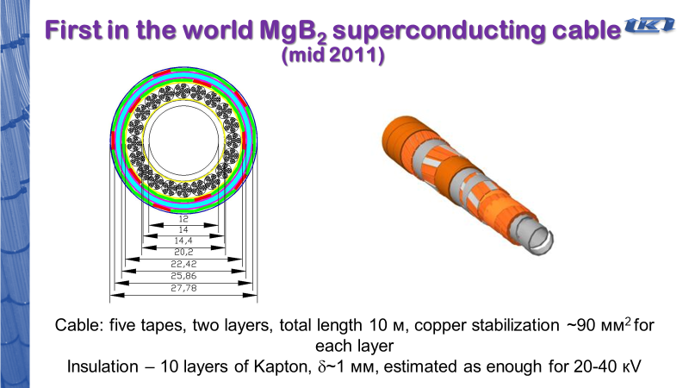
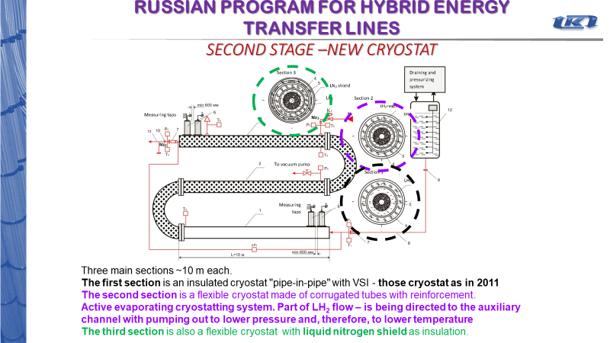
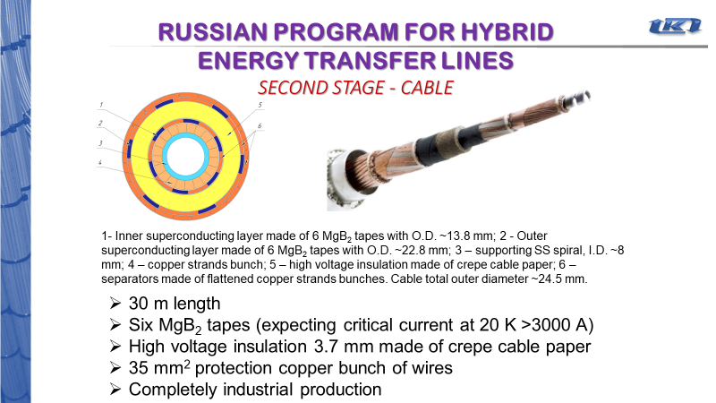
Russia – 2011 MgB₂ Superconducting
Transfer Line
Vitaly Vysotsky’s paper
MgB₂ cable for a high current transfer line in LH₂
  Cable from ASG (Italy, formaly Columbus)
  (2011) 2 layers of 5 MgB₂ tapes
  (2013) 2 layers of 6 MgB₂ tapes
  3 sections of 10 m
Tests performed at site
used to rocket engines
using LO₂ and LH₂

Slide 29
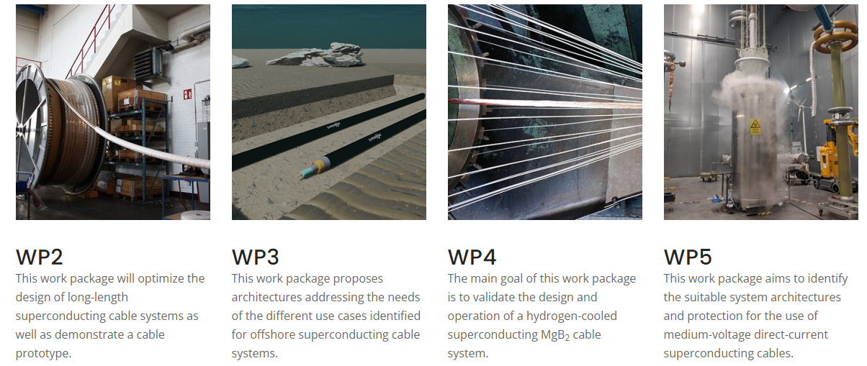
EU SCARLET Project – 2022 LH2-cooled MgB₂ cables
SCARLET: Superconducting cables for sustainable Energy Transition
Project website: https://scarlet-project.eu/project/
4.5-year project started in Oct 2022

Slide 30
References
Chester, P F. 1967. “Superconducting Magnets.” Reports on Progress in Physics 30 (2): 561–614. https://doi.org/10.1088/0034-4885/30/2/305.
De Haas, W. J., and J. B. Westerdijk. 1946. “Strong Magnetic Fields.” Nature 158 (4008): 271–72. https://doi.org/10.1038/158271c0.
Laquer, H. L. 1960. “Handling Liquid Hydrogen on a Pilot Plant Scale.” In Advances in Cryogenic Engineering. Springer. http://link.springer.com/10.1007/978-1-4757-0537-9.
Laquer, Henry L., and Edward F. Hammel. 1957. “Cryogenic Electromagnets. I. Feasibility Study.” Review of Scientific Instruments 28 (11): 875–78. https://doi.org/10.1063/1.1715752.
McDonald, K. T., M. Iarocci, H.G Kirk, G.T. Mulholland, P.H. Titus, and R.J. Weggel. 2009. “Use of He Gas Cooled by Liquid Hydrogen with a 15-T Pulsed Copper Solenoid Magnet.”
Meneghelli, Barry. 2016. “Energy Efficient Cryogenics”, conference presentation
Montgomery, Bruce. 1963. “The Generation of High Magnetic Fields,” 37.
Parkinson, D H. 1962. “International Conference on High Magnetic Fields, Massachusetts Institute of Technology, November 1961.” British Journal of Applied Physics 13 (10): 496–500. https://doi.org/10.1088/0508-3443/13/10/308.
Purcell, John R., and E. G. Payne. 1963. “High‐Field Liquid H ₂ ‐Cooled Aluminum‐Wound Magnet.” Review of Scientific Instruments 34 (8): 893–97. https://doi.org/10.1063/1.1718616.
Shigeta, H., Y. Shirai, M. Shiotsu, H. Tatsumoto, S. Nonaka, H. Kobayashi, Y. Naruo, and Y. Inatani. 2016. “Over-Current Properties of MgB ₂ Wire Cooled by Liquid Hydrogen Under Magnetic Field.” IEEE Transactions on Applied Superconductivity 26 (3): 1–5. https://doi.org/10.1109/TASC.2016.2532473.
Shirai, Y. 2017. “Prospect of Liquid Hydrogen Cooled Superconducting Power Apparatus and Carbon Free Energy System.” Conference Talk, EUCAS2017, Geneva.
Shirai, Yasuyuki, Hiroto Kobayashi, Taiki Takegami, Kyosuke Hikawa, Masahiro Shiotsu, Hideki Tatsumoto, Yoshihiro Naruo, Hiroaki Kobayashi, Yoshifumi Inatani, and Katsuhiko Kinoshita. 2012. “Over Current Properties of HTC Superconducting Wire Cooled by Liquid Hydrogen.” Physics Procedia 36: 1384–89. https://doi.org/10.1016/j.phpro.2012.06.309.
Tatsumoto, H, Y Shirai, K Hata, T Kato, M Futakawa, and M Shiotsu. 2010. “Forced Convection Heat Transfer of Subcooled Liquid Nitrogen in a Vertical Tube.” Journal of Physics: Conference Series 234 (3): 032057. https://doi.org/10.1088/1742-6596/234/3/032057.
Tatsumoto, H, Y Shirai, M Shiotsu, K Hata, H Kobayashi, Y Naruo, Y Inatani, T Kato, M Futakawa, and K Kinoshita. 2010. “Development of a Thermal-Hydraulics Experimental System for High Tc Superconductors Cooled by Liquid Hydrogen.” Journal of Physics: Conference Series 234 (3): 032056. https://doi.org/10.1088/1742-6596/234/3/032056.
Tatsumoto, H, Y Shirai, M Shiotsu, Y Naruo, H Kobayashi, and Y Inatani. 2014. “Development of an Experimental System for Characterization of High-Temperature Superconductors Cooled by Liquid Hydrogen under the External Magnetic Field.” Journal of Physics: Conference Series 507 (2): 022042. https://doi.org/10.1088/1742-6596/507/2/022042.
Timmerhaus, K. D., ed. 1960. Advances in Cryogenic Engineering. Boston, MA: Springer US. https://doi.org/10.1007/978-1-4757-0537-9.

Slide 31
References (extra)
Books of interest not available online
  Liquid hydrogen (properties, production and applications), Paris, 1965, https://berkeley.primo.exlibrisgroup.com/permalink/01UCS_BER/s4lks2/cdi_cern_primary_oai_cds_cern_ch_108979
  1st International Conference on High Magnetic Fields, MIT Press, 1962, https://berkeley.primo.exlibrisgroup.com/permalink/01UCS_BER/s4lks2/cdi_cern_primary_oai_cds_cern_ch_221821, (MIT, UCB interlibrary loan request made)

Slide 32
Cooling Superconducting Magnets with LH₂
An overview of our LDRD proposal

Slide 33
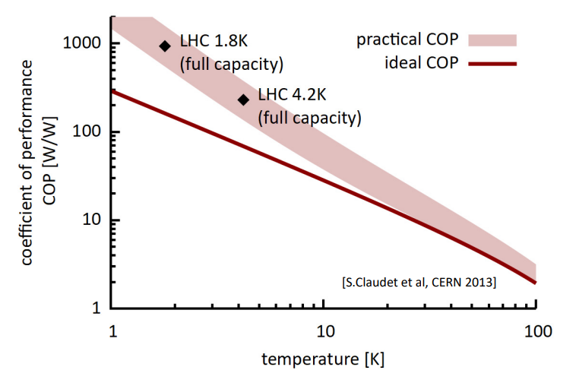
Sustainable Future Colliders by Increasing the Operating Temperature to 20 K
Proposals to increase the collision energy of particle accelerators including ever larger colliders, e.g. a ~100 km circular collider at CERN (FCC)
Energy supply issues in Europe and high electricity costs
Power consumption of the cryogenics system of the FCC would be 47% of total power
Operating at 20K instead of 1.9K would increase
the cooling efficiency (10-fold Carnot)
Helium supply has been unreliable and prices
unsustainable in recent years
Moving from He to LH₂ would be synergistic
with the hydrogen economy
LH₂ at 1 atm
Increase in cooling efficiency
Cryogenics

Slide 34
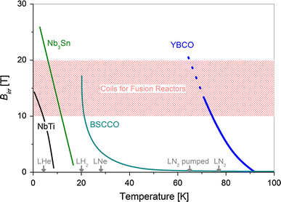
Increasing the Operating Temperature to 20 K is Possible with High Temperature Superconductors
Moving from LHe to LH₂ is possible with HTS
The performance of commercial REBCO tapes at high fields has recently improved and cost is significantly lower due to large orders from the fusion community (economy of scale)
LBL is developing high-field REBCO magnets for
particle accelerators
All magnets currently developed for HEP are
being cooled with helium
Fundamental applied research is necessary to
develop safe setups to assess superconducting
magnet performances in LH₂ before considering
LH₂ as a coolant for large-scale projects
LH₂ at 1 atm
Superconductors
Compatible superconductor for high field magnets
≥ 16T HEP dipoles
Cooling efficiency ↑ ~10x
https://doi.org/10.1007/s10894-015-0050-1

Slide 35
Plans at LBL
Toward Using Liquid Hydrogen As a Magnet Coolant For Sustainable Circular Colliders
Applied for Laboratory Director R&D (LDRD) funding – expecting an answer in July
Plans at LBL
  Buy LH₂ or liquefy (if necessary)
    Ongoing liquefaction project for particle detector (Li Wang)
  Design a setup for LH₂ transfer (or liquefaction) and basic measurements at LBL
    SME expert for design review
    LH₂ transfer, venting, liquid level sensors, pressure, …
  Operate superconductors and magnets with current in LH₂
    Current lead design, superconductor characterization at small to large scale

Slide 36
Project timeline with setup commissioning around summer 2024 and first test with current in Fall 2024
Design
Hardware procurement
Setup assembly and commissioning
LH₂ transfer test
HTS test with current
Project start
Safety review
Commissioning
First LH₂ transfer
First test with current
Performance of HTS conductors and magnets
Oct 23
Jan 24
Apr 24
Jul 24
Oct 24
Jan 25
Apr 25
Jul 25
Oct 25
FY24
FY25
Phase 1
Phase 2
Phase 4
Phase 3
Phase 1: Design
Phase 2: Assemble + transfer
Phase 3: Current leads + HTS sample
Phase 4: Performances of HTS conductors and magnets

Slide 37
Ongoing Efforts
Monthly meetings with lab’s EH&S and fire marshal
  No safety showstoppers at the moment
  Visit of Richmond Field Station to look at potential sites
Ongoing discussions with PNNL and MIT
  PNNL: experts in magnetocaloric refrigeration and leading the DOE hydrogen safety panel
  MIT: sharing the interest for LH2 and gas/liquid mixtures for fusion (group of John Brisson: https://www.hytec.mit.edu/)
  Meeting notes are available here: GDrive link
  (TBC) Planning for a visit in October at PNNL and WSU (Prof. Leachman – the only cryogenic hydrogen research center in US academia https://hydrogen.wsu.edu/)

Slide 38
Conclusions
LH2 was safely used in the past with normal conducting magnets
Growing interest for 20 K superconducting magnets, higher electricity costs, and cost and supply issues with LHe are motivating new studies in LH₂
Lab-scale experiments are required if we want to consider LH₂ as the cryogen of future accelerators

Slide 39
Thank you!
A short literature review on liquid hydrogen: A high-potential 20 K cryogen for superconducting magnets
Jean-Francois Croteau
2023.09.05

Slide 40
Additional Slides and Literature

Slide 41
USA – LANL 1956 High Field Magnets in LH₂ (Laquer)
Los Alamos started designing and testing electromagnets in LH2 in January 1955
2 coils built, wire spaced jelly roll, 60 kG field, dissipating 15 kW, free boiling hydrogen
Safety problems are relatively minor since “the magnet shuts itself off […] when heat transfer ceases”
More details on the same magnet in the next slide
Note that a considerable amount of papers in the same conference proceedings are on liquid hydrogen, e.g. liquefaction. According to Notardonato, 2019 (NASA) this was motivated by the hydrogen bomb with liquefiers built in Boulder (NBS)
  “cryogenically cooled liquid deuterium device used for the Ivy Mike test in 1952” which was cooled by LH2
Proceedings, 1956 Cryogenic Engineering Conference (CEC 1956) : Boulder, Colorado, September 5-7, D-1, p. 117-119 (book available in the kitchen)

Slide 42
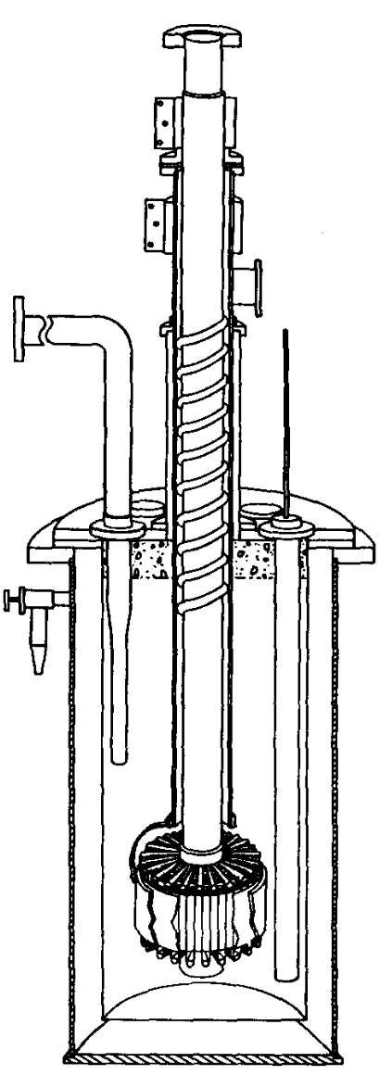
USA – LANL 1957 Cu Coil in LH₂ (Laquer and Hammel)
Electromagnet continuous operation in LH2 (Laquer, 1957)
Operation of a continuous magnet (copper coil) in LH₂ to reduce resistance
  17 kW would boil 30 L/min of LH₂ ;large liquefiers (300 L/h with 6000 L storage) available at NBS (now NIST) in Boulder
“The liquid hydrogen enters through a transfer tube and boil-off gas leaves through the space between the leads”
  Heat transfer to boiling liquid in narrow channels
“Access for measuring leads, float, and sight holes is provided by 8 identical ports in the cover plate”
Seals are made of neoprene O-rings
2 coils design tested (difference in the insulator)
  120 turns of 0.01 in thick, 5 in wide copper, 2.5 in ID, 7.5 in OD, 5 in length
“since pure hydrogen is inert, both oxygen and a spark have to occur simultaneously to cause an accident.”
  Must be careful not to introduce or have trapped air in the chamber (10 to 20 min for cooldown)
  Venting (not burning) through a 3 in pipe that extends 30 ft above the roof (exhaust line as special
  design to prevent air from diffusing back toward the dewar)
Maintained a field of 62 kilo-oersted (7300 A) for 5 s
Cryostat and magnet assembly
Current lead: concentric Cu tubes
Freely boiling hydrogen

Slide 43
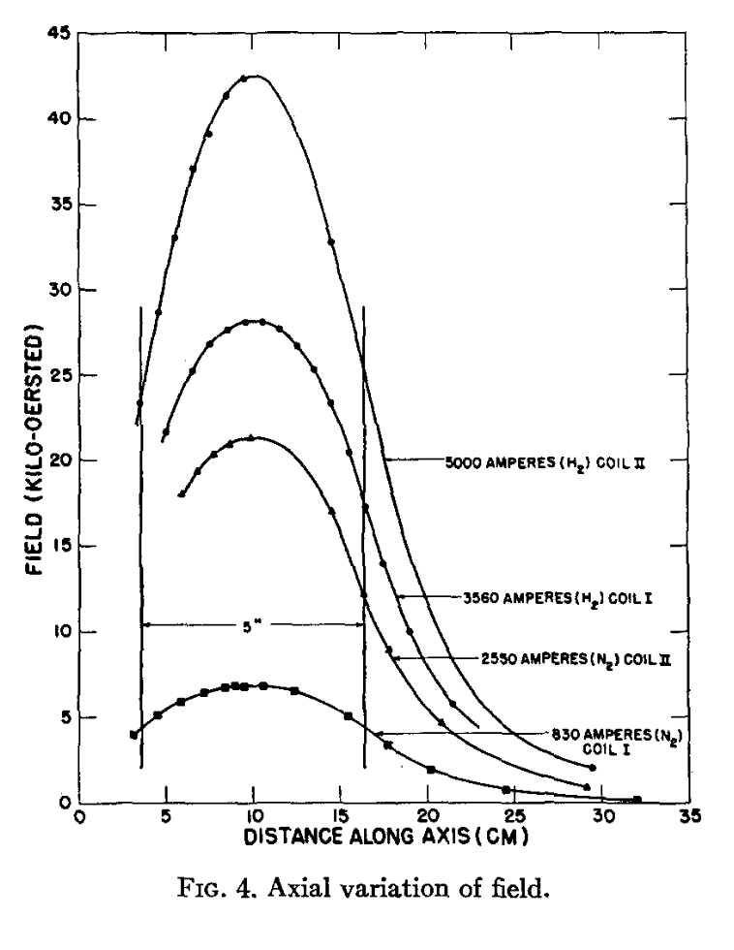
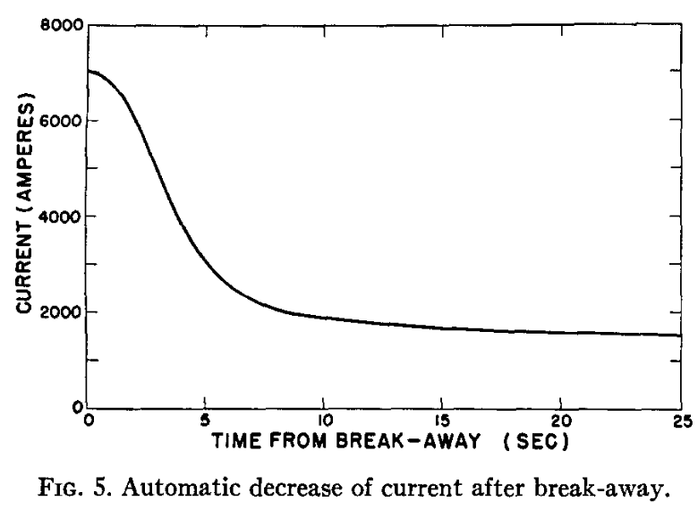
USA – LANL 1957 Cu Coil in LH₂ (Laquer and Hammel)
Electromagnet continuous operation in LH2 (Laquer, 1957)
Cryostat and magnet assembly
Current lead: concentric Cu tubes
Freely boiling hydrogen

Slide 44
USA – LANL 1960 Handling on a Pilot Plant Scale LH₂ (Laquer)
Advances in Cryogenics, 1960, p. 85
Summary of 3 years of work handling 5500 L batches of LH2
  Work done to support the development of LH2 cooled electromagnets
  Topics covered: transportation, transfer, instrumentation, and safety
Magnet normal operating power of 15 kW
  LH₂ boiling rate of 0.5 L/s (~2.09 kg/min)
  Venting outside of the building with tall pipe and wind is enough to avoid cloud build-up
  Higher flow rate (~18.2 kg/min) and windless day lead to higher concentration (~34%) that becomes a combustible gas
  Ignition of the exhaust H₂ was tested
Most important safety feature is a check valve at the top of the vent stack
  Objective: prevent any air from flowing back in the dewar

Slide 45
USA – LBNL and LLNL 1960 Sodium Solenoid in LH₂ (conceptual study only) (Post and Taylor)
Advances in Cryogenics, 1960, p. 13
Conceptual study only (no reference found for a magnet built and tested)
Comparison of Cu, Al, and Na as the metals used for the coils
Not of much interest for us

Slide 46
USA – 1962 1st International Conference on High Magnetic Fields
Papers of interest
  Laquer 1962 forced convection cooling, LH₂ rate of ~4L/s, ribbon-wound coils (H. L. Laquer in High Magnetic Fields, edited by H. H. Kolm, B. Lax, F. Bitter, and R. Mills (MIT and John Wiley & Sons, Inc., New York, 1962), p. 156.)
  Purcell 1962, ideal operation temperature for aluminum magnet is 17 K, so LH₂ is a great cryogenics at 20 K (“An aluminum magnet cooled with liquid hydrogen”)
    J. R. Purcell in High Magnetic Fields, edited by H. H. Kolm, B. Lax, F. Bitter, and R. Mills (MIT and John Wiley & Sons, Inc., New York, 1962), p. 166.
    Should discuss another design of LH₂ cooled magnet from NIST where the forced flow of LH₂ is not radially outward in the stack, but rather through machined grooves
  Normal free-boiling conditions in hydrogen, heat transfer limit of 0.2 to 0.5 W/cm² (Taylor and Post, 1962 (LBL)). Modest forced convection can increase this by a factor of 2 or 3 (Laquer 1962)
  Typical systems were using a closed system hydrogen heat exchanger outside the experimental area to cool He or Ne (Laurence and Brown 1962)

Slide 47
UK – Ministry of Aviation 1962 Short Summary of the High Magnetic Fields Conference
Discusses the use of LH₂ cooled magnets with the work at LANL and NBS
  Pumped LH₂ (higher power level)
  Boiling hydrogen (lower power level)
Limitation of the normal-conducting coils is from higher magnetoresistivity at low temperature
  High for Cu, so not a suitable material
  Aluminum and sodium are more suitable in that regard
    Al coils built at NBS
    Na coil concept proposed at LBL

Slide 48
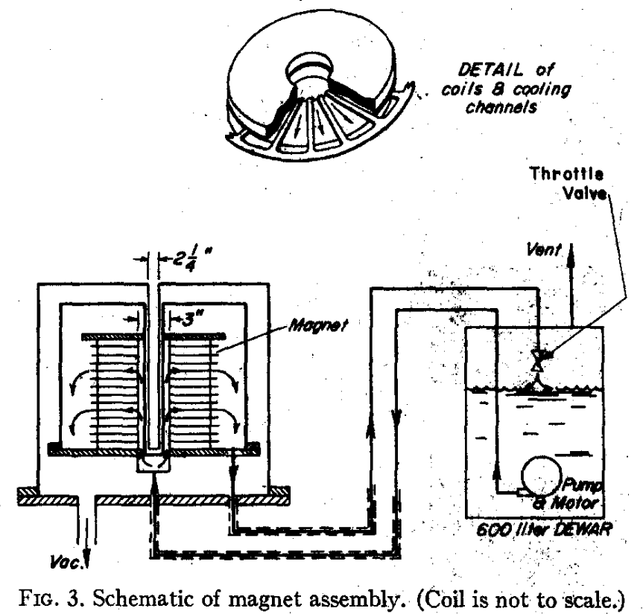
USA – NIST 1963 Al Coil in LH₂ (Purcell and Payne)
Wound Al magnet
  Stack of multiple circular slabs made by spiral-wrapped bonded foils with turns insulated with capacitor paper and vacuum impregnated
  14 coils were stacked, each with 1000 turns (high turn density to operate at low current), ID 3 in, OD 11 in, length 5.7 in
Cooled by forced circulation of LH₂ to avoid boiling LH₂ in the magnet (like the Cu coil of Laquer)
  Commercial pump at ~379 L/min with a pressure rise of 20 psi
  Throttle valve maintains back pressure for the fluid to be subcooled upon exit of the magnet
  Calculated maximum power dissipation to avoid LH₂ boiling is 12.5 kW
Operating procedure: system evacuated, nitrogen blown through the stack,
3 purges with H₂ gas, transfer of LH₂
  “In the event of an accidental vent fire an automatic alarm would be thermally
  activated, and helium gas could then be admitted into the bottom of the vent
  through a manually operated solenoid valve in order to extinguish the fire.”
  LH₂ consumption of 1000 L/h at 70 kG
outward radial LH₂ flow
Inflation adjusted magnet cost of ~$300k

Slide 49
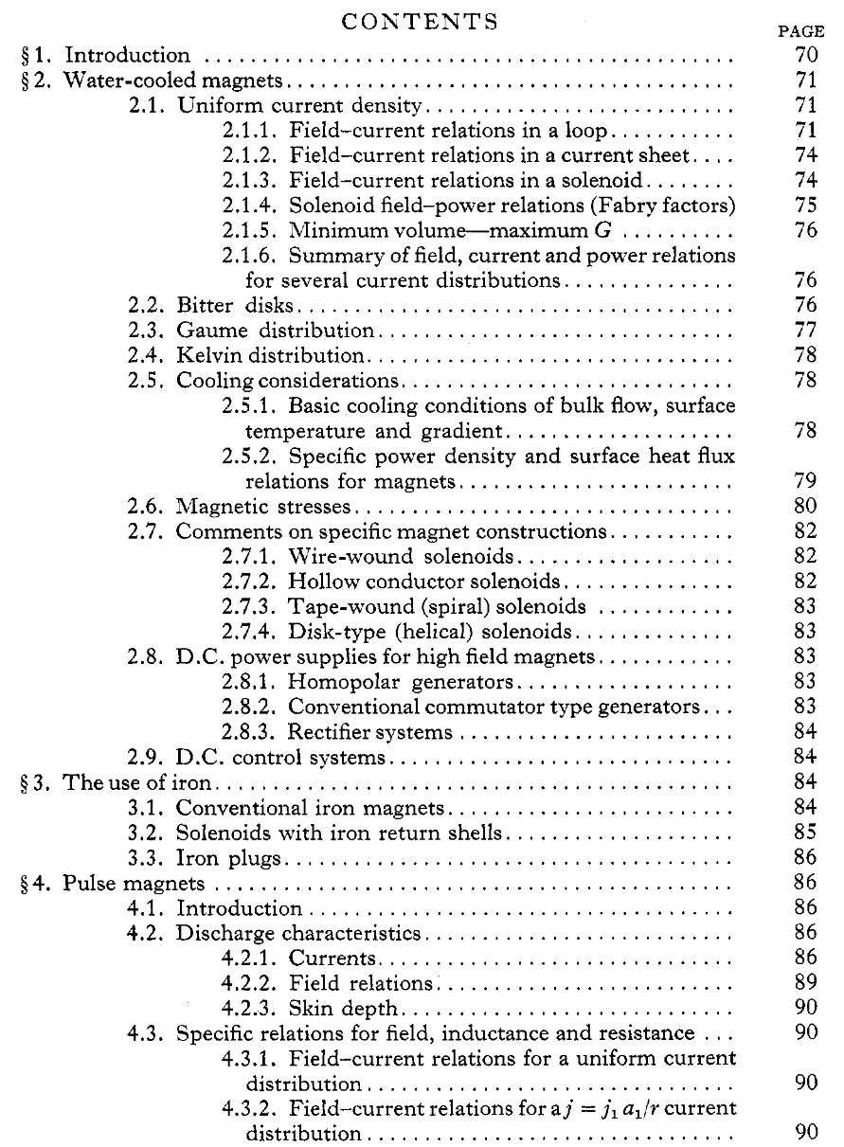
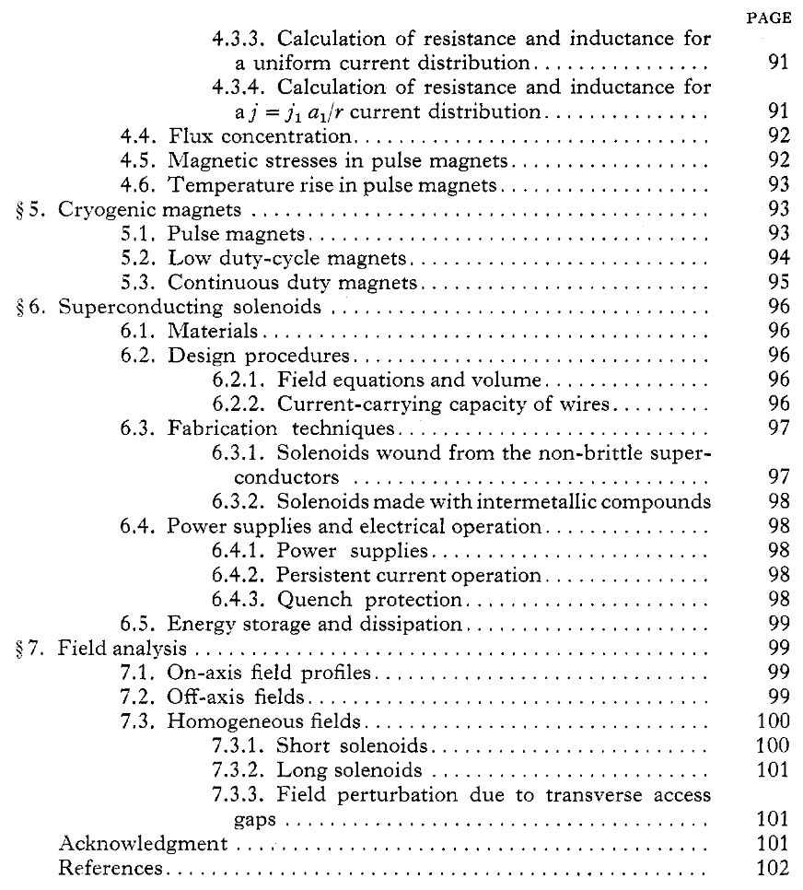
USA – MIT 1963 Review Paper: The Generation of High Magnetic Fields
MIT 1963 – Review paper from the National Magnet Lab on The Generation of High Magnetic Fields (Montgomery, 1963)
  Types of normal conducting magnets that used LH₂:
  Pre-cooled pulsed magnets, low duty-cycle magnets,
  continuous duty magnets
  p.95 – not all labs are willing to circulate hydrogen
  directly in the magnet as was done by Laquer.
Low duty-cycle Laquer’s 1962 magnet with circulating
LH₂ at 4 L/s operated for ~1h then needed more LH₂
  Modest forced convection can increase heat transfer
  by a factor of 2–3 vs free-boiling H2 gas
    Heat transfer limit of 0.2–0.5W/cm² for the latter

Slide 50
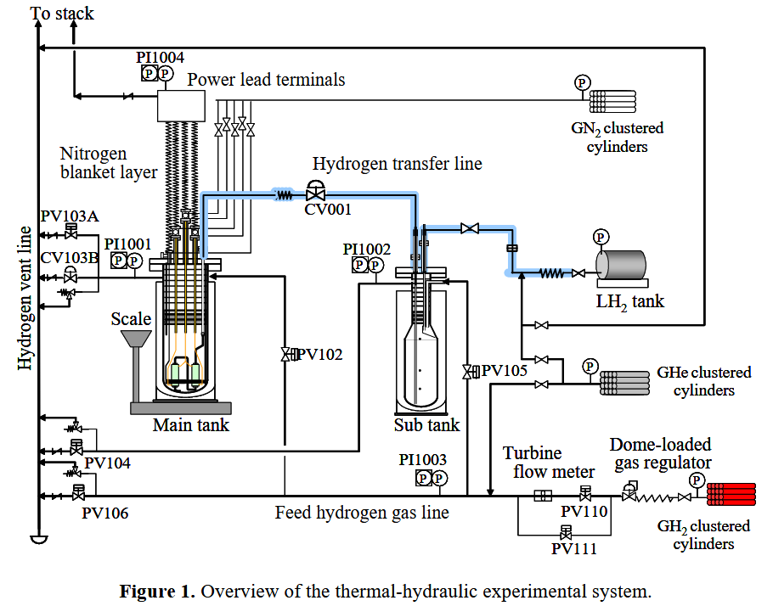
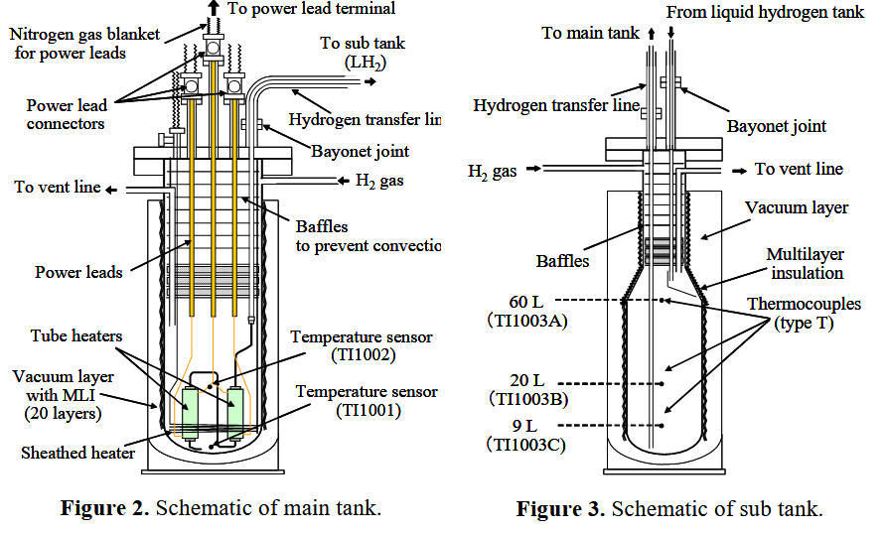
Japan – 2010 Development of Setup to Characterize HTS Cooled by LH₂
Thermal-hydraulics system developed to “to investigate
the forced flow heat transfer characteristics in the
various cooling channels for wide ranges of
subcoolings, flow velocities, and pressures up
to supercritical”
There is also a 2010 paper by Tatsumoto on LN2 cooling (very likely related to this work, for the power leads)

Slide 51
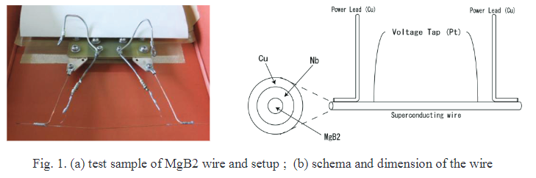
Japan – 2012 Over-Current Characteristics of MgB₂ Wire Cooled by LH₂
Design and fabrication of a setup to perform over-current measurements in LH2
“Critical current and resistivity of a test MgB2 wire submerged in liquid hydrogen were measured for exponentially increasing heat input, while the transport current exceeded the critical current.”

Slide 52
Japan – 2014 Experimental Setup to Characterize HTS Cooled by LH₂ under External Magnetic Field
Presented at EUCAS2013 (H Tatsumoto, Y Shirai, M Shiotsu, Y Naruo, H Kobayashi and Y Inatani)
Cryostat and setup developed to test HTS in an external field of up to 7 T
LH₂ cryostat concentrically mounted in LHe cryostat that cools a NbTi solenoid magnet
Explosion proof room
  Explosion proof electrical
  devices
  Current leads are covered
  with enclosure filled with
  nitrogen gas
see 2010 paper for details

Slide 53
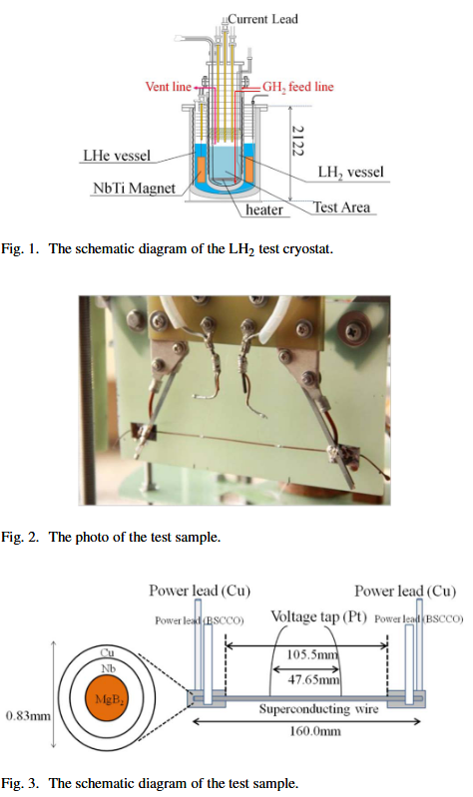
Japan – 2016 Characterization of MgB₂ in Magnetic Field
Transient over-critical-current tests on a short MgB₂ sample cooled by LH₂
under magnetic field
Sample temperatures were calculated from test data
Temperature change of the wire just after the transport current exceeds
the critical current is affected by external magnetic fields

Slide 54
Japan – 2017 MgB₂ Cooled with LH₂ and More Development on MgB₂
List of talks and posters from EUCAS 2017 conference
Talk: 3LO1-02 Prospect of Liquid Hydrogen Cooled Superconducting Power Apparatus and Carbon Free Energy System (Yasuyuki Shirai, Kyoto University)
Poster: 1MP4-03 Experimental evaluation for characteristics of MgB₂ Rutherford cables with a large current capacity (Sora Mizuochi, Sophia University)
Wire Development
Talk: 4MO2-01 Improvement in microstructure and critical current density of in situ PIT MgB2 wires by cold working with a swaging machine (Hiroaki Kumakura, NIMS)
Talk: 4MO2-02 Copper stabilized dense MgB₂ wires fabricated by two types of methods: mechanical milling and internal magnesium diffusion (Motomune Kodama, Hitachi)

Slide 55
Others
(including superconductivity)

Slide 56
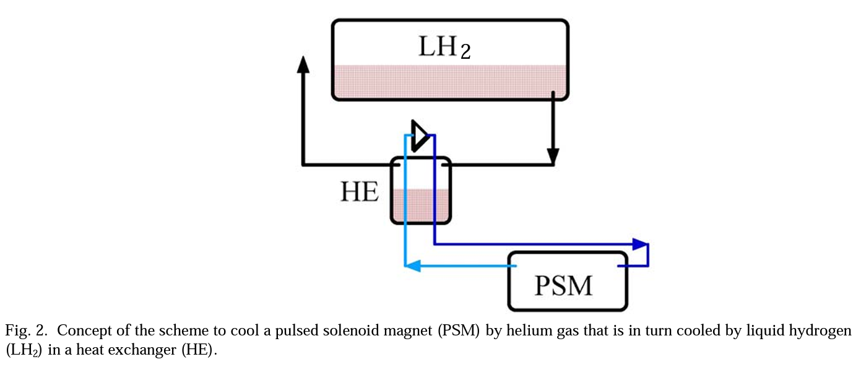
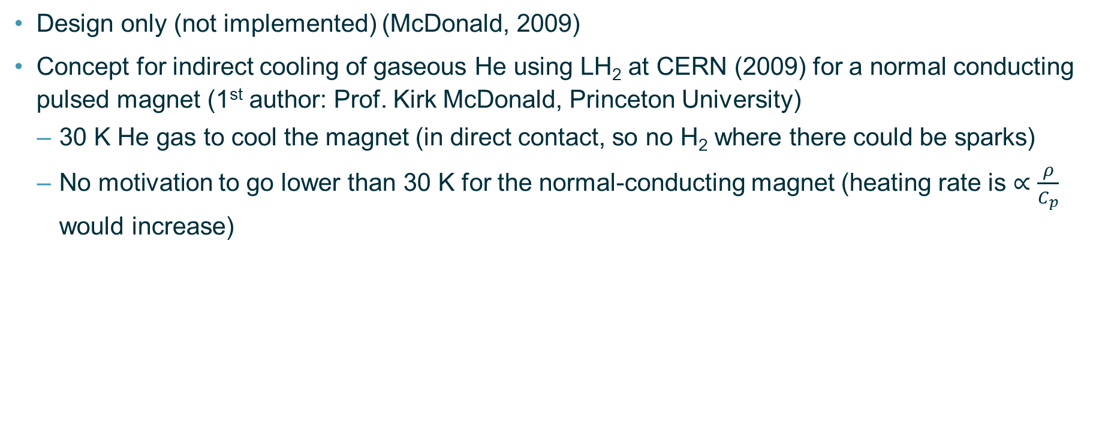
Switzerland and USA – 2009 Indirect Cooling of Gaseous He (Concept)
Design only (not implemented) (McDonald, 2009)
Concept for indirect cooling of gaseous He using LH₂ at CERN (2009) for a normal conducting pulsed magnet (1st author: Prof. Kirk McDonald, Princeton University)
  30 K He gas to cool the magnet (in direct contact, so no H₂ where there could be sparks)
  No motivation to go lower than 30 K for the normal-conducting magnet (heating rate is $∝\frac{ρ}{C_{p}}$ would increase)
Design rational: very large cryogenic cost reduction for each magnet pulse, but only LN₂ was used (no LH₂) in the end

Slide 57
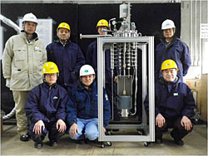
Japan – 2012 MgB₂ SC Pump Cooled with LH₂ for Used in Aircrafts
Work at JAXA in 2012 on a superconducting pump with the final application in mind being aircrafts (website)
  “the world's first transport of liquid hydrogen with a superconducting pump”
  MgB₂ superconducting motor, 1800 rpm, 6.5 L/min
  “High Temperature Superconducting Induction/Synchronous
  Machine (HTS-ISM) concept proposed by Associate
  Professor Taketsune Nakamura of Kyoto University was
  utilized for the motor”
  Wire rods manufactured by Hitachi

Slide 58
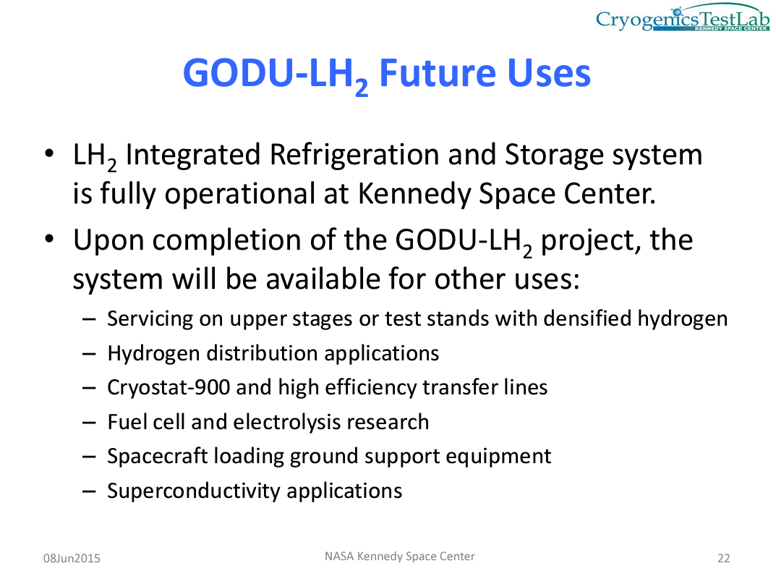
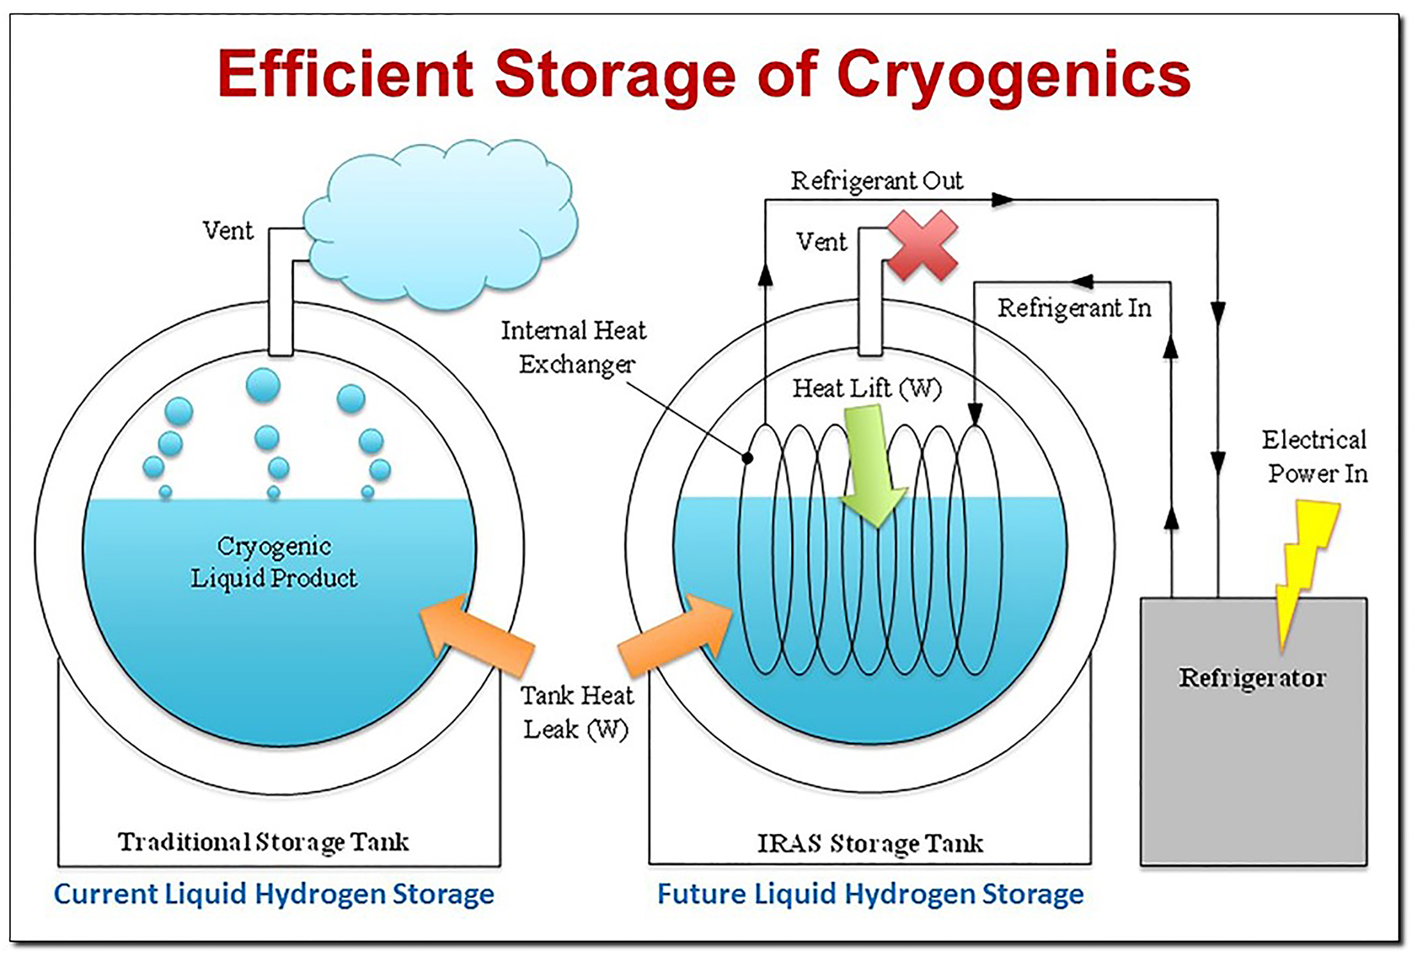
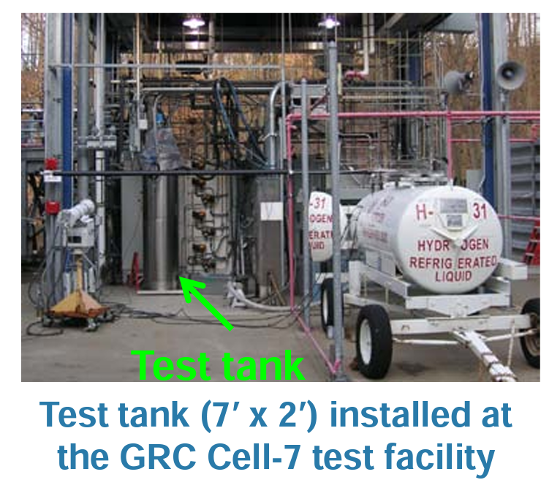
USA – NASA and Liquid Hydrogen
2018: “at the agency's Kennedy Space Center in Florida is preparing to build the world's largest liquid hydrogen storage tank” link
Nov. 2022: “NASA awarded contracts to supply … 15 million pounds of liquid hydrogen for use at facilities across the agency … two-year base period” link
  Delivered to Alabama, Mississippi, Ohio, Florida
Cryogenics Test Lab at Kennedy Space Center (William Notardonato, now at ETA Space LLC)
and see Meneghelli, 2016
link

