Slide 1
Interlaminar Fracture Toughness of Nb3Sn Composites: Preliminary results
S. Krave, C. English
27 September 2023

Slide 2
Outline
Introduction to interlaminar fracture toughness
Silanes
Experimental method
Results
Future plans

Slide 3
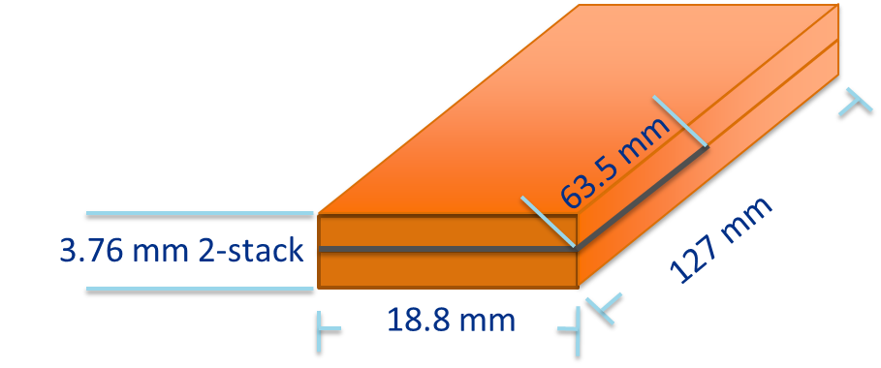
Why interlaminar Fracture Toughness
Past ten stack measurements focus on engineering properties for overall mechanical design
  Plastic deformation, strain, thermal contraction and modulus are not good predictors of training behavior
  Some work on interface properties exists, but the existing literature is thin and not directly comparable to cable
Interlaminar fracture toughness probes the interface between objects and relates the energy release rate to loading.
  Stronger interfaces debond less
  Stronger interfaces release more energy per unit crack area
The above criteria work against each other in a magnet application
  Applying realistic parameters in FEA or other analysis may be able to guide interface design.
Relative Training
Interface Strength

Slide 4
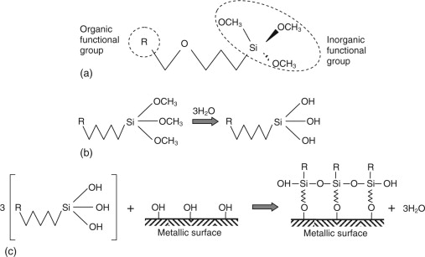
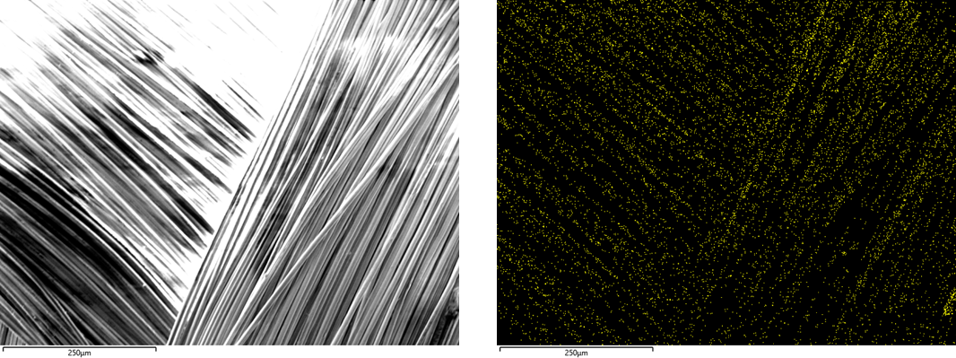
Silanes: Good or bad
Fiberglass fabrics (Cable insulation) are treated with a lubricant so they can be manufactured into products
This lubricant may additionally function as a finish or coupling agent, as is the case with he 955 HTS often found on S2 glass
Reaction in argon causes this substance to decompose
  Decomposition (cracking) leaves behind carbon residue and potentially other silicon compounds (SiC?)
Contamination leads to shorts, low dielectric strength, and poor adhesion
Silanes do not like to be washed away
No luck with organic acid or basic cleaning, or even vapor degreasing
They will burn in air, leaving only SiO₂
From: https://www.sciencedirect.com/topics/engineering/organosilane
S2 glass after reaction in Argon. Right image shows carbon visible by EDS.

Slide 5
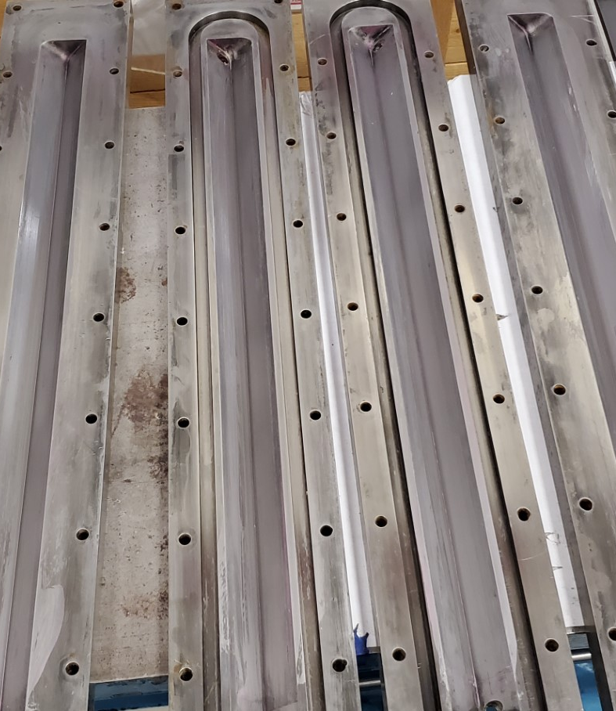
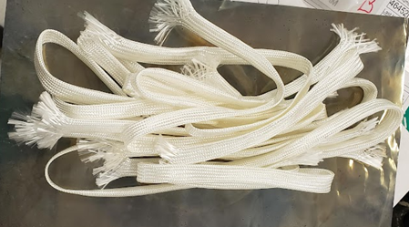
Experimental Method
Preparation
  Set of ten layers of coil are laid out with a 0.5 mil insert every 5 inches
  Heat treatment per standard AUP
  101K epoxy impregnation
  The samples are then numbered and coated for visibility
  Piano hinge bonded per standard using epoxy
Tests
  Sample is put into the Instron and set to be pulled apart at a constant extension rate (up to 5mm/min)
Pair of fixtures used to house the two stacks for heat treatment and impregnation
Heat Cleaned cable insulation: Standard QXF insulation removed from coil, heat cleaned at 600°C for 4 hours. Yarn is 933 sized AGY S2 Glass

Slide 6
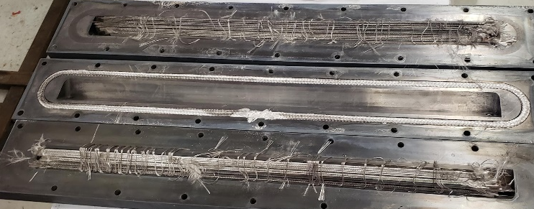
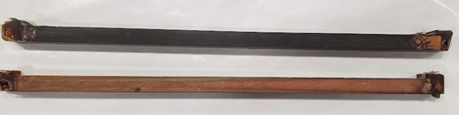
Samples After reaction and Impregnation
Samples after reaction. Top samples use raw glass, bottom use heat cleaned (except last two fillers on bottom)
Both samples reacted simultaneously under argon. Argon does not remove contamination.
Samples after impregnation. Top samples turn black as glass has gone clear once full of epoxy. Carbon residue gives black color
Bottom sample glass is now clear when full of epoxy. Typical of epoxy impregnated glass

Slide 7
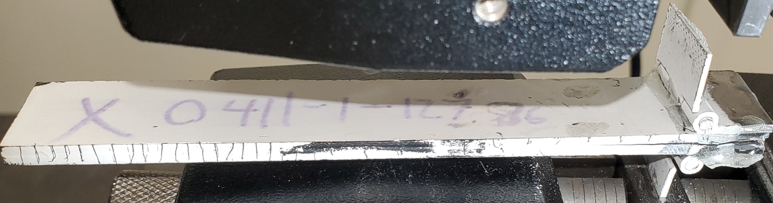
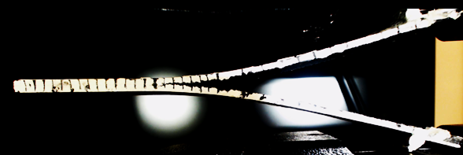
Experimental Method Continued
Measurement System
  Data is recorded by Instron and a webcam
  What we are looking for
Results gained
  Measured
    Force (by Instron loadcell)
    Displacement (by Instron)
    Crack Elongation (by Webcam)
    Time
  Calculated
    Strain Energy Release Rate (SERR)
    Change in the measured results
A sample before testing starts
Sample during testing. Samples were painted white for contrast.

Slide 8
Results
Samples are loaded as shown above at a few mm per minute, with crack front plotted vs calculated G_{IC} from crosshead displacement and load.
The heat cleaned samples show higher values of fracture toughness, with stars showing onset of cracking in the heat cleaned samples. This is roughly a factor of 3-4
Heat cleaned insulation was also more difficult to cause to de-bond, with 40% of samples cracking rather than delaminating.
See Interlaminar Fracture Toughness
Testing of Nb3Sn Insulation Systems presented at MT-28

Slide 9
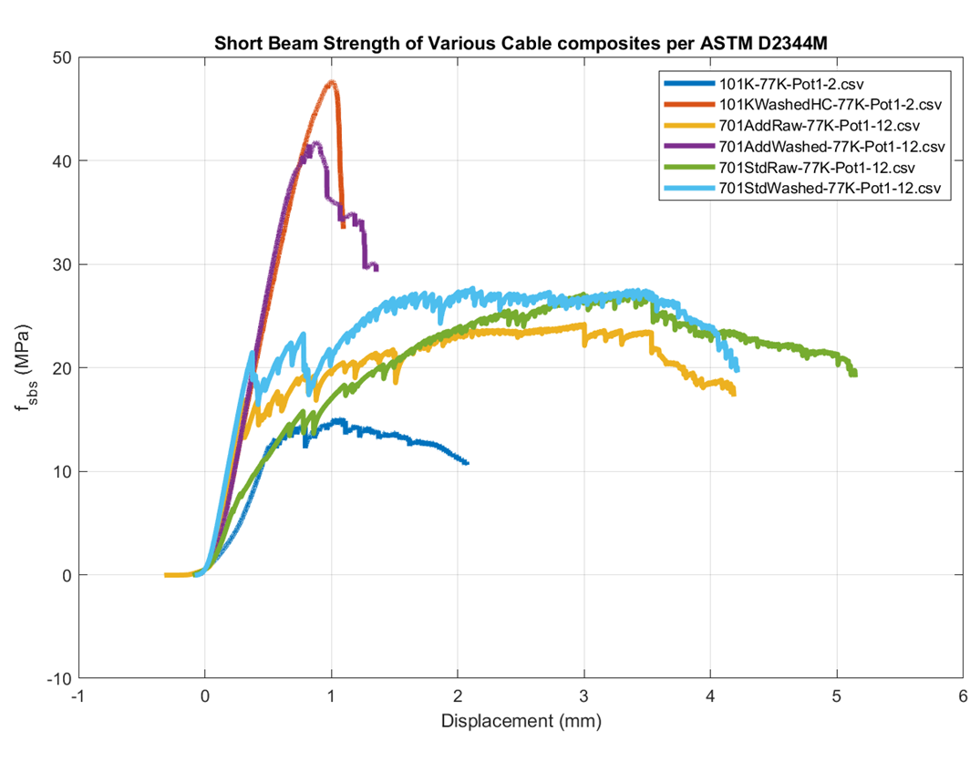
Conclusions
Clean Insulation = Good, Dirty insulation = Bad
  In the spirit of making quality composites, might not apply to magnets
  This is in line with previous work on shear strength measurements
Clean glass should be attempted
  Cold oxidation
  In-situ oxidation in reaction
  Unsized glass braiding
G_{IC} at room temperature for raw glass is ~500 J/m², for heat cleaned glass it is closer to 2000 J/m²
Heat cleaned insulation outperforms standard raw insulation by more than a factor of 3 compared to untreated glass. This is repeatable. The above data also does not reflect a shear failure, as such the “true” value is higher. Special resins can approach this limit on standard glass.

Slide 10
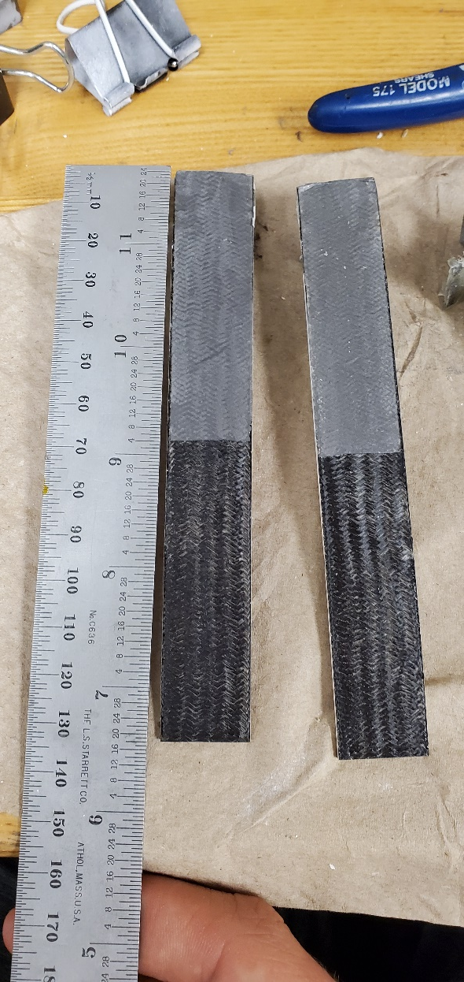
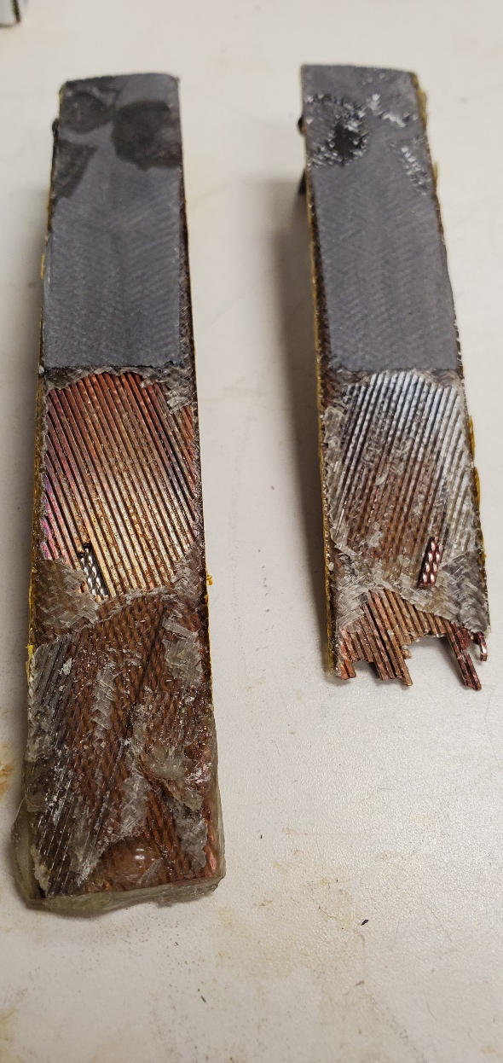
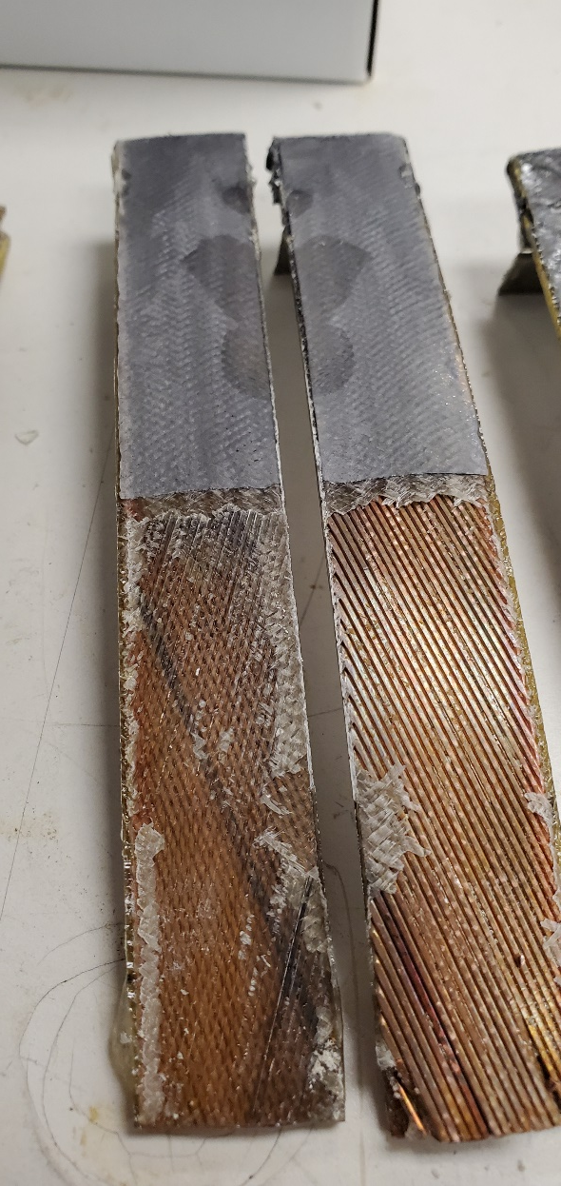
Next Steps
It never ends…
More samples of the same types have been fabricated
  Increase statistics at room temperature
  Take data at 77K
    Needs some tooling design to facilitate viewing
Test different in-situ oxidation techniques
  See A. Brem talk from MT
Add shear measurements for similar sample types
Investigate interface between insulation and cable

Slide 11
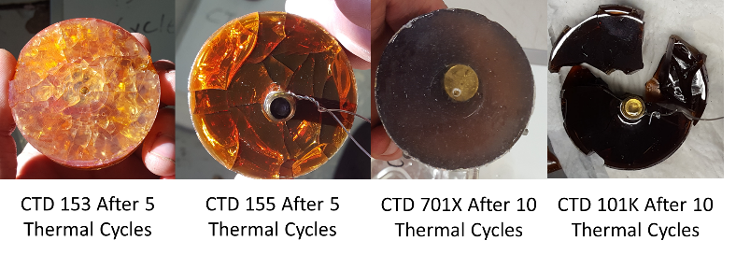
Additional Topics
Old work…
High Toughness Resins for Magnet Applications
From Exploring New Resin Systems for Nb₃Sn Accelerator Magnets

Slide 12
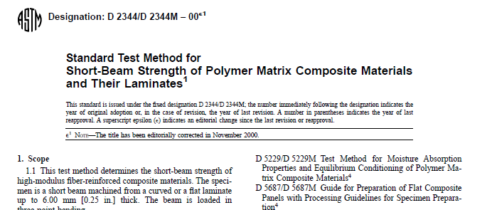
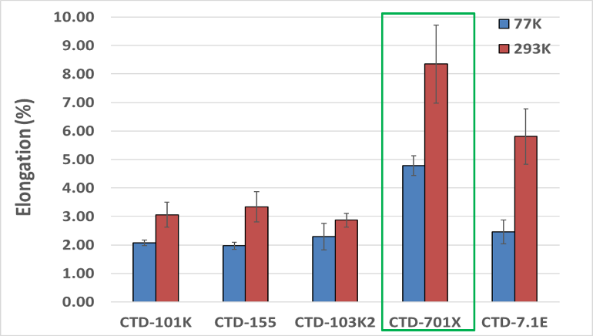
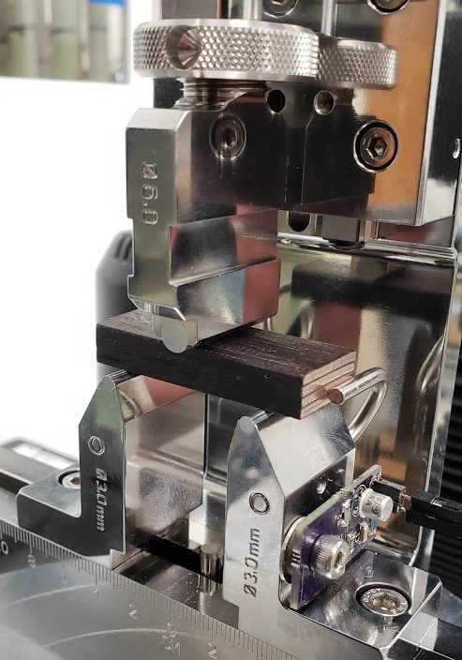
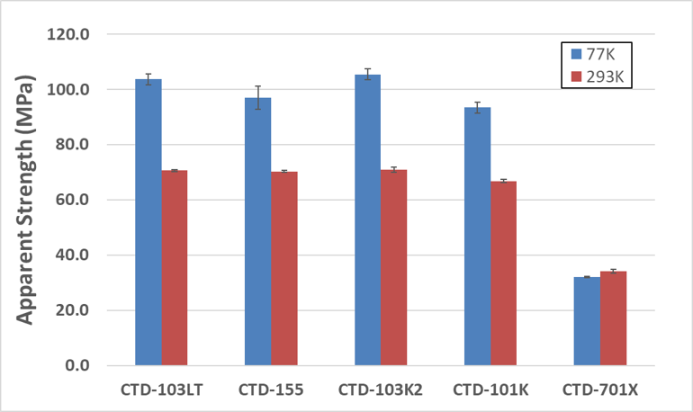
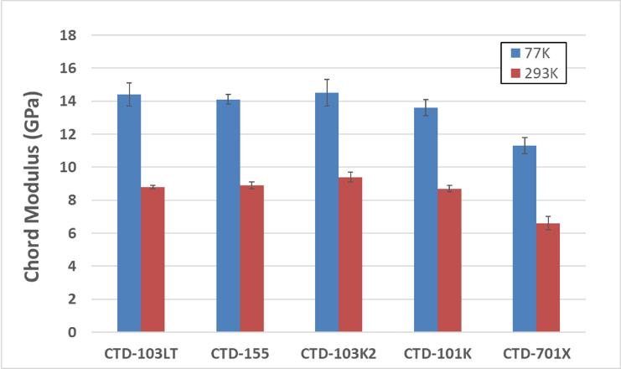
Old work…
Under an SBIR Collaboration between CTD, FNAL and LBNL, several impregnation materials were studied. Several properties were measured.
  Modulus
    With glass
    In Nb3Sn
  Handling
  Ductility
  Thermal Shock
  Shear strength
    With Glass
    With Nb3Sn

Slide 13
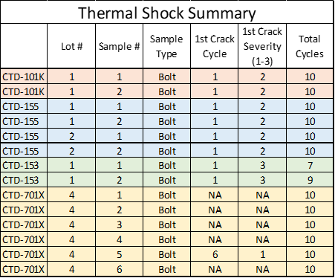
Boring table to the right.
Bottom line: CTD 701X is drastically different and stronger than anything else we have seen
  This includes previous work at LBNL in the past (Stycast etc)
701X Does not break even when struck with a hammer while at 77K. (This was fun)

Slide 14
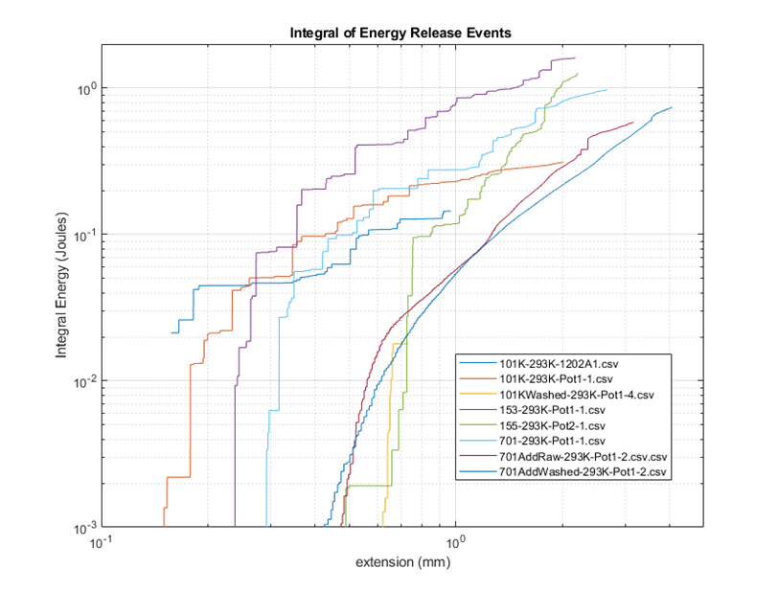
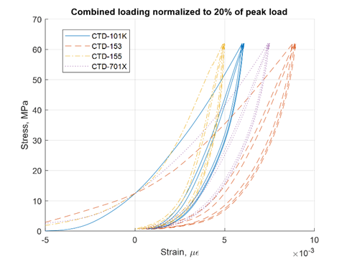
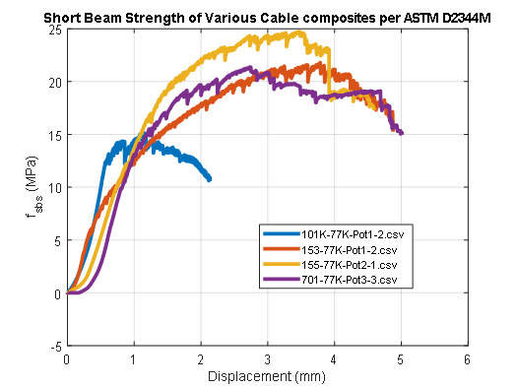
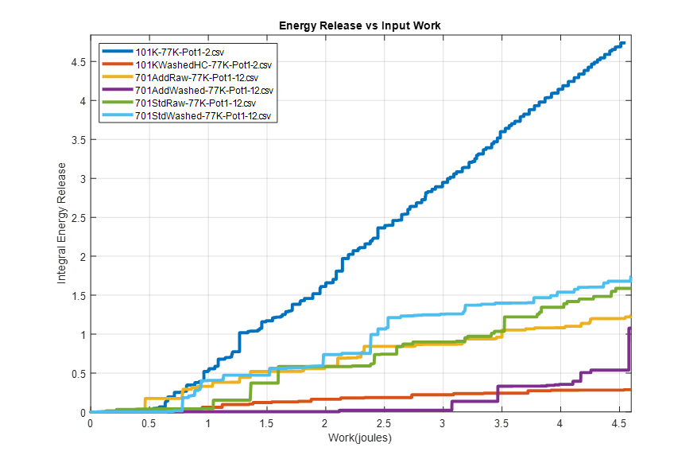
701X is a little soft, but does not show abrupt energy release as seen in epoxy composites
101K has very little fracture activity, until it begins to fail. Typical with other tested epoxies.
701 maintains a low rate of microfracture events
  Deformation did not occur in large discrete unloading events as in other systems but deformed uniformly and plastically, even at 77 K
  No audible cracking unlike all other samples
Note that the heat cleaned 101K sample performs extremely well as well.
  Failure mode was not through shear, but tension on bottom of sample.
  No audible cracking until failure

Slide 15
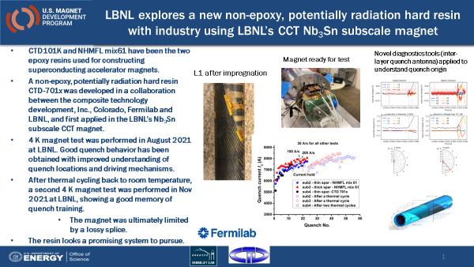
This has been tested: mixed results – Bad Splices
CCT Sub 4, Using 701 was tested at LBNL
Training was promising, and very fast, but limited for technical reasons
All the last six quenches occur at the first ¾ turns including the Nb-Ti/Nb3Sn splice.
Can we retest single good layer along wax outer layer?
See CCT sub4 magnet with CTD701x resin

Slide 16
End

