Slide 1
Development of a 15 T Model Dipole for a Very High Energy Hadron Collider
A.V. Zlobin
APT seminar
17 April 2018

Slide 2
Outline
Introduction
15 T dipole magnet design and parameters
Magnetic and mechanical analysis
Conductor R&D
Magnet fabrication status
Conclusion

Slide 3
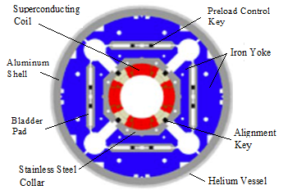
Introduction
During past two decades Nb₃Sn accelerator magnet technology has made significant progress from short demonstration models to long prototypes
HL-LHC: 11-12 T magnets with ~20% margin
Future needs
affordable for mass production 16 T dipole (FCC)
11 T dipole MBH for LHC collimation system upgrade
150-mm aperture IR quadrupoles MQXB for HL-LHC

Slide 4
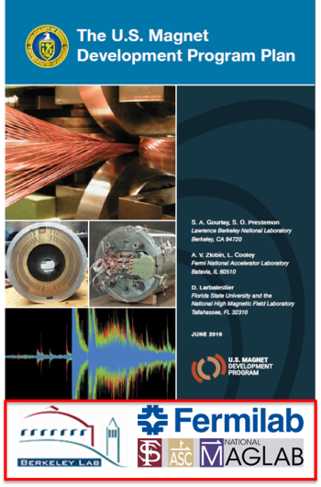
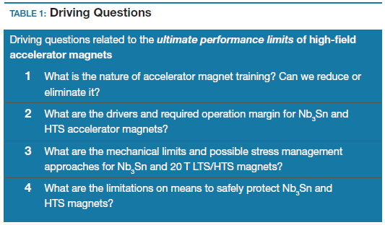
Open questions and goals
Open questions
long training
conductor degradation
cost
US-MDP goals

Slide 5
Challenges and motivation
The base for success: better design and analysis tools, new materials (Nb₃Sn wires), advanced technologies

Slide 6
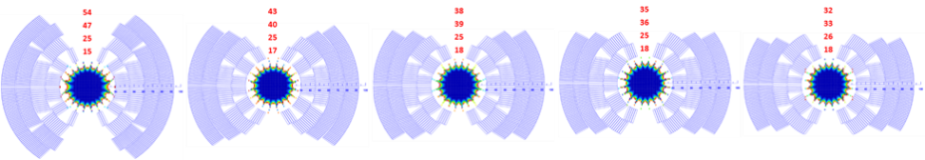
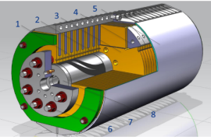
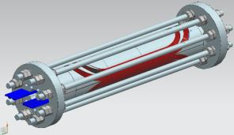
Cos-theta coil
Coil: 60-mm aperture, 4-layer graded coil
Cable:L1-L2: 28 strands, 1 mm L3-L4: 40 strands, 0.7 mm
Insulation: 0.15 mm thick
Mechanical structure:
Thin StSt coil-yoke spacer
Vertically split iron laminations
Aluminum I-clamps
12-mm thick StSt skin
Thick end plates and StSt rods

Slide 7
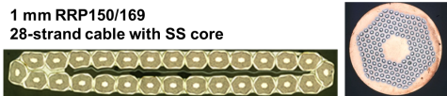


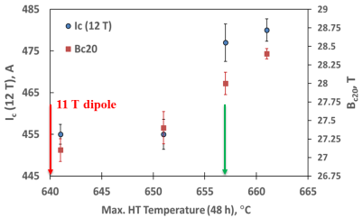
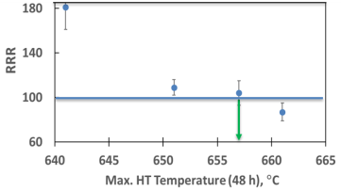
Cable Development and Test
SS core
Final cable cross-section parameters have been selected
PF~87%,
Ic degradation <5%,
RRR>100
HT optimization to achieve optimal J_{c} and RRR

Slide 8
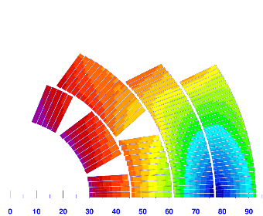
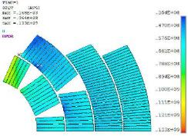
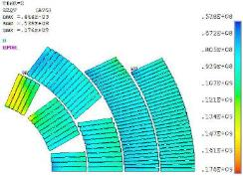
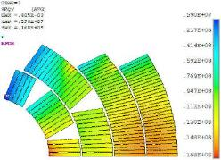
Magnet Conductor and Mechanical limits
100% SSL
87% SSL
Magnet conductor limit:
B_{ap}=15.3T @4.5K
B_{ap}=16.7T @1.9K
J_{c}(4.2K, 12T)~2600 A /mm²
300K
4K
4K+15T
S_{eqv}=133 MPa
S_{eqv}=176 MPa
S_{eqv}=168 MPa
Magnet design limit is determined by the mechanical constraints and it is 15 T!

Slide 9
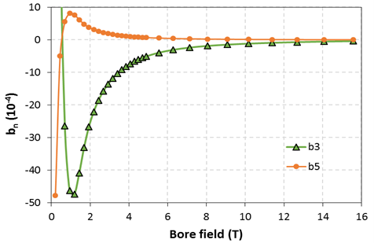
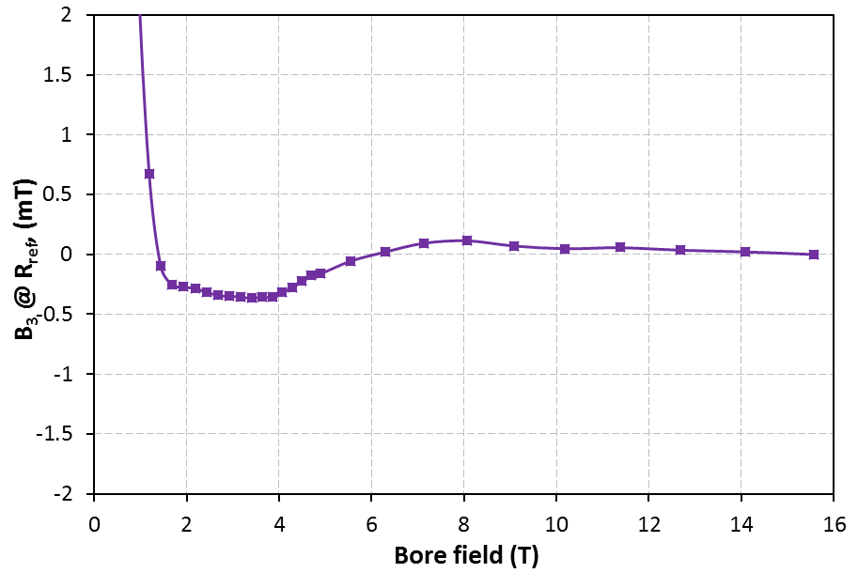

Coil magnetization effect and its correction
LHC MB b₃~-7 units
50-75 deg
LHC MBH b₃~-25 units
Peak values of b₃=-48 and b₅=+8 units @ B~1.4 T.
Geometrical b₃=-0.8 and 0.375 mm thick iron strips

Slide 10
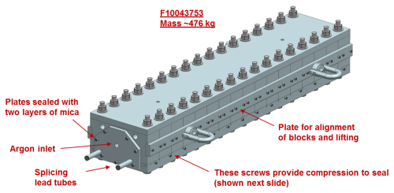
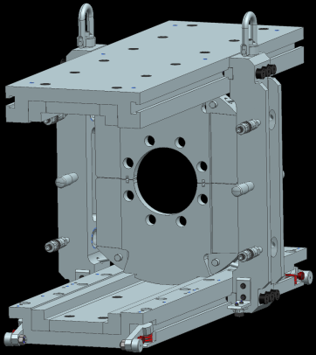
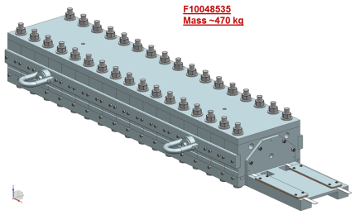
Magnet tooling
Reaction fixture
Yoking tooling
Reaction/impregnation (2 sets)
L1-L2
L3-L4
Impregnation fixture

Slide 11
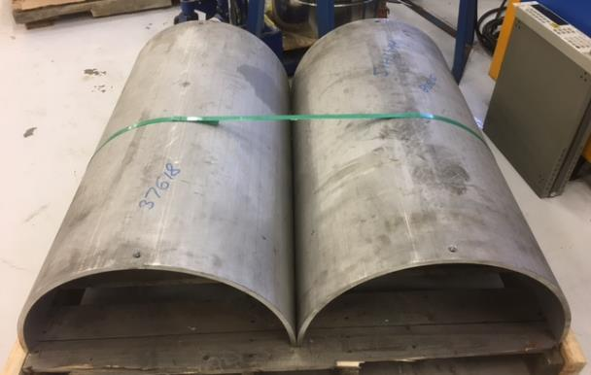
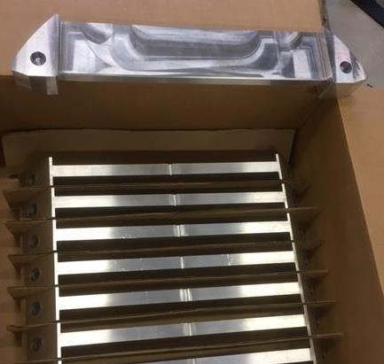
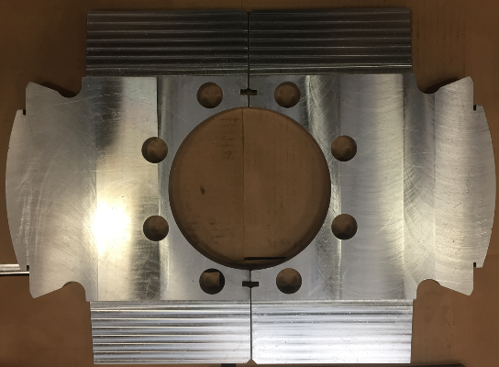
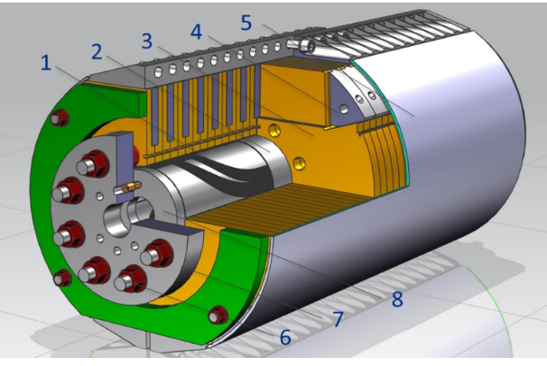
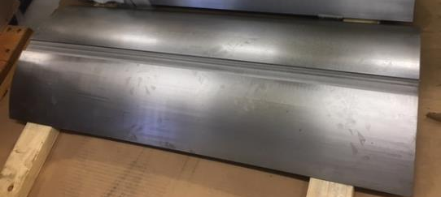
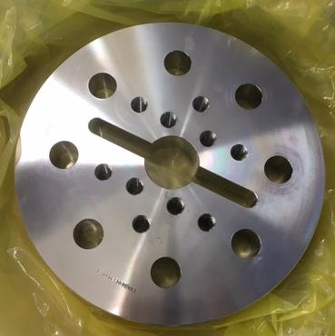
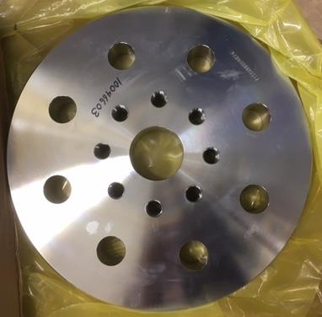
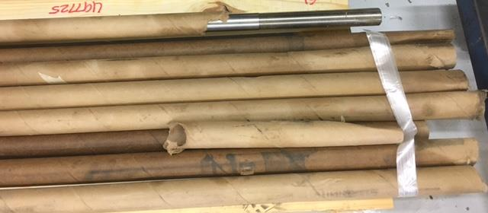
15 T dipole: Mechanical Stricture Components
StSt Skin
AL I-Clamps
Iron Laminations
Fillers
End Plates
Axial Rods
All structural components are available

Slide 12
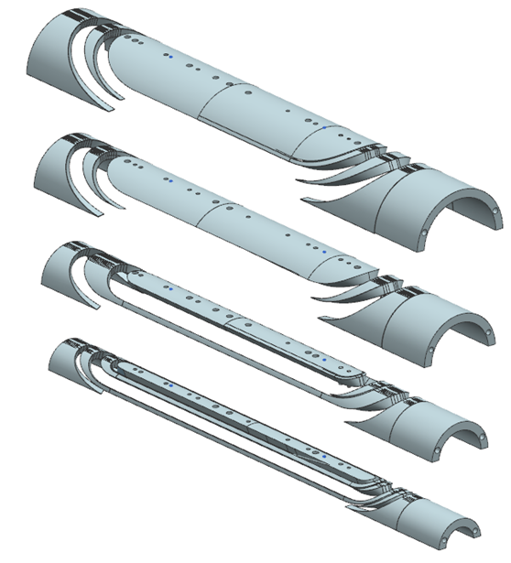
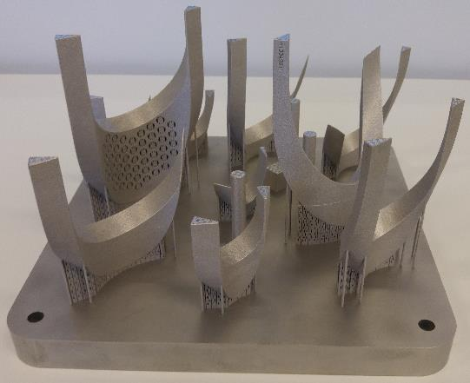
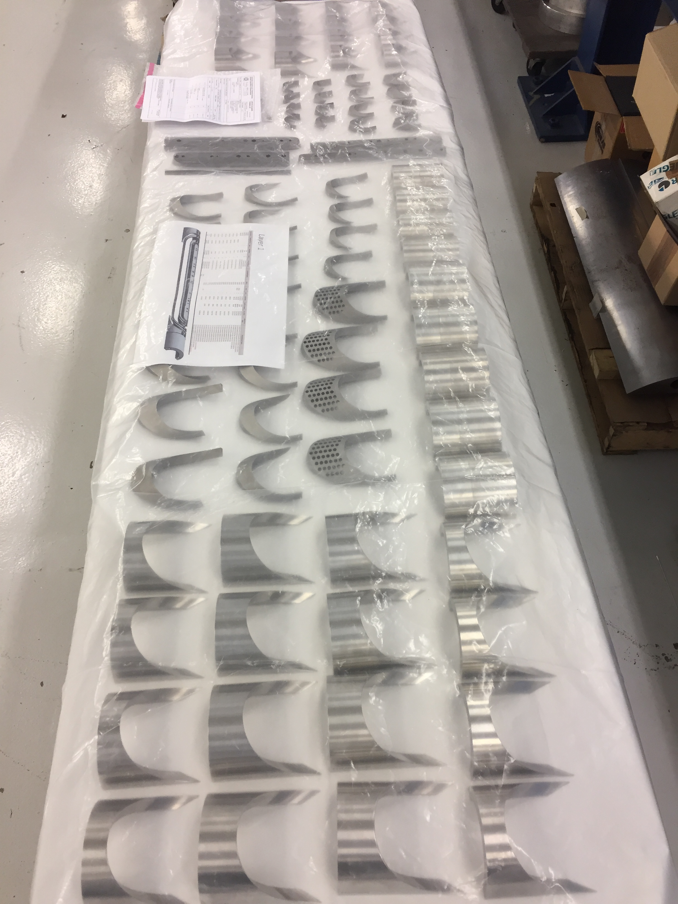
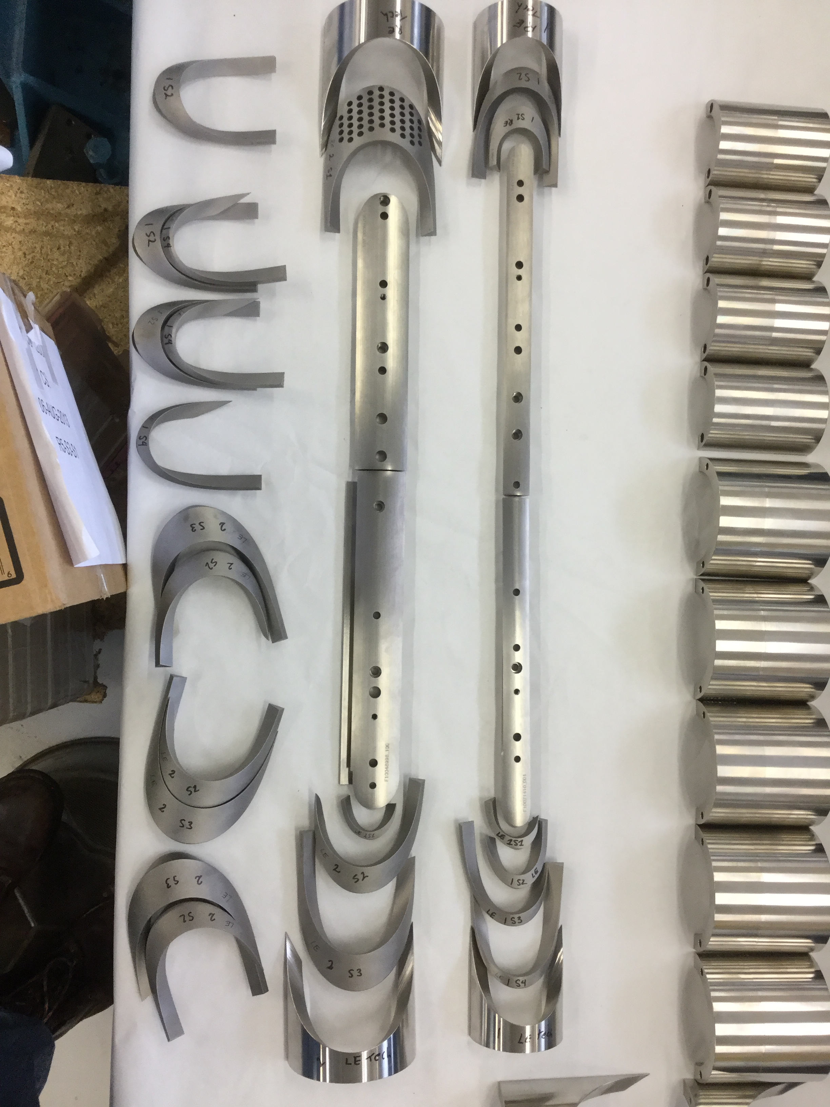
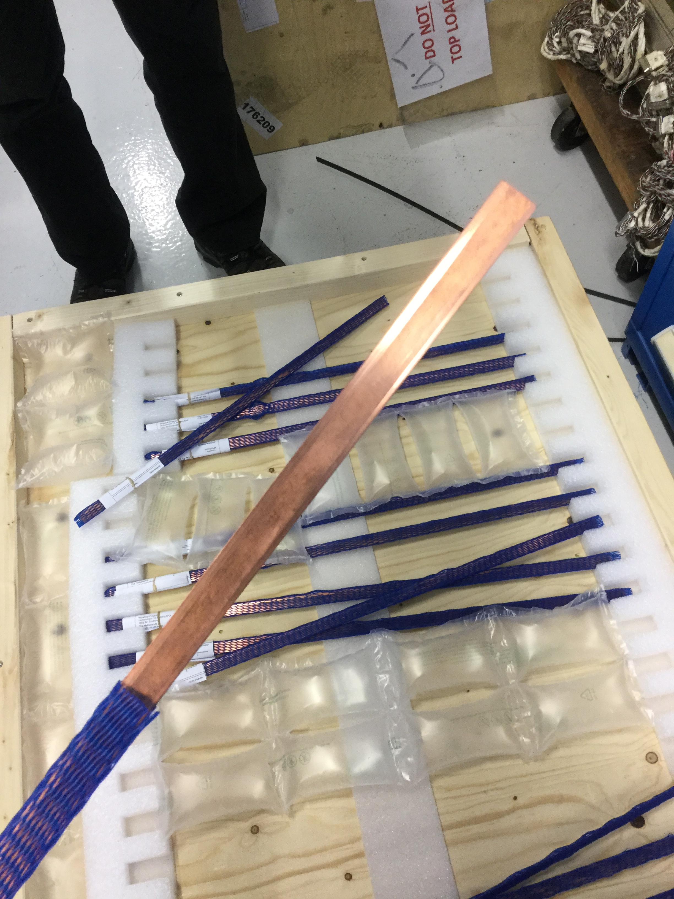
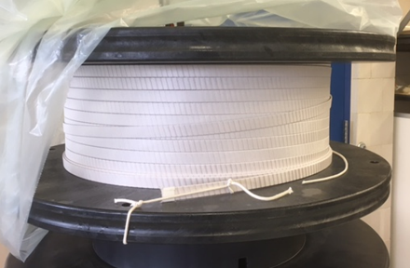
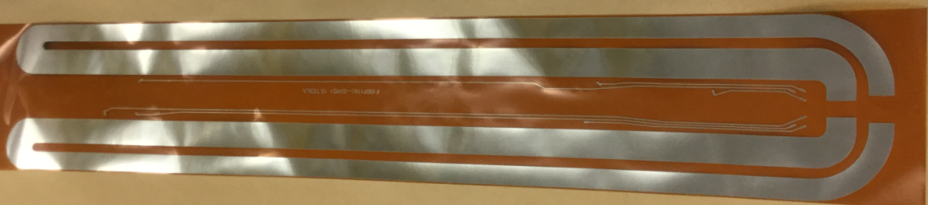
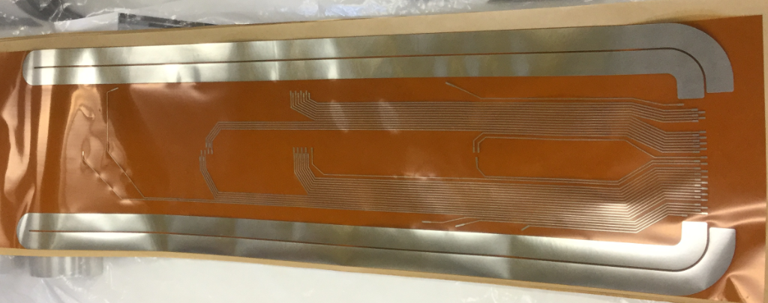
15 T dipole: Coil Components
L3/4 parts (FNAL)
L1/2 parts (CERN)
Cable (FNAL)
Traces (LBNL/FNAL)
Ti and Glidcop wedges
4 sets: Ti poles and spacers, SS saddles

Slide 13
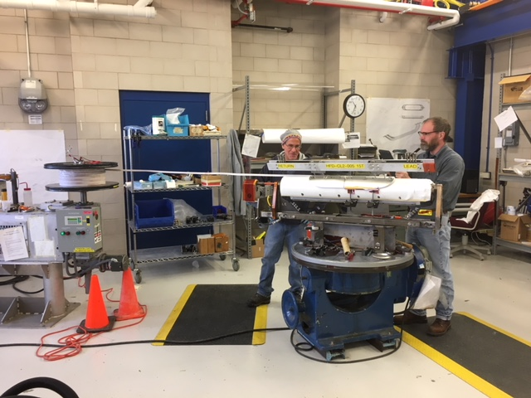
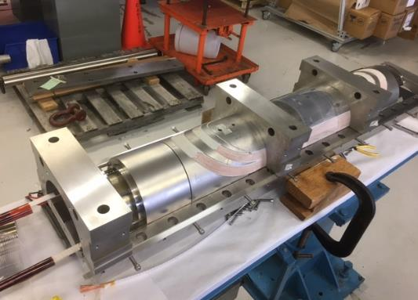
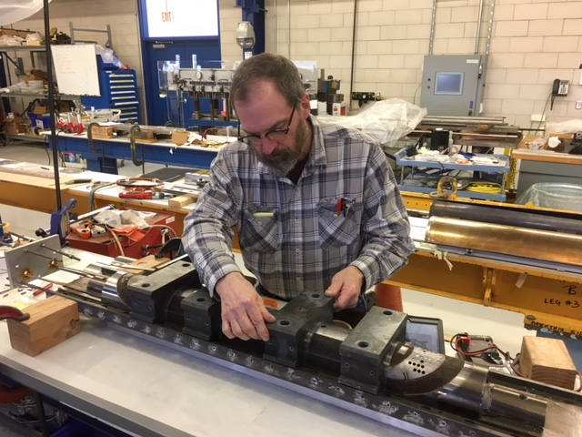
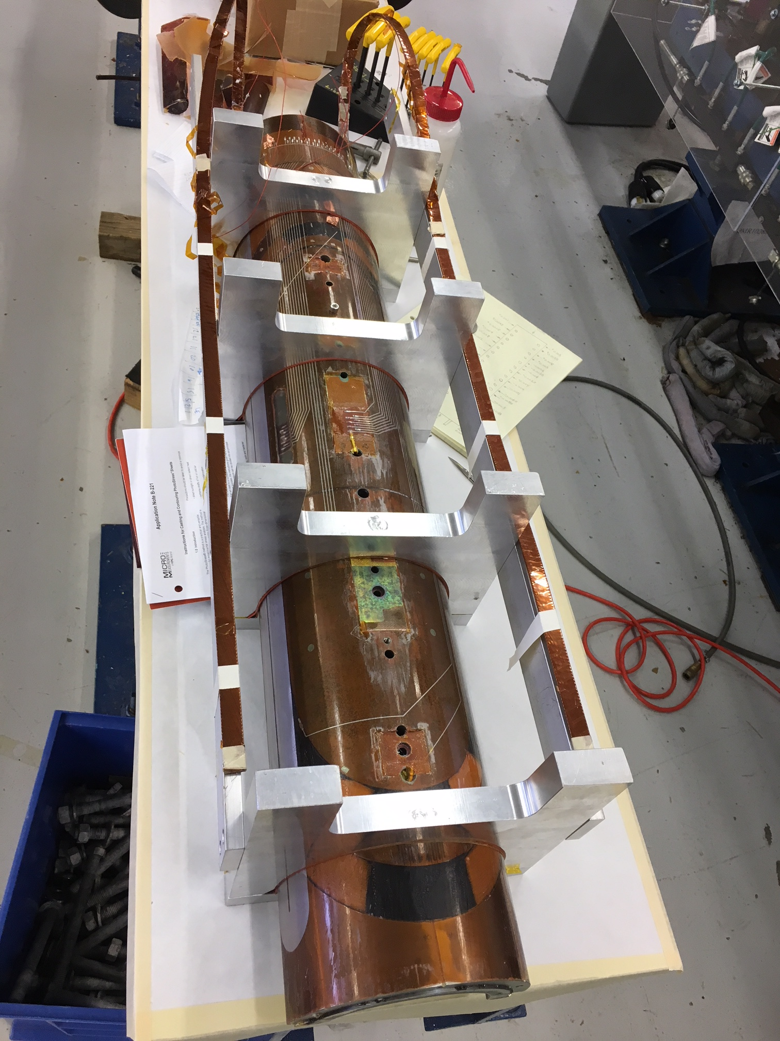
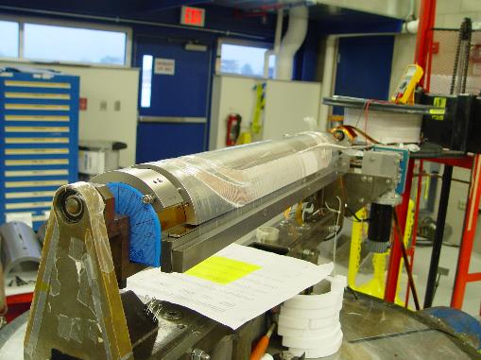
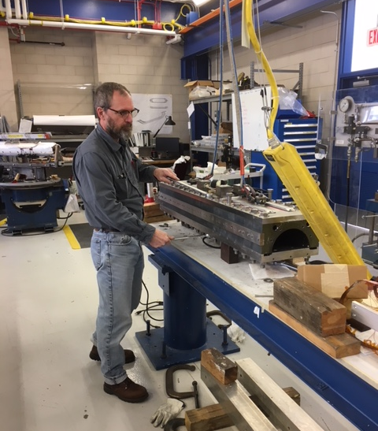
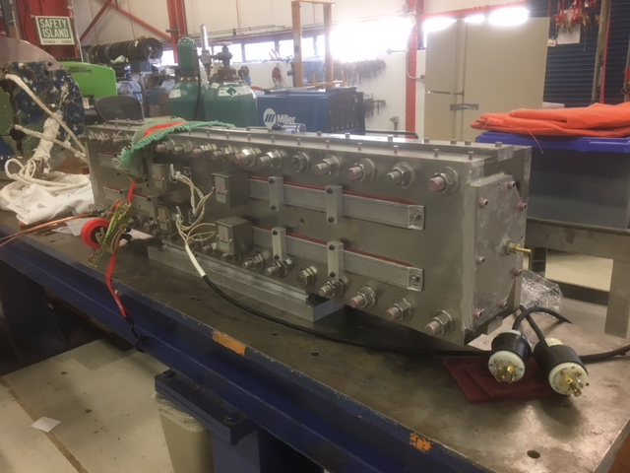
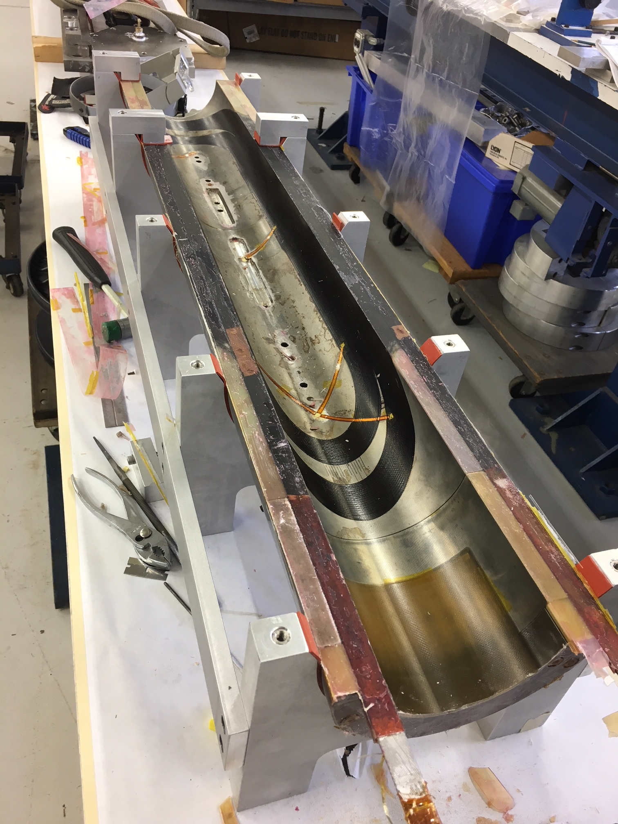
Coil fabrication process
Coil (Layer ) | Coil # | Winding, curing | Reaction, witness samples | Instrumentation, epoxy impregnation | Instrumentation
Inner (L1-L2) | 1 | complete | complete | in progress
 | 2 | complete | in progress
 | 3 | Not started
Outer (L3-L4) | 1 | complete | complete | complete | in progress
 | 2 | complete | in progress
 | 3 | complete
Coil winding and curing
Coil reaction
Coil epoxy impregnation
Coil instrumentation
Coil fabrication time ~3 months

Slide 14
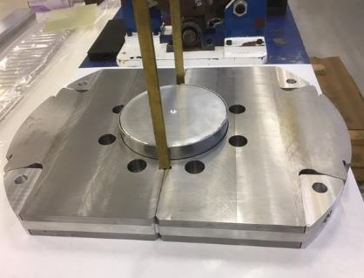
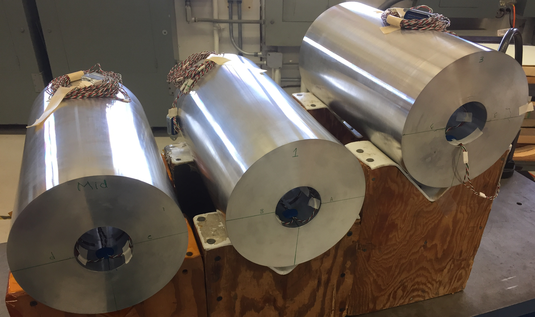
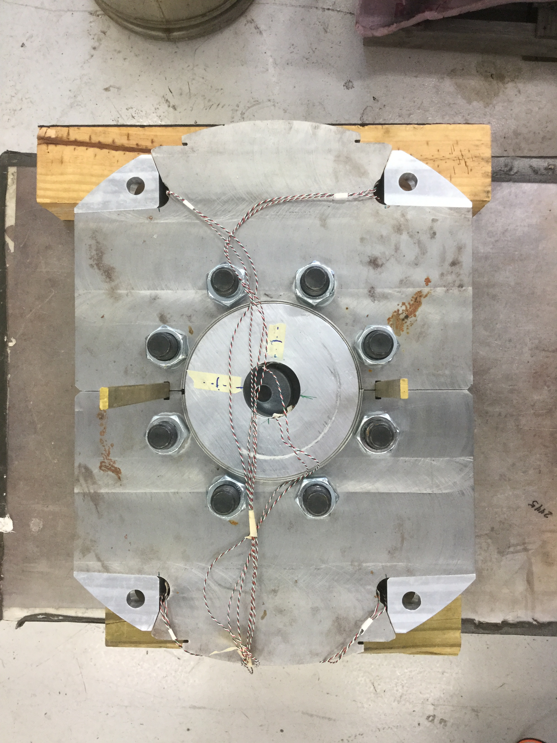
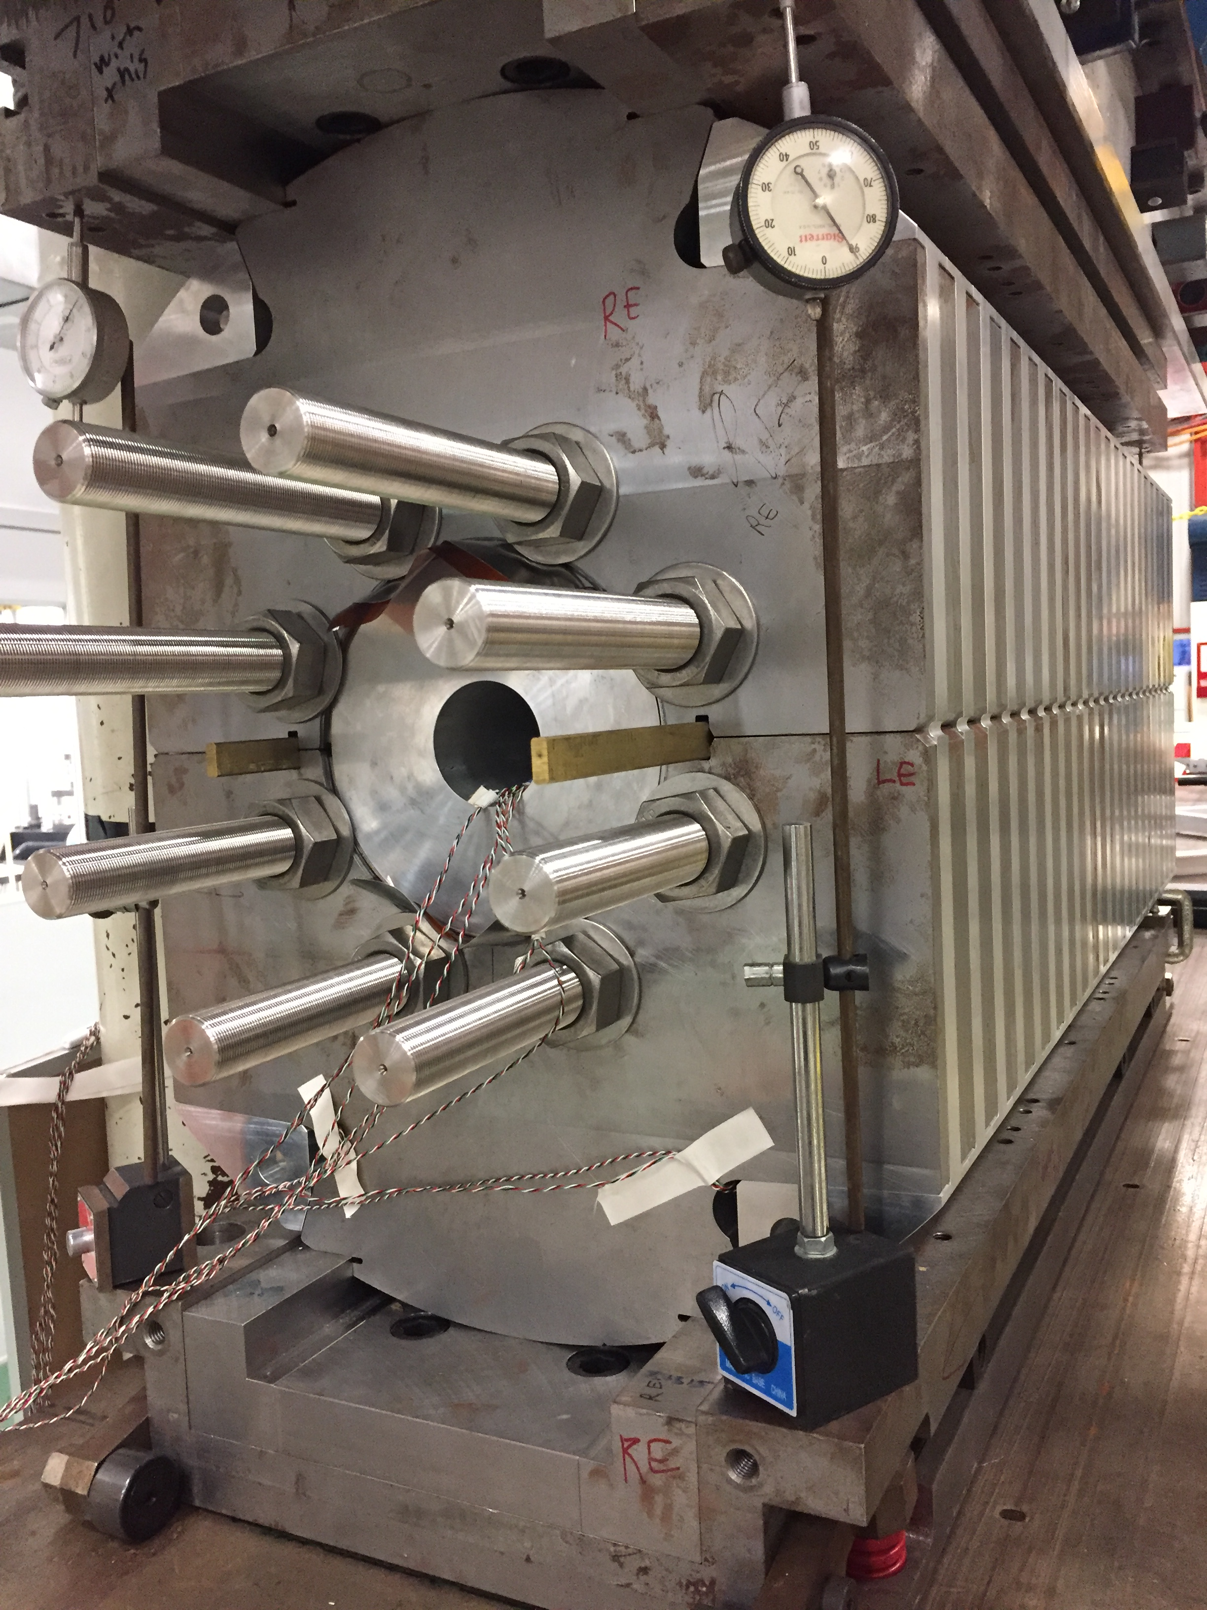
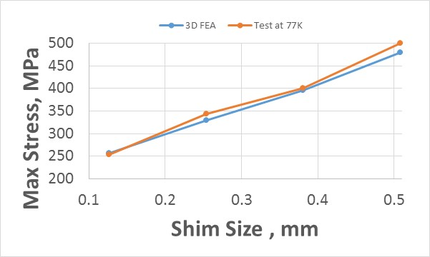
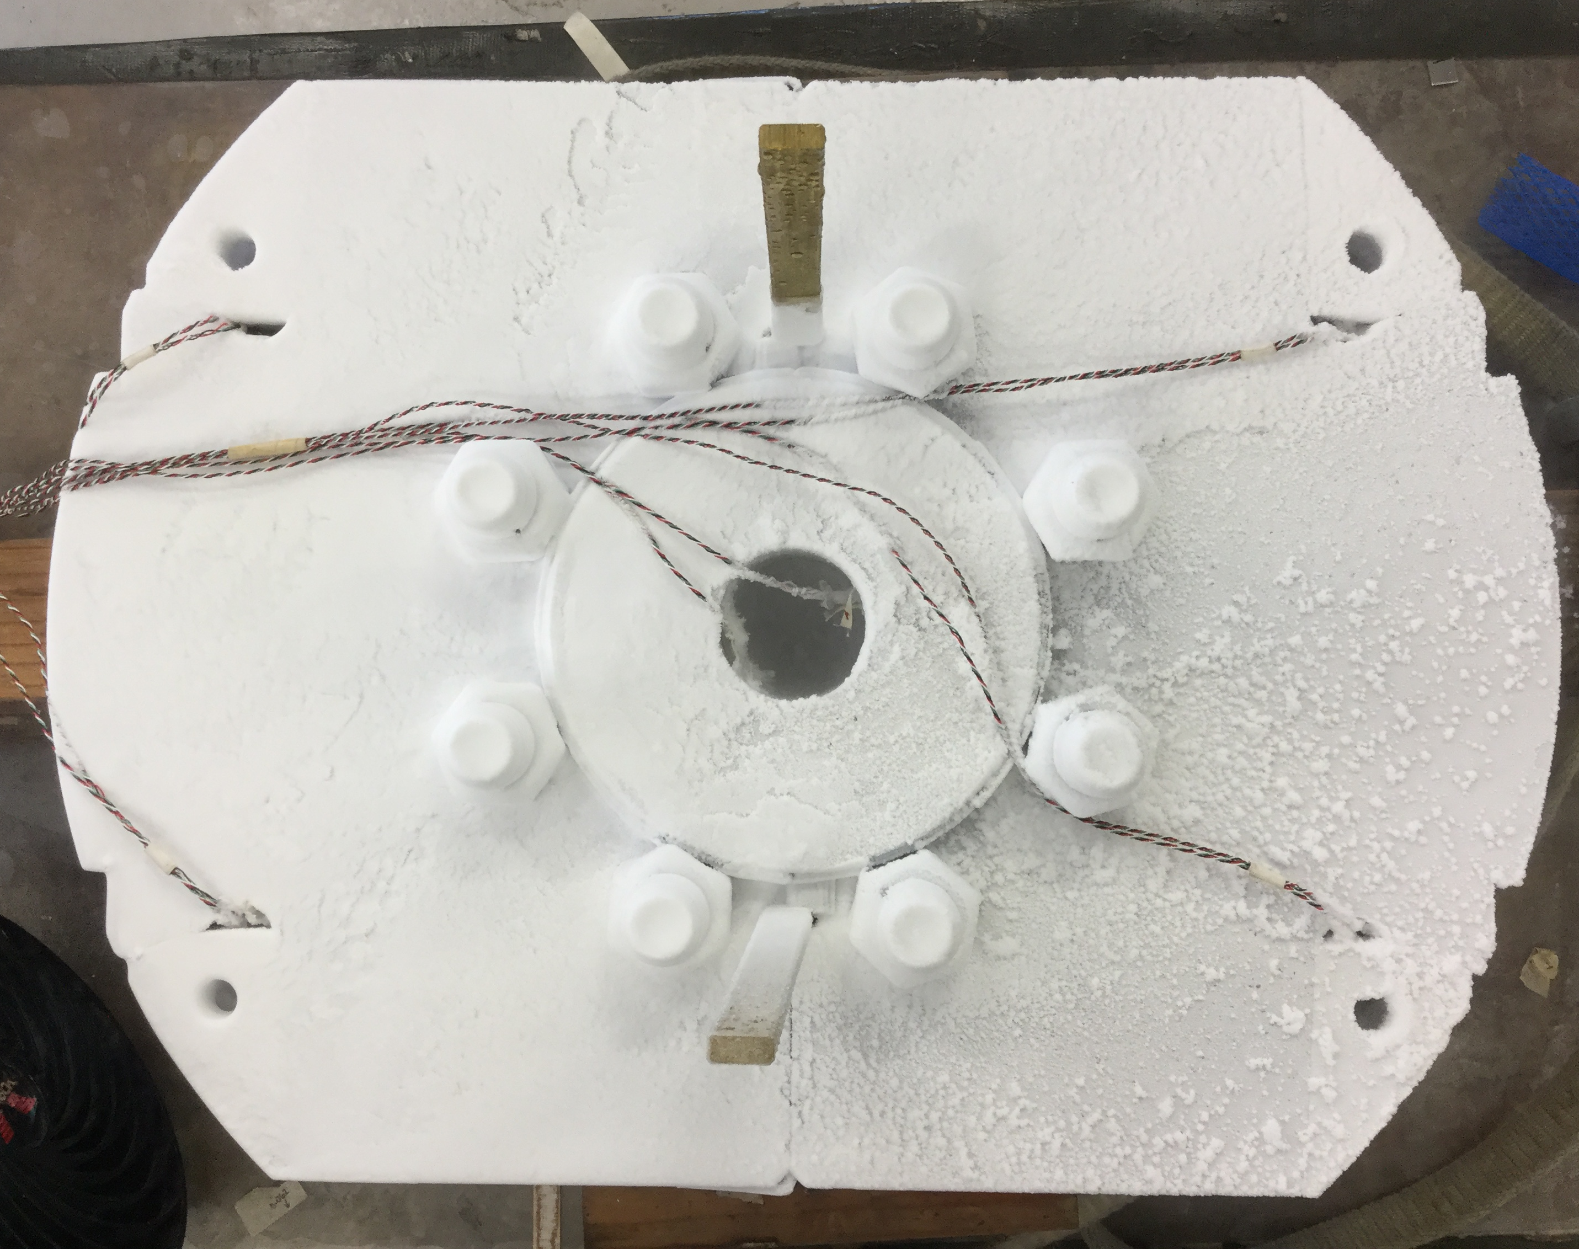
Mechanical Models
Goals:
Validate the results of mechanical analysis
Development of the coil assembly plan and pre-stress targets
Test all structural components, tooling and instrumentation

Slide 15
Conclusions
15 T dipole is a challenging and important MDP milestone to understand limits of Nb₃Sn accelerator technology
break the 14 T “wall”
15 T dipole demonstrator has been developed
optimized coil design
innovative mechanical structure
Magnetic and mechanical analysis is complete
large persistent current effect in Nb3Sn accelerator magnets was effectively reduced to the acceptable level
Design conductor and mechanical limits well understood
Fabrication of 15 T dipole demonstrator is in progress
important contributions from CERN - great integrated international effort
Magnet test is expected in September 2018

Slide 16
Acknowledgment
FNAL: E. Barzi, J. Carmichael, V.V. Kashikhin, S. Krave, I. Novitski, C. Orozco, S. Stoynev, D. Turrioni, G. Velev, A.V. Zlobin, A. Rusy, L. Ruiz, S. Jonhson, J. Karambis.
LBNL: S. Caspi, M. Juchno, M. Martchevskii
CERN: D. Schoerling, D. Tommasini
FEAC/UPATRAS: C. Kokkinos.

