Slide 1
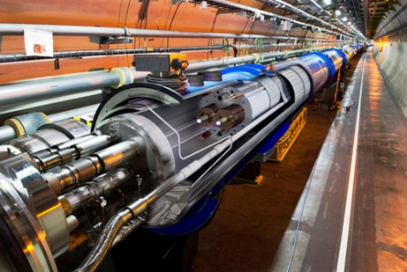
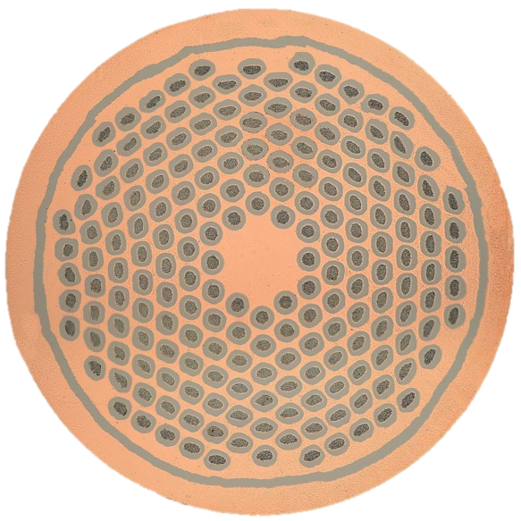
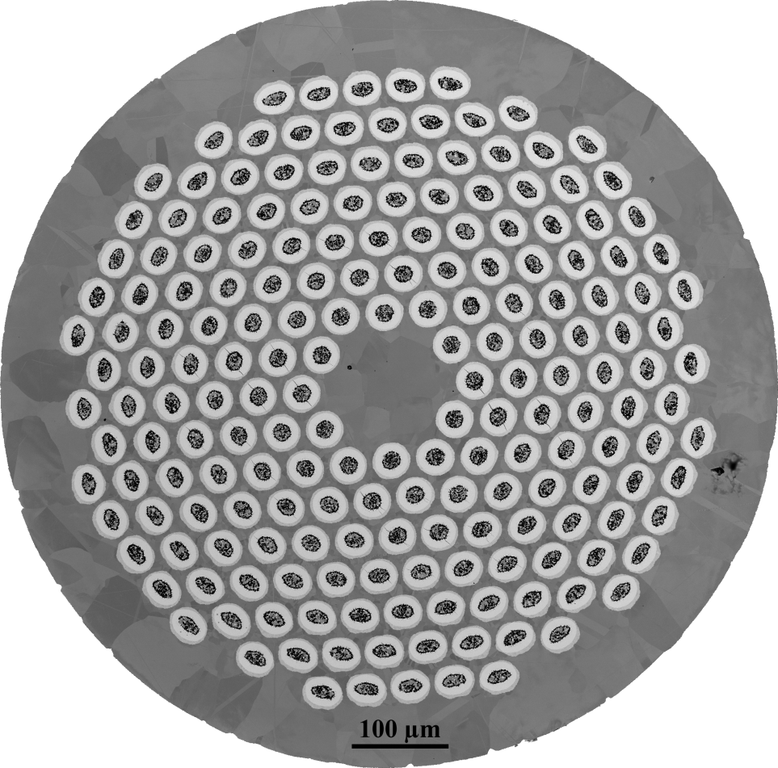







Beyond the bundle barrier: Potential improvements for an advanced PIT conductor
Chris Segal
Peter Lee, Chiara Tarantini, David Larbalestier
May 9th, 2018
US MDP meeting
Bundle barrier
Funding provided: This work was supported by the US Department of Energy (DOE) Office of High Energy Physics under award DE-SC0012083, by CERN, and by the National High Magnetic Field Laboratory (which is supported by the National Science Foundation under NSF/DMR-1157490) and by the State of Florida.

Slide 2
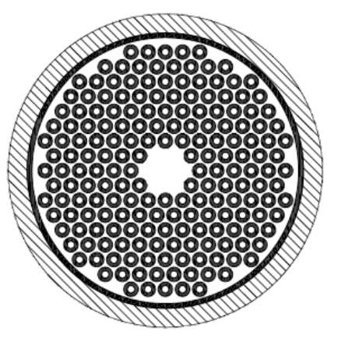
Development of the bundle barrier wire
Benefits from adding a bundle barrier
Sn leaks are contained
  Pure Cu annulus retains high RRR
  Allows an increase in Sn content to form more A15
Longer reaction times form A15 closer to stoichiometry, leading to an increase in high field J_{c}.
What we found compared to non- bundle barrier wire
J_{c} went up ~10%, RRR was maintained >150
SG/LG A15 ratio dropped substantially
Filament damage is substantially worse, and can be cm’s long
Bundle barrier
[1] B. Bordini et al., “The Bundle-Barrier PIT Wire Developed for the HiLumi LHC Project,” IEEE Transactions on Applied Superconductivity, vol. 27, no. 4, pp. 1–6, Jun. 2017.

Slide 3
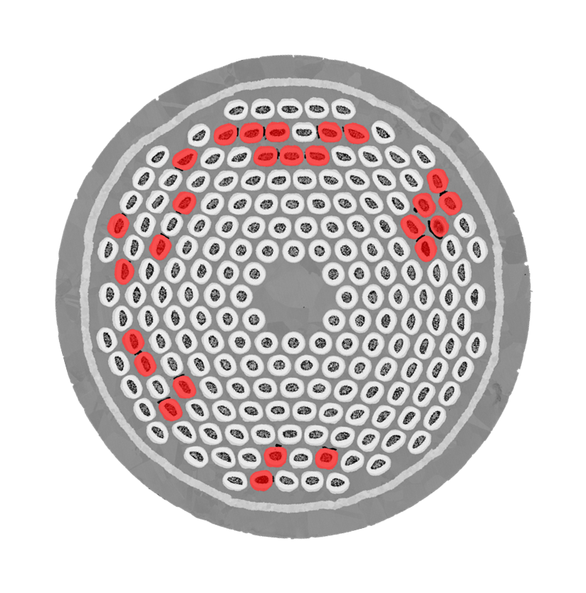
Driving questions of the bundle barrier design
Are filaments compromised for long lengths?
  Do all breached filaments show a Kirkendall void somewhere along the length of the filament?
    4 cm long sample cut into 8 pieces
    Polished and imaged in SEM
How is centroid drift influencing leaks?
Filaments which leak enough Sn to produce a Kirkendall void will have a reduced A15 volume

Slide 4
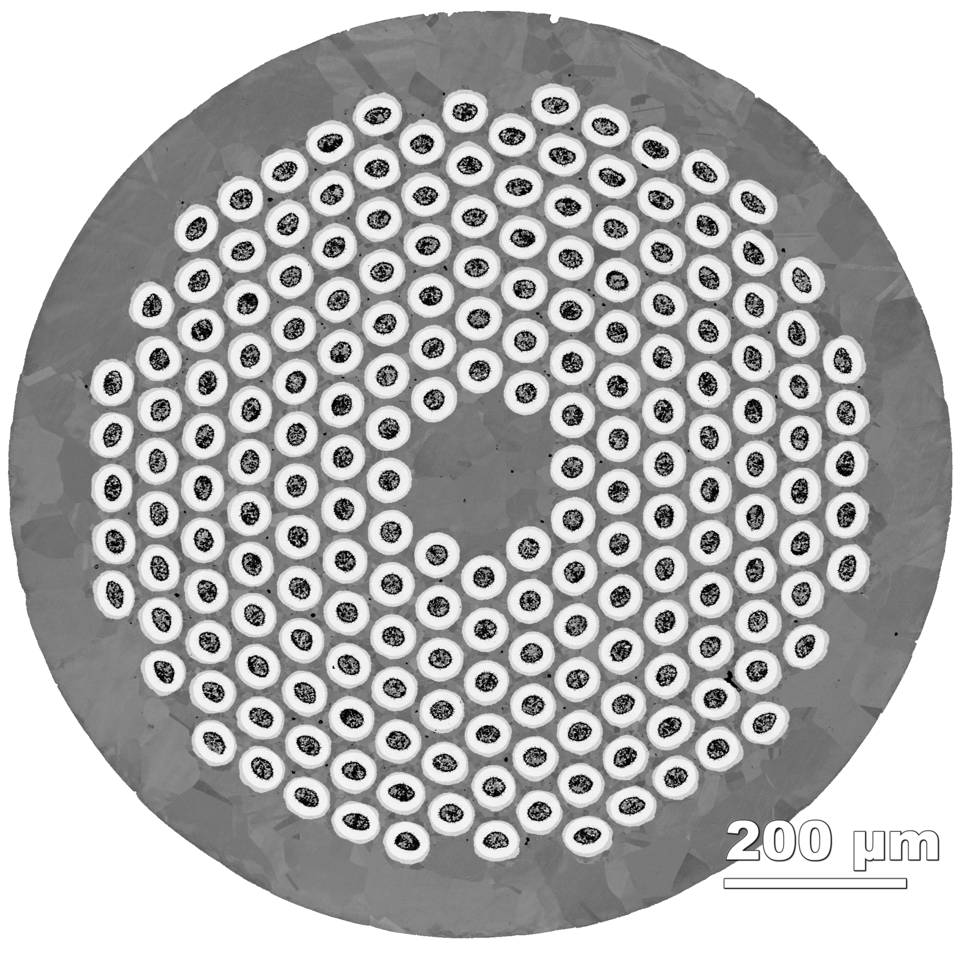



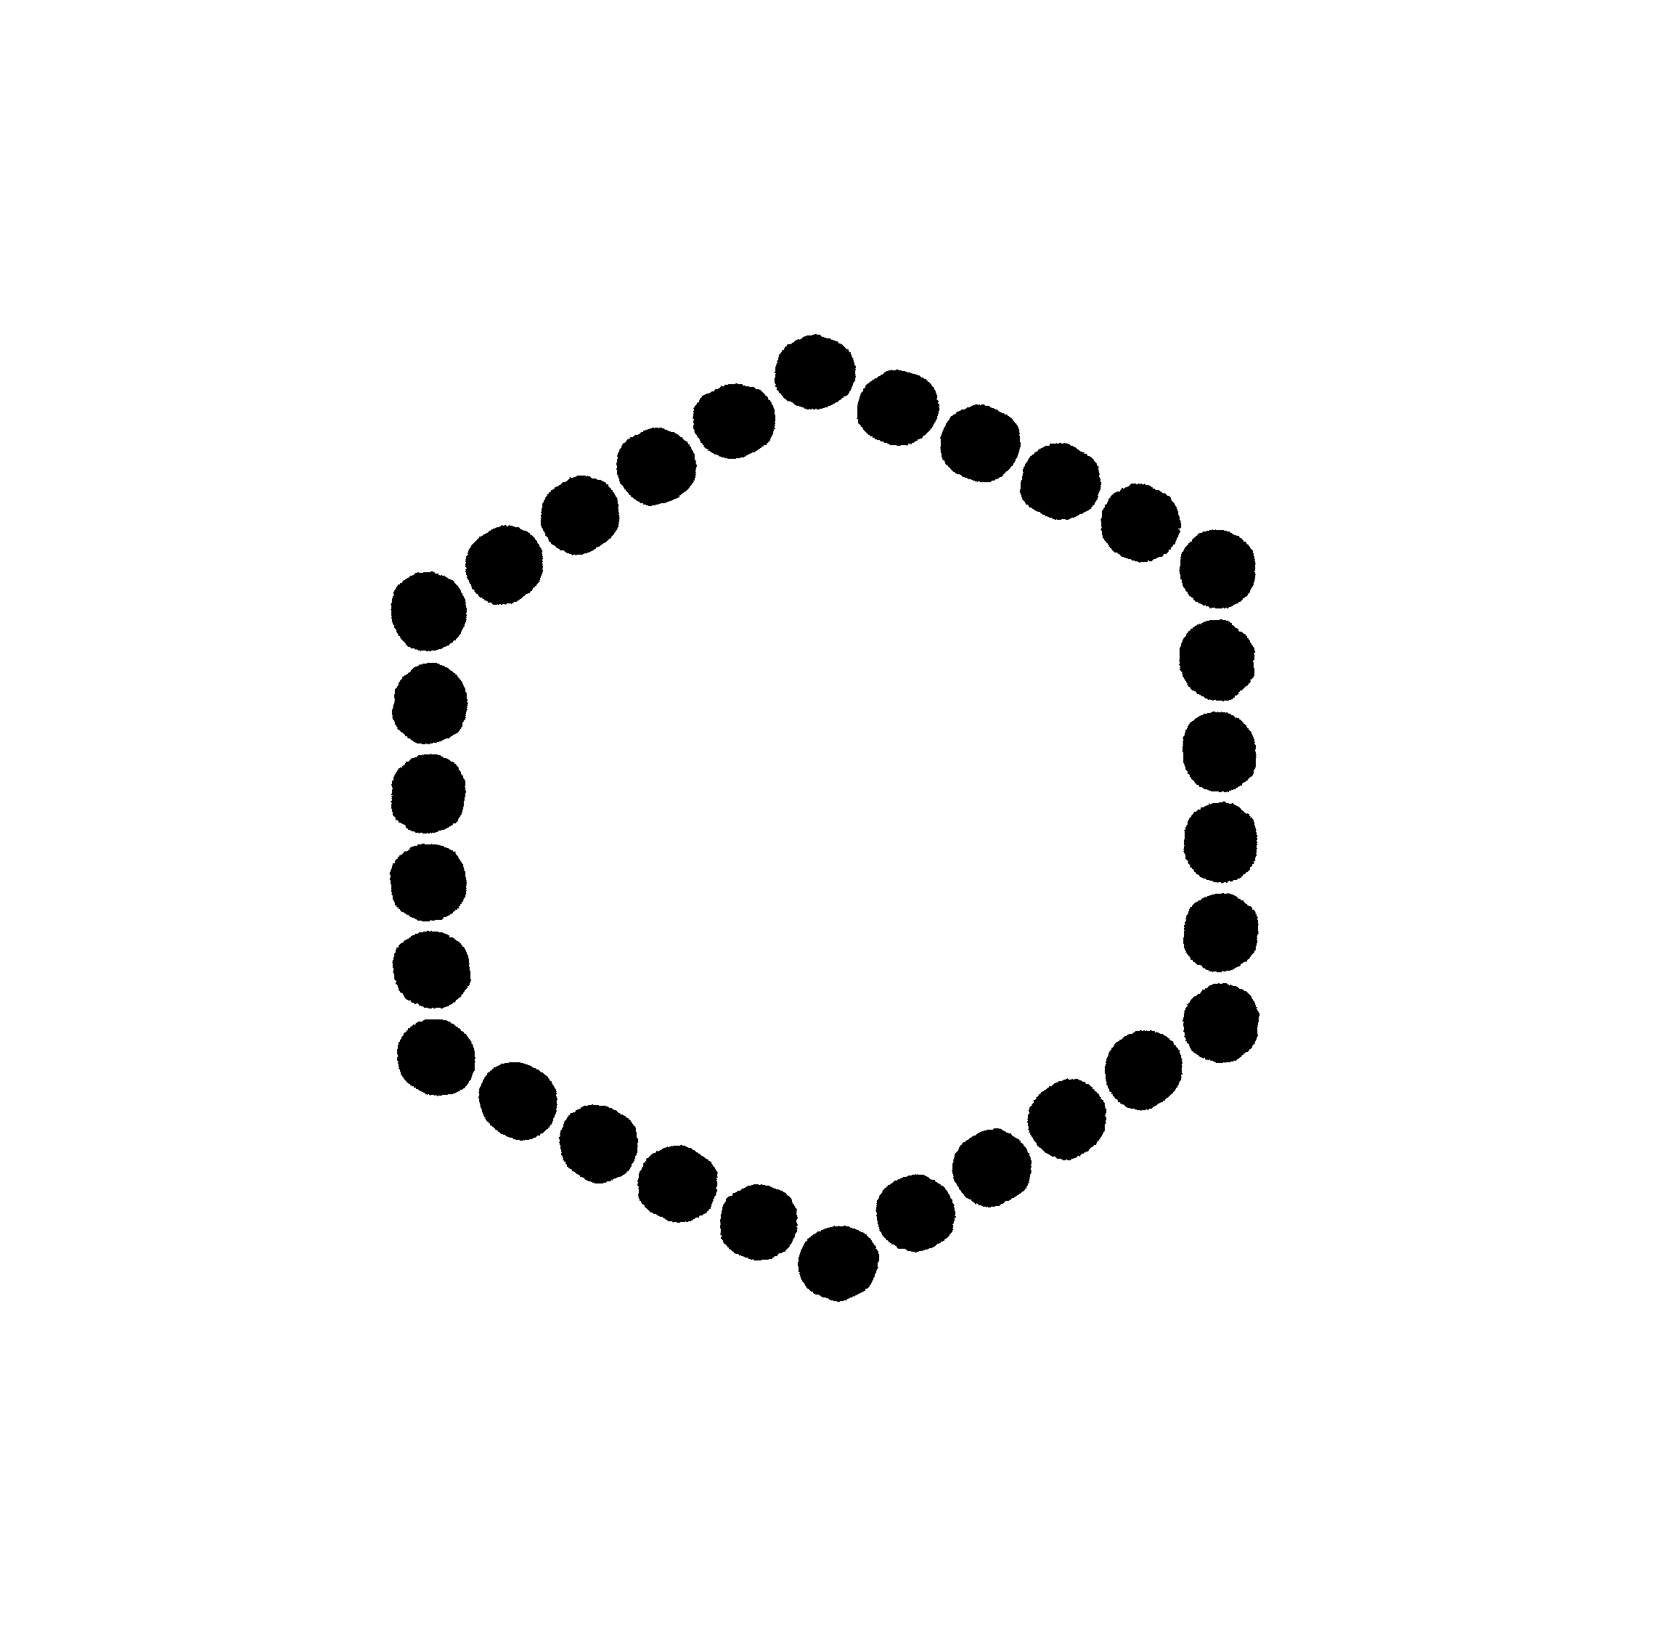
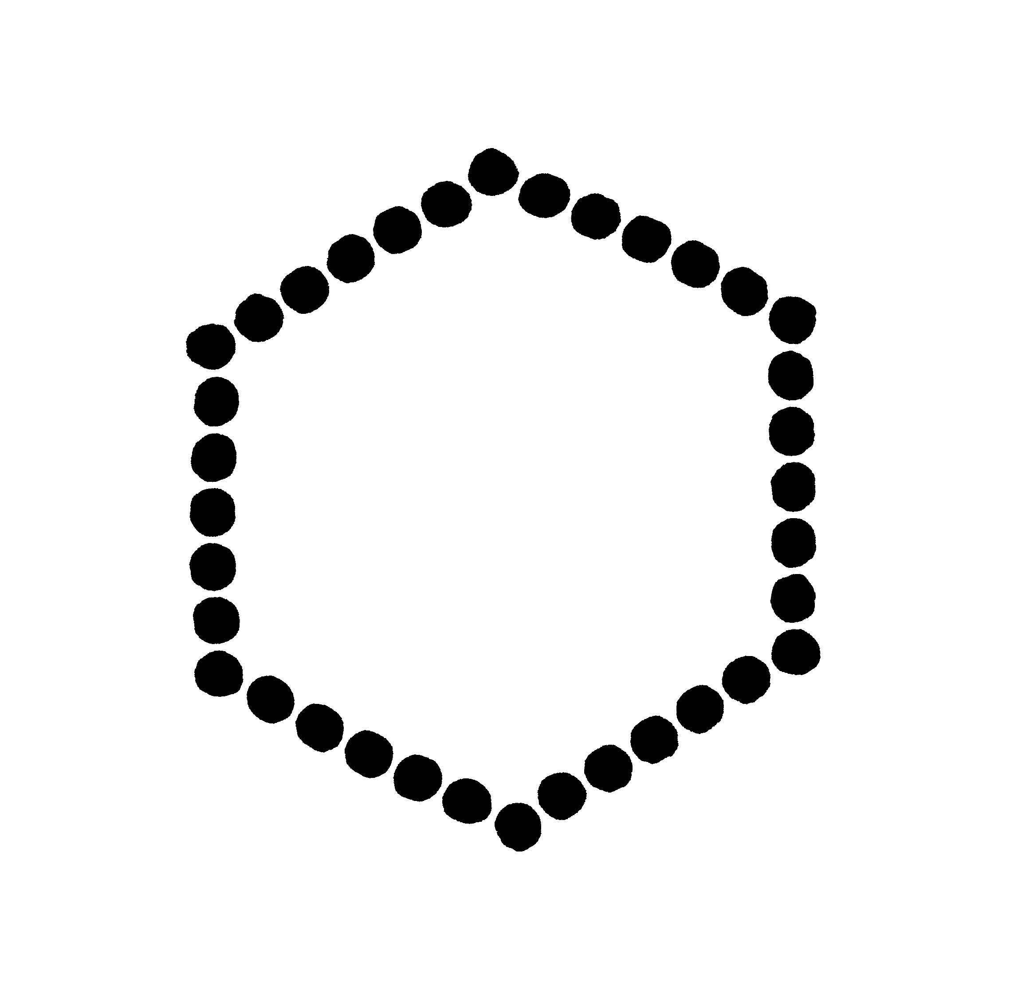
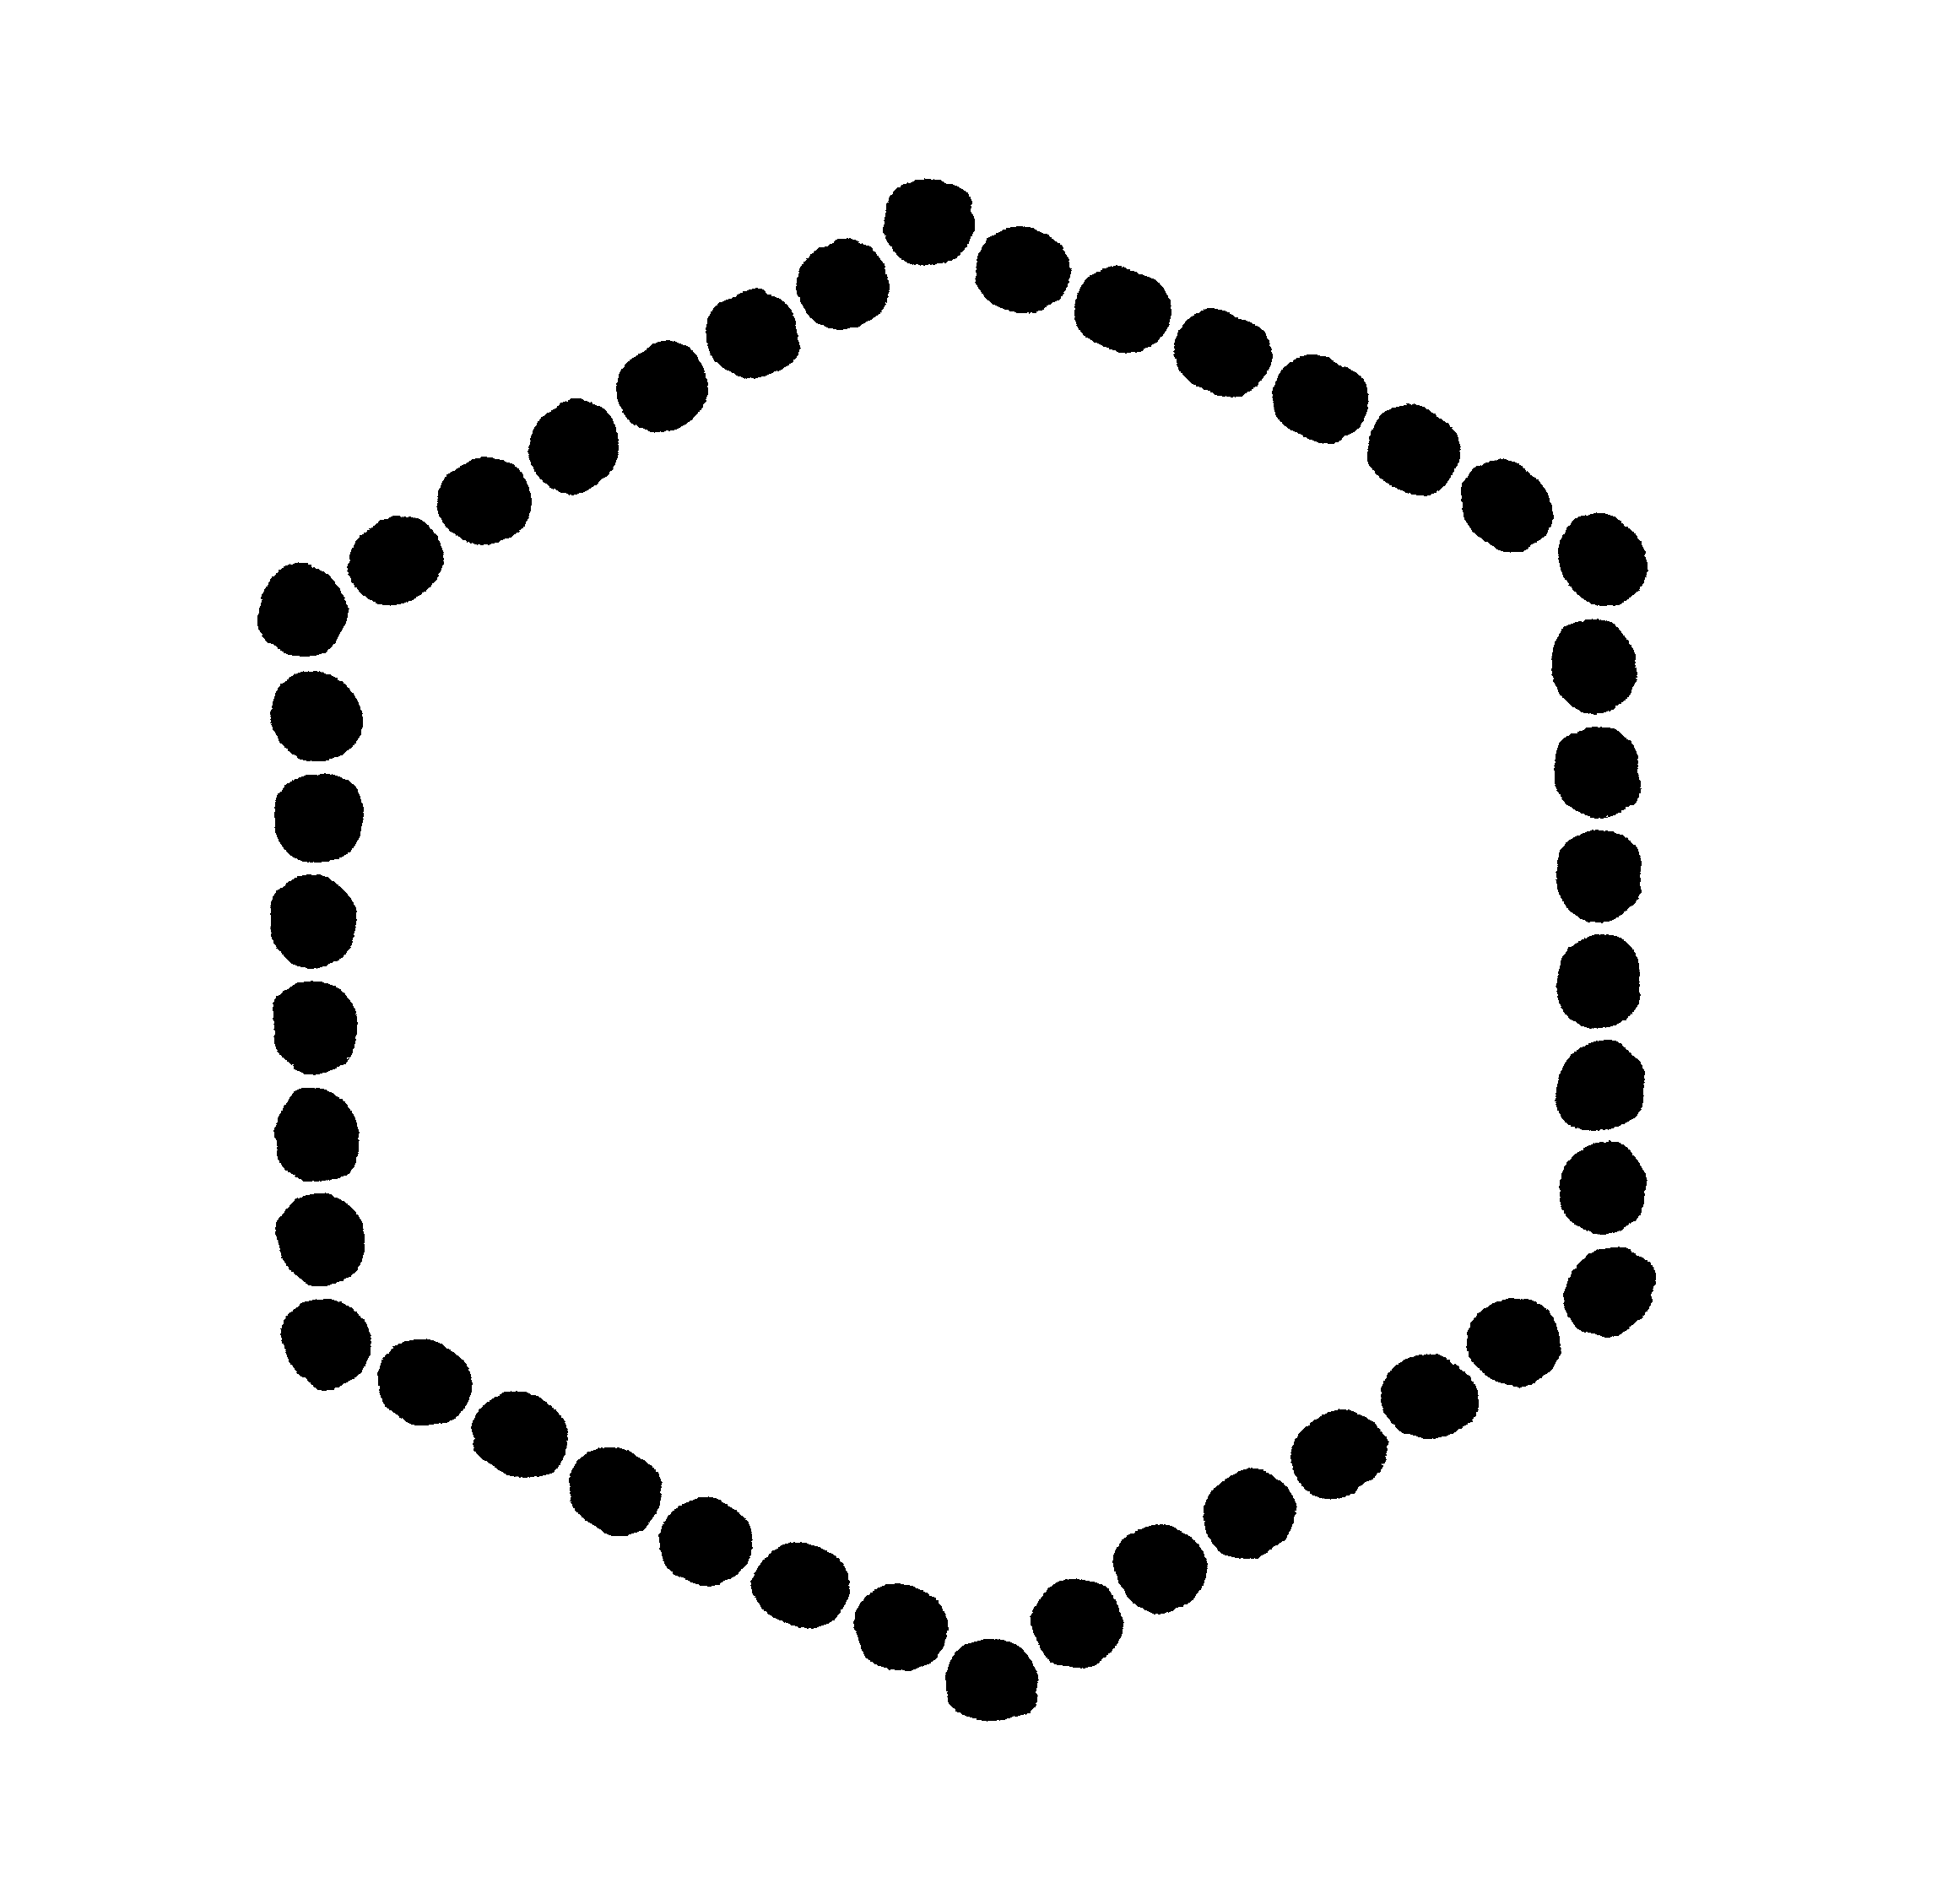
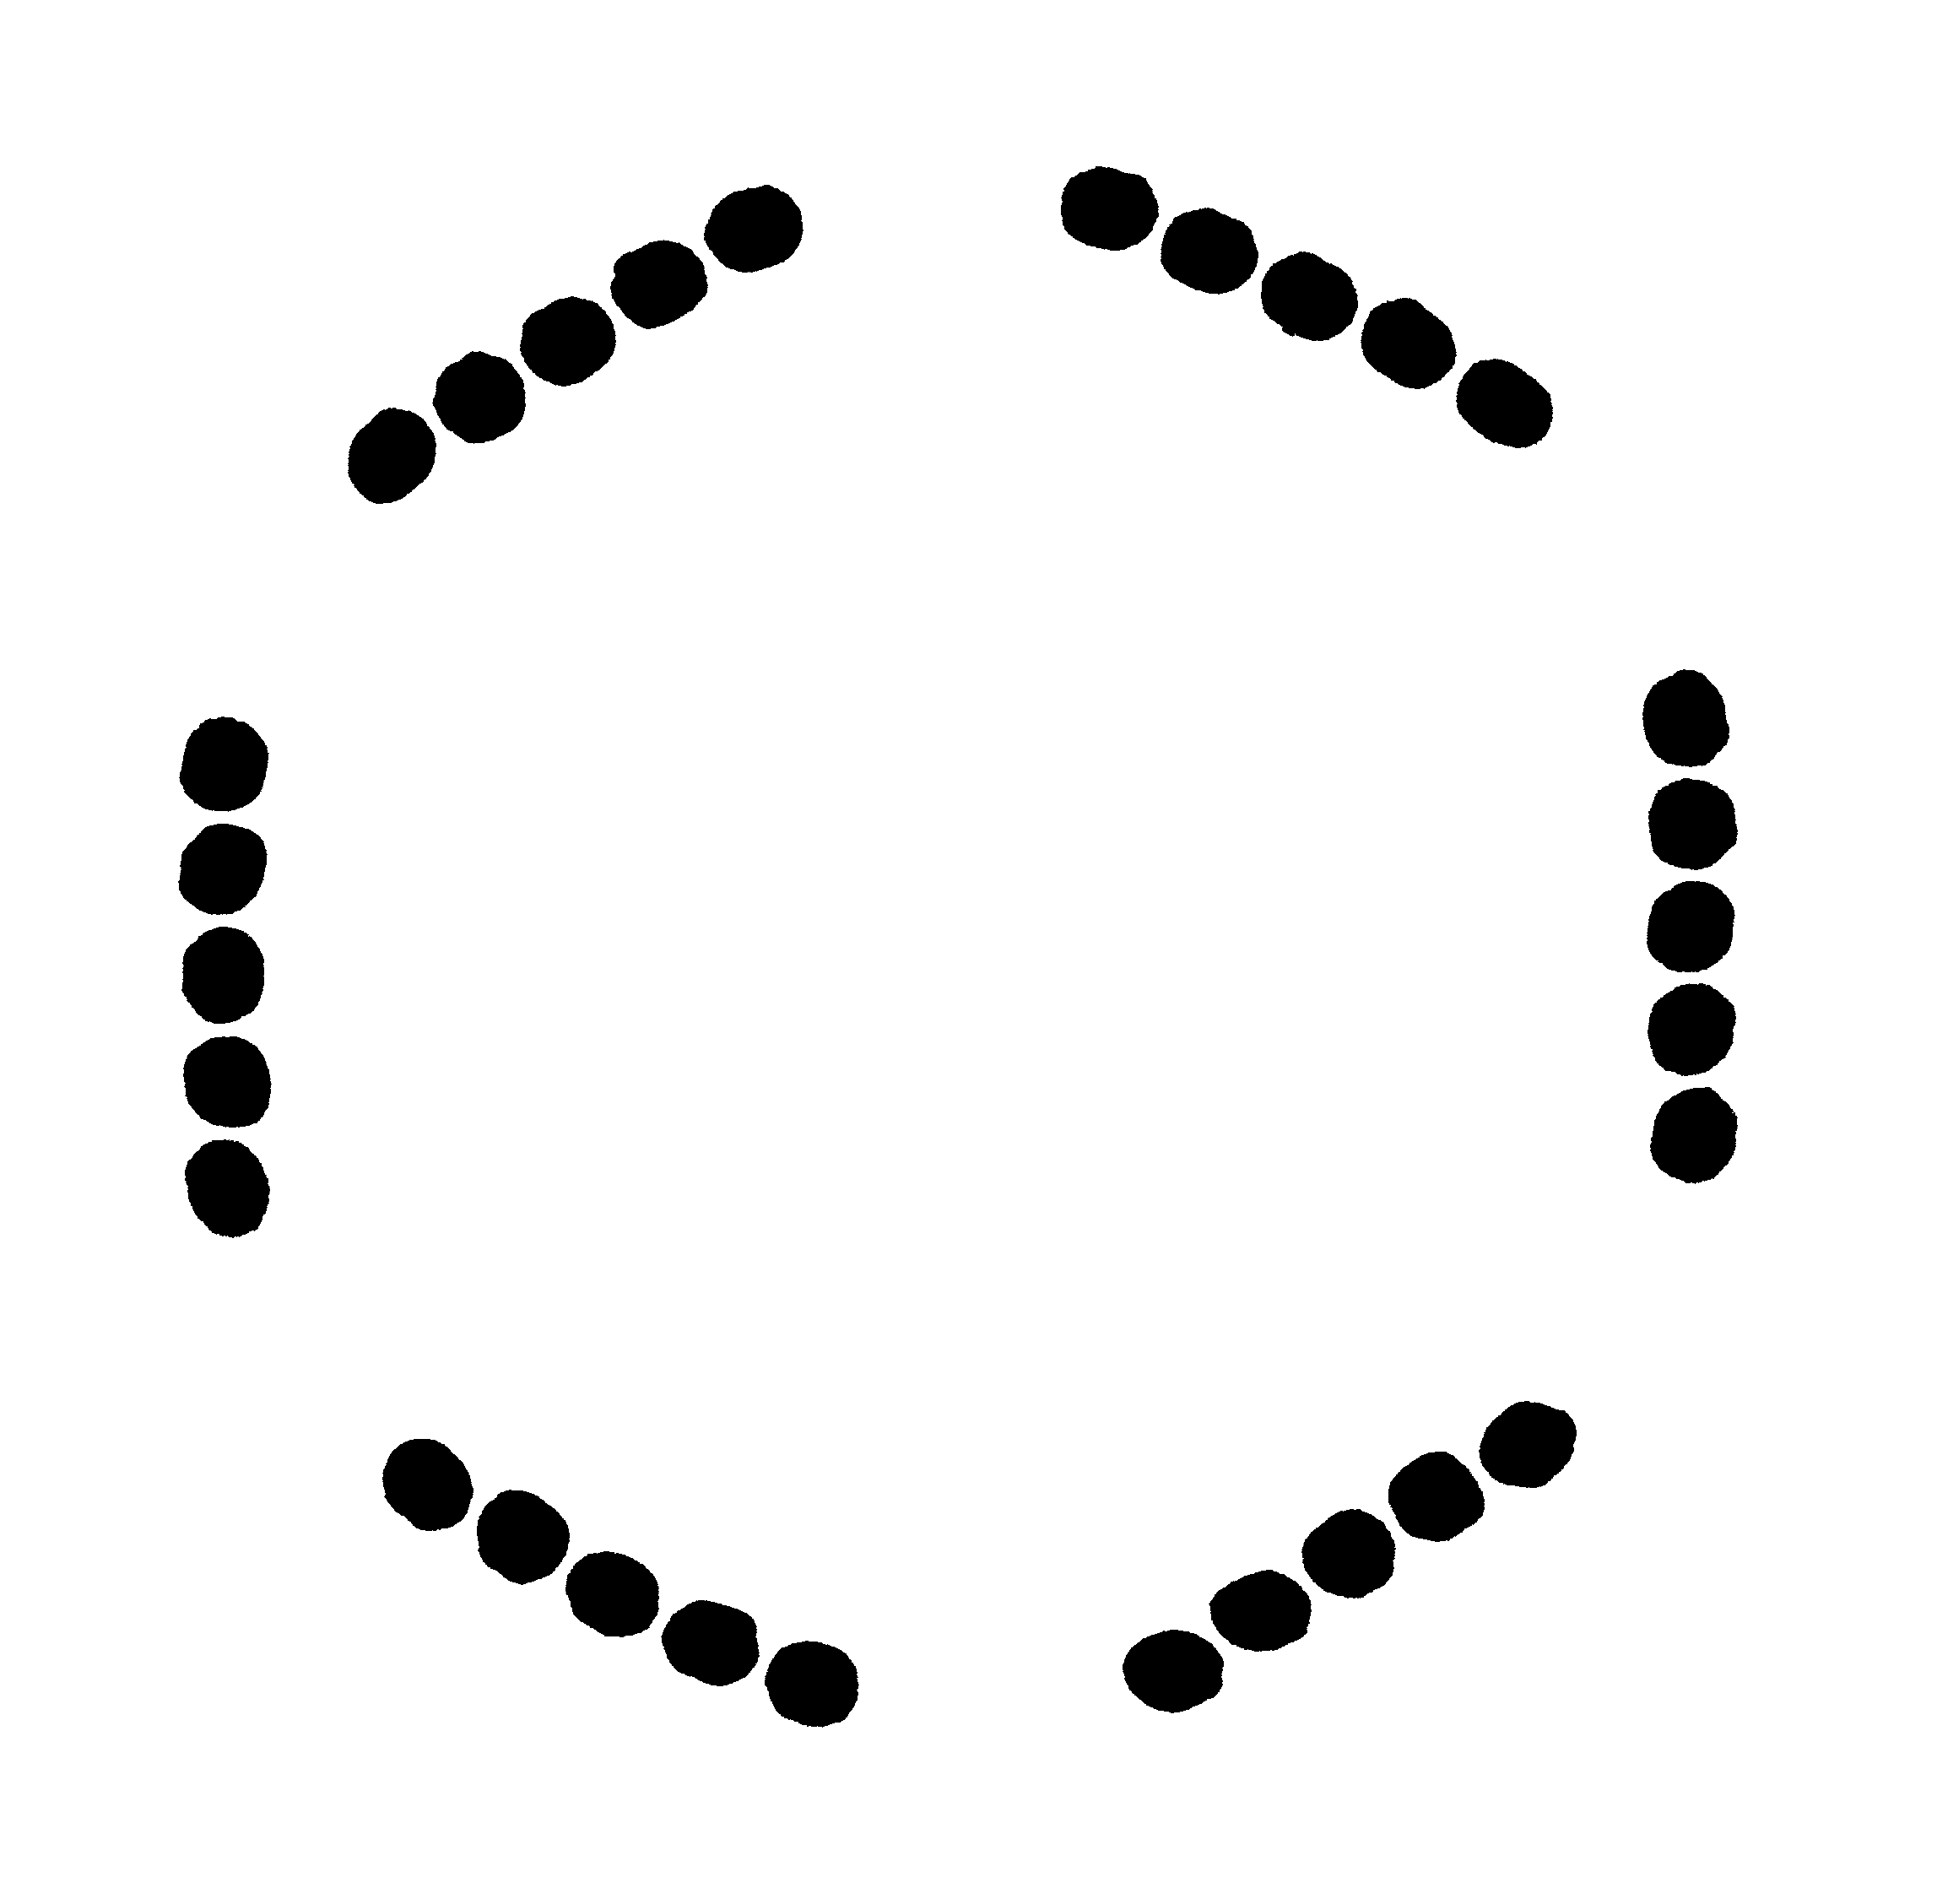
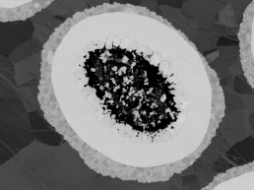
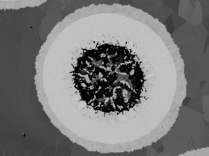
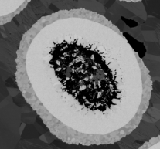
How is non-uniform deformation impacting wire performance?
7
6
5
We can measure this deformation in two ways
Variation in barrier thickness
Centroid drift
4
3
2
1
Leaks!
[1] C. Segal et al., “Evaluation of critical current density and residual resistance ratio limits in powder in tube Nb₃Sn conductors,” Supercond. Sci. Technol., vol. 29, no. 8, p. 085003, 2016.
Notes:
Here we see an overview of an entire wire package with 192 filaments. Slight ovalization is seen going from ring 1 to ring 7. preferential barrier thinning leads to break through and drop in RRR, here is the linear pattern, colorization shows external two rings are bad. Can we prove this is killing RRR?

Slide 5
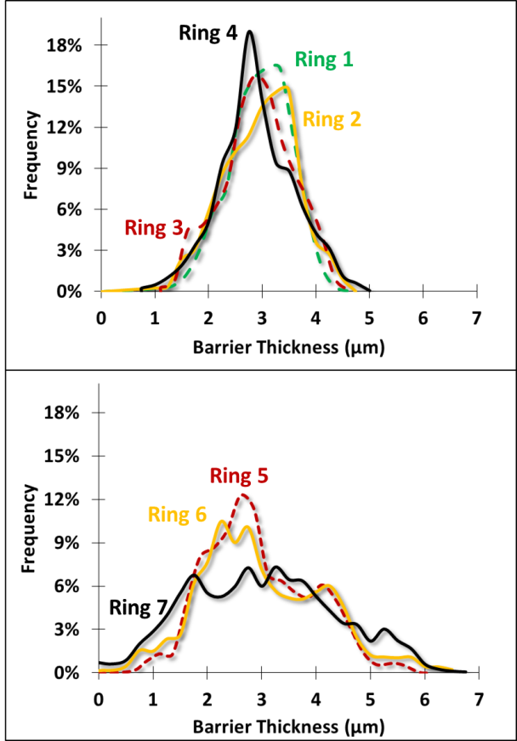
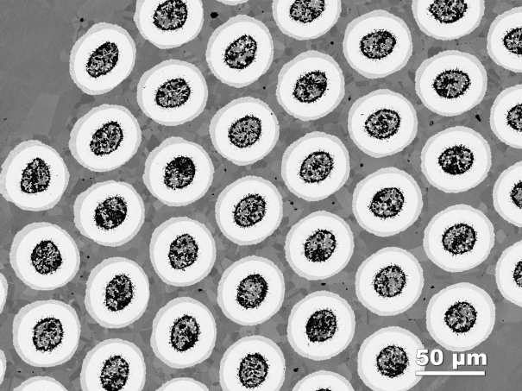
Filaments show a wide distribution of barrier thickness
-Bad for RRR, and bad for A15 formation
Ring7
Ring 1
[1] C. Segal et al., “Evaluation of critical current density and residual resistance ratio limits in powder in tube Nb₃Sn conductors,” Supercond. Sci. Technol., vol. 29, no. 8, p. 085003, 2016.
What is the mechanism that causes thinned regions of diffusion barrier?

Slide 6
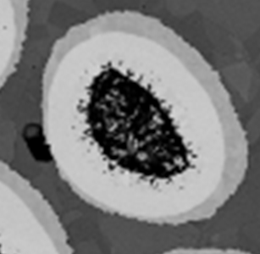
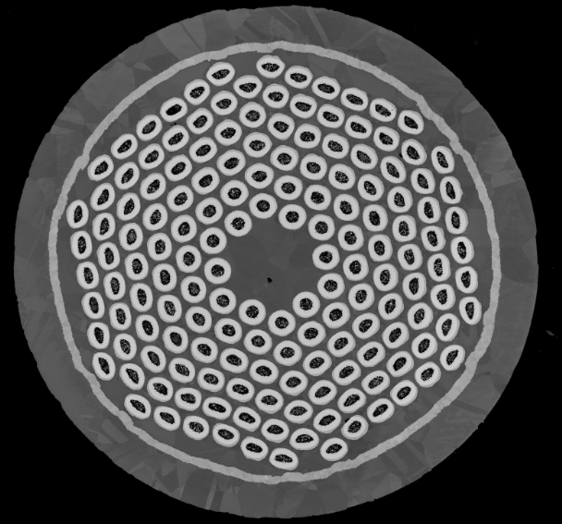
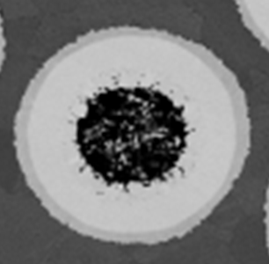
Thinned diffusion barriers caused by centroid drift between Nb-Ta tube and powder core
Thick side
1.5 μm (4.2% of diameter)
The powder core deforms at a different rate than the Nb-Ta tube housing it, causing the centers to drift from one another.
  This creates an uneven reaction front.
The centroid drift is the distance between the centroid of the entire filament (orange) and the centroid of the A15 layer (green)
To most accurately compare between filaments and wires, we normalize each filament’s core offset to its own effective diameter, derived from its area.
Thin side
72 nm (0.2% diameter)
3 um
Luca 0.7 mm wire diameter, 36 μm filament diameter

Slide 7
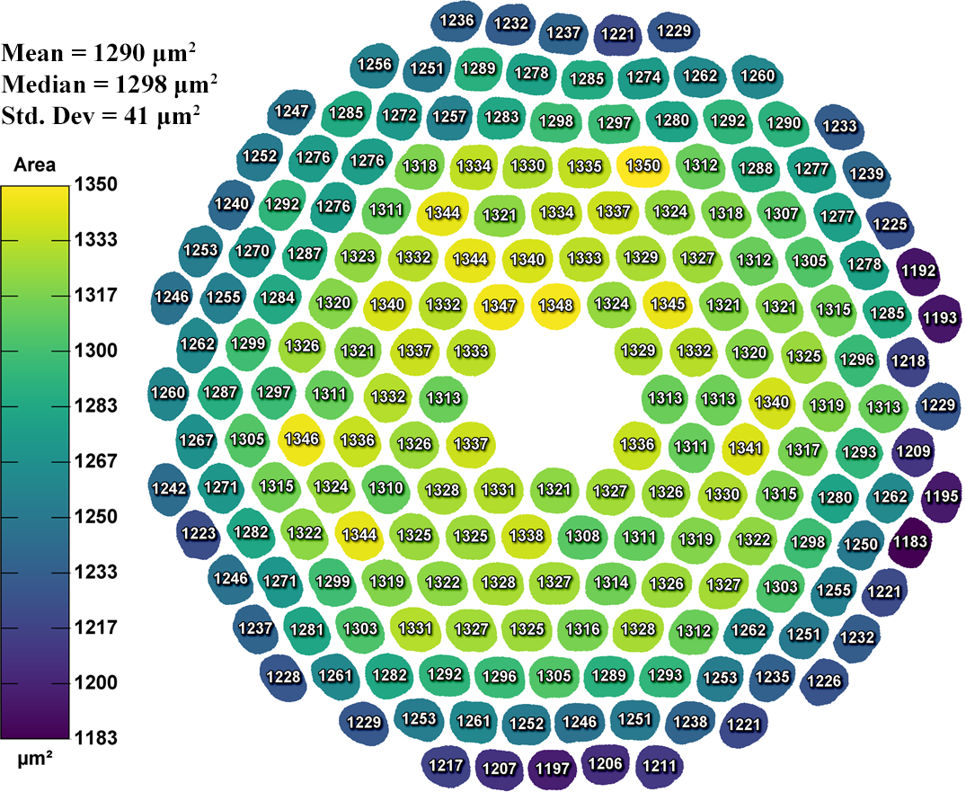
Bundle Barrier wires have large, radial variation of filament area
Filament area
Bernardo 0.85 mm
reacted wire
~12% reduction in area from inside to outside
Important consideration during data analysis: Filament diameter increases by 2-3 μm from inside to outside

Slide 8
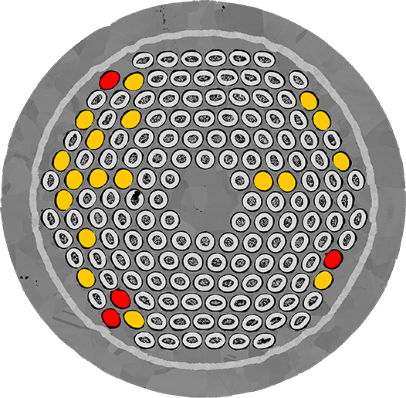
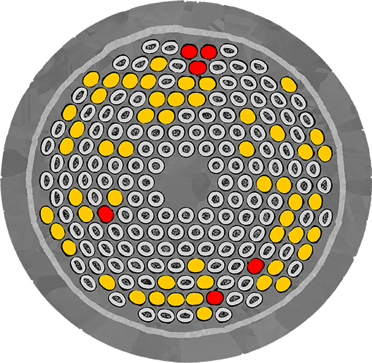
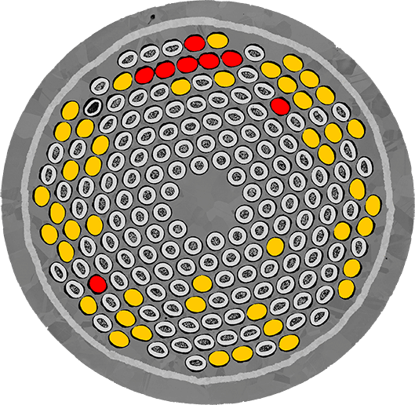
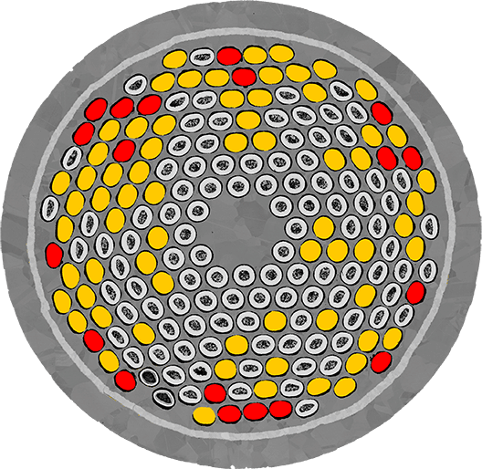
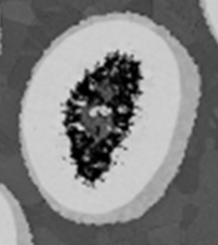

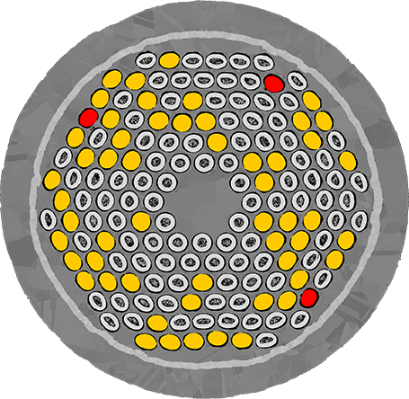
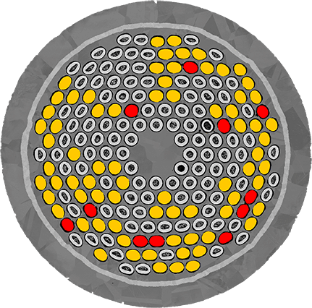
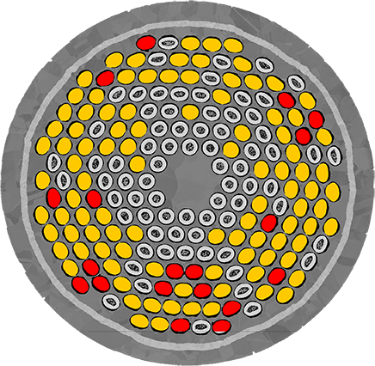
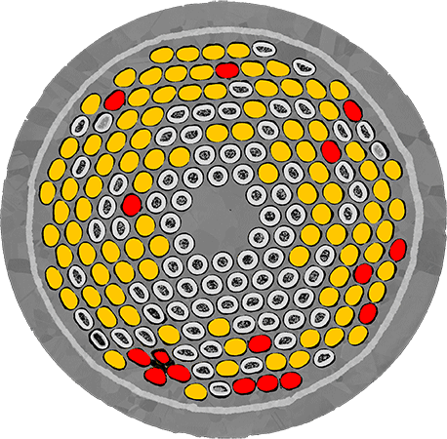
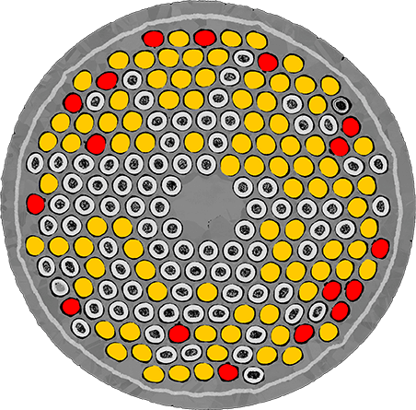
Wire architecture strongly effects filament integrity
3 types of filaments
A15 in contact with Cu
Kirkendall void, indicating a major Sn leak to the Cu, also appears
Unbreached: fully continuous barrier
Med Sn
High Sn
Very High Sn
Luca
Bernardo
Bernardo 2
Lucio
Bernd
0.85 mm
Breached:
-A15 contacts Cu
-Sn leaks out
*J_{c} (12T,4.2K) A/mm²
Best J_{c} 2658*
Worst J_{c} 2310
Breached:
-Kirkendall void
-severe Sn leak
0.7 mm

Slide 9
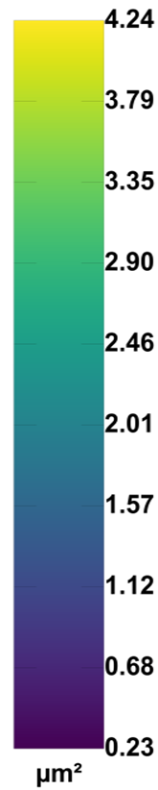
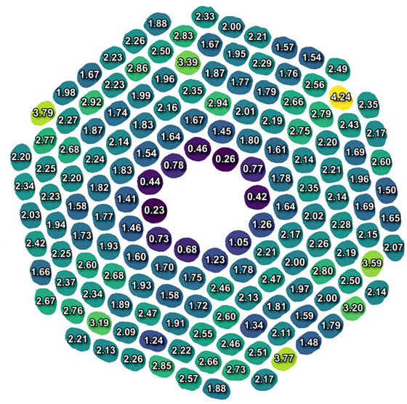


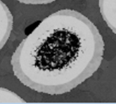
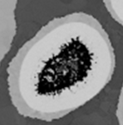
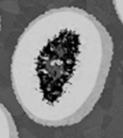
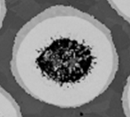
Centroid drift in bundle barrier wire is large contributor to Sn leaks
Best J_{c} (12T,4.2K) 2658*
Luca 0.7 mm
8 filaments > 3%
Normalized Centroid drift
Distance from wire center (um)
0.2%
4.2%
3.8%
3.8%
3.6%
3.4%

Slide 10
Luca shows strong dependence of A15 volume fraction on centroid drift
8 filaments > 3%
  2 with Kirkendall voids
  25% failure rate
Normalized Centroid drift
0.2%
4.2%
3.8%
3.8%
3.6%
3.4%

Slide 11
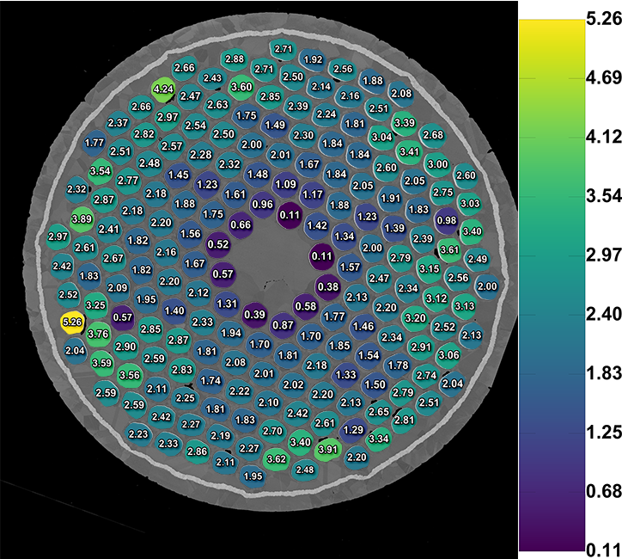
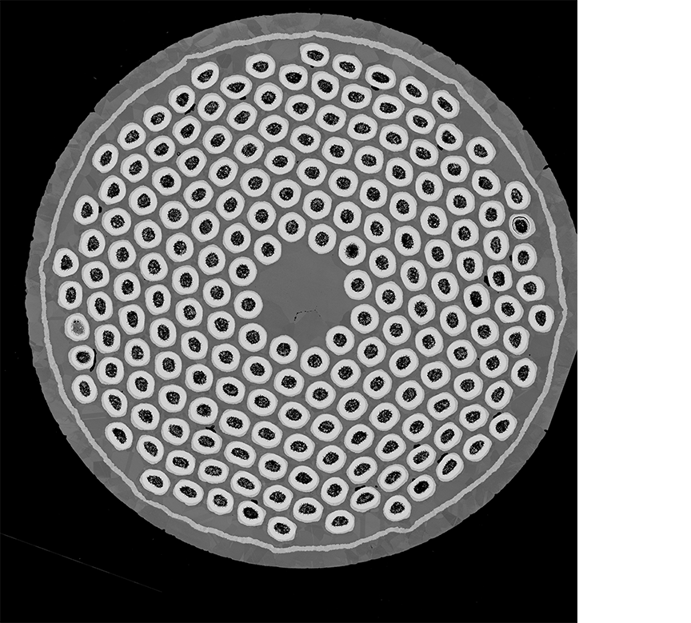
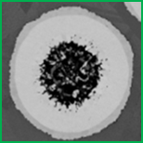
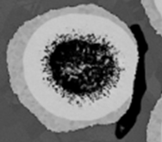
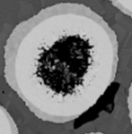
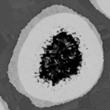
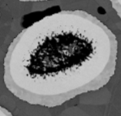
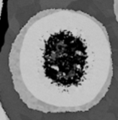
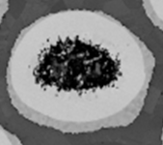
Filaments with large centroid drift are much more likely to leak Sn
Centroid offset (%)
Bernd 0.7 mm
Worst J_{c} (12T,4.2K)=2310*
24 filaments > 3%
Normalized Centroid offset
Distance from wire center (um)
Centroid drift of select filaments
0.1%
5.3%
4.2%
3.9%
3.9%
3.7%
3.7%

Slide 12
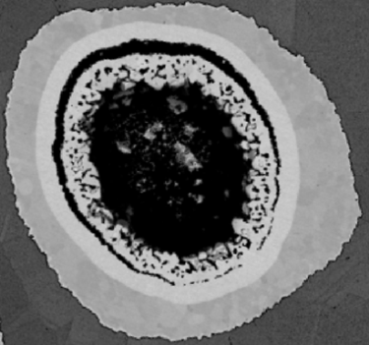
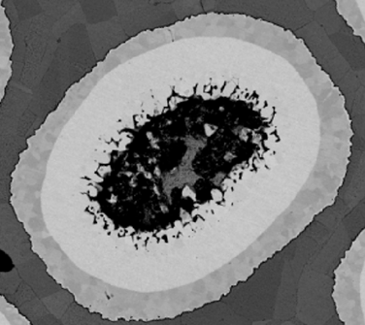
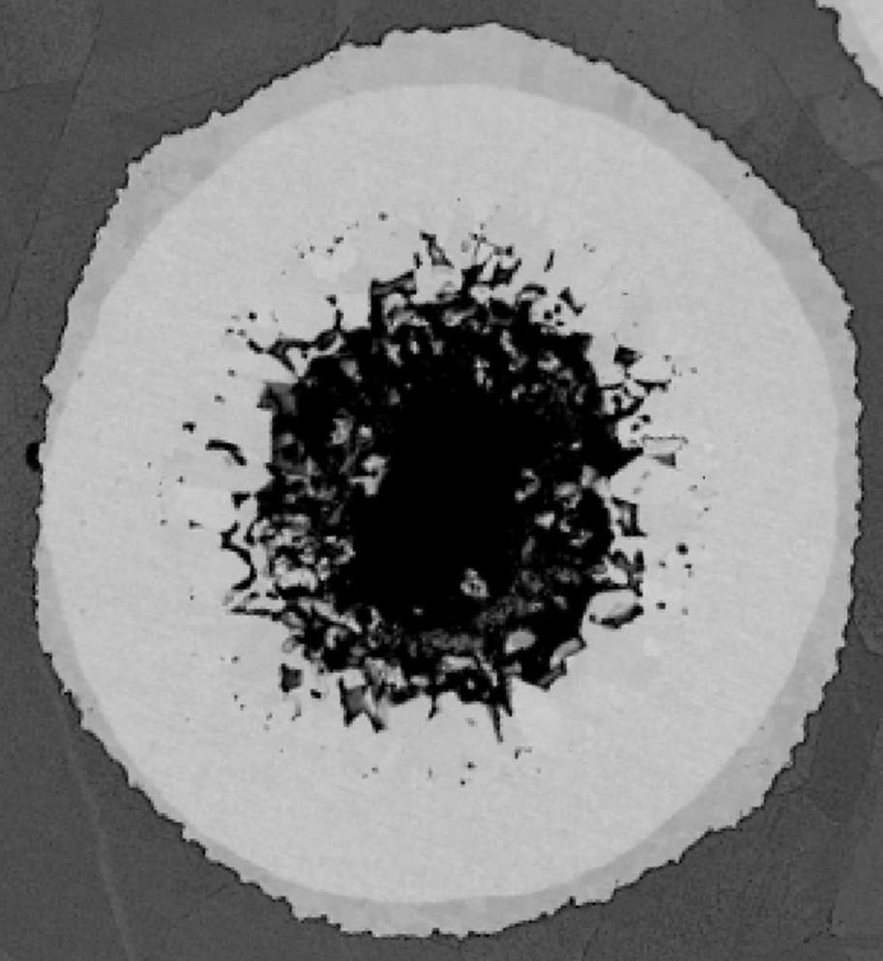
Bernd shows radial dependence of A15 volume
25 filaments > 3%
  6 with Kirkendall voids
  ~25% failure rate
A15_{ave} = 57%
(LG+SG) A15 area%
Leaked filaments with Kirkendall void
Is this damage local? Or is it consistent going down a length of wire?
Normalized centroid drift (% diameter)
15% residual DB!
5.3%
4.2%
3.9%
0.1%
3.9%
3.7%
3.7%
28.3%
47.9%
62.3%
Normalized centroid drift
A15 fraction

Slide 13
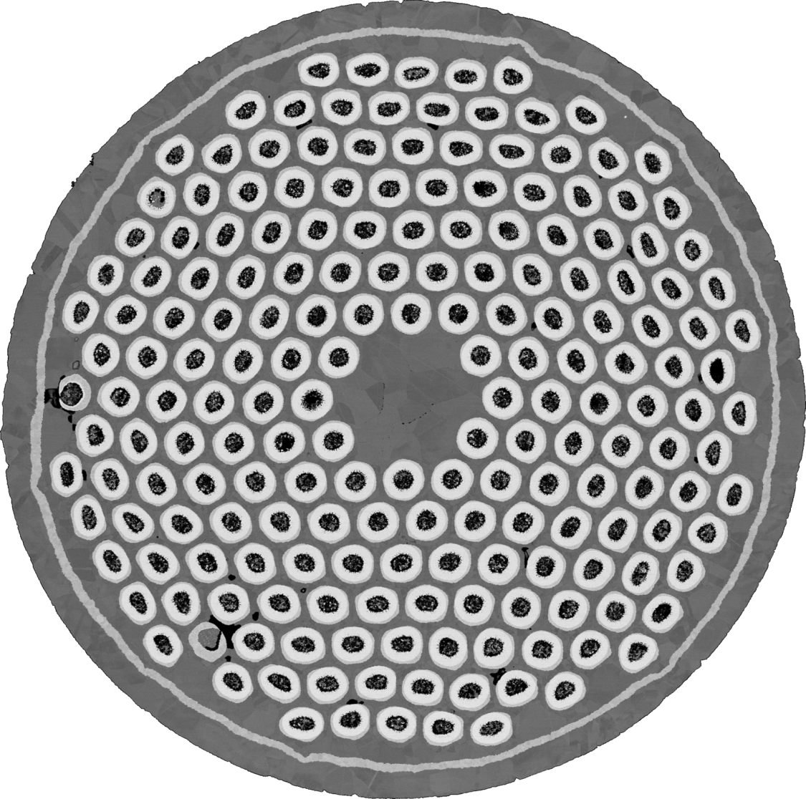
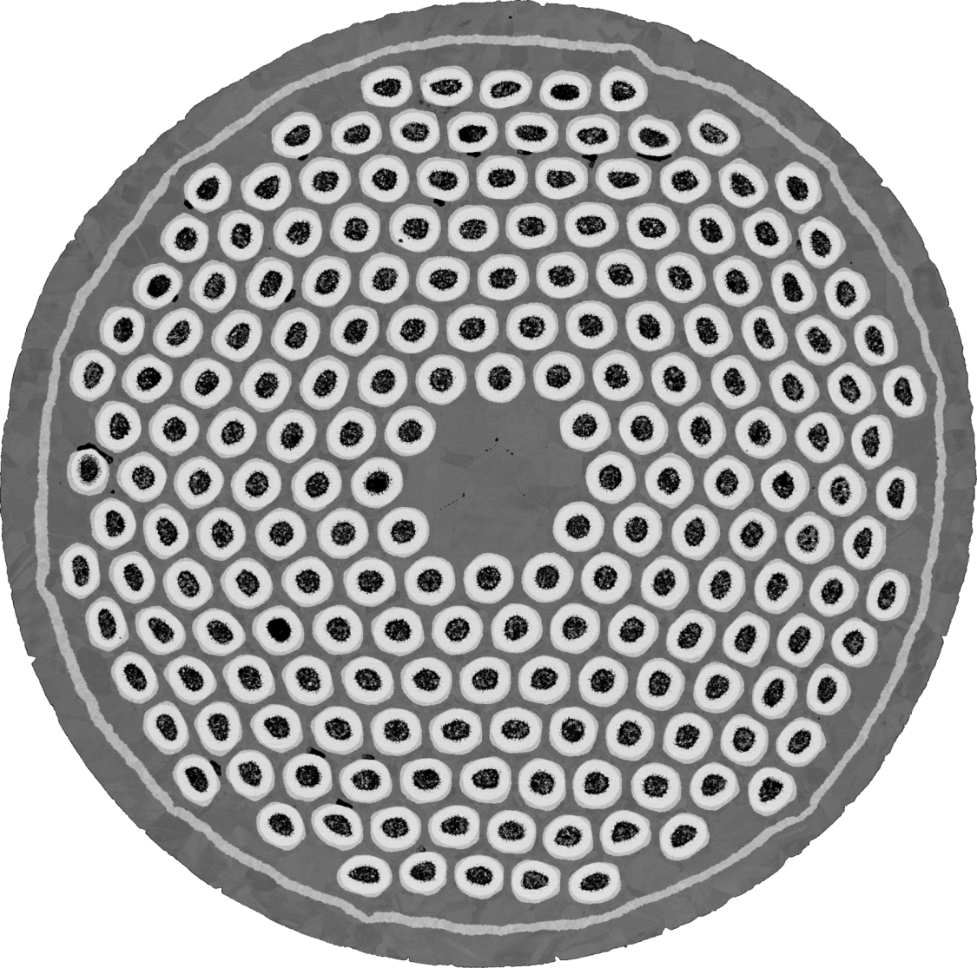
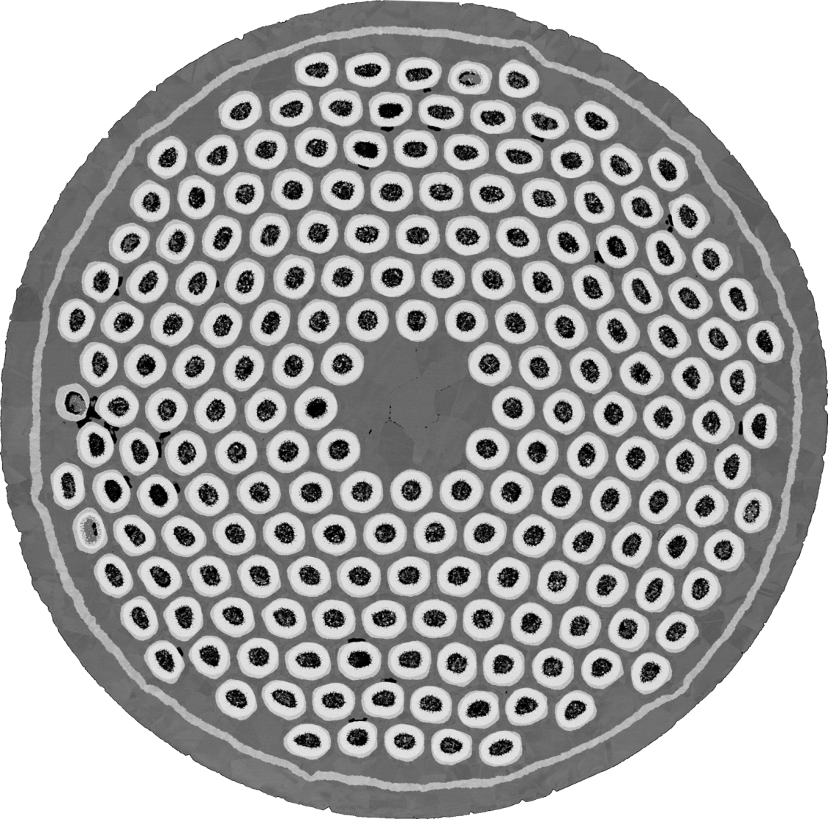













Metallographic tomography reveals damage over many centimeters
Bernd 0.7 mm very high Sn
5 mm
The effect of a breached filament can be much larger than suggested by a single cross-section
4 cm – 8 cross sections

Slide 14








One filament is severely breached in 4/8 cross sections
A
B
C
D
E
F
G
H
A
B
C
D
E
F
G
H
5 mm

Slide 15









Leaks are plentiful along the entire 4 cm of wire
Bernd 0.7 mm wire, very high Sn
15-20 leaks with Kirkendall void in any given cross-section
81 leaked filaments with Kirkendall voids over 4 cm
(8 cross sections)

Slide 16











For future work, it is recommended to use 5-10 cross sections along the wire together better statistics and ensure proper representation of wire properties, which may not be captured in a single cross section as shown here. You could do a 3D autopsy and plot the # of leaks and # A15 contact as a function of wire distance to see how well the wire was fabricated.
If we consider any filament whose A15 is in contact with the Cu, things get worse…
Bernd 0.7 mm-very high Sn
15-20 K-void leaks in any given cross-section
81 leaked filaments with K-voids over 4 cm, 8 cross sections
171/192 (89%) of filaments are breached with A15 in contact with Cu
Lighter is breached in more cross-sections

Slide 17





PIT performance degrades after cabling and under transverse load
Bernardo Bordini – FCC 2018
We can improve this with inverted multistage heat treatments¹
[1] C. Segal, C. Tarantini, P. J. Lee, and D. C. Larbalestier, “Improvement of small to large grain A15 ratio in Nb₃Sn PIT wires by inverted multistage heat treatments,” IOP Conf. Ser.: Mater. Sci. Eng., vol. 279, no. 1, p. 012019, 2017.

Slide 18




Microstructure can be improved with inverted multistage HT, but J_{c} degrades
BEAS HT
Multistage C
40 μm
Sample Description | Heat treatment (temp/dwell time) | I_{c} (A) | J_{c} (A/mm²) | J_{c} _{SG-layer} (A/mm²) | Nb | Total A15 | Core A15 | LG A15 | SG A15 | SG/LG ratio
Luca 0.85 mm | 280/20 + 620/120 + 640/160 | 546 | 2640 | 7021 | 22.6% | 56.4% | 2.3% | 16.5% | 37.6% | 2.3
Luca 0.85 mm | Stage C +630/238 | 512 | 2476 | 5370 | 21.1% | 60.7% | 3.7% | 10.9% | 46.1% | 4.2
% change from recommended HT |  | -6% | -6% | -24% | -7% | +7% | +61% | -33% | +22.6% | +82.6%
Optimize heat treatment for this wire
Measure I_{c} under realistic loading conditions

Slide 19


How to get PIT…out of the pit
Non-uniform deformation during wire fabrication robs PIT of its potential in two main ways
  J_{c}: the full A15 volume cannot form because too much Sn leaks out of the core,
  RRR: Sn leaks out and poisons the Cu
  The biggest contributor to Sn leaking is the Sn-rich core drifting from the center of its Nb-Ta tube
  A reduction of the non uniform deformation during wire fabrication will have huge returns since it appears to impact both electrical properties
  ***Keep the Sn in the core!!!***
My simple suggestion: Use the very high Sn core (Bernd) in the least deformed wire architecture (Luca) to retain as much Sn as possible.
  This means: more reaction to form A15 (increase J_{c}), retain high RRR everywhere in the wire
2nd option: fabricate wire with high Sn inner filaments which can fully react the uniform diffusion barrier, and low Sn outer filaments which will be depleted of Sn before the barrier`s breach.
Inverted multistage HT’s may have higher J_{c} than standard HT under realistic loading conditions
*J_{c} (12T,4.2K) A/mm²
The irony is that any method to prevent Sn leak will make the bundle barrier redundant

Slide 20
END OF PRESENTATION

